Slide 1

CS130 Project: Ohmage
http://ohmage.wikispaces.com/

Slide 2
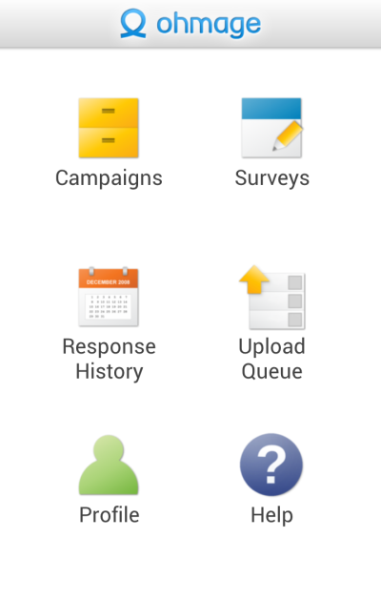
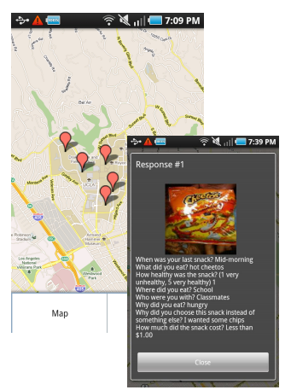
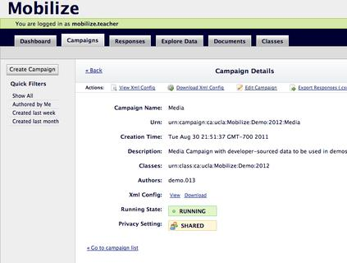
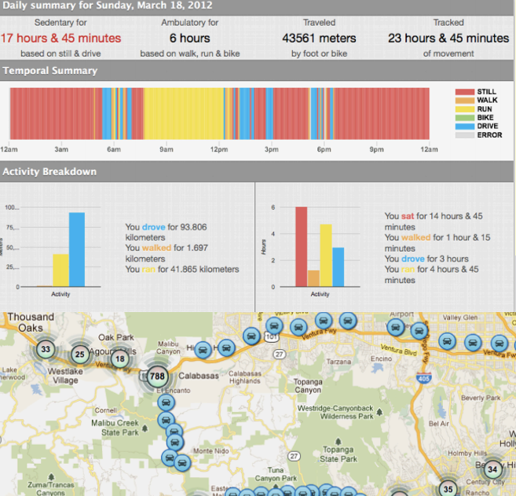
What is Ohmage?
An open-source participatory sensing technology platform.
Researchers, Students, Patients create campaigns to do large-scale study, self-monitoring, life journaling.
Mobile phone-based data capture through inquiry-based surveys & automated data capture & temporally/spatially triggered reminders
Data visualization and real-time feedback.

Slide 3




Who use Ohmage?
Researchers
  UCLA CS, STATS, MED, and Cornell MED use Ohmage to collect valuable data from patients or participants

Slide 4
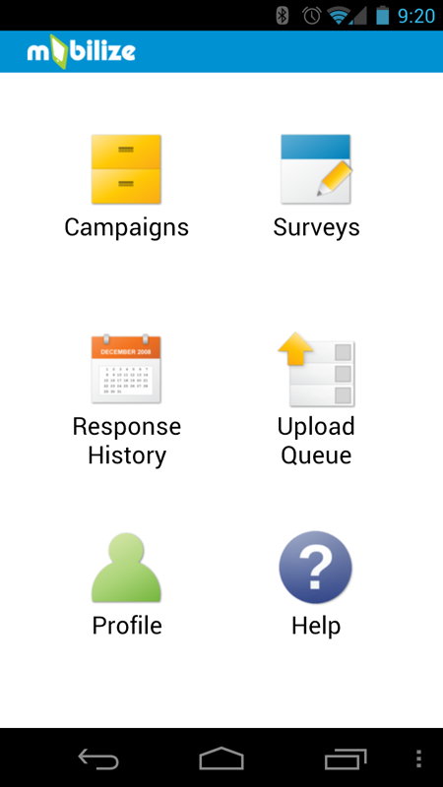
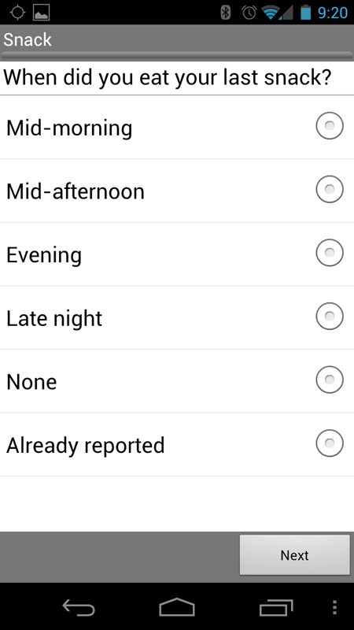
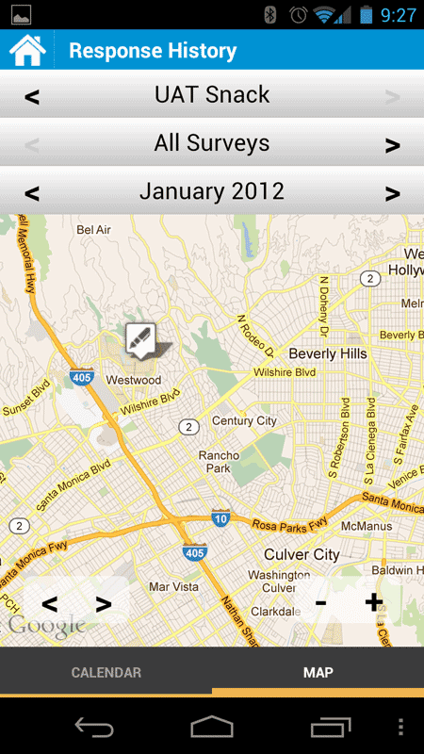
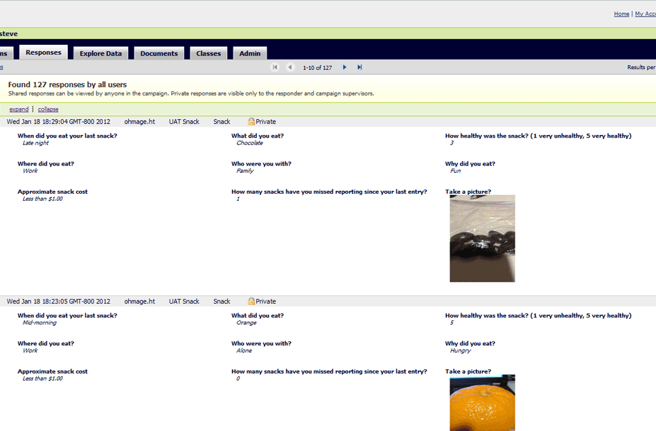
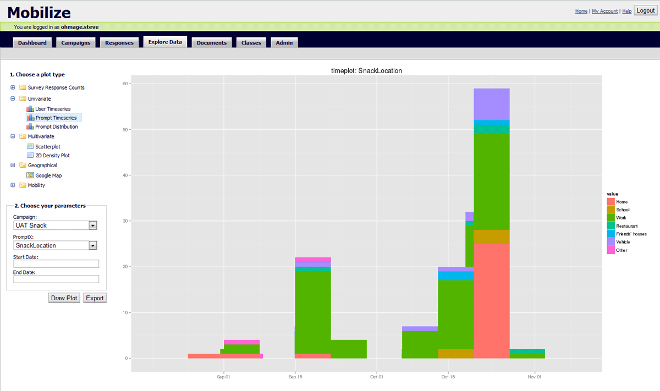
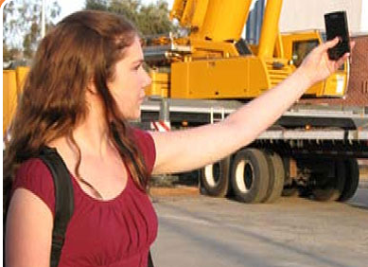
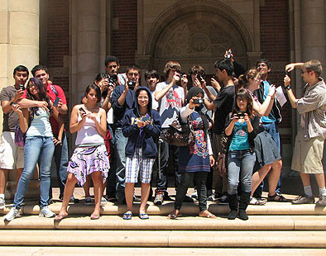
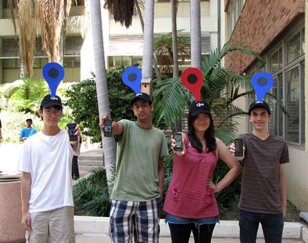
Who use Ohmage?
Hundreds of LAUSD High School Students use Ohmage to capture information about their neighborhood and community.
http://www.mobilizingcs.org/

Slide 5
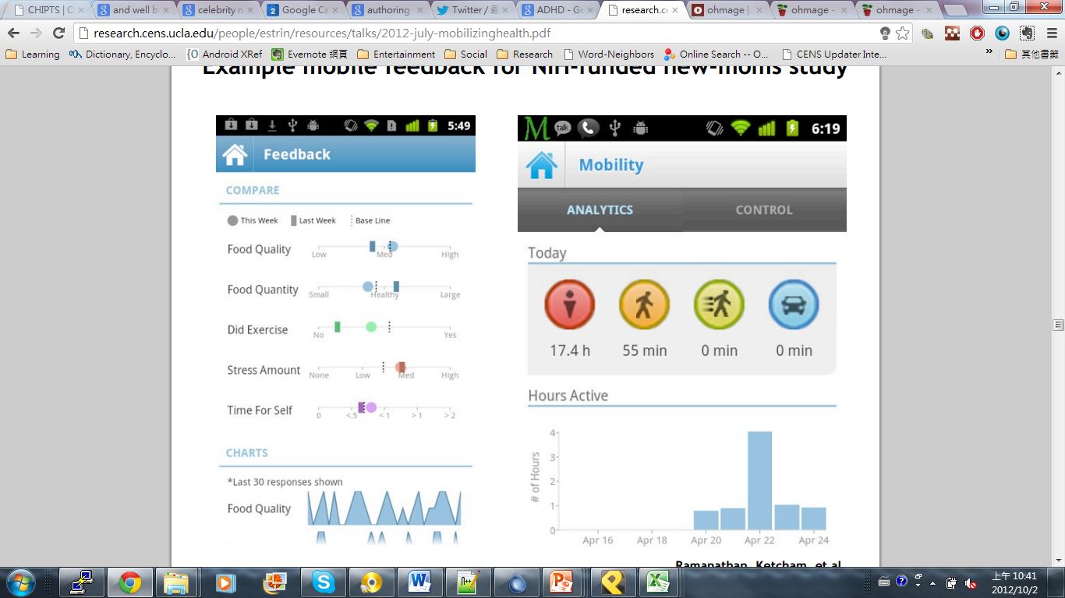
Who else use Ohmage?
After-pregnancy moms
Heart disease patients
Attention deficit hyperactivity disorder (ADHD) patients
HIV+ Patients
And many many….

Slide 6
Ohmage is an active open-source project!
Impacts you can make by joining the Ohmage project:
  Research
  Education
  Wellbeing
  Community building
The following are the projects we have in mind.
  Feel free to propose your own!

Slide 7
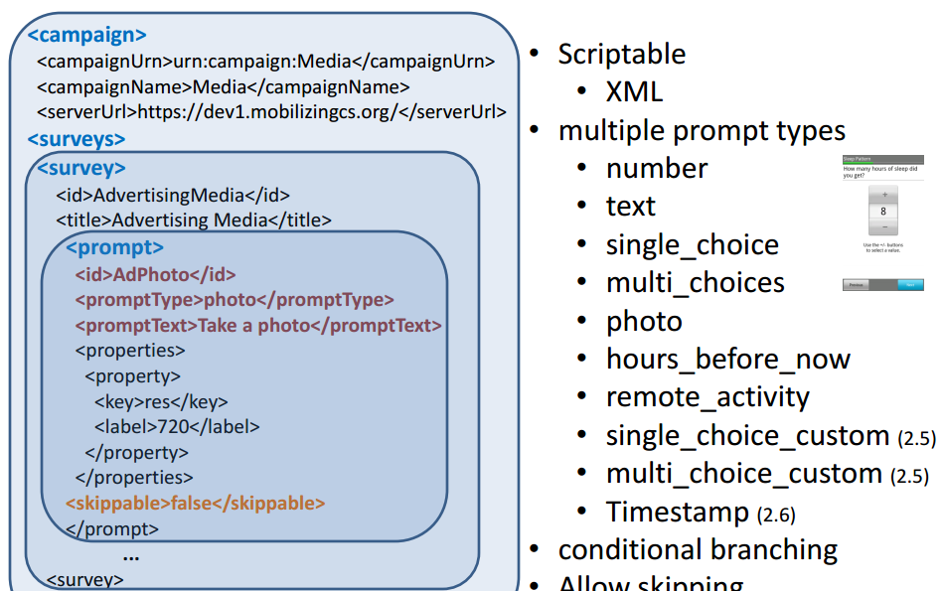
Project : Campaign Authoring GUI

Slide 8
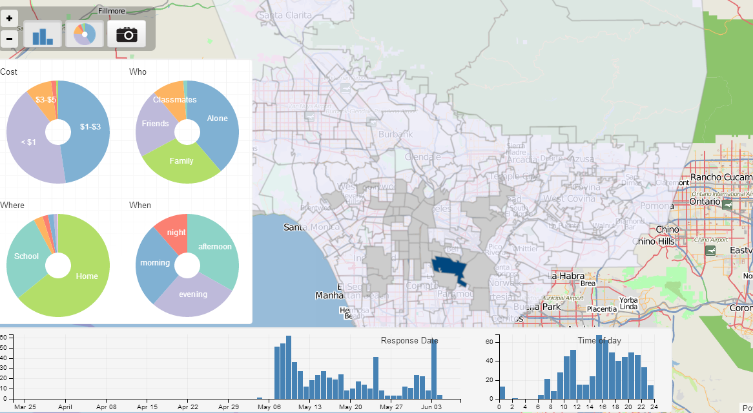
Project : Dashboard for Ohmage

Slide 9
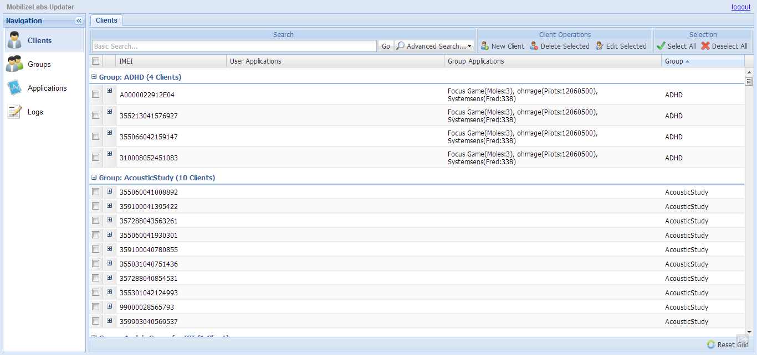
Project : Fine-grained Android App Dispatcher

Slide 10
Skills we are looking for!
Front-end designs:
  Javascript (jquery, D3…) GWT, HTML, CSS, any visualization tool kits..
Back-end designs
  Python (Django), Java, MySQL.

Slide 11
Thank you!
Pointers
  http://www.ohmage.org/
  http://www.mobilizingcs.org/
  http://ohmage.wikispaces.com/
  https://pilots.ohmage.org/
Contact me
  Andy (chnagun@cs.ucla.edu)

