Slide 1
From Counting Sketches to
Equi-Depth Histograms
University of California, Los Angeles
Computer Science Department
CS240B Notes from a EDBT11 paper entitled:
A Fast and Space-Efﬁcient Computation of
Equi-Depth Histograms for Data Streams.
By: Hamid Mousavi and Carlo Zaniolo
hmousavi@cs.ucla.edu zaniolo@cs.ucla.edu
Computer Science Department, UCLA

Slide 2
Outline
Introduction
  Histograms vs. Quantiles
Exponential Histogram structure
BASH Algorithm
Experimental results
Conclusion

Slide 3
Histograms
Equi-width: all buckets have the same width, and the number of items in each bucket is reported.
Equi-depth, a.k.a equi-height or equi-probable: All buckets must contain the same number of items and we must specify boundaries between buckets to achieve that.
Computationally very challenging. No previous work of equi-depth histograms on windows. Previous work only considered the related problem of Quantiles.

Slide 4
Quantiles
A problem akin to equi-depth histograms;
  Query: find the item that occupies a given position in a sorted list of N items.
  Thus given a ϕ, 0 ≤ ϕ ≤ 1, that describes the scaled rank of an item in the list, the quantile algorithm must return the ⌈ϕN⌉-th item in the list.
Quantile algorithms guarantee an ϵ-approximate answer for any given ϕ
  [Greenwald et al. 2001]: Proposed an algorithm called GK for the whole history of the stream.
  [Arasu et al. 2004]: used GK to solve the problem on sliding windows. We refer to this algorithm as AM.
  [Lin et al. 2004]: also used GK for the sliding window case; however, with higher space usage.

Slide 5
Quantiles as Equi-depth Histograms
To compute the B -1 boundaries of any equi-depth histograms, we could employ a quantile structure and report ϕ-quantiles for ϕ = 1/B , ϕ = 2/B , …
However, on data streams:
  Quantile algorithms over sliding windows are too slow, since they derive more information than is needed to derive boundaries,
  Quantiles algorithms focus on minimizing the rank error, while in equi-depth histograms we want to minimize the bucket size error.

Slide 6
The BASH Algorithm:
Goals and Contributions
BASH constructs equi-depth histograms
  For data streams over sliding windows
  A faster algorithm
  Producing more accurate results
  Using a reasonable amount of memory
This kind of histograms have many applications, e.g.:
  Query optimization,
  Approximate query answering,
  Distribution fitting
  Parallel database partitioning
BASH builds on the EH Sketch [Datar, Gionis, Indyk, Motwani: SIAM J. Comput. 2002]

Slide 7
The EH Sketch
Counting the number of 1’s in a 0-1 stream
Is trivial for the whole data stream, but
Over a sliding windows we must memorize the whole window to detect expiring items, … or
Use approximation to reduce memory usage
  EH Sketches require:
  O(1/δ log(W)) memory for δ-approximation on a window of size W--i.e. the error is guarantee to be less than δ.
  Sketch contains boxes of size 2⁰, 2¹ … 2^{j}
  At most K/2+1 (or K/2+2) boxes for each size j, where K=1/δ:
  Otherwise the boxes are merged into a larger box.

Slide 8
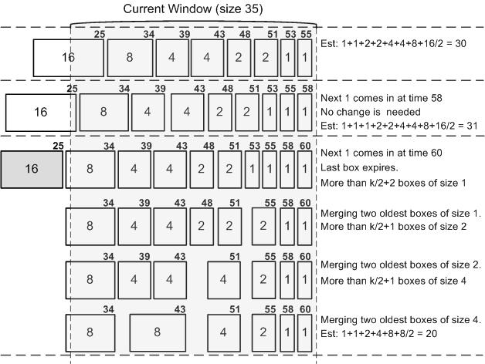
Adding 1,0,1 to an EH Sketch k=2; k/2+2=3
Time-Stamp
count

Slide 9
BAr-Splitting Histograms (BASH)
Instead of counting the 1’s in a 0-1stream,
  count the number of values in interval [B_{i}, B_{i+1})
For a Histograms with B buckets
  For accuracy we need p×B intervals
  p is the expansion factor ~ 6 or 7
  An interval will be called a bar.

Slide 10
General Idea: the number of items in each bar is approx. W/(p×B)
Bar
B1
B2
B3
B4
B5
Bmax
Bmin=B₀
…
…
Imaginary
Ordered
List of
Items
…
Notes:
BASH () {
initialize();
while (true) {
next = next item in the data stream;
find appropriate bar bar for next;
insert next into bar.EH;
maxSize = maxCoef ×W/Sm;
if (bar.count > maxSize)
splitBar(bar);
remove expired boxes from all EHs;
if (window slides)
output computeBoundaries();
}
}

Slide 11
Initialization Phase
BASH starts with an empty bar
As items arrive bars, grow up to size:
Coef × W × 1/S_{m} where:
  W is the window size (i.e., number of items)
  S_{m} is the number of bars: ≤ p×B
  Coef ≅ 1.7

Slide 12
Inserting a New Item N:
Find i-th bar where Bi≤N<Bi+1
Insert N provided that size of bar ≤ Coef ×W/(B × p).
B0=min
B1
B2
B3
B4
Bi
Bi+1
Bi+2
Bmax
N
…
…
…

Slide 13
Inserting an New Item in the i^{th} bar
B0=min
B1
B2
B3
B4
Bi
Bi+1
Bmax
≤
…
…
…
When the size of i^{th} bar is larger than Coef ×W/(B × p) we need split it.
But if we have already B × p bar, then we must first make room for the new bar, by merging two existing bars

Slide 14
Merging two bars
We only merge when we need to make some room.
B0=min
B1
B2
B3
B4
Bi
Bi+1
Bmax
…
…
…
Blocked Bar
We never add to a blocked bar. We only remove old blocks until it is empty.
Notes:
if (! findBarsToMerge(Xl, Xr))
return false;
Initialize new bar X;
if (EHXl.BoxNo ≥ EHXr.BoxNo) {
EHX = EHXr ;
Add EHXl to the blocked bars list of EHX;
} else {
EHX = EHXl ;
Add EHXr to the blocked bars list of EHX;
}
Add the blocked bars of both EHXl
and EHXr to the blocked bars list of EHX;
X.start = Xl.start;
X.end = Xr.end;
Remove Xr and Xl from the bars list;
Add bars X and to the bars list;
return true;

Slide 15
Splitting a bar
B0=min
B1
B2
B3
Bi-1
Bi
Bi+1
Bmax
…
…
…

Slide 16
Divide an EH structure into Two
It’s easy to show that the resulting structures are EHs as well

Slide 17
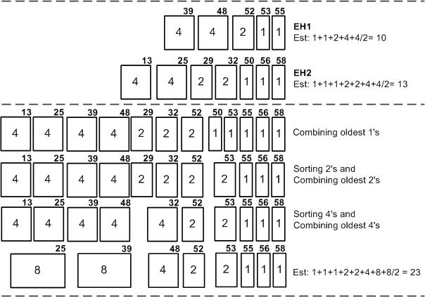
Alternative Merge Function (BASH-AL)
For interval 1009-1221
For interval 1221-1278
Now, the original EH algorithm can be executed to merge extra boxes.
New interval 1009-1278

Slide 18
Computing Final Boundaries
We assume that data items are uniformly distributed in each bar.
B0=min
B1
B2
B3
Bi4
Bmax
…
…
R1
R2
R3
RB-1
Notes:
b = −1; //An index over bars list
count = 0;
idealBuckSize = totalEst/B;
for (int i = 0; i < B; i++) {
while (count ≤ idealBuckSize) {
b ++;
count += bars[b].count;
}
surplus = count − idealBuckSize;
boundaries[i] = bars[b].start+
bars[b].length ∗ (1−surplus/bars[b].count)
count = surplus;
}
return boundaries;

Slide 19
Error definitions: ϵ-approximation
An equi-depth histogram on a window of size W is a:
size-based expected ϵ-approximate summary when the expected error on the reported number of items in each bucket is bounded by ϵ×W/B.
rank-based expected ϵ-approximate if the expected error of the rank of every reported boundary is bounded by ϵ×W.
boundary-based expected ϵ-approximate if the expected value error for every reported boundary is bounded by ϵ×S, where S is the diff between max and min values in W.

Slide 20
Theoretical Results: we proved that
BASH-BL provides a size-based expected ϵ-approximate equi-depth summary
Average time complexity:
  O(log(B×p)+(B×p)/S) per single entry
  S ≥1 is the size of the window-slide
Memory usage:
  Bounded by O(log(ϵ²W/B) ×B/ϵ²)
  In practice, smaller than that.

Slide 21
Experimental results
We have compared our algorithms with one of the best existing ones called AM algorithm.
Both BASH-BL and BASH-AL
  Are at least 4 times faster than AM,
  provide more accurate results
  While using approximately the same amount of memory

Slide 22
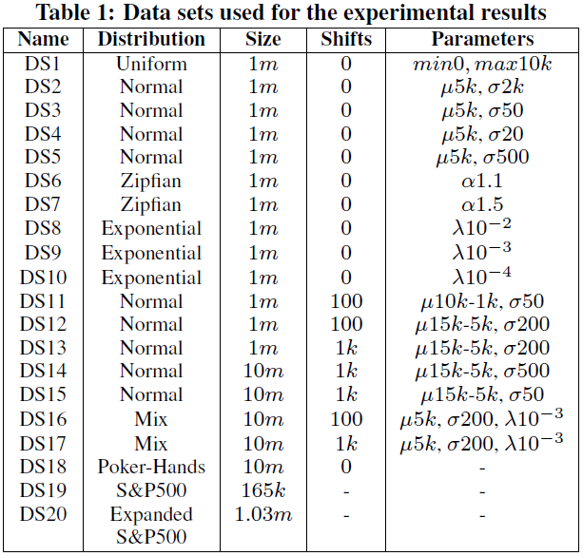

Slide 23
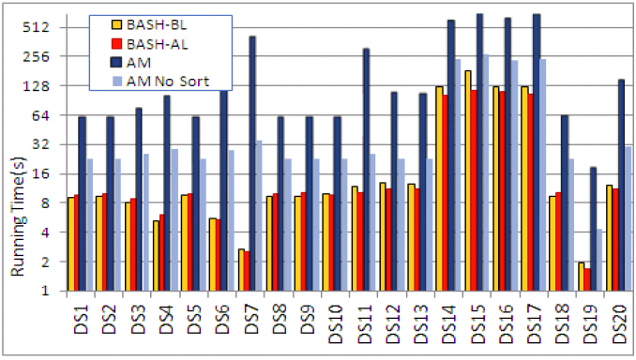
Running Time (for ϵ=0.01, W=100K, B=20)

Slide 24
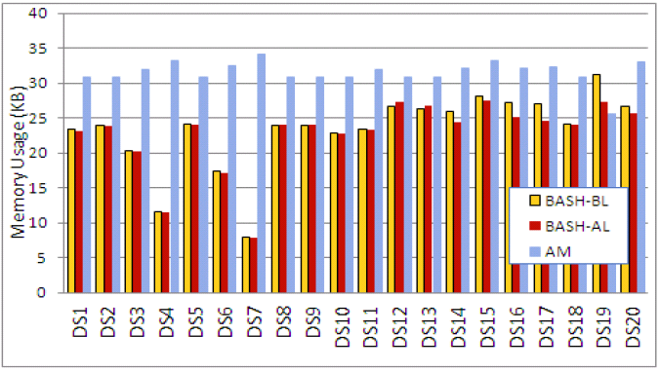
Memory Usage

Slide 25
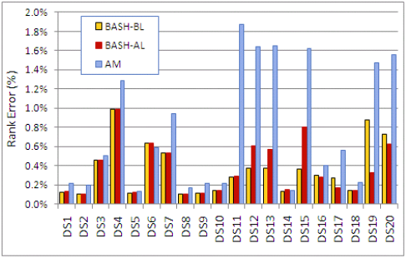
Rank Error

Slide 26
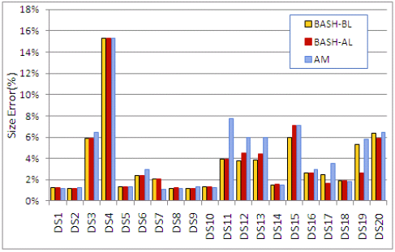
Size Error

Slide 27
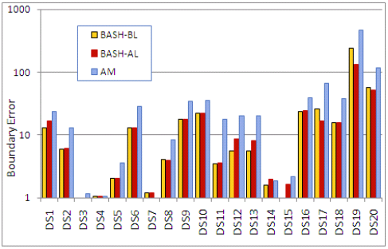
Boundary Error

Slide 28
Effect of changing window size on the running time (DS13)

Slide 29
Effect of changing window size on the size error (DS13)

Slide 30
Boundary error for DS15 (Mix) data set

Slide 31
Boundary error for the extended S&P500 dataset

Slide 32
Conclusion and Future Works
The BAr Splitting Histograms (BASH) compute expected sized-based ϵ-approximate equi-depth histogram. Moreover,
  There is no need to know the min and max of values
  Is more than 4 times faster than previous approaches
  While typically requires smaller memory footprints
  Provides more accurate results
Future work
  Reducing memory even further.
  Other Types of Histograms: Biased Histograms Compressed Histograms: MaxDiff Histograms, V-Optimal Histograms

Slide 33
questions?
Thanks for listening

Slide 34
References:
A. Arasu and G. S. Manku. Approximate counts and quantiles over sliding windows. In PODS, pages 286–296, 2004.
M. Datar, A. Gionis, P. Indyk, and R. Motwani. Maintaining stream statistics over sliding windows. SIAM J. Comput., 31(6):1794–1813, 2002.
M. Greenwald and S. Khanna. Space-efficient online computation of quantile summaries. In SIGMOD Conference, pages 58–66, 2001.
X. Lin, H. Lu, J. Xu, and J. X. Yu. Continuously maintaining quantile summaries of the most recent n elements over a data stream. In ICDE, pages 362–374, 2004.

Slide 35
  Fast computation of approximate biased histograms on sliding windows over data
by:
Hamid Mousavi and Carlo Zaniolo
SSDBM 2013 (best paper award)

Slide 36
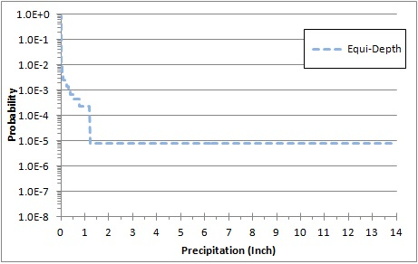
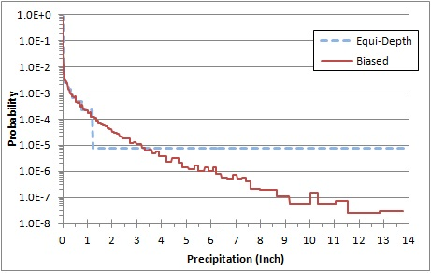
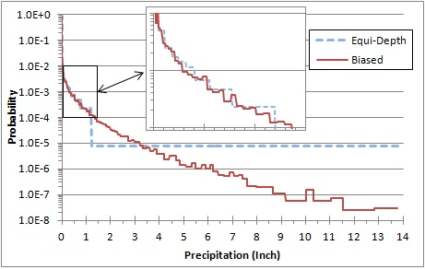
Biased Synopses for A Better Estimation at Tails
Probability of precipitation amounts*
* The data is taken from www.ncdc.noaa.gov

Slide 37
Biased Histograms
Buckets
%ϕ⁷
(%48)
%ϕ⁶
(%53)
%ϕ⁵
(%59)
%ϕ⁴
(%65)
%ϕ³
(%73)
%ϕ²
(%81)
%ϕ
(%90)
We exponentially decrease the bucket size once approaching the biased point with the factor of ϕ.
For the rest of the presentation ϕ is called the biased factor.

Slide 38
Biased Histograms: many critical applications
Network performance monitoring systems need to watch the round-trip time (RTT) distribution with a biased interest over the tail of the RTTs to detect suspicious or malicious behaviors.
Efficiently partitioning large datasets in which data items in the tail of distribution are more costly to handle. (Web Graph)

Slide 39
Our Contributions:
An accurate and efficient algorithm to maintain
ε-approximate
biased histograms
on sliding windows over data streams,
by biased sampling techniques to adjust to the memory and CPU requirements.
Our technique is called Bar Splitting Biased Histogram or BSBH.

Slide 40
Conclusion
We formalized the concept of approximate Biased Histograms.
We proposed a new algorithm for generating approximate Biased Histograms which:
  works efficiently for data streams with sliding windows (no previous work for that),
  outperforms previous approaches for the entire data streams, and
  adapts to memory and CPU requirements by exploiting biased sampling.
We proved that BSBH is able to construct ε-approximate biased histogram for the case of having to concept shifts.

Slide 41
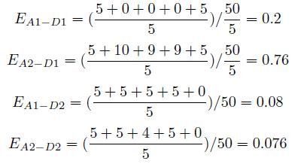
Rank Error vs. Size Error
Algorithms A1 and A2 construct two 5-bucket equi-depth histograms as follows:
  Bucket sizes Boundaries Ranks
  A1: 5, 10, 10, 10, 15 5, 15, 25, 35, 50
  A2: 5, 20, 1, 19, 5 5, 25, 26, 45, 50

