Slide 1
Clustering on Data Streams
Parth Doshi
Pratik Nichat

Slide 2
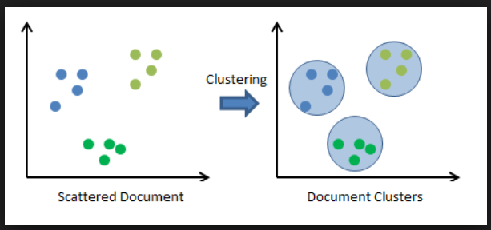
Clustering
Clustering in data mining is the grouping of a particular set of objects based on their characteristics, aggregating them according to their similarities.
Methods include kmeans, k-mediods, dbscan etc.

Slide 3
Data streams and clustering
Continuous, massive, unbounded sequences of data objects that are continuously generated at a rapid rate are said to be data streams.
The problem of data stream clustering is defined as:
Input: a sequence of n points in metric space and an integer k.
Output: k centers in the set of the n points so as to minimize the sum of distances from data points to their closest cluster centers.
This is the streaming version of the k-median problem.

Slide 4
Issues in data streams
For data stream mining, the successful development of algorithms has to take into account the following restrictions:
(1) Data objects arrive continuously.
(2) There is no control over the order in which the data objects should be processed.
(3) The size of a stream is (potentially) unbounded.
(4) Data objects are discarded after they have been processed. In practice, one can store part of the data for a given period of time, using a forgetting mechanism to discard them later.
(5) The unknown data generation process is possibly nonstationary, that is, its probability distribution may change over time.

Slide 5
Data Stream Clustering: A Survey
JONATHAN A. SILVA, University of Sao Paulo ELAINE R. FARIA, University of Sao Paulo and Federal University of Uberlandia RODRIGO C. BARROS, EDUARDO R. HRUSCHKA, and ANDRE CARVALHO, University of Sao Paulo JOAO GAMA, University of Porto
The paper presents a survey of data stream clustering algorithms, providing a thorough discussion of the main design components of state-of-the-art algorithms.
The design components include data structures and mechanisms that can be used to efficiently store and retrieve data objects, keep track of the latest ones and detect anomalies.
This paper is particularly focused on algorithms for clustering data streams.

Slide 6
Clustering problem
The clustering problem can be posed as determining a ﬁnite set of categories (clusters) that appropriately describe a dataset.
Objects within a cluster are more similar to each other than they are to objects belonging to a different cluster.
Batch-mode clustering algorithms have been both studied and employed as data analysis tools for decades.
Clustering data streams requires a process able to continuously cluster objects within memory and time restrictions.

Slide 7
Requirements for a Data stream clustering algorithm
Provide timely results by performing fast and incremental processing of data objects
Rapidly adapt to changing dynamics of the data, which means algorithms should detect when new clusters may appear, or others disappear
Scale to the number of objects that are continuously arriving
Provide a model representation that is not only compact but that also does not grow with the number of objects processed
Rapidly detect the presence of outliers and act accordingly
Deal with different data types, for example, XML trees, DNA sequences, GPS temporal and spatial information.

Slide 8
Stream Clustering Algorithm steps
Data Abstraction
  Summarize the data into memory-efficient data structures
Clustering phase
  Use a clustering algorithm to find the data partition

Slide 9
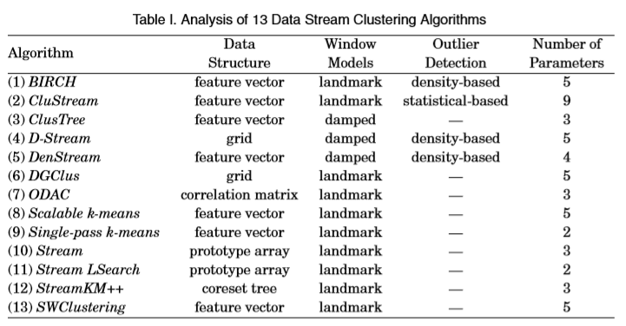
Features of the prominent Stream Clustering Algorithms

Slide 10
Data Abstraction Step
Data Structures
Considering that the entire stream cannot be stored in the main memory, special data structures must be employed for incrementally summarizing the stream.
Commonly used data structures:
Feature vectors
Prototype array
Coreset trees
Grids

Slide 11
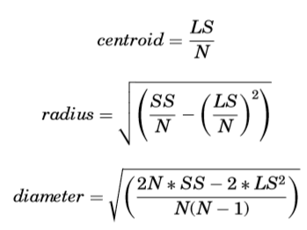
CF Tree
Data structure: Feature Vector
First introduced in BIRCH clustering algorithm
Called Clustering Feature(CF) vector
Has 3 components :
N – number of data objects
LS – linear sum of data objects
SS – sum of squared data objects
These three components help us to compute cluster measures, such as cluster mean, radius and diameter.

Slide 12
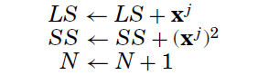

CF Tree
Incrementality. A new object xj can be easily inserted into CF vector by updating
Its statistic summaries as follows.
Additivity. Two disjoint vectors CF1 and CF2 can be easily merged into CF3 by summing up their components.

Slide 13
CF-Trees
Height balanced tree (B+ Tree)
Each non-leaf node contains at most B entries, having each a CF vector and a pointer to a child node.
Every leaf node contains at most L entries, where each entry is a CF vector.
Adjacent figure depicts the CF tree structure, where every non-leaf node represents a cluster consisting of sub clusters (its entries).

Slide 14
CF-Trees
In the initial phase of BIRCH, the dataset is incrementally scanned to build a CF tree in-memory.
When a new object arrives, it descends the CF tree from the root to the leaves by choosing in each non-leaf node its closest CF entry(closeness is deﬁned by the Euclidean distance between new objects and the centroids of CF entries in non-leaf nodes).
In a leaf node, the closest entry is selected and tested to verify whether it can absorb the new object.
if absorbed – CF vector is updated
else a new CF entry is created (with just 1 object)
If there is no space for a new CF entry in leaf node, leaf is split into two leaves and farthest pair of CF entries is used as seed to the new leaves.
Afterwards, update each non leaf node entry in the path until root.

Slide 15
Prototype Array
Some data stream clustering algorithms use a simplified summarization structure, called prototype array. It is an array of prototypes (e.g., medoids or centroids) that summarizes the data partition.
Usually algorithms employ an array of prototypes for summarizing the stream by dividing the data stream into chunks of size m. Each chunk of m objects is summarized in 2k representative objects by using a variant of the k-medoids algorithm
The process of compressing the description of the data objects is repeated until an array of m prototypes is obtained. Next, these m prototypes are further compressed (clustered) into 2k prototypes

Slide 16
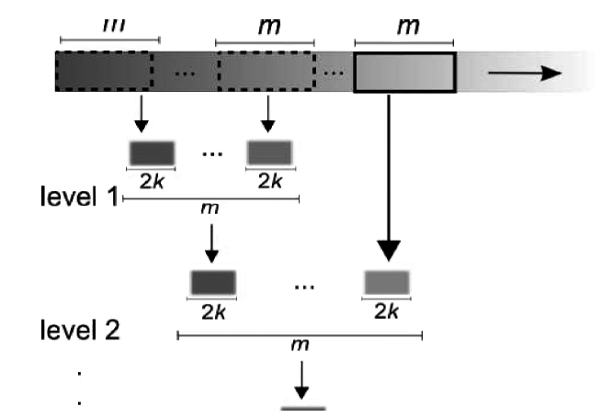
Prototype Array
The same process is repeated until one gets m prototypes.

Slide 17
Coreset Tree
The data structure used for coreset tree is a binary tree in which each tree node i contains the following components:
a set of objects, Ei ;
a prototype of Ei , Xpi ;
the number of objects in Ei , Ni ;
and the sum of squared distances of the objects in Ei to Xpi , SSEi .
Ei only has to be stored in the leaf nodes of the coreset tree, because the objects of an inner node are implicitly defined as the union of the objects of its child nodes.

Slide 18
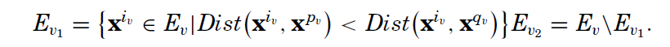
Coreset Tree
The coreset tree structure is responsible for reducing 2m objects to m objects. The construction of this structure is defined as follows.
First, the tree has only the root node v, which contains all the 2m objects in Ev. The prototype of the root node Xpv is chosen randomly from Ev and Nv = |Ev| = 2m. Afterwards, two child nodes for v are created, namely: v1 and v2.
To create these nodes, the object that is farthest away from the protoype object is selected.
After the object has been selected, the next step is to distribute the objects in Ev to Ev1 and Ev2 such that

Slide 19
Coreset Tree
So now we have two nodes and the summary statistics of both the nodes are updated accordingly.
This process is known as the expansion step and is continued until there are m leaf nodes.
When there are multiple leaf nodes, the decision on which one to expand first depends on the ratio of SSE of child to SSE of root.

Slide 20
Coreset Tree
StreamKM++ is a two-step algorithm, that is, merge and reduce.
The reduce step is performed by the coreset tree, considering that it reduces 2m objects to m objects.
The merge step is performed by another data structure, namely the bucket set, which is a set of L buckets (also named buffers), where L is an input parameter.
Each bucket can store m objects. When a new object arrives, it is stored in the first bucket. If the first bucket is full, all of its data are moved to the second bucket.
If the second bucket is full, a merge step is computed, that is, the m objects in the first bucket are merged with the m objects in the second bucket, resulting in 2m objects, which, by their turn, are reduced by the construction of a coreset tree, as previously detailed.
The resulting m objects are stored in the third bucket, unless it is also full,and then again a new merge-and-reduce step is needed

Slide 21
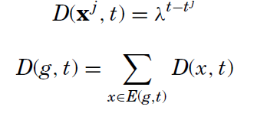
Grid
Some data stream clustering algorithms perform data summarization through grids that is, by partitioning the n-dimensional feature space into density grid cells.
For instance, D-Stream maps each data stream object into density grid cells. Each object at time t is associated to a density coefficient that decreases over time.
The density of a grid cell g at time t, D(g, t), is given by the sum of the adjusted densities of each object that is mapped to g at or before time t (E(g, t)),
Each grid cell is represented by a tuple <tg, tm, D, label, status>, where tg is the last time the grid cell was updated, tm is the last time the grid cell was removed from the hash table that holds the valid grid cells, D is the grid cell density at its last update, label is the class label of the grid cell, and status indicates whether the grid cell is NORMAL or SPORADIC

Slide 22
Grid
The grid cells maintenance is performed during the online phase. A grid cell can become sparse if it does not receive new objects for a long time. In contrast, a sparse grid cell can become dense if it receives new objects.
At fixed intervals of time (dynamic parameter gap), the grid cells are inspected with regard to their status. Considering that the number of grid cells may be large, especially in high-dimensional streams, only the grid cells that are not empty are stored. Additionally, grid cells with few objects are treated as outliers (status = SPORADIC).
Sporadic grid cells are periodically removed from the list of valid grid cells. Also, during the online phase, when a new n-dimensional object arrives, it is mapped into its corresponding grid cell g. If g is not in the list of valid grid cells (structured as a hash table), it is inserted in it and its corresponding summary is updated

Slide 23
Scalable k-means / Extended k-means
Application of Data Structures
Employs a CF vector structure to enable the application of the k-means algorithm in very large datasets.
The basic idea is that the objects in the dataset are not equally important to the clustering process.
This algorithm stores data objects in a block (buffer) in the main memory. Through the CF vectors, it discards objects that were previously statistically summarized into buffer.
When the block is full, an extended version of k-means is executed over the stored data. This extended version of k-means, named Extended k-means, can handle with both single data objects and sufﬁcient statistics of summarized data.

Slide 24
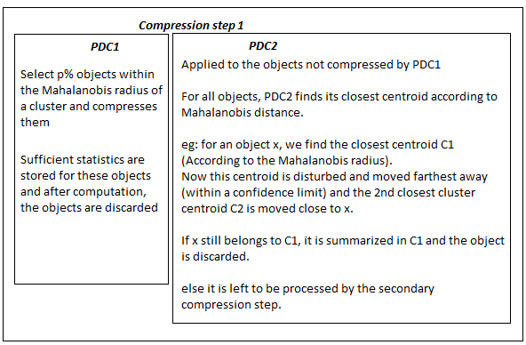
Procedure

Slide 25
Procedure
Compression step 2
Applied to those objects that were not discarded in the primary compression.
Objective is to release space in memory to store new objects.
Objects are clustered by k means into user defined clusters k2.
Each of the K2 clusters is evaluated to check whether variance of a cluster is below a threshold β.
The statistical summary (CF Vector) of the clusters that meet this criterion are stored in the buffer, along with CF vectors from compression step 1.
The CF vectors that don’t meet the aforementioned criteria are permanently discarded.

Slide 26
Single Pass k-means
Simplification of Scalable k-means.
This does not employ the compression steps of Scalable k-means.
Instead, in each iteration of the algorithm, all objects in the buffer are discarded after the summary statistics are computed, and only the summary statistics of the k-means clusters are kept in the buffer.

Slide 27
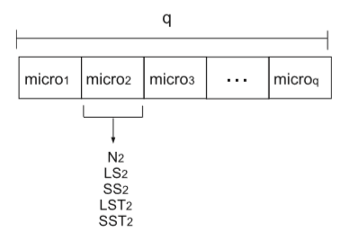
CluStream Algorithm
CF Vector concept is extended and named microcluster.
Each microcluster has 5 components:
N – number of data objects
LS – linear sum of data objects
SS – sum of squared data objects
LST – sum of the timestamps
SST – sum of squares of the timestamps
The online phase stores q microclusters in memory, where q is an input parameter.
Each microcluster has maximum boundary – Std. deviation of the mean distance of the cluster objects to their centroids multiplied by a factor f.

Slide 28
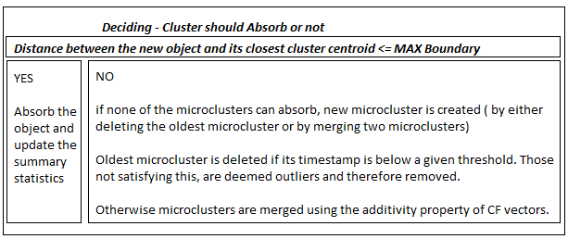
Procedure
For each new object, the closest microcluster (According to Euclidean distance) is selected to absorb it.

Slide 29
Window Models
In most data stream scenarios, more recent information from the stream can reﬂect the emerging of new trends or changes on the data distribution.
This information can be used to explain the evolution of the process under observation. Systems that give equal importance to outdated and recent data do not capture the evolving characteristics of stream data.
Moving window techniques have been proposed to partially address this problem.

Slide 30
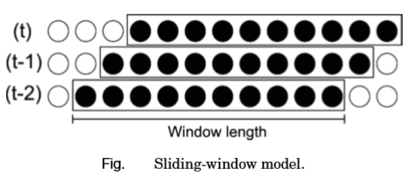
Sliding Window Model
In the sliding-window model, only the most recent information from the data stream are stored in a data structure whose size can be variable or ﬁxed.
This data structure is usually a ﬁrst in, ﬁrst out (FIFO) structure, which considers the objects from the current period of time up to a certain period in the past.
The organization and manipulation of objects are based on the principles of queue processing, where the ﬁrst object added to the queue will be the ﬁrst one to be removed.

Slide 31
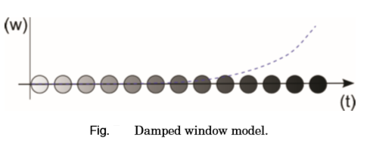
Damped Window Model
Considers the most recent information by associating weights to objects from the data stream
More recent objects receive higher weight than older objects, and the weights of the objects decrease with time.
The weight of the objects exponentially decays from black (most recent) to white (expired).
This model is usually adopted in density-based clustering algorithms

Slide 32
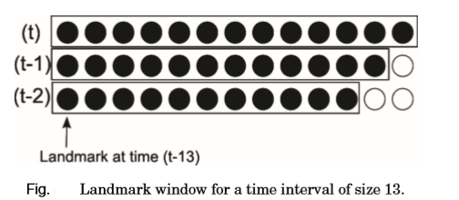
Landmark Window Model
Processing a stream based on landmark windows requires handling disjoint portions of the streams (chunks), which are separated by landmarks (relevant objects).
Landmarks can be deﬁned either in terms of time (e.g., on daily or weekly basis) or in terms of the number of elements observed since the previous landmark.
All objects that arrived after the landmark are kept or summarized into a window of recent data. When a new landmark is reached, all objects kept into the window are removed and the new objects from the current landmark are kept in the window until a new landmark is reached.

Slide 33
Outlier Detection
Besides the requirements of being incremental and fast, data stream clustering algorithms should also be able to properly handle outliers throughout the stream
Outliers are objects that deviate from the general behavior of a data model and can occur due to different causes, such as problems in data collection, storage and transmission errors, fraudulent activities, or changes in the behavior of the system.
Outlier detection is extremely difficult to implement in theory because there it is difficult to identify the deviant behavior is characteristic of a new cluster or is actually noise and should be eliminated from the Database.

Slide 34
Offline Clustering
The last step is the clustering step, which typically involves the application of a standard clustering algorithm to find clusters on the previously generated statistical summaries.
One of the most popular algorithms for data clustering is k-means due to its simplicity, scalability, and empirical success in many real-word applications Not surprisingly, k-means and its variants are widely used in data stream scenarios

Slide 35
Offline Clustering
APPROACHES
Approach 1
Calculate the centroid of each CF vector—LS N —and consider each centroid as an object to be clustered by k-means.
Approach 2
Do the same as before, but weighting each object (CF vector centroid) proportionally to N, so that CF vectors with more objects will have a higher influence on the centroid calculation process performed by k-means.
Approach 3
Apply the clustering algorithm directly to the CF vectors, since their components keep the sufficient statistics for calculating most of the required distances and quality metrics.

Slide 36
CONCLUSION
The paper describes the techniques used for clustering streams of data using two prominent steps – data abstraction(online step) and clustering step(offline step).
The paper details the data structures used for summarizing the data streams which are used afterwards directly for the offline clustering step.
We saw the three prominent techniques used in the offline clustering step to actually cluster the data stream.
The paper briefly gives a glance at the window models that can be used to store the summarized data in case memory is a constraint.

Slide 37
REFERENCES
J. A. Silva et al. Data Stream Clustering: A Survey. ACM Computing Surveys, Vol. 46, No. 1, Article 13, Publication date: October 2013.
ACKERMANN,M.R.,MARTENS,M.,RAUPACH,C.,SWIERKOT,K.,LAMMERSEN,C.,ANDSOHLER,C.2012. StreamKM++: A clustering algorithm for data streams. ACM J. Exper. Algor. 17, 1.
AGGARWAL, C. C. 2007. Data Streams – Models and Algorithms. Springer.
ARTHUR, D.AND VASSILVITSKII, S. 2007. K-means++: The advantages of careful seeding. In Proceedings of the 18th Annual ACM-SIAM Symposium on Discrete Algorithms. 1027–1035.
BRADLEY, P. S.AND FAYYAD, U. M. 1998a. Reﬁning initial points for k-means clustering. In Proceedings of the 15th International Conference on Machine Learning (ICML’98). Morgan Kaufmann Publishers, San Francisco, 91–99.
BENTLEY, J. L. 1975. Multidimensional binary search trees used for associative searching. Comm. ACM 18, 9, 509–517.
CSERNEL, B., CLEROT, F.,AND HEBRAIL, G. 2006. Datastream clustering over tilted windows through sampling. In Proceedings of the Knowledge Discovery from Data Streams Workshop (ECML/PKDD).
GUHA, S., MISHRA, N., MOTWANI, R.,AND O’CALLAGHAN, L. 2000. Clustering data streams. In Proceedings of the IEEE Symposium on Foundations of Computer Science. 359–366.
HAR-PELED, S.AND MAZUMDAR, S. 2004. On coresets for k-means and k-median clustering. In Proceedings of the 36th Annual ACM Symposium on Theory of Computing. 291–300.
KHALILIAN, M.AND MUSTAPHA, N. 2010. Data stream clustering: challenges and issues. In Proceedings of International Multi Conference of Engineers and Computer Scientists. 566–569.
KRANEN,P.,ASSENT,I.,BALDAUF,C.,ANDSEIDL,T.2011.Theclustree:Indexing micro clusters for anytime stream mining. Knowl. Inf. Syst. 29, 2, 249–272.
LUHR, S.AND LAZARESCU, M. 2009. Incremental clustering of dynamic data streams using connectivity based representative points. Data Knowl. Engin. 68, 1–27.
DE MAESSCHALCK, R., JOUAN-RIMBAUD, D.,AND MASSART, D. L. 2000. The mahalanobis distance. Chemometrics Intell. Laboratory Syst. 50, 1–18.
MAHDIRAJI, A. R. 2009. Clustering data stream: A survey of algorithms. Int. J. Knowl.-Based Intell. Engin. Syst. 13, 2, 39–44.
SILVA, J. A.AND HRUSCHKA, E. R. 2011. Extending k-means-based algorithms for evolving data streams with variable number of clusters. In Proceedings of the 4th International Conference on Machine Learning and Applications (ICMLA’11). Vol. 2. 14–19.
ZHANG,T.,RAMAKRISHNAN,R.,ANDLIVNY,M.1997.BIRCH:A new data clustering algorithm and its applications. Data Mining Knowl. Discov. 1, 2, 141–182.

Slide 38
ANY QUESTIONS ?

