Slide 1
Decision Trees for Mining Data Streams
240B Fall 2018
Liangkun Zhao

Slide 2
Outline
Introduction
Background Knowledge
Challenges
Numerical Interval Pruning
A New Sampling Approach
Experiment result
Conclusion & future work

Slide 3
Introduction
Decision tree construction is an important data mining problem
Got attention from disk-resident datasets to data streams
Key issue: 1. Only one pass over entire data
2. Real-time constraint
3. Memory limit
Domingos and Hulten’s algorithm guarantees a probabilistic bound on the accuracy of the decision tree. But…

Slide 4
Background knowledge
Decision tree classifier
given a data set D = {t₁, t₂ … t_{N} }, t_{i} =< x, c > ∈ X × C
X - domain of data instances X = X₁× X₂ … X_{m}
X_{j} – domain of attribute, either categorical set or numerical set ([1,100])
C – domain of class labels
Find a function f: X → C
Typically binary tree, split point.
Growing stage and pruning stage
Selecting the attribute and the spilt condition that maximizes information gain is the key step in decision tree construction

Slide 5
Challenges
The total size of the data is typically much larger than the available memory.
It is not possible to store and re-read all data from memory.
Single pass algorithm is required
Also meet the real time constraint

Slide 6
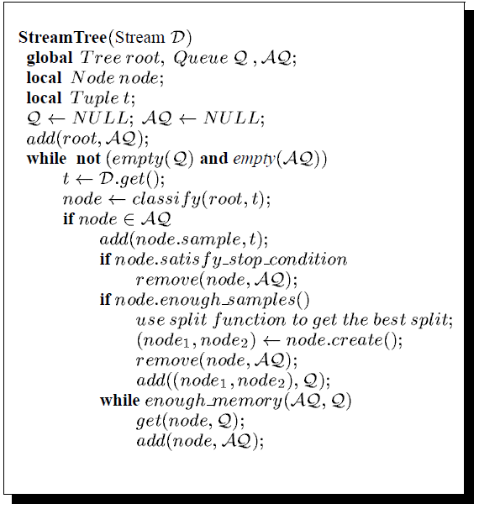
Template of algorithm
AQ – active queue
Q – set of decision tree node not yet
been splited

Slide 7
Challenges
When we have sufficient samples to make the splitting decision
What information needs to be stored from the sample for splitting decision
How we effectively examine all possible splitting conditions with a node
Number of distinct values associated with a numerical attribute can be large, can make it computationally demanding to choose the best split point

Slide 8


Sampling
Statistical test
g(x_{i}) - estimate of the best gain we could get from attribute x_{i}
ϵ - a small positive number
Original test

Slide 9


Sampling
α - probability that the original test holds if the statistical test holds, should be as close to 1 as possible
ϵ can be viewed as a function of α and sample size |S|
Domingos and Hulten use the Hoeffding bound to construct this function

Slide 10
Numerical Interval Pruning
Basic idea: partition the range of numerical attribute into intervals, and then use statistical test to prune these intervals.
An interval is pruned if it does not appear likely to include the split point.
Small class histograms: comprised of class histograms for all categorical attributes. Also add small numerical attributes.
Concise class histograms: records the occurrences of instances with each label whose value of numerical interval is within that interval.

Slide 11
Numerical Interval Pruning
Detailed Information: one of to formats
1. class histogram for the samples which are within the interval.
2. maintain the samples with each class label.
Do not need to process detailed information associated with pruned interval.
Significant reduction in the execution time but no loss of accuracy.

Slide 12
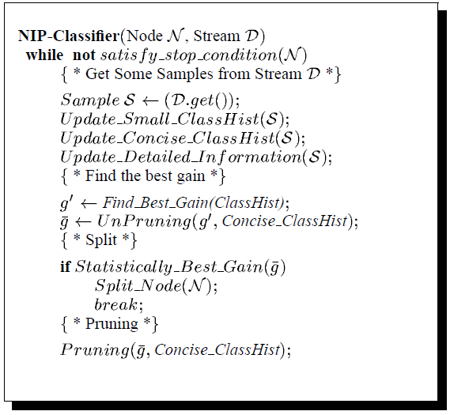
NIP algorithm for numerical attributes
Main challenge: effectively but correctly
prune the intervals.
Over-pruning: prune the interval after
analyze a small sample, unpruned later.
Under-pruning: keep the interval, but
have not yet been pruned.

Slide 13
A new sampling approach
Hoeffding bound based result is independent of the data instances in the data set.
Our method is still independent of the data instances and uses the property of gain functions like entropy.

Slide 14

A new sampling approach
z_{a} – the (1- α) th percentile of the standard normal distribution.
τ² – variance
x, y - variables

Slide 15


A new sampling approach
We are interested in the sample size that could separate g_{xa} and g_{yb} , where x_{a} and x_{b} are the points that maximize the gain of split function for top two attributes X_{a} and X_{b}
The required sample size from Hoeffding bound is
N_{n} <= N_{h} (conclusion from other paper)

Slide 16
Experiment result
Sample-H is the version that uses Hoeffding bound.
ClassHist-H uses Hoeffding bound and creates full class histograms.
NIP-H and NIP-N use numerical interval pruning, with Hoeffding bound and the normal distribution of entropy function, respectively.

Slide 17
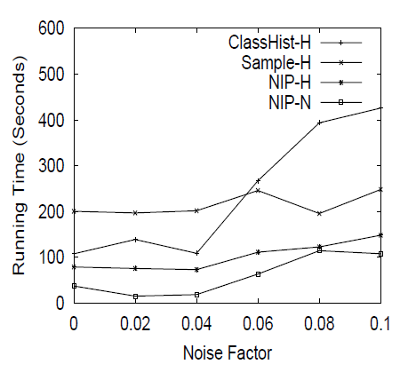
Experiment result
Dataset – 10 million training records
with 6 numerical attributes and 3
categorical attributes.
Memory bound – 60MB
Consistent with what was reported from
Domingos and Hulten.

Slide 18
Conclusion & future work
Numerical interval pruning (NIP) approach which significantly reduces the processing time for numerical attributes, without any loss of accuracy.
Use the properties of the gain function entropy to reduce the sample size required to obtain the same probabilistic bound.
Future work: 1. Other ways of creating intervals.
2. Extend work to drifting data streams.

Slide 19
reference
Efficient Decision Tree Construction on Streaming Data, by Ruoming Jin, Gagan Agrawal, in the ACM International Conference on Knowledge Discovery and Data Mining (SIGKDD) 2003.

