Slide 1
Outlier Detection in Data Streams
By : Aditya Maniar and Ashutosh Chandra

Slide 2
Content
What is an Outlier? Properties
Outlier Detection in Data Streams and challenges
Applications of outlier detection
Data Mining
Methods of Outlier Detection
Clustering based detection
Frequency based detection

Slide 3
Definition
An outlier, also known as outlying observation, is one that appears to deviate markedly from other members of the sample in which it occurs.
It is an observation (or subset of observations) which appears to be inconsistent with the remainder of that set of data.
An outlier may be due to variability in the measurement or it may indicate experimental error; the latter are sometimes excluded from the data set. An outlier can cause serious problems in statistical analyses.

Slide 4
Data Mining
Data Mining deals with the discovery of non-trivial, hidden and interesting knowledge from different types of data.
To discover knowledge, there are steps that are carried out before data mining such as selection of data, cleaning of data, pre-processing and data transformation.
Notes:
there is a concern about latest data, modification and deletion partly or fully of the currently available data set throughout the process of data mining. Earlier users had to reiterate the whole procedure which is time-consuming and also not much efficient.

Slide 5
Data Mining Categories
Dependencies Detection
Class Identification
Class Description
Outlier/Exception Detection

Slide 6
Outlier Detection on Data Streams
The fundamental and active research problem in a lot of fields is outlier detection. It is involved in many applications. A lot of these methods based on distance measure.
But for stream data these methods are not efficient. Most of the existing work on outlier detection in data stream declare a point as an outlier as soon as it arrive due to limited memory resources as compared to the huge data stream.
This approach, to declare an outlier as it arrives often can lead us to a wrong decision, because of dynamic nature of the incoming data.

Slide 7
Other Challenges in Detection of Outliers
Massive Data Processing: Data stream have huge amount of data which changes dynamically, due to this it is difficult to scan the data in one go. In this scenario major challenge in traditional outlier detection methods is providing of a high detection rate in the dynamic data stream.
Limited Computation Resources: In many application domain there is requirement of more calculating power and the other calculating factor such as intake of available memory at hand are not in accordance with huge amount of data in a data stream. Stream mining algorithms should learn fast and moreover it should consume less memory resources.

Slide 8
Challenges (cont’d)
Uncertain and missing data: In most application domains we do not have enough data for operations. Such situations arise as a consequence of uncertain and missing data. If we do not have sufficient information about the data in data streaming it may lead us to wrong decisions.
Distributed Streaming Data: Data coming from dissimilar datasets may change dynamically and in such situations distribution of data stream may not be known.

Slide 9
Challenges (cont’d)
High Dimensional Data Stream: High dimensional data stream contain a tremendous amount of data. Such massive amount data contains a large data with high dimensions and complexity. For example in wireless sensor, Google search, etc. traditional methods are not appropriate for high dimensional data as they require very high computation cost for processing data

Slide 10
Applications
The outlier analysis in data streams leads in detection and prevention of fake activities, criminal activities, failures and improvement in security and safety in diverse applications, e.g. in credit card industry.
Outlier detection is a challenging work because of the characteristics of data streams. Most of the outlier detection techniques work on static time sequences. They process outliers by working on the entire time sequences to detect global outliers.
This would be computationally infeasible in case of data streams.

Slide 11
Methods of Outlier Detection
Model
Build a model based on domain values and the object that do not match with the model are marked as outliers
Connectivity
Used when object are associated, objects which have few association are flagged as outliers.
Density
Objects that fall in low-density region of space are treated as outliers.

Slide 12
Methods of Outlier Detection
Distance
Distance with nearest neighbour that exceed a threshold are flagged as outliers.
Clusters
Objects that do not belong to any cluster, or to a small cluster are marked.
Frequent Patterns
Objects that do not reflect “common patterns” that apply to many objects are treated as outliers

Slide 13
Density Based Method
Outlier Detection
This method compares the density around a point with the density around its local neighbours. Relative density of a point compared to its neighbours is computed as an outlier score.
Basic idea behind this approach is that if the outlier score of a point is unusually lower than that of its nearest neighbours, we can declare that the point is an outlier.
Disadvantage: Density based models need the cautious settings of several factors. It requires quadratic time complexity. It may rule out anomalies close to some non-anomalies patterns that have low density.

Slide 14
Distance Based Method
Outlier Detection
Judges a point based on the distance to its neighbours. Objects that have distances to their nearest neighbors that exceed a specific threshold are considered probable anomalies.
Few algorithms for this method: Index-based: Compute distance range join using spatial data index structure. Nested-loop based: Divide buffer into two parts and use the second part to compare all points with points from first Grid based: Build a grid such that any two points from the same grid cell will have a distance of at most k from each other.

Slide 15
Model Based
Outlier Detection
We create a model based on the understanding of the domain and mark objects as outliers when they do not follow the expected convention
This method requires an expertise in the domain and is expensive to create.
Implemented using supervised learning on time series data streams.

Slide 16
Connectedness Based
Outlier Detection
This technique is used when objects have associations between each other, Eg: Social Network
Objects which have few or no associations are treated as anomalies.
The connectedness is calculated by giving a score to each point as they are inserted.
Higher the score, higher its chance of being marked as an outlier

Slide 17
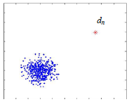
Clustering Based
Outlier Detection
Clustering-based methods detect outliers by examining the relationship between objects and clusters
An outlier is an object that belongs to a small and remote cluster, or does not belong to any cluster.

Slide 18
Thus it leads us to three general methods of clustering based outlier detection,
Does the object belong to any cluster? If not, then it is identified as an outlier.
Is there a large distance between the object and the cluster to which it is closest? If yes, it is an outlier.
Is the object part of a small or sparse cluster? If yes, then all the objects in that cluster are outliers.

Slide 19
Local Outlier Factor Algorithm
Assign to each data record, a degree of being outlier called Local Outlier Factor of the data record
Based on a concept of a local density, where locality is given by k nearest neighbors, whose distance is used to estimate the density.
Points that have substantially lower density than their neighbours are considered Outliers.
local reachability density

Slide 20
Incremental Local Outlier Factor Algorithm
Computes LOF value for each data record inserted into the data set and instantly determines whether inserted data record is outlier.
On Insertion
Computes reach-dist, LRD and LOF values of a new point
Updates k-distances, reach-dist, LRD and LOF values for affected existing points

Slide 21
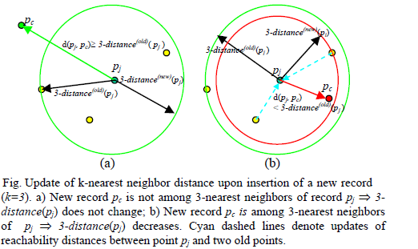
Insertion will always lead decrease in the k-distance for those points that have the new point n in their k-neighborhood.
Deletion will lead to increase in the k-distance for those points.

Slide 22
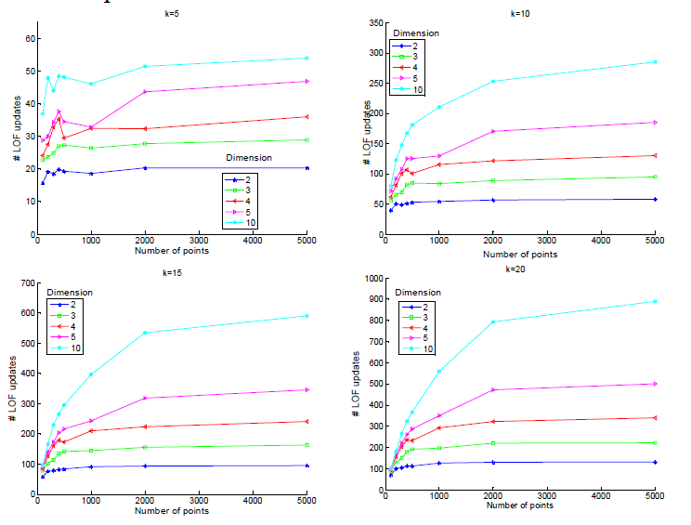
Time complexity of Incremental LOF is dependent on the dimensionality of the data, and is given by
O(k⋅F⋅ log n + F²⋅k)
n - Number of points added/removed
F - Dimensions in data

Slide 23
Elahi, Manzoor, et al. (2008). "Efficient clustering-based outlier detection algorithm for dynamic data stream."
Cluster each chunk using K-means.
Pay attention to the points detected as outlier only.
Means value of every cluster for the next fixed number of steam chunks.
Decide outlines for data stream objects by utilizing the mean values of the current chunk of stream with the mean value of the clusters of previous chunk
Uses LOF(Local Outlier Factor) Algorithm

Slide 24
Frequent Pattern Based Method
Given user defined threshold for the permissible minimal support, find all itemsets with support greater or equal to min-support. Frequent itemsets are also called frequent patterns.
From the viewpoint of knowledge discovery, frequent patterns reflect the “common patterns” that apply to many objects, or to large percentage of objects in the dataset.
In contrast, outlier detection focuses on a very small percentage of data objects. Hence, the idea of making use of frequent patterns for outlier detection is very intuitive.

Slide 25
Frequent Pattern Based Detection (cont’d)
Let the database D = {t1, t2, …, tn} be a set of n transactions with items I. Given threshold min-support, the set of all frequent patterns is donated as: FPS (D, minisupport). For each transaction t, the Frequent Pattern Outlier Factor of t is defined as:
The interpretation of the formula is as follows. If a data object contains more frequent patterns, its FPOF value will be larger, which indicates that it is unlikely to be an outlier. In contrast, objects with smaller FPOF values will have greater outlying-nesses. This FPOF value will always be between 0 and 1.

Slide 26
Frequent Pattern Based Detection (cont’d)
To describe the reasons why identified outliers are abnormal, the itemsets which are not contained in the transaction (it is said that the itemset is contradict to the transaction) are good candidates.
For each transaction t, the itemset X is said to be a top k contradict frequent pattern if there exist no more than (k-1) itemsets whose contradict-ness is higher than that of X, where X∈FPS (D, minisupport).
Our task is to mine top-n outliers with regard to the value of frequent pattern outlier factor. For each identified outlier, its top k contradict frequent patterns will also be discovered for the purpose of description.

Slide 27
Frequent Pattern Approximation
However, existing methods for frequent pattern mining require multiple passes over the datasets, which is not allowed in the data stream model.
Thus, instead of finding the exact frequent patterns with multiple passes, we get the estimated frequent patterns by exploring approximation counts technique over data streams
We use the lossy counting algorithm for this purpose.

Slide 28
Frequent Pattern Approximation (cont’d)
The lossy counting algorithm accepts two user-specified parameters: a support threshold s∈(0,1) and an error parameterε ∈(0,1) such that ε <<s. Let N donate the current length of the stream, i.e., the number of tuples seen so far.
The incoming stream is conceptually divided into buckets of width ‘w’ transactions each. Buckets are labeled with bucket ids, starting from 1. The current bucket id is donated by Bcurrent , whose value is N*w. For an element e, its true frequency in the stream seen so far is donated by f. The data structure D is a set of entries of the form (e, f, Δ), where e is an element in the stream, f is an integer representing its estimated frequency, and Δ is the maximum possible error in f.

Slide 29
Frequent Pattern Approximation (cont’d)
Initially, D is empty. Whenever a new element e arrives, we first look up D to see whether an entry for e already exists or not. If the lookup succeeds, the entry is updated by incrementing its frequency f by one.
Otherwise, a new entry of the form (e, 1, -1) is created.
Also, D is pruned by deleting some of its entries at bucket boundaries, i.e., whenever N ≡ 0 mod w. The rule for deletion is: an entry (e, f, ) is deleted if f + Δ ≤ Bcurrent .

Slide 30
Questions?

Slide 31
References
Morady, Hossein & Lumpur, Kuala & Suhaimi, Malaysia & Hosseinkhani, Javad. (2013). Outlier Detection in Stream Data by Clustering Method.
Chugh N, Chugh M, Agarwal A. Outlier detection in streaming data: a research perspective. 2014 Int Conf Parall Distrib Grid Comput. 2014;429–432
https://en.wikipedia.org/wiki/Local_outlier_factor
Pokrajac, David & Lazarevic, Aleksandar & Jan Latecki, Longin. (2007). Incremental Local Outlier Detection for Data Streams. Proceedings of the 2007 IEEE Symposium on Computational Intelligence and Data Mining, CIDM 2007. 504-515. 10.1109/CIDM.2007.368917.
A. Ghoting, M. Otey, S. Parthasarathy, Loaded: link-based outlier and anomaly detection in evolving data sets, in: Proceedings of the 4th IEEE International Conference on Data Mining, ICDM’04, IEEE, 2004, pp. 387–390

