Slide 1
Top-K Monitoring
CS240B - Fall 2018
Professor Carlo Zaniolo
Rishab Doshi (305220397)
Nandan Parikh (605226525)

Slide 2
Outline
Introduction
Challenges
Monitoring Top-K in Streaming Windows
Distributed Top-K Monitoring
Generalization of Distributed Query Processing
Distributed Set expression cardinality

Slide 3
Introduction and Applications
Top-K monitoring refers to keeping track of best k values in a data stream. Wide variety of applications require maintaining Top-K values as below:
Bidding System
Financial Analysis
Most significant Transactions over a network
DDoS Attack Analysis
And so on...

Slide 4
Challenges
Major challenge of handling expirations
Data storage
Number of re-computations
Communication overhead by distributed query processing architecture
Exchange of information: All updates shipped to central processing site is impractical - too much strain on network and central processor.
Wireless sensor networks have a limited battery life and communication is more expensive than local computation.

Slide 5
An Optimal Strategy for Monitoring Top-k Queries in Streaming Windows
Di Yang, Avani Shastri, Elke A. Rundensteiner and Matthew O. Ward
Problem Statement
Given a streaming dataset S and preference function F, a continuous top-k query Q(S, win, slide, F, k) returns the top-k objects within each query window W_{i} on the stream
Query Window - Time or count based
Remove expired objects from W_{i-1} and include new objects from S
Notes:
Preference function can be - highest value nodes, least value nodes, is it greater than the median/mean, does it satisfy a function and by how much!
Top K must also be sorted for certain use cases!

Slide 6
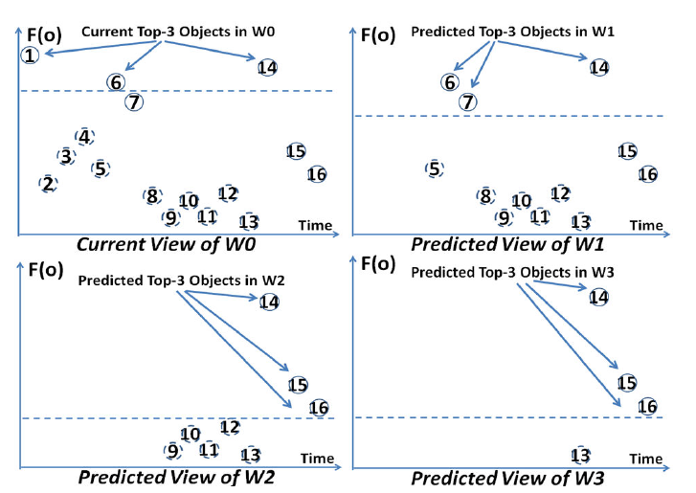
Predicted top-k for consecutive windows
16 objects initially
Slide size = 4 Objects
Result = Top 3
Approach :
  Predicted results at time of W₀
  Keeping all elements for each prediction in memory

Slide 7
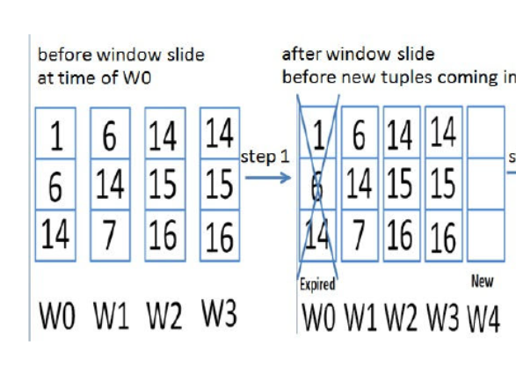
Update process from time W₀ to W₁

Slide 8
Properties of Predicted top-k
1. Overlap :
Windows tend to overlap, predicted values will have inherited as well as new values
For any object in W_{i} but not in W_{i-1}, F(o_{i}) < F(o_{j})
2. Fixed Relative Positions
Since F score is fixed, the relative positions never change
If an object is in predicted for W_{i} then it will be predicted for W_{j} ( j > 0 )

Slide 9
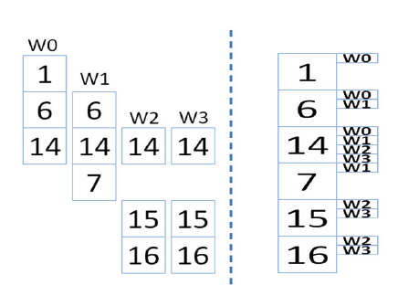
Integrated View Maintenance
Have only one superTopK list
Keep pointers of all windows it can be a part of
Large number of window marks according to use case
More computations for insertion and expiration

Slide 10
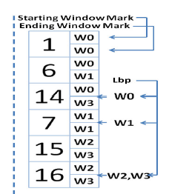
Optimal Integration Strategy
Keep track of start and end mark
Keep lower bound pointer for each predicted window
Easier List maintenance
Reduces space and helps in handling expiration/insertion

Slide 11
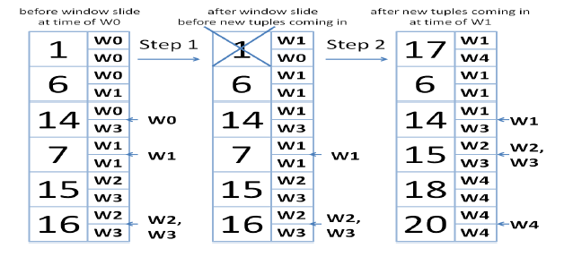
Update process from time W₀ to W₁
Update windows for top K elements, remove tuple where start > end
Remove one object from each window for an object inserted above the window
To handle each new object
  O(log(MinTopK.size))
Average Memory
  2k elements

Slide 12
Distributed Top-K Monitoring
Brian Babcock and Chris Olston
Data streaming query and analysis has been a growing topic with lots of upcoming applications in networks, web-applications and financial systems.
Lot of these applications require monitoring of top-k values across distributed systems.
Shipping these to a central location and processing them continually is not practical.
Authors have come up with an algorithm to provide top-k answer within user-specified error tolerance with minimum communication costs. Arithmetic constraints have been maintained at remote stream sources ensuring validity of top-k answers to within a user-specified error tolerance. Distributed communication is only necessary on occasions when constraints are violated.

Slide 13
Real World Scenario
Monitoring Query 1 :
Which web documents are currently the most popular, across all servers?
Monitoring Query 2 :
Within the local cluster of web servers at each of the four geographical locations, which server in the cluster has the lowest current load?

Slide 14
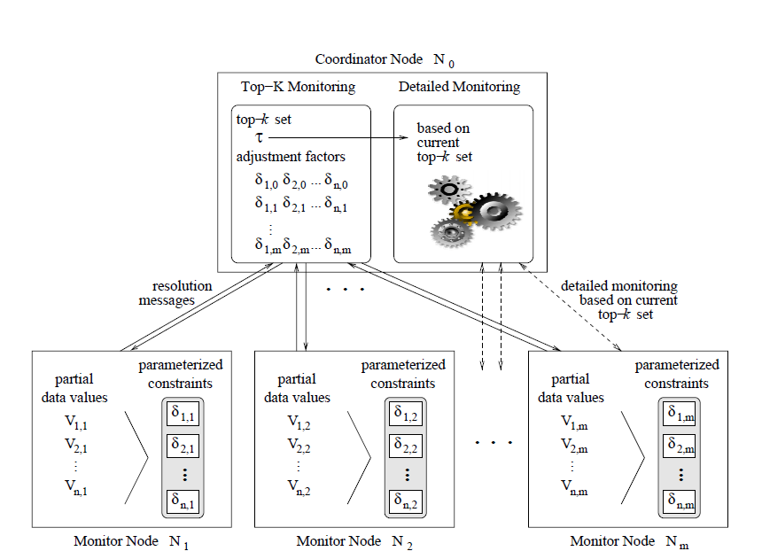
Architecture
Monitor Nodes : N_{i} ( m nodes)
Coordinator Node : N_{o}
Objects : O ( Total n )
Values corresponding to each : V
Partial Values : V_{(object ,node)}

Slide 15
Formal Model
N₀ maintains an approximate top-k set T valid within an error 𝜺
For each node N_{j} define partial data values V_{i,j} for every Object O_{i}
The total value for an object is the sum across all nodes
  V_{i,j} = ∑ ( O_{i}, N_{j}, ∆ ) _{t} ∆
Adjustment Factors are defined so that top-k at each node are maintained
  ẟ _{i,j} (object i and node j) where ∑ _{j} ẟ _{i,j} = 0
At all nodes the sum of adjustment factor and partial value for top-k should be greater than the other objects

Slide 16
Example
Consider two monitor nodes N1 and N2
Two objects O1 and O2
Partial values at : N₁ are V_{1,1} = 9 and V_{2,1} = 1
N₂ are V_{1,2} = 1 and V_{2,2} = 3
We can choose : ẟ_{1,1} = -3 and ẟ_{2,1} = 0
ẟ_{1,2} = 3 and ẟ_{2,2} = 0

Slide 17
Algorithm Steps
Phase 1 : The node at which one or more constraint fails, sends a message to the coordinator with the failed constraints and its border value ( Resolution )
Phase 2 : The coordinator determines whether all invalidations can be ruled out based on information from nodes N_{f} and N₀ alone.
If so, re-establish constraints for nodes N₀ and N_{f}
Phase 3: The coordinator requests relevant partial data values from all other nodes and then computes a new top-k. Reallocation is called then.

Slide 18
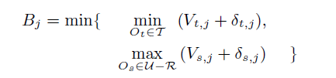
Calculation of border values
Calculated whenever an arithmetical constraint has been violated at node
It is minimum of (least value in Top-k and max value not in Top-k).
As name suggests, it is at the border of being in the Top-k values in the set

Slide 19
Reallocation Phase
Called when one of arithmetic constraints has been invalidated.
If reallocation phase is called in phase 2 of resolution, only co-ordinator node N₀ and violated node N_{f} are involved in resolution
If reallocation phase is called in phase 3 of resolution, this implies that top-k set T has changed, in this case all nodes N₀...N_{M} are involved.
This computes the new adjustment factors for all the objects in the resolution set.
This is done by first making sure all violated constraints are fixed and all invariants are tight. Total leeway l_{i} for each object O_{i} is then distributed across all nodes based on fraction F_{j} for node j.
The values for F_{j} and l_{i} can affect the frequency with which reallocation is called again and hence values must be chosen carefully.

Slide 20
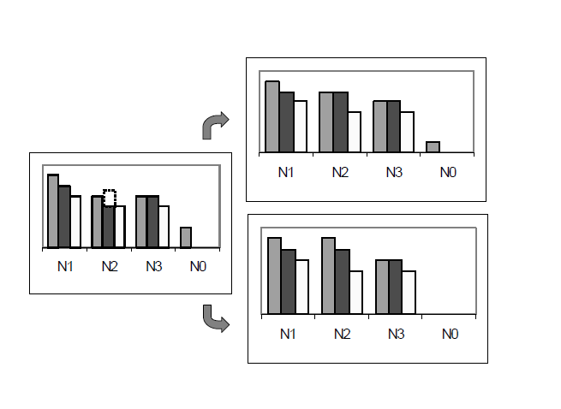
Example of reallocation

Slide 21
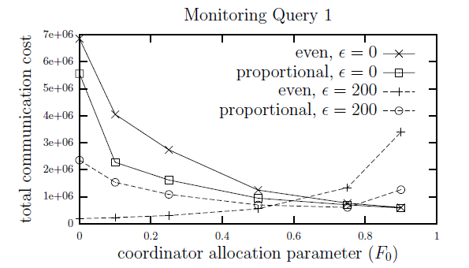
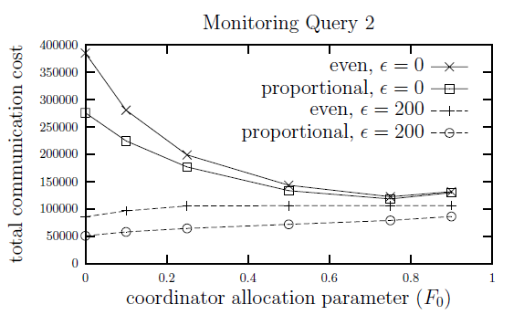
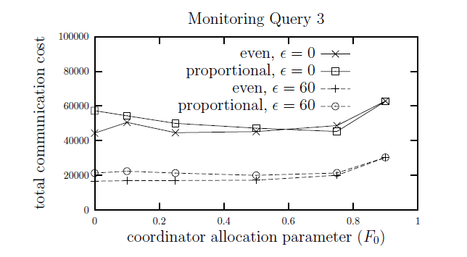

Slide 22
Generalization of Top-k monitoring
So far, we have considered top-k elements in a single and a distributed streaming system.
To generalize, top-k is essentially a query applied to a distributed system.
Can these concepts be generalized/extended to other queries in a distributed system?
YES!
We discuss one example:
Set expressions on Distributed Datasets

Slide 23
Problem Statement
If a set is being continually updated by distributed streams of data at different remote locations, how do we efficiently perform queries like cardinality of set, union, intersection of the set?

Slide 24
Queries on Distributed Sets
Challenges
Suffers from similar challenges as discussed previously.
Key observation
Often, we don’t need exact answer to the query in a distributed data stream environment.

Slide 25
Use-case: Detecting DDOS
Consider detecting distributed denial-of-service (DDoS) attacks by analyzing network flow information collected from an ISP’s border routers.
100s of compromised “zombie” hosts flood a specific victim destination with large numbers of seemingly legitimate packets.
IP address spoofed to escape identification
Sudden spike in number of unique IP source addresses can be used to detect distributed denial of service attacks. (cardinality of set of IP source addresses)
Difference cardinality query |S − T | to detect significant traffic deviations – S is the IP source address set for the sliding window spanning the past week (until now) and T is the set of IP source addresses from the week prior to that (e.g., two weeks ago)
Don’t need exact count, just want to be able to detect spike or sudden change.

Slide 26
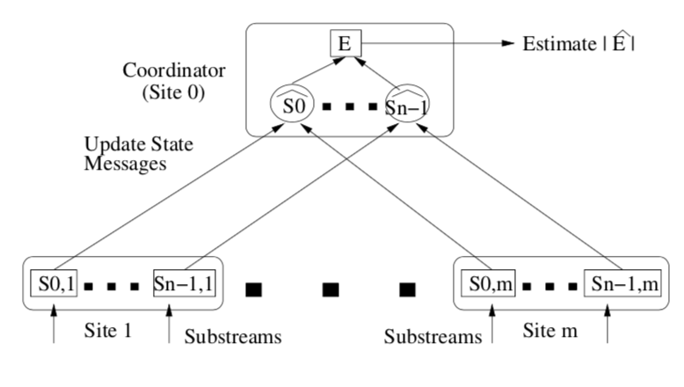
Proposed System
m + 1 sites and n update streams
0 is a special coordinator site responsible for generating answers to user (set-expression cardinality) queries

Slide 27
At each remote site j, the n update streams render n distinct multi-sets S_{0,j} , . . . , S_{n−1,j} of elements from the integer domain [M] = {0,...,M − 1}.
Each stream up-date at remote site j is a triple of the form < i,e,±v >,
i identifies the multi-set S_{i,j} being updated,
e ∈ [M ] is the specific data element whose frequency changes
±v is the net change in the frequency of e in S_{i,j} , i.e., “+v” (“−v”) denotes v insertions (resp., deletions) of e. Deletion in the model helps in handling window queries.
For each i=0,...,n−1, let S_{i} =∪_{j}S_{i,j}. Thus, S_{i} reflects the global state of the i’th update stream, while each multi-set S_{i,j} captures the local state of stream i at site j.

Slide 28
Formalizing Requirement
Answering set-expression cardinality queries over the underlying collection of distributed update streams.
Given a set expression E over streams S₀, . . . , S_{n−1} (with the standard set operators ∪, ∩, and − as connectives), estimate cardinality |E|, the number of distinct elements in E.
Example, |S₀ ∩ S₁| is the number of distinct elements in the intersection of streams S₀ and S₁. Where S₀ and S₁ are distributed across remote sites.
Since approximate answers suffice - Compute: Ẋ such that,
X = |E|
X - ε < Ẋ < X + ε.
ε is allowable error value - large ε value implies fewer communication costs

Slide 29
Values maintained
curr_S_{i,j} - most recent state of substream S_{i,j}
last_S_{i,j} - last value of S_{i,j} sent to co-ordinator(co-ordinators view of S_{i})
For each stream S_{i}, co-ordinator constructs last_S_{i} by Union(last_S_{i,j}) and computes cardinality by |last_S_{i}|
error tolerance ε
ε_{j} is error budget allocated to site j
Ci(e) of the number of remote sites whose states Si,j contain the element e.
Elements whose counts Ci(e) exceed a threshold T are considered to be frequent, and added to a frequent element set F_{i} for stream Si .
Site j:
curr_S_{i,j}
last_S_{i,j}
ε_{j}
F_{i}
Other values discussed ahead
Co-ordinator:
last_S_{i,j}
ε
F_{i}
Threshold T

Slide 30
Procedure to estimate Single Stream Cardinality
Consider estimating cardinality of a single stream S_{i} distributed across j sites with maximum permissible error: ε.
Distribute error tolerance ε among m remote sites, proportional to stream updates at each site. ε_{j} is error budget allocated to site j
  Ex: If sites 1, 2, 3 exist & 2 has highest update rate, then 2 gets largest error tolerance ε₂.
Compute charge for every tuple(discussed ahead) and update curr_S_{i,j}
Communicate to co-ordinator when total charge exceeds error budget ε_{j}.
On communication, co-ordinator updates last_S_{i,j} and communicates changes to frequent elements F_{i} and threshold values to other sites.

Slide 31
Charge System
Every remote site computes a charge value associated with every update.
Total_positive_charge(tpc) - sum of all new additions at the site
Total_negative_charge(tnc) - sum of all deletions at the site
Whenever the absolute value of total charge(+/-) value exceeds error budget at that site, it communicates to the coordinator with the latest state of the site.
Send curr_Si,j to co-ordinator if tpc > ε_{j} or tnc < -ε_{j}
Charge updation:
Charge=1 is added to tpc if a new element is inserted. i.e., it doesn’t exist in last_Si,j but is present in curr_Si,j
Charge=1 is subtracted from tpc if an element is removed from curr_Si,j, i.e., it doesn’t exist in curr_Si,j but is present in last_Si,j

Slide 32
Treatment of Frequent Elements
Frequent elements appearing in the stream updates can be exploited to reduce charge.
Ex: In an IP network monitoring scenario, popular sites like Google, Facebook will appear many times in the destination IP address.
Even if frequent elements are added or deleted from one particular site, it is unlikely to have modified the global picture
=> we should not charge 1 every time a change occurs to a frequent element.
Instead we charge a fraction 1/ϴi(e) where ϴi(e) is the min. number of sites for which e appears in last_Si,j.
ϴi(e) is calculated by co-ordinator for all frequent elements Fi after every central update. The values of ϴi(e) and Fi are synchronous between co-ordinator and remote sites

Slide 33
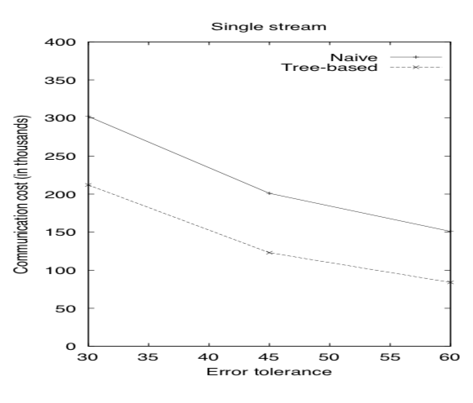
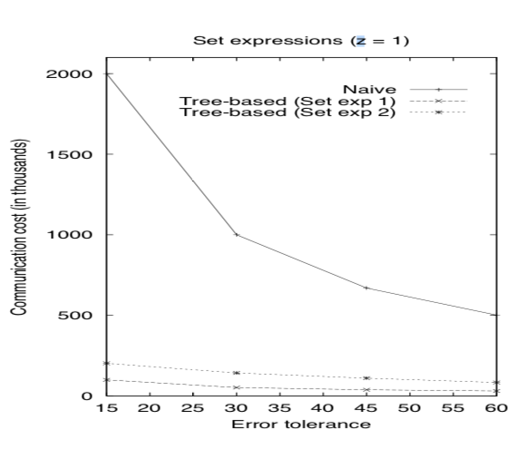
Results
Distinct Values Query.
Set Expression Query.
Dataset description:
Packet trace containing two hour’s worth of all wide-area TCP traffic between the Lawrence Berkeley Laboratory and the rest of the world.
Queries:
Sets: S0, S1 and S2.
Exp1:(S0 −S1)∪S2
Exp2: (S0 ∪S1)∩S2

Slide 34
References
Di Yang, Avani Shastri, Elke A. Rundensteiner, and Matthew O. Ward. 2011. An optimal strategy for monitoring top-k queries in streaming windows. In Proceedings of the 14th International Conference on Extending Database Technology (EDBT/ICDT '11), Anastasia Ailamaki, Sihem Amer-Yahia, Jignesh Pate, Tore Risch, Pierre Senellart, and Julia Stoyanovich (Eds.). ACM, New York, NY, USA, 57-68. DOI=http://dx.doi.org/10.1145/1951365.1951375
Brian Babcock and Chris Olston. 2003. Distributed top-k monitoring. In Proceedings of the 2003 ACM SIGMOD international conference on Management of data (SIGMOD '03). ACM, New York, NY, USA, 28-39. DOI: https://doi.org/10.1145/872757.872764
Abhinandan Das, Sumit Ganguly, Minos Garofalakis, and Rajeev Rastogi. 2004. Distributed set-expression cardinality estimation. In Proceedings of the Thirtieth international conference on Very large data bases - Volume 30 (VLDB '04), Mario A. Nascimento, M. Tamer Özsu, Donald Kossmann, Renée J. Miller, José A. Blakeley, and K. Bernhard Schiefer (Eds.), Vol. 30. VLDB Endowment 312-323.

