Slide 1
CS239 Parallel/Distributed Programming: Languages & Systems
Madan Musuvathi
Visiting Professor, UCLA
Principal Researcher, Microsoft Research

Slide 2
What this course is about
“Big Data” computations

Slide 3
What this course is about
“Big Data” computations
big volume
- petabytes or more
big velocity
- generated at fast speeds
- sensor data, gaming, stock trading, …
big variety
- relational data, excel sheets, text, web pages, logs

Slide 4
What this course is about
“Big Data”
big volume, velocity, variety
computations
- simple analytics (filter, project, join, aggregate)
- complex math operations (machine learning, clustering,…)
- temporal analysis (customer behavior, debugging, …)
- domain-specific (genomics, astronomy, …)

Slide 5
This course is also about Parallel Programming
programming abstractions
runtimes
applications

Slide 6
Be prepared to learn about multiple disciplines
Programming Languages
Systems
Machine Learning
Large-Scale Databases

Slide 7
Course logistics
read papers in a broad set of topics
delve deep and present one topic of choice
do a course project on a topic of choice

Slide 8
Schedule*
Date | Papers to Read
Mar 28-30 | Introduction to large-scale data analytics: MapReduce
Apr 4-6 | Language Integration: DryadLINQ, FlumeJava
Apr 11-13 | Runtimes & Performance: Spark
Apr 18-20 | Optimizations and Complex event processing
Apr 25-27 | Complex Analytics and Streaming: SciDB, Google Dataflow
May 2-4 | Transactions: Hstore, FaRM
May 9-11 | Graph Analytics: GraphLab, Arabesque
May 16-18 | Data Curation & Approximation
May 23-25 | Misc + Project Presentations
Memorial Day onwards | End of CS239 – no exams!
* Schedule subject to change

Slide 9
Expected outcomes of the course
breadth of understanding in this broad area
learn to survey relevant literature in a new topic
learn to present/teach research ideas
“stretch” outcomes:
- identify a new research direction
- solve an interesting open problem

Slide 10
What I expect from you
please read the papers before class
1-2 hours per class
pop-quiz with probability 0.5
actively participate in the class discussions
we learn from each other
pick a paper to present
learn related work and read some related papers
teach what you have learnt to the class
plan on 12+ hours of work for your presentation
distribute work throughout the quarter

Slide 11
Course Project
plan on 40+ hours
flexible wrt topics
single or in groups of 2
examples
- comprehensive literature survey in an area, identify an open problem, and a method of attack
- solve a research problem
- build a system that solves an interesting problem
email me your project choice, and get my approval

Slide 12
Grading
50% - course project
25% - class presentation
15% - pop quizzes
10% - class participation

Slide 13
Immediate asks
email me a preference order of the papers you want to present
I will assign the papers in the order of emails starting 12pm today.
madanm@ucla.edu
decide on the project and let me know by Apr 11

Slide 14
Office hours
by appointment only.
in person on Mon & Wed, Skype on other days
feel free to use me as a resource as much as possible
(I will push back if necessary!)

Slide 15
Lecture 1
Introduction

Slide 16
Data processing requires parallelism
Reading 1 TB of data
sequentially
in parallel
100 MBps
100 MBps
1
1
100 MBps
2
…
100 MBps
1000
2.8 hrs
10 secs

Slide 17
Simple Web Applications
Web Servers
DB Server

Slide 18
How to scale this?
Web Servers
DB Server

Slide 19
Scale Up vs Scale Out
Scale Up

Slide 20
Scale Up vs Scale Out
Scale Out

Slide 21
Possible DB Architectures
shared memory (“shared everything”)
shared disk
shared nothing

Slide 22
Shared Everything vs Shared Nothing

Slide 23
Shared Disk
Storage Area Network

Slide 24
we will mostly be dealing with shared-nothing architectures
scales embarrassingly
programming them is a challenge

Slide 25
Relational Model [Edgar Codd ’70]
select, filter, join, group-by, aggregate
expressive and embarrassingly parallel
data independent
well-studied query optimization techniques
(optionally read: “A Relational Model of Data for Large Shared Data Banks” by Edgar Codd)
filter
select count(*)
from objects
where type = square
group by color
group-by
count
3
3

Slide 26
Relations
given domains $D_{1}, D_{2},…, D_{k},$a k-ary relation is
a subset of $D_{1}×D_{2}×…D_{k}$
informally, a “table of tuples”
or a collection of objects of a given type
describes data independent of its representation in memory/disk
ID | Name | Color | #Vertices
1 | A Square | Blue | 4
2 | A Circle | Blue | 0
3 | B Square | Orange | 4
4 | C Square | Blue | 4
…

Slide 27
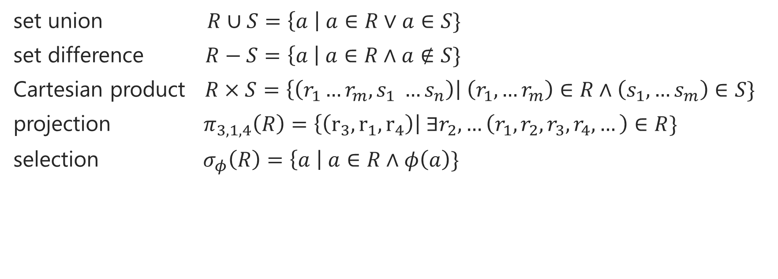
Relational Operations
set union $R∪S=\left\{a \right| a∈R∨a∈S\}$
set difference $R−S=\left\{a \right| a∈R∧a∉S\}$
Cartesian product $R×S=\left\{\left(r_{1}…r_{m}, s_{1} …s_{n}\right)\right| \left(r_{1}, …r_{m}\right)∈R∧\left(s_{1}, …s_{m}\right)∈S\}$
projection $π_{3,1,4}\left(R\right)=\left\{\left(r_{3},r_{1}, r_{4}\right)\right| ∃r_{2},…\left(r_{1},r_{2},r_{3},r_{4},…\right)∈R\}$
selection $σ_{φ}\left(R\right)=\left\{a \right| a∈R∧φ\left(a\right)\}$

Slide 28

Join operation
$R⋈S=$
$\{{(r}_{1}, r_{2}, …c_{1}, c_{2}, …s_{1}, s_{2}, …) | \left(r_{1}, r_{2}, …, c_{1},c_{2}, …\right)∈R∧(c_{1},c_{2},…, s_{1}, s_{2}, …∈S$}
$R⋈S={π_{r_{1},r_{2},r.c_{1},r.c_{2}, s_{1},s_{2}}(σ}_{r.c_{1}=s.c_{1}∧…}(R×S))$

Slide 29

Extension operations
group-by-key
$GroupBy\left(R, k\right)=\left\{R_{1}, R_{2}, …\right| R_{i}=σ_{key=k_{i}}(R)\}$
aggregation
- sum, avg, min, max, …

Slide 30
Optimizations
based on relational algebra equivalences
- commutativity, associativity of unions, joins
- join distributes over unions
- move selections
$σ_{φ}\left(σ_{γ}\left(R\right)\right)=σ_{φ∧γ}(R)$
$σ_{φ}\left(R⋈S\right)=σ_{φ}\left(R\right)⋈S$ (assuming $φ$ only refers to fields in R)
- project “unused” columns

Slide 31
Partitioning for parallelism
block partitioning
hash partitioning
range partitioning
repartitioning for groupby
broadcast joins
hash joins

Slide 32
Count the number of reviews read per user
S
mapper1
mapper2
R
R
S
P
R
R
P
S
R
R
S
P
R
P
S
S
R
R
S
P
R
R
P
S
R
R
S
P
R
R
P
S
R
R
S
P
R
P
S
S
R
R
S
P
R
R
P
R
R
R
R
R
R
R
R
R
R
R
3
3
4
1
reducer1
R
R
3
4
3
1
reducer2
R
R
R
R
R
R
R
R
R
sum
psum
psum
sum
psum
psum
7
4

