Slide 1
CS239-Lecture 10 Streaming
Madan Musuvathi
Visiting Professor, UCLA
Principal Researcher, Microsoft Research

Slide 2
Discretized Streams: Fault-Tolerant Streaming Computation at Scale

Slide 3
Abstract
Introduction
Goals and Background
Discretized Streams (D-Streams)
System Architecture
Evaluation
Discussion
Related Work
Conclusion

Slide 4
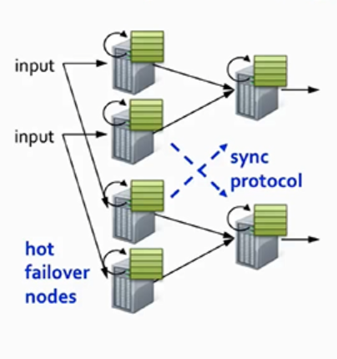
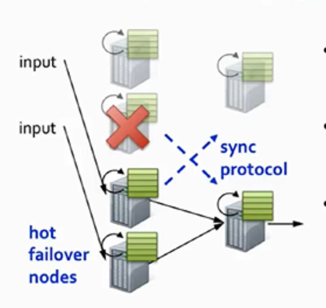
Abstract Node Replication
current distributed stream processing models provide fault recovery in an expensive manner
Fast, but cost 2x hardware cost

Slide 5
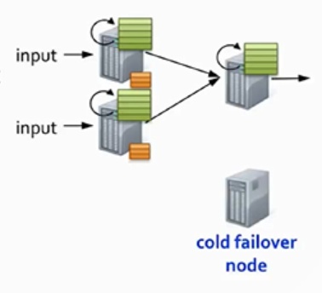
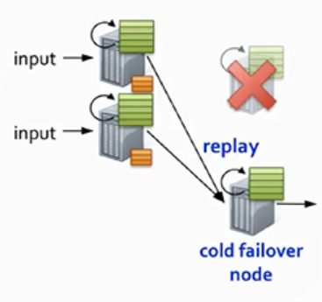
Abstract Upstream backup
current distributed stream processing models provide fault recovery in an expensive manner
Only 1 standby, but slow recovery

Slide 6
Introduction
“big data” arrive in real time and most valuable at the time of arrival.
Stream computation + MapReduce
faults and stragglers are worse in streaming
Current solutions suck
D-Streams!

Slide 7
Goals and Background
1. Scalability to hundreds of nodes. 2. Minimal cost beyond base processing—we do no wish to pay a 2X replication overhead 3. Second-scale latency. 4. Second-scale recovery from faults and stragglers

Slide 8
Discretized Streams (D-Streams)
structuring computations as a set of short, stateless, deterministic tasks instead of continuous, stateful operators.

Slide 9
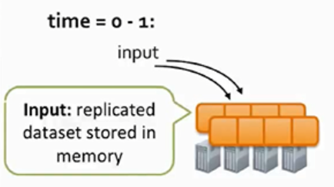
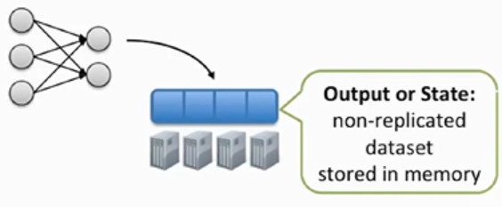
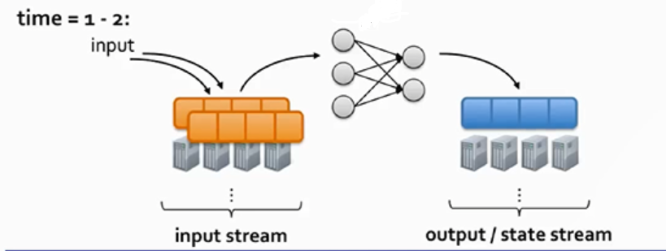
Discretized Streams (D-Streams)
Map-reduce

Slide 10
Discretized Streams (D-Streams)
Creating a Dstream
Transformation

Slide 11
Discretized Streams (D-Streams) Fine-grained Lineage

Slide 12
Discretized Streams (D-Streams)

Slide 13
Discretized Streams (D-Streams)
Parallel straggler Recovery
Straggler Mitigation techniques
Detect slow tasks (e.g 2X slower than other tasks)
Speculatively launch more copies of the tasks in parallel on other machines

Slide 14
Discretized Streams (D-Streams) API
For example, a program could run a canonical MapReduce word count on each time interval of a D-Stream of words using the following code:

Slide 15
Fault and Straggler Recovery
？

Slide 16
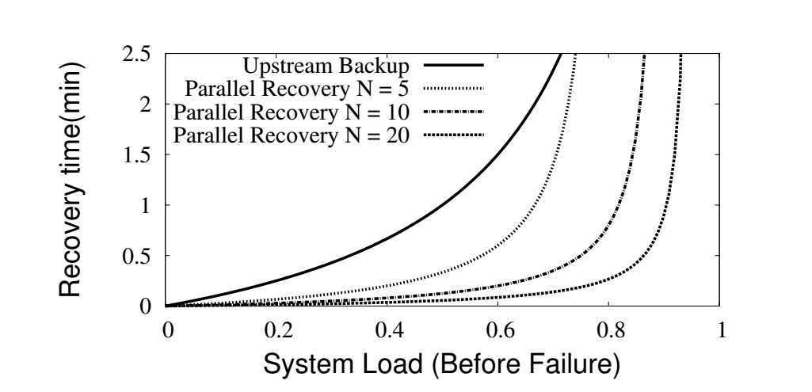
System Architecture
Parallel recovery with 5 nodes faster than upstream backup
Parallel recovery with 10 nodes faster than 5 nodes

Slide 17
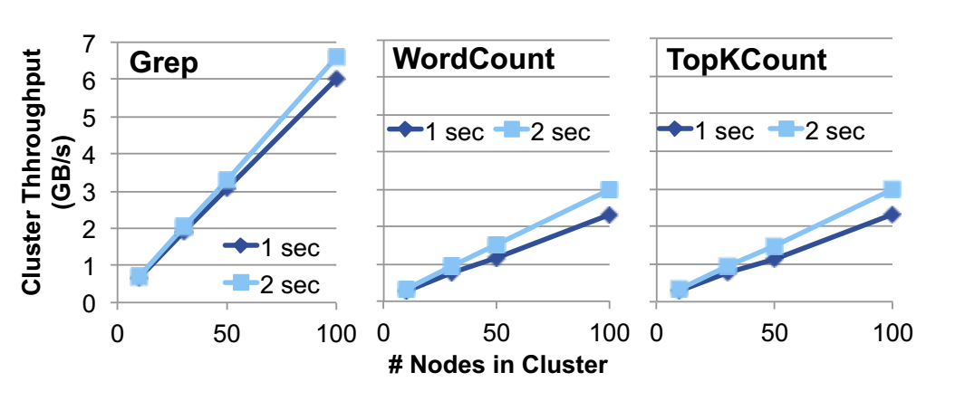
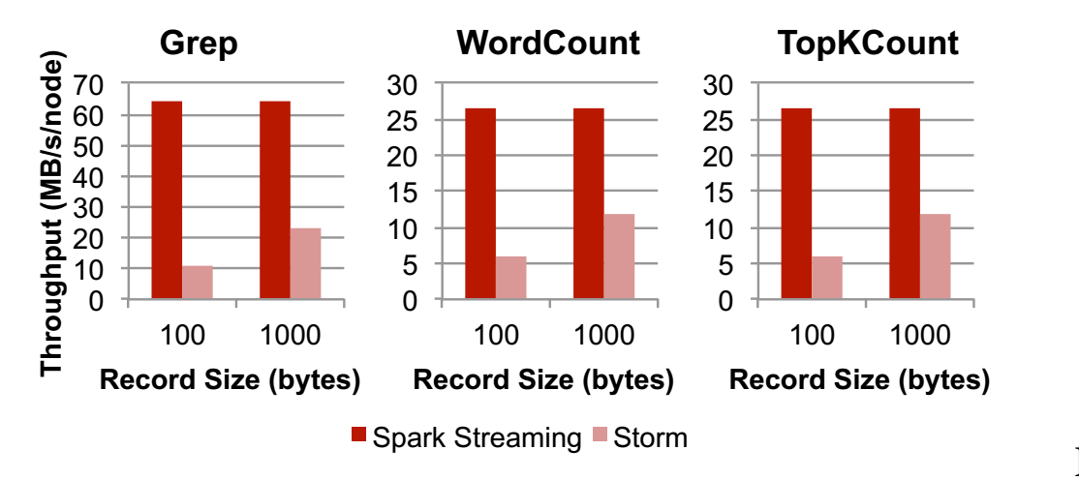
Evaluation
StreamBase
Storm
Oracle CEP
S4
Spark Steaming

Slide 18
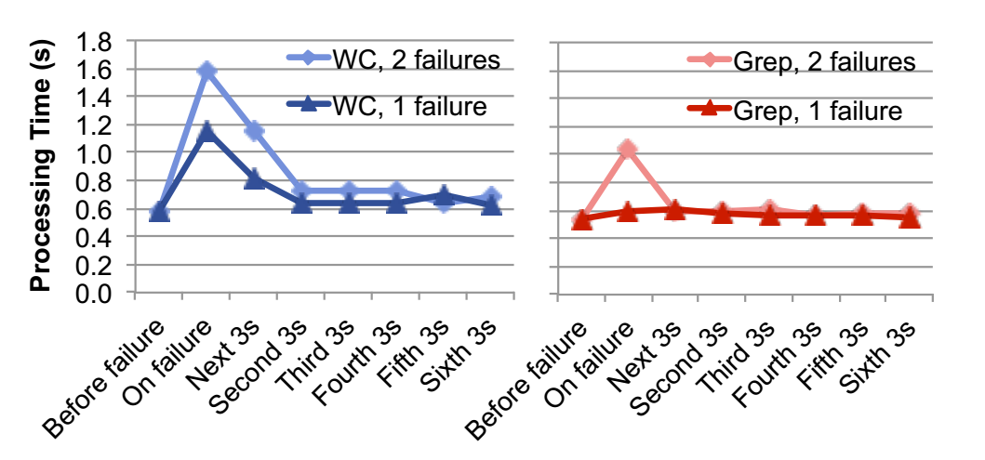
Evaluation

Slide 19
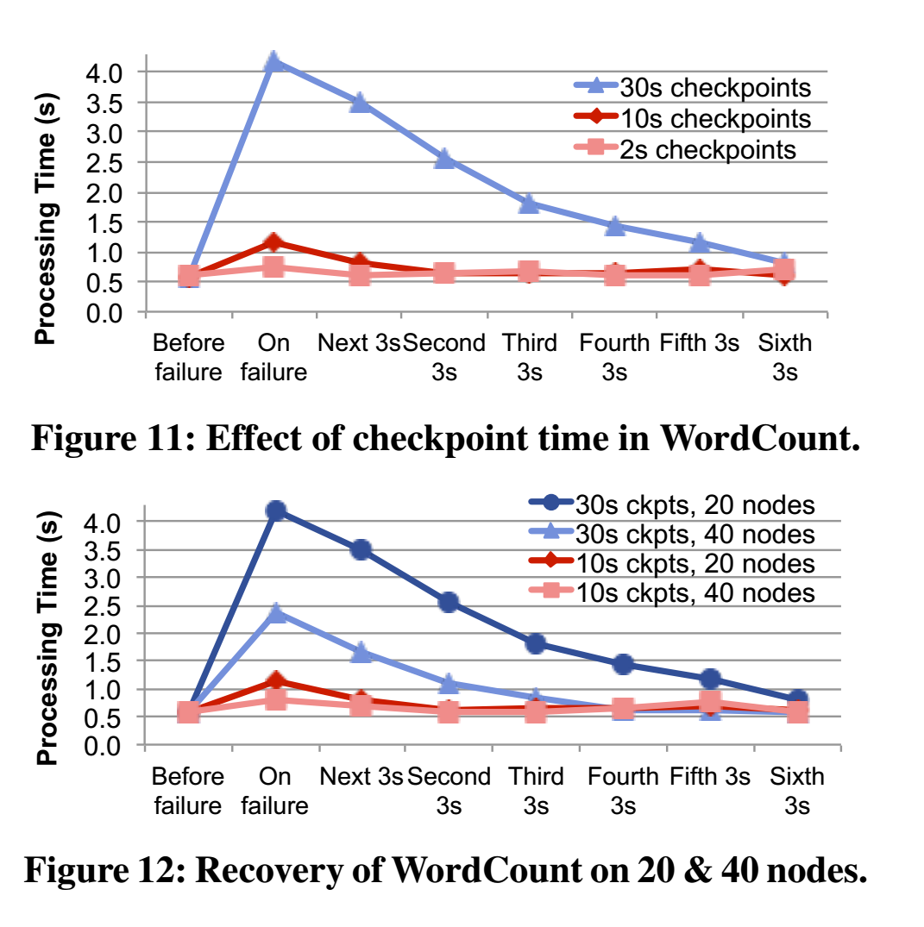
Evaluation

Slide 20
Evaluation
Straggler Mitigation

Slide 21
Discussion
D-Streams is that they show that streaming, batch and interactive computations can be unified in the same platform.
Expressiveness It would be interesting to port languages like streaming SQL [4] or Complex Event Processing models [14] over them.
Setting the batch interval It may be possible for the system to tune it automatically
Memory usage It may be possible to reduce the memory usage by storing only the deltas between these state RDDs
Approximate results In addition to recomputing lost work, another way to handle a failure is to return approximate partial results.

Slide 22
The Google Cloud Dataflow Model
Akidau, Tyler, et al. "The dataflow model: a practical approach to balancing correctness, latency, and cost in massive-scale, unbounded, out-of-order data processing." Proceedings of the VLDB Endowment 8.12 (2015): 1792-1803.
Mingshu Li

Slide 23
Outline
Introduction and terminology
Windowing
Triggering
Example

Slide 24
A Streaming video platform example
Properties: 1. Support online and offline view. 2. Over large swaths of data. 3. The diaspora of global scale data. | Requirements: 1. Want to know the cost per day. (run time) 2. Want to know frequency, benefits, demographic groups. (how to deal with the data) 3. Quick and correct. (tradeoff between correctness, latency, and cost)
Notes:
First, let’s discuss a real life example. A streaming video provider want to make money by displaying advertisements. So they need a system to analyze a large amount of data to decide the price of every advertisement. The platform has properties such as supporting online and offline view, and complicated data distribution and amount. The provider requires the system to be near real time, correct, and can do some calculation on the input data.

Slide 25
Problems of modern data processing systems
Batch systems Execution of a serious of programs on a computer without manual intervention | Suffer from latency.
Streaming systems Processing involves continual input and outcome of data | Lack of fault-tolerant. Limitation window type. Lack high-level programming models.
Lambda Architecture Run a streaming system alongside a batch system, both performing essentially the same calculation | Need to build, provision, and maintain two independent versions of pipeline. Merge the results from the two pipelines at the end.
Notes:
Given the modern data processing systems, they all have more or less problems. As this table shows, batch systems, which need all input before processing, suffer from latency. Streaming systems, which is quick enough, may lack fault-tolerant. Even Lambda Architecture, which is a combining of these two systems, suffer from maintaining two independent versions of pipeline.

Slide 26
Requirement and Design Principles for the new model
1. Input data may never be complete. 2. Ability to balance correctness, latency and cost at hand. 3.Execution engine should not dictate system semantics. | 1. Never rely on any notion of completeness. 2. Be flexible, to accommodate the diversity of known use cases, and those to come in the future. 3. Not only make sense, but also add value, in the context of each of the envisioned execution engines. 4.Encourage clarity of implementation. 5. Support robust analysis of data in the context in which they occurred.
Notes:
To solve those problems, researchers in google list some requirements for their new model.
And set up design principles based on it.

Slide 27
Terminology
1. watermarks
Perfect
heuristic
2. window
Fixed
Sliding
Session
3. time domains
Processing time
Event time
Notes:
A watermark is a notion of input completeness with respect to event times.
Perfect watermarks: In the case where we have perfect knowledge of all of the input data
Heuristic watermarks: Heuristic watermarks use whatever information is available about the inputs (partitions, ordering within partitions if any, growth rates of files, etc.) to provide an estimate of progress that is as accurate as possible.
Then we come to the representation of time in systems. Processing time is when an event be observed. It is easy to find the completeness sign. But it requires data arrives at event time order which is hard to satisfy in real life. In this situation, we prefer to use event time processing. This image shows the skew between processing time and event time.

Slide 28
Dataflow Model
ParDo: for every element -> translates naturally to unbounded data
GroupByKey: need all data -> must window the data

Slide 29
Window
4
AssignWindows
DropByKey
GroupByKey
MergeWindows
GroupAlsoByWindow
ExpandToElements
2
3
1
13:00
14:00
Event time
4
2
3
1
13:00
14:00
Event time
GroupByKeyAndWindow
4
2
3
1
13:00
14:00
Event time

Slide 30
Window
Why do window before sum?

Slide 31
Triggers & Incremental Processing
Predefined trigger implementations for triggering at completion estimates.
Plus,
Discarding
Accumulating
Accumulating & Retracting
Notes:
Then we come to the triggering part because we need to know when to emit the results. Dataflow model predefined trigger implementations at completion estimates, such as at watermarks. Besides, it also allows three refinement modes: discarding, accumulating and accumulating and retracting. We will discuss these three types later in the example part.

Slide 32
Examples
Notes:
To better understand the dataflow model, one simple example is displayed. 10 integers are infused into the system at different time. What we need to do is to sum them up. In this example, we assume all these events have same key. This image shows the both the processing and event time of every integer. The dark dash line show the actual watermark, which is heuristics and similar to the previous image about processing time and event time. And we can find that 9 is after the watermark, which means it is a late datum.

Slide 33
Classic Batch Execution
?
Notes:
If we assume this data is bounded, we can use basic batch processing. After all the events observed, the system starts to sum all the integers up. It is somehow hard to understand the slope of the dash line. I think it should be a horizon line.

Slide 34
GlobalWindows
Accumulating, AtPeriod
Discarding, AtPeriod
Discarding, AtCount
Notes:
Then we assume this data to be unbounded. We first use a global window to test the difference between different triggering types. The first image shows the accumulating at period of 1. The second image shows the discarding at period of 1. The difference is accumulating result is related to the previous ones while the discarding drops all previous results. The third image shows discarding at count of 2. It is a simple implementation of custom windowing strategies.

Slide 35
FixedWindows, Batch
Windowing determines where in event time data are grouped together for processing.
Triggering determines when in processing time the results of groupings are emitted as panes.
Pcollection<KV<String, Integer>> output = input
.apply(Window.into(FixedWindows.of(2, MINUTES))
.trigger(RepeatUntil(
AtPeriod(1, MINUTE),
AtWatermark()))
.accumulating()
.apply(Sum.integersPerKey());
Batch
Micro-Batch
Notes:
Then we try fixed windows using batch processing. The left image shows batch result and the right one shows micro batch result. They all use accumulating. For the micro batch one. The repeat until function has two inputs, which I guess refers to the step length and the stop condition. In other words, this repeat until means do 1 minute micro batch trigger until meet the watermark. Then we can return result which is different than the previous one in different windows. We can find if we use micro batch processing, we can save some time.
Another thing we can get from this figure is that windowing is related to event time while triggering is related to processing time. So these two function can help to improve the performance in different aspects.

Slide 36
FixedWindows, Streaming
Streaming
Streaming+micro-batch
Notes:
Streaming is another important processing method, which do not need to wait all the data arrival. It just refreshes the result when late data arrive. This two images shows result of streaming alone and streaming plus micro batch. However, I cannot find any sentence in this code to do refresh job. For the streaming plus micro-batch one, it just uses a sequence of repeat methods. First a micro batch processing method using repeat until and then a streaming processing use repeat. But I am confused that where is the refresh function. From this code, I think we are simply drop integer 9. From another paper of this author, I found codes which is more believable for me. It take the early and late data into consideration.

Slide 37
Sessions, Retracting
Notes:
The last is using session windowing and retracting triggering. The result is even better.

Slide 38
Sessions, Retracting
-3
-12
-5
39
-25
3
-7
25
-10
10
?
5
7
Notes:
Now let’s go detail of this method. We first generate four different sessions. I think the generation of sessions there is different from the method the paper mentioned before. Because if we first generate windows for every event, we will not get result like this. For example, for 7,8,3,4,3 will become a large session rather than two separated ones. In this case, I think the author build windows for early event and if late event is in the coverage of the early one, they become one session, such as 7 and 8 in this case. Besides, if several window overlapped, they will merge together like mentioned before. With the time passing, 5 and 7 are firstly observed and calculated. Then 343 are summed up. Then it pass the watermark, so 7 and 10 combine and emit a result of 25 with -7 and -10 retracting. Then for the third minute, the 3 is observed and calculated. Then 9 is observed and it will combine the 5 and 25 sessions and return 39 with -5 and -25 retracting. Then it comes to the 8 and 1.
There is also a problem. I think for the first 5, it should be fired by watermark. So the boundary of this should be lower.

Slide 39
Motivating Experiences
Unified Model: Large scale backfills & the lambda architecture
Sessions: Unaligned windows
Triggers, Accumulation, & Retraction: Billing
Watermark Triggers: Statistics
Processing Time Triggers: Recommendations
Data-Driven & Composite Triggers: Anomaly detection
Notes:
The paper also provides motivating experiences for this dataflow model.

Slide 40
Conclusions
Dataflow Model
Unbounded data processing
Unaligned, event-time-based windows: Sessions
Flexible triggering: tradeoff of correctness, latency, and cost
Notes:
In conclusion, this paper introduce a new type of data processing method named dataflow model. It is good for unbounded data processing. The two most important contributions of this paper are introduction of sessions and flexible triggering.
To review, we can go through the 4 question the author raised to decompose the pipeline:
What result are being computed refers to the transformation of data, which is sum of integers in this case. Where in event time they are being computed? It is related to windowing. When in processing time they are materialized? It is related to triggering. And how earlier results relate to later refinements? The answer is related to refinement modes.

Slide 41
Reference
1. http://static.googleusercontent.com/media/research.google.com/en//pubs/archive/43864.pdf
2. https://blog.acolyer.org/2015/08/18/the-dataflow-model-a-practical-approach-to-balancing-correctness-latency-and-cost-in-massive-scale-unbounded-out-of-order-data-processing/
3. https://www.oreilly.com/ideas/the-world-beyond-batch-streaming-101
4. https://people.csail.mit.edu/matei/courses/2015/6.S897/slides/dataflow.pdf

