Slide 1
CS239-Lecture 11 Approximation
Madan Musuvathi
Visiting Professor, UCLA
Principal Researcher, Microsoft Research

Slide 2
Changes based on mid-term evaluation
thanks for the feedback!
all of you found the papers interesting
all of you found the class discussion helpful

Slide 3
Projects
deadline postponed by a week
will have class presentations on June 1st
one presentation on May 23rd

Slide 4
Quizzes
most of you hate them
- 8 am is too early
- terrible to have quizzes on Wednesdays (reading two papers between Mon-Wed is hard)
- nondeterminism is bad
so, we will have more quizzes
- with probability 1
- will send questions at least the day before
- the goal is to provide guidance on understanding the paper and background
- you can discuss the paper with classmates, but not the answers directly
“discussion assignments”

Slide 5
Class discussions
make the discussions more inclusive
- need ideas here

Slide 6
Things that I cannot change
8 am class
the workload of four papers per week
suggestions on other papers to discuss

Slide 7
Keep the feedback coming
send me email
if you prefer anonymity, create a one-off email account
e.g XXX-CS239-feedback@gmail/hotmail/whatever_the_cool_kids_use_today.com

Slide 8
BlinkDB: Queries with Bounded Errors and Bounded Response Times on Very Large Data
Sameer Agarwal, Barzan Mozafari, Aurojit Panda, Henry Milner, Samuel Madden, Ion Stoica
Presented by: Zhaoxing Bu (zbu@ucla.edu)

Slide 9
A friendly reminder, before we start…
Although I do research in AI, I know neither AI nor DB, let alone statistics/sampling and optimization.
I personally have interests in system and database, but no interests in statistics or optimization, where I have no experience/knowledge at all.
I sent to our professor a list of 10 papers, this paper ranked 10 in my list.

Slide 10
A friendly reminder, before we start…
So, this paper will be presented by a completely DB/statistics outsider, based on a rookie’s knowledge and understanding.
Suggestions, comments, helps, and discussions are warmly welcomed!
Especially discussions, so I can have a rest ;-)

Slide 11
What I have learnt from this paper
A brand new DB application and research domain that I never knew before: approximate query engine. This is a very interesting topic to me. At least the program committees for EuroSys 2013 agreed with me, so they gave the best paper award to this paper. Look at the huge time improvement we can gain with only a tiny sacrifice in the correctness of the result!
Almost nothing in Parallel/Distributed Programming: Languages and Systems.

Slide 12
Abstract
This paper presents BlinkDB, a massively parallel, approximate query engine for running interactive SQL queries on large volumes of data.
BlinkDB allows users to trade-off query accuracy for response time, enabling interactive queries over massive data by running queries on data samples and presenting results annotated with meaningful error bars.

Slide 13
Abstract
BlinkDB uses two key ideas: (1) an adaptive optimization framework that builds and maintains a set of multi-dimensional stratified samples from original data over time, and (2) a dynamic sample selection strategy that selects an appropriately sized sample based on a query’s accuracy or response time requirements.
Experiments on a 100 node cluster show that BlinkDB can answer queries on up to 17 TBs of data in less than 2 seconds (over 200× faster than Hive), within an error of 2-10%.

Slide 14
Outline, yes, exactly the paper section names
Introduction
Background
System Overview
Sample Creation
BlinkDB Runtime
Inplementation
Evaluation
Related Work
Conclusion

Slide 15
Introduction
Many new DB applications demand near real-time response rates. Two examples:
Update ads on a website based on trends in social networks like Facebook and Twitter.
Determine the subset of users experiencing poor performance based on their service provider and/or geographic location.
A large number of approximation techniques have been proposed, which allow for fast processing of large amounts of data by trading result accuracy for response time and space. For example, sampling, sketches, and on-line aggregation.

Slide 16
Consider the following simple query that computes the average SessionTime over all users originating in New York:
SELECT AVG(SessionTime)
FROM Sessions
WHERE City = ‘New York’
The Sessions table may be too large to fit in memory, which costs the query to take a long time due to disk reading. However, we can run the query on a sample containing only 10,000 New York tuples, which all fits in memory.
Orders of magnitude faster, an approximate result within a few percent of the actual value, good enough for many practical purposes.

Slide 17
Previously techniques make different trade-offs between efficiency and the generality of the queries they support.
At one end, existing sampling and sketch based solutions exhibit low space and time complexity, but typically make strong assumptions about the query workload (e.g., they assume they know the set of tuples accessed by future queries and aggregation functions used in queries).
At the other end, systems like online aggregation (OLA) make fewer assumptions about the query workload, at the expense of highly variable performance.

Slide 18
This paper argues none of the previous solutions are a good fit for today’s big data analytics workloads. OLA provides relatively poor performance for queries on rare tuples, while sampling and sketches make strong assumptions about the predictability of workloads or substantially limit the types of queries they can execute.
BlinkDB strives to achieve a better balance between efficiency and generality for analytics workloads. It allows users to pose SQL-based aggregation queries over stored data, along with response time or error bound constraints. As a result, queries over multiple terabytes of data can be answered in seconds, accompanied by meaningful error bounds relative to the answer that would be obtained if the query ran on the full data.

Slide 19
In contrast to most existing solutions, BlinkDB supports more general queries as it makes no assumptions about the attribute values in the WHERE, GROUP BY, and HAVING clauses, or the distribution of the values used by aggregation functions.
Instead, BlinkDB only assumes that the sets of columns used by queries in WHERE, GROUP BY, and HAVING clauses are stable over time.
They call these sets of columns “query column sets” or QCSs.

Slide 20
BlinkDB consists of two main modules: (i) Sample Creation and (ii) Sample Selection.
The sample creation module creates stratified samples on the most frequently used QCSs to ensure efficient execution for queries on rare values.
By stratified, they mean that rare subgroups are over-represented relative to a uniformly random sample. This ensures that BlinkDB can answer queries about any subgroup, regardless of its representation in the underlying data.

Slide 21
Background
Any sampling based query processor, including BlinkDB, must decide what types of samples to create. The sample creation process must make some assumptions about the nature of the future query workload. One common assumption is that future queries will be similar to historical queries.
They present a taxonomy of workload models.

Slide 22
Predictable Queries: At the most restrictive end, one can assume that all future queries are known in advance, and use data structures specially designed for these queries.

Slide 23
Predictable Query Predicates: A slightly more flexible model assumes that the frequencies of group and filter predicates — both the columns and the values in WHERE, GROUP BY, and HAVING clauses — do not change over time. For example, if 5% of past queries include only the filter WHERE City = ‘New York’, then this model predicts that 5% of future queries will also include only this filter. Under this model, it is possible to predict future filter predicates by observing a prior workload.

Slide 24
Predictable QCSs (query column set): Even greater flexibility, assumes a model where the frequency of the sets of columns used for grouping and filtering does not change over time, but the exact values that are of interest are unpredictable. For example, if 5% of prior queries grouped or filtered on the QCS {City}, this model assumes that 5% of future queries will also group or filter on this QCS, though the particular predicate may vary. This model can be used to decide the columns on which building indices would optimize data access.

Slide 25
Unpredictable Queries: Finally, the most general model assumes that queries are unpredictable.

Slide 26
They use the model of predictable QCSs.
This model provides enough information to enable efficient pre-computation of samples, and it leads to samples that generalize well to future workloads in their experiments.
To empirically test the validity of the predictable QCS model they analyze a trace of 18, 096 queries from 30 days of queries from Conviva and a trace of 69, 438 queries constituting a random, but representative, fraction of 7 days’ workload from Facebook to determine the frequency of QCSs.

Slide 27
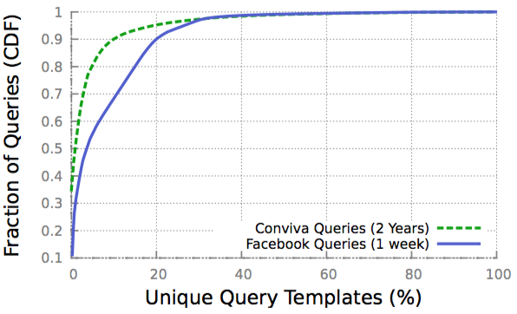
The distribution of QCSs across all queries for both workloads. Surprisingly, over 90% of queries are covered by 10% and 20% of unique QCSs in the traces from Conviva and Facebook respectively.

Slide 28
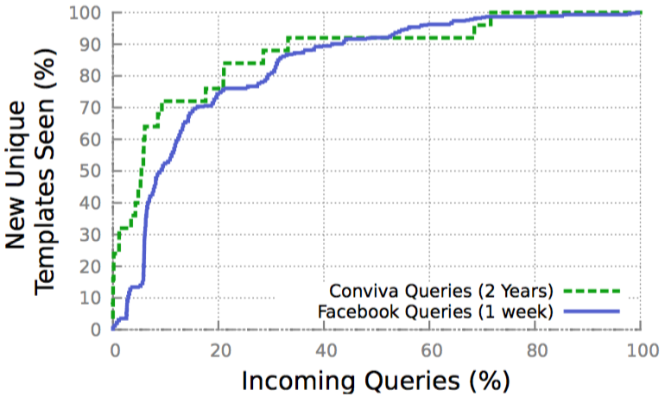
Shows the number of unique QCSs (appear in more than 10 queries) versus the queries arriving in the system. The two graphs suggest that past history is a good predictor for the future workload.

Slide 29
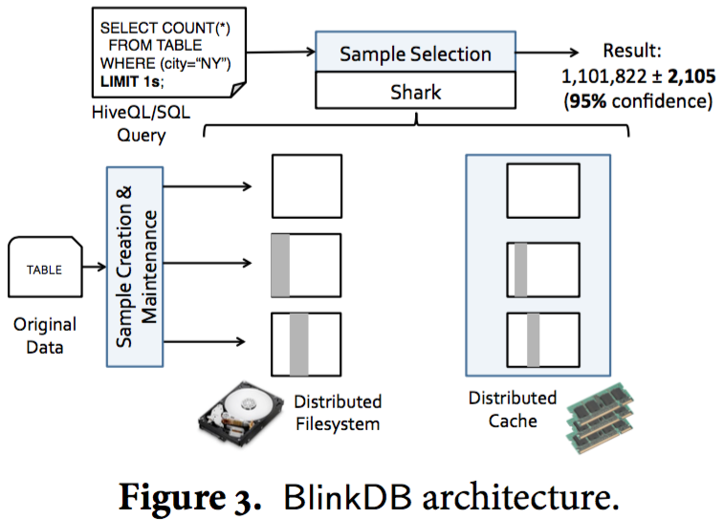
System Overview

Slide 30
System Overview
BlinkDB extends the Apache Hive framework by adding two major components to it: (1) an offline sampling module that creates and maintains samples over time, and (2) a run-time sample selection module that creates an Error-Latency Profile (ELP) for queries.
To decide on the samples to create, they use the QCSs that appear in queries. Once this choice is made, a range of uniform and stratified samples are created across a number of dimensions.

Slide 31
System Overview
At run-time, BlinkDB employs ELP to decide the sample to run the query. The ELP characterizes the rate at which the error (or response time) decreases (or increases) as the size of the sample on which the query operates increases. This is used to select a sample that best satisfies the user’s constraints.
BlinkDB also augments the query parser, optimizer, and a number of aggregation operators to allow queries to specify bounds on error, or execution time.

Slide 32
BlinkDB can currently provide approximate results for standard SQL aggregate queries involving COUNT, AVG, SUM and QUANTILE.
Queries involving these operations can be annotated with either an error bound, or a time constraint. Based on these constraints, the system selects an appropriate sample, of an appropriate size.
As an example, let us consider querying a table Sessions, with five columns, SessionID, Genre, OS, City, and URL, to determine the number of sessions in which users viewed content in the “western” genre, grouped by OS.

Slide 33
SELECT COUNT(*)
FROM Sessions
WHERE Genre = ‘western’
GROUP BY OS
ERROR WITHIN 10% AT CONFIDENCE 95%
will return the count for each GROUP BY key, with each count having relative error of at most ±10% at a 95% confidence level.
SELECT COUNT(*)
FROM Sessions
WHERE Genre = ‘western’
GROUP BY OS
WITHIN 5 SECONDS
will return the most accurate results for each GROUP BY key in 5 seconds, along with a 95% confidence interval for the relative error of each result.

Slide 34
At that time, BlinkDB did not support arbitrary joins and nested SQL queries.
They did provide support for joins in some settings which are commonly used in distributed data warehouses. In particular, BlinkDB can support joining a large, sampled fact table, with smaller tables that are small enough to fit in the main memory of any single node in the cluster, which is one of the most commonly used form of joins in distributed data warehouses.
Currently? I do not know.

Slide 35
Sample Creation
BlinkDB creates a set of samples to accurately and quickly answer queries.
They formulate the problem of sample creation as an optimization problem. Given a collection of past QCS and their historical frequencies, a collection of stratified samples with total storage costs below some user configurable storage threshold is chosen. These samples are designed to efficiently answer queries with the same QCSs as past queries, and to provide good coverage for future queries over similar QCS.

Slide 36
Queries that do not filter or group data (for example, a SUM over an entire table) often produce accurate answers when run on uniform samples.
However, uniform sampling often does not work well for queries on filtered or grouped subsets of the table. When members of a particular subset are rare, a uniform sample may not contain any members of the subset at all, leading to a missing row in the final output of the query. The standard approach to solving this problem is stratified sampling, which ensures that rare subgroups are sufficiently represented.

Slide 37
First, consider the smaller problem of optimizing a stratified sample for a single query.
We are given a query Q specifying a table T, a QCS φ, and either a response time bound t or an error bound e. A time bound t determines the maximum sample size on which we can operate, n; n is also the optimal sample size. Similarly, given an error bound e, it is possible to calculate the minimum sample size that will satisfy the error bound, and any larger sample would be suboptimal because it would take longer than necessary. In general n is monotonically increasing in t (or monotonically decreasing in e) but will also depend on Q and on the resources available in the cluster to process Q.

Slide 38
Among the rows in T, let D(φ) be the set of unique values x on the columns in φ. For each value x there is a set of rows in T having that value,T_{x} = {r∶r∈T and r takes values x on columns φ}. We will say that there are ∣D(φ)∣ “groups” T_{x} of rows in T under φ.
It is expansive to compute an aggregate value for each T_{x}. Instead we will choose a sample S ⊆ T with ∣S∣ = n rows. For each group T_{x} there is a corresponding sample group S_{x} ⊆ S that is a subset of T_{x} , which will be used instead of T_{x} to calculate an aggregate.
BlinkDB simply assigns equal sample size to each groups. In addition, the assignment of sample sizes is deterministic, not random.

Slide 39
Algorithm for sample selection

Slide 40
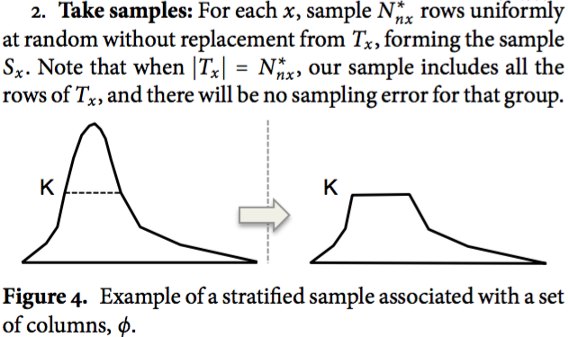
Algorithm for sample selection

Slide 41
We denote a sample by S(φ, K) or simply S when there is no ambiguity.
Consider query Q grouping by QCS φ, and assume we use S(φ, K) to answer Q. For each value x on φ, if ∣T_{x}∣ ≤ K, the sample contains all rows from the original table, so we can provide an exact answer for this group. On the other hand, if ∣T_{x} ∣ > K, we answer Q based on K random rows in the original table. For the basic aggregate operators AVG, SUM, COUNT, and QUANTILE, K directly determines the error of Q’s result.

Slide 42
We want to create samples for a set of queries that share a QCS φ but have different values of n because the number of rows we read to satisfy a query, will vary according to user-specified error or time bounds.
Simply, given any sample S_{nmax} , for any n ≤ n^{max} there is an S_{n} ⊆ S_{nmax} that is an optimal sample for n.
The rows of stratified sample S(φ, K) are stored sequentially in blocks in the underlying file system, like HDFS.

Slide 43
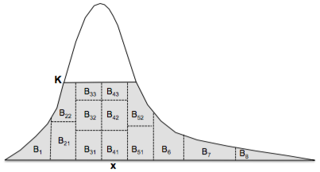
Records corresponding to consecutive values in φ are stored in the same block, e.g., B₁.
If the records corresponding to a popular value do not all fit in one block, they are spread across several contiguous blocks e.g., blocks B₄₁, B₄₂ and B₄₃.

Slide 44
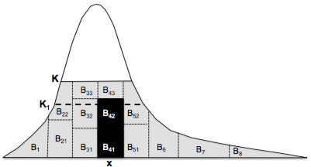
When S_{x} is spread over multiple blocks, each block contains a randomly ordered random subset from S_{x}. This makes it possible to efficiently run queries on smaller samples since we can just read any subset of blocks for S_{x}, as long as these blocks contain enough records.

Slide 45
Then is the optimization framework to select subsets of columns on which to build sample families.
Unlike prior work which focuses on single-column stratified samples or on a single multi-dimensional (i.e., multi-column) stratified sample, BlinkDB creates several multi-dimensional stratified samples.
Each stored sample has a storage cost equal to its size, and the number of potential samples is exponential in the number of columns. So we need to be careful in choosing the set of column-sets on which to build stratified samples.

Slide 46
They formulate the trade-off between storage cost and query accuracy/performance as an optimization problem.
The optimization problem takes three factors into account in determining the sets of columns on which stratified samples should be built: the “sparsity” of the data, workload characteristics, and the storage cost of samples.
Sparsity of the data: A stratified sample on φ is useful when the original table T contains many small groups under φ. D(φ) denotes the set of all distinct values on columns φ. A “sparsity” function ∆(φ, M) is defined as the number of groups whose size in T is less than some number M:
∆(φ,M)=∣{x ∈ D(φ)∶∣T_{x}∣< M}∣

Slide 47
Workload: Under their model for queries, a query has a QCS q_{j} with some (unknown) probability p_{j} - that is, QCSs are drawn from a Multinomial (p₁ , p₂ , ...) distribution. The best estimate of p_{j} is simply the frequency of queries with QCS q_{j} in past queries.
Storage cost: Storage is the main constraint against building too many stratified samples, and against building stratified samples on large column sets that produce too many groups. We must compute the storage cost of potential samples and constrain total storage. Assume a single value of K for all samples; a sample family φ either receives no samples or a full sample with K elements of T_{x} for each x ∈ D(φ). ∣S(φ, K)∣ is the storage cost (in rows) of building a stratified sample on a set of columns φ.

Slide 48
Let the overall storage capacity budget (again in rows) be ℂ. Our goal is to select 𝛽 column sets from among m possible QCSs, say φ_{i1} , ⋯, φ_{i𝛽} , which can best answer our queries, while satisfying:

Slide 49
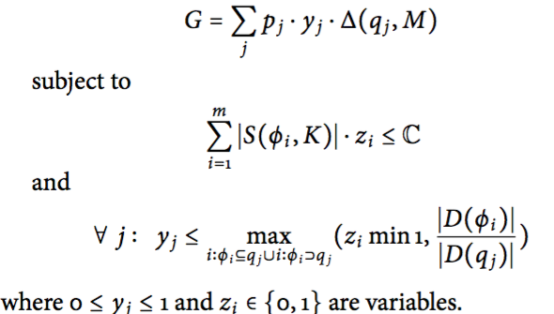
BlinkDB maximizes the following mixed integer linear program (MILP) in which j indexes over all queries and i indexes over all possible column sets:

Slide 50
Here,z_{i} is a binary variable determining whether a sample family should be built or not, i.e., when z_{i} = 1, we build a sample family on φ_{i} ; otherwise, when z_{i} = 0, we do not.
The goal function aims to maximize the weighted sum of the coverage of the QCSs of the queries, q_{j}. If we create a stratified sample S(φ_{i}, K), the coverage of this sample for q_{j} is defined as the probability that a given value x of columns q_{j} is also present among the rows of S(φ_{i},K). If φ_{i}⊇q_{j}, then q_{j} is covered exactly, but φ_{i} ⊂ q_{j} can also be useful by partially covering q_{j} . At runtime, if no stratified sample is available that exactly covers the QCS for a query, a partially-covering QCS may be used instead.

Slide 51
The coverage probability is hard to compute in practice, in this paper they approximate it by y_{j}. The y_{j} value is in [0, 1], with 0 meaning no coverage, and 1 meaning full coverage. The intuition is that when we build a stratified sample on a subset of columns φ_{i} ⊆ q_{j}, i.e. when z_{i} = 1, we have partially covered q_{j} , too.
They compute this coverage as the ratio of the number of unique values between the two sets, i.e., ∣D(φ_{i})∣/∣D(q_{j})∣. When φ_{i} ⊂ q_{j}, this ratio, and the true coverage value, is at most 1. When φ_{i} = q_{j}, the number of unique values in φ_{i} and q_{j} are the same, we are guaranteed to see all the unique values of q_{j} in the stratified sample over φ_{i} and therefore the coverage will be 1. When φ_{i} ⊃ q_{j}, the coverage is also 1, so we cap the ratio ∣D(φ_{i})∣/∣D(q_{j})∣ at 1.

Slide 52
Finally, we need to weigh the coverage of each set of columns by their importance: a set of columns q_{j} is more important to cover when: (i) it appears in more queries, which is represented by p_{j}, or (ii) when there are more small groups under q_{j}, which is represented by ∆(q_{j}, M). Thus, the best solution is when we maximize the sum of p_{j} ⋅ y_{j} ⋅ ∆(q_{j}, M) for all QCSs.
In practice they set M = K = 100000.

Slide 53
BlinkDB Runtime
Given a query Q, the goal is to select one (or more) sample(s) at run-time that meet the specified time or error constraints and then compute answers over them. Picking a sample involves selecting either the uniform sample or one of the stratified samples, and then possibly executing the query on a subset of tuples from the selected sample.
The selection of a sample depends on the set of columns in Q, the selectivity of its selection predicates, and the data placement and distribution. In turn, the size of the sample subset on which we ultimately execute the query depends on Q’s time/accuracy constraints, its computation complexity, the physical distribution of data in the cluster, and available cluster resources (i.e., empty slots) at runtime.

Slide 54
Maintaining a large number of samples (which are cached in memory to different extents), allows BlinkDB to generate many different query plans for the same query that may operate on different samples to satisfy the same constraints.
In order to pick the best possible plan, BlinkDB’s run-time dynamic sample selection strategy involves executing the query on a small sample (i.e., a subsample) of data of one or more samples and gathering statistics about the query’s selectivity, complexity and the underlying distribution of its inputs. Based on these results and the available resources, BlinkDB extrapolates the response time and relative error with respect to sample sizes to construct an Error Latency Profile (ELP) of the query for each sample.

Slide 55
Choosing an appropriate sample for a query primarily depends on the set of columns q_{j} that occur in its WHERE and/or GROUP BY clauses and the physical distribution of data in the cluster (i.e., disk vs. memory).
If BlinkDB finds one or more stratified samples on a set of columns φ_{i} such that q_{j} ⊆φ_{i}, we simply pick the φ_{i} with the smallest number of columns, and run the query on S(φ_{i} , K).

Slide 56
If there is no stratified sample on a column set that is a superset of q_{j}, we run Q in parallel on in-memory subsets of all samples currently maintained by the system. Then, out of these samples we select those that have a high selectivity as compared to others, where selectivity is defined as the ratio of (i) the number of rows selected by Q, to (ii) the number of rows read by Q (i.e., number of rows in that sample). The intuition behind this choice is that the response time of Q increases with the number of rows it reads, while the error decreases with the number of rows Q’s WHERE/GROUP BY clause selects.

Slide 57
Once a set of samples is decided, BlinkDB needs to select a particular sample φ_{i} and pick an appropriately sized subsample in that sample based on the query’s response time or error constraints.
This is accomplished by constructing an Error Latency Profile (ELP) for the query. ELP characterizes the rate at which the error decreases (and the query response time increases) with increasing sample sizes, and is built simply by running the query on smaller samples to estimate the selectivity and project latency and error for larger samples.

Slide 58
Error Profile: is created for all queries with error constraints. BlinkDB error profile tries to predict the size of the smallest sample that satisfies Q’s error constraint. Variance and confidence intervals for aggregate functions are estimated using standard closed-form formulas from statistics. For all standard SQL aggregates, the variance is proportional to ∼ 1/n, and thus the standard deviation (or the statistical error) is proportional to ∼ 1/$\sqrt{n}$, where n is the number of rows from a sample of size N that match Q’s filter predicates. Using this notation, the selectivity s_{q} of the query is the ratio n/N.

Slide 59
Let n_{i,m} be the number of rows selected by Q when running on a subset m of the stratified sample, S(φ_{i}, K). Furthermore, BlinkDB estimates the query selectivity s_{q}, sample variance S_{n} (for AVG/SUM) and the input data distribution f (for Quantiles) by running the query on a number of small sample subsets. Using these parameter estimates, we calculate the number of rows n = n_{i,m} required to meet Q’s error constraints using standard closed form statistical error estimates. Then, we run Q on S(φ_{i}, K) until it reads n rows.

Slide 60
Latency Profile: is created for all queries with response time constraints. BlinkDB selects the sample on which to run Q the same way as above. Again, let S(φ_{i}, K) be the selected sample, and let n be the maximum number of rows that Q can read without exceeding its response time constraint. Then we simply run Q until reading n rows from S(φ_{i}, K).
The value of n depends on the physical placement of input data (disk vs. memory), the query structure and complexity, and the degree of parallelism (or the resources available to the query). BlinkDB simply predicts n by assuming that latency scales linearly with input size, as is commonly observed with a majority of I/O bounded queries in parallel distributed execution environments.

Slide 61
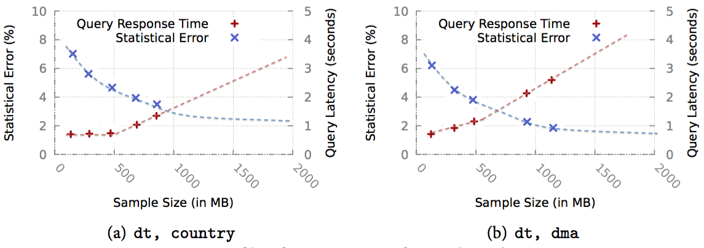
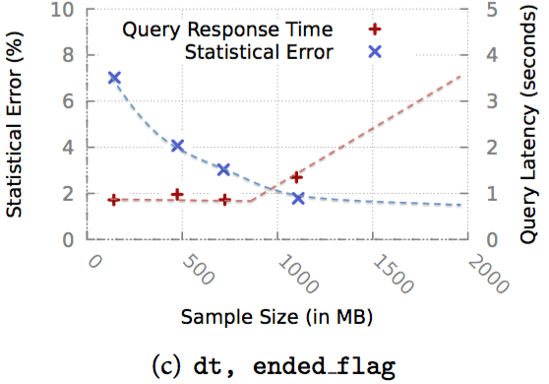

Slide 62
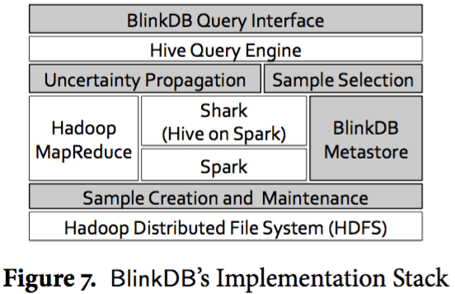
Implementation

Slide 63
BlinkDB is built on top of the Hive Query Engine, supports both Hadoop MapReduce and Spark (via Shark) at the execution layer and uses the Hadoop Distributed File System at the storage layer.
They add a shim layer to the HiveQL parser to handle the BlinkDB Query Interface, which enables queries with response time and error bounds, and can detect data input, triggering the Sample Creation and Maintenance module, which creates or updates the set of random and multidimensional sample. They further extend the HiveQL parser to implement a Sample Selection module that re-writes the query and iteratively assigns it an appropriately sized uniform or stratified sample. They also add an Uncertainty Propagation module to modify all pre-existing aggregation functions with statistical closed forms to return errors bars and confidence intervals in addition to the result.

Slide 64
BlinkDB replaces the set of samples used by running a low priority background task which periodically (typically, daily) samples from the original data, creating new samples which are then used by the system.
BlinkDB keeps track of statistical properties of the underlying data (e.g., variance and percentiles) and periodically runs the sample creation module to re-compute these properties and decide whether the set of samples needs to be changed.

Slide 65
In BlinkDB, uniform samples are generally created in a few hundred seconds. This is because the time taken to create them only depends on the disk/memory bandwidth and the degree of parallelism.
On the other hand, creating stratified samples on a set of columns takes anywhere between a 5 − 30 minutes depending on the number of unique values to stratify on, which decides the number of reducers and the amount of data shuffled.

Slide 66
Evaluation
They evaluate BlinkDB’s performance on a 100 node EC2 cluster using a workload from Conviva Inc. and the well-known TPC-H benchmark.
The Conviva and the TPC-H datasets were 17 TB and 1 TB in size, respectively, and were both stored across 100 Amazon EC2 extra large instances (each with 8 CPU cores (2.66 GHz), 68.4 GB of RAM, and 800 GB of disk). The cluster was configured to utilize 75 TB of distributed disk storage and 6 TB of distributed RAM cache.

Slide 67
Conviva: the data consists of a single large fact table with 104 columns, such as customer ID, city, media URL, genre, date, time, user OS, browser type, request response time, etc. The 17 TB dataset has about 5.5 billion rows and shares all the key characteristics of real-world production workloads observed at Facebook Inc. and Microsoft Corp.
The raw query log consists of 19,296 queries, from which they selected different subsets for each experiment. They ran their optimization function on a sample of about 200 queries representing 42 query column sets. They repeated the experiments with different storage budgets for the stratified samples– 50%, 100%, and 200%.

Slide 68
TPC-H: The 22 benchmark queries in TPC-H were mapped to 6 unique query column sets.
The following figures show the set of sample selected by their optimization problem for the storage budgets of 50%, 100% and 200%, along with their cumulative storage costs. Unless otherwise specified, all the experiments in this paper are done with a 50% additional storage budget (i.e., samples could use additional storage of up to 50% of the original data size).

Slide 69
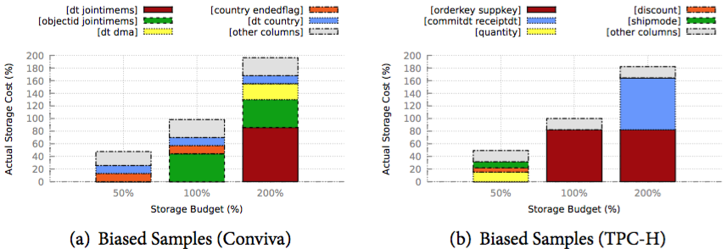

Slide 70
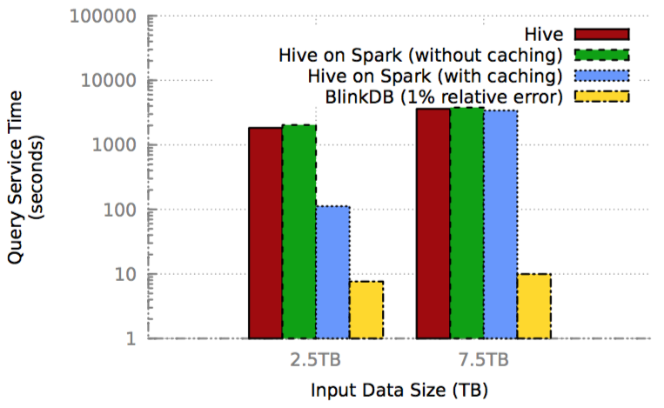
BlinkDB vs. No Sampling, 1% error bound

Slide 71
Multi-Dimensional Stratified Sampling
To evaluate the error and convergence properties of their optimal multi-dimensional stratified-sampling approach against both simple random sampling, and one-dimensional stratified sampling (i.e., stratified samples over a single column).
They compared the average statistical error at 95% confidence while running a query for 10 seconds over the three sets of samples, all of which were constrained to be of the same size.

Slide 72
Multi-Dimensional Stratified Sampling
For Conviva’s data they used a set of 40 of the most popular queries (with 5 unique QCSs) and 17 TB of uncompressed data on 100 nodes. They ran a similar set of experiments on the standard TPC-H queries (with 6 unique QCSs).
Based on the storage constraints, BlinkDB’s optimization framework had samples stratified on QCS₁ and QCS₂ for Conviva data and samples stratified on QCS₁, QCS₂ and QCS₄ for TPC-H data.

Slide 73
Multi-Dimensional Stratified Sampling

Slide 74
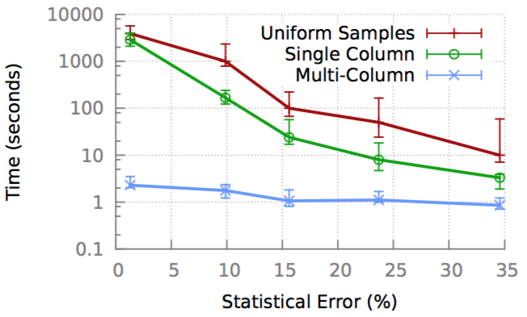
Convergence Properties
Error bars from running queries over multi-dimensional samples converge orders-of-magnitude faster than random sampling, and are significantly faster to converge than single-dimensional stratified samples.

Slide 75
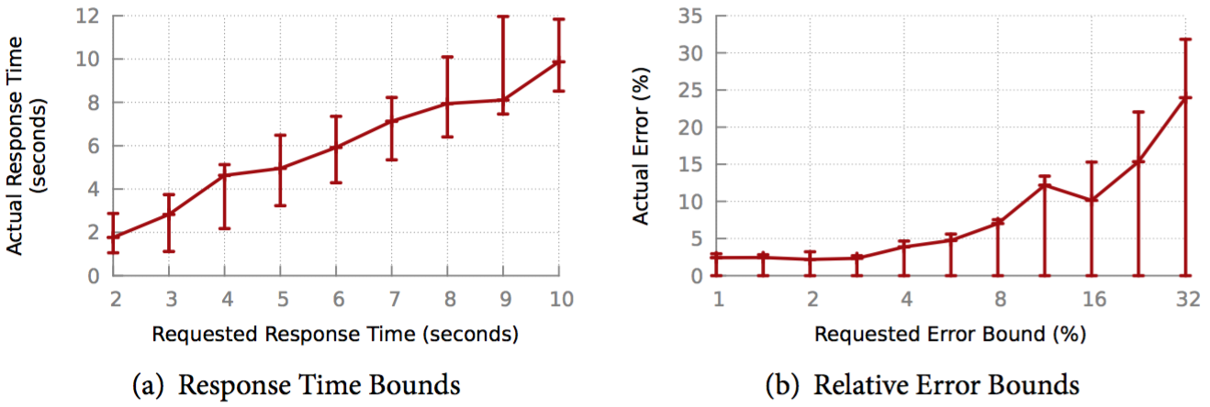
Time/Accuracy Guarantees

Slide 76
Scaling Up
They created 2 different sets of query workload suites consisting of 40 unique Conviva queries each. The first set (marked as selective) consists of highly selective queries that only operate on a small fraction of input data.
The second set (marked as bulk) consists of those queries that are intended to crunch huge amounts of data. While the former set’s input is generally striped across a small number of machines, the latter set of queries generally runs on data stored on a large number of machines, incurring a higher communication cost.

Slide 77
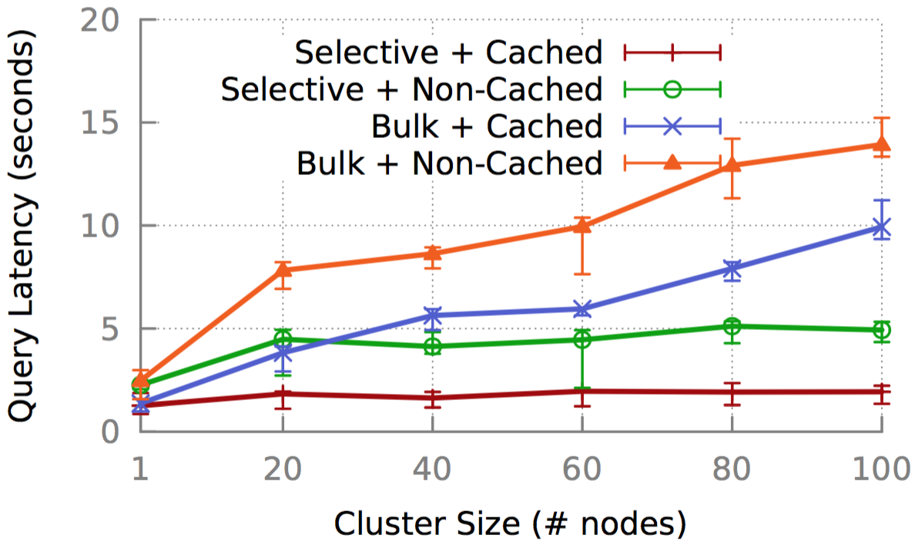
Scaling Up: indicating the min/max latency bounds

Slide 78
Related Work
Prior work on interactive parallel query processing frameworks has broadly relied on two different sets of ideas.
One set has focused on using additional resources (i.e., memory or CPU) to decrease query processing time. Examples include Spark, Dremel and Shark. While these systems deliver low-latency response times when each node has to process a relatively small amount of data, they become slower as the data grows unless new resources are constantly being added. A significant portion of query execution time in these systems involves shuffling or re-partitioning massive amounts of data over the network, which is often a bottleneck for queries. By using samples, BlinkDB is able to scale better as the quantity of data grows.

Slide 79
Related Work
Another line of work has focused on providing approximate answers with low latency, particularly in database systems. Approximate Query Processing (AQP) for decision support in relational databases has been the subject of extensive research, and can either use samples, or other non-sampling based approaches.
Sampling Approaches: STRAT, SciBORQ, Babcock et al., AQUA, Olston et al.
Online Aggregation
Materialized Views, Data Cubes, Wavelets, Synopses, Sketches, Histograms

Slide 80
Conclusion
This paper presents BlinkDB, a parallel, sampling-based approximate query engine that provides support for ad-hoc queries with error and response time constraints.
BlinkDB is based on two key ideas: (i) a multi-dimensional sampling strategy that builds and maintains a variety of samples, and (ii) a run-time dynamic sample selection strategy that uses parts of a sample to estimate query selectivity and chooses the best samples for satisfying query constraints.
Evaluation results on real data sets and on deployments of up to 100 nodes demonstrate the effectiveness of BlinkDB at handling a variety of queries with diverse error and time constraints, allowing us to answer a range of queries within 2 seconds on 17 TB of data with 90-98% accuracy.

Slide 81
Thank you!

Slide 82
Quickr: Lazily Approximating Complex AdHoc Queries in BigData Clusters
Qi Zhao
CS239
5/4/2016

Slide 83
Outline
1, Overview
2, Motivation
3, Approximability of Big-data queries
4, Sampling
5, Evaluation

Slide 84
something BEFOREHAND
I have no background and experience on DB, therefore, my presentation is based on my limited knowledge and experience
I am sorry that I have no choice on picking up paper since I was late for doing this. Moreover, the schedule has been changed…
Honestly, I cannot say that I understand this paper well. Sorry in advance that I might not be able to answer your question. Discussion and help are welcomed:)

Slide 85
Overview
Quickr: A system that approximates the answer to complex adhoc queries in big-data clusters by injecting samplers on-the-fly and without requiring pre-existing samples
The problem of approximating jobs in big-data clusters
On-the-fly sampling

Slide 86
The distribution of queries over inputs is heavy-tailed
The smallest subset of inputs which supports half of the queries is 20PB in size. The next 30% of queries touch another 40PB of inputs.
Queries are complex
Many joins: median value is 3 and 90% is 11
Execution graphs are deep
Median graph having 192 operators and a depth of 28
Queries also have aggregations and their output is much smaller than the input indicating the potential for speed-up from approximation

Slide 87
Data scientists can tolerate imprecise answers for exploratory analysis and faster responses increase productivity
Queries that generate aggregated dashboard reports
Machine learning queries that build models by iterating over datasets
State-of-art techniques cannot approximate complex queries

Slide 88
Goal
Given a query, decide whether or not it can be sampled and output an appropriate query plan with samplers
Support complex queries
Ensure that answers will be accurate
“We are unaware of any system that achieves these goals”

Slide 89
Sampler:
Uniform sampler
Mimic a Bernoulli process
Distinct sampler
Ensure that no groups will be missed by stratifying
Universe sampler
Sample multiple join inputs to cover many more queries

Slide 90
Quickr offers turn-key support for approximations by picking for every newly arriving query an execution plan with samplers
How to decide which sampler and where to place?
Add sampler on top pf the plan output by a query optimizer
Treat samplers as first-class operators within the query optimizer
The former is computationally expensive and leads to poor quality plans
“place appropriate samplers at appropriate locations in the query plan automatically” --- ASALQA
Can reason about the accuracy of a sampled expression

Slide 91
Motivation
Input sample stratifies store_sales on {item_sk, date_sk, customer_sk}
The sample will be as large as the input since the three columns have many distinct combinations
Zero performance gain

Slide 92
Quickr speeds up this query since Quickr reasons that:
Universe sampling all fact tables on the join key customer_sk and then joining them is identical to a universe sample of the join output
The group columns {i_color, d_year} are independent with customer_sk
The group has only a few distinct values

Slide 93
APPROXIMABILITY OF BIGDATA QUERIES
Query Q over input I
Apriori sampling -> Q(I ′ ) ≈ Q(I)
I ′ : the best sample of input
Quickr -> Q ′ (I) ≈ Q(I)
Q ′: the best query plan

Slide 94
Heavy tail over inputs
The last percentage of queries access large number of inputs
Makes storing apriori samples meaningless
Query Approximability
Avoid processing all the data
An unbiased estimate of the answer per group
Ensure that no groups are missed
Offer an estimate of the expected error per aggregation

Slide 95
Handling joins
“None of the known approximation systems handle joins well”
Quickr’s universe sampler uniquely samples both join inputs without any data exchange between the inputs at runtime
Allow Quickr to speed-up many more queries than prior work

Slide 96
Just-in-time sampling
Quickr uses statistics of the input datasets to generate at query optimization time an execution plan with samplers placed at appropriate locations

Slide 97
Uniform sampler
Given probability p, the uniform sampler lets a row pass through with probability p uniformly-at-random
The number of rows output is governed by a binomial distribution and each row can be picked at most once

Slide 98
Distinct sampler
Queries with group-by can miss groups in the answer when using uniform sampler
Guarantee at least a certain number of rows pass per distinct combination of values of a given column set
To be partitionable, adjust δ based on the degree-of-parallelism of the sampler
For small memory footprint, Quickr adapts a sketch that identifies heavy hitters in one pass over data
To reduce bias, Quickr holds in a reservoir rows that are early in the probabilistic mode and passes them with the correct weight

Slide 99
Universe sampler
Allow Quickr to sample the inpts of joins
If on both join inputs pick all rows whose value of join keys falls in some chosen subspace, a join over these samples is statistically equivalent to sampling after the join
Uses a cryptographically strong hash function
Pick a subspace without apriori knowledge of the range of values
Can vary the desired sample size by choosing a corresponding portion of the hash range

Slide 100
ASALQA
Given an input query, ASALQA outputs an execution plan with appropriate samplers inserted at appropriate locations
Plan has to achieve the best performance with accuracy as the constraint
As we talked about how to choose better plan with sampler:
Incorporate samplers as first-class operators along with the other database operators and explore the larger combined space of possible plans within a query optimizer
Offer a new ASALQA algorithm that incorporates samplers as native operators into a Cascades-style costbased optimizer

Slide 101
1, Samplers are injected into the query execution tree before every aggregation
2, Quickr has a set of new transformation rules that push samplers closer to the raw input
3, Plan costing uses data statistics to identify the best plan, both in terms of performance and accuracy

Slide 102
Seeding samplers
The precursor mimics the original statement but for aggregations
The successor performs these aggregations by replacing each with
an unbiased estimator of the true value computed over the sampled rows
appends an optional column that offers a confidence interval

Slide 103
Pushing sampler
If the select has many predicate columns but is not very selective, A2 is better
If the select is highly selective, A1 may be better
Otherwise, neither alternative is better.

Slide 104
Costing sampled expressions
1, Is stratified column requirement S empty or can some sample probability p ∈ [0, 0.1] ensure that each distinct value of the columns in S receives at least k rows?
2, Is univ col requirement U empty?
Both true -> Uniform sampler
1 true -> Universe sampler
2 true-> Distinct sampler

Slide 105
Accuracy analysis
Use Horvitz-Thompson (HT) estimator to calculate unbiased estimators of the true aggregate values and the variance of these estimators
Use central-limit-theorem to compute confidence intervals
Use dominance to analyze the case when samplers are at arbitrary locations

Slide 106
Evaluation
How much do queries speed-up?
How often are the output plans correct?
Where do the gains come from? And, how may these results translate to other queries?

Slide 107
Performance
Quickr lowers resource usage of the median query by over 2×
Query runtime improves by a median 1.6×. Roughly 20% of the queries speed up by over 3×. A handful speed up by over 6×
“interm. data” shows that the total amount of intermediate data written by sampled plansis much smaller. Almost 40% of the queries have reductions larger than 4×
the shuffled volume does not decrease as much as intermediate data

Slide 108
Quantifying error
“Missed Groups” shows that up to 20% of queries have missing groups
applying LIMIT 100 on the answer
output the answer before LIMIT 100 and call that the full answer
“Missed Groups: Full” shows that Quickr misses no groups in full answers
“Agg. Error” and “Agg. Error: Full” depict the error for aggregates. We see that 80% of the queries have error within ±10% and over 90% are within ±20%

Slide 109
characteristics PERFORMANCE GAIN
“Sampler-Source dist” shows that the gains increase when the samplers are closer to the sources
“Total/First pass time” and “# of passes” show that the gains due to Quickr are larger for deeper queries
“Interm. Data/10” shows that queries that gain most by Quickr have substantial reductions in intermediate data

Slide 110
OTHERS
The increase in QO latency is below 0.1 seconds
51% of the queries have exactly one sampler
25% of the queries are unapproximable

Slide 111
Quickr vs. Apriori samples
sample-set, the best coverage was 13%
Aparameter sweep on BlinkDB’s internal parameters, the best coverage overall was 22%, obtained at 10× the size of the input
Of the 14 queries that benifited, the median speedup was 24%

Slide 112
Summary
Quickr offers a new way to lazily approximate complex adhoc queries with zero apriori overhead
Through careful analysis over queries in a big-data cluster, we find apriori samples are untenable because query sets make diverse use of columns and queries are spread across many datasets. The large number of passes over data per query makes the case for lazy approximations
We introduce a new sampler operator – universe – that effectively samples multiple join inputs
We consider query optimization over samples much more extensively. Our ASALQA algorithm automatically outputs sampled query plans only when appropriate
We present implementation results from a production big-data system

