Slide 1
CS239-Lecture 12 Graph Computing
Madan Musuvathi
Visiting Professor, UCLA
Principal Researcher, Microsoft Research

Slide 2
A Distributed Framework for Machine Learning and Data Mining in the Cloud
A presentation by Tushar Sudhakar Jee

Slide 3
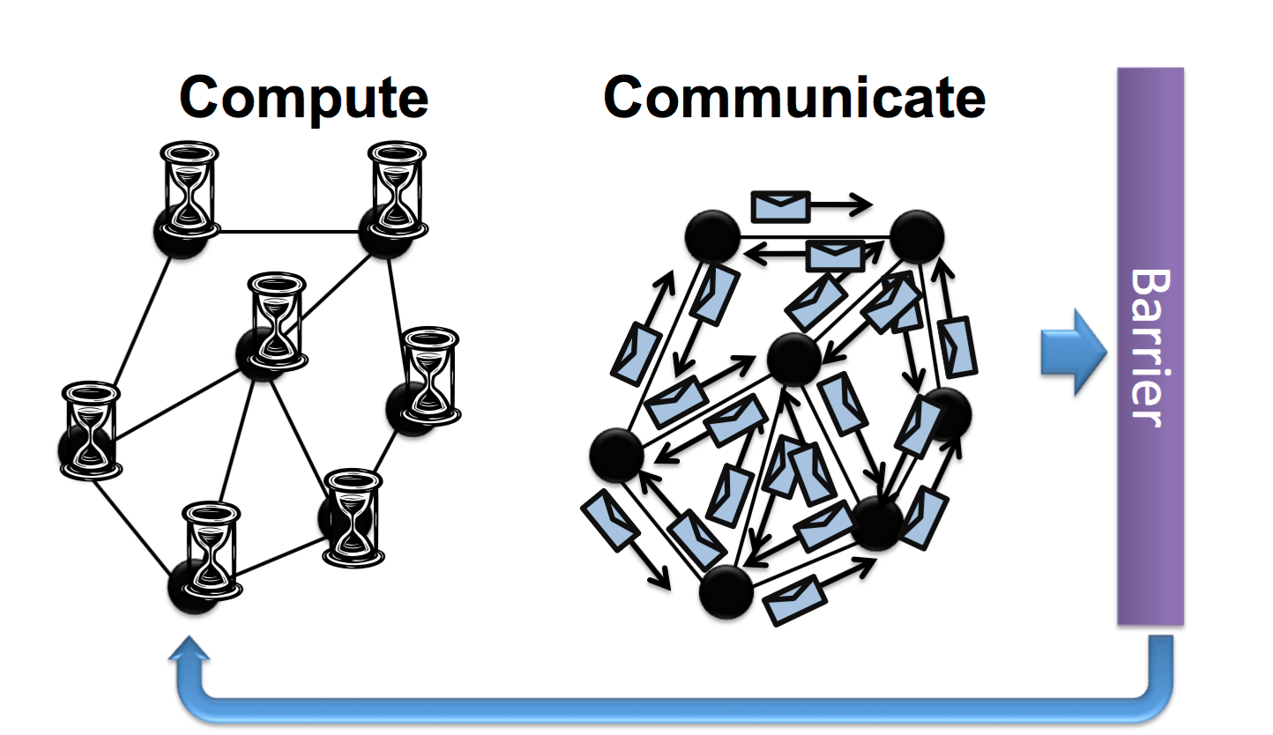
Bulk Synchronous Parallel(BSP)
• A bridging model for designing parallel
Algorithms(eg: message relaying).
• Implemented by Google Pregel 2010.
• The model consists of :
1. Concurrent computation:Every
participating processor may
perform local computations.
2. Communication: The processes
exchange data between
themselves to facilitate remote
data storage capabilities.
3. Barrier synchronisation : When a
process reaches this point (the barrier),
it waits until all other processes have
reached the same barrier.

Slide 4
Bulk Synchronous Parallel(BSP)
• Advantages:
1. No worries about Race conditions.
2. Barrier guarantees Data consistency.
3. Simpler to make fault tolerant,save data on barrier.
• Disadvantages:
1. Costly performance penalties since runtime of each phase is decided by
slowest machine.
2. Fail to support the properties of asynchronous,graph-parallel and dynamic
computation,critical to Machine Learning and Data Mining Community.

Slide 5
Asynchronous processing
• Implemented by GraphLab 2010, 2012 .
• Advantages:
1. Directly targets properties of asynchronous,graph-parallel and dynamic
computation,critical to Machine Learning and Data Mining Community.
2. Involves updating parameters using most recent values as input,most closely
related to Sequential execution.
• Disadvantages:
1. Race conditions can happen all the time.

Slide 6
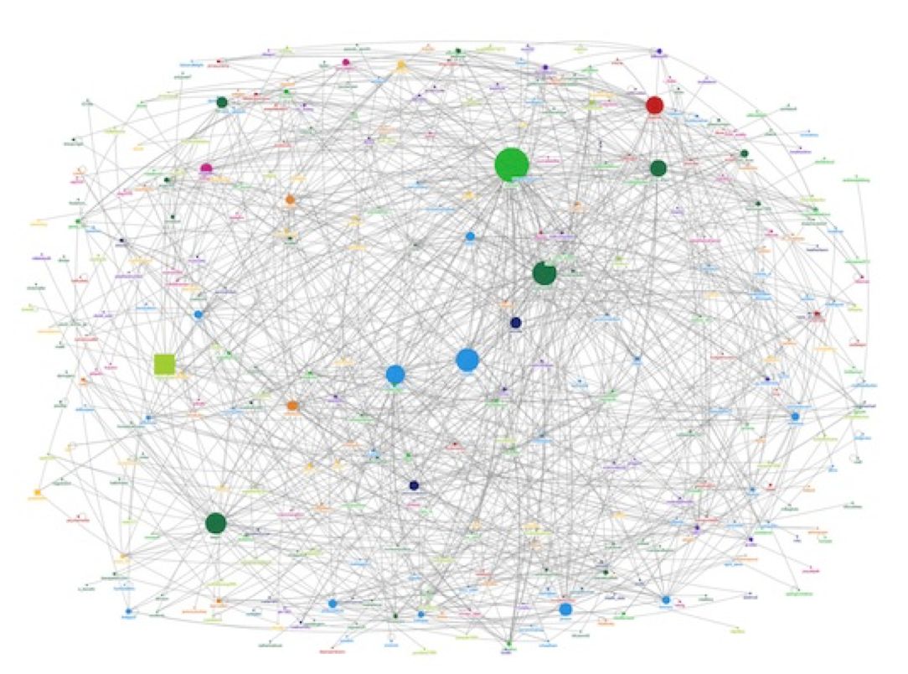
Why GraphLab?
•Implementing Machine Learning and Data Mining algorithms in parallel on current systems like Hadoop,MPI and MapReduce is prohibitively complex and costly.
•It targets asynchronous, dynamic, graph-parallel computation in the shared-memory setting as needed by the MLDM community.

Slide 7
MLDM Algorithm Properties
•Graph Structured Computation
•Asynchronous Iterative Computation
•Dynamic Computation
•Serializability

Slide 8
Graph Structured Computation
•Recent advances in MLDM focus on modeling the dependencies between data, as it allows extracting more signal from noisy data.
For example, modeling the dependencies between similar shoppers allows us to make better product recommendations than treating them in isolation.
•Consequently, there has been a recent shift toward graph-parallel abstractions like Pregel and GraphLab that naturally express Computational dependencies.

Slide 9
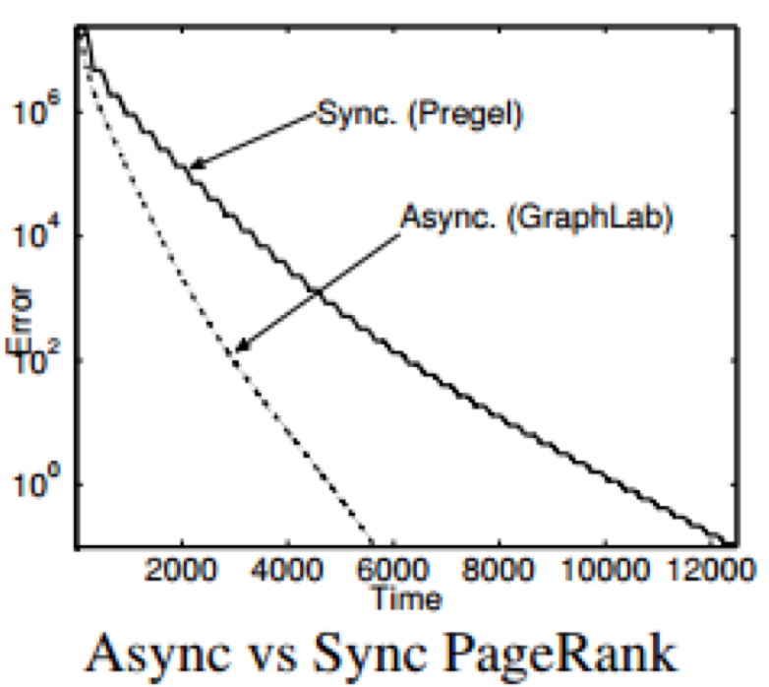
Asynchronous Iterative Computation
•Synchronous systems update all parameters simultaneously (in parallel) using parameter values from the previous time step as input.
•Asynchronous systems update parameters using the most recent parameter values as input.
Many MLDM algorithms benefit from asynchronous systems.

Slide 10
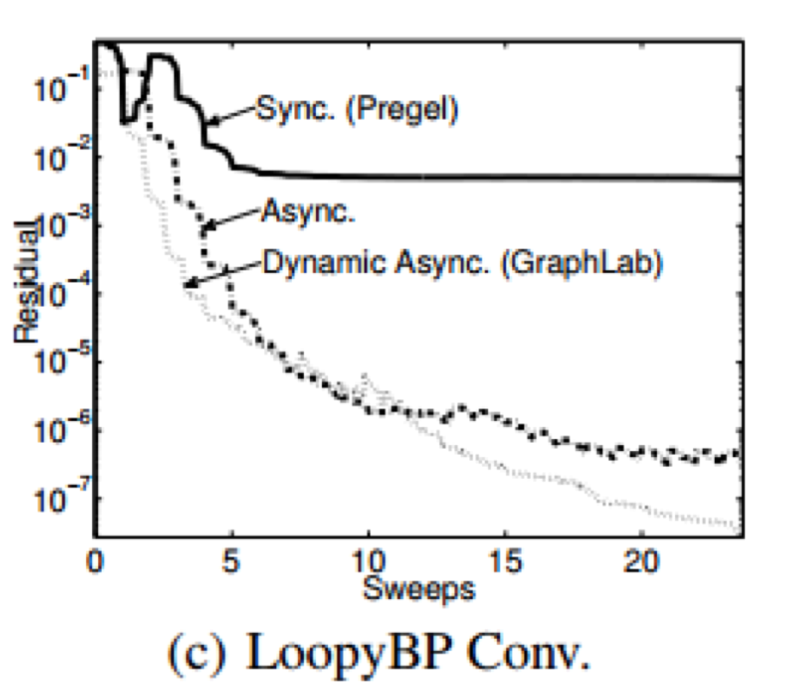
Dynamic Computation
•Dynamic computation allows the algorithm to save time since it only recomputes vertices with recently updated neighbors .
•Static computation requires the algorithm to update all vertices equally often. This wastes time recomputing vertices that have already converged.

Slide 11
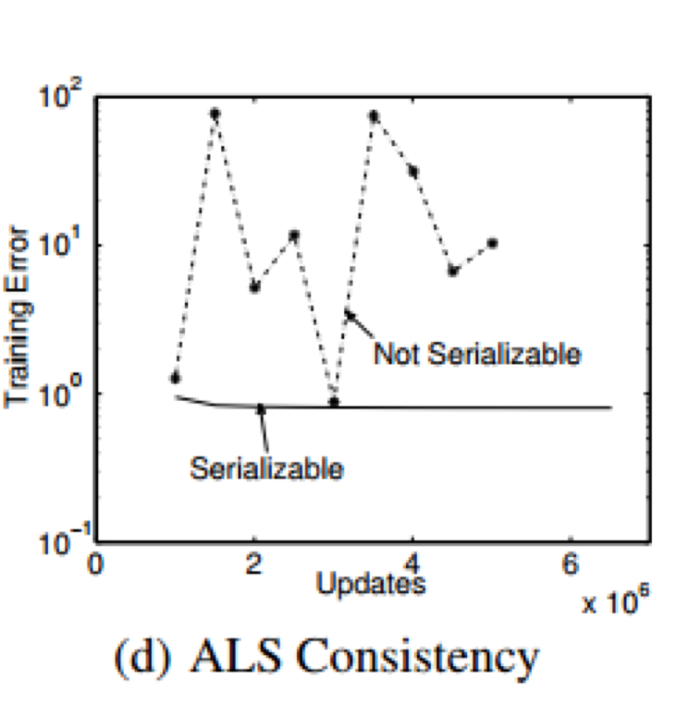
Serializability
•Serializability ensures that all parallel executions have an equivalent sequential execution,thereby eliminating race conditions.
•MLDM algorithms converge faster if serializability is ensured.Gibbs sampling, requires serializability for correctness.

Slide 12
Distributed GraphLab Abstraction
•Data Graph
•Update function
•Sync Operation
•GraphLab Execution Model
•Ensuring Serializability

Slide 13
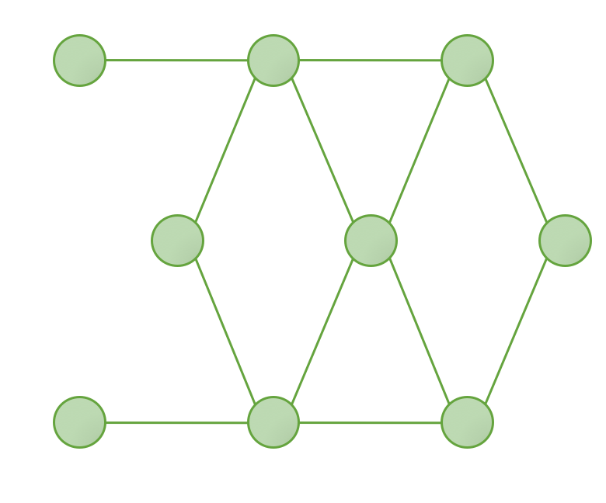
Data Graph
•The GraphLab abstraction stores the program state as a directed graph called the data graph, G = (V, E, D), where D is the user defined data.
Data here represents model parameters, algorithm state, and statistical data.
Data graph

Slide 14
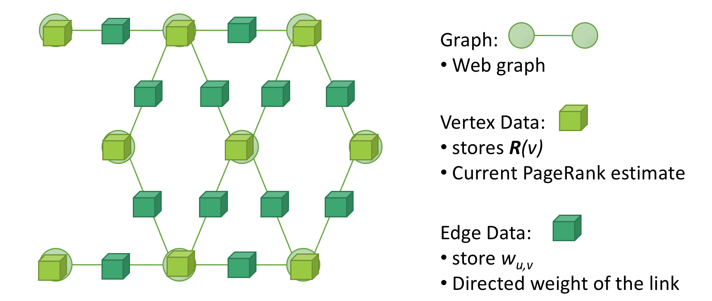
Data Graph (PageRank example):

Slide 15
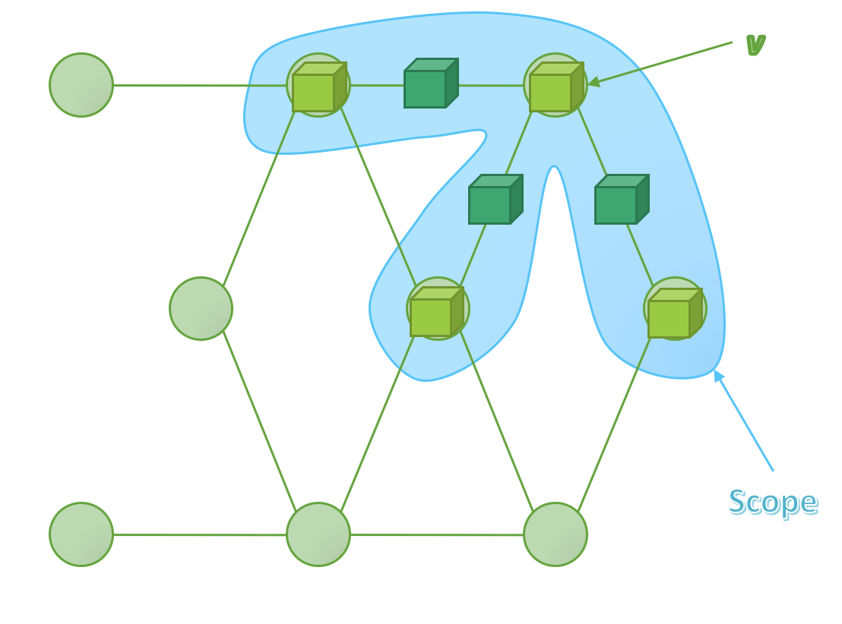
Update function
• An update function is a stateless procedure that modifies the data within the scope of a vertex and schedules the future execution of the update functions on other vertices.
•The function takes a vertex v and its scope S_{v} and returns new versions of the data in the scope as well as a set vertices T:
Update: f(v, S_{v} ) -> (S_{v} ,T)

Slide 16
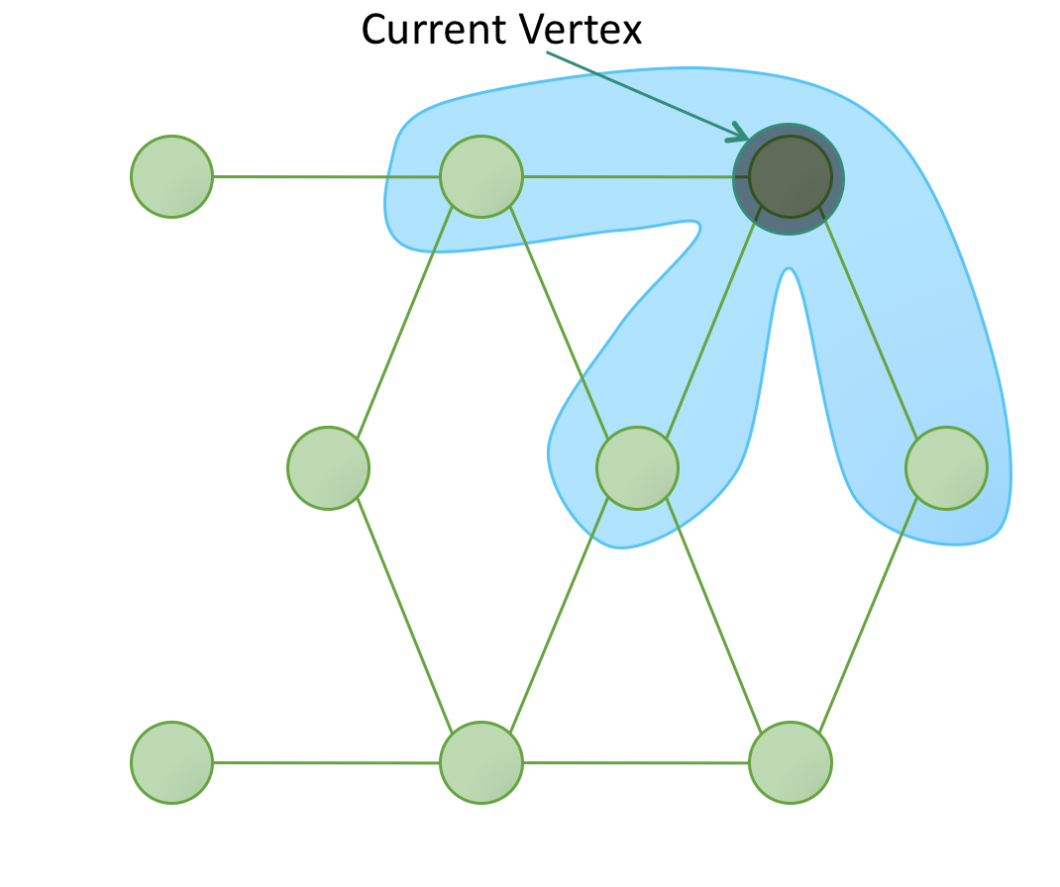
Update function(PageRank example):
•The update function for PageRank computes a weighted sum of the current ranks of neighboring vertices and assigns it as the rank of the current vertex.
• The Neighbors are scheduled for update only if the value of the current vertex crosses the threshold.

Slide 17
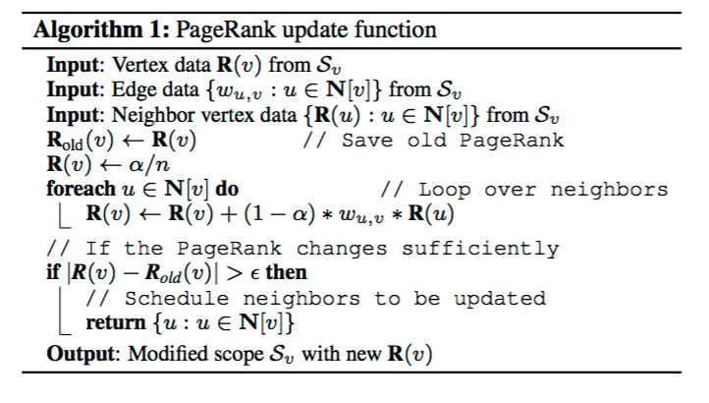
Update function(PageRank example):

Slide 18
Sync Operation
•It is an associative commutative sum defined over all scopes in the graph.
•Supports normalization common in MLDM algorithms.
•Runs continuously in the background to maintain updated estimates of the
global value.
•Ensuring serializability of the sync operation is costly and requires
synchronization.

Slide 19
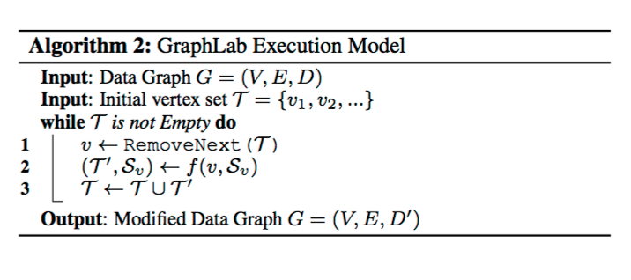
The GraphLab Execution Model
•The model allows the GraphLab runtime engine to determine best order in which to run vertices.
•Since many MLDM algorithms benefit from prioritization,GraphLab abstraction allows users to assign priorities to vertices in T.

Slide 20
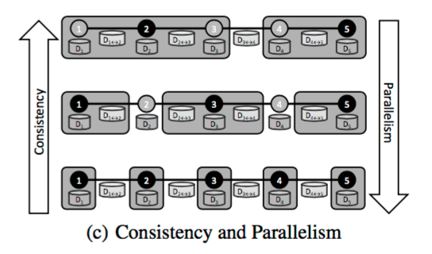
Ensuring Serializability
•It implies that for every parallel execution, there exists a sequential execution of update functions that would give the same results.
•For Serializability ensure no overlapping in scopes of concurrently executing scopes of update functions.
•The greater the consistency, the lower the parallelism.

Slide 21
Ensuring Serializability(Full Consistency):
• This model ensures that scopes of concurrently executing update functions do not
overlap.
• Update function has complete read/write access to entire scope.
• Concurrently executing update functions must be at least two vertices apart
limiting parallelism.

Slide 22
Ensuring Serializability(Edge Consistency):
• This model ensures each update function has exclusive read/write access to its
vertex and adjacent edges, but read only access to adjacent vertices.
• Increases parallelism by allowing update functions with slightly overlapping
scopes to run in parallel.

Slide 23
Ensuring Serializability(Vertex Consistency):
• This model provides write access to the central vertex data.
• It allows all update functions to be run in parallel, providing maximum
parallelism.
• It is the least consistent.

Slide 24
Using GraphLab(K-means):
• Using GraphLab Create K-means with dataset from the June 2014
Kaggle competition to classify schizophrenic subjects based on MRI scans.
• The original data consists of two sets of features: functional network
connectivity (FNC) features and source-based morphometry (SBM) features,
incorporated into a single SFrame with SFrame.join.
• Data downloaded from public AWS S3 bucket.

Slide 25
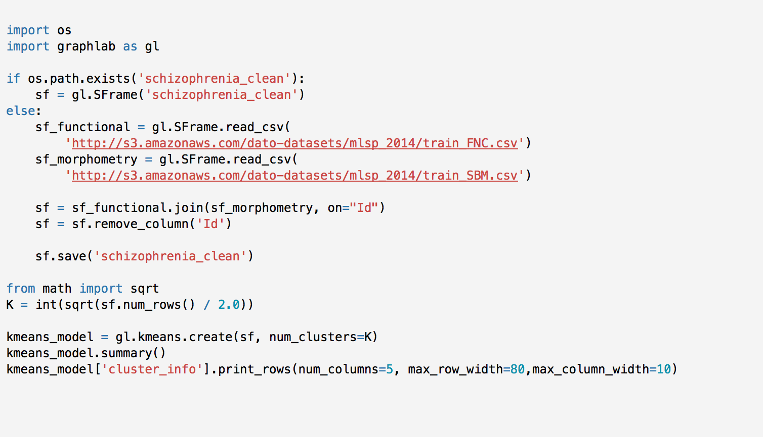

Slide 26
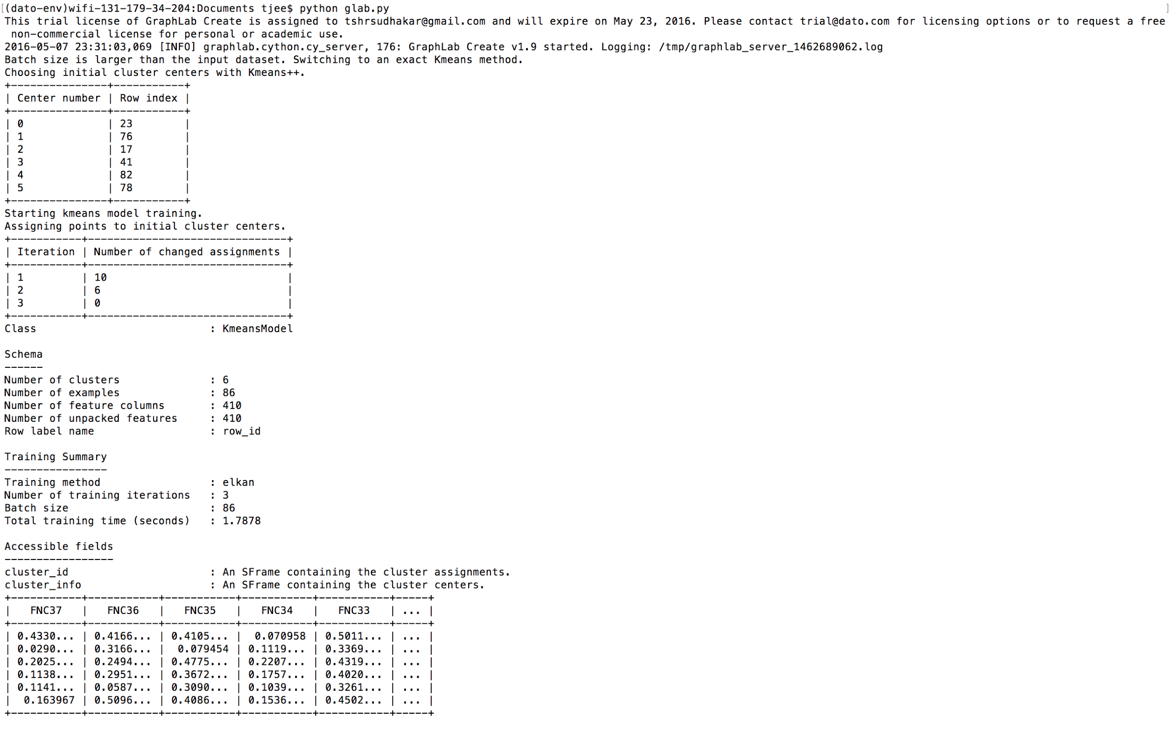

Slide 27
Distributed GraphLab Design
•Distributed Data Graph
•Distributed GraphLab Engines
•Fault tolerance
•System design

Slide 28
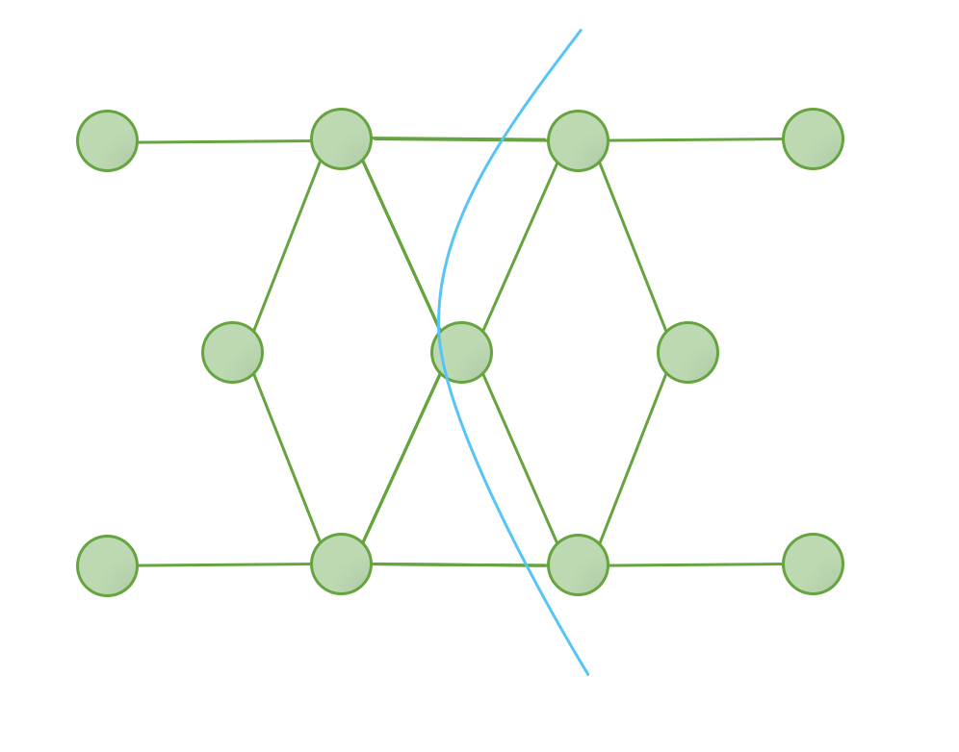
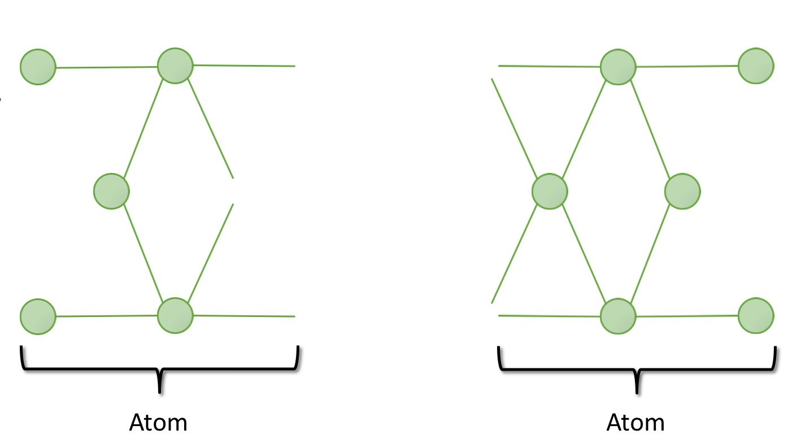
Distributed Data Graph
•A graph is partitioned into k parts where k is much greater than the number of machines.
•Each part, called an atom is stored as a separate file on a distributed storage system(Amazon S3).

Slide 29
Distributed GraphLab Engines:
1. Emulates the GraphLab execution model and is responsible for:
•Executing update functions.
•Executing sync operations.
•Maintaining the set of scheduled vertices T.
•Ensuring serializability with respect to the appropriate consistency model
2. Types:
• Chromatic Engine
• Distributed Locking Engine

Slide 30
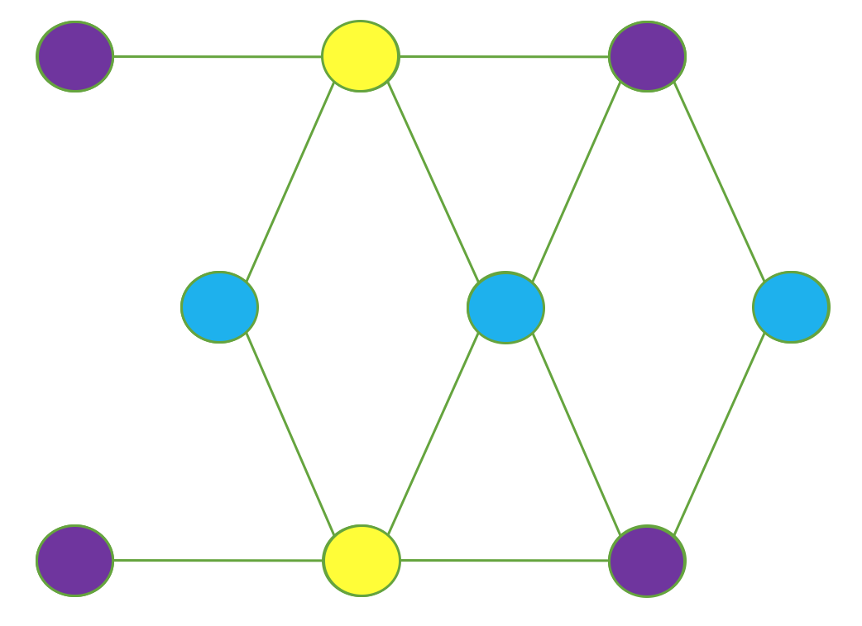
Chromatic Engine:
•It uses vertex coloring to satisfy the edge consistency model by executing synchronously all vertices of the same color in the vertex set T before proceeding to the next color.
•Full consistency model is satisfied by ensuring that no vertex shares the same color as any of its distance two neighbors.
•Vertex consistency model is satisfied by assigning all vertices the same color.
• It executes the set of scheduled vertices T partially asynchronously.
Edge Consistency model using Chromatic Engine.

Slide 31
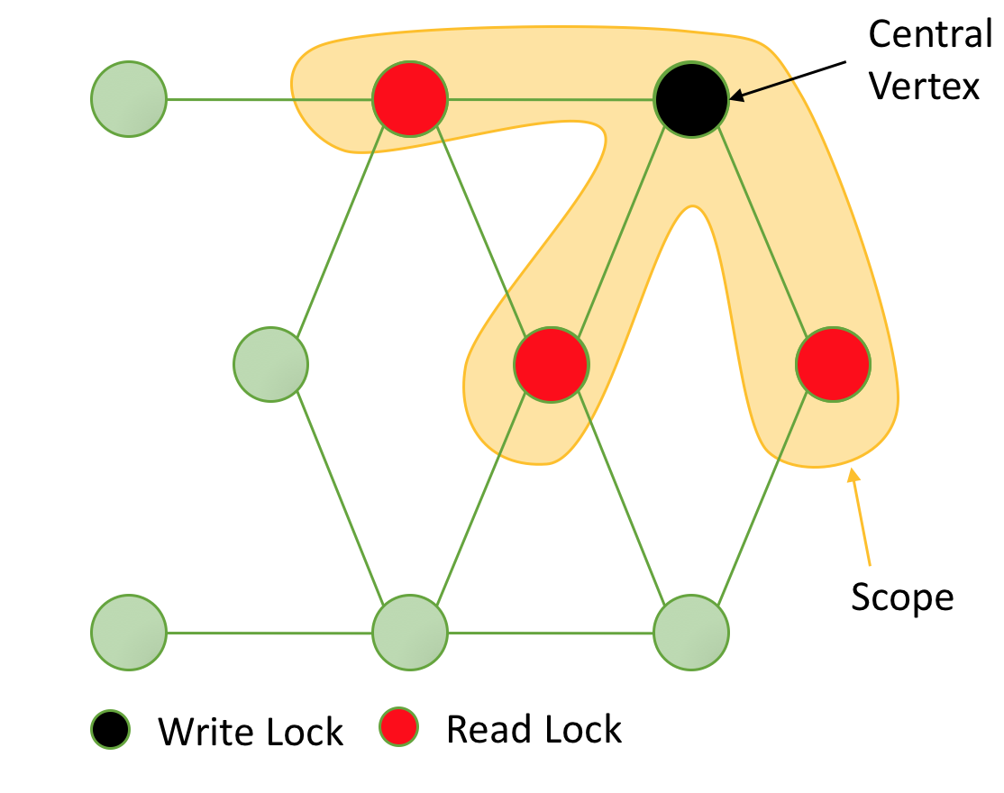
Distributed Locking Engine
1. Why use it?
•Chromatic engine does not provide
sufficient scheduling flexibility.
• Chromatic engine presupposes availability
of graph coloring which might not always
be readily available.
2.The Distributed Locking Engine uses mutual exclusion by associating a readers-writers lock with each vertex.
3.Vertex consistency is achieved by acquiring a write-lock on the central vertex of each requested scope.

Slide 32
4. Full consistency is achieved by acquiring write-locks on the central vertex and all adjacent vertices.
5.Edge consistency is achieved by acquiring a write-lock on the central vertex and read locks on adjacent vertices.

Slide 33
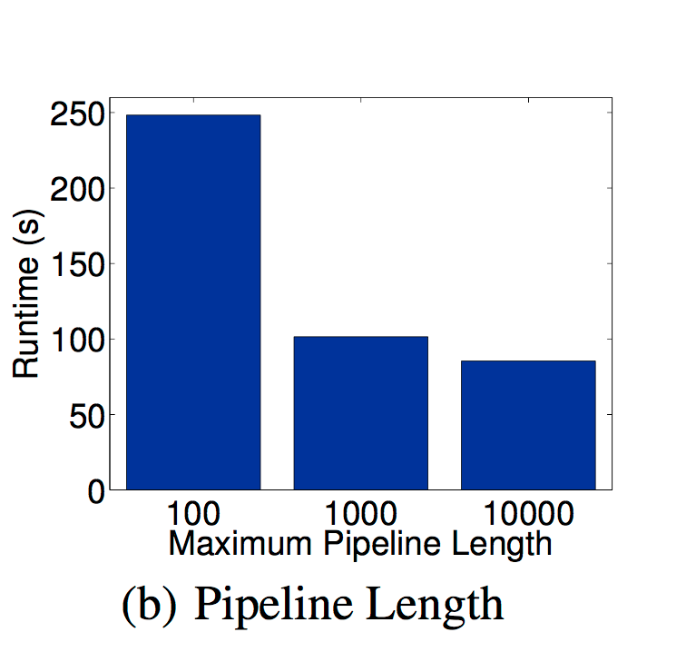
Distributed Locking Engine(Pipelined locking)
•Each machine maintains a pipeline of
vertices for which locks have been
requested, but not yet fulfilled.
•The pipelining system uses callbacks
instead of readers/writer locks since the
latter would halt the pipeline.
•Pipelining reduces latency by
synchronizing locked data immediately
after a machine completes its local lock.

Slide 34
Chandy-Lamport Snapshot Algorithm

Slide 35
Fault Tolerance
•Using a distributed checkpoint mechanism called Snapshot Update fault tolerance is introduced in GraphLab.
•Snapshot Update can be deployed synchronously or asynchronously.
•Asynchronous snapshots are more efficient and guarantee consistent snapshot under the following conditions:
a)Edge consistency is used on all update functions.
b)Schedule completes before the scope is unlocked.
c)Snapshot Update is prioritized over other updates.

Slide 36
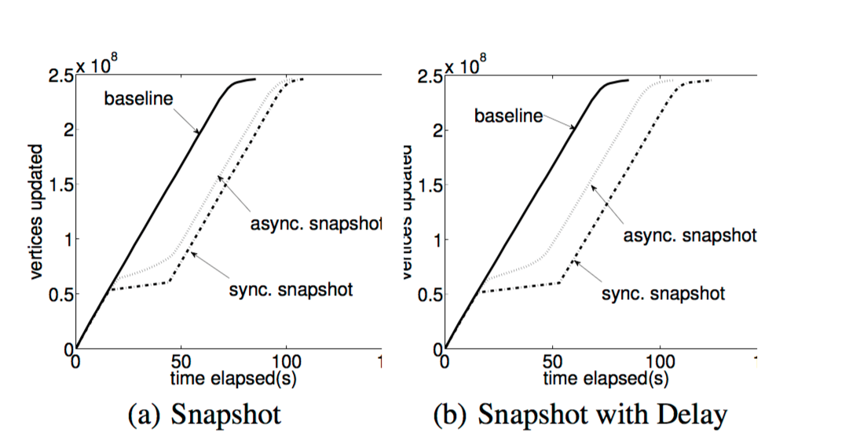
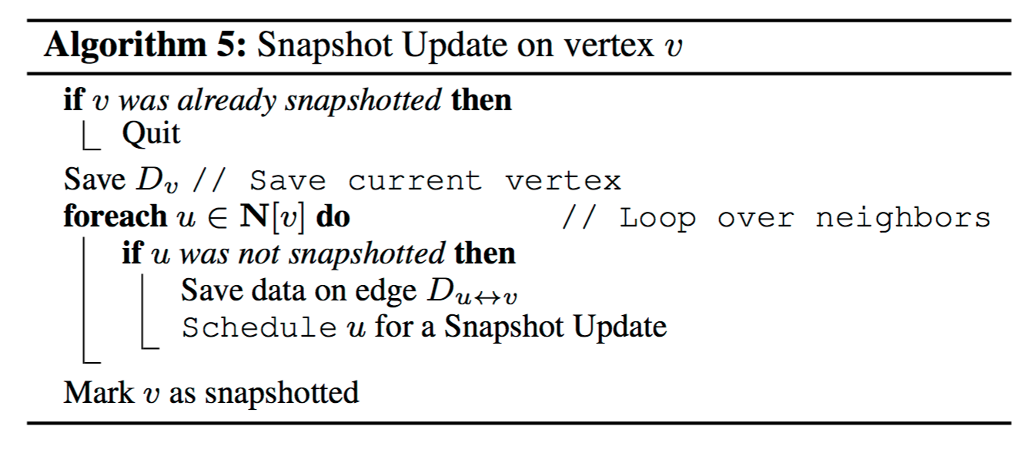
Synchronous snapshot have the “flatline” whereas asynchronous snapshots allow computation to proceed.

Slide 37
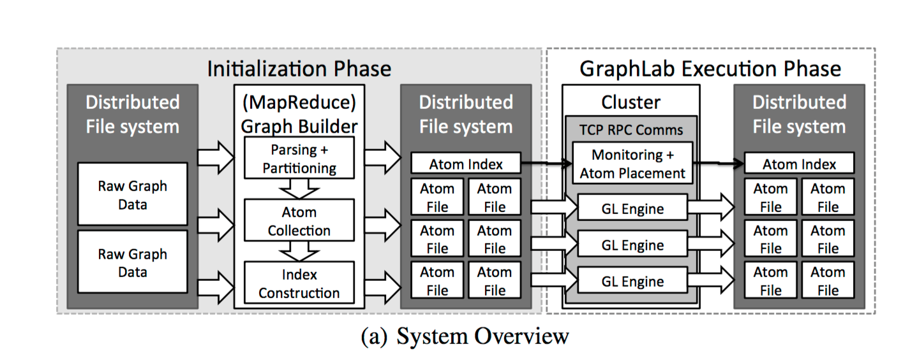
System design
In the Initialization phase the atom file representation of data graph is constructed.
In the GraphLab Execution Phase atom files are assigned to individual execution engines from the DFS.

Slide 38
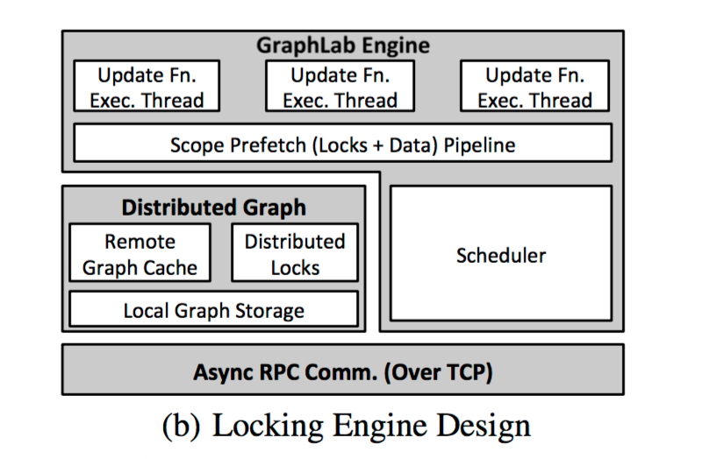
System design(Locking Engine Design)
• Partition of distributed graph managed within Local Graph storage.
• Cache used to provide access to remote data.
• Scheduler manages vertices in T assigned to the process. • Each block makes use of block below it.

Slide 39
Applications
Netflix Movie Recommendation
Video Co-segmentation(Coseg)
Named Entity Recognition(NER)

Slide 40
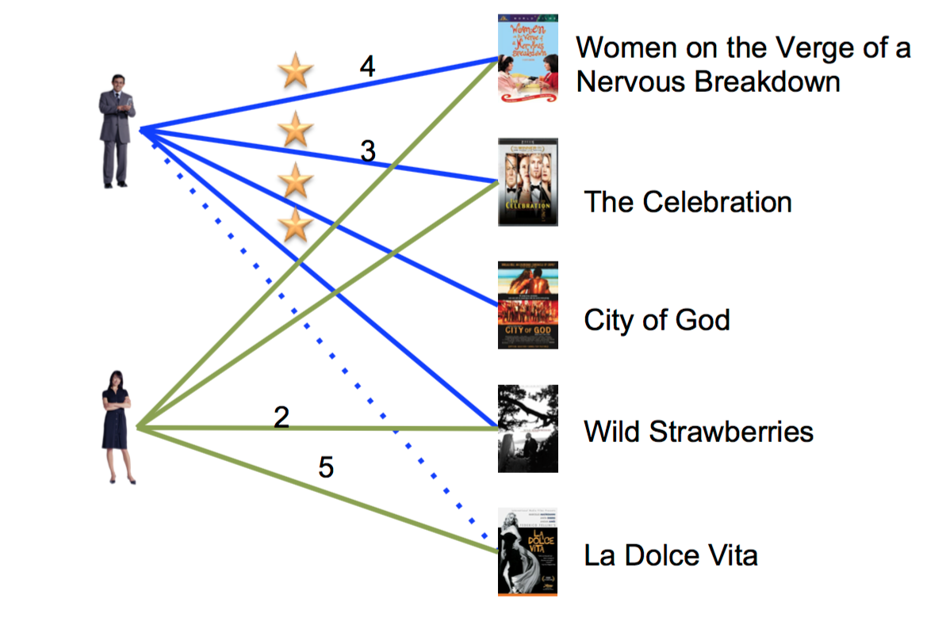
Netflix Movie Recommendation
It makes use of collaborative filtering to predict the movie ratings for each user based on the ratings of similar users.
The alternating least squares(ALS) algorithm is used to iteratively compute a low-rank matrix factorization.
The sparse matrix R defines a bipartite graph connecting each user with the movies that they rated.
Vertices are users(rows U) and movies(columns V) and edges contain the ratings for a user-movie pair.
GraphLab update function predicts ratings(edge-values).

Slide 41
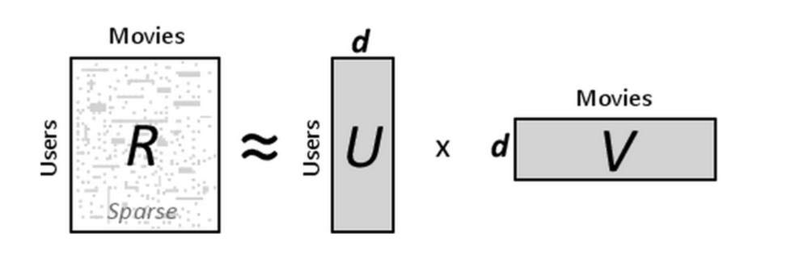
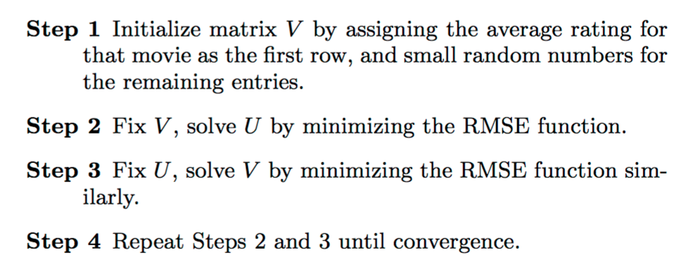
•ALS rotates between fixing one of the unknowns ui or vj. When one is fixed the other can be computed by solving the least-squares problem. The ALS algorithm is as:

Slide 42
•R = {rij }nu ×nv is user-movie matrix where each item Rij represents the rating score of item
j by user i where ri,j =< ui,vj > ∀i,j.
• U represent the user feature matrix and V represent the movie feature matrix.
• Dimension of the feature space(d) is a system parameter that is determined by a hold-out dataset or cross- validation.
• The low rank approximation problem is thus formulated as follows to learn the factor vectors (ui,vj):
Where pi,j =<ui,vj > is the predicted rating ,λ is the regularization coefficient and K is the
Set of known ratings from the Sparse matrix R.

Slide 43
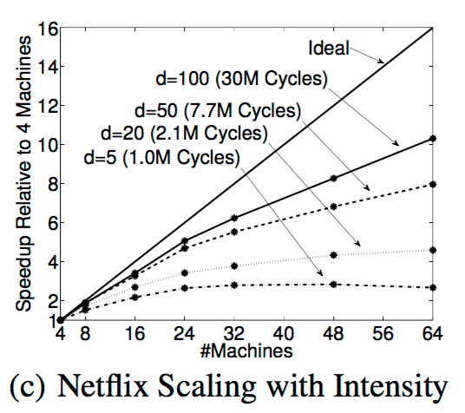
Netflix Scaling with Intensity
•Plotted is the speedup achieved for
varying values of dimensionality(d).
•Extrapolating to obtain the
theoretically optimal runtime, the
estimated overhead of Distributed
GraphLab at 64 machines is 12x for
d=5 and 4.9x for d= 100.

Slide 44
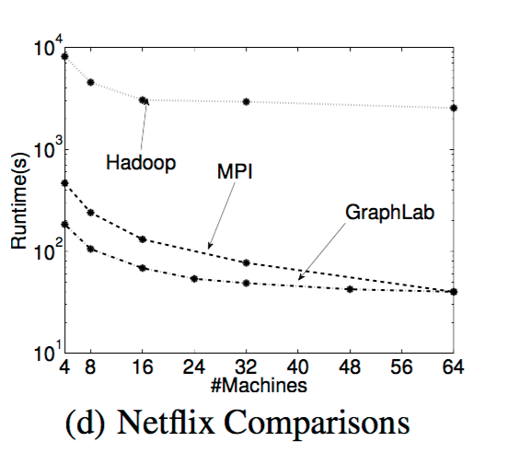
Netflix Comparisons
• GraphLab implementation was
compared against Hadoop and MPI
using between 4 to 64 machines.
•GraphLab performs between 40-60
times faster than Hadoop.
•It also slightly outperformed the
optimized MPI implementation.

Slide 45
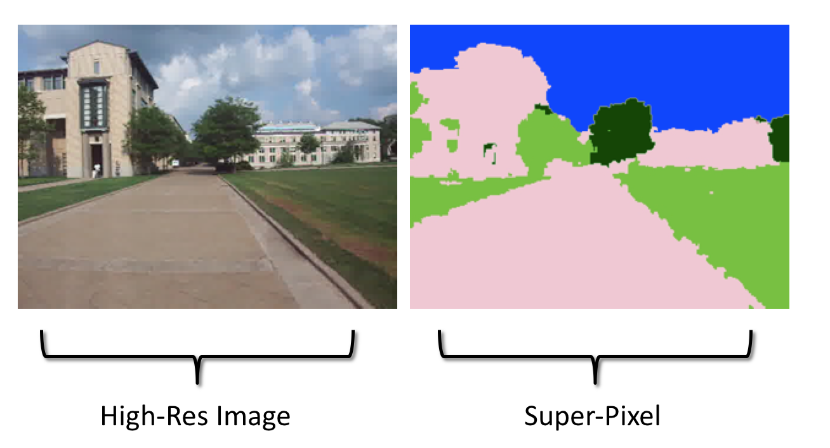
Video Co-segmentation(Coseg)
•Video co-segmentation automatically identifies and clusters spatio-temporal segments of video that share similar texture and color characteristics.
•Frames of high-resolution video are pre-processed by coarsening each frame to a regular grid of rectangular super-pixels.
•The CoSeg algorithm predicts the best label (e.g., sky, building, grass etc.) for each super pixel using Gaussian Mixture Model (GMM) in conjunction with Loopy Belief Propagation (LBP).

Slide 46
• The two algorithms are combined to form an Expectation-Maximization problem
alternating between LBP to compute the label for each super-pixel given the GMM and
then updating the GMM given the labels from LBP.
• The GraphLab update function executes the LBP local iterative update where updates
expected to change values significantly are prioritized.The BP update function is as:

Slide 47
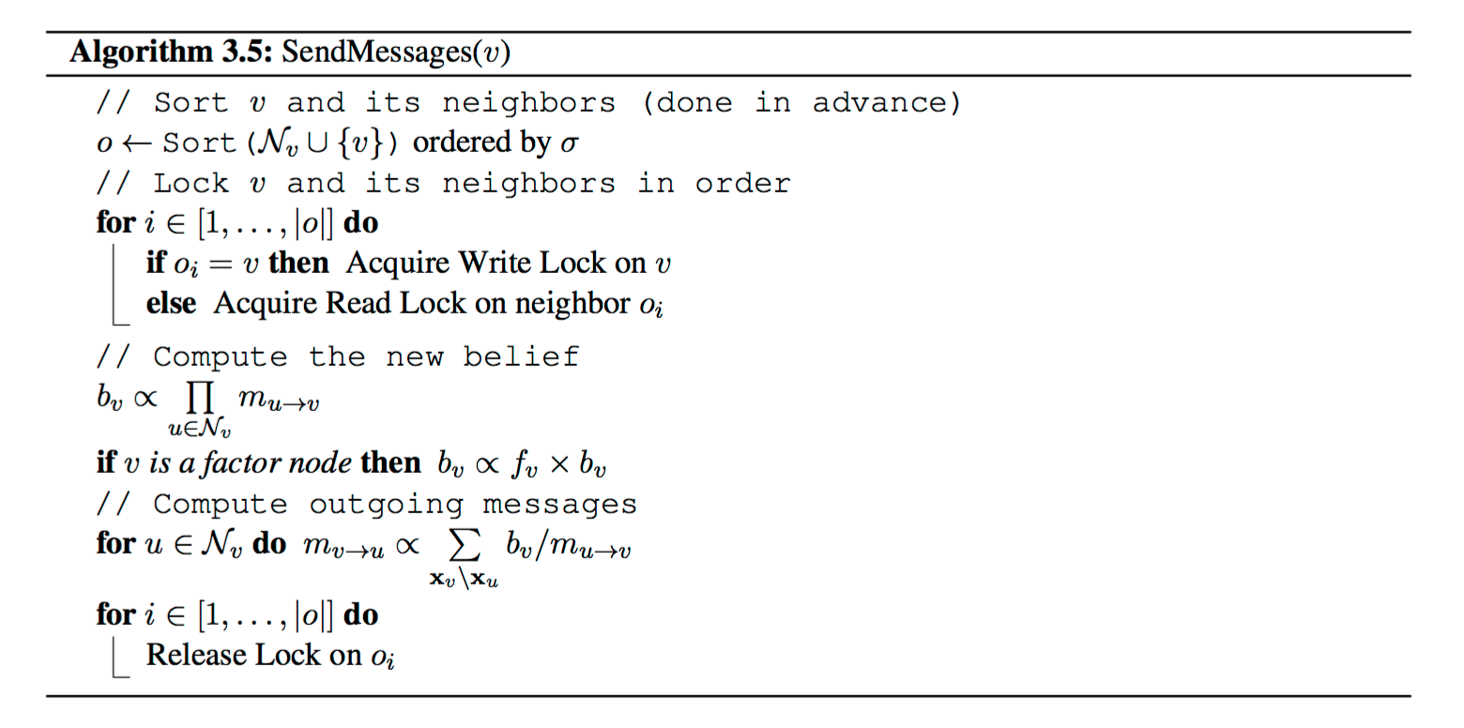

Slide 48
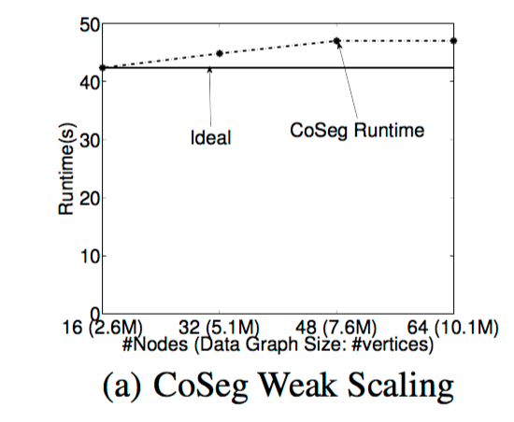
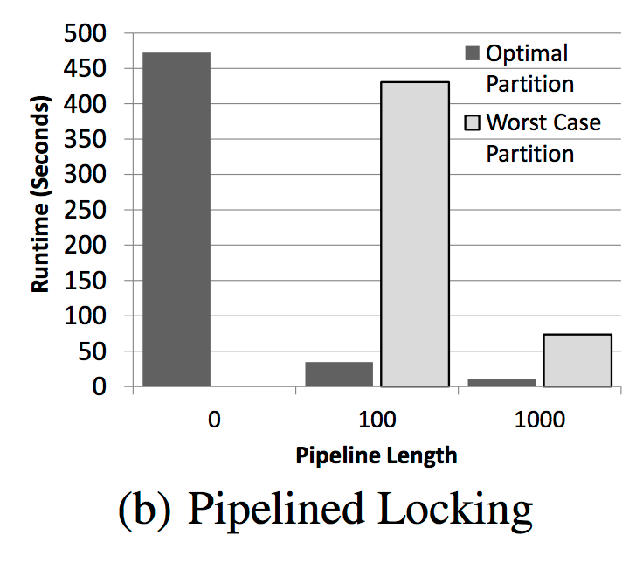
• The locking engine provides nearly optimal weak scaling: the runtime does not
increase significantly as the size of the graph increases proportionately with
the number of machines.
• It was also observed that increasing the pipeline length increased
performance significantly and compensated for poor partitioning.

Slide 49
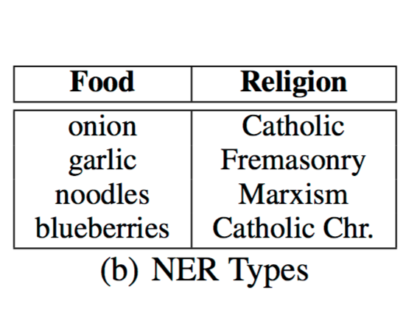
Named Entity Recognition(NER)
• Named Entity Recognition is the task of determining the type (e.g., Person, Place, or Thing) of a noun-phrase (e.g. Obama, Chicago, or Car) from its context (e.g. “President..”, “Lives near..”, or “bought a..”).
• The Data graph for NER is bipartite with one set of vertices corresponding to noun-phrases and the other to contexts.
•The CoEM vertex program updates estimated distribution for a vertex (either noun-phrase or context) based on the current distribution for neighboring vertices.

Slide 50
•Below is CoEM algorithm in which adjacent vertices are rescheduled ,if the type distributions at a vertex changes by more than some predefined threshold.

Slide 51
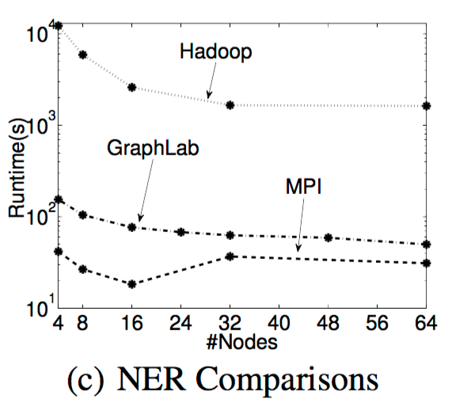
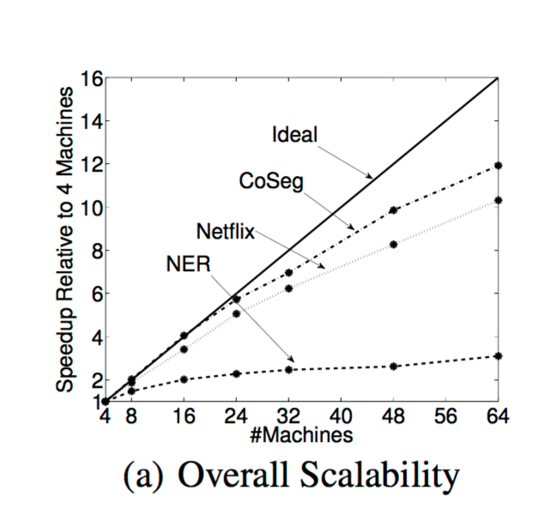
NER Comparisons
•GraphLab implementation of NER
achieved 20-30x speedup over
Hadoop and was comparable to the
optimized MPI.
•GraphLab scaled poorly achieving
only a 3x improvement using 16x
more machines, majorly due to
large vertex data size, dense
connectivity, and poor partitioning.

Slide 52
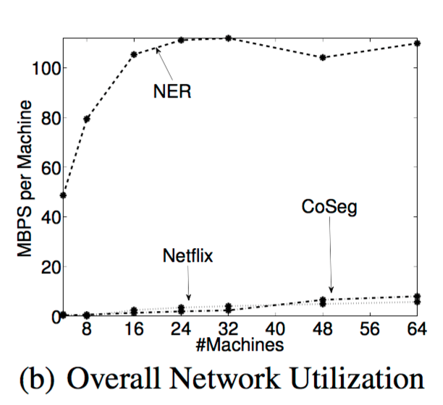
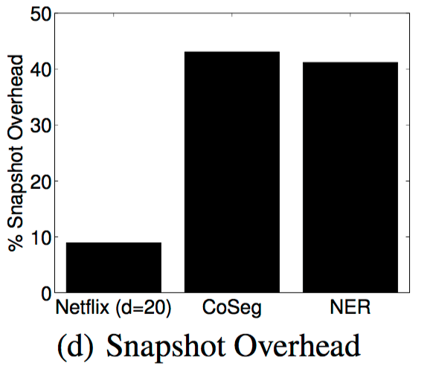
Comparison(Netflix/CoSeg/NER)

Slide 53
Comparison(Netflix/CoSeg/NER)
• Overall network utilization: Netflix and CoSeg have very low bandwidth requirements while NER appears to saturate when #machines > 24.
• Snapshot overhead: Overhead of performing a complete snapshot of the graph every|V | updates is highest for CoSeg, when running on a 64 machine cluster.

Slide 54
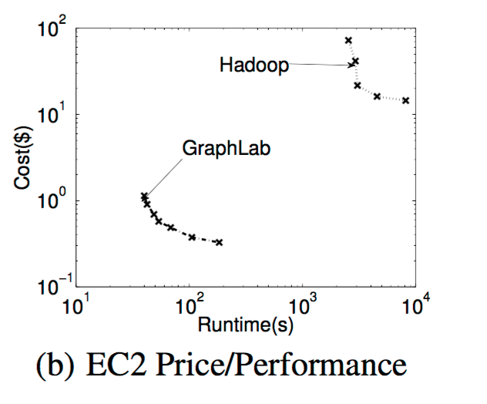
EC2 Cost Evaluation
• The price-runtime curves(log-log scale)
for GraphLab and Hadoop illustrate the
cost of deploying either system.
• For the Netflix application, GraphLab is
about two orders of magnitude more
cost-effective than Hadoop.

Slide 55
Conclusion
• In the paper we talked about:
• Requirement of MLDM algorithms.
• Graphlab extended to the distributed setting by:
•Relaxing the schedule requirements
•Introducing a new distributed data-graph
•Introducing new execution engines
•Introducing fault tolerance.
•Distributed Graphlab outperforms Hadoop by 20-60x and is competitive with tailored MPI implementations.

Slide 56
Future Work
• Extending abstraction and runtime to support dynamically evolving graphs and external storage in graph databases.
• Further research into theory and application of Dynamic asynchronous graph parallel computation thus helping in defining emerging field of big learning.

Slide 57
References
• Y. Low, J. Gonzalez, A. Kyrola,D. Bickson, C. Guestrin, and J. M. Hellerstein. Graphlab: A
new parallel framework for machine learning. In UAI, pages 340–349, 2010.
• Y. Low, J. Gonzalez, A. Kyrola,D. Bickson, C. Guestrin, and J. M. Hellerstein.Distributed
Graphlab: A Framework for Machine Learning and Data Mining in the Cloud.
• Thesis:Parallel and Distributed Systems for Probabilistic Reasoning
Joseph Gonzalez,CMU-ML-12-111 ,December 21, 2012.
• GraphLab ppt by Yucheng Low, Joseph Gonzalez, Aapo Kyrola,Danny Bickson,Carlos
Guestrin.
•Y. Zhou, D. Wilkinson, R. Schreiber, and R. Pan. Large-scale parallel collaborative filtering
for the netflix prize. In AAIM, pages 337–348, 2008.
• Christopher R. Aberger. Recommender: An Analysis of Collaborative Filtering Techniques.
• GraphLab create : http://graphlab.org.
• CS-425 Distributed Systems ppt: Chandy-Lamport Snapshot Algorithm and Multicast
Communication by Klara Nahrstedt
• CSE 547 Graph Parallel Problems Synchronous vs Asynchronous Computation pdf by Emily Fox.

Slide 59
Scalability! But at what cost?
Frank McSherry Michael Isard Derek G. Murray
Presented by: Zhouyihai Ding
dzyh1118@g.ucla.edu

Slide 60
Scalability
Which system is better?
Michael J.Quinn, "Parallel Programming in C with MPI and OpenMP," 2003.􏰀

Slide 61
But at what COST
“You can have a second computer once you’ve shown you know how to use the first one.” – Paul Barham
Which system is better?
mistaking scalability for performance

Slide 62
But at what COST
COST: The COST of a given platform for a given problem is the hardware configuration(like cores) required before the platform outperforms a competent single-threaded implementation.
Avoid poor baselines and low expectations

Slide 63
Outline
Implementation and Measurement in Single Thread
Apply COST to Prior Work
Lesson Learned

Slide 64
Scalable system Vs simple single-threaded implementation on a high-end 2014 laptop
Dataset

Slide 65
Scalable system Vs simple single-threaded implementation on a high-end 2014 laptop
Basic graph computations
PageRank
Label Propagation

Slide 66
Baseline
Simple Baseline
Simple Implementation
Better Baseline
Improving Graph Layout
Improving Algorithms

Slide 67
Page Rank Implementation
20 PageRank iterations
Textbook PageRank Implementation:
a: src node
b: dest node
d: degree

Slide 68
Page Rank Implementation
EdgeMapper:
graph.nodes contains a sequence of (u32, u32) pairs representing (node_id, degree)
graph.edges contains a sequence of u32 values representing edge endpoints.

Slide 69
Page Rank Measurements
Reported elapsed times for 20 PageRank iterations, compared with measured times for single threaded implementations from SSD and from RAM. GraphChi and X-Stream report times for 5 PageRank iterations, which multiplied by four.

Slide 70
Label Propagation Implementation
Label Propagation: each node maintains a label, and repeatedly improves it by asking their neighbors if they have a smaller label.

Slide 71
Label Propagation Measurements
Reported elapsed times for label propagation, compared with measured times for single- threaded label propagation from SSD.

Slide 72
Better Baseline
Improving Graph Layout
Improving Algorithms

Slide 73
Improving graph layout
The order in edge affects performance :enumerated edges in vertex order
Do data layout as pre-processing
Hilbert curve order
Cache locality: (x,y) -> (great,poor) -> (good,good)

Slide 74
Improving graph layout
Reported elapsed times for 20 PageRank iterations, compared with measured times for single- threaded implementations from SSD and from RAM. The single-threaded times use identical algorithms, but with different edge orders.

Slide 75
Improving algorithms: Union Find Implementation & Measurements
Union Find: a simple O(m log n) algorithm to implement label propagaion:
scans the edges once, merging roots when it finds edges whose endpoints have different roots.

Slide 76
Outline
Implementation and Measurement in Single Thread
Apply COST to Prior Work
Lesson Learned

Slide 77
Applying COST to Prior Work
Published scaling measurements for PageRank on twitter rv. The first plot is the time per warm iteration. The second plot is the time for ten iterations from a cold start. Horizontal lines are single- threaded measurements.
two horizontal lines are single-threaded measurements

Slide 78
Applying COST to Prior Work
The intersection with the upper line indicates the point at which the system out-performs a simple resource-constrained implementation, and is a suitable baseline for systems with similar limitations
The intersection with the lower line indicates the point at which the system out- performs a feature-rich implementation, including pre- processing and sufficient memory, and is a suitable base- line for systems with similar resources

Slide 79
Applying COST to Prior Work
Two Naiad implementations of union find.
Faster one: arrays.
Slower one: hash table.

Slide 80
Outline
Implementation and Measurement in Single Thread
Apply COST to Prior Work
Lesson Learned

Slide 81
Lessons learned
Distinguish “scalability” from “efficient use of resources”
Lots of people struggle with the complexities of getting big data systems up and running, when they possibly shouldn’t be using the systems in the first place.
Scalable system design -> overhead -> COST
Overhead:
High level language: garbage collection, bounds checks, memory copy.
System: memory management, networking, serialization.
Design: good at solving sets of problems. GraphX uses hash tables to maintain its per-vertex state, to provide a layer of robustness
Benefit: fault tolerance, security, integration with existing ecosystem.

Slide 82
Future directions (for the area)
Understand systems who have achieved both performance and scale and do well on single machine like Galois, Ligra, Naiad, other than finding new domains and compare with poor prior work.
Only needs to look back to the parallel computing research of decades past to find the appropriate algorithms.

Slide 83
Future directions
“You can have a second computer once you’ve shown you know how to use the first one.” – Paul Barham
“Can systems be made to scale well?” is not the right question
What you are going to do:
1. If you are going to use a big data system for yourself, see if it is faster than your laptop.
2. If you are going to build a big data system for others, see that it is faster than my laptop.

Slide 84
Thank You

