Slide 1
CS239-Lecture 12 Graph Mining
Madan Musuvathi
Visiting Professor, UCLA
Principal Researcher, Microsoft Research

Slide 2
Latency-Tolerant Software Distributed Shared Memory (Grappa)
David Hong
May 10, 2016

Slide 3
Overview
Introduction and Motivation
Data-Intensive Application Frameworks
MapReduce, Vertex-centric, Relational query execution
Key challenges
Grappa Design
Distributed shared memory
Tasking system
Communication support
Fault tolerance
Evaluation
Conclusion

Slide 4
Introduction and Motivation
Software distributed shared memory (DSM)
User-programmable
Gains throughput by trading latency (communication)
Useful for graph analytics
Where are you supposed to store data?
What about partitioning and parallelism?
Previous implementations of DSM were poorly built

Slide 5
Data-Intensive Application Frameworks
Analytics frameworks
MapReduce, Vertex-centric models, Relational queries
Typically: distributed PRIVATE memory systems
Goal: distributed SHARED memory systems
Challenges
Small messages = small inter-node messages
Poor locality = difficult partitioning
Need fine-granularity = frequent synchronization
Fortunately, abundant data can be exploited (parallelizable)

Slide 6
Grappa Design

Slide 7
Distributed Shared Memory (DSM)
Provides fine-grain access to data, anywhere
Global data is stored in a particular core
How do you access data on a remote node?
Answer: Delegate operations

Slide 8
DSM - Addressing Modes
Local memory addressing
Local memory = single core
Conventional pointers
Cannot access data on other cores
Global memory addressing
Partitioned Global Address Space (PGAS)
(job rank/global process ID, addr)
Symmetric allocation
Copy/proxy of an object

Slide 9
DSM - Addressing Modes

Slide 10
DSM - Delegate Operations
Short ops performed locally per node
Why?
More efficient

Slide 11
DSM - Delegate Operations
Ops must be run on the home core
Enables serialization
If data structure is spread across multiple nodes
Multiple delegate ops
Synchronization ops
Question to all:
Why does the paper say delegate operations are short operations performed at memory location’s home node and not come core? Doesn’t it make more sense to say home core?

Slide 12
DSM - Memory Consistency
All delegate ops are executed on home cores
Serialized
Globally linearizable
All updates to data will be visible to all cores
Synchronization ops are execute in program order
All this means:
Data-race-free programs!
But… restrictive

Slide 13
Tasking System
Basic unit of execution is a task
A task is assigned a worker thread
Tasks
Specified by a closure or lambda
Closures are read-only objects
Workers
Collection of status bits and an execution stack
Execute tasks until completion
Scheduling
Worker yields when there is long-latency

Slide 14
Tasking System
Each core has a scheduler
Each scheduler has a ready worker queue
Three queues of tasks to be assigned
Public, private, priority queues
Context switching
Non-preemptive
Worker references:
ready-unscheduled, ready-scheduled, ready-resident
Parallel tasks
Tasks can spawn individual tasks
Parallel loops generate log-deep tree of tasks

Slide 15
Communication Support
Messages between nodes
User-level
Network-level
Active message interface
Template-generated deserializer pointer
Copy of the task closure
Optional data payload
Message aggregation
Cores have a list of their own outgoing messages
The list is globally accessible

Slide 16
Communication Support
Messages delivery
Tasks on a core allocate a buffer
Determine destination node
Write messages to their buffer
Links buffer to the node’s outgoing message list
Message retrieval
Compare-and-swap avoids high synchronization costs
ACK is sent to sending system node
Overall system is quicker than a global array of messages

Slide 17
Communication Support

Slide 18
Communication Support
Remote Direct Memory Access vs Grappa

Slide 19
Fault Tolerance
There is none… Why?
Grappa delegate operation and communication is cost efficient enough to restart the job

Slide 20
Review

Slide 21
Evaluation
C++ on Linux
AMD Interlagos processor (128 nodes)
32 cores per node (4096 total cores)
Cores operate at 2.1GHz spread on two sockets
64GB memory and 40Gb network cards per node
Inter-node communication
GraphLab and Spark: IP-over-InfiniBand
Grappa: QLogic InfiniBand switch

Slide 22
Evaluation
Data and Vertex Partitioning
GraphLab: Intelligent partitioning
Grappa: Random placement
Issued four graph tests:
PageRank, Single Source Shortest Path (SSSP), Connected Components (CC), and breadth-first-search (BFS)
Relational queries
Shark: RDD
Grappa: Parallel shared memory code

Slide 23
Evaluation

Slide 24
Evaluation

Slide 25
Evaluation

Slide 26
Evaluation

Slide 27
Conclusion
Benefits of latency tolerance when warranted
Prefetching is effective at hiding DRAM latency in context switching
Grappa provides DSM at user-level
Grappa implements the PGAS system at language level

Slide 28
References
[1] Latency-Tolerant Software Distributed Shared Memory http://sampa.cs.washington.edu/papers/grappa-usenix-2015.pdf
[2] B. Holt, J. Nelson, B. Myers, P. Briggs, L. Ceze, S. Kahan, and M. Oskin. Flat combining synchronized global data structures. In International Conference on PGAS Programming Models (PGAS), Oct 2013.
[3] http://www-numi.fnal.gov/offline_software/srt_public_context/WebDocs/Companion/cxx_crib/array.html

Slide 29
Arabesque A system for distributed graph mining
Carlos Teixeira, Alexandre Fonseca, Marco Serafini, Georgos Siganos, Mohammed Zaki, Ashraf Aboulnaga
Qatar Computing Research Institute

Slide 30
Exercise in developing a DSL
domain
applications
challenges
abstractions
optimizations

Slide 31
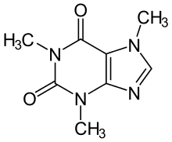
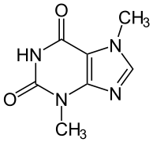
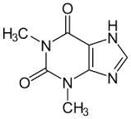
Frequent subgraph mining
find repeating graph structures
- molecules with similar properties
- common biological pathways among species
- recurring patterns of human interactions during an epidemic

Slide 32
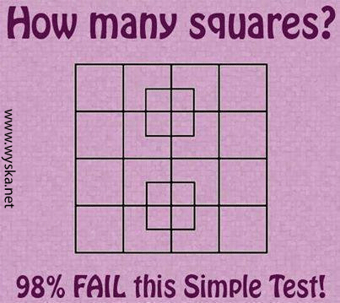
Motif mining

Slide 33
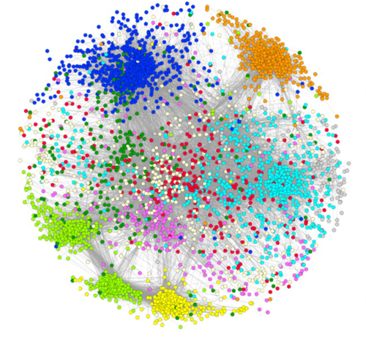
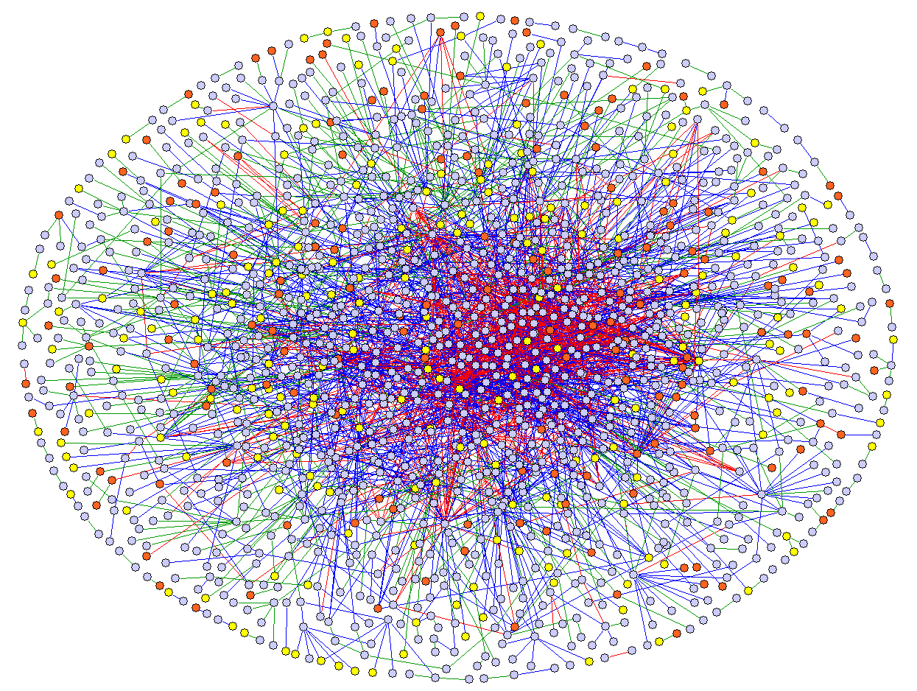
Motif mining (serious example)
are these protein-protein interaction network similar?
compare the distribution of motifs in each
$$\overset{?}{≈}$$

Slide 34
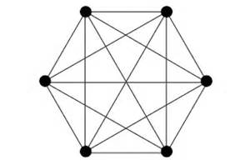
Clique mining
an instance of motif mining (?)
e.g. identify “communities” in a social network
- a group of people who are friends with everyone else in the group

Slide 35
Arabesque - basic idea
1. systematically enumerate all embeddings (“labelled subgraphs”)
2. check if an embedding matches a user-provided pattern
3. output/aggregate matches
Problems:
number of embeddings can be astronomically large
need to detect and eliminate isomorphic embeddings - hard problem

Slide 36
Arabesque - solution
use distribution to alleviate the “embedding explosion” problem
incrementally extend embeddings using anti-monotonicity to filter early
only explore canonical embeddings

Slide 37
Canonical embeddings
traverse the graph
- start by adding the lowest id vertex in the frontier
- remove the lowest id vertex from the frontier
- add its unvisited neighbors to the frontier, and repeat
important property – extendibility
- canonical order of an extension of G is
an extension of the canonical order of G
- why is this necessary ?
1
4
3
5
2
canonical order: 1 3 2 4 5

Slide 38
Incremental canonicality check
bool IncrementalCanonicalityCheck(List<Node> emb, Node v)
{
if (v < emb[0]) return false;
int i;
// foundNeighbor = false
for(i=0; i < emb.Count; i++)
if(IsNeighbor(v, emb[i])) break;
// foundNeighbor = true
for(i++; i < emb.Count; i++)
if(v < emb[i]) return false;
return true;
}
why is this algorithm correct?
can this be made more efficient?

Slide 39
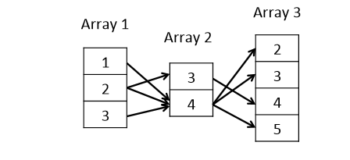
Compressing embeddings - ODAGs

Slide 40
Two-level pattern aggregation
aggregate based on quick patterns
then aggregate based on isomorphic embeddings

Slide 41
Baseline comparison (thanks McSherry)

Slide 42
Scalability

Slide 43
Scalability

Slide 44
Exercise in developing a DSL
domain - ?
applications - ?
challenges - ?
abstractions - ?
optimizations - ?

