Slide 1
CS239-Lecture 14
Data Curation
Madan Musuvathi
Visiting Professor, UCLA
Principal Researcher, Microsoft Research

Slide 2
Course Project
1 presentation on May 23rd
12 presentations on June 1st
Each presentation will be 7 mins + 3 mins questions
Counts towards 50% of your grade
I expect “substantial” contributions (40+hours/person)

Slide 3
Expectations
Project based
  - include a demo in your presentation
  - 1 page write-up describing the problem, your solution, and other competing approaches
  - empirically compare against well-designed baseline(s)
Survey based
  - comprehensive survey of related work in a specific domain
  - identify a new research direction
  - submit a 5 page write up
Research based
  - significant contributions towards a specific problem
  - submit a 5 page paper

Slide 4

Trifacta Demo
https://youtu.be/sB5SQoHd8HQ

Slide 5
Wrangler: Interactive Visual Specification of Data Transformation Scripts
Hao Chen
May,16, 2016

Slide 6
Overview
Introduction & Related work
Usage Scenario
Design Process
    The wrangler transformation language
    The wrangler interface design
The Wrangler Inference Engine
Comparative evaluation with excel
    Strategies for navigating suggestion space
Conclusion and future work

Slide 7
Introduction
Data cleaning: Analyst needs to reformat, correct data and integrate multiple data sources. This can occupy up to 80% of the total time and cost.
Problem: Reformatting and validating data requires transforms that can be difficult to specify and evaluate.
Wrangler is an interactive system for creating data transformation, while simplifying specification and minimizing manual repetition.

Slide 8
Related Work
Technique aiding data cleaning and integration: methods for detecting erroneous values, information extraction, entity resolution ,type inference, and schema matching.
Wrangler applied techniques: regular expression inference, mass editing, semantic role, natural description of transforms.
Wrangler extends Potter’s Wheel language, which provides a transformation language for data formatting and outlier detection.
Difference with PBD model: PBD lacks reshaping, aggregation and missing value imputation.

Slide 9
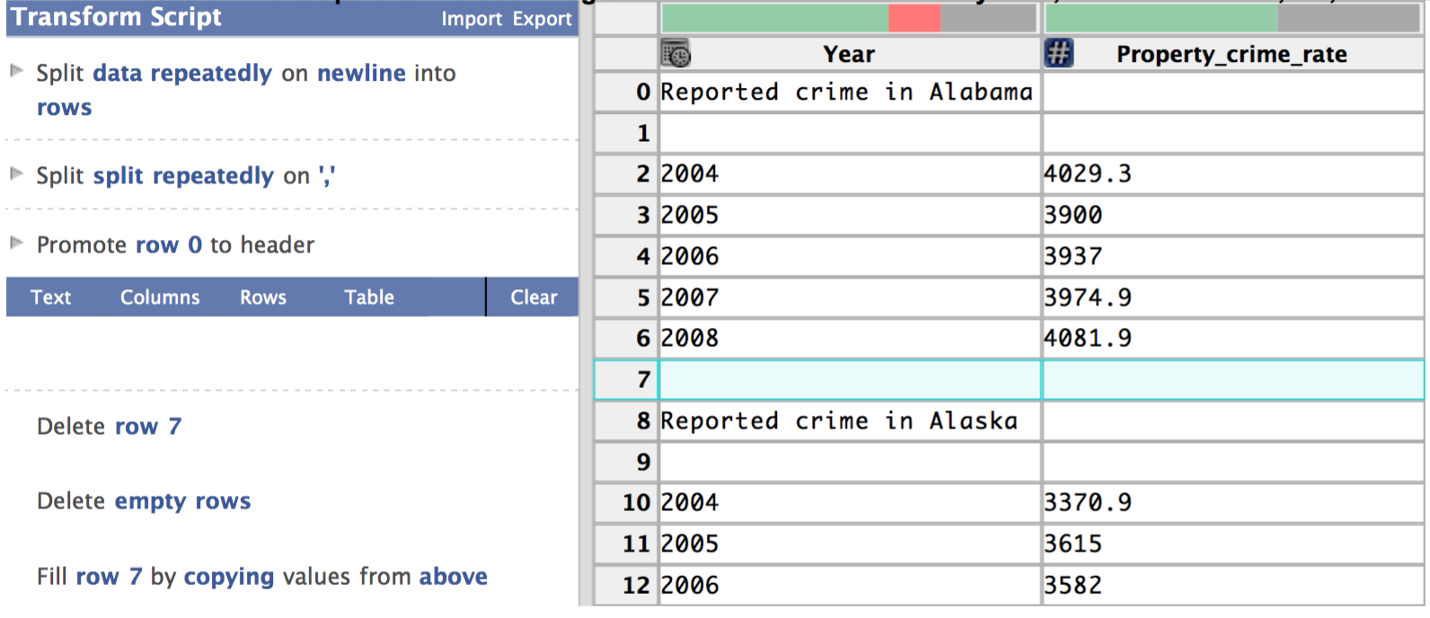
Usage Scenario
http://vis.stanford.edu/wrangler/app/

Slide 10
Designing Process
Wrangler is based on transformation language with a handful of operators.
Unable to devise an intuitive and unambiguous mapping between simple gestures and the full expressiveness of the language
A mixed-initiative method: instead of mapping an interaction to a single transform, we surface likely transforms as an ordered list of suggestions. We then focused on rapid means for users to navigate—prune, refine, and evaluate—these suggestions to find a desired transform.

Slide 11
The wrangler transformation language
Start from Potter’s Wheel transformation language and then extends the language with additional operators for common data cleaning tasks.
Included features: positional operators, aggregation, semantic roles, complex reshaping operators.
Consists of transforms: Map, Lookups and join, Reshape, Positional.
Wrangler supports standard data type and higher-level semantic roles. Semantic roles consist of additional functions for parsing and formatting values.
The wrangler language design co-evolved with the interface. Want a consistent mapping between the transform shown in the interface and statements in the language.

Slide 12
Transforms
Map: transforms map one input data row to zero or multiple output rows.
    one to zero transform: delete.
    one to one transform: extracting, cutting, splitting
    one to many transforms: splitting data into multiple rows
Lookups and joins: incorporate data from external tables. Currently support two types of join: equi-joins and approximate joins with string-edit distance
Reshape: transforms manipulate table structure and schema. Wrangler provides two operators: fold and unfold.
Positional transforms: includes functions for fill and lag operations. Fill operations generate values based on neighboring values in a row or column and so depend on the sort order of the table. The lag operator shifts the values of a column up or down by a specified number of rows.

Slide 13
The wrangler interface design
The goal is to enable analysts to author expressive transformations with minimal difficulty and tedium.
Wrangler provides inference engine that suggests data transforms.
Wranglers provides natural language descriptions and visual transform preview.
Wranglers also couples verification(run in background ) to help users discover data quality issues.

Slide 14
The wrangler interface design
Six Basic interactions: Users can select rows, select columns, click bars in the data quality meter, select text within a cell, edit data values within the table, and assign column names, data types or semantic roles.
Automated transformation suggestions: As the user interacts with data, wrangler generates a list of suggested transform. Users can edit the transformation directly.
Natural language descriptions: Wrangler generates short natural language descriptions of the transform type and parameter. These descriptors are editable.
Visual transformation preview: Wrangler use visual previews to enable users to quickly evaluate the effect of transform. It maps transform to at least one of the five preview classes: selection, deletion, update, column and table.
Transformation histories and export: Wranglers adds their description to an interactive transformation history viewer. Users can edit individual transform descriptions and selectively enable and disable individual transforms.

Slide 15
The wrangler inference engine
Inputs to the engine consist of user interactions; the current working transform; data descriptions such as column data types, semantic roles, and summary statistics; and a corpus of historical usage statistics.
Transform suggestions proceed in three phases:
    Inferring transform parameters from user interaction
    Generating candidate transforms from inferred parameters
    Ranking the results
To generate transformations, wrangler relies on a corpus of usage statistics

Slide 16
Usage corpus and transform equivalence
The corpus consists of frequency counts of transform descriptors and initiating interactions.
Transforms are considered equivalent in this way:
    they have an identical transform type
    they have equivalent parameters as defined below
Four types of parameters: row, column, text selection and enumerable.
    row selections are equivalent: if they both contains filtering conditions or match all rows in the table.
    column selection are equivalent if they refer to columns with the same data type or semantic rules.
    Text selections are equivalent if both are index-based selections or contain regular expressions
    enumerable parameters are equivalent if they match exactly

Slide 17
Inferring transform parameters from user interaction
Infer three types of transform parameter: row, column or text selection
For each type, enumerate possible parameter values, resulting in a collection of inferred parameter set.
Parameter’s value is independent of each other.
row selection is based on row indices and predicate matching.
column selection returns columns users have interacted with.
text selection is either simple index ranges or inferred regular expressions

Slide 18
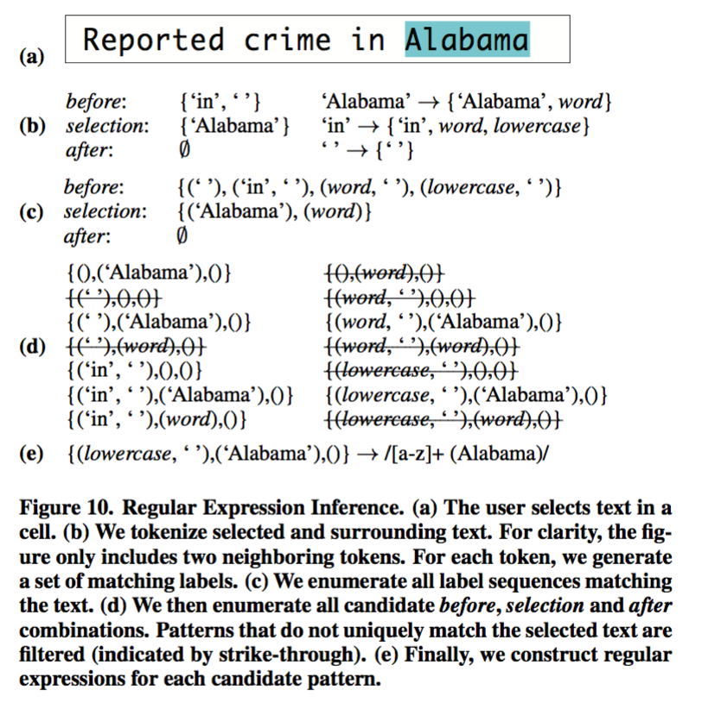
Regular expression inference

Slide 19
Generating Suggested transform
For each parameter sets, loop over each transform type in the language, emitting the types that can accept all parameters in the set
To determine values for missing parameters, query the corpus for the top-k parameterisations that cooccur most frequently with the provided parameter set.
Filter the suggestions set to remove degenerate transform that would have no effect on the data

Slide 20
Ranking suggested transforms
Ranking according to five criterias:
    First three criteria rank transform by their type
    Remaining two transforms within type
First three criterias by transform type:
    explicit interactions, if a user choose a transform in the menu, we assign higher ranking to that transform.
    specification difficulty, label row and text selection as hard, other as easy, sort according to count of hard parameter
    based on their corpus frequency, conditioned on their initiating user interaction
Remaining two criterias with transform type:
    sort by frequency of equivalent transforms in the corpus
    sort transforms in ascending order using simple measure of transform complexity, transform complexity is defined as the sum of complexity scores for each parameter. The complexity of row selection predicate is the number of clauses it contains, the complexity of a regular expression is defined to be the number of tokens.
Surface diverse transform types in the final suggestion list. No types accounts for more than 1/3 of the suggestions.

Slide 21
Comparative evaluation with excel
12 participants, all professional analysts or graduate students regularly working with data
Subjects perform three common data cleaning tasks: value extraction, missing value imputation and table reshaping.
10 minutes wrangler tutorial describing how to create, edit, and execute transforms.
ask subjects to perform three tasks.
Perform a repeated-measures ANOVA of competition times with task, tool and Excel novice/expert as independent factors.

Slide 22
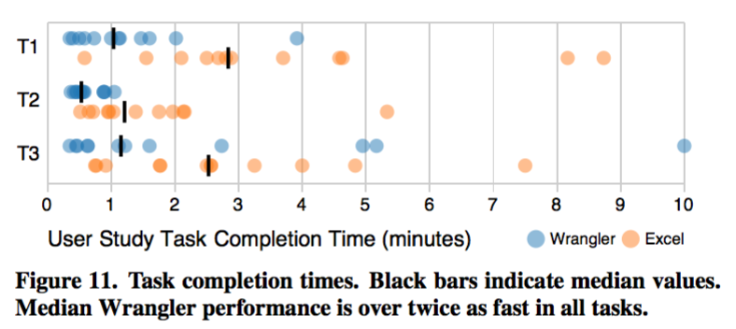
Comparative evaluation with excel
Across all tasks, median performance in Wrangler was over twice as fast as Excel.

Slide 23
Strategies for navigating suggestion space
Users turned to manual parameterisation only as a last resort
Users of both tools experienced difficulty when they lacked a conceptual model of the transform
Wranglers does not provide the recourse of manual editing
A few users got stuck in a “cul-de-sac” of suggestion space by incorrectly filtering

Slide 24
Conclusion and future work
The system provides a mixed-initiative interface that maps user interactions to suggested data transforms and presents natural language descriptions and visual transform previews to help assess each suggestion.
Novice Wrangler users can perform data cleaning tasks significantly faster than in Excel, an effect shared across both novice and expert Excel users.
We believe that more research integrating methods from HCI, visualization, databases, and statistics can play a vital role in making data more accessible and informative.

Slide 25
Thank you :)

Slide 26
https://docs.google.com/presentation/d/1EDJVbt3iyShZZY4cyfZAlIdavJkUbYIq9UqqARD1-r0/edit?usp=sharing

Slide 27
Data Curation at Scale:
The Data Tamer System
CS239 Paper Presentation
Saswat Padhi
(PhD Student, CS @ UCLA)

Slide 28
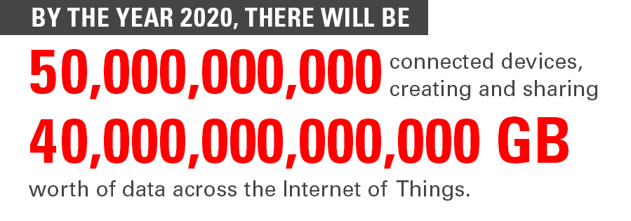
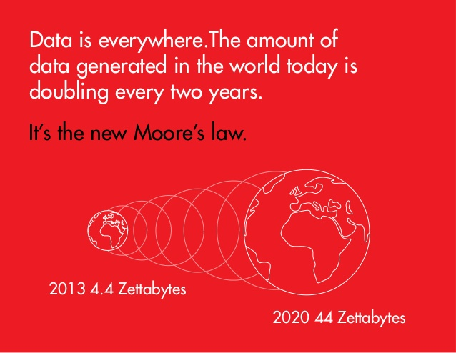


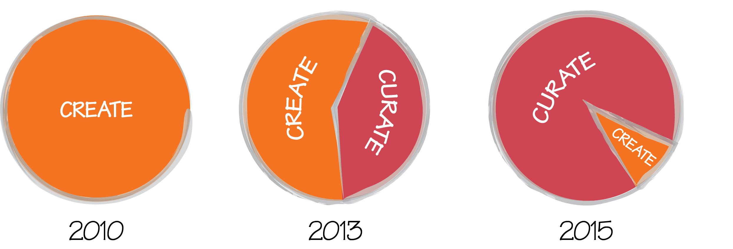
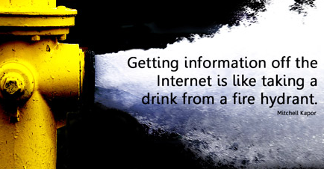
Dataaa…
Image Courtesy of Oracle
Image Courtesy of Informatica
Image Courtesy of DeakinPrime
Image Courtesy of GiveUpInternet

Slide 29
Automated Curation
Can machines organize our data?
with a little push from us
Scalability
Robustness
Usability
Incrementality
Humans, for example, do not scale!
Data is almost always dirty.
If users cannot use it, it does NOT work.
No one likes to start over.

Slide 30
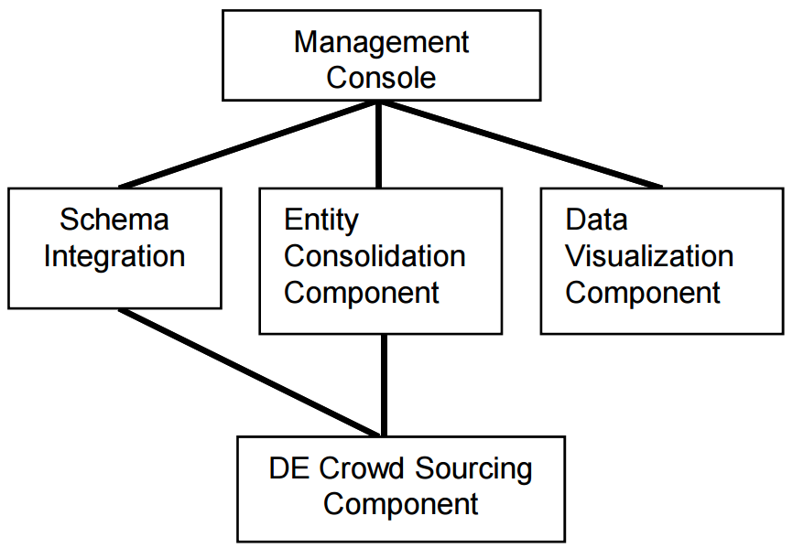
Data Tamer Architecture
Data Tamer Admin (DTA)
Incremental consolidation
DTA may request recomputation
Data Tamer keeps “snaps”
  No-overwrite updates
Import Data & Identify Attributes
No inter-entity relationships
Minimal support for ontologies
Dynamic sources not supported
  Not incremental
Uniquify Records
Domain Expert (DE)

Slide 31
Schema
Integration
Compare a field to known attributes …
… by running experts (not DEs)
  comparators for attributes
  4 built-in, user-defined experts supported
Combine expert scores
Find best match / ask a human
Ingesting sources &
Mapping attributes

Slide 32
Schema Integration
(Experts)
Intuition:
Is the field name similar to an attribute name?
Small names, so n-gram works well
Trigram Cosine Similarity on Name

Slide 33
Schema Integration
(Experts)
Intuition:
Does the field have values similar to that of an attribute?
Treat column (all values) as a document
  TF-IDF is a standard technique
Trigram Cosine Similarity on Name
TF-IDF Cosine Similarity on Values

Slide 34
Schema Integration
(Experts)
Intuition:
Does the field take values from a categorical attribute?
Jaccard similarity
  | A ∩ B | / | A U B|
Trigram Cosine Similarity on Name
TF-IDF Cosine Similarity on Values
Jaccard Similarity on Values

Slide 35
Schema Integration
(Experts)
Intuition:
Does the field take values over the same distribution as a numerical attribute?
Trigram Cosine Similarity on Name
TF-IDF Cosine Similarity on Values
Jaccard Similarity on Values
Welch’s t-Test

Slide 36
Schema Integration (Attribute Mapping)
Level 3
Level 2
Level 1
Complete Knowledge
If class is known, compare to attributes in class.
Else, run for all classes and pick the best match.
Partial Knowledge
If a template is known, compare template members in -- match other incoming better matches before matching current. (2 passes)
No Knowledge
Compare to all known attributes.
Worst case: quadratic in number of attributes

Slide 37
Entity
Consolidation
Train an ML model to deduplicate records
  Bootstrapping Initial hints from humans
  Categorization Separate highly likely non-duplicates
  Learning Learn de-duplication rules
  Joining Get duplicates beyond user-provided ones
  Clustering Attempt to “close” the set of duplicates
Duplicate Elimination

Slide 38
Entity Consolidation
Intuition:
User identifies some initial duplicates
For each attribute:
Partition the range of its similarity function into equal-width bins
Guess two records are duplicate if they belong to same bin (for many attributes)
Ask user to confirm
Ignore categorical attributes
Bootstrapping

Slide 39
Entity Consolidation
Intuition:
Separate “obvious” non-duplicates
Categorize user-provided duplicates
  Cluster (using k-means++)
Assign other records to nearest category
  Combination of expert functions?
As the user asserts new duplicates, categories might change
Bootstrapping
Categorization

Slide 40
Entity Consolidation
Intuition:
Define heuristics to de-duplicate unseen data
Simple Not enough similarity
Complex Not enough conditional similarity
  P(Same_Title | Duplicate) > 0.9
  P(Same_ID | NonDuplicate) < 0.01
  P(Different_Phone | Duplicate) < 0.01
Bayes’ classifier for complex rules
  Assumes conditional independence of attributes
Bootstrapping
Categorization
Learning

Slide 41
Entity Consolidation
Intuition:
Check likely duplicates
Pick a pair of records in same category
Compare using learned rules
Bootstrapping
Categorization
Learning
Joining

Slide 42
Entity Consolidation
Intuition:
Every step is heuristic-y, so the results might be inconsistent … Add one more heuristic!
Build a huge graph:
  Records at nodes
  Connect duplicates
Merge correlated clusters
  # shared_edges > threshold
Each cluster is (hopefully) consistent
Consolidate records in clusters
Bootstrapping
Categorization
Learning
Joining
Clustering

Slide 43
Discussion
How are the thresholds chosen?
  They should not be data-independent. So does the DTA do some initial research to set these values?
Why no feedback loop?
  Why not re-learn / update rules after joining & clustering?
How “consistent” is the duplicates set, after clustering?
  Why not use a simple union-find?

Slide 44
Human
Interface
Disambiguation queries are boolean valued
  Does an attribute map to another attribute?
  Is an entity duplicate of another entity?
Manual Mode DTA routes human requests
Crowd Sourcing Mode Forward to many non-guru DEs
  Response Quality
  Domain Expertise
  Incentivization
  Workload Balance
Display Data Sources

Slide 45



Human Interface
(DTX)
Idea:
Maintain ratings, from DTAs and expert DEs
Cumulative confidence of response:
Cumulative probability of response vector:
Response Quality
Weird notation
Assumption:

Slide 46
Human Interface
(DTX)
Idea:
Cluster DEs into classes, based on their ratings.
DTX presents statistics on each class, for new tasks:
  # of DEs
  Cost / DE Response
  Min { ratings of DEs in the class }
Response Quality
Domain Expertise
But DTA has to decide allocation of $$$
  Could DTX use a heuristic cost-function? And present an allocation plan?

Slide 47
Human Interface
(DTX)
Idea:
Fairness
Incentivize better experts (based on class)
Dynamic pricing to balance workload:
  Encourage underutilized classes
  Discourage overtaxed classes
Response Quality
Domain Expertise
Incentivization
Workload Balance

Slide 48
Thanks! ☺
padhi@cs.ucla.edu

