Slide 1
CS239-Lecture 16 Distributed Machine Learning
Madan Musuvathi
Visiting Professor, UCLA
Principal Researcher, Microsoft Research

Slide 2
Course Project
Write-ups due June 1st
Project presentations
12 presentations, 10 mins each, 15 min slack
Let me know if you cannot stay till 10:15

Slide 3
DistBelief: Large Scale Distributed Deep Networks
Presented by Liqiang Yu
05.23.2016

Slide 4
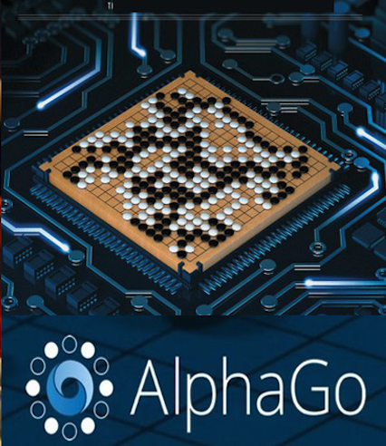
Background & Motivation
Deep learning has shown great promise in many practical applications
Speech Recognition
Visual Object Recognition
Text Processing

Slide 5
Background & Motivation
Increasing the scale of deep learning can drastically improve ultimate classification accuracy
Increase the number of training examples
Increase the number of model parameters

Slide 6
The limitation of GPU
Speed-up is small when the model doesn’t fit in the GPU memory
Data and parameter reduction aren’t attractive for large scale problems(e.g. high-resolution image)
MapReduce, GraphLab
New distributed framework needs to be developed for large scale deep network training

Slide 7
DistBelief
Allow the use of clusters to asynchronously compute gradients
Not require the problem to be either convex or sparse
Two novel methods : (1) Downpour SGD (2) Sandbalster L-BFGS
Two level parallelism : (1) Model Parallelism (2) Data Parallelism

Slide 8
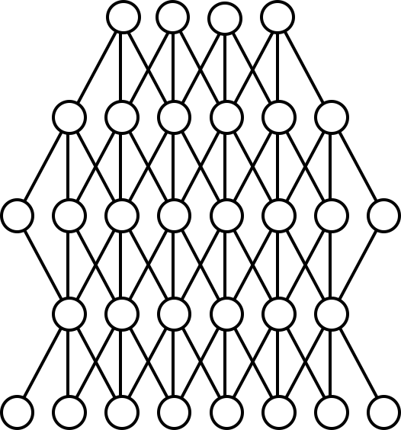
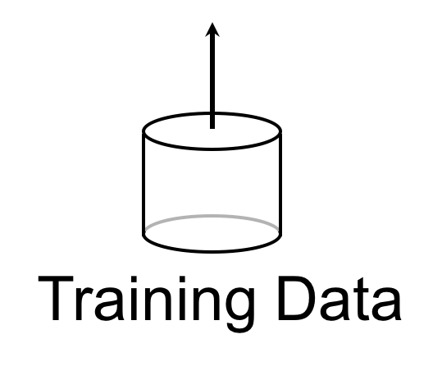
Model Parallelism
Machine

Slide 9
Model Parallelism
Model
DistBelief enables model parallelism
Across machines via message passing(blue box)
Within a machine via multithreading(orange box)
Machine (Model Partition)
Training Data
Core

Slide 10
What’s next ?
Model
Training is still slow with large data sets if a model only considers tiny minibatches (10-100s of items) of data at a time.
How can we add another dimension of parallelism, and have multiple model instances train on data in parallel?
Training Data

Slide 11
Data Parallelism
Downpour SGD Sandblaster L-BFGS
Parameter server

Slide 12
Downpour SGD
A variant of asynchronous stochastic gradient descent
Divide the training data into a number of subsets and run a copy of the model on each of these subset
Update the derivatives through a centralized parameter server
Two asynchronous aspects : model replicas run independently and parameter shards run independently

Slide 13
Downpour SGD
p’ = p + ∆p
Parameter Server
p’’ = p’ + ∆p’
∆p
∆p’
p’
p
Model
Data

Slide 14
Downpour SGD
Parameter Server
p’ = p + ∆p
∆p
p’
Model
Workers
Data
Shards

Slide 15
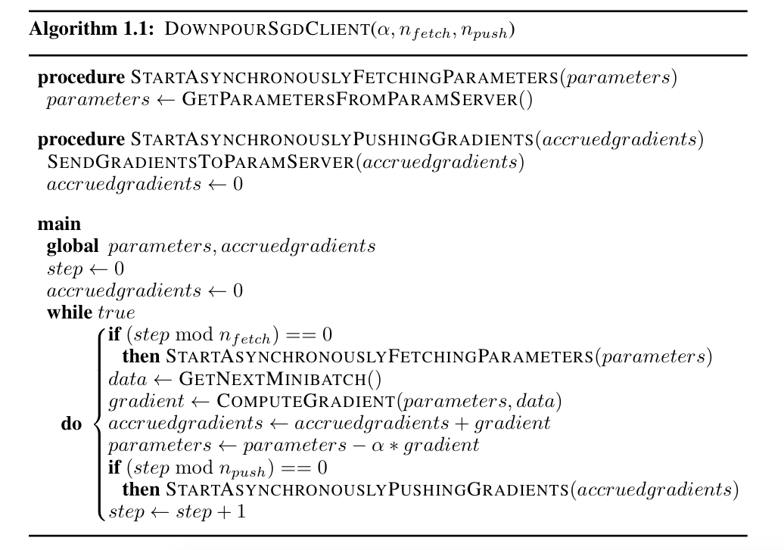
Downpour SGD

Slide 16
Downpour SGD
Each model replica computes its gradients based on slightly out of date parameters
No guarantee that at any given moment each shard of the parameter server has undergone the same number of updates
Subtle inconsistencies in the timestamps of parameters
Little theoretical grounding for the safety of these operation, but it works!

Slide 17
Adagrad learning rate
$$η_{i,k}=\frac{γ}{\sqrt{\sum_{j=1}^{k}{Δw_{i,j}^{2}}}}$$
Adagrad can be easily implemented locally within each parameter server shard
Adagrad learning rate becomes smaller during the iteration, which increases the robustness of the distributed models.
$η_{i, k}$ is the learning rate of the ith parameter at iteration K
$∆w_{i,k}$ is its gradient
$γ$ is the constant scaling factor

Slide 18
Sandblaster L-BFGS
Coordinator
(small messages)
Parameter Server
Model
Workers
Data

Slide 19
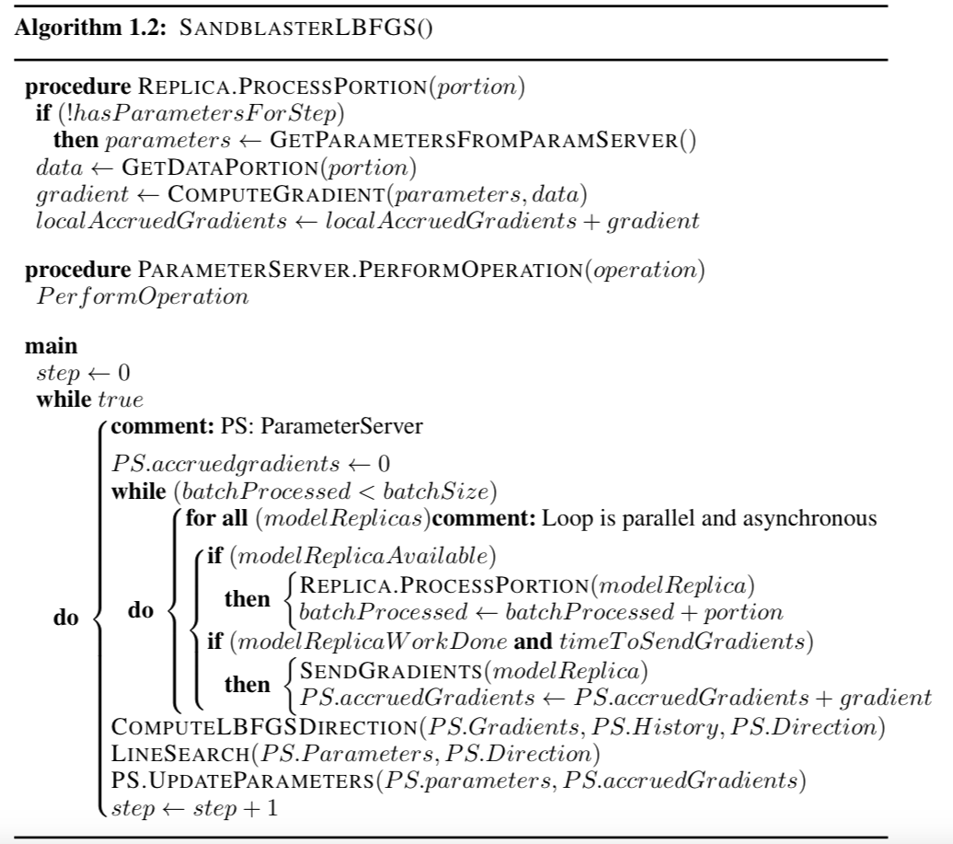
Sandblaster L-BFGS

Slide 20
Compare SGD with L-BFGS
Async-SGD
first derivatives only
many small steps
mini-batched data (10s of examples)
tiny compute and data requirements per step
at most 10s or 100s of model replicas
L-BFGS
first and second derivatives
larger, smarter steps
mega-batched data (millions of examples)
huge compute and data requirements per step
1000s of model replicas

Slide 21
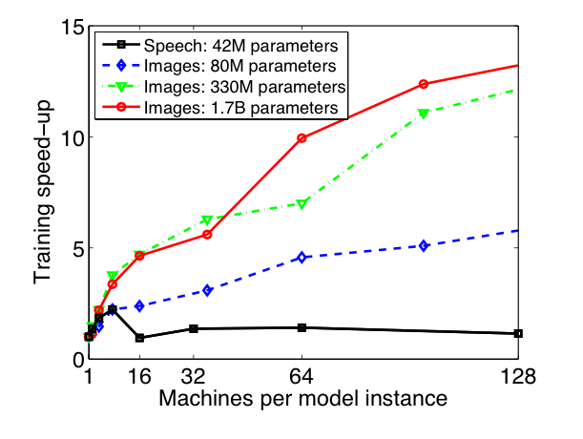
Experiment

Slide 22
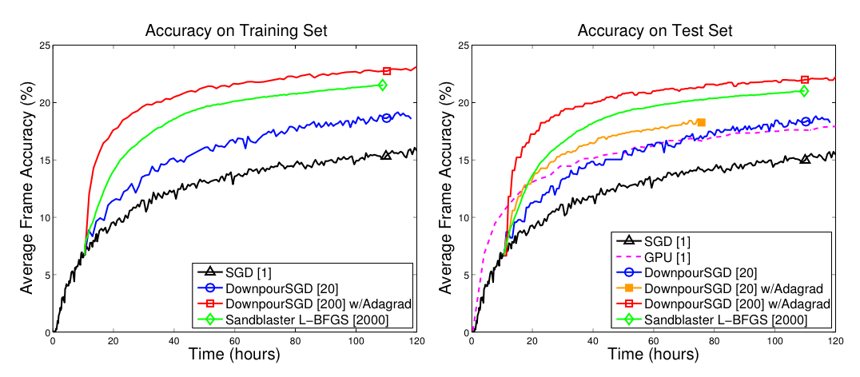
Experiment

Slide 23
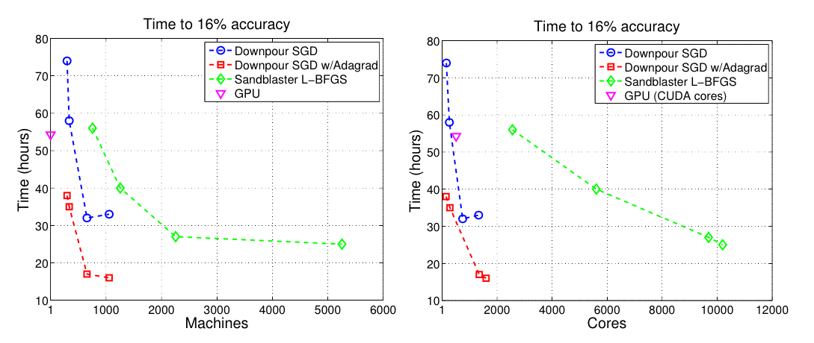
Experiment

Slide 24
Conclusions
Downpour SGD works surprisingly well for training nonconvex deep learning models
Sandblaster L-BFGS can be competitive with SGD and easier to scale to larger number of machines
Distbelief can be used to train both modestly sized deep networks and larger models.

Slide 25
Thank you

Slide 26
Distributed Parameter Server
Mu Li et al. OSDI 2014

Slide 27
Machine learning
Given $(x_{i}, y_{i})$ learn a parametrized model
$$y≈f\left(w, x\right)$$
$w$ is the parameters that we want to learn
Large scale:
Datasets can range between 1 TB to 1PM
Parameter sizes: 1B to 1T

Slide 28
This paper
A generic framework for distributing ML algorithms
Sparse logistic regression, topic modeling (LDA), sketching, …
The system abstracts
Efficient communication through asynchrony and consistency models
Fault tolerance
Elasticity
What other system we have studied is this the most similar to?

Slide 29
What is the programming model?

Slide 30
Flexibility
Asynchronous tasks & dependency
Requires sophisticated vector clock managment
Consistency: BSP > bounded delay > complete asynchrony

Slide 31
Consistent Hashing

Slide 32
Evaluation: Logistic Regression

Slide 33
Effect of consistency model

Slide 34
Scalability

