Slide 1
CS239-Lecture 2 MapReduce
Madan Musuvathi
Visiting Professor, UCLA
Principal Researcher, Microsoft Research

Slide 2
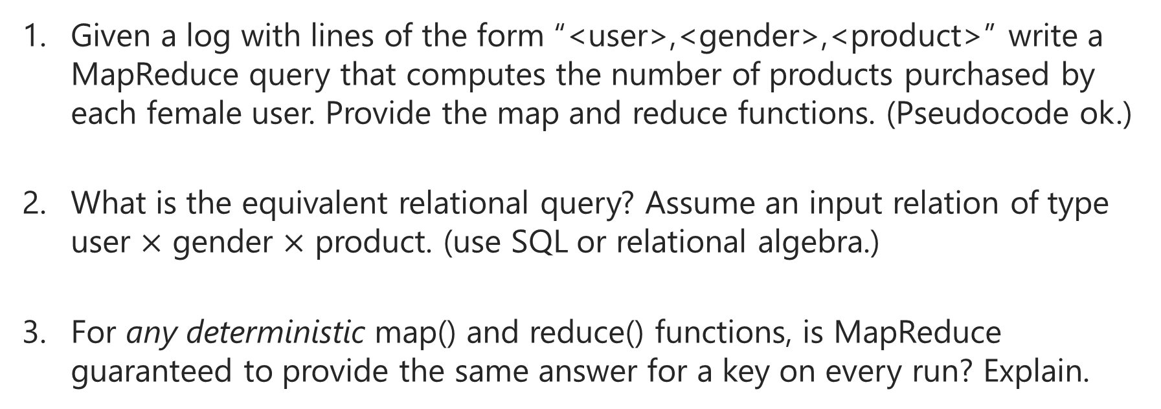
Pop Quiz
Given a log with lines of the form “<user>,<gender>,<product>” write a MapReduce query that computes the number of products purchased by each female user. Provide the map and reduce functions. (Pseudocode ok.)
What is the equivalent relational query? Assume an input relation of type user $×$ gender $×$ product. (use SQL or relational algebra.)
For any deterministic map() and reduce() functions, is MapReduce guaranteed to provide the same answer for a key on every run? Explain.

Slide 3
Google’s MapReduce (and Hadoop)
simple programming model
for large-scale computation
on commodity hardware

Slide 4
Challenges
large amount of data
- size of the web =~ 50 B pages x 20 KB = 1 petabyte
distributed computation
- programming is hard
faults always occur
- if mean time to failure of a server is 3 years (~1000 days)
- in a cluster of 1000 machines, 1 machine fails every day

Slide 5
Programming model
user provides a map and a reduce function
the system implements (abusing notation)
input is a set of records
apply map to generate (key, value) for each record
group by key
reduce all values belonging to a key
select reduce(*)
from (select map(*) from input)
group by key

Slide 6
Execution model
1. partition input data
a
b
c
d
e
f
g
h
i
j
k
l
m
n
o
2. apply map() to each record
a
b
f
g
l
k
v
(key, v)
c
d
i
h
m
n
e
j
o
3. partition based on key
mappers
reducers
a
f
l
b
g
k
4. pull partitions from mappers
c
i
m
d
h
n
j
e
o
a
c
b
d
g
h
5. sort by key
i
f
l
j
e
n
m
o
k
6. apply reduce()

Slide 7
Semantics
non-commutative reducers?
nondeterministic mappers/reducers?

Slide 8
Fault tolerance
multiple map/reduce tasks are assigned to a worker --- why?
on map worker failure
- re-execute in-progress map tasks
- re-execute completed map tasks --- why? could we have avoided this?
- notify reduce workers
on reduce worker failure
- re-execute in-progress reduce tasks
- not necessary to execute completed reduce tasks
on master failure
- retry entire job

Slide 9
Number of map tasks and reduce tasks
assigning multiple map/reduce tasks to a worker
- achieves better dynamic load balancing
- provides finer error recovery
- enables pipelining between mappers and reducers
dangers of too-fine-grained map/reduce tasks
- O(M*R) state in the master
- O(M*R) intermediate files
- output is in O(R) files

Slide 10
Optimizations
move computations from mappers to reducers
overcome stragglers

Slide 11
Performance
grep of 1 TB on 1800 machines takes 150 seconds

Slide 12

Implementing joins in MapReduce
A = (R, S) B = (S,T) A $⋈$ B = (R,S,T)
map( (r,s) ) -> (s, (r,A))
map( (s,t) ) -> (s, (t,B))
reduce( s, [(r1, A), (r2, A), …, (t1, B), (t2, B), …] ) ->
[(r1, s, t1), (r1, s, t2), … , (r2, s, t1), (r2, s, t2), … ]

Slide 13
Should Google have used parallel databases instead?

Slide 14
Programming model: MapReduce vs Relational
flexibility
- need richer data types (nested relations, such as lists)
- call general-purpose functions on inputs (images, documents, …)
absence of data-schema
- how does one MapReduce job interpret the output of another job?

Slide 15
Optimizations
indexes
- do we need them?
multi-job optimizations
push-vs-pull model
- advantages of pull
- disadvantages of pull

Slide 16
Performance

Slide 17
Performance

Slide 18
Performance

Slide 19
Performance

