Slide 1
CS239-Lecture 3 DryadLINQ
Madan Musuvathi
Visiting Professor, UCLA
Principal Researcher, Microsoft Research

Slide 2
New Schedule

Slide 3
Course Project
plan on 40+ hours
flexible wrt topics
single or in groups of 2
examples
- comprehensive literature survey in an area, identify an open problem, and a method of attack
- solve a research problem
- build a system that solves an interesting problem

Slide 4
Project Proposal
Present to class on April 13
1 slide (5 mins)
Describe the problem
Explain why it is interesting to solve
Get my approval by April 11

Slide 5
Pop Quiz
A DryadTable input is a sequence of objects of type
struct Obj { int key; int value;};
input is hash-partitioned by key and each partition is sorted by key.
The DryadTable output is computed as
// convert (k,v) to (2*k+1, v+5)
var output = input.Select(x => Tuple.Create(x.key*2+1, x.value+5));
What properties of output can DryadLINQ rely on? Why?
The DryadTable output2 is computed as
var output2 = input.Select(x => Tuple.Create(x.key%2, x.value+5));
What properties of output2 can DryadLINQ rely on? Why?

Slide 6
DryadLINQ: A System for General-Purpose Distributed Data-Parallel Computing Using a High-Level Language
CS 239 Paper Presentation
Mickey Sweatt 4/4/2016

Slide 7
Contents
Motivation
Introduction to DryadLINQ
System Architecture
Programming Model
System Implementation Details
Performance
Comparison

Slide 8
Motivation
Same initial motivation as MapReduce
Writing distributed computations is hard
Large data sets however require these systems
Build a library to perform distributed computations over commodity hardware
MapReduce is too restrictive
No explicit JOIN requires many separate reduce jobs preventing many optimizations
SQL is too limited
Common concepts like iteration are not expressible
Notes:
Our goal is to give the programmer the illusion of writing for a single computer and to have the system deal with the complexities that arise from scheduling, distribution, and fault-tolerance.

Slide 9
2. Introduction to DryadLINQ
Context
Many DSLs exist atop Hadoop but they are too restrictive and therefore under optimize
Intended for commodity hardware
Clusters of hundred of machines
Part of .NET ecosystem

Slide 10
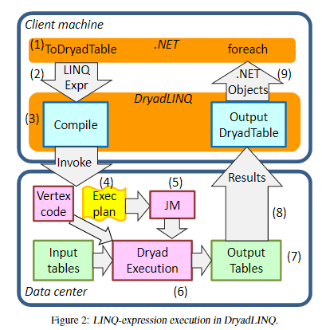
3. System Architecture
Enter DryadLINQ (Language INtegrated Query over Dryad Platform)
Declarative/Imperative language in OO .NET C#
Dryad handles all distributed system concerns
DryadLINQ is a C# compiler
Notes:
Step 1. A .NET user application runs. It creates a DryadLINQ expression object. Because of LINQ’ s deferred evaluation (described in Section 3), the actual execution of the expression has not occurred.
Step 2. The application calls ToDryadTable triggering a data-parallel execution. The expression object is handed to DryadLINQ.
Step 3. DryadLINQ compiles the LINQ expression into a distributed Dryad execution plan. It performs:
(a) the decomposition of the expression into subexpressions, each to be run in a separate Dryad vertex;
(b) the generation of code and static data for the remote Dryad vertices; and
(c) the generation of serialization code for the required data types. Section 4 describes these steps in detail.
Step 4. DryadLINQ invokes a custom, DryadLINQ specific, Dryad job manager. The job manager may be executed behind a cluster firewall.
Step 5. The job manager creates the job graph using the plan created in Step 3. It schedules and spawns the vertices as resources become available. See Figure 1.
Step 6. Each Dryad vertex executes a vertex-specific program (created in Step 3b).
Step 7. When the Dryad job completes successfully it writes the data to the output table(s).
Step 8. The job manager process terminates, and it returns control back to DryadLINQ. DryadLINQ creates the localDryadTableobjects encapsulating the out- puts of the execution. These objects may be used as inputs to subsequent expressions in the user program. Data objects within a DryadTable output are fetched to the local context only if explicitly dereferenced.
Step 9.Control returns to the user application. The iterator interface over a DryadTable allows the user to read its contents as .NET objects.
Step 10.The application may generate subsequent DryadLINQ expressions, to be executed by a repetition of Steps 2–9.

Slide 11
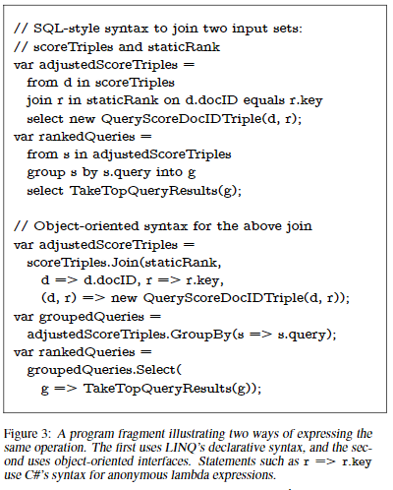
3. Abstractions
LINQ common abstraction is iterators over collections of .NET objects
System explicitly specifies all functions must be side-effect free
Supports annotations for Associative and Homomorphic operations

Slide 12
4. Example Program (Associative)
[Associative] static double Add(double x, double y) { return x + y; } ... double total = numbers.Aggregate((x, y) => Add(x, y));

Slide 13
4. Example Program (MapReduce)
public static MapReduce( //returns set of Rs source, //set of Ts mapper, //function from T → Ms keySelector, //function from M → K reducer //function from (K,Ms) → Rs ) { var mapped = source.SelectMany(mapper); var groups=mapped.GroupBy(keySelector); return groups.SelectMany(reducer); }

Slide 14
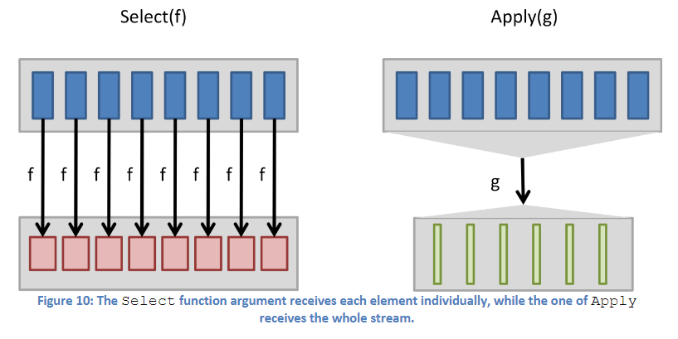
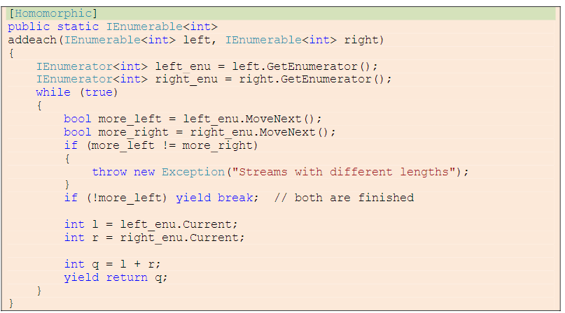
4. Apply
For operations that cannot be expressed in LINQ, Apply exists
Serializes on particular machine (unless annotations allow otherwise)
DryadLINQ will repartition data automatically to match conditions

Slide 15
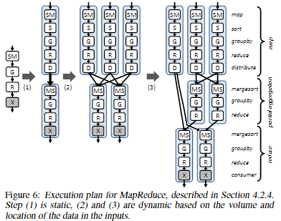
5. Implementation
Execution Plan Graph
Static optimizations
Pipelining
Removing redundancy
Eager Aggregation
I/O reduction
Dynamic
Depending on load and location of data
Notes:
Pipelining: Multiple operators may be executed in a single process. The pipelined processes are themselves LINQ expressions and can be executed by an existing single-computer LINQ implementation.
Removing redundancy: DryadLINQ removes unnecessary hash or range-partitioning steps.
Eager Aggregation: Since repartitioning datasets is expensive, downstream aggregations are moved in front of partitioning operators where possible
I/O reduction: Where possible, DryadLINQ uses Dryad’s TCP-pipe and in-memory FIFO channels instead of persisting temporary data to files. The system by default compresses data before performing a partitioning, to reduce network traffic. Users can manually override compression settings to balance CPU usage with network load if the optimizer makes a poor decision.
For MapReduce example the mapper and reducer are known to be associative and commutative. Execution plan similar to hand tuned Google one, but was autogenerated

Slide 16
4. Leveraging LINQ
LINQ Code at vertices dynamically generated and shipped at runtime
Auto-generated and efficient serialization code
Can inline reference variable values
Access to .NET library code (auto-packaged)
May use PLINQ on machine to parallelize further
Direct access to SQL if desired through LINQ-to-SQL system
LINQ-to-Object allows programs to run locally

Slide 17
4. Debugging
Upon failure vertex and failing inputs are reported to manager
DryadLINQ does not seem to support MapReduce style approximates
Log collection is simple, log analysis is an open problem

Slide 18
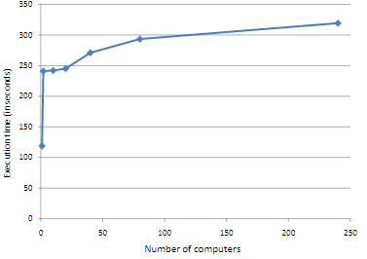
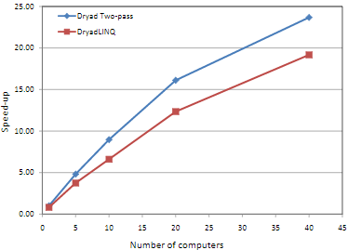
Performance
(Below) Sky server in seconds
(top right) Sorting increasing while volume/computer fixed
(bottom right) Speed-up compared to number of computers
Majority of “performance” focus revolves around small changes required to parallelize
Notes:
The query identifies a “gravitational lens” effect by comparing the locations and colors of stars in a large astronomical table, using a three-way Join over two input tables containing 11.8 GBytes and 41.8 GBytes of data, respectively

Slide 19
Competition
FlumeJava
Hadoop
Pig
Hive
Spark
Map-Reduce-Merge
Distributed SQL

Slide 20
Comparison
No direct performance comparison to competition provided
Less portable than competition
More flexible programming model than MapReduce, SQL
More SQL-esque than Spark
Similar model of depending on a separate underlying system for distributed systems concerns

Slide 21
Spark
Similarities
Language integrations for distributed computations
Leverage underlying language to build iterations,etc (more general structures)
Auto-generates serializations (i.e no handspun ProtoBuf)
Differences
More function than declarative
Underlying primitive (RDD) changes execution from DAG to general graph
Shared variables (broadcast/accumulation)
Notes:
Spark allows simpler expression of ML style algorithms

Slide 22
Analysis
Again hard to perform performance comparison (Spark paper uses much smaller clusters)
From examples Spark seems simpler to use (may have been brainwashed by UCLA PL Profs)

Slide 23
References
M. Isard, M. Budiu, Y . Y u, A. Birrell, and D. Fetterly . “Dryad: distributed data-parallel programs from sequential building blocks”. In EuroSys ’07, 2007
Yang, Hung-chih, et al. "Map-reduce-merge: simplified relational data processing on large clusters." Proceedings of the 2007 ACM SIGMOD international conference on Management of data. ACM, 2007.
Yu, Yuan, et al. "DryadLINQ: A System for General-Purpose Distributed Data-Parallel Computing Using a High-Level Language." OSDI. Vol. 8. 2008.
Yu, Yuan, et al. Some sample programs written in DryadLINQ. Tech. Rep. MSR-TR-2008-74, Microsoft Research, 2008.
Zaharia, Matei, et al. "Resilient distributed datasets: A fault-tolerant abstraction for in-memory cluster computing." Proceedings of the 9th USENIX conference on Networked Systems Design and Implementation. USENIX Association, 2012.
Zaharia, Matei, et al. "Spark: Cluster Computing with Working Sets." HotCloud 10 (2010): 10-10.

