Slide 1
CS239-Lecture 4 FlumeJava
Madan Musuvathi
Visiting Professor, UCLA
Principal Researcher, Microsoft Research

Slide 2
New Schedule

Slide 3
Course Project
plan on 40+ hours
flexible wrt topics
single or in groups of 2 or 3
- prefer groups
examples
- comprehensive literature survey in an area, identify an open problem, and a method of attack
- solve a research problem
- build a system that solves an interesting problem

Slide 4
Project Proposal
Present to class on April 13
Send a proposal (2-3 paragraphs) by April 13
Describe the problem
Explain why it is interesting to solve
Get my approval by April 11

Slide 5
Pop Quiz
From input, a sequence of objects of type
struct PurchaseEvent { string user; string product; int purchase_price };
a FlumeJava pipeline computes
Total money spent by each user (i.e. output is a set of struct{ string user; int sum})
Total money spent on each product (i.e. output is a set of struct{ string product; int sum})
How many MapReduce (MSCR) operations will be present in the compiled pipeline?
Specify the mapper and reducer functions (pseudocode ok) in each of the MSCR operations.
(feel free to refer to the FlumeJava paper and the MapReduce paper)

Slide 6
FlumeJava: Easy, Efficient Data-Parallel Pipelines
Zishan Zhou
CS 239 course presentation
Notes:
Good morning, everyone, I am Zishan, and I will have my presentation on FluemeJava .BTW, I am not a expert in Cs, So let’s just focus on this paper.

Slide 7
OUTLINE
Background
FlumeJava class
Data member (2) Basic operation
(3) Derived operation
Algorithm
(1) Execution plan (2) Optimizer
Example
Data flow (2) Real example
Notes:
Here is my outline. First part will be background introduction, which will tell you why do we need FlumeJava. Second part will be the detailed introduction to it, which will include the program code and its algorithem. Finally, I will show you a case where flumejava can really do. Now, here we go to the first part, if you have any questions, just interrupt me, its ok.

Slide 8
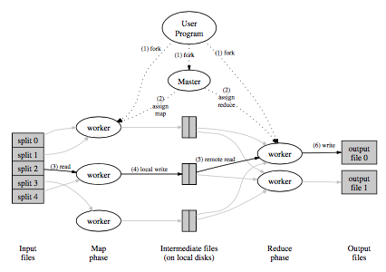
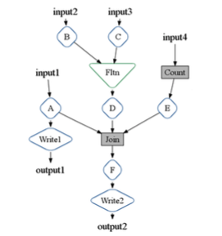
Background
Process massive amounts of data in parallel
MapReduce: a model works well for computation that can be broken into: map, shuffle, reduce
A chain of MapReduce stages is required
Additional work to chain MapReduce stages,
to manage the internal result.

Slide 9
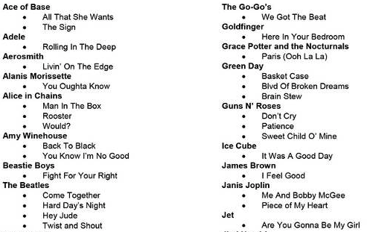
Example: Song list
Imagine you are hired by a really big Music Company.
You have a list or can be said a database of more than 100000 songs
Each song has a name, type, player, year, grade….
You task is to sell the music to the clients.
One day, Our professor said I paid 100 dollars for 50 songs, I like balabala…., give me a list and show me the song.

Slide 10
Simple example
You can do MapReduce for one time to find a list which is in the order of “popular”, and get the best 50 songs.
You can do MapReduce for one time to find a list which has the same preferred type and sorted them to find.
You can do MapReduce for one time to find a list which has the exact preferred year and sorted them to find.
But you can’t do it at the same time to find the best solution! Your client(professor) will be mad!

Slide 11
After that, you may find a chain of MapReduce is needed.
If it is done one by one, which will be slow and draggy.
Then,let’s talk about the FlumeJava, which will solve the problem.

Slide 12
What’s it: a Java library
What’s it for:
(1) Targeting at the a chain of MapReduce
(2) Makes it easy to develop, test, and run efficient
data-paralleled pipelines
What’s in it: several classes, represent parallel collections, each supports some parallel operation
Some function
Pcollection
Class obj
output
result
data
Pcollection class

Slide 13
Data Member
Pcollection<T>
Ptable<K,V> ==Pcollection<pair<K,V>>
Can be sorted(bst?) or unsorted(hash?)
Input and Output
readTextFileCollection()
readRecordFileCollection()
writeToRecordFileTable()

Slide 14
BasicFunction
Collection of data<T>: A,B,C
Map: A->B.
for each element in A, apply the user defined
function and emit B.
Reduce: B<K,list<V>>->C<K,V>.
for each element in B, apply the group
function and emit C.
…..
Same pattern and can be modeled.

Slide 15
Basic Function
ParallelDo(Function object), return type.
For each element in the input, apply the funtion to it and gather the result to return.
Potentially distribute and parallel do the task
Pure function object

Slide 16
Basic Function
Groupbykey()
Capture the entire shuffle step, the result can be ordered or unoreder
Combinevalues()
Special case of parallelDo
Flatten()
Not copy the inputs, create a view of them as one logical Pcollection

Slide 17
Derived Function
Count(): P->F->G->P
Top():P->G->C
Read in different files: F
P=parallelDo
F=flatten
G=groupbykey
C=combinevalue

Slide 18
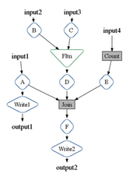
Algorithms
Deferred Evaluation: execute lazily, which result in a execution plan (graph)
After we have a graph,
a lot can be done to
optimize it!

Slide 19
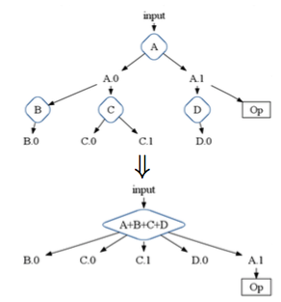
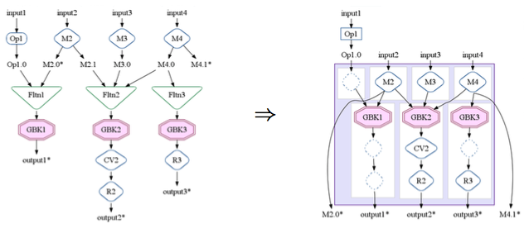
Algorithm
Optimizer
paralledDo Fusion, sibling fusion.
f, g => f o g,
MSCR Operation
MSCR Fusion

Slide 20
Algorithm
Optimizer Strategy
Sink flatten
Lift conbinevalue
Insert fusion blocks
Fuse parallelDos
Fuse MSCRs

Slide 21
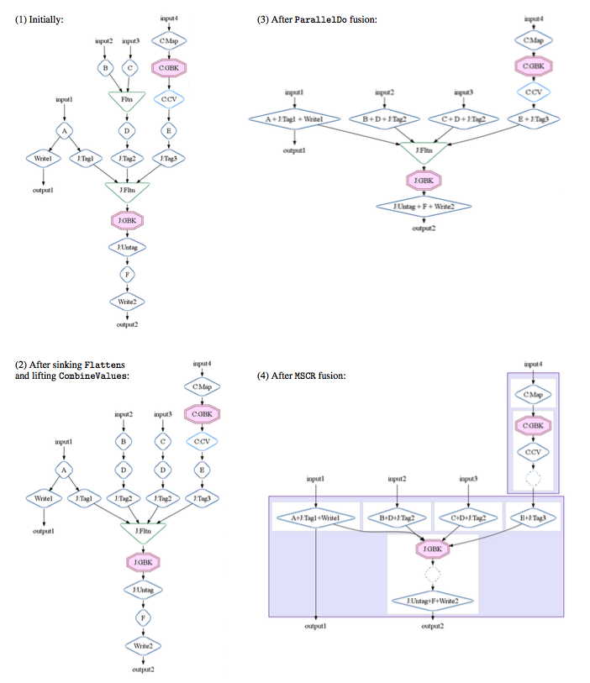
The Whole
Flow
optimization

Slide 22
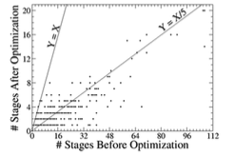
Optimizer Effectiveness
the optimizer appears to achieve on average a 5x reduction in the number of stages, and some pipelines had compression ratios over 30x.

Slide 23
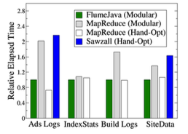
Execution Performance

Slide 24
advantages
Construct an execution plan dataflow graph
First optimize the plan
Combination of high-level abstractions
Deferred evaluation and optimization
Efficient parallel primitives

Slide 25
Easy to test: small scale to large
Abstract away the detail of how data is represented
Abstract away the implementation strategy

Slide 26
Question Solving: Client’s Need
One possible solution:
(1)use P to filter the song with preferred type
(2)use P to filter the song with related type
(3)use F to merge
(4)use G and C to sort with the year and grade
(5)use to P to filter like first 200 places
(6)random pick 50 songs as result
(7)use P to update the database.

Slide 27
Thanks for watching!

