Slide 1
CS239-Lecture 5 Spark + SparkSQL
Madan Musuvathi
Visiting Professor, UCLA
Principal Researcher, Microsoft Research

Slide 2
Project Proposal
Send a proposal (2-3 paragraphs) by April 13
Describe the problem
Explain why it is interesting to solve
Get my approval by April 11 (today)

Slide 3
Other announcements
Quiz grades are in
Added a topic on the discussion forum on
- publicly available large datasets
- access to AWS resources

Slide 4
Resilient Distributed Datasets: A Fault-Tolerant Abstraction for In-Memory Cluster Computing
Zaharia et al.
Presented by Manoj Reddy

Slide 5
Motivation
MapReduce, Pregel and Dryad popular for large-scale data analytics
Users write high-level operators
Need not worry about parallelization and fault tolerance
Issues:
Do not leverage distributed memory
Bottleneck: Data replication, disk I/O and serialization
Support only specific computation patterns
Inefficient for iterative ML and graph algorithms
Keeping data in memory can improve performance by orders of magnitude
Interactive data mining: Run multiple ad-hoc queries on the same subset of data

Slide 6
Resilient Distributed Datasets (RDDs)
RDD is a read-only, partitioned collection of records
Created through deterministic transformations on either:
Data in stable storage
Other RDDs
Transformations include: map, filter & join
RDDs do not need to be materialized at all times
Lazy computation
RDDs can be derived by computing the partitions through lineage
Persistence: Users can specify a storage strategy for RDDs
Partitioning: Useful for placement optimizations
Join 2 RDDs that are co-partitioned
Partitions
RDD

Slide 7
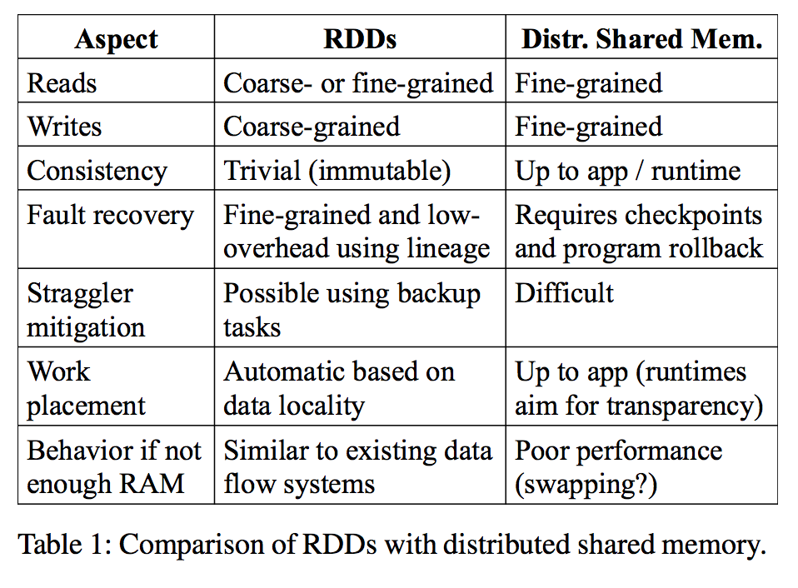
Advantages of RDD Model
In RDDs, writes are only possible through coarse-grained transformations
More efficient fault tolerance
Notes:
The main contribution of this paper is not just to compute things in memory, but in fact the data sharing abstraction in the form of RDD.
This allows for more efficient fault tolerance since the lost partitions can be computed in parallel through lineage.

Slide 8
Disadvantages of RDD model
RDDs best suited for batch applications
Apply the same operation to all elements in a dataset
Useful for efficiently recovering lost partitions using lineage graph
Avoids logging large amounts of data
Not suitable for asynchronous fine grained updates to shared state
Storage system for web application
Incremental web crawler
Databases such as RAMCloud, Percolator and Piccolo more suitable
Perform traditional update logging and data check-pointing

Slide 9
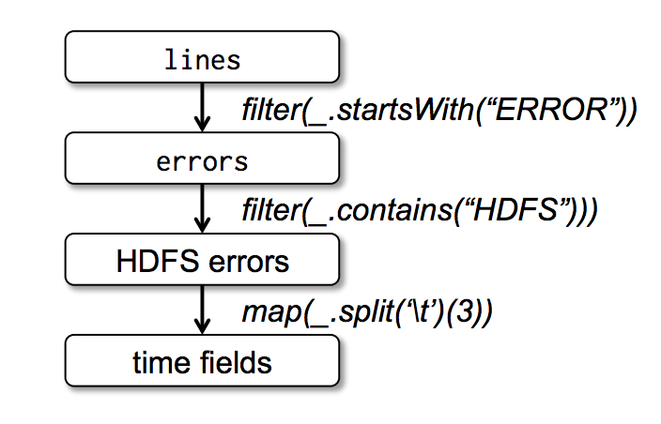
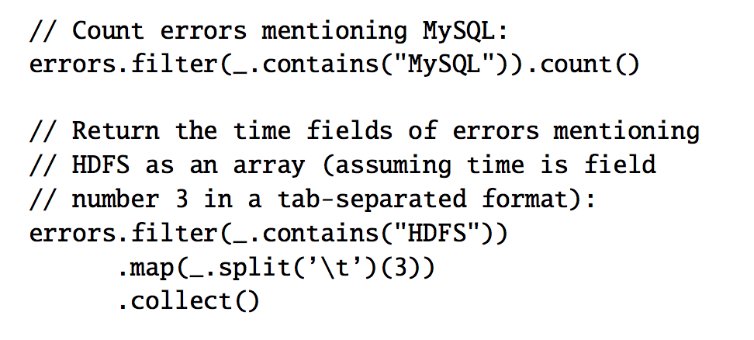
Example
Stored in HDFS
Stored in memory
Count and Collect are actions
Pipeline filter and map and send a set of tasks to compute them on nodes containing partitions of errors

Slide 10
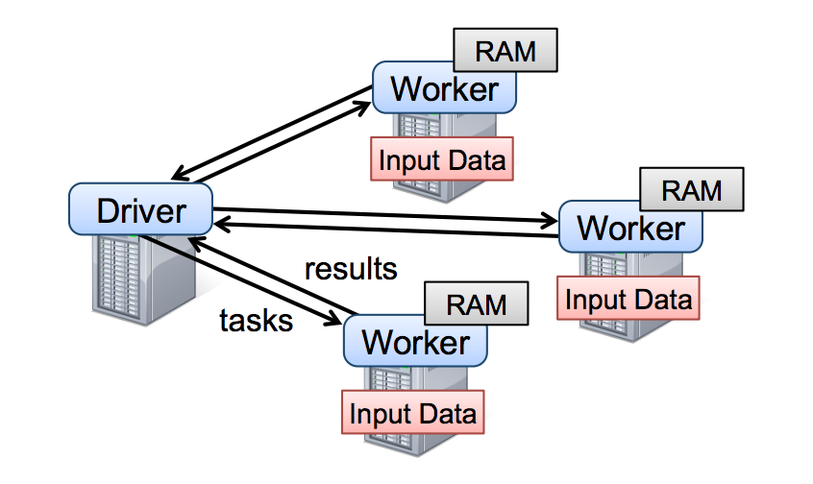
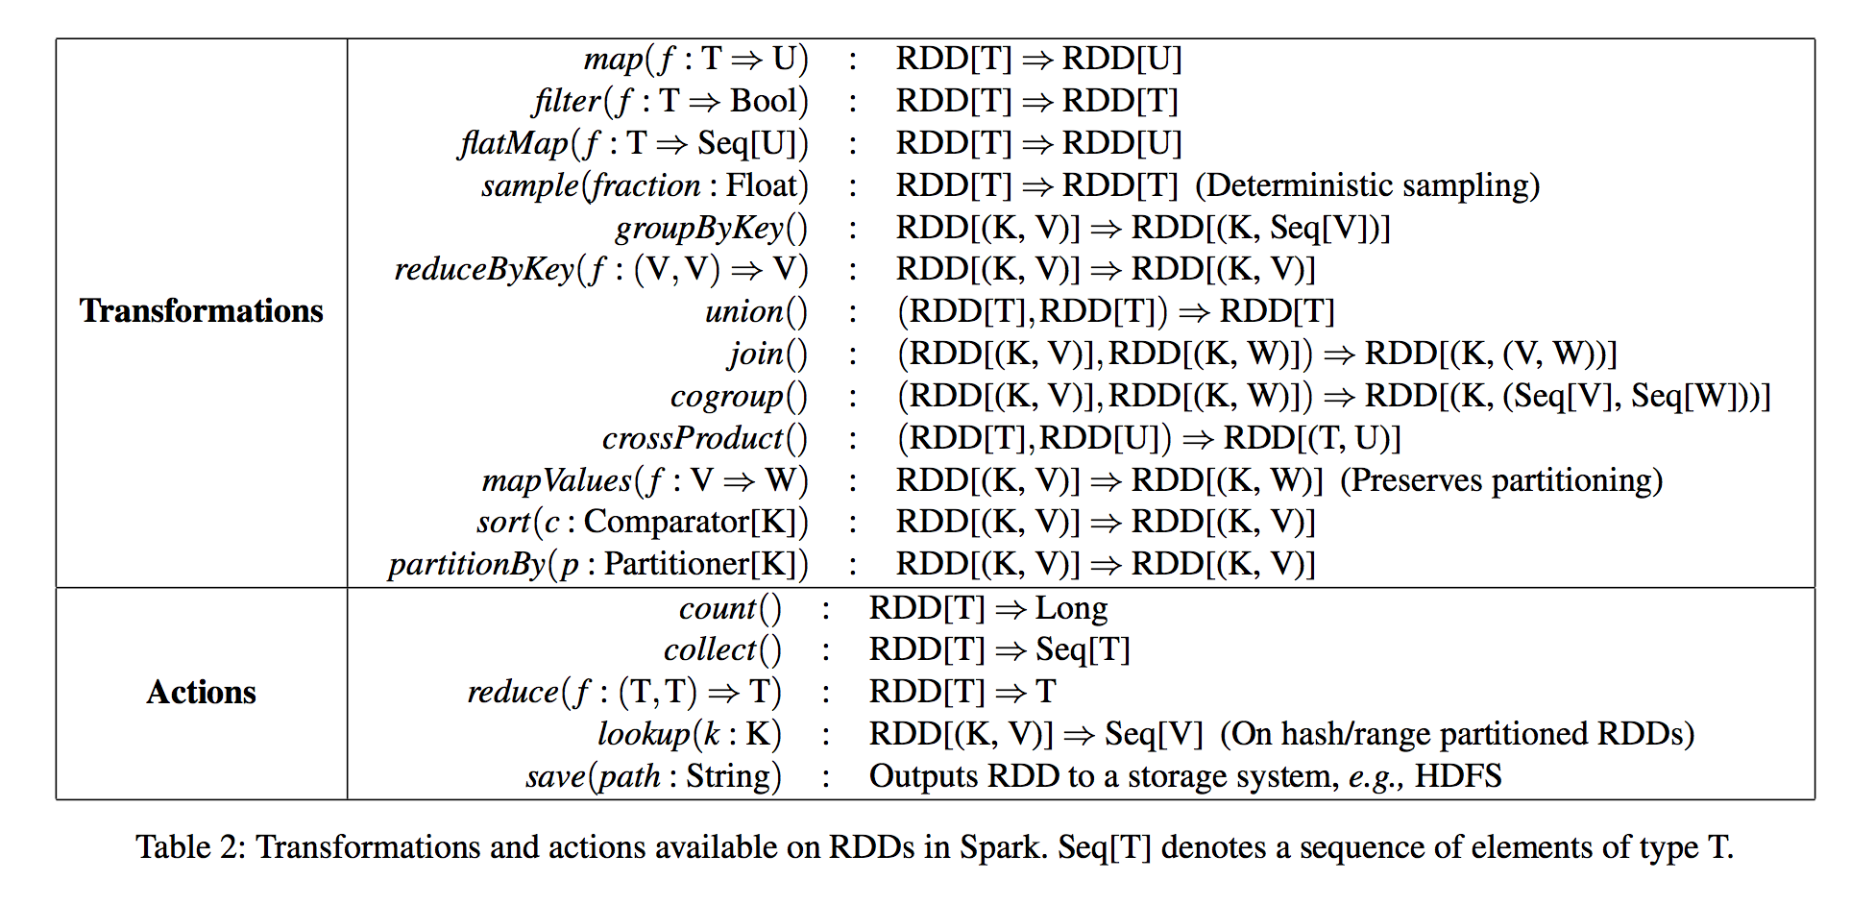
Spark
Scala
OO + Functional Programming
Provides RDD abstraction in API similar to DryadLINQ
RDD Operations in Spark
Notes:
Spark = Object-oriented programming + Functional

Slide 11
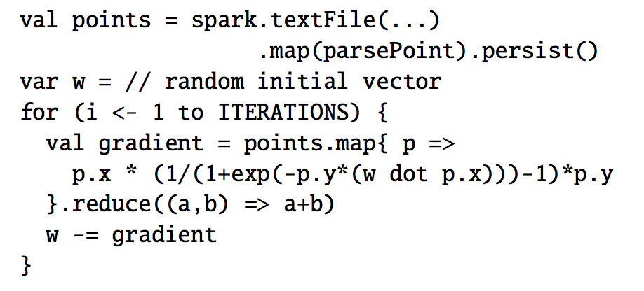
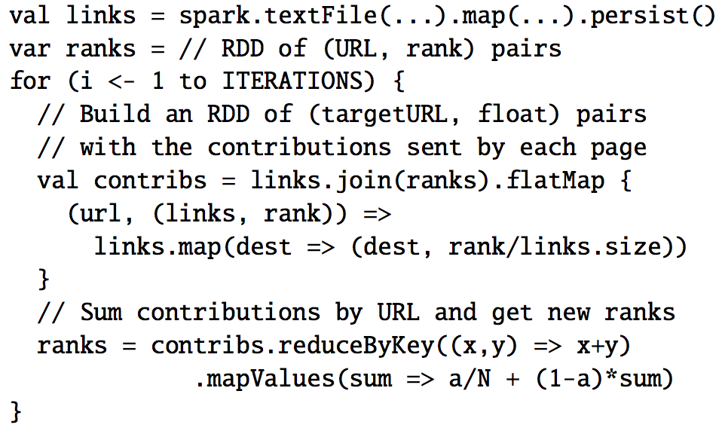
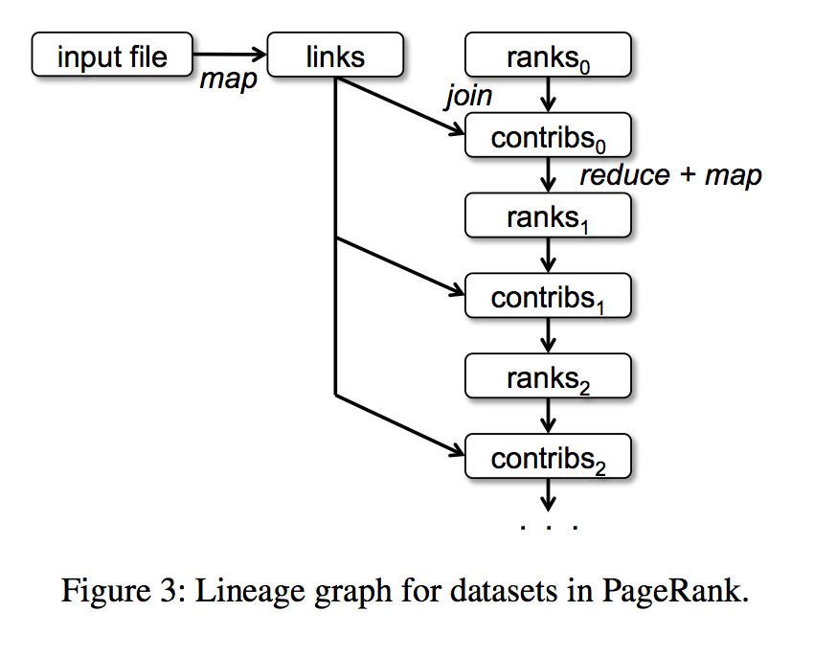
Logistic Regression & Page Rank
Uses iterative algorithm called Gradient Descent
20x speedup over Hadoop
Each document sends a contribution of $\frac{r}{n}$
r – its current rank
n – number of neighbors
Updates it’s rank as:
$\frac{α}{N}+(1−α)\sum{c_{i}}$
Notes:
Can optimize the join in Page rank through co-partitioning of links and ranks

Slide 12
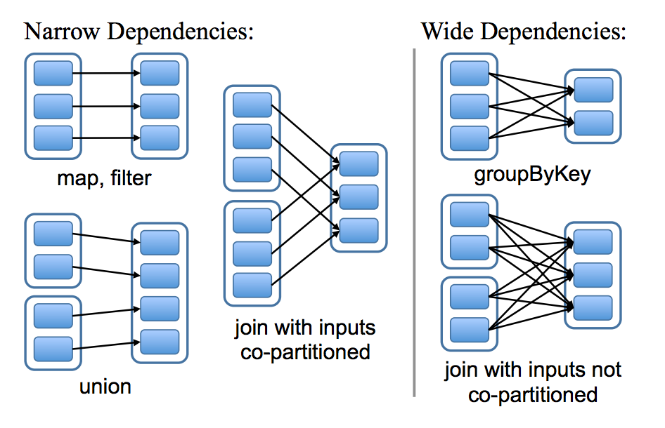
RDD Representation
Relationship between RDDs
Each partition of the parent RDD is used by at most one partition of the child RDD
Multiple child partitions may depend on parent partition

Slide 13
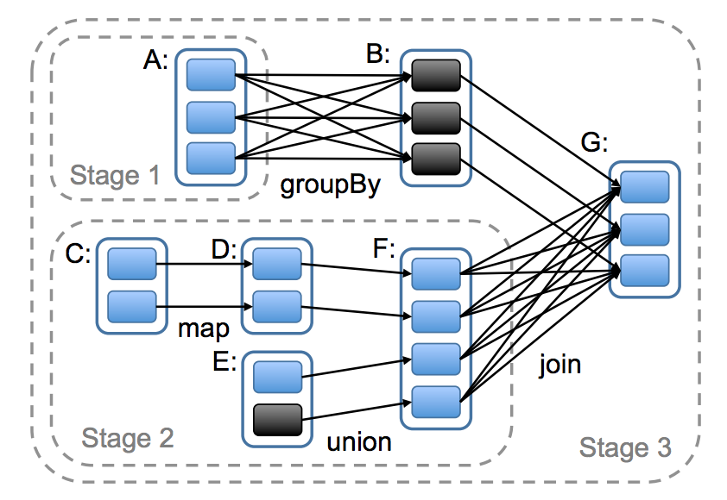
Implementation (I)
Shuffle
Spark implemented using 14,000 lines of Scala
Runs on top of Mesos cluster manager
Job Scheduler: Similar to Dryad
Takes in to account which partitions of persistent RDDs are in memory
Builds a DAG of stages to execute using lineage graph
Stages contains pipelined transformations with narrow dependencies

Slide 14
Implementation (II)
Job Scheduling
If a node contains a partition in memory that needs to be processed then task is executed on that node
If RDD provides preferred locations then the task is sent to the respective node
Fault tolerance
If a task fails, it is re-run on another node as long as its stage’s parents are still available
If some stages become unavailable then, tasks are resubmitted to compute the missing partitions in parallel
Scheduler failures can be tolerated by replicating the RDD lineage graph
(About 10Kb)

Slide 15
Implementation (III)
Interpreter integration
Interactive shell similar to Ruby and Python. Extension to SQL
Memory management
3 types: in-memory de-serialized java objects, in-memory serialized objects, on-disk
Default is LRU policy but user can control via “persistence priority”
Support for check pointing
Useful for RDDs with long lineage graphs containing wide dependencies
Users are in control (REPLICATE flag)
For example, PageRank: a loss of partition on rank requires full recomputation
Tradeoff: Not worthwhile for logistic regression
Open problem: Determine which RDDs is worth checkpointing
Notes:
Checkpointing:
Can be based on the size of the dataset and the time it took to compute.
For example: If the dataset is small but took a long time to compute then it makes sense to check point.

Slide 16
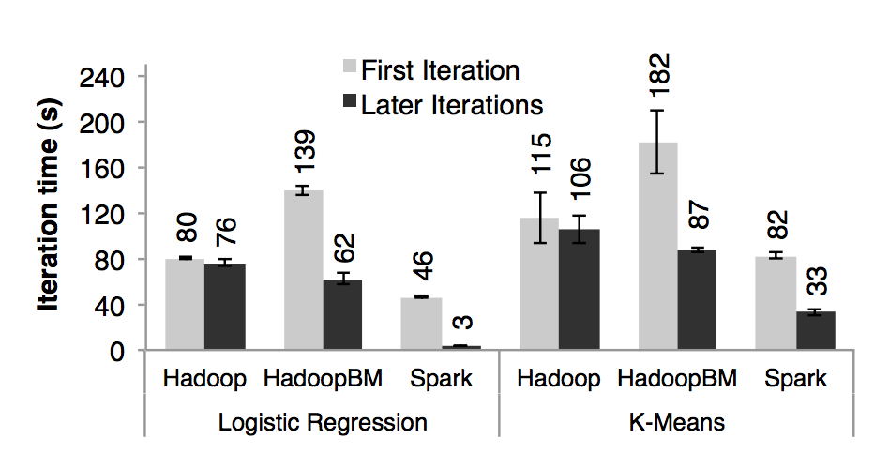
Evaluation (I) – Logistic Regression, K-Means
Logistic Regression and K-Means was run for 10 iterations on 100GB using 25-100 machines
Hadoop: Vanilla Hadoop 0.20.2 stable release
HadoopBinMem: Converts input data into a low-overhead binary format in the first iteration to eliminate text parsing in later ones and stores it in an in-memory HDFS instance
Spark: The paper’s implementation of RDDs

Slide 17
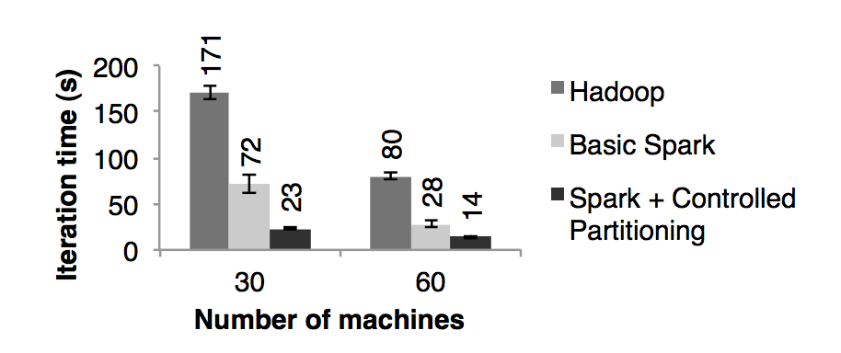
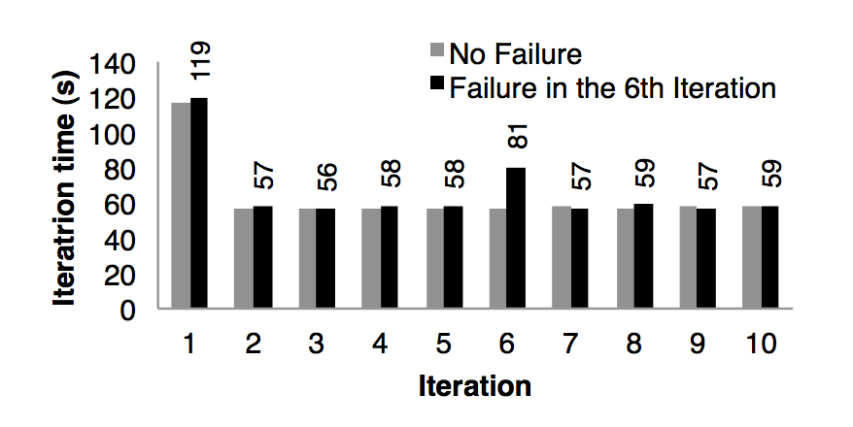
Evaluation (II) – PageRank
54GB Wikipedia Dump, 10 iterations, graph of 4 million articles
Speedup of 2.4x – 7.4x over Hadoop on 30 – 60 nodes.
PageRank
Fault Recovery

Slide 18
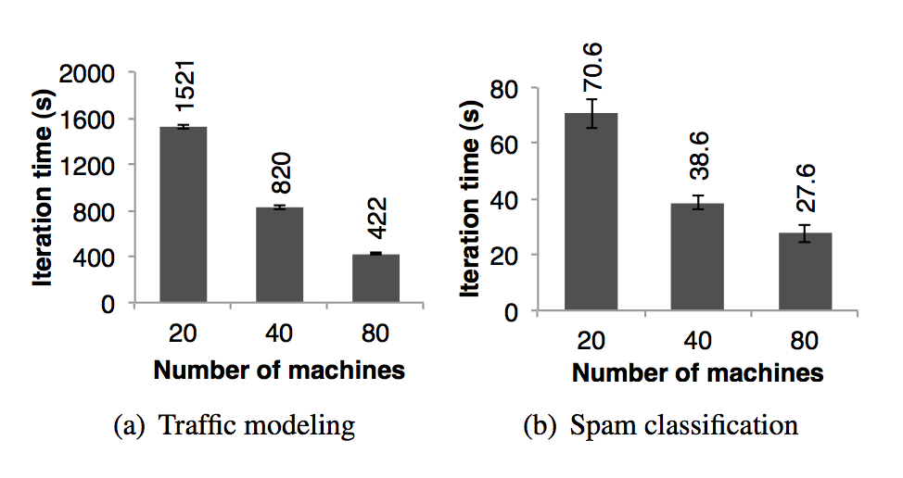
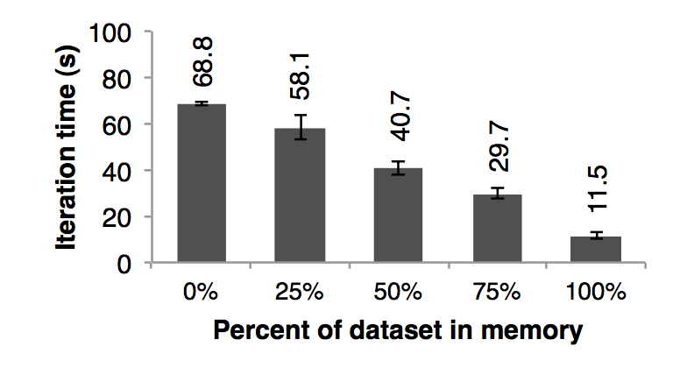
Evaluation (III)
User applications
Insufficient Memory
Experiment to test the behavior with insufficient memory
The data overflows to disk
Based on the plot above, performance degrades gracefully with less space
Experiments to test Spark’s scalability
Traffic Modeling
10,000 link road network with 600,000 samples of point-to-point trip times
Uses Expectation Maximization algorithm
Twitter Spam Classification
Logistic regression classifier that uses reduceByKey to sum gradient vectors in parallel
50 GB training data

Slide 19
Interactive Data Mining
Query 1 TB Wikipedia page view logs
100 m2.4xlarge EC2 instances
8 cores and 64GB RAM each
3 queries, Total views of:
All pages
Pages with titles exactly matching a given word
Pages with titles partially matching a given word
Spark took 5-7 seconds for queries
Querying as a file from disk took 170s

Slide 20
Conclusion
RDDs can express so far proposed cluster programming models
MapReduce, DryadLINQ, Pregel using 200 line library on top of Spark
Supports interactive data mining and batch stream processing
Another benefit of RDD model is debugging using the lineage information
Spark performs really well because previous frameworks did not provide data sharing abstractions
Coarse-grained transformations allow Spark to recover data efficiently using lineage
Spark is up to 20x faster than Hadoop for iterative applications, 40x for real-world data analytics report and can scan 1TB dataset with 5-7s latency

Slide 21
References
Zaharia, M., Chowdhury, M., Das, T., Dave, A., Ma, J., McCauley, M., ... & Stoica, I. (2012, April). Resilient distributed datasets: A fault-tolerant abstraction for in-memory cluster computing. In Proceedings of the 9th USENIX conference on Networked Systems Design and Implementation (pp. 2-2). USENIX Association.
Dean, J., & Ghemawat, S. (2008). MapReduce: simplified data processing on large clusters. Communications of the ACM, 51(1), 107-113.
G. Malewicz, M. H. Austern, A. J. Bik, J. C. Dehnert, I. Horn, N. Leiser, and G. Czajkowski. Pregel: a system for large-scale graph processing. In SIGMOD, 2010.
Y. Bu, B. Howe, M. Balazinska, and M. D. Ernst. HaLoop: efficient iterative data processing on large clusters. Proc. VLDB Endow., 3:285–296, September 2010.
Yu, Y., Isard, M., Fetterly, D., Budiu, M., Erlingsson, Ú., Gunda, P. K., & Currey, J. (2008, December). DryadLINQ: A System for General-Purpose Distributed Data-Parallel Computing Using a High-Level Language. In OSDI(Vol. 8, pp. 1-14).
Chambers, C., Raniwala, A., Perry, F., Adams, S., Henry, R. R., Bradshaw, R., & Weizenbaum, N. (2010, June). FlumeJava: easy, efficient data-parallel pipelines. In ACM Sigplan Notices (Vol. 45, No. 6, pp. 363-375). ACM.

Slide 22
Spark SQL: Relational Data Processing in Spark
Lana Ramjit

Slide 23
Overview

Slide 24
Two Paradigms
MapReduce
+ parallelism abstractions make it easy to run distributed computation
+ flexible, complete programming language
-programmer responsible for optimizations
-difficult/inefficient for many queries (join)
SQL
+ Easy for certain operations like filter, join
+ Optimizations built-in
+ Simple, declarative query statements
-must perform ETL on data
-doesn't scale well
-hard to perform iteration, row-by-row

Slide 25
What is Spark SQL?
Tries to allow users to have the advantages of both without the disadvantages of either
Make it easier to construct a “pipeline” or mix of SQL queries fed into procedural constructs, similar to FlumeJava or DryadLINQ
Transforms SQL operations into RDD operations
Data can be loaded from HDFS
Stores data in memory
Supports both relational and Spark-style queries
Provides a configurable optimization engine

Slide 26
Shark: Spark SQL predecessor
+ Extended Hive to run on top of Spark
+ Implemented optimizations that are common in RDBMS
- only worked with external data stored in HDFS, not on native RDDs
-optimizations were limited to those for MapReduce
-only usable through forming SQL queries

Slide 27
Features and Constructs

Slide 28
DataFrame API
The DataFrame is the main abstraction provided
Conceptually, similar to a table in a relational database
Can be constructed from RDDs, Hive tables, or most structured data files (CSVs, JSON) (top image)
Can run SQL style queries on them (bottom image)

Slide 29
DataFrames cont'd
The most compelling features (in my opinion!)
can embed relational style queries inside of a non-declarative language
Allows use of things like loop constructs and conditionals surrounding SQL-style queries
Can access, name, and use intermediate results of those queries
Spark-style lazy-eval allows optimization (more on this later)
Immediate error detection and response despite lazy-evaluation

Slide 30
Catalyst Optimizer
“At its core, Catalyst contains a general library for representing trees and applying rules to manipulate them.”
Trees consist of nodes, which have a type and 0+ children.
Rules are functions that transform a tree from one state to another, usually using pattern matching native to functional languages.

Slide 31
Four Stages
Analysis
Takes a query, finds the matching relation from the Catalog, performs type matching, and resolves aliases
Logical optimization
Performs basic rule-based optimization to transform the tree (for example, simplifying a boolean expression)
Physical planning
generates plans based on the physical layout of the data and the costs of those plans
Code Generation
uses quasiquotes to generate Java bytecode

Slide 32
Query Planning Diagram

Slide 33
Analytics Features
Can infer a schema from semi-structured data (neat!)
Passes over data, finds the most specific but sufficient Spark SQL data-type that covers all instances of a field
Find all instances of field, find largest matching data type, and set that as the “type” of that column
MLLib added a DataFrame API for ML
Created a user-defined type to represent vectors (not sure why this wasn't an original type)
Had the incidental effect of introducing cross-compatibility across all Spark languages

Slide 34
Performance and Evaluation

Slide 35
Performance: SQL Queries
SQL Query Performance
Use AMPLab big data benchmark
Four queries which perform scans, aggregation, joins and a MapReduce job that uses a UDF
First three queries have multiple parameters that increase selectivity such that query 1b is more selective than 1a and 1c is more selective than 1b
Compared against Impala and Shark
Competitive performance, overall

Slide 36
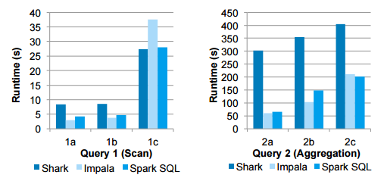

Slide 37
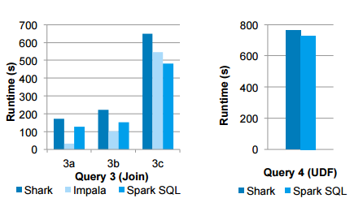

Slide 38
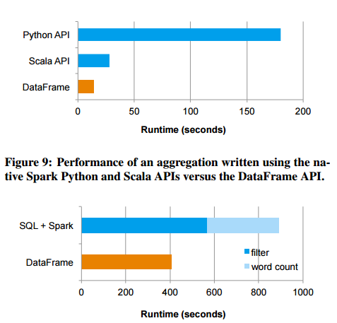
Comparison against Spark + SQL
Compared against applications that intermingle relational and procedural programming in a pipeline
Two stage pipeline: query followed by a computation
2X performance improvement

Slide 39
Issues? Improvements?
Extensible optimization
Cool in theory! But having written a compiler using a functional language...doesn't seem useful for the average programmer.
I didn't find Catalyst's method of adding rules intuitive and still find it a bit confusing
Evaluation
Found the spark + sql evaluation method lacking—wanted a better comparison against larger pipelines
Choosing two separate engines felt like a straw-man
Would also be interested in a “softer” usability report

Slide 40
Comparison to Dryad-LINQ, FlumeJava
If pipeline optimization and language-integrated relational queries sound familiar, that's because it is
Comparison of performance?
Does SparkSQL do anything new?
The DataFrame abstraction is novel—DryadLINQ works on C# objects.
Iteration via Spark
Offers immediate feedback on type and compilation errors
Other?

Slide 41
Spark SQL
DataFrames API
- relational interface
- associate schemas with RDDs
- lazy evaluation (unlike R & Python)
- columnar format
Catalyst optimizer
- use Scala’s pattern matching feature to write tree transformation rules

