Slide 1
CS239-Lecture 6 Performance
Madan Musuvathi
Visiting Professor, UCLA
Principal Researcher, Microsoft Research

Slide 2
Project proposal due today
Send a proposal (2-3 paragraphs) by April 13
Describe the problem
Explain why it is interesting to solve

Slide 3
Row Store vs Column Store
struct Employee { string name; int age; int salary;};
Two ways to represent a set of Employees
array of struct (row storage):
struct of arrays (col storage):
Employee[] employees;
name
age
sal
name
age
sal
name
age
sal
string[] names;
int[] ages;
int[] salaries;
name
name
name
age
age
age
sal
sal
sal

Slide 4
Advantages of Column Storage
name
age
sal
name
age
sal
name
age
sal
Better cache locality (?)
Better encoding
Ability to utilize SIMD
name
name
name
age
age
age
sal
sal
sal

Slide 5
CS239 Presentation
Reining in the Outliers
in Map-Reduce Clusters using Mantri
Lei Ding

Slide 6
Outline
Introduction
Outlier Problem
Mantri Design
Evaludation
Conclusion

Slide 7
Outline
Introduction
Outlier Problem
Mantri Design
Evaludation
Conclusion

Slide 8
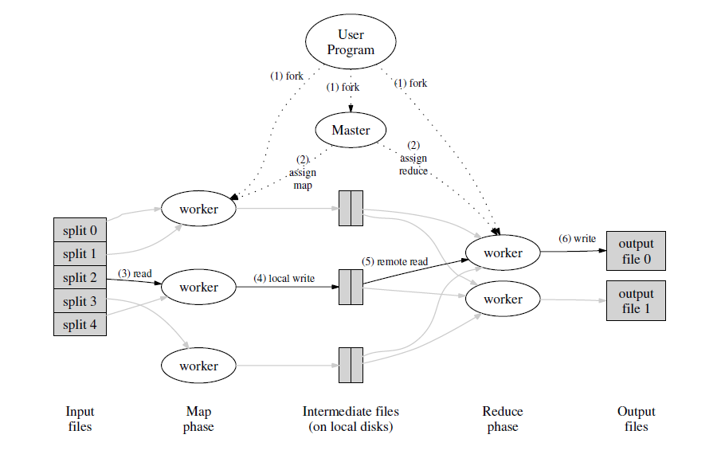
Thinking...

Slide 9
Outliers
The causes for outliers:
1. runtime contention for processor, memory and other resources
2. disk failures
3. varying bandwidth
4. congestion along network paths
5. imbalance in task workload

Slide 10
Outliers
Three categories of root causes
machine characteristics
network characteristics
imbalance in work due to MapReduce specification

Slide 11
Outliers
Current outlier mitigation in MapReduce
focus only on duplicating tasks
no protection against data loss induced recomputation
no protection against network congestion induced outliers
......

Slide 12
Mantri --cause aware and resource aware
Restarting outlier tasks cognizant of resource constraints and work imbalances
Network-aware placement of tasks
Protecting output of tasks based on a cost-benefit analysis

Slide 13
Outline
Introduction
Outlier Problem
Mantri Design
Evaludation
Conclusion

Slide 14
Phase level
Settings for a phase:
n: the number of tasks in a phase
s: the number of slots in a phase
t_{i}: the completion time of task i

Slide 15
Phase level
The completion time of task i can be affected by multiple factors, which can be represented by a function:
t_{i} = f(datasize, code,machine, network)
The phase completion time can be represented by:

Slide 16
Phase level
So the goal is to make t_{p} close to !

Slide 17
Job level
An outlier in an early phase, by delaying when tasks that use its output may start, has cumulative effects on the job.
Dependency across phases also leads to outliers when task output is lost and needs to be recomputed

Slide 18
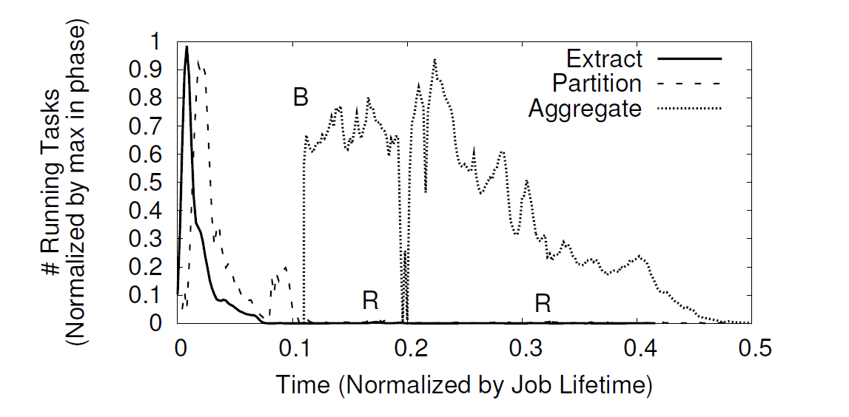
Example job from the production cluster

Slide 19
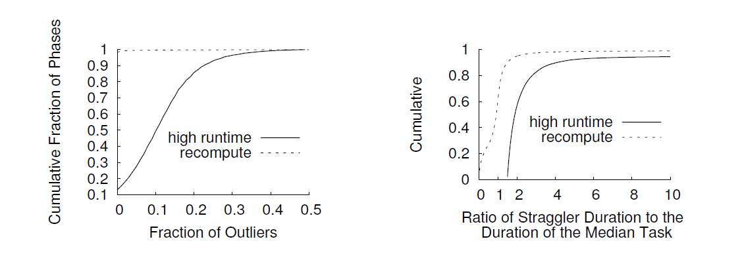
Prevalence of outliers
Prevalence of outliers

Slide 20
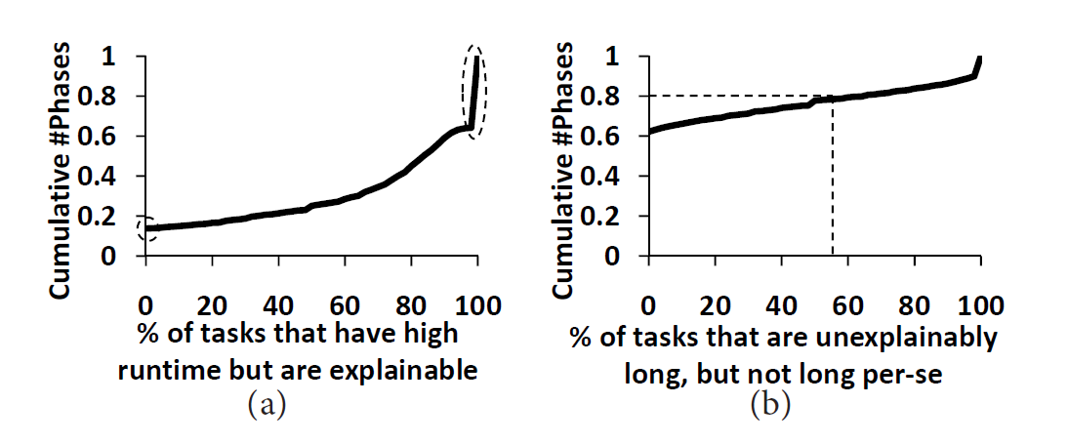
Causes of outliers
Whether a task's runtime can be explained by the amount of data it processes or reads across the network?
workload imbalance or poor placement
vs
resource contention or problematic machines

Slide 21
Causes of outliers
Data skew
Crossrack traffic
Bad and busy machines

Slide 22
Data skew
Why data size varies across tasks in a phase?
scheduling each additional task has overhead at the job manager
Network bandwidth
poor coding practice

Slide 23
Crossrack traffic
Lead to outliers in two ways
in phases where moving data across racks is avoidable (through locality constraints), a task that ends up in a disadvantageous network location runs slower than others
in phases where moving data across racks is unavoidable, not accounting for the competition among tasks within the phase (self-interference) leads to outliers

Slide 24
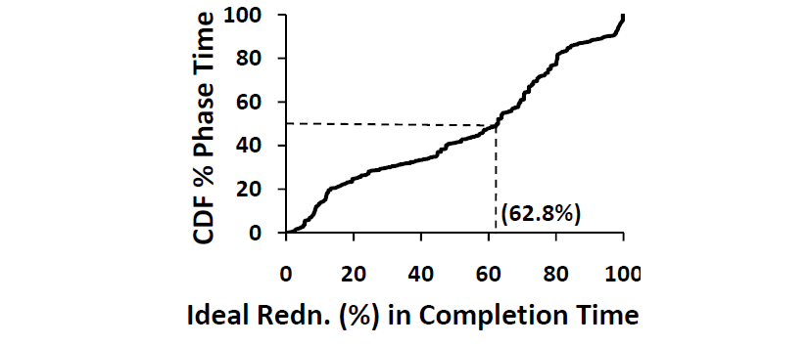
Crossrack traffic

Slide 25
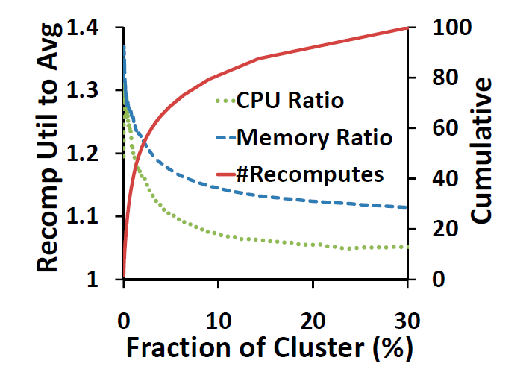
Bad and busy machines
---Recomputation

Slide 26
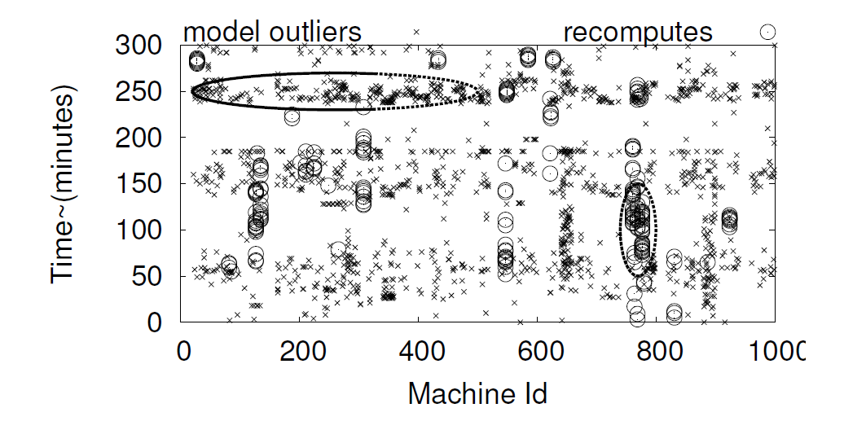
Bad and busy machines
---spikes

Slide 27
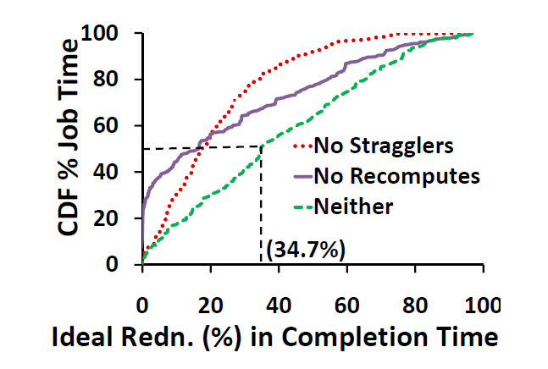
Impacts of outliersad

Slide 28
Outline
Introduction
Outlier Problem
Mantri Design
Evaludation
Conclusion

Slide 29
General solution outliers

Slide 30
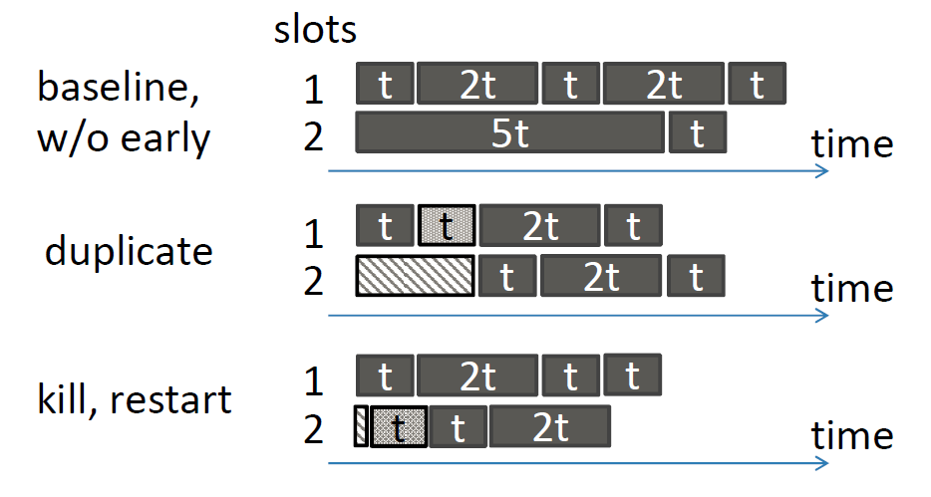
Resource aware restart--simple example

Slide 31
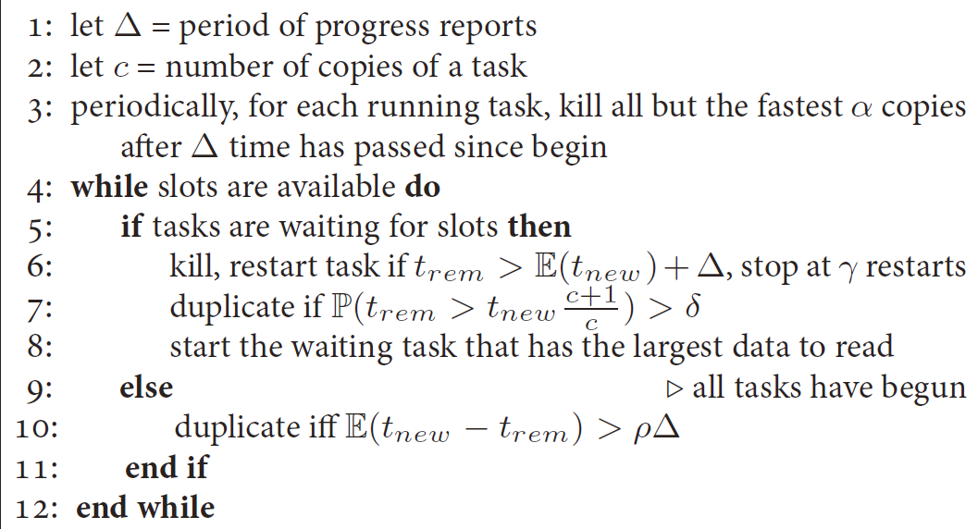
Resource aware restart--Algorithm
t_{rem}: estimates for remaining time to finish
t_{new}: predicted completion time of a new copy of the task
∆: tasks progress report interval
γ: maximum times of reduplication
c: currently running copies

Slide 32
Network aware placement
Settings:
I_{n,r}: specify the size of input in each rack for each of the tasks
d_{u,i}, d_{v,i}: the data to be moved out (on the uplink) and read in (on the downlink) on the i_{th} rack
b_{u,i}, b_{d,i}: the corresponding available bandwidths for d_{u,i}, d_{v,i}
c_{2i-1}: d_{u,i}/b_{u,i}
c_{2i}: d_{v,i}/b_{d,i}
Based on the settings, we can calculate the total data transfer time, which we aim to minimize!

Slide 33
Network aware placement
Notes:
For bandwidths, use Start and Equal to estimate
For phases other than reduce, Mantri complements the Cosmos policy of placing a task close to its data

Slide 34
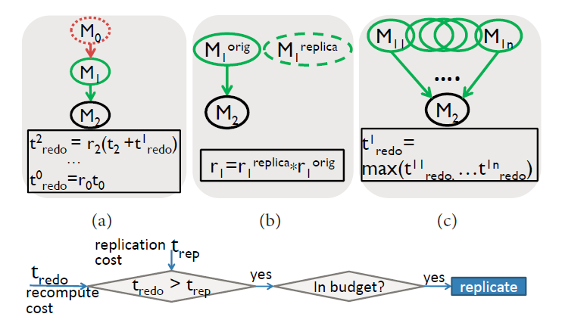
Avoiding Recomputation
Mantri protects against interim data loss by replicating task output.
It acts early by replicating those outputswhose cost to recompute exceeds the cost to replicate.
The time to repeat the tast is t_{redo}
Mantri estimates the cost to recompute as the product of the probability that the output will be lost and the time to repeat the task

Slide 35
Avoiding Recomputation
Effective situations
when the cumulative cost of not replicating many successive tasks builds up
when tasks ran on very flaky machines (high r_{i})
when the output is so small that replicating it would cost little (low t_{rep})
To avoid excessive replication, Mantri limits the amount of data replicated to 10%of the data processed by the job
Mantri proactively recomputes tasks whose output and replicas, if any, have been lost

Slide 36
Data aware task ordering
Mantri improves job completion time by scheduling tasks in a phase in descending order of their input size.
Estimation of t_{rem} and t_{new}
t_{rem} = t_{elapsed} ∗ d / d_{read} + t_{wrapup}
t_{new} = processRate ∗ locationFactor ∗ d + schedLag

Slide 37
Outline
Introduction
Outlier Problem
Mantri Design
Evaludation
Conclusion

Slide 38
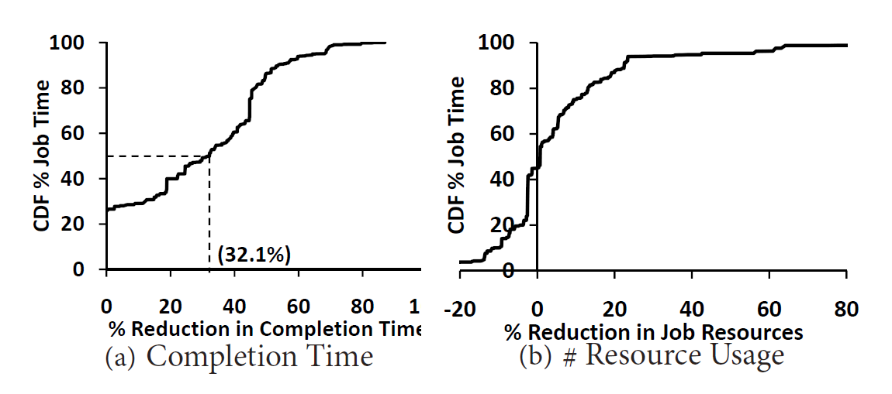
Evaluation--Jobs in the wild

Slide 39
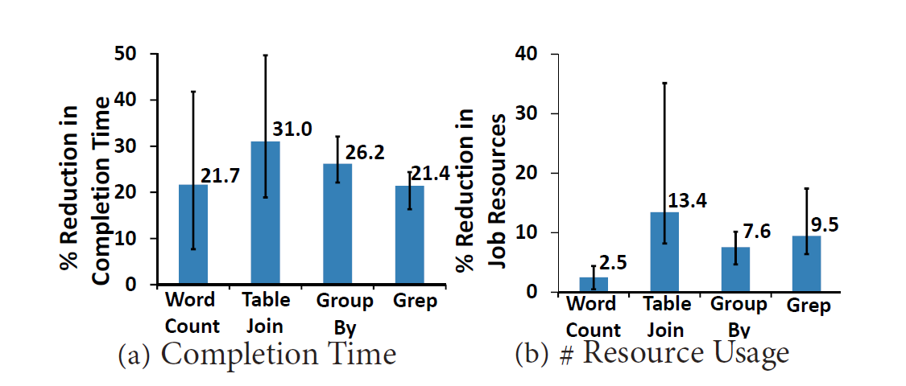
Evaluation--straggler mitigation

Slide 40
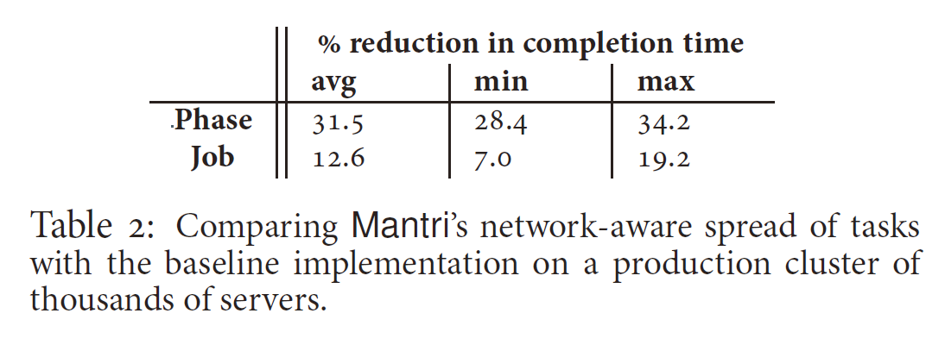
Evaluation--Placement of tasks

Slide 41
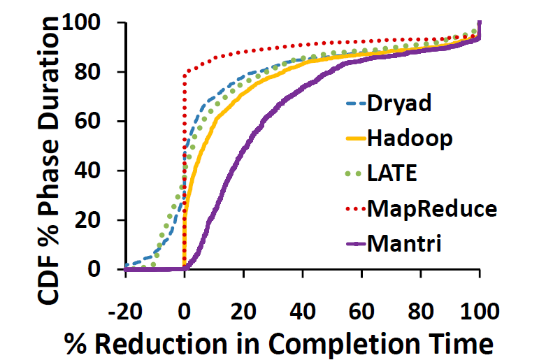
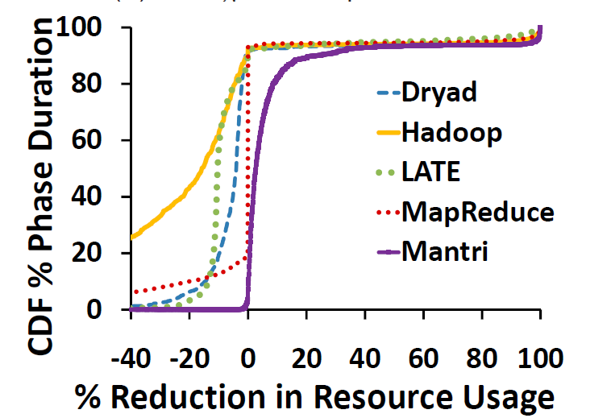
Evaluation--Straggler mitigation comparison

Slide 42
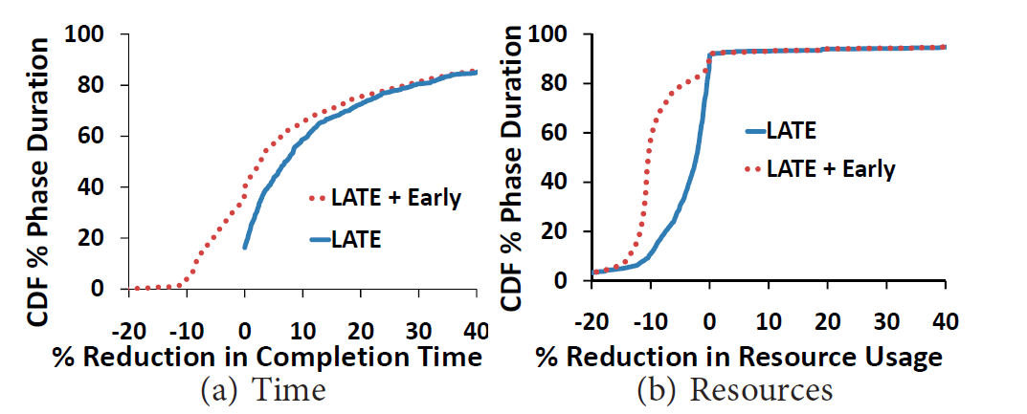
Evaluation--early action on straggler is non-trivial

Slide 43
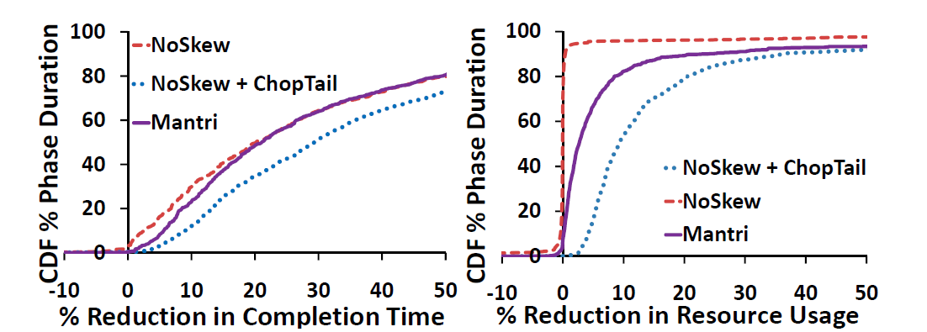
Evaluation--Mantri vs NoSkew, NoSkew+ChopTail

Slide 44
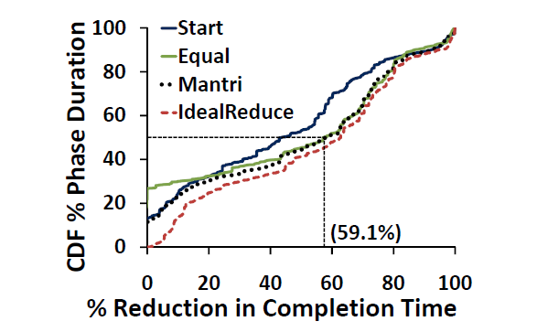
Evaluation--placement performance comparison

Slide 45
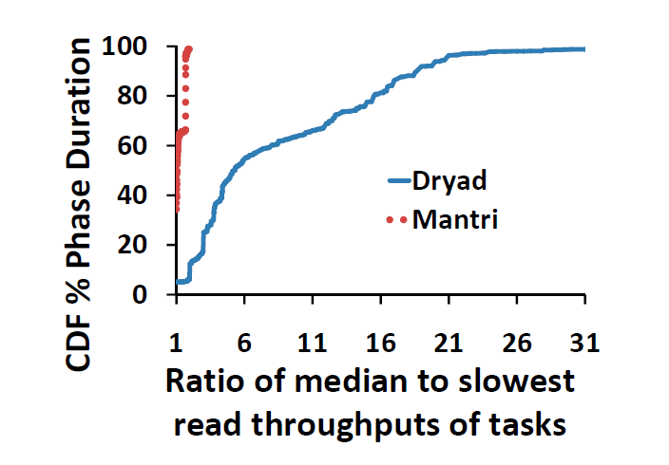
Evaluation--Mantri vs Dryad

Slide 46
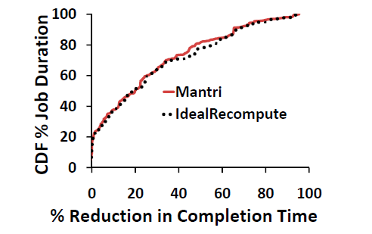
Evaluation--Mantri vs IdealRecompute

Slide 47
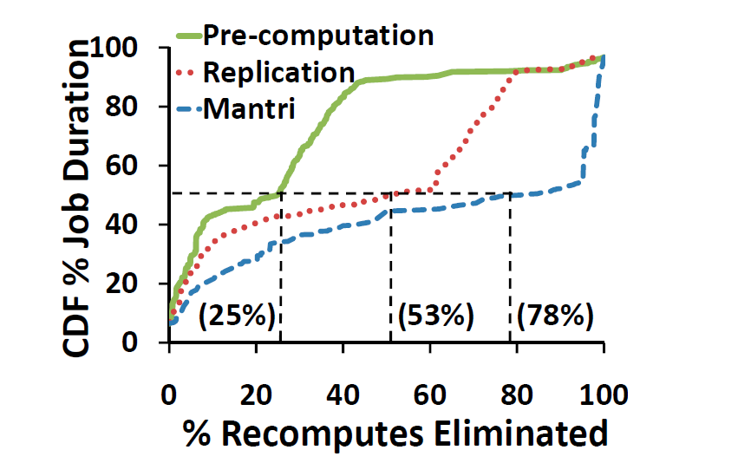
Evaluation--contributions from replication and pre-computation

Slide 48
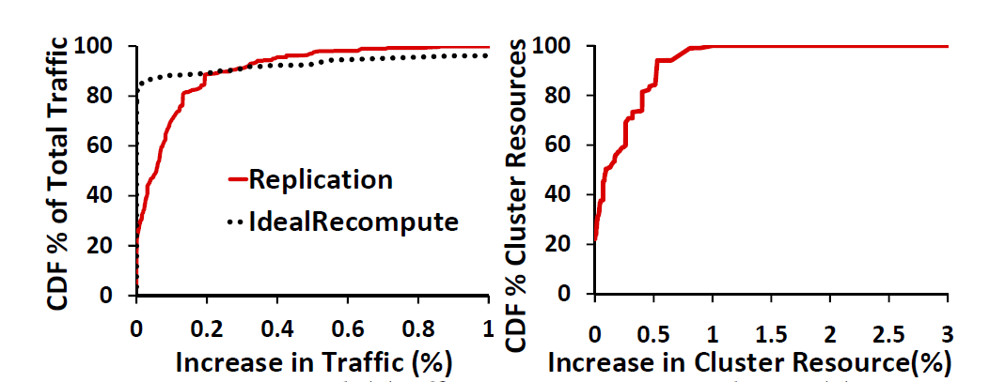
Evaluation--Replication vs IdealReduce, precomputation consumption

Slide 49
Outline
Introduction
Outlier Problem
Mantri Design
Evaludation
Conclusion

Slide 50
Conclusion
Mantri delivers effective mitigation of outliers in MapReduce networks.
The root of Mantri's advantage lies in integrating static knowledge of job structure and dynamically available progress reports into a unifed framework that identifies outliers early, applies cause-specific mitigation and does so only if the benefit is higher than the cost.

Slide 51
Thank you

Slide 52
Making sense of Performance in Data Analytics Frameworks
Chunnan Yao

Slide 53
Recap:MapReduce
Bottleneck?
network?
disk I/O?
struggler?
Notes:
Spark falls into MapReduce paradigm but uses advanced data abstraction (in memory RDD), language support(Scala), task pipelining(DAG).
partitions

Slide 54
Tons of previous works
Not true
30+ previous work mentioned
Focus on network, disk I/O or strugger optimization.
Paper from SIGCOMM, NSDI, Hadoop Summit, SIGMOD, …..
Notes:
They are not true.

Slide 55
Findings of this paper
Network
At most 2%
Disk I/O
At most 19%
Strugglers
At most 10%
CPU TIME !

Slide 56
Outline
Problems of previous work
Methodology
Result
Future direction

Slide 57
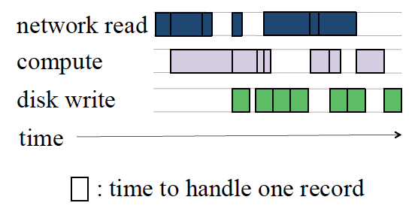
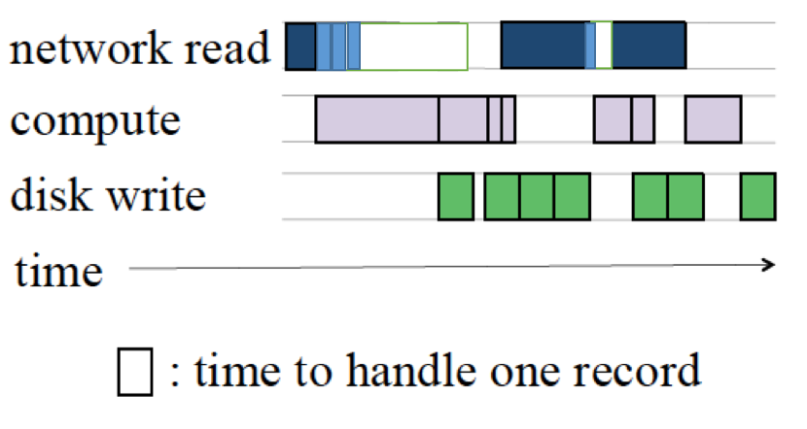
Problems of previous work
End-to-end
performance
0
5
2
4
1
1
6
1
5
2
0 0 0
6
network
optimization
Wait, my response time is the same!
I alleviated 35% network load ☺
Engineer
Boss

Slide 58
Problems of previous work
Same task, different bottlenecks.
2. Many tasks, unique performance profile.
3. Stage time counts
Fine-grained instrumentation
Blocked-time Analysis

Slide 59
Outline
Problems of previous work
Methodology
Workloads
Blocked time analysis
Simulation
Result
Future direction

Slide 60
Methodology - Workloads
Workload Name | Total queries | Cluster size | Data size
BDB (in-mem clumnar cache & on disk HDFS) | 50 | 40 cores (5 machines) | 60 GB
TPC-DS (in memory) | 140 | 160 cores (20 machines) | 17 GB (200 GB in mem)
TPC-DS (on disk) | 260 | 160 cores (20 machines) | 850 GB
Production (databricks. In-mem; on disk) | 30 | 72 cores (9 machines) | Tens of GB
Course-grained company traces (Facebook, Google, Microsoft) | Thousands of jobs | Thousands of machines | /
To simulate data queries:
SQL, join, PR, ETL, data mining, business-intelligence-style
Notes:
Thoroughly represents frequent used operations on Spark analysis
Company traces are used for sanity check and prove that our high-level takeaways are compatible with production data

Slide 61
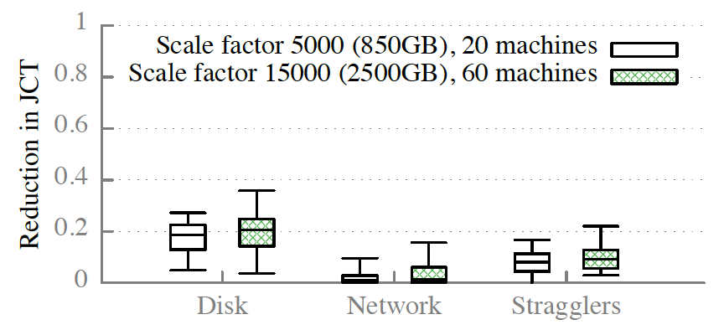
Methodology - workloads
Scalability of results ?
Not fatal (TPC-DS cluster scalability test)

Slide 62
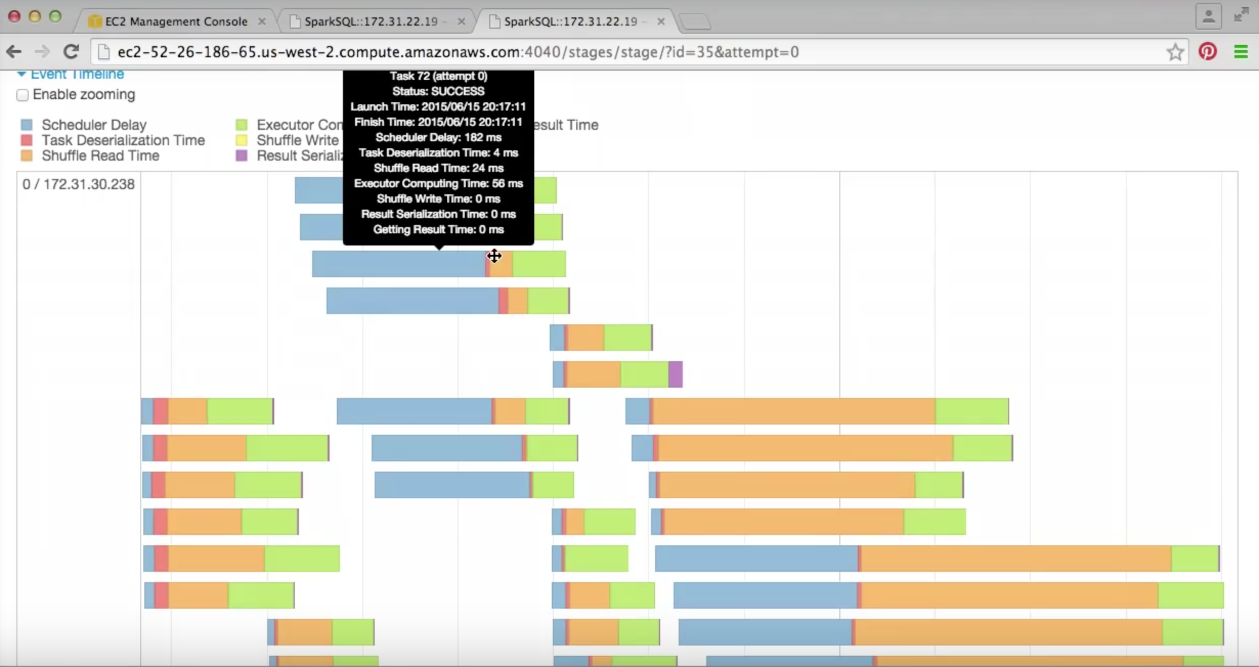
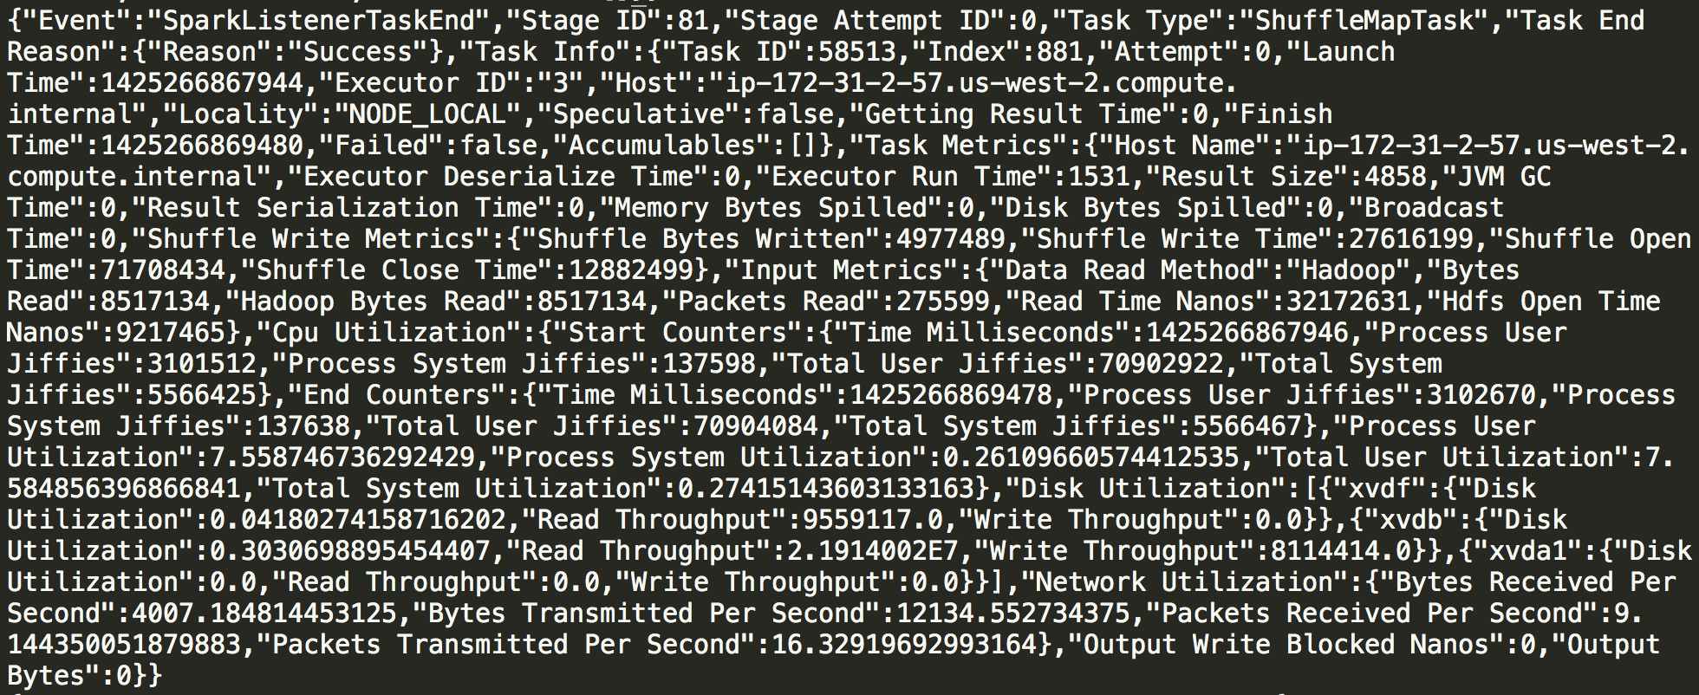
Methodology – Blocked Time Analysis
Instrumentation
Add detailed logging to Spark run-time application code
Construct detailed task profile.
From: http://kayousterhout.github.io/trace-analysis/
Notes:
http://kayousterhout.github.io/trace-analysis/

Slide 63
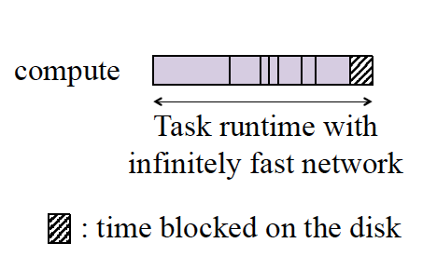
Methodology – Blocked Time Analysis
Blocked Time Analysis (per task)
Best-case scenario of possible
job completion time optimization
Notes:
Blocked time analysis provides a single, easy to understand number to characterize the importance of disk and network use.
Lacks sophistication and generality of general purpose distributed systems performance analysis tools.
[5] Performance Debugging for Distributed Systems of Black Boxes
One uses tim- ing information from RPC messages to infer inter-call causality; the other uses signal-processing techniques. Our algorithms can ascribe delay to specific nodes on specific causal paths. Unlike previous approaches to similar problems, our approach requires no modifications to applications, middleware, or messages.
Not black-box, requires adding instrumentation within the application.

Slide 64
Methodology – Simulation
Simulation (per stage)
Aim: find an upper bound of optimization
Don’t care: stage pause, data locality
Notes:
Easy to misunderstand here: simulate original, we get for benchmark 7%, production 27%. The reason why production is higher is not because task gap, it’s because of stage gap per updated SQL plan. This is not in this picture.

Slide 65
Outline
Problems of previous work
Methodology
Workloads
Blocked time analysis
Simulation
Result
Future direction

Slide 66
Result – Disk I/O
Time Blocked Analysis & Accessory Analysis
Sanity-checking
Why ?

Slide 67
Result – Disk I/O
Time Blocked Analysis
Which part of disk I/O will block the task ?
Reading input data from disk
Writing shuffle data to disk (Spark also does this)
Reading shuffle data from remote (coupled with network; upper bound)
Writing output data to disk (local or remote)
Contain approximations that exaggerate disk I/O
=> Upper bound
Notes:
Why two remote disks ? Might be typo
As we claim disk I/O is not important, exaggeration in measuring disk I/O only strengthens our claim.

Slide 68
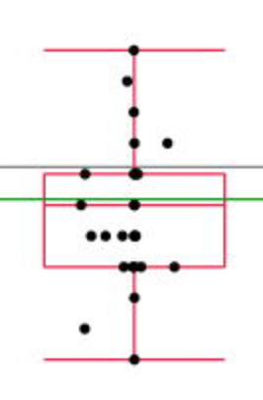
Result – Disk I/O
19%
Shuffle to disk
Notes:
And we have figure 4 showing that in-memory and on-disk query time is not affected too much after eliminate all disk access

Slide 69
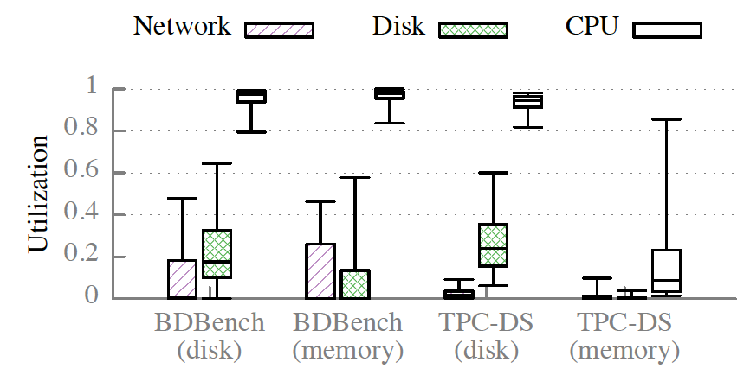
Result – Disk I/O
Accessory Analysis
Cluster configuration
Smaller [# disks] / [# CPU cores], larger block time
This paper: 1:4. Way smaller than common practice.
Upper bound !
Disk/CPU utilization
More CPU bounded than I/O bounded

Slide 70
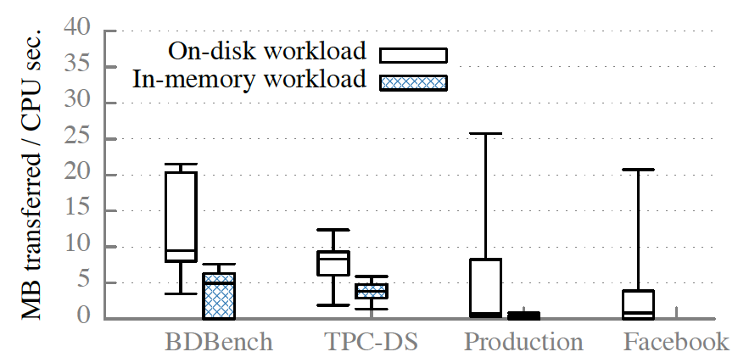
Result – Disk I/O
Sanity checking: What if the workloads are unusually CPU bound ?
No.
Our workloads are
comparable with
Facebook traces.
Notes:
Also they used a very rough estimate to claim that disk I/O of Google smaller. and Microsoft’s workload is even smaller. Do not reflect tail behavior, do not include additional I/O use.
The rough estimation assume that input data is read one from disk, intermediate data is written once and read once, the output data is written to disk three times.

Slide 71
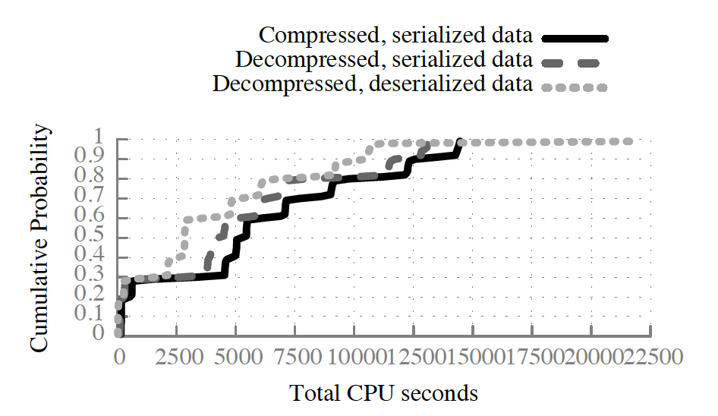
Result – Disk I/O
Why the result are different from previous work?
Today’s frameworks often store compressed data
Data must be de-serialized from a byte buffer to Java object
Choice of higher-level language (Scala, Java)
Notes:
For some work load there are 2X improvement in CPU time.
But the author doesn’t give for a chunk of data, the proportion of time spent in I/O and serialization. It’s possible that serialzation costs lots of CPU time, but it’s way smaller than I/O time.

Slide 72
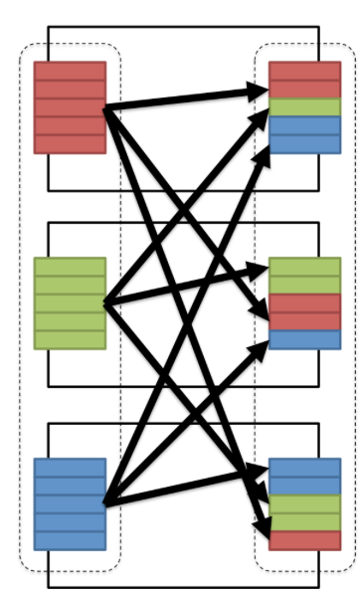
Result – Network I/O
Time Blocked Analysis
Sanity-checking
Why ?

Slide 73
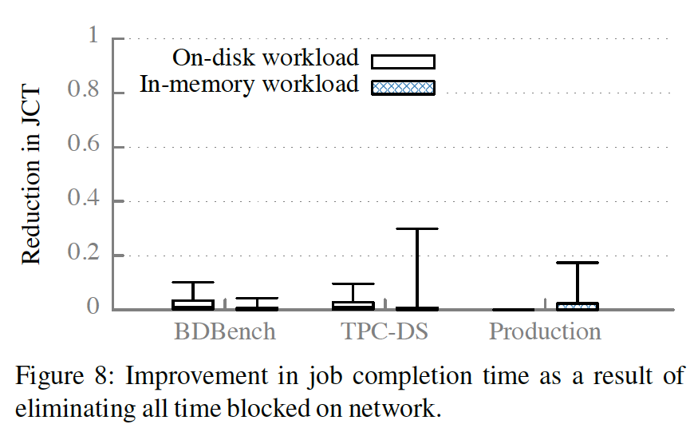
Result – Network I/O
Time Blocked Analysis
What time should be included in network I/O?
Read shuffle data over network
Write output data to remote machines
Disk and network I/O are interlaced => upper bound!
No more than 2% performance boost due to optimization

Slide 74
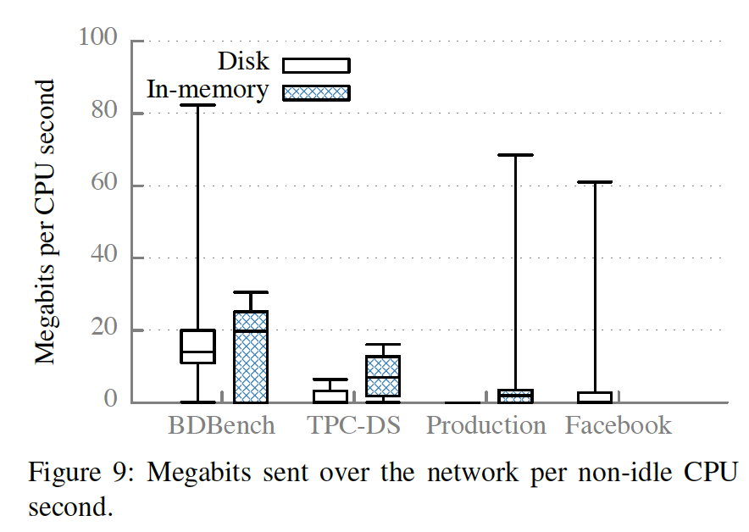
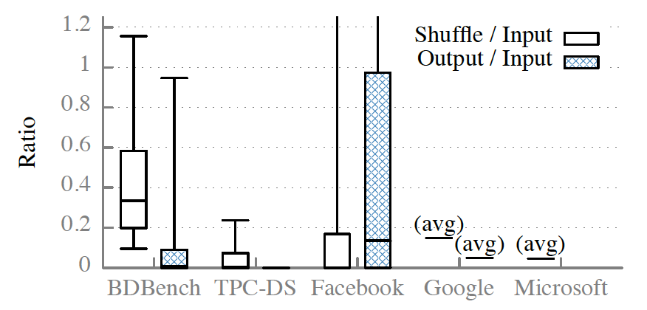
Result – Network I/O
Sanity checking: is our workload unusually network-light ?
Production workloads doesn’t have
dramatically different network requirements.
Data analysis often centers around aggregating data
to derive a business conclusion.

Slide 75
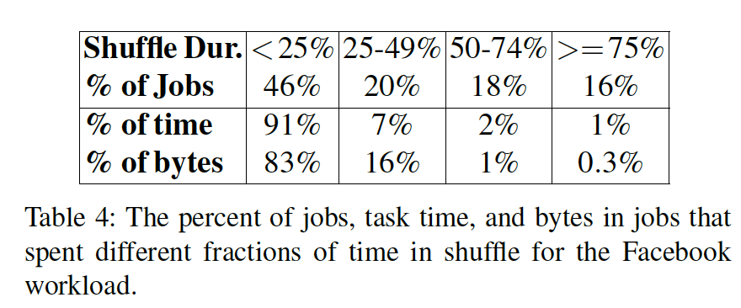
Result – Network I/O
Why the result are different from previous work?
Many papers have used workloads with ratios of shuffled data to input data of 1 or more. Not representative.
Only heuristically estimated network I/O instead of adding fine-grained instruments to measure it.
Ignored framework overhead.
Notes:
Some prior work claims that percent of job time spent in shuffle (quo: 16% jobs spent more than 75%), this is not sufficient. In fact num of jobs != execution time (performance). That 16% jobs only 1% of the total time taken by all jobs and 0.3% of the total bytes send across network.

Slide 76
Result - Straggler
Time Blocked Analysis
Why ?
Understanding stragglers

Slide 77
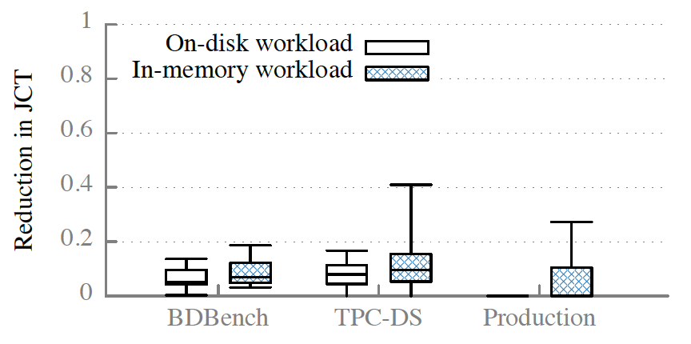
Result - Straggler
Blocked Time Analysis
Inverse progress rate (t_{task} / d_{input} _{data})
Replace tasks that is slower than median progress rate with the median progress rate
5-10%
lower
Notes:
Past work demonstrates that struggler could be significant bottleneck. Characterized some are due to data skew, but does not characterize what causes some tasks to take longer than others.
Inverse progress rate is used to let analysis be agonistic to input data skew (but we will check output data skew later)
The median improvement from eliminating stragglers is 5-10% for the big data benchmark and TPC-DS workloads. Lower for production work loads

Slide 78
Result - Straggler
Why the result are different from previous work?
Previous work may focus on improving bad straggler mitigation algorithms, not straggler themselves.
Framework differences.
Spark has much lower task launch overhead than Hadoop.
Spark break jobs into many more tasks and run each job (stage) in multiple task waves.
Healthier machine run more
Sited from:
https://github.com/jaceklaskowski/mastering-apache-spark-book/blob/master/spark-taskschedulerimpl.adoc#speculative-execution
Notes:
Recent frameworks have optimized struggler at framework level. Spark breaks jobs into many more tasks (user explictily program), with its task assign protocol (speculative execution, run a new copy of slow task in parallel ), struggler will be mitigated.

Slide 79
Result - Straggler
Understanding strugglers
A straggler as caused by X if it would not have been considered a straggler had X taken zero time for all of the tasks in the stage
Case study: EC2 instances from ext3 to ext4
Struggler causes vary across workloads and even within queries for a particular workload
Notes:
Straggler causes vary across workloads and even within queries for a particular workload
For some queries, most strugglers can be attributed to HDFS, some can be attributed to garbage collection
The fact that some straggler tasks are caused by long times spent blocked on disk does not necessarily imply that overall, eliminating time blocked on disk would yield a large improvement in job completion time (end-to-end performance)
Some causes like output size and running before code has been jitted cannot be mitigated.

Slide 80
Summarize
Proposed blocked time analysis using instrumentation in Spark
Provide detailed performance study of three workloads. Proved jobs are often not bottlenecked on I/O, network performance
Many causes of strugglers can be identified.
Not the last word on performance of analytics frameworks.

Slide 81
Future direction
Author think
Performance understandability should be first-class concern in system design
Unveil performance factors facilitates performance optimization
I think
More workloads
Larger scale
More frameworks (OpenMP, MPI, GraphLab, Pregel, etc.)
More combined analysis (will network + cpu make a difference ?)
Balance academia and industry (when to focus and when to see the whole picture).
End-to-end performance !

Slide 82
Thank you

