Slide 1
CS239-Lecture 7 UDF Optimizations
Madan Musuvathi
Visiting Professor, UCLA
Principal Researcher, Microsoft Research

Slide 2
Schedule update
 | Approximation
May 2 | Guest Lecture Andy Konwinski of Databricks
May 4 | a) BlinkDB: Queries with Bounded Errors and Bounded Response Times on Very Large Data | Zhaoxing Bu
 | b) Quickr: Lazily Approximating Complex AdHoc Queries in BigData Clusters | Qi Zhao
 | Graph Analytics
May 9 | a) Distributed GraphLab: A Framework for Machine Learning and Data Mining in the Cloud | Tushar Sudhakar Jee
 | b) Scalability! But at what COST? | Zhouyihai Ding
May 11 | a) Latency-Tolerant Software Distributed Shared Memory | David Hong
 | b) Arabesque: A System for Distributed Graph Mining | Yushu Qin
 | Curation & Transactions
May 16 | a) Wrangler: Interactive Visual Speciﬁcation of Data Transformation Scripts | Sakshi Goplani
 | b) Data Curation at Scale: The Data Tamer System | Saswat Padhi
May 18 | a) No compromises: distributed transactions with consistency, availability, and performance | Lun Liu
 | b) Type-Aware Transactions for Faster Concurrent Code | Nisarg Shah
 | Large Scale Machine Learning + Project Presentations
May 23 | a) Large Scale Distributed Deep Networks | Liqiang Yu
 | b) Scaling Distributed Machine Learning with the Parameter Server | Hao Chen
May 25 | Project Presentations

Slide 3
Paper presentations
read your paper well before the presentation (ideally, at least a week before)
- consult with me on the difficult parts
assume everyone has read the paper
- your goal is to quickly summarize the paper
- bring out the key points for discussion in the class
- cull insights about the topic by reading related work
plan on 15-20 minute talk with 25 minutes discussion

Slide 4
Pop Quiz
The State of California recently decided to charge sales taxes on Amazon shipments to California residents. The following query calculates the additional taxes incurred by this change:
purchases: a set of (user_id, purchased_product, price_before_taxes)
addresses: a set of (user_id, address, zipcode)
A = join(purchases, addresses, purchases.user_id == addresses.user_id)
B = reduce(A, user_id, sum(price_before_taxes))
C = filter(B, if_in_california(zipcode))
Output C
Name two optimizations that you can perform on this query. Justify why these optimizations will produce a faster plan

Slide 5
Opening the Black Boxes in Data Flow Optimization
Yi Ding ydinglavender@ucla.edu

Slide 6
Overview
What is a Black Box?
User Define Functions!
What does “open” mean?
Static Code Analysis!
No Knowledge of Algebraic Properties!

Slide 7
Background
Stratosphere:
Nephele engine + PACT complier
PACT | Map-Reduce
Map, Reduce, Cross, Match, CoGroup | Map, Reduce
Arbitrary acyclic data flow graphs | Map$→$Reduce
Operator: Second-Order Function + First-Order User-Defined Function(UDF).

Slide 8
Background

Slide 9
Example 1
$$\left\langle A\right.,\left.B\right\rangle$$
$$P:I→{Map}_{1}→{Map}_{2}→{Map}_{3}→O$$
$${Map}_{1}−f_{1}:B→\left|B\right|$$
$${Map}_{2}−f_{2}:A→\left\{\begin{aligned}A, A≥0 \\ ⊥, A<0\end{aligned}\right.$$
$${Map}_{3}−f_{3}:A→A+B$$
$$\left\langle 2,\left.−3\right\rangle \right.→f_{1}→\left\langle 2,\left.3\right\rangle \right.→f_{2}→\left\langle 2,\left.3\right\rangle \right.→f_{3}→\left\langle 5,\left.3\right\rangle \right.$$
$$\left\langle −2,\left.−3\right\rangle \right.→f_{1}→\left\langle −2,\left.3\right\rangle \right.→f_{2}→⊥f_{3}→⊥$$

Slide 10
Reorder!
$$P^{′}:I→{Map}_{2}→{Map}_{1}→{Map}_{3}→O$$
$$\left\langle 2,\left.−3\right\rangle \right.→f_{2}→\left\langle 2,\left.−3\right\rangle \right.→f_{1}→\left\langle 2,\left.3\right\rangle \right.→f_{3}→\left\langle 5,\left.3\right\rangle \right.$$
$$\left\langle −2,\left.−3\right\rangle \right.→f_{2}→⊥→f_{1}→⊥f_{3}→⊥$$
$P^{′}$ is better!
$$P^{′′}:I→{Map}_{2}→{Map}_{3}→{Map}_{1}→O$$
$$\left\langle 2,\left.−3\right\rangle \right.→f_{2}→\left\langle 2,\left.−3\right\rangle \right.→f_{3}→\left\langle −1,\left.−3\right\rangle \right.→f_{1}→\left\langle −1,\left.3\right\rangle \right.$$
Wrong answer!
We don’t have any knowledge of $f_{1}$, $f_{2}$ and $f_{3}$!

Slide 11
Review Example
Problem!!!!!
$$P:I→{Map}_{1}→{Map}_{2}→{Map}_{3}→O$$
$${Map}_{2}−f_{2}:A→\left\{\begin{aligned}A, A≥0 \\ ⊥, A<0\end{aligned}\right.$$
$${Map}_{1}−f_{1}:B→\left|B\right|$$
$${Map}_{3}−f_{3}:A→A+B$$
$$\left\langle 2,\left.−3\right\rangle \right.→f_{1}→\left\langle 2,\left.3\right\rangle \right.→f_{2}→\left\langle 2,\left.3\right\rangle \right.→f_{3}→\left\langle 5,\left.3\right\rangle \right.$$
$$P^{′′}:I→{Map}_{2}→{Map}_{3}→{Map}_{1}→O$$
$$\left\langle 2,\left.−3\right\rangle \right.→f_{2}→\left\langle 2,\left.−3\right\rangle \right.→f_{3}→\left\langle −1,\left.−3\right\rangle \right.→f_{1}→\left\langle −1,\left.3\right\rangle \right.$$
Wrong answer!

Slide 12
Conditions
Global record: $\left\{A,B\right\}$
Read set: $R$ – all attributes that might influence the operator’s output.
Write set: $W$ – all attributes whose values change after the operator.
$$R_{f_{1}}=\left\{B\right\},W_{f_{1}}=\left\{B\right\},R_{f_{2}}=\left\{A\right\},W_{f_{2}}=φ,R_{f_{3}}=\left\{A,B\right\},W_{f_{3}}=\left\{A\right\},$$
Conflict – one attribute appears in both operators’ write set or in one operator’s read set and in another’s write set.
$f_{1} \& f_{3}$ Conflict!!!

Slide 13
Condition
ROC Condition
$$R_{f_{1}}∩W_{f_{2}}=R_{f_{2}}∩W_{f_{1}}=W_{f_{1}}∩W_{f_{2}}=φ$$

Slide 14
Example 2
$$P:I→{Map}_{f}→S→{Reduce}_{g}→O$$
$$f:emit all odd values of A and B$$
$$g:calculate the sums of B using A as key,$$
$$and append C as the sum$$
ROC Holds!
$$R_{f}=W_{f}=φ,R_{g}=\left\{A,B\right\},W_{g}=\left\{B,C\right\}$$

Slide 15
Condition
KGP condition
function $f$, when applied to a set of records
$I_{k}$ with the same value for $K$, either emits or filters all these records.
Together with ROC & KGP, we can determine almost all UDFs whether they can be reordered!

Slide 16
$${Cross}_{f}\left(R,S\right)≡{Map}_{f}\left(R×S\right)$$
$${Match}_{f}\left(R,S\right)≡{Map}_{f^{′}}\left(R×S\right)$$
$${Map}_{f}\left(R×S\right)≡{Map}_{f}\left(R\right)×S iff \left(R_{f}∪W_{f}\right)∩S=φ$$
$${Match}_{g}\left({Match}_{f}\left(R,S\right),T\right)$$
$$→{Match}_{g}\left({Map}_{f^{′}}\left(R×S\right),T\right)$$
$$→{Map}_{g^{′}}\left({Map}_{f^{′}}\left(R×S\right)×T\right)$$
$$\left(R_{f^{′}}∪W_{f}\right)∩T=φ$$
$$→{Map}_{g^{′}}\left({Map}_{f^{′}}\left(R×S×T\right)\right)$$
$$ROC Condition$$
$$→{Map}_{f^{′}}\left({Map}_{g^{′}}\left(R×S×T\right)\right)$$
$$→{Map}_{f^{′}}\left(R×{Map}_{g^{′}}\left(S×T\right)\right)$$
$$\left(R_{g^{′}}∪W_{g}\right)∩R=φ$$
$$→{Map}_{f^{′}}\left(R×{Match}_{g}\left(S,T\right)\right)$$
$${Match}_{f}\left(R, {Match}_{g}\left(S,T\right)\right)$$

Slide 17
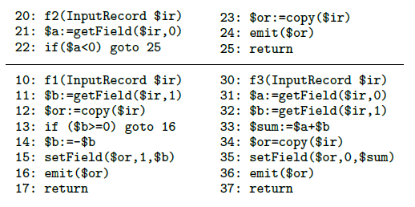
Implementation
Read set $\$t≔getField(\$ir,n)$
Write set $\$or=new OutputRecord(\$ir)$,
$$setField\left(\$or,n,\$t\right),$$

Slide 18
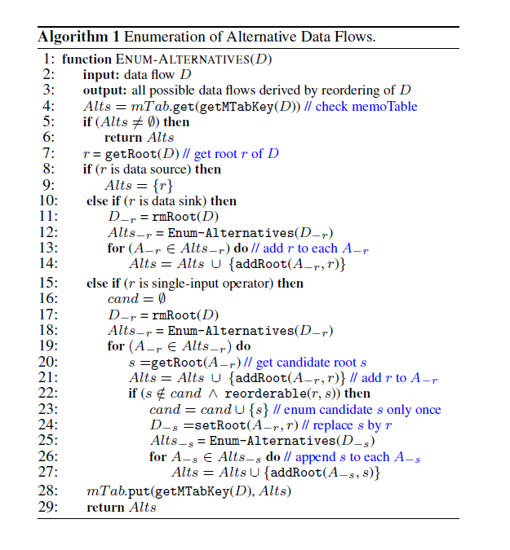
Enumeration

Slide 19
Evaluation
Relational Online Analysis Processing
Text mining
Non-relational Clickstream Processing
New Model:
Static Code Analysis, Enumeration
Cost Model:
Network IO, Disk IO, CPU Cost

Slide 20
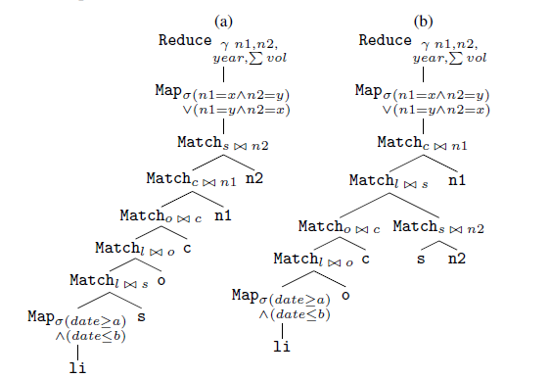
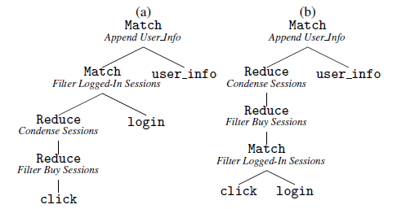
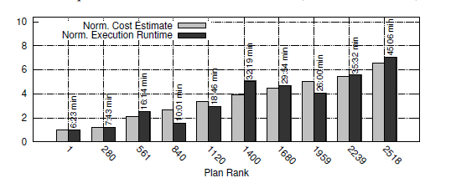
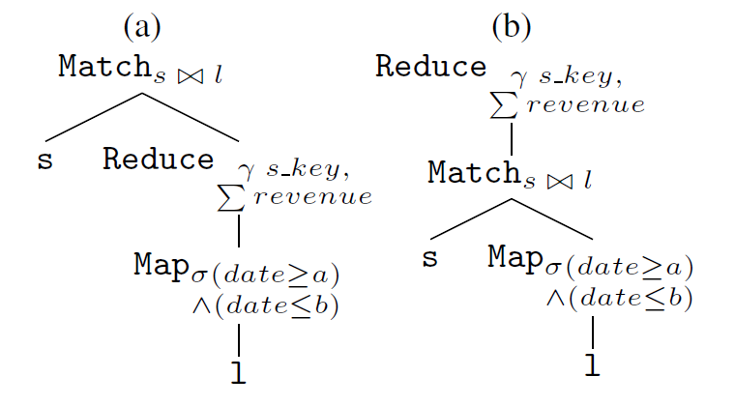
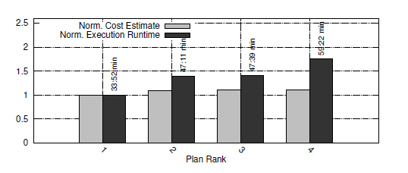
Evaluation

Slide 21
Future Work
Enumeration costs time
To identify beneficial reorderings
Wider range of optimizations
Semantic information

Slide 22
Spotting Code Optimization in Data Parallel Pipelines through PeriSCOPE
Muhammad ALi Gulzar

Slide 23
Outline
Introduction
Running Example
Optimizations using PeriSCOPE
Column Reduction
Early Filtering
Smart Cut
Evaluation

Slide 24
Data Shuffling is Expensive

Slide 25
Disconnect b/w Pipeline and Code Optimizers
Pipeline Optimizers
Logical optimizers work on high level pipeline topology
Unable to consider procedural code (black box) while optimizing
Compiler Optimizations
Works only on user defined functions
Unaware of the pipeline -> No inter-stage optimizations
Manual Optimizations
Tedious
Error-prone
Spark, MapReduce etc , being unaware of the UDFs, apply only logical optimizations on the workflow

Slide 26
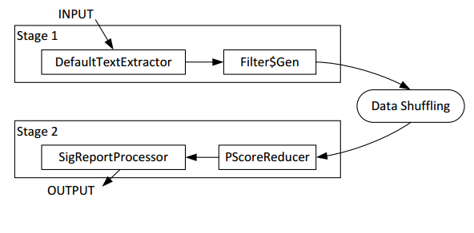
Example
If filter GetLength(query) > 4 was written in the procedural code PScoreReducer then this optimization could not be performed

Slide 27
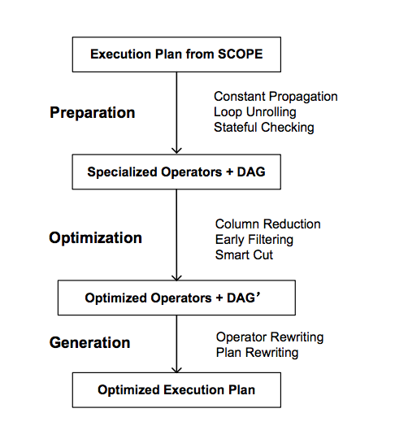
PeriSCOPE -- Overview
Optimizes procedural code of SCOOPE programs
Connects data-flow of the program to the high-level pipeline
Searches for code candidates susceptible to optimizations
Three core optimizations:
Column reduction
Early filtering
Smart cut

Slide 28
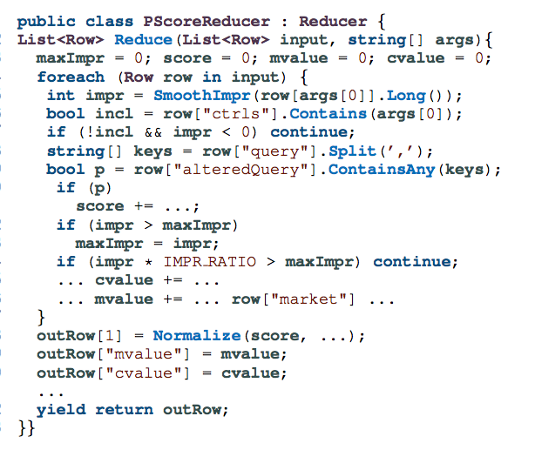
Running Example

Slide 29
Column Reduction
Problem
Unused column in data parallel programs consume high network I/O
Well established concept i.e. Early Projection and also applied on procedural code (UDFs) [Manimal '11]
Solution by PeriSCOPE
Analyze dependency between input and output columns of all operators
Remove unused columns and associated computations
Limitation in PeriSCOPE's column reduction
No column reduction can be applied if the column name is unresolved
Notes:
Commonly occur due to code reuse

Slide 30
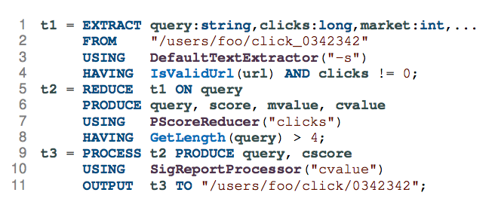
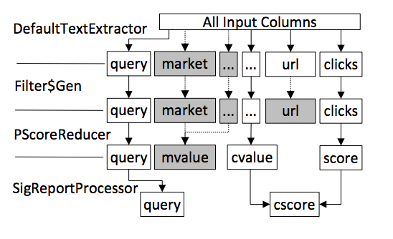
Column Reduction in Example
Notes:
Why didn't we removed url ?

Slide 31
Code Motion
Moving code from user defined functions across stages
Goal is to reduce the number and size of inter stage rows.
Program correctness has to be maintained --- Safe Code Motion
Safety Rules
Rule 1: Must not move statement if it generates shuffle-key column
Rule 2: Must not move stateful statement across shuffle
Rule 3: Must not filtering statement if it is, or is reachable from , a stateful statement
Perform loop dependency analysis to confront dependencies in different iterations of loop
Notes:
Stateful : Computations relies on order and number of rows

Slide 32
Early Filtering
Filtering earlier reduces the I/O burden on shuffling
Similar to Early Selection
Related works [Manimal etc] perform the same optimization—but can not rewrite UDFs
How ?
First UDF after shuffling is analyzed for filtering statements
Stateful filtering statements are removed
Backward slice to collect the filter and the statements that can affect it
Removal and addition of code slice into appropriate earlier location (Rewriting UDFs)

Slide 33
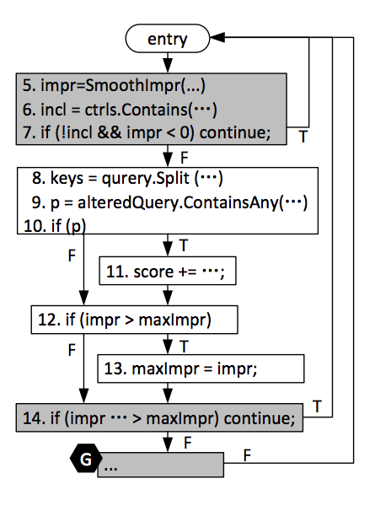
Early Filtering -- Example
Notes:
Why are if(p) and if(impr > maximpr) not marked as filtering statements?

Slide 34
Smart Cut
Minimize cross stage data flow
Similar to combiners but more fine grained – instruction level
How ?
Move row-local computations upstream to leverage parallelism
Builds a data dependency graph -- Vertices are instructions, Edges are RAW
Edge weight is name and size of the dependent variable
Applies a minimum cut algorithm (one directional, same variables are counted once)
Notes:
Assumption is that the reducer is running a loop over all the collected rows one by one without any manupulation

Slide 35
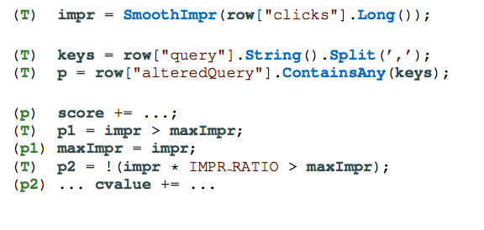
Smart Cut -- Example

Slide 36
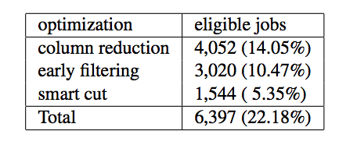
Evaluation
Optimization coverage evaluation on 28K jobs
Nature and type of jobs are not clear

Slide 37
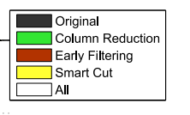
Case Study
Performance improvements
I/O reduction at shuffling phase
Notes:
Case 1 - > For optimizations, I/O is lower for column reduction than smart cut but time is greater than smart cut.
Ans: Instructions moved across in smart cut are computationally expensive and making them run on parallel make it faster.

Slide 38
Thoughts
Intelligent tool to perform optimizations from within UDFs.
Not platform specific – Can be generalized to other frameworks
Early filtering and column reduction is already well established optimizations in Databases
Column reduction can only be applied only to columnar data engines
In the context of Spark, users are bound to use specific APIs designed for filters. Early filtering is not needed.

