Slide 1
CS239-Lecture 8 Streaming Abstractions
Madan Musuvathi
Visiting Professor, UCLA
Principal Researcher, Microsoft Research

Slide 2
Efficient Pattern Matching over Event Streams
Zhanwei Ye
04/20/16

Slide 3
Outline
Background
Formal Evaluation Model (NFA^{b})
Runtime Complexity Analysis
Runtime Algorithms and Optimizations

Slide 4
Background
Event Stream Processing(ESP) deals with the task of processing streams of event data with the goal of identifying the meaningful pattern within those streams, employing techniques such as detection of relationships between multiple events, event correlation, event hierarchies, and other aspects such as causality, membership and timing.
Pattern matching over event streams is increasingly being employed in many areas
Two challenges
Richer Languages
Efficiency over Streams
The goal of author’s work is to provide a fundamental evaluation and optimization framework for the new class of pattern queries over event streams.

Slide 5
Background – Event Pattern Language
The PATTERN clause specifies a sequence pattern
The WHERE clause uses these variables to specify predicates on individual events as well as across multiple events (enclosed in the ‘{’ ‘}’ pair, called event selection strategy)
the WITHIN clause to specify a time window over the entire pattern.
Notes:
detects shoplifting activity in RFID-based retail management
detects contamination in a food supply chain
captures a complex stock market trend

Slide 6
Event Selection Strategy
Strict contiguity
two selected events must be contiguous in the input stream
Partition contiguity
two selected events do not need to be contiguous; the next relevant event must be contiguous to the previous one in the same partition.
Skip till next match
all irrelevant events will be skipped until the next relevant event is read
Skip till any match
skip till any match relaxes the previous one by further allowing non-deterministic actions on relevant events

Slide 7
Formal Evaluation Model (NFA^{b})
NFA^{b} = Nondeterministic Finite Automaton and a match buffer
Formally, an NFA^{b} automaton, A = (Q,E,θ,q₁,F), consists of a set of states, Q, a set of directed edges, E, a set of formulas, θ, labelling those edges, a start state, q1, and a final state, F.
State
Edge
Formula
Non-determinism

Slide 8
Query Compilation using NFA^{b}
Step 1
NFA^{b} structure
Step 2
Predicates
Step 3
Event selection strategy
Step 4
Time window
Notes:
Q about step 1
It’s not clear about how can we separate a Kleene plus operator into two state.
Edge-state: singleton state or the first state has a forward begin edge
second state, p[i], of a pair has a forward proceed edge, and a looping take edge
Every state (except the start and final states) has a looping ignore edge

Slide 9
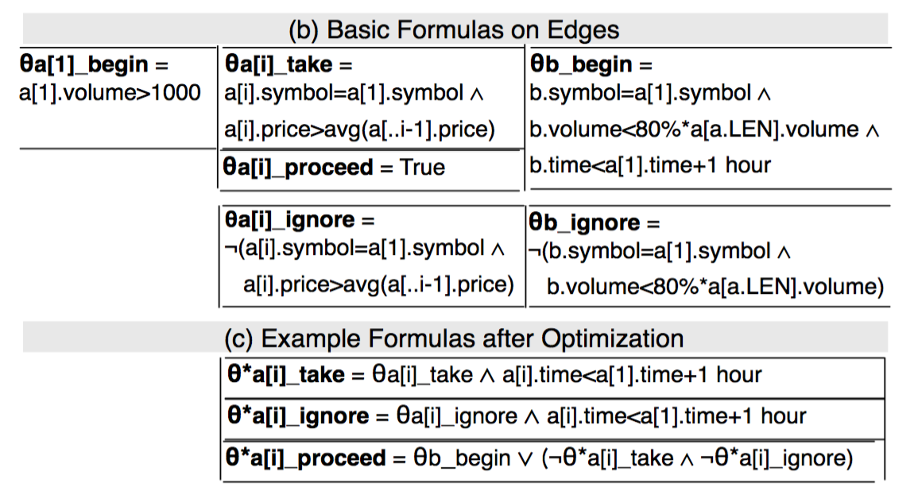
Query Compilation using NFA^{b}
Two optimizations:
Step 5
Pushing the time window early
Step 6
Constraining proceed edges
Notes:
Step 5 Pushing the time window early
Just like what previous paper do, it has the function as early filtering
At the state a[i], this proceed edge causes nondeterminism with the take (or ignore) edge, resulting in a new run created for every event. To avoid nonviable runs, deciding if it can satisfy the begin condition of the next state b.

Slide 10
Expressibility of NFA^{b}
Though the full SQL with recursion expresses all polynomial- time computable queries over streams and it is a strict superset of D(NFA^{b}), D(NFA^{b}) is enough to express necessary queries for pattern matching over event streams.
Notes:
Not go deep about it. Just get the conclusion about it.

Slide 11
Runtime Complexity Analysis
Simultaneous runs
two sources:
1. an event sequence initiates multiple runs from the start state and a newer run can start before an older run completes
2. the inherent non-determinism in NFA^{b}
Four types of non-determinism in NFA^{b}
Take – Proceed
Ignore – Proceed
Take – Ignore
Begin – Ignore
Duration of a run
Notes:
The runtime complexity of evaluating pattern queries is reflected by a potentially large number of simultaneous runs, some of which may be of long duration.
These worst case bounds indicate that a naive approach that implements runs separately may not be feasible.
The importance of sharing and coping with output cost
two output modes for applications to choose based on their uses of the matches and requirements of runtime efficiency

Slide 12
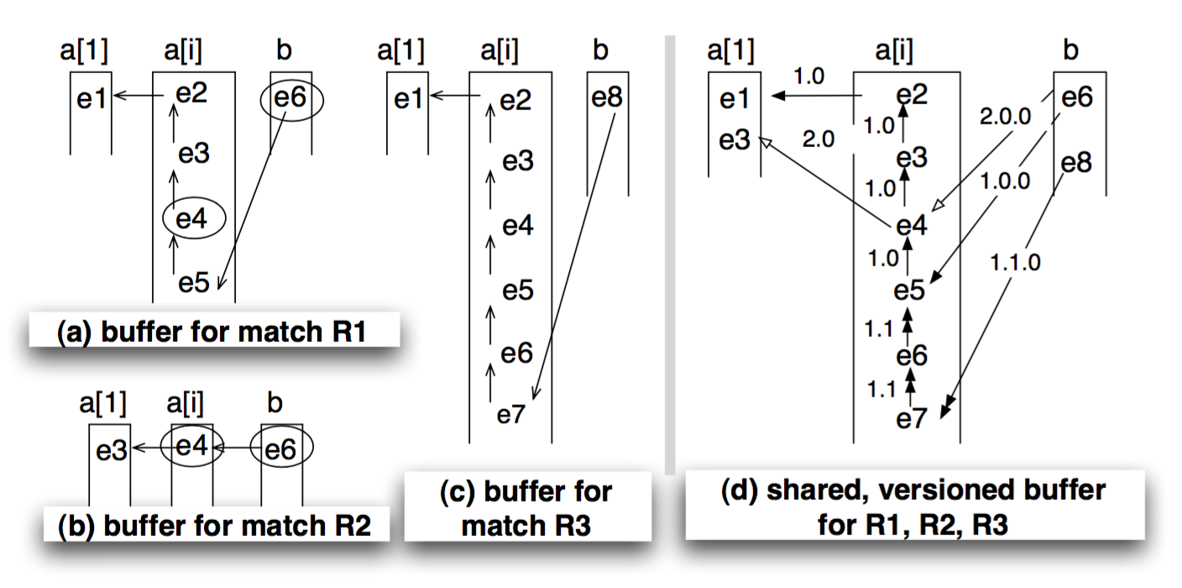
A Shared Version Match Buffer
To retrieve the complete match correctly, we assign a version number to each run
Notes:
Each buffer contains a series of stacks, one for each state except the final state.
For any event that triggers a transition to the final state, a traversal in the buffer from that event along the predecessor pointers retrieves the complete match.
merging the same events in those stacks while preserving their predecessor pointers.
It assigns a version number to each run and uses it to label all pointers created in this run

Slide 13
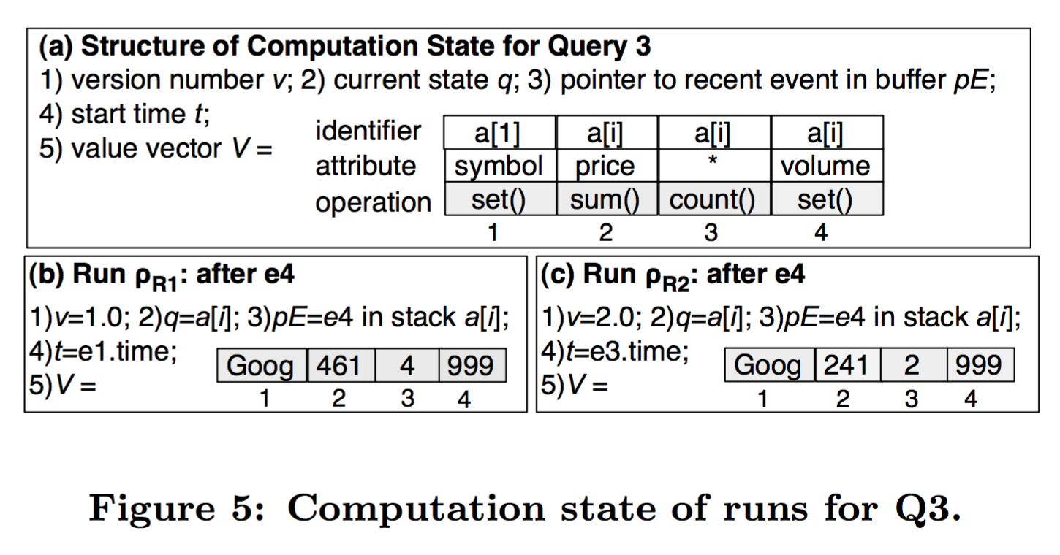
NFA^{b} Execution with Multiple Run
Use Computation state to minimize set of values necessary for future evaluation of edges formulas
Notes:
creating a small data structure to maintain the computation state separately from the buffer.

Slide 14
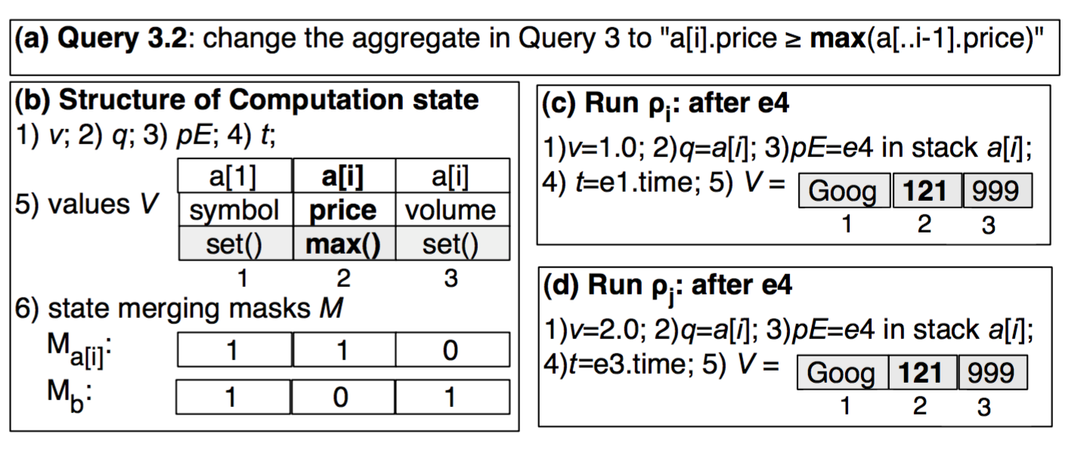
Merging Equivalent Runs
Two runs have the same computation state at present, then their processing of all future events will be the same and thus can be merged.
State merging masks M
Notes:
computation state will be extended with all the version numbers and start times of the merged runs.
To allow the combined run to proceed as far as possible, we set the start time of the combined run as that of the youngest merged one

Slide 15
Backtrack Algorithm
The basic idea is that we process a single run per partition at a time, which we call the singleton run for the partition.
Processor usage V.S. Time

Slide 16
DISTRIBUTED Complex event processing with query rewriting
Nicholas Poul Schultz-Moller, Matteo Migliavacca, Peter Pietzuch
Slides by Shaghayegh Mardani

Slide 17
Complex Event Processing Systems
New data as stream of events
Query as high-level patterns of events
Example: Credit card fraud detection
To scale such systems:
Distributing pattern detection across additional computational resources
Optimize resource usage through query rewriting

Slide 18
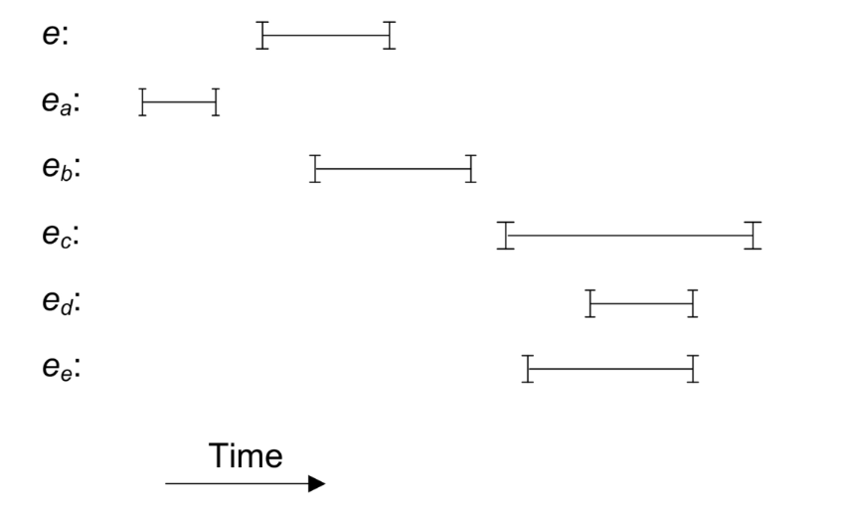
Event and Temporal Model
Event model e = <s, t>
Temporal Model <T, ≺, SUCC, ⊗>
associative “next” operator ‘;’
E1; (E2; E3) = (E1; E2); E3
Immediate successor of e : $e_{e}$
t = [$t_{s}$, …, $t_{e}$]

Slide 19
Event Query Language and Operators
Event Query Language:
SELECT selection FROM event_pattern WHERE qualifications
Operators:
Union ( | )
Next ( ; )
Iteration ( + )
Exception ( \ )
Filter
Time

Slide 20
Optimization Goals
Query Rewriting:
Minimize Operators’ CPU usage
Lower detection latency
Distributed Deployment
Reuse existing operators to minimize CPU usage and latency
Minimize variance of CPU usage to avoid overloading

Slide 21
Cost Model
Asymptotic costs of operators
Ignore predicate evaluation and selectivity of operators

Slide 22
Cost Model (Cont.)
Cost of Next Operator:
Cost of deployment plan:

Slide 23
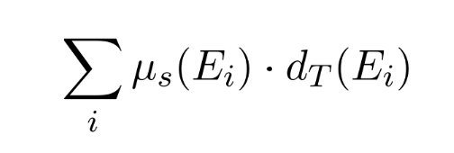
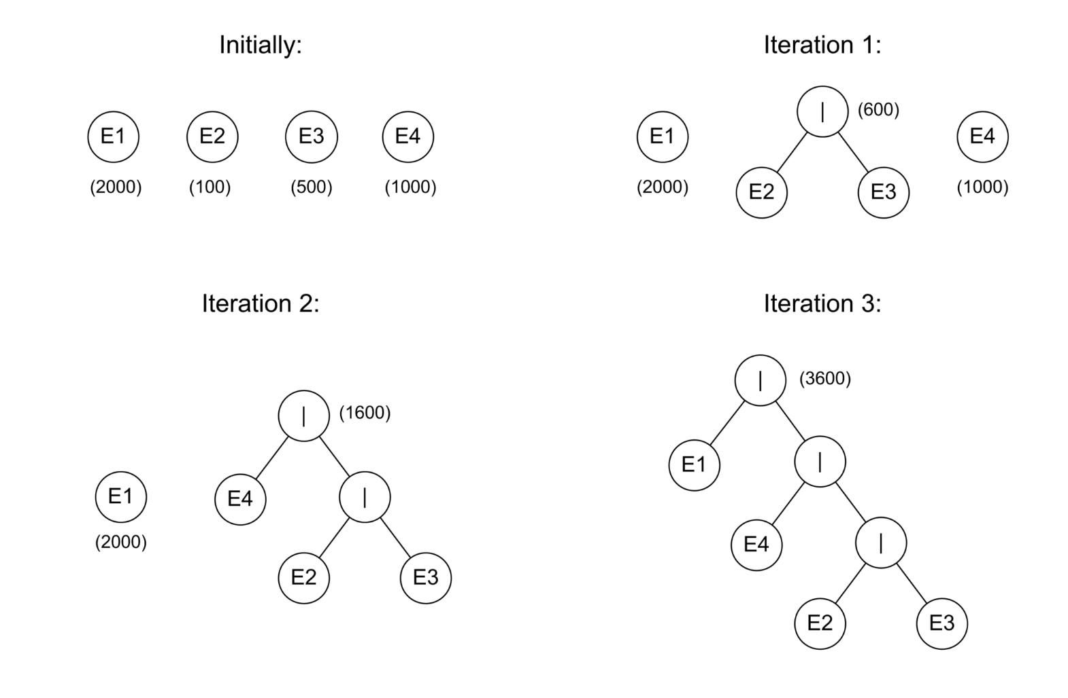
Query Rewriting
Union Operator
Total Cost =
Greedy Huffman Algorithm

Slide 24
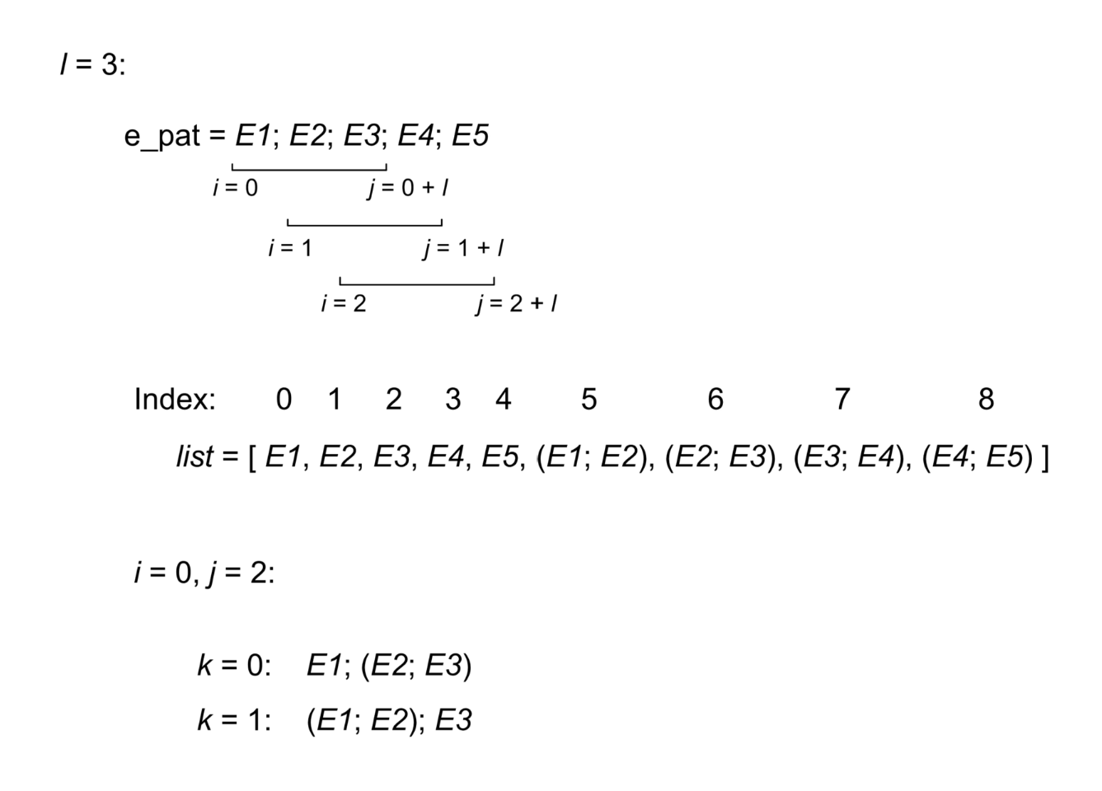
Query Rewriting (Cont.)
Next Operator:
Dynamic Programming
Exception Operator
E1; (E2\E3) = (E1;E2)\E3

Slide 25
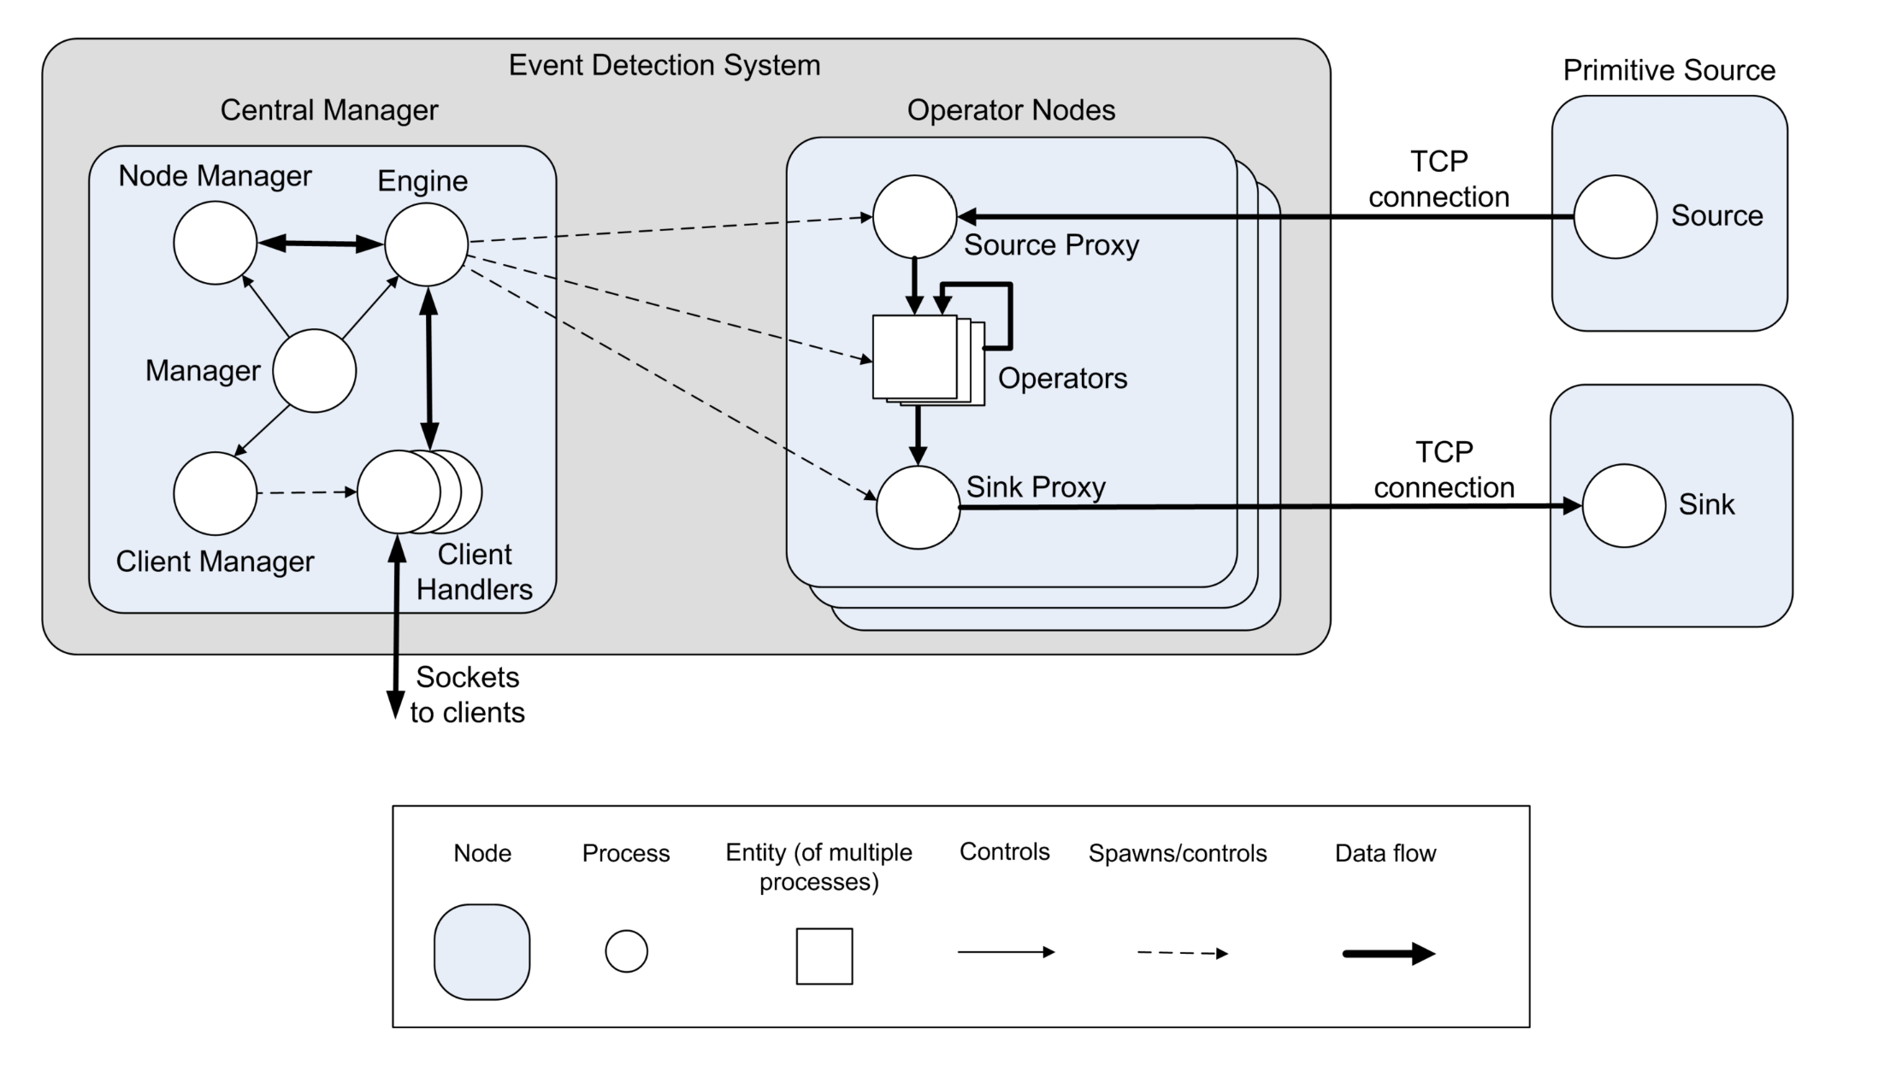
Operator Distribution
Reusing already deployed operators (stored in a hash map)
Deploy rest of operators in a bottom-up manner
select the lowest cost node to place the operator O(Q.N)

Slide 26
Evaluation
Single Node case (rewriting queries)
5 run average results

Slide 27
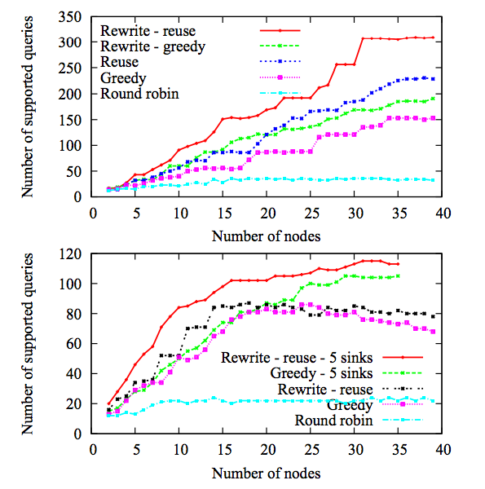
Evaluation (Cont.)
Distributed case

Slide 28
Future Work?
More complex optimizations:
(E1; E2) | (E1; E3) = E1; (E2 | E3)

