Slide 1
CS239-Lecture 9 Array Processing
Madan Musuvathi
Visiting Professor, UCLA
Principal Researcher, Microsoft Research

Slide 2
Mid-point feedback
Are you learning from the papers we are reading?
Do you find class discussions helpful?
Does preparing for the class presentation help?
What would you change moving forward?

Slide 3
Architecture and Demonstration of SciDB
Tian Yu

Slide 4
What is SciDB
LSST(Large Synoptic Survey Telescope) is the next “big science” astronomy project. They realized current DB can not handle more and more data in 2007.
RDBMS: wrong data model, wrong operators, missing required capabilities.
Why can’t somebody do for science what RDBMS did for business???
SciDB is an open-source analytical database oriented toward the data management needs of scientists. It mixes statistical and linear algebra operations with data management ones, using a natural nested multi-dimensional array data model.
SciDB

Slide 5
SciDB vs RDBMS
 | SciDB | RDBMS
schema | Shared-nothing | Shared-nothing
Data model | Array | Table
Overhead of loading data | Support “In Situ” data | Must load data into system
storage | Overlapping between chunks | No overlapping
provenance | Support | Not support
uncertainty | Support | Not support
Version | Support | Not support
Built-in operators | No | Yes

Slide 6
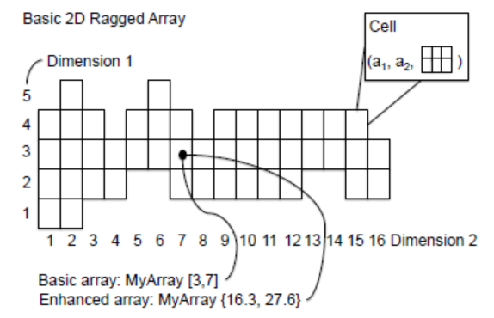
Array Data Model
Why using array rather than table?
Most complex analytics the science community uses are based on core linear algebra operations.
Arrays can have any number of named dimensions.
Dimension can be traditional integer, non-integer or even user-defined data type.
To facilitate queries, non-integer dimensions are stored as integer mapping index.
Each dimension either has starting and ending points, or be unbounded.

Slide 7
Array Data Model (cont’d)
Each combination of dimension values defines a cell of array.
Allow nested array data model and support hierarchical decomposition of cells.
Every cell in a given array has same data types for its values including scalars and arrays.
How to specify an array in SciDB?
CREATE ARRAY example<M: int, N: float> [I=1:1000, J=1000:2000]
//creating an array with attributes M and N along with dimensions I and J.

Slide 8
Storage of Arrays
Chunk arrays into blocks using some (or even all) of the dimensions with certain stride. Each is stored in a container(file) on disk.
fixed logical size but different physical size or fixed physical size?
In some cases, CPU time can be economized by splitting chunk internally into tiles. Compression system optionally elect to tile the chunk.
To facilitate neighborhood queries, chunks in SciDB should overlap by a specific amount in each of several dimensions, which is the size of the largest feature that will be searched for.
SciDB allows the partitioning to change over time: e.g., a first partitioning scheme is used for time less than T and second one for time greater then T.
 | Fixed logical size | Fixed physical size
advantages | Simple addressing schema Easily join(frequent ) | Enable simple main memory buffer pool
disadvantages | Complex main memory buffer pool | Extra indexing scheme like R-tree to track chunk definitions

Slide 9
Storage of Arrays(example)
Suppose we want to find areas of imagery with larger sensor amplitude than neighboring area.
In RDBMS, some calculation of the chunk requires data of other chunks.
This query is not “embarrassingly parallel”
In SciDB, to facilitate such neighborhood queries, the chunks can be specified to overlap by a specific amount in each of several dimensions.
Parallel feature extraction can occur without requiring any data movement
If insufficient overlap is present, SciDB reshuffles data to generate required overlap.

Slide 10
Query operator and Language
No built-in operators! Why and How?
Structural operators: subsample, cross product, concatenate, remove dimension…
Content-dependent operators: filter, update…
Both structural and content-dependent operators: join…
AQL(SQL-like language) is compiled into AFL(functional language)

Slide 11
Query Language and operator(Join)
1. Equi-dimensional joins:
Two dimensions: I and J
2. Non equi-dimensional joins:
Three dimensions: I from A, I
from B and J
3. Attribute joins:
In the case of a Join on an m-dimensional array and
an n-dimensional array that involves only k index attributes
from each of the arrays in the join predicate, the result will
be an (m+n-2k)-dimensional array with concatenated cell
tuples wherever the predicate is true.
Four dimensions: I from A, I from B
J from A and J from B

Slide 12
Query Language and operator
Bulk changes to dimensions, e.g. push all dimension values up one to make a slot for new data;
Flip dimensions for attributes, e.g. replace dimension I in array A with a dimension made up from d.
Transform one or more dimension, e.g. change I and J into polar co-ordinates.
Increment a value for a specific cell

Slide 13
Query Processing
Three guiding principles of query processing in SciDB:
Aim for parallelism in all operations with as little data movement as possible.
Incremental optimizers have more accurate size information and use this to construct better query plans
Use a cost-based optimizer.
Until no more {
Choose and optimize next sub-plan
Reshuffle data, if required
Execute a sub-plan in parallel on a collection of local nodes
Collect size information from each local node
}
Examines operations that commute, and push the cheaper commuting operation down the tree(e.g., filter first, then join)
If an operation cannot be run in parallel because of poorly distribution, SciBD will reshuffle it.
Tenet 2: result size information is beneficial for picking next sub-tree

Slide 14
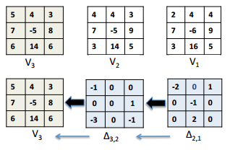
Version Control
SciDB preserves raw data, so different scientists can cook and recook different dishes using the same raw “material”.
For example, using different feature extraction algorithm on the same image for different purposes.
Scientists never want to throw away old data, whether wrong or not. One important reason is “cooking” of raw data into derived information.
All SciDB arrays are versioned. Query processing refers to certain version data according to timestamp and version number.
Clearly, one wants to support versions without paying the cost of a copy for unchanged data.
Versions are stored as a delta off their parents. The physical organization of each chunk contains a reserved area to maintain the delta chain.
Keep the most up-to-date version chunks stored contiguously.

Slide 15
Skew Management
It is advantageous to move data from disk to main memory in fixed size blocks.
Recall that our chunk is not physical size fixed (because of update traffic and density of non-null data skew). How to solve the problem?
SciDB’s main memory buffer pool is composed of a collection of fixed size slots containing “worthy” fixed size blocks (e.g.: B bytes):
If a chunk is too large, cycling through the chunking dimensions, splitting each in turn. SciDB supports arbitrary number of splits to keep chunk size below B.
If a chunk is too small, because it is sparsely populated with data, it can accommodate many updates before it fills or be co-located with neighboring sparse chunks.

Slide 16
Compression
Different data has different optimal compression method. SciDB’s compression system examines a chunk, and then chooses the appropriate compression scheme on a chunk-by-chunk basis.
If we only need several tiles within one chunk, SciDB can only decompress and recompress tiles.
The compression engine controls the splitting and packing of chunks.
Decide chunks or tiles needed
encoding
Split and pack
Load into main memory

Slide 17
Provenance
☹ OMG!! Some data looks wrong…
☺ NO Problem!! SciDB records a log of the commands that were run to create D:
For a given data element D, trace backward to find the collection of processing steps that created it from input data.
For a given data element D, trace forward to find all the downstream data elements whose value is impacted by the value of D.
Provenance for arrays or cells?
The solution is specifying the amount of space willing to allocate for provenance data by varying the granularity of provenance information.

Slide 18
Other features
support uncertainty: essentially all scientific data is imprecise and calls for uncertainty. SciDB requires two values for any data element (value and error).
In-situ data: can use some SciDB’s capabilities without going through the effort of loading data.
Approach: define a self-describing data format and then write adaptors to various popular external formats. If an adaptor exists for the user's data or if he is willing to put it in the SciDB format above, then he can use SciDB without a load stage.

Slide 19
Thank You
Tian Yu

Slide 20
Decoupling Algorithms from Schedules for Easy Optimization of Image Processing Pipelines
Authors: J. Ragan-Kelley, A. Adams, S. Paris, M. Levoy, S. Amarasinghe, F. Durand
Speaker: Ryan Hsu
Notes:
It is about applying the idea of functional language to feed-forward imaging pipelines. I think this paper is different from the others because it aims to solve something different.

Slide 21
Contents
Motivation
Introduction
Representation
Implementation
Evaluation
Conclusion

Slide 22
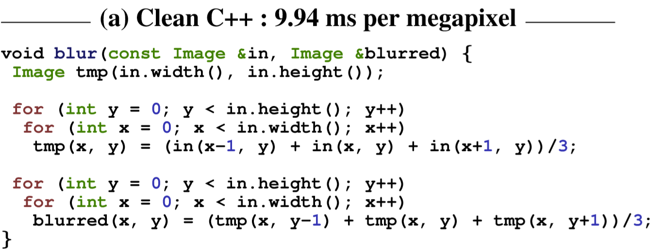
Motivation - Example (Clean C++)
Notes:
Computational photography algorithms require highly efﬁcient implementations to be used in practice, especially on power-constrained mobile devices.
First, let’s start with the example of the paper. This is an example of a 3x3 box filter. The goal is to filter an image so that it has a value equal to the avg value of its neighboring pixels in the input image. The first double loop blurs the input horizontally, and the second double loop blurs the intermediate output vertically.

Slide 23
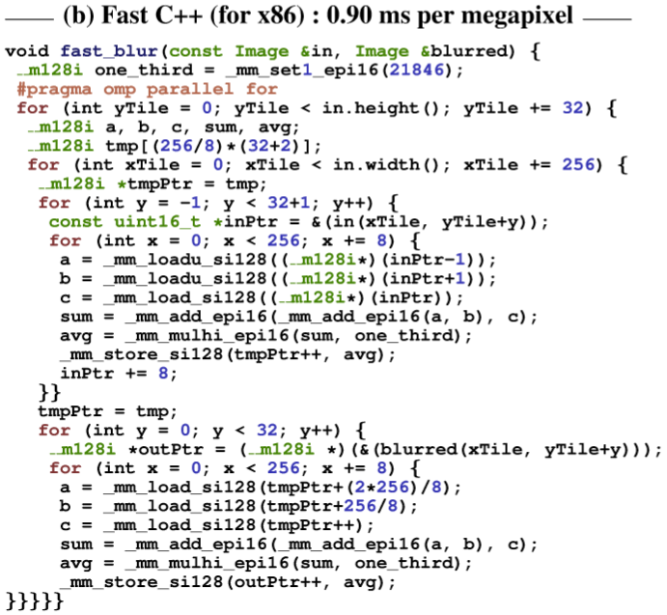
Example (Fast C++)
Notes:
It exploits the assembly code in order to speed up. It’s more memory-efficient and more than 10x faster, but the code readability is lower. It seems that, by using the existing language, if you want to achieve high performance, you need to sacrifice the readability, portability, and modularity.

Slide 24
Example (Halide)
Notes:
After you define the algorithm and specify a schedule, the compiler combines them into an efficient implementation. As we can see, the representation is concise but does not affect the correctness at all.

Slide 25
Introduction
Solution: algorithm separated from schedule
Algorithm: about what is computed
Functional: objs treated as funcs
Schedule: about when and where resources should be executed
Caller-callee relationships

Slide 26
Relationship 1 – Inline
Notes:
Blurred may inline tmp, computing values on demand and not storing anything for later use
+: it requires the least storage
-: each point of tmp will be computed thrice

Slide 27
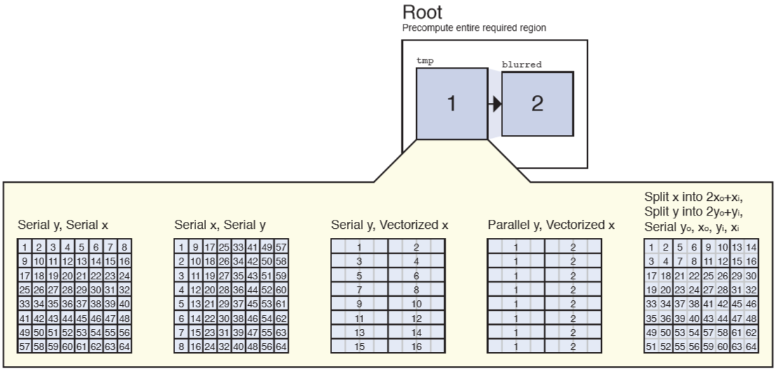
Relationship 2 – Root
Notes:
This is the opposite. Blurred computes everything in tmp beforehand
+: every value is computed once.
-: since it requires storage for the entire region, so the locality is very poor, and we cannot guarantee that the value lies in the cache.

Slide 28
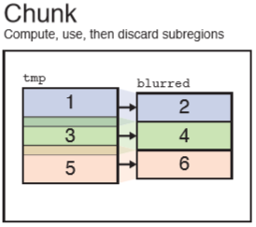
Relationship 3 – Chunk
Notes:
Therefore, dividing arrays into chunks sounds a good idea so that blurred only computes everything for that iteration.

Slide 29
Relationship 4 – Reuse
Notes:
Finally, it is best to reuse the result.

Slide 30
Specifying a Schedule
A desired partial schedule is specified after an algorithm is described
Many schedules need lots of transformation of code in C
Schedules can be made tersely and return refs to funcs so that they can be chained

Slide 31
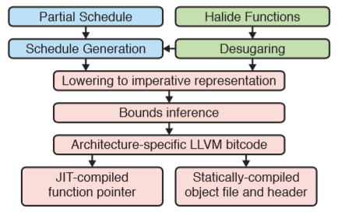
Compiler Implementation
Notes:
Lowering: transform the functional representation of the algorithm into an imperative one using the schedule
Bounds inference: it determines the bounds of the domains over which each use of each function must be evaluated
CPU code gen & CUDA code gen

Slide 32
Application 1 – Camera Pipeline

Slide 33
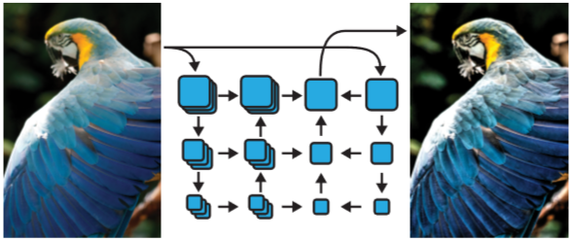
Application 2 – Local Laplacian Filters

Slide 34
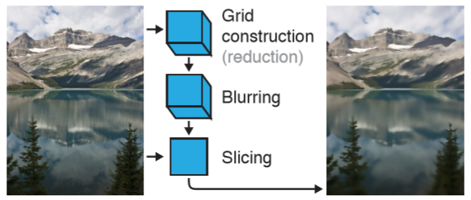
Application 3 – The Bilateral Grid

Slide 35
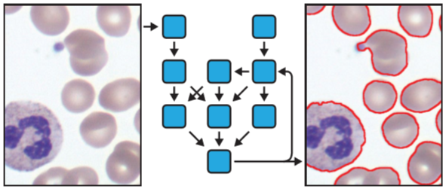
Application 4 – Image Segmentation

Slide 36
Discussion
Compact and efficient
Lazy evaluation of functional language
Needless to think the transition between states
Not enough to include non-image data structures
Notes:
Personally, the four applications clearly demonstrate the correctness and efficiency of the language Halide, and the nature of lazy evaluation enables faster computation of data. Therefore, I think it is nice if we are able to use a more flexible language to handle big data queries.

Slide 37
Conclusion
Efficiency and speed matter in image processing pipelines
Decoupling algorithm from schedule benefits
Future language should utilize compiler automation

Slide 38
References
Ragan-Kelley et al., "Decoupling Algorithms from Schedules for Easy Optimization of Image Processing Pipelines“ (2012).
Box Blur – Wikipedia, the free encyclopedia.

Slide 39
Thank you for listening ☺

