Slide 1
CS130 Spring 2018
Notes:
Hi Everyone, hope you are enjoying ShopTalk so far
My name is Chris from ShopYourLikes and I am here to talk about Influencer and affiliate marketing

Slide 2
What Is ShopYourLikes
Division of Connexity Inc.
Monetization platform for social influencers and content curators
Connect retailers with leads through our users
Retailers pay for leads
We split revenue with our SYL users

Slide 3
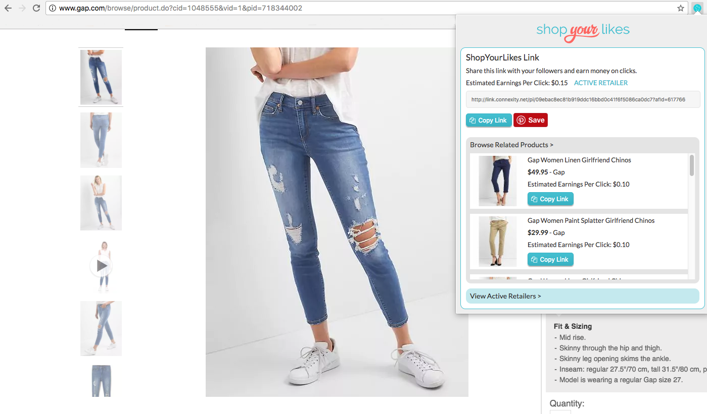
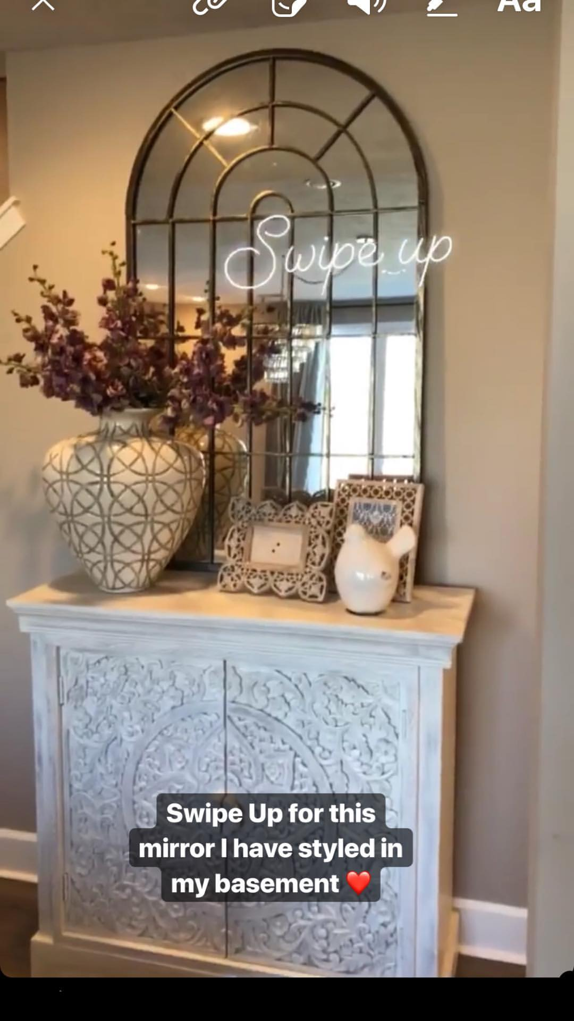
What Our Influencers Already Get
Tools to make ShopYourLikes links that they can use on social media

Slide 4
PROJECT IDEA
ShopYourLikes Link Journal

Slide 5
What Our Users Have Asked For
Simple ways to keep track of the links they have created and new links they want to use in the future
Ways to create several links at once
Content inspiration
Easy to use features that are mobile friendly

Slide 6
What You Will Build
Web application that leverages our core technology frameworks

Slide 7
What You Will Build
Java web application
Communicates with ShopYourLikes API
Database connection to manage:
Link data
Performance data
Any outside data
Communicates with another external API or datasource
Front-end UI that supports all the required features

Slide 8
Customer Problems You Will Solve
How can I easily keep track of all the unique links I have created?
How can I easily create multiple SYL Links?
How can I see what images I pinned with my links?
What useful analytics can you provide regarding my SYL links performance?

Slide 9
Technical Problems You Will Face
How do you make your UI easy to navigate?
How well does your implementation scale if the number of links managed increases 10x? 100x?
How do you implement this using the technology frameworks required?
What outside technical source will you supplement the provided data with?

Slide 10
Logistics
Mentorship from former CS130 students
Direct experience with enterprise level engineering practices
Setup Guidelines
On site development workshops
Various methods of communication between team and the Connexity mentors

Slide 11
Any Questions???

