Slide 1
CS144: Spatial Index

Slide 2
Example Dataset

Slide 3
Grid File (2 points per bucket)
40
55
225
90

Slide 4
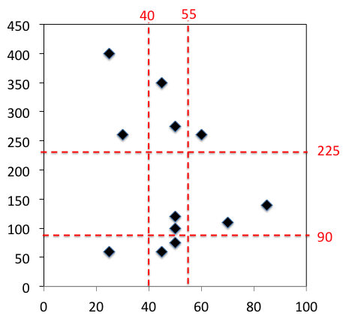
Grid File Data Structure
0 − 40
40 − 55
55 −
225 −
90 − 225
0 − 90
30,260
25,400
70,110
85,140
25,60
60,260
45,60
50,75
50,100
50,120
45,350
50,275

Slide 5
Querying Grid File
40
55
7
8
9
225
4
5
6
90
1
2
3

Slide 6
Grid File Insertion
40
55
225
◆
90

Slide 7
Quad Tree (2 points per bucket)

Slide 8
Quad Tree (2 points per bucket)
First Level

Slide 9
Quad Tree (2 points per bucket)
Second Level

Slide 10
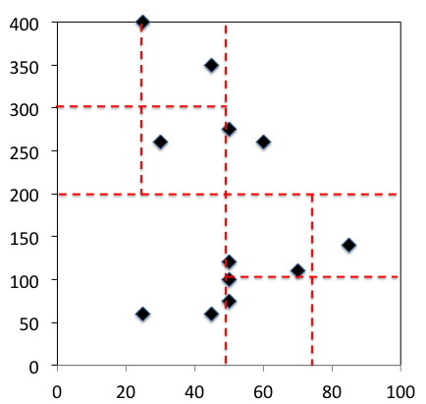
Quad Tree Data Structure
50,200
SW
NW
SE
NE
25,60
45,60
75,100
50,275
60,260
25,300
50,75
50,100
85,140
50,120
70,110
30,260
25,400
45,300

Slide 11
Querying Quad Tree

Slide 12
Quad Tree Insertion
◆

Slide 13
General (n x m) Quad Tree
At each level, split into (n x m) subregions

