Slide 1
Logic for Explainable AI
Adnan Darwiche
Computer Science Department
UCLA
Tutorial at LICS 2023

Slide 2
(e.g., loan application)
Instance
Classifier
(Function)
BN, NN, RF
(Labeled) Data
Learning
Process
Classifier
(Function)
BN, NN, RF
symbolic representation of input-output behavior
Decision
Why did you make this decision?
Why not this some other decision?
What would it take to change the decision?
How robust is the decision? Is it biased?
Is the classifier biased?
…
(e.g., decline)

Slide 3
Classifiers as Symbolic Functions
Threshold 90%
P
Pr(p)
Test results: U, B, S
Pregnant?
yes
0.87
(P)
no
0.13
Urine test
Blood test
Scanning test
Discrete
Function
(U)
(B)
(S)
P
U
Pr(u|p)
P
B
Pr(b|p)
P
S
Pr(s|p)
yes
-ve
0.27
yes
-ve
0.36
yes
-ve
0.10
+ Probabilistic Inference
no
+ve
0.107
no
+ve
0.106
no
+ve
0.01
Yes, No

Slide 4
Classifiers as Symbolic Functions
Threshold 90%
Instance: U=+ve, B=-ve, S=-ve
P
Pr(p)
Test results: U, B, S
Pregnant?
yes
0.87
U
(P)
no
0.13
+ve
-
ve
Urine test
Blood test
Scanning test
B
Decision
Function
(U)
(B)
(S)
-
ve
P
U
Pr(u|p)
P
B
Pr(b|p)
P
S
Pr(s|p)
+ve
S
yes
-ve
0.27
yes
-ve
0.36
yes
-ve
0.10
+ve
+ Probabilistic Inference
-
ve
no
+ve
0.107
no
+ve
0.106
no
+ve
0.01
Yes
No
Yes, No
Decision Graph

Slide 5
Classifiers as Symbolic Functions
What Classifiers?
What symbolic representation?
What can we do with the symbolic representation?
Threshold 90%
Instance: U=+ve, B=-ve, S=-ve
P
Pr(p)
Test results: U, B, S
Pregnant?
yes
0.87
U
(P)
no
0.13
+ve
-
ve
Urine test
Blood test
Scanning test
B
Decision
Function
(U)
(B)
(S)
-
ve
P
U
Pr(u|p)
P
B
Pr(b|p)
P
S
Pr(s|p)
+ve
S
yes
-ve
0.27
yes
-ve
0.36
yes
-ve
0.10
+ve
+ Probabilistic Inference
-
ve
no
+ve
0.107
no
+ve
0.106
no
+ve
0.01
Yes
No
Yes, No
Decision Graph

Slide 6
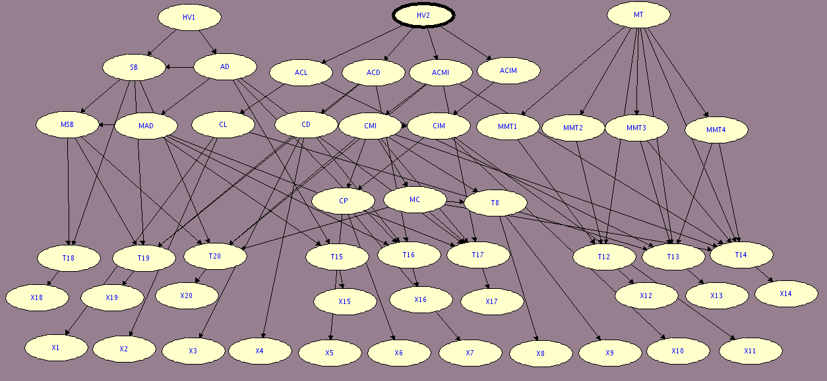
Education Network

Slide 7
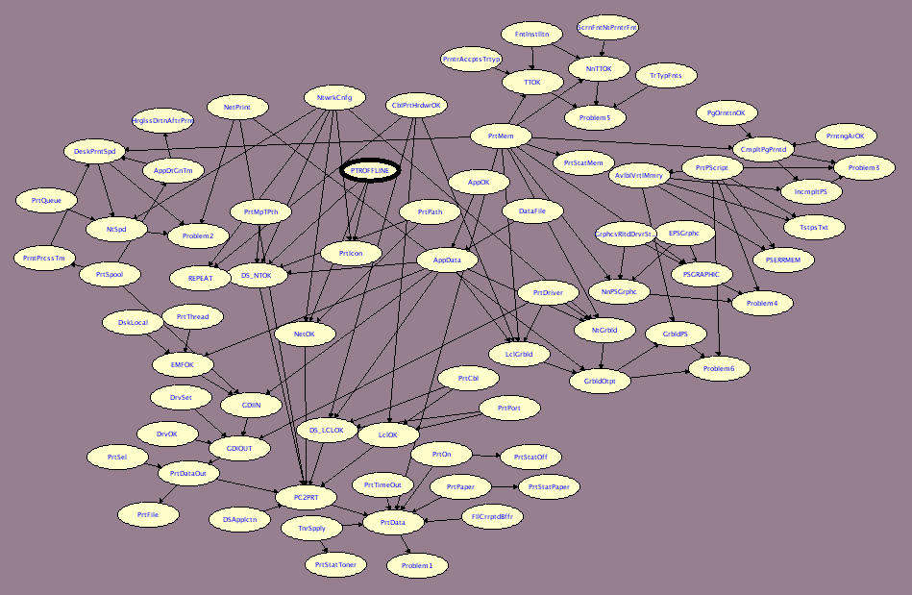
Printing Diagnosis Network

Slide 8
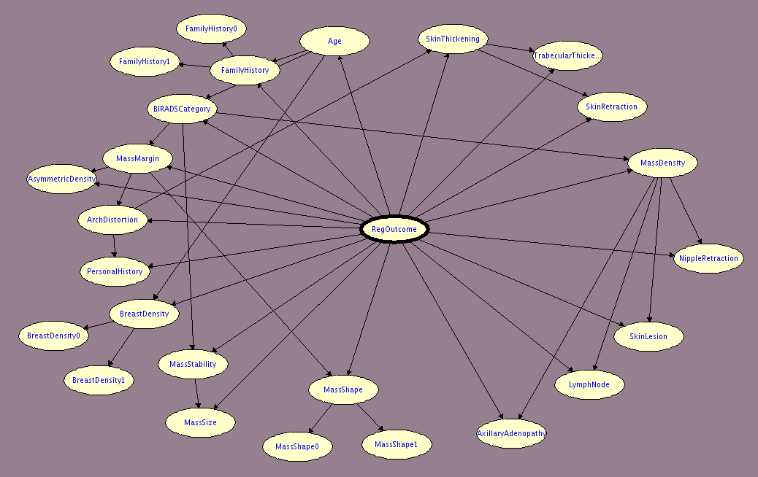
Cancer Network
Bayesian Network Classifier
Equivalent Decision Graph

Slide 9
Size of Decision Graphs
Name | # Vars | Root | Threshold | Decision Graph Size | Time (s)
Mammography | 15 | Reg-Outcome | 0.02 | 156 | 7
Win95pts | 16 | Printer-Offline | 0.50 | 291 | 21
Immex | 17 | Not-Understand | 0.50 | 115 | 9
Adaptive-Testing | 20 | HV1 | 0.50 | 1164 | 40
Mooring | 22 | Environment | 0.75 | 12840 | 938
Andes | 24 | Try-Kinematics | 0.50 | 47 | 11708
Math-Skills | 46 | S6 | 0.50 | 3693629 | 61088

Slide 10
Explainable AI
Reasoning About the Behavior of Learned Classifiers
What classifiers?
What symbolic representation?
What can we do with the symbolic representation?

Slide 11
Compiling Learned Classifiers into symbolic representations
Bayesian Networks
  Chan, Darwiche. UAI 03
  Shih, Choi, Darwiche. IJCAI 18
  Shih, Choi Darwiche. AAAI 19
Neural Networks (restricted classes)
Decision Trees & Random Forests
conceptual difficulty
many works by the SAT/SMT community on symbolic “encodings”

Slide 12



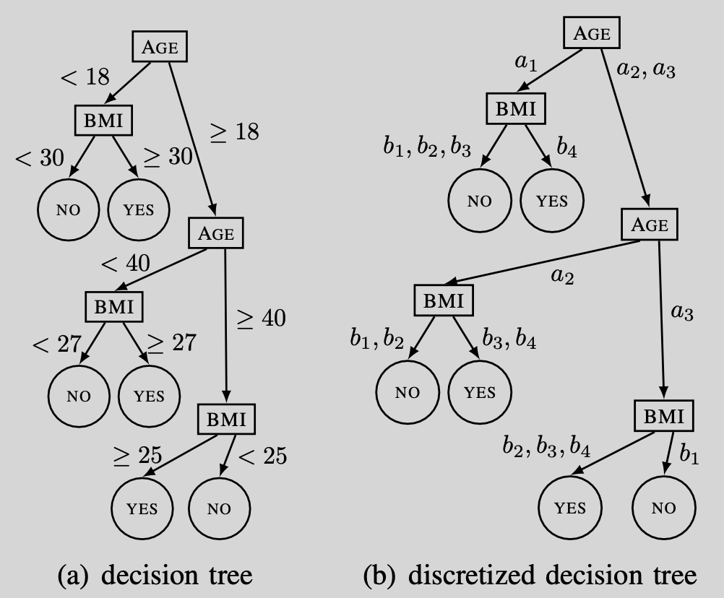
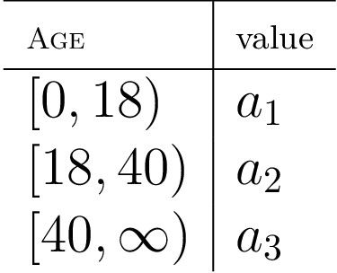
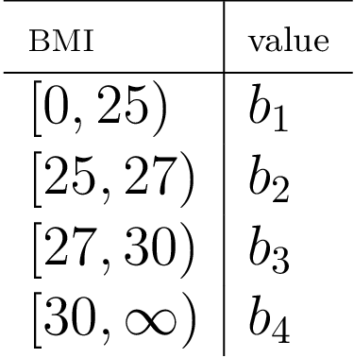
Numeric Features

Slide 13
Explainable AI
Reasoning About the Behavior of Learned Classifiers
What classifiers?
What symbolic representation?
What can we do with the symbolic representation?

Slide 14


Decision Graphs are Circuits
or
Decomposability
Decision
Ordering
X
and
and
⍺
⍺
X
¬X
$${β}$$
or
$${β}$$
or
Y
Y
and
and
and
and
Z
Z
¬Y
Y
Y
¬Y
or
or
and
and
and
and
1
0
Z
Z
¬ Z
¬Z
true
false
(Ordered) Decision Graph
NNF Circuit

Slide 15
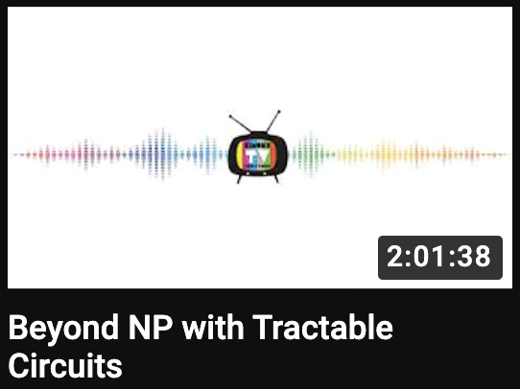
Tractable Circuits Knowledge Compilation
Darwiche & Marquis, JAIR 2002
complexity classes
NNF Circuits
PP^{PP}
MAJ-MAJ-SAT
DNNF
d-DNNF
SDD
OBDD
…
or
Decomposability
Determinism
Smoothness
Flatness
Decision
Ordering
…
and
and
NP^{PP}
E-MAJ-SAT
or
or
or
or
PP
MAJ-SAT
and
and
and
and
and
and
and
and
NP
SAT
¬A
B
¬ B
A
C
¬ D
D
¬ C
Simons Institute

Slide 16
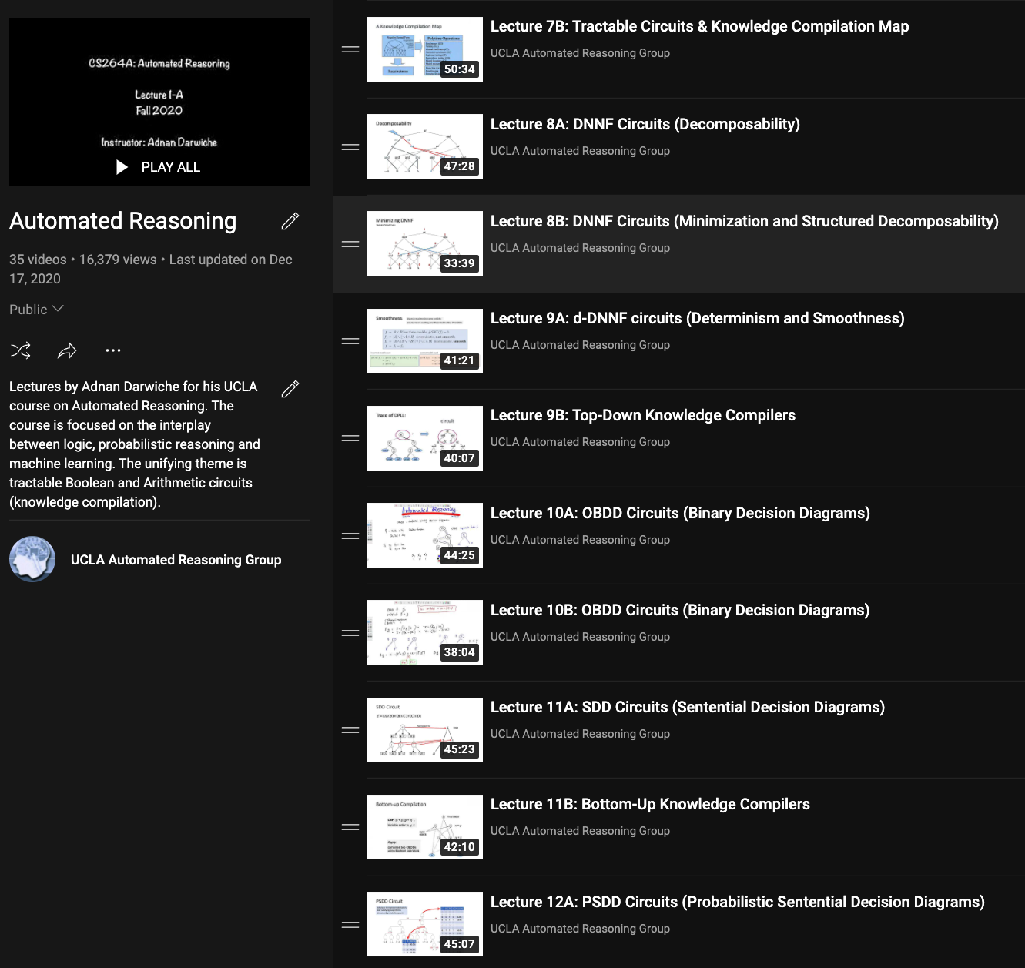

https://youtube.com/@UCLA.Reasoning

Slide 17
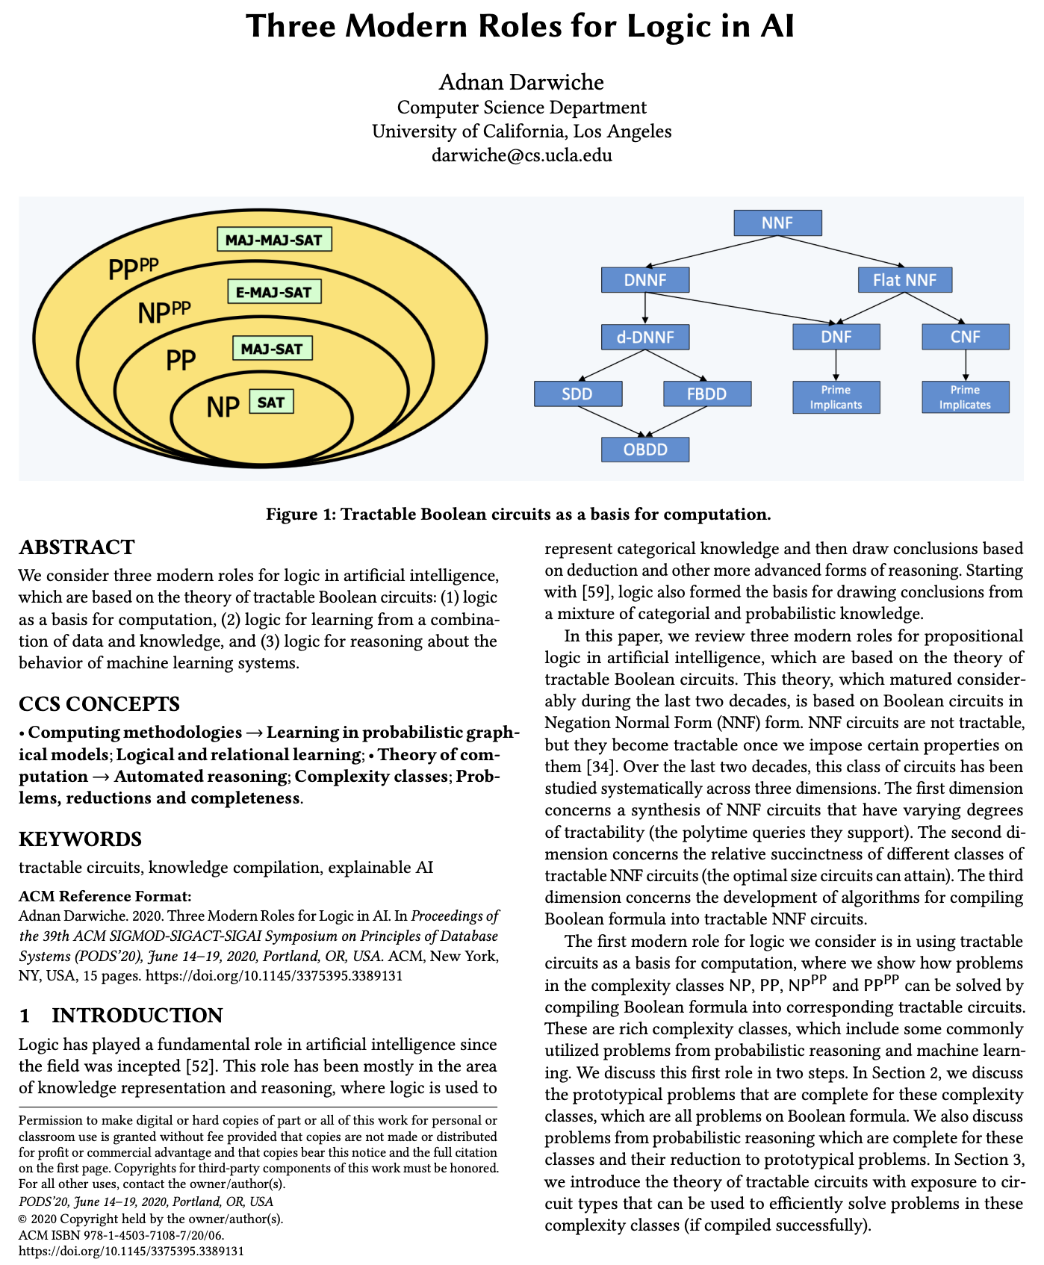
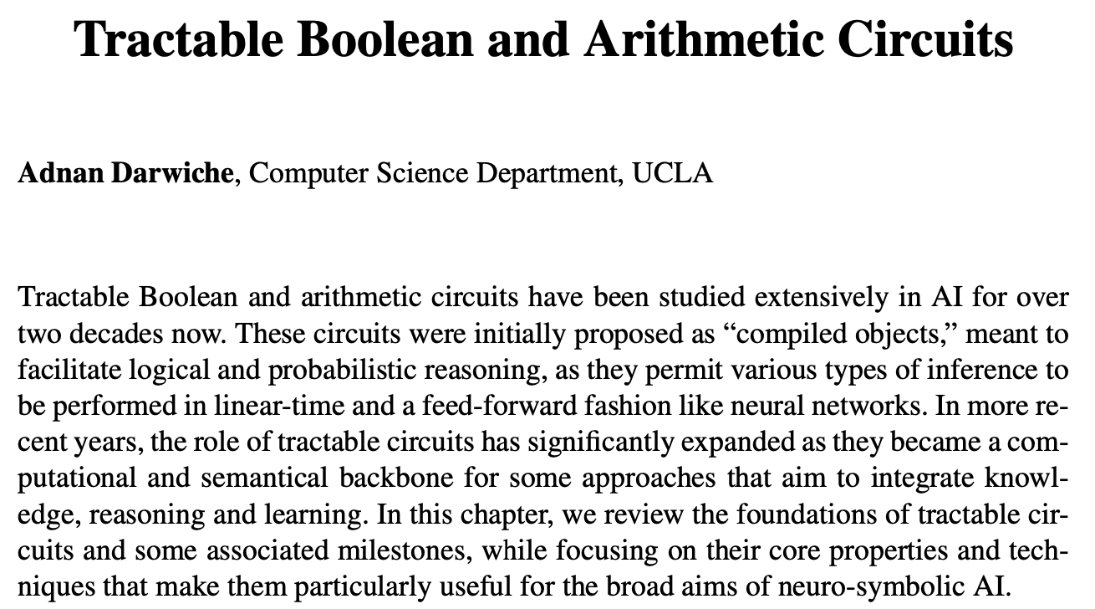
PODS Tutorial
Book Chapter (Neuro-Symbolic AI, IOS Press 2022)
https://arxiv.org/abs/2202.02942

Slide 18


Representing Classifiers using “Class Formulas”
Threshold 90%
P
Pr(p)
Class Formulas
Pregnant?
yes
0.87
(P)
no
0.13
five positive instances:
Urine Test
Blood Test
Scanning Test
(U)
(B)
(S)
P
U
Pr(u|p)
P
B
Pr(b|p)
P
S
Pr(s|p)
yes
-ve
0.27
yes
-ve
0.36
yes
-ve
0.10
three negative instances:
+ Probabilistic Inference
no
+ve
0.107
no
+ve
0.106
no
+ve
0.01
Binary Features, Binary Classifier (two classes)

Slide 19
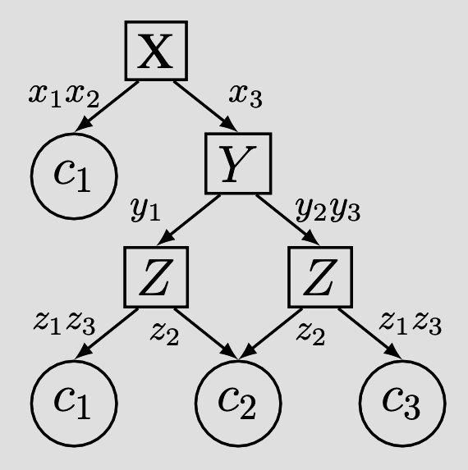
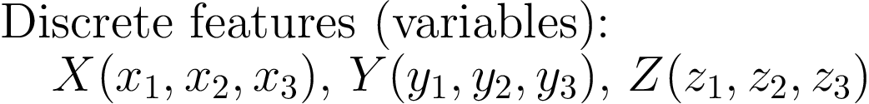
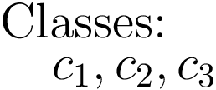
Discrete Features, Multi Classes
classifier (decision graph)

Slide 20
Discrete Features, Multi Classes
classifier (decision graph)
20 instances
3 instances
4 instances
class formulas
mutually exclusive and exhaustive (partition)
one-to-one correspondence with classes/decisions
typically represented as tractable circuits

Slide 21
Binary vs Discrete Variables (Features)
Traditional & most common:
  Binarize discrete variables
  One discrete variable, say, Color:
    three values: red, blue, green
    three Boolean variables: color_red, color_blue, color_green
Computational issues:
discrete variables with thousands of values (e.g., random forests)
Semantical issues:
sub-optimal when applying Boolean formulations to discrete features
New: “Native” discrete

Slide 22
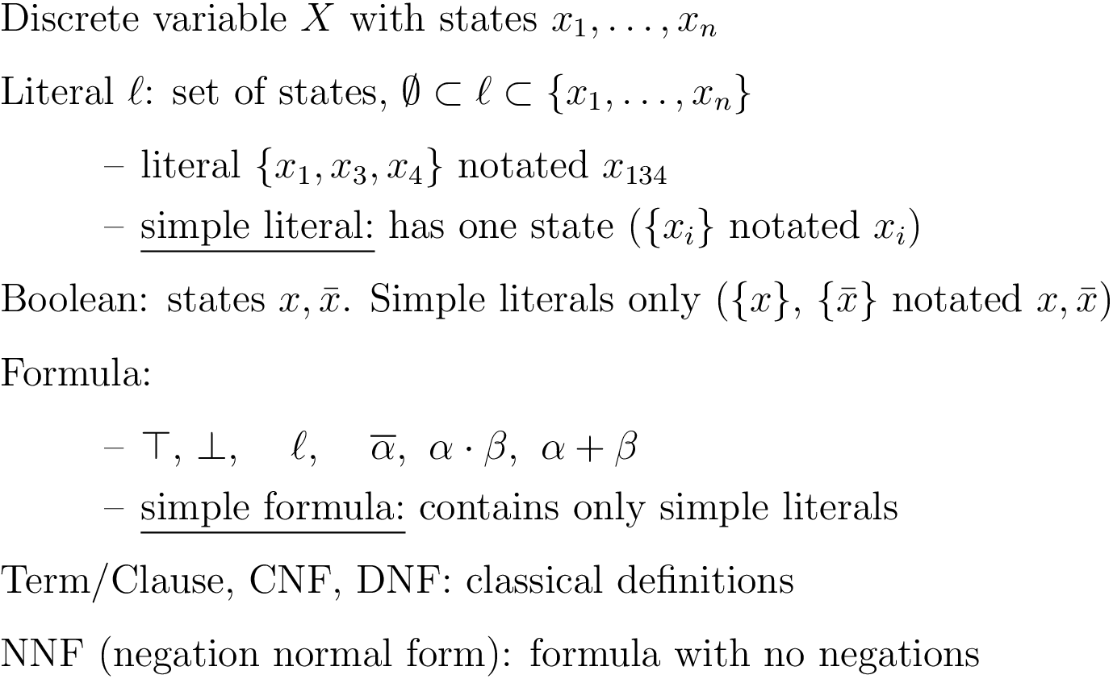
Discrete Logic vs Boolean Logic

Slide 23
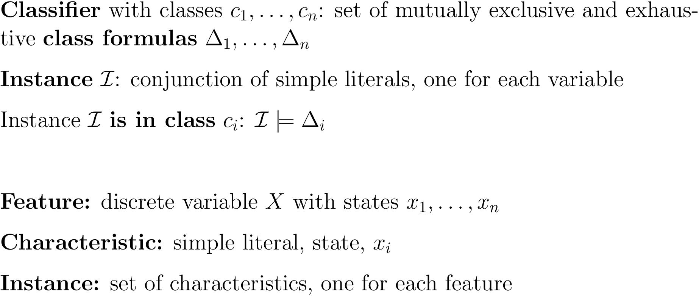
Classifiers

Slide 24
Explainable AI
Reasoning About the Behavior of Learned Classifiers
What classifiers?
What symbolic representation?
What can we do with the symbolic representation?

Slide 25
Explaining Decisions
Sufficient Reason (PI-Explanation)
minimal set of instance characteristics that can trigger the decision
(other characteristics are irrelevant)
Shih, Choi & Darwiche (IJCAI 18)

Slide 26


Example: Sufficient Reason
Susan tested positive for Scanning, Blood and Urine
Why did you conclude that Susan is pregnant?
Sufficient Reasons
Instance: U=+ve, B=+ve, S=+ve
Test results: U, B, S
U
+ve
-
ve
B
Decision
Function
-
ve
+ve
S
+ve
-
ve
Yes
No
not on decision path
Yes, No
Decision Graph

Slide 27

Example: Sufficient Reason
Why did you conclude
that this image is a 0?

Slide 28

Example: Sufficient Reason
Why did you conclude
that this image is a 0?
Sufficient Reason
3 white pixels are sufficient
to label the image 0

Slide 29

Example: Sufficient Reason
Why did you conclude
that this image is a 0?
Sufficient Reason
3 white pixels are sufficient
to label the image 0
We know that this
classifier will also
label this image as a 0

Slide 30



Example: Sufficient Reason
Why did you conclude
that this image is a 1?
Sufficient Reason
pixels are sufficient
to label the image 1
We know that this
classifier will also
label this image as a 1
many papers on (the computation and complexity of) sufficient reasons

Slide 31
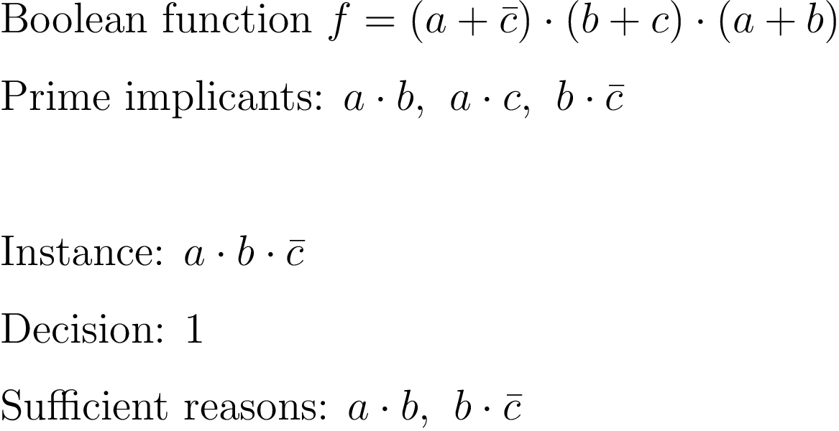
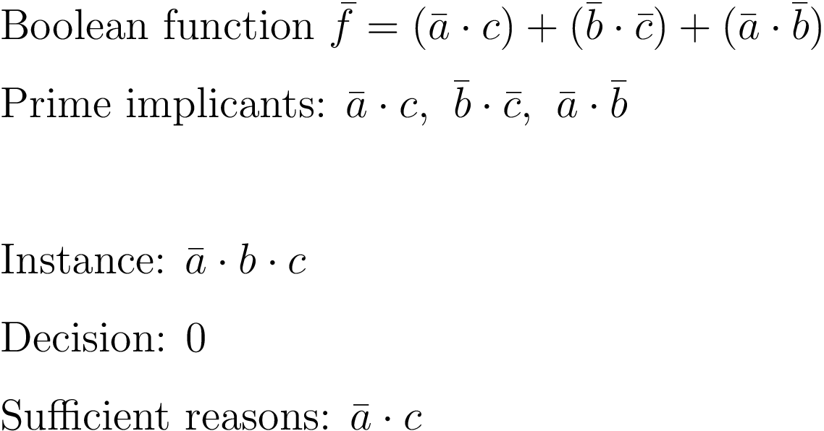






Prime Implicants
decades old: CS + AI
positive-class formula
negative-class formula
$$\overline{f}= \overline{(A+\overline{C})(B+C)(A+B)}$$
Boolean function
Prime implicants
Instance:
Decision: 0
Sufficient reasons:
$$\overline{A}C, \overline{B} \overline{C}, \overline{A} \overline{B}$$
$$AB\overline{C}$$
$$\overline{A}BC$$
$$AB, B\overline{C}$$
$$\overline{A}C$$
Issue: a class formula may have an exponential number of prime implicants
dual notion: prime implicates

Slide 32
The Complete Reason Behind a Decision
Darwiche, Hirth (ECAI 2020)
weakest condition (and, or) on instance characteristics that
triggers the decision

Slide 33
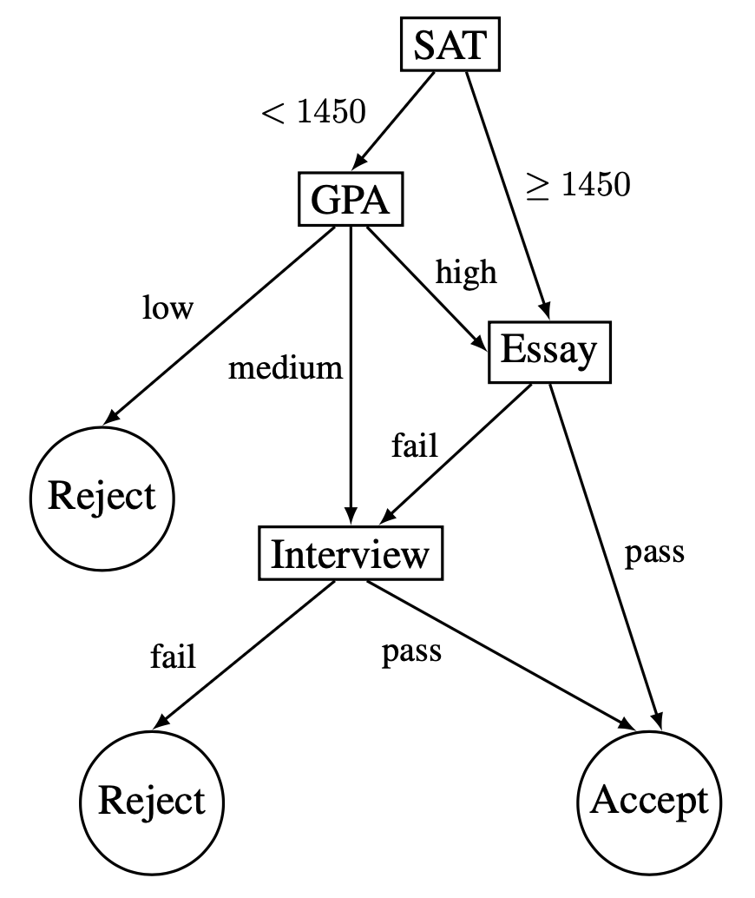
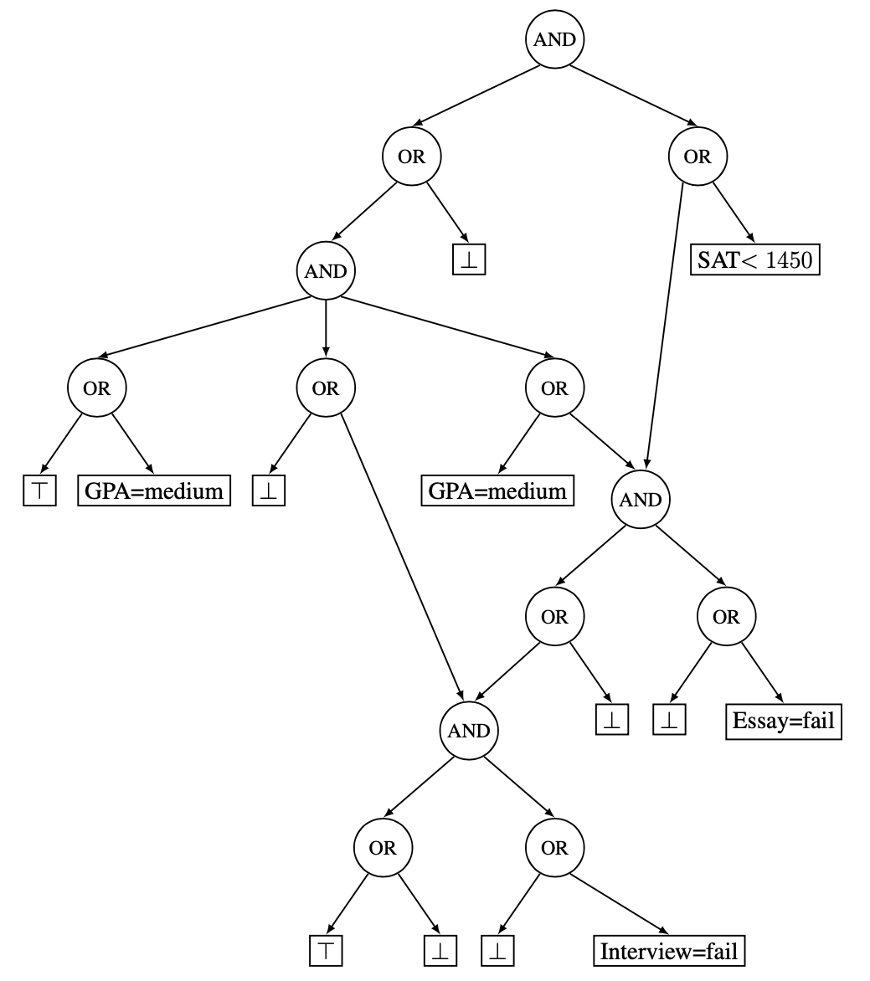
The Complete Reason Behind a Decision
Darwiche, Hirth (ECAI 2020)
Complete Reason
Instance
SAT < 1450
GPA=medium
Essay=fail
Interview=fail
Sufficient Reasons
prime implicants of complete reason
Darwiche, Hirth (ECAI 2020)
Closed-form complete reason
for decision graphs
Darwiche, Ji (AAAI 22)

Slide 34
Why did you make this decision?
Sufficient Reasons
Instance
SAT < 1450, GPA=medium, Essay=fail, Interview=fail
Decision
Reject
Sufficient Reasons
SAT < 1450, GPA=medium, Interview=fail
Essay=fail, Interview=fail
prime implicants
Darwiche, Ji (AAAI 22): Length-minimal sufficient reasons

Slide 35
The Complete Reason Behind a Decision
Darwiche, Hirth (ECAI 2020)
Complete Reason
Instance
SAT < 1450
GPA=medium
Essay=fail
Interview=fail
Sufficient Reasons
prime implicants of complete reason
Darwiche, Hirth (ECAI 2020)
Necessary Reasons
prime implicates of complete reason
Darwiche, Ji (AAAI 22)
Correspond to contrastive explanations

Slide 36
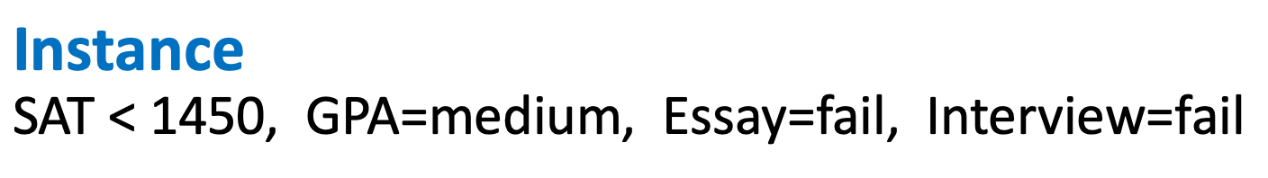



What would it take to change the decision?
Necessary Reasons
Instance
SAT < 1450, GPA=medium, Essay=fail, Interview=fail
Decision
Reject
Necessary Reasons
Interview=fail
SAT < 1450 + Essay=fail
GPA=medium + Essay=fail
prime implicates
Interview=pass
SAT >= 1450, Essay=pass
GPA=low, Essay=pass
GPA=high, Essay=pass
Darwiche, Ji (AAAI 22): Length-minimal necessary reasons

Slide 37
Complete, Necessary & Sufficient Reasons
Complete Reason
Instance
SAT < 1450
GPA=medium
Essay=fail
Interview=fail
Sufficient Reasons
prime implicants of complete reason
Necessary Reasons
prime implicates of complete reason

Slide 38
Terminology
Sufficient Reasons
  PI-Explanations
  Abductive Explanations
Necessary Reasons
  Contrastive Explanations
  (Counterfactual Explanations)
Darwiche & Hirth (ECAI 20)
complete reason
Shih, Choi & Darwiche (IJCAI 18)
Ignatiev, Narodytska & Marques-Silva (AAAI 19)
Darwiche & Ji (AAAI 22)
Lipton (RIPS, 1990), Miller (AIJ, 19)
shown correspondence
Ignatiev, Narodytska, Asher & Marques-Silva (AI*IA 20)
Audemard, Koriche & Marquis (KR 20)

Slide 39
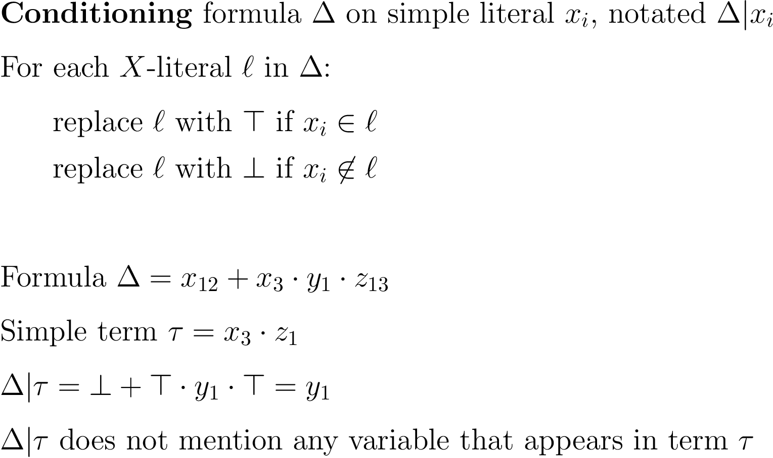
Conditioning a Formula

Slide 40
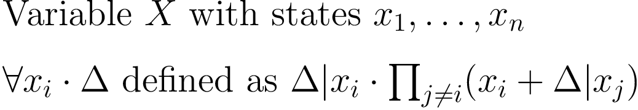
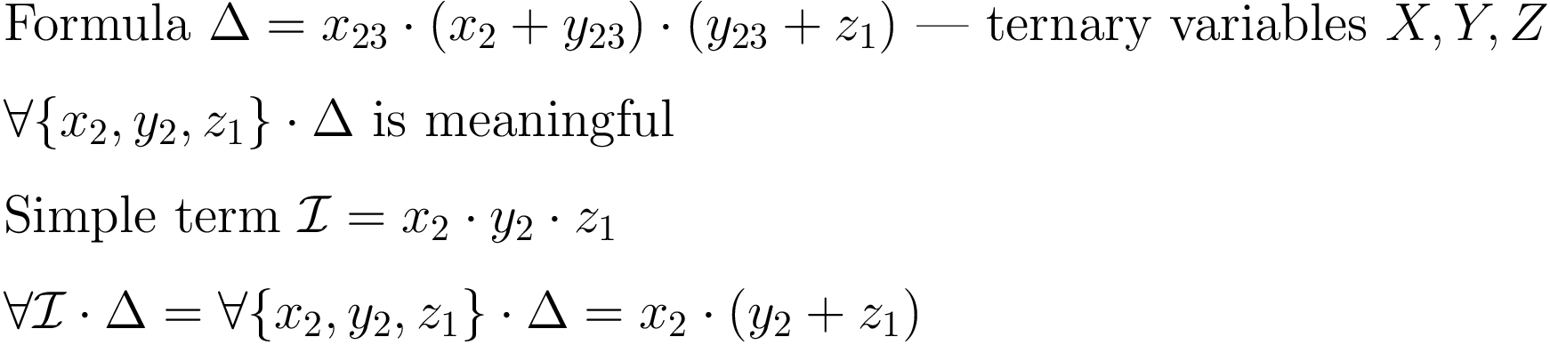
Quantification Operator
Darwiche & Marquis (JAIR 2021)

Slide 41
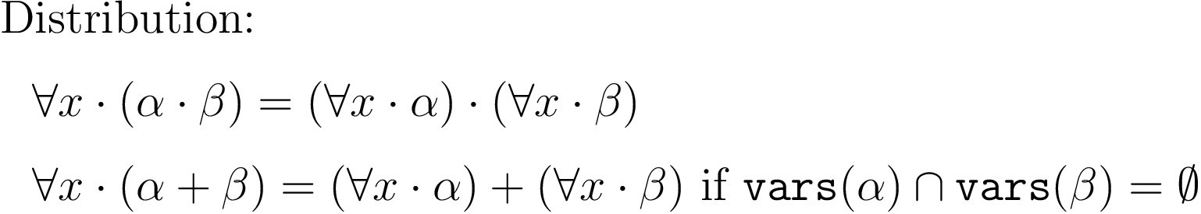
Computing Complete Reasons
or-decomposable NNF circuits

Slide 42






Instance
Classifier
Class Formulas
Complete Reason
What
characteristics
guarantee
the decision?
Decision
What would it take to
change the decision?
Necessary Reasons
prime implicates of complete reason
Sufficient Reasons
prime implicants of complete reason
Darwiche & Marquis (JAIR 2021), Darwiche & Ji (AAAI 22)

Slide 43
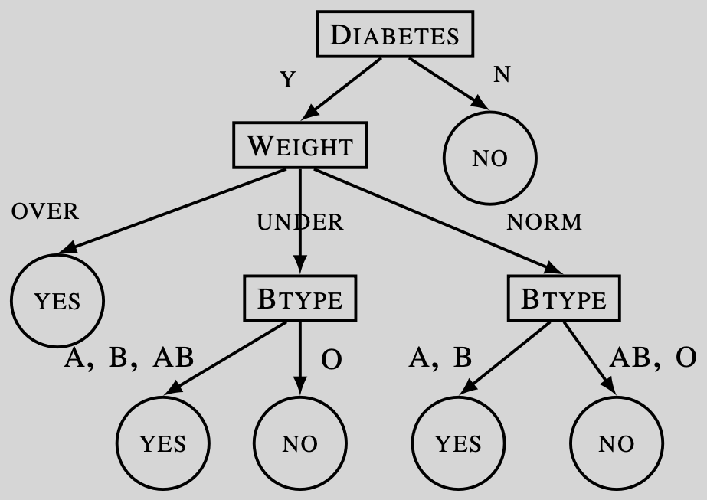
Key Insight!
first observed in
Choi, Shih, Goyanka, Darwiche (arXiv:2007.01493, 2020)

Slide 44
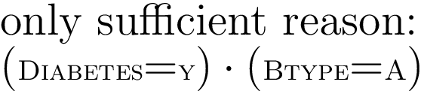
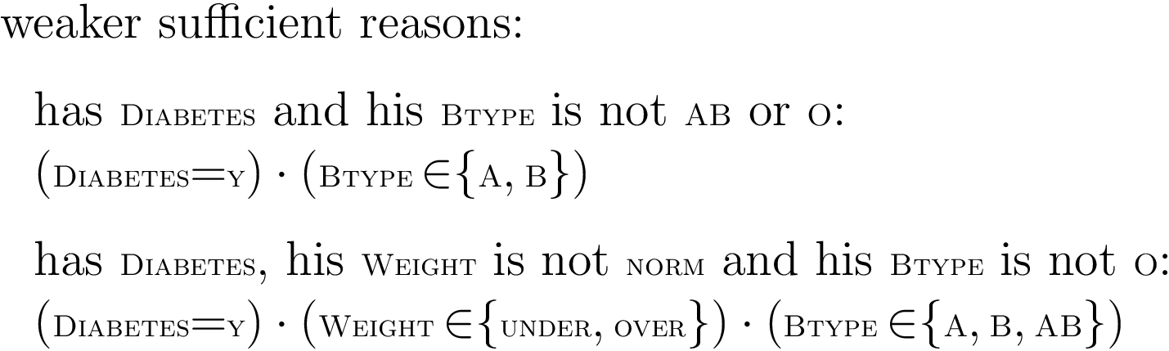
Key Insight!

Slide 45
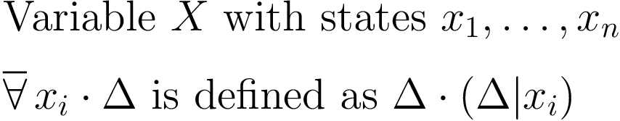
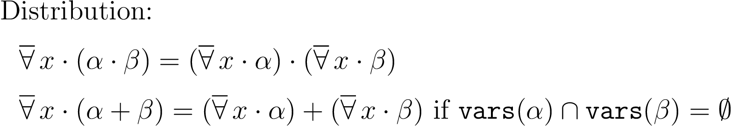
New Notion: The General Reason for a decision
Ji & Darwiche (arXiv:2304.14760, 2023)
contained in
complete reason = general reason, when all features are binary

Slide 46
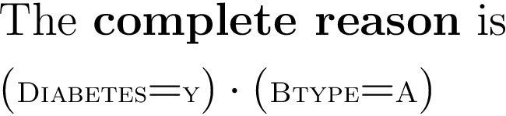
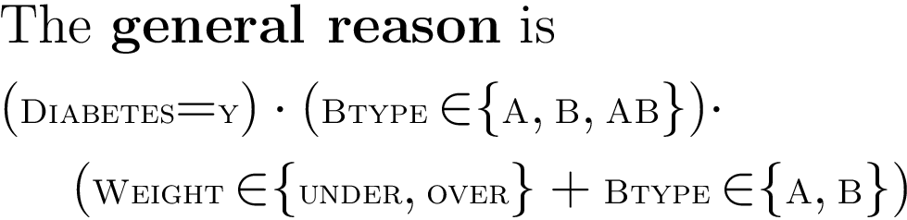
Complete vs General Reason

Slide 47
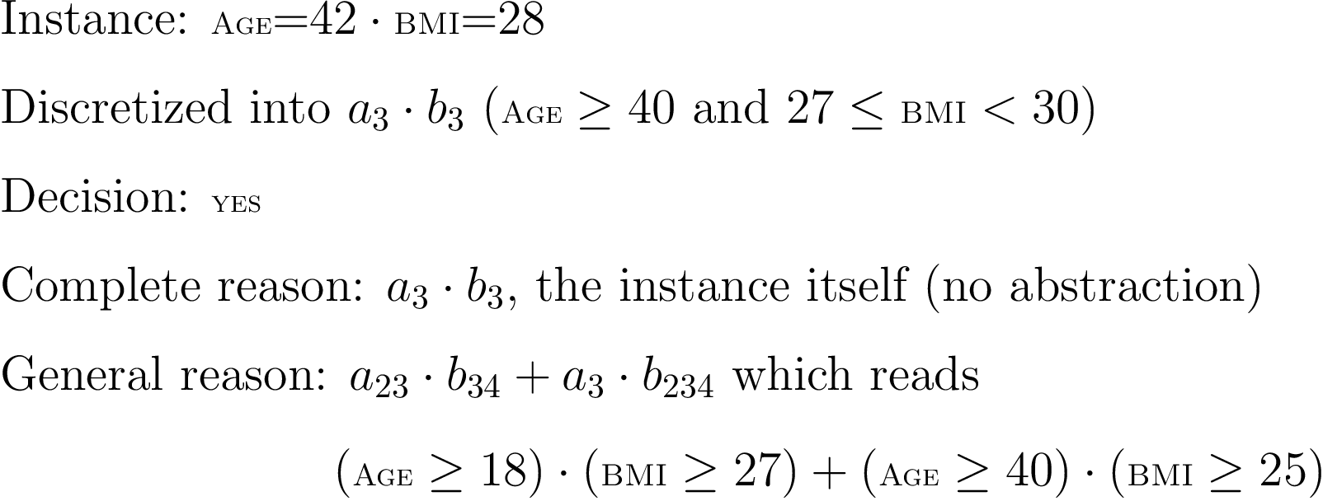
Complete vs General Reason

Slide 48
Necessary & Sufficient Reasons
simple term
simple clause
term
clause

Slide 49
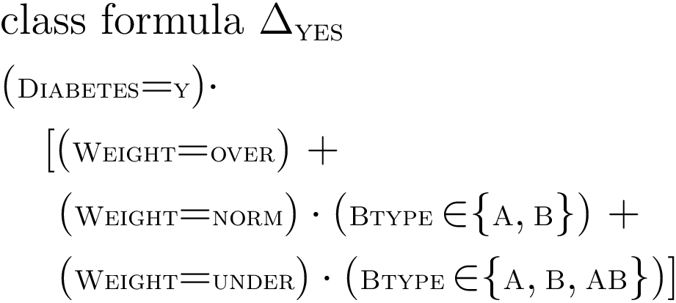
Beyond Simple Explanations

Slide 50
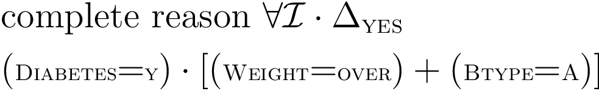
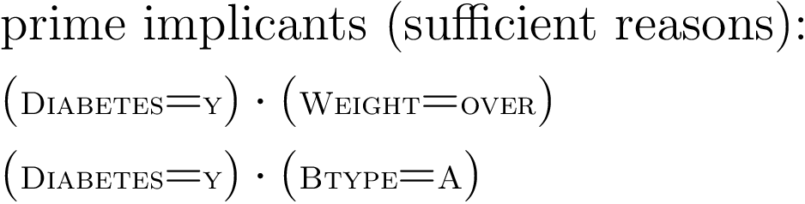
Sufficient Reasons (SRs)

Slide 51
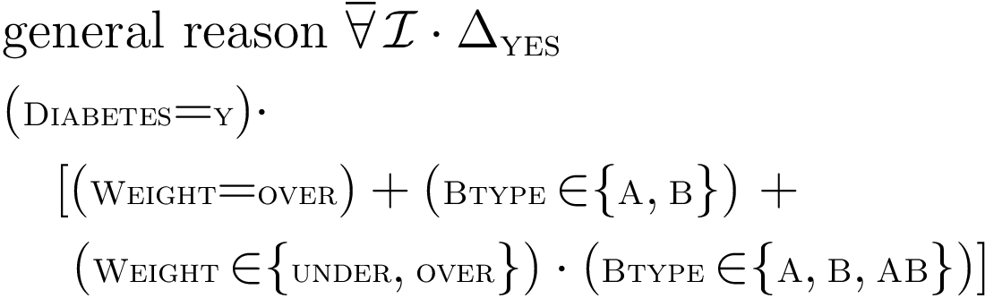
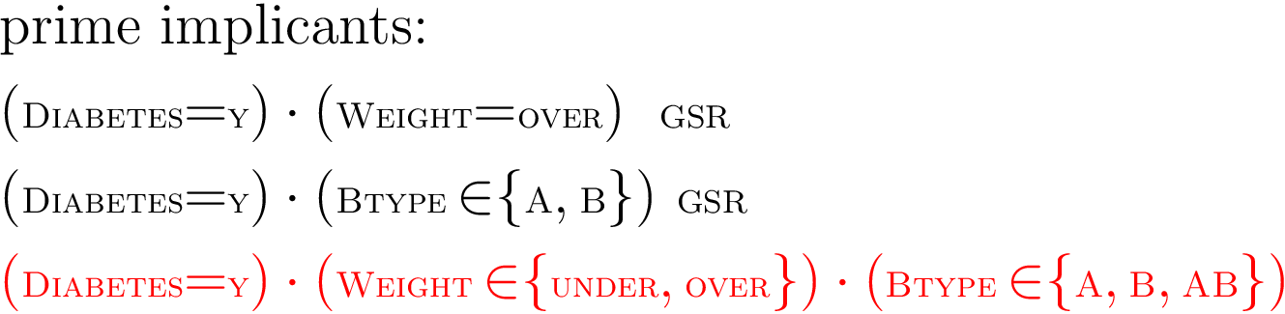
General Sufficient Reasons (GSRs)

Slide 52
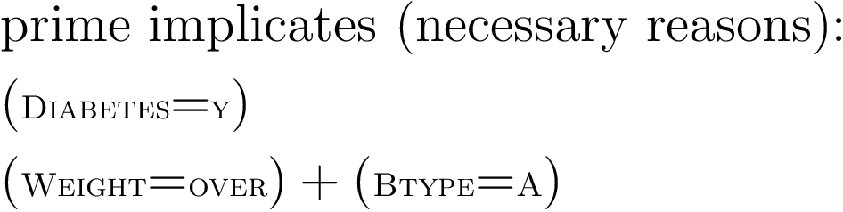
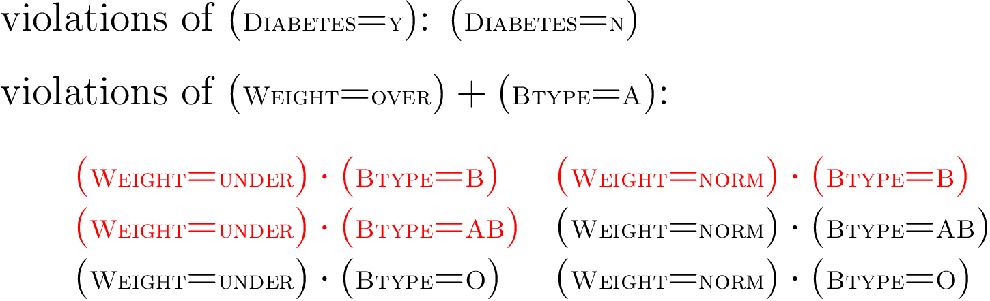
Necessary Reasons (NRs)

Slide 53
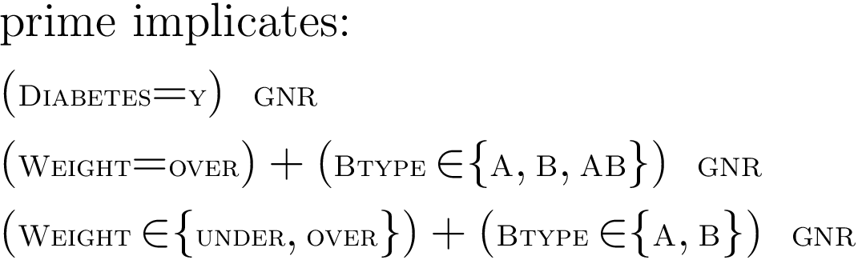
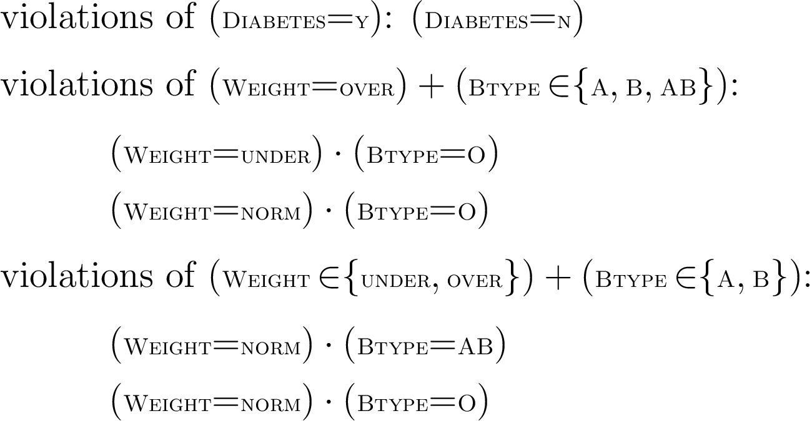
General Necessary Reasons (GNRs)

Slide 54

Instance
Classifier
Class Formulas
General Reason
What
characteristics
guarantee
the decision?
Decision
What would it take to
change the decision?
General Necessary Reasons
variable-minimal prime implicates
General Sufficient Reasons
variable-minimal prime implicants
Ji & Darwiche (arXiv:2304.14760, 2023)

Slide 55
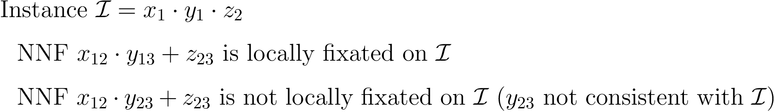
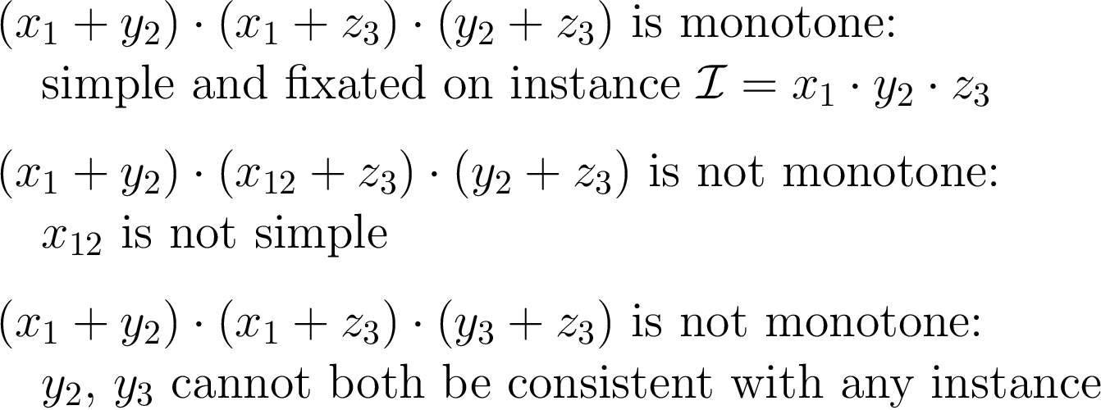
Fixation
computational implications

Slide 56
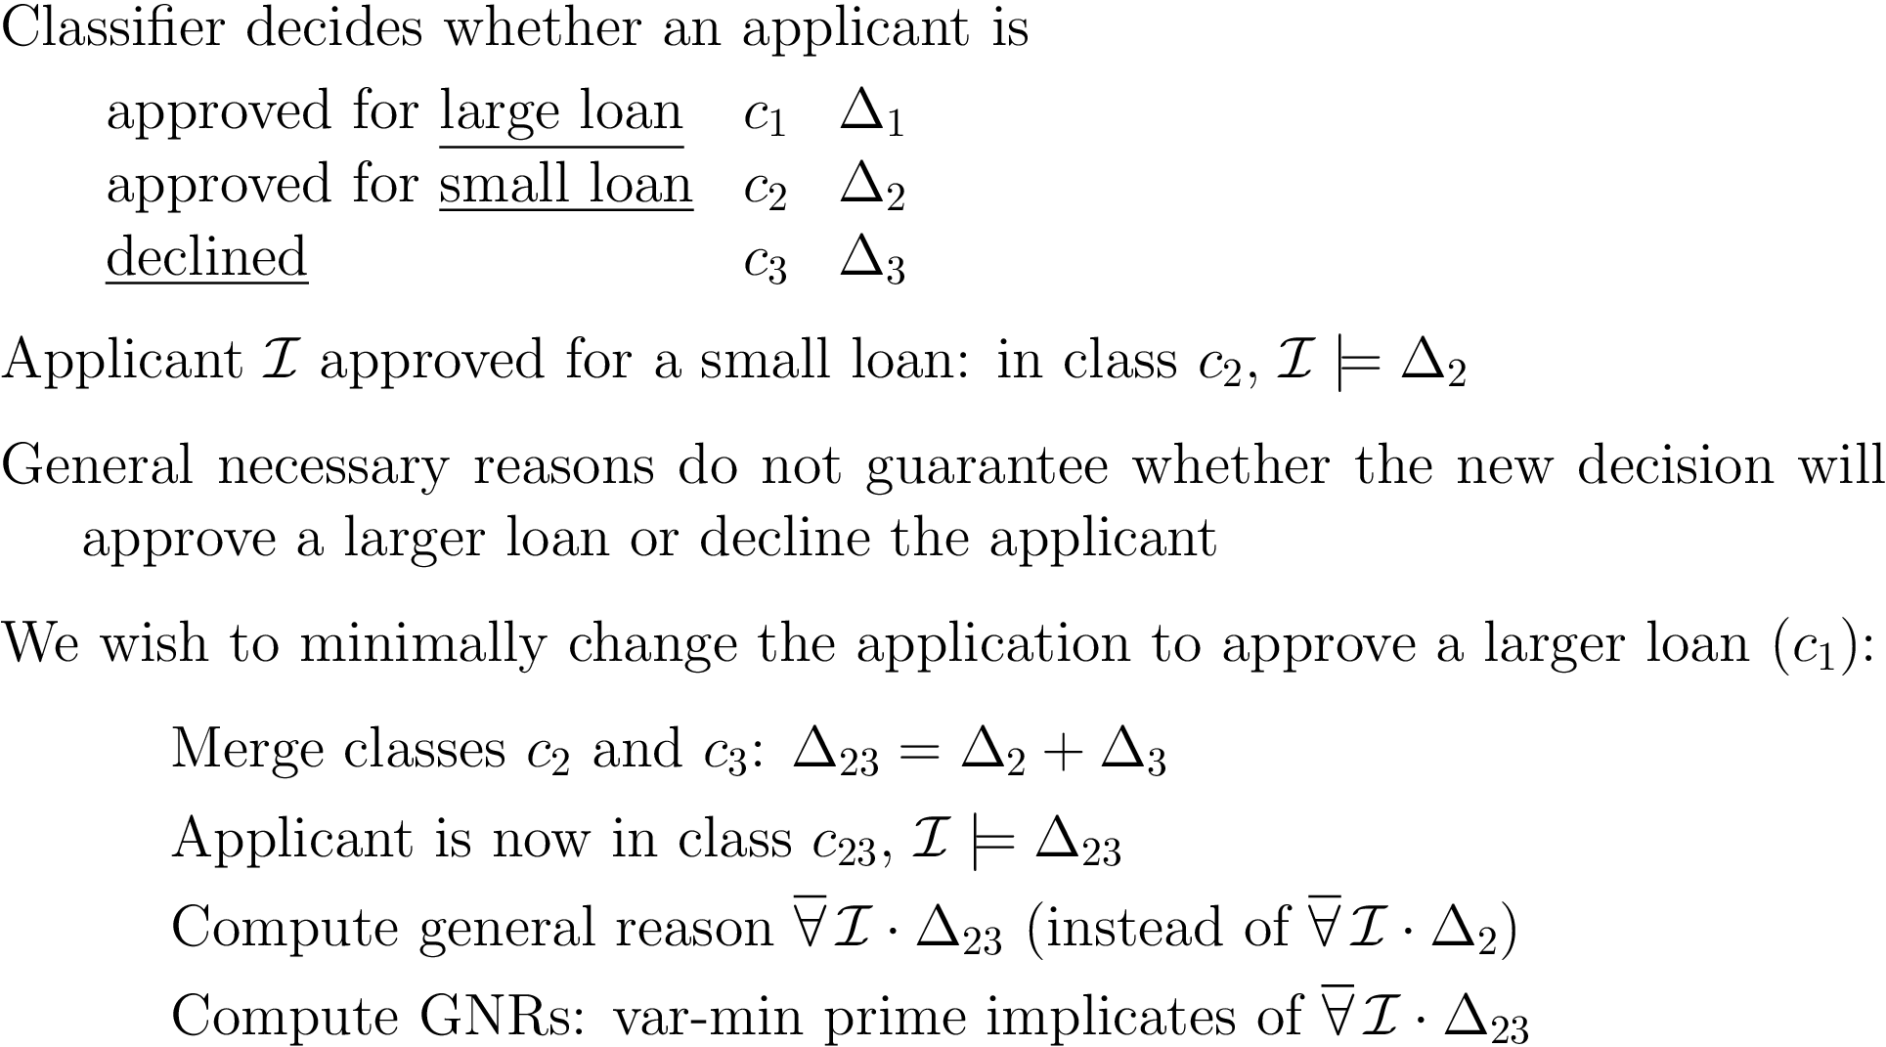
Targeting a New Decision
targeted contrastive explanation
this technique
Ignatiev, Narodytska, Asher & Marques-Silva (AI*IA 20)
Darwiche & Ji (AAAI 22)

Slide 57




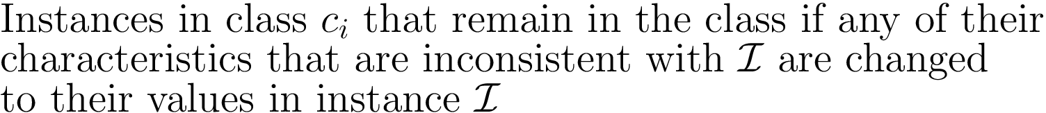
Selection Semantics
…
…
complete reason
general reason

Slide 58
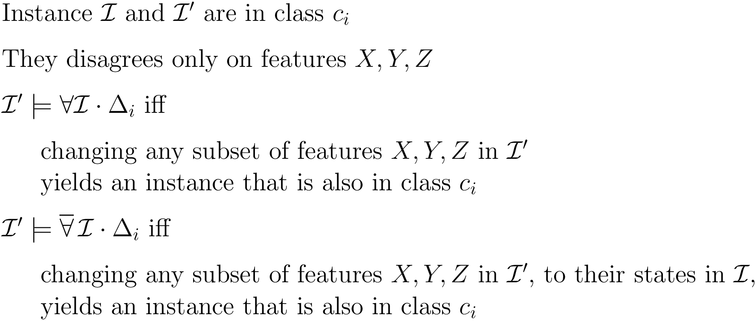
Selection Semantics
…
…

Slide 59
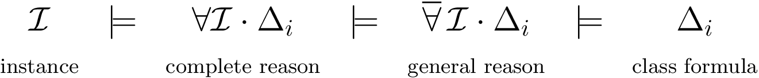
Selection Semantics
…
…
selection semantics
Binary variables, complete reason (Darwiche & Marquis, JAIR 2021)
Discrete variables, complete/general reason (Ji & Darwiche, arXiv 2023)

Slide 60

What else can be done with complete reasons?
Decision Counterfactuals: “decision will stick even if…because…”
Susan would still be admitted even if she did not have a high GPA because she passed the entrance exam and comes from a rich hometown.
Decision Bias: Decision is biased iff it can change due only to changing protected features
decided in linear time
using an appropriate representation of the complete reason
Open-Ended Queries
e.g., find all instances on which a positive, biased decision will be made
(Darwiche & Marquis, JAIR 2021)

Slide 61
Explainable AI
Reasoning About the Behavior of Learned Classifiers
What classifiers?
What symbolic representation?
What can we do with the symbolic representation?

Slide 62
Compiling Classifiers into class formulas (tractable circuits)
Bayesian Networks
Neural Networks (restricted classes)
Decision Trees & Random Forests
conceptual difficulty
many works by the SAT/SMT community on symbolic “encodings”

Slide 63
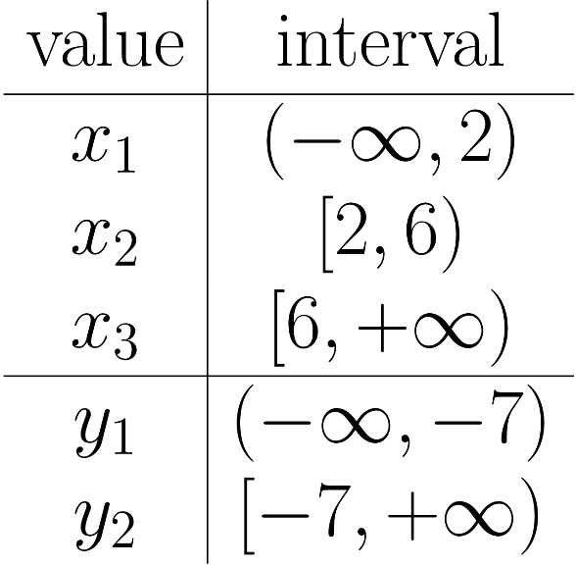
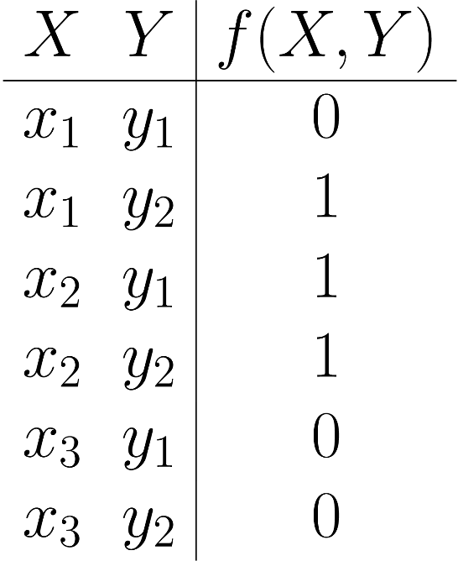
Decision Tree → Discrete Function
X ≥ 2
Y ≥ -7
X ≥ 6
0
1
1
0
straightforward to construct class formulas (DNF)
Notes:
Finally, by enumerating all the possible states, like a truth table, we can obtain a propositional function that is equivalent to the original decision tree.

Slide 64
or
X
and
and
Binary classifier:
positive, negative
instances
Circuit for positive
instances
X
¬X
Y
Y
or
or
and
and
and
and
Z
Z
¬Y
Y
Y
¬Y
or
or
and
and
and
and
1
0
¬Z
Z
Z
¬ Z
true
false
Binary Decision Graph
NNF Circuit
class c₂
0
Circuit for class c₂
0
1
0
class formulas as or-decomposable NNF circuit (Darwiche & Ji, AAAI 2022)

Slide 65
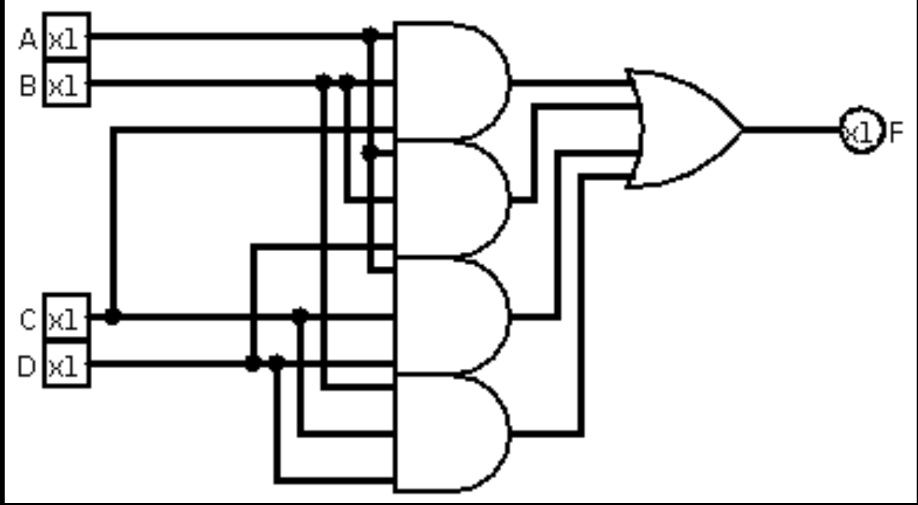
Random Forest
majority
circuit
X ≥ 2
X ≥ 2
X ≥ 2
X ≥ 2
Y ≥ -7
X ≥ 6
Y ≥ -7
X ≥ 6
Y ≥ -7
X ≥ 6
Y ≥ -7
X ≥ 6
0
1
1
0
0
1
1
0
0
1
1
0
0
1
1
0

Slide 66
Compiling BN Classifiers
Naïve Bayes
Chan, Darwiche
UAI 03
Tree BN
Shih, Choi, Darwiche
IJCAI 18
YES
NO
Decision
Graph
General BN
Shih, Choi Darwiche
AAAI 19

Slide 67
Numbers Don’t Matter as Much
Equivalence interval [0.684, 0.970]
P | Pr(p)
yes | 0.684
no | 0.316
P | Pr(p)
yes | 0.870
no | 0.130
P | Pr(p)
yes | 0.970
no | 0.030
Pregnant?
(P)
Urine test
Blood test
Scanning test
(U)
(B)
(S)
P | U | Pr(u|p)
yes | -ve | 0.27
no | +ve | 0.107
P | B | Pr(b|p)
yes | -ve | 0.36
no | +ve | 0.106
P | S | Pr(s|p)
yes | -ve | 0.10
no | +ve | 0.01
Threshold 0.9

Slide 69
Compiling NNs into Tractable Circuits
Shi, Shih, Darwiche & Choi (KR 20)
Neural Network:
Binary Inputs &
Step Activations
Neural Network’s
Boolean Circuit
Each Neuron is a
Linear Classifier

Slide 70


Slide 71
new role for symbolic AI & CS methods
Reason About What Was Learned
Systems 1 / 2 (thinking fast and slow), reflection, meta-reasoning
(VNN community: other techniques including SAT/SMT)

Slide 72

https://youtube.com/@UCLA.Reasoning
Thank You

Slide 73
Thank You!

