Slide 1
Causality Part II: Counterfactuals
Adnan Darwiche
UCLA
March 7, 2022
Part I: Interventions

Slide 2
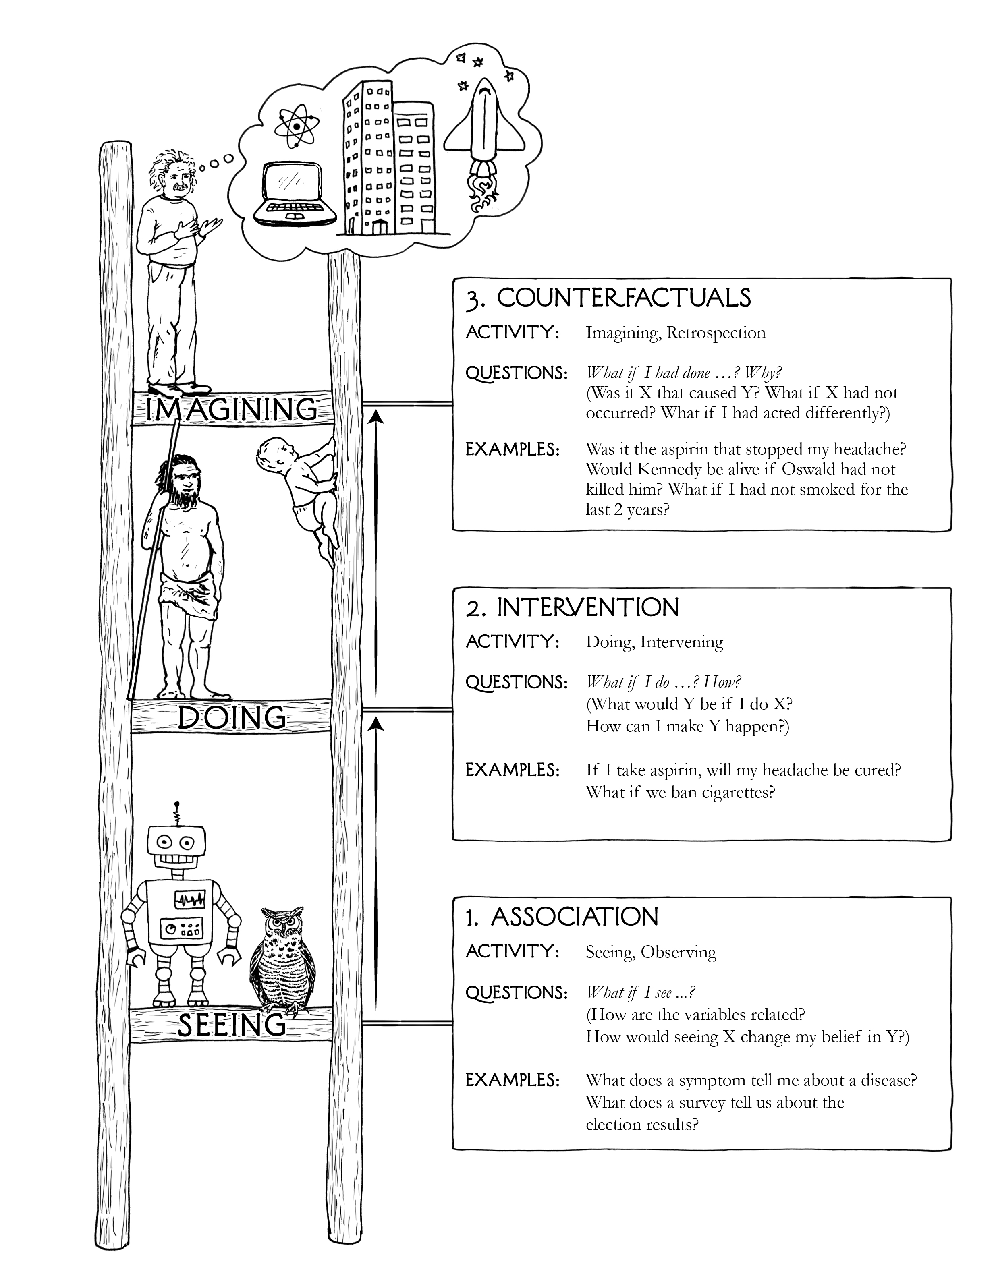
Why Causality?
layers/rungs of the causal hierarchy
Counterfactual reasoning
Interventional reasoning
Associational reasoning
this lecture
last lecture

Slide 3
Counterfactuals examples
What is the probability that exposure to radiation was a necessary cause of death due to leukemia? (Someone was exposed to radiation and died. Would they be alive if they were not exposed?)
What is the probability that a random person in the population would both die of leukemia if exposed and survive if not exposed?
What is the probability that any unexposed surviving person would have died of leukemia had they been exposed?
Key Marks of Counterfactual Reasoning
Involves contemplating alternate, conflicting scenarios.
Requires an ability to transfer information from one scenario to another.
Requires more refined information than is needed for associational or interventional reasoning.

Slide 4
Themes
layers/rungs of the causal hierarchy
Why do we need it?
What additional information do we need so we can do it?
How can we do it in an idealized setting? (complete model: causal graph + parameters + functions)
How can we do it in a practical setting? (partial model: functional causal graph + data)
General semantics of interventional and counterfactual queries
this lecture
last lecture

Slide 5
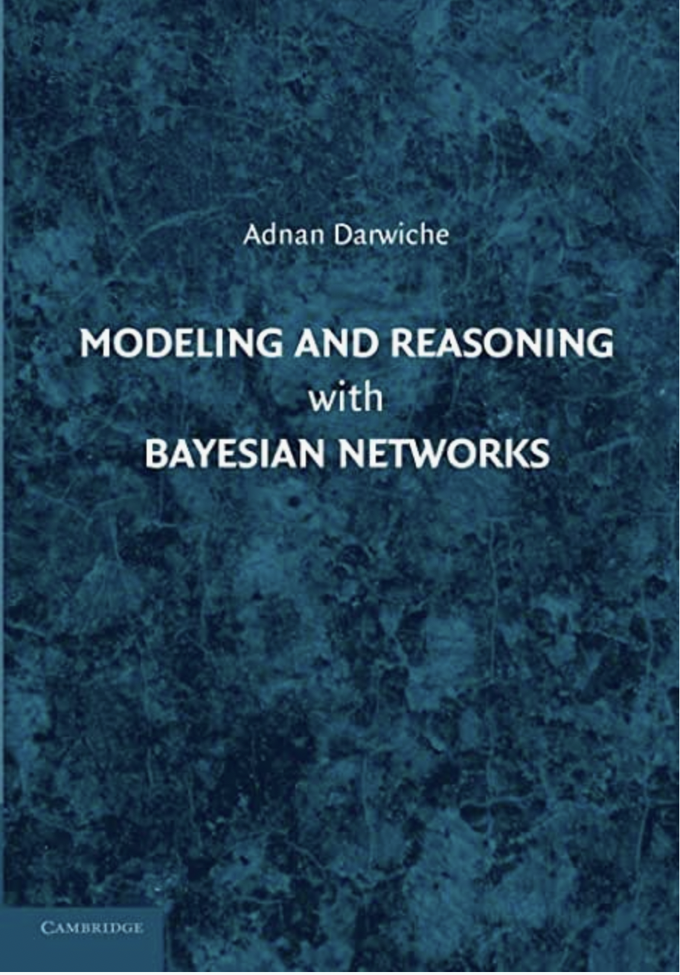
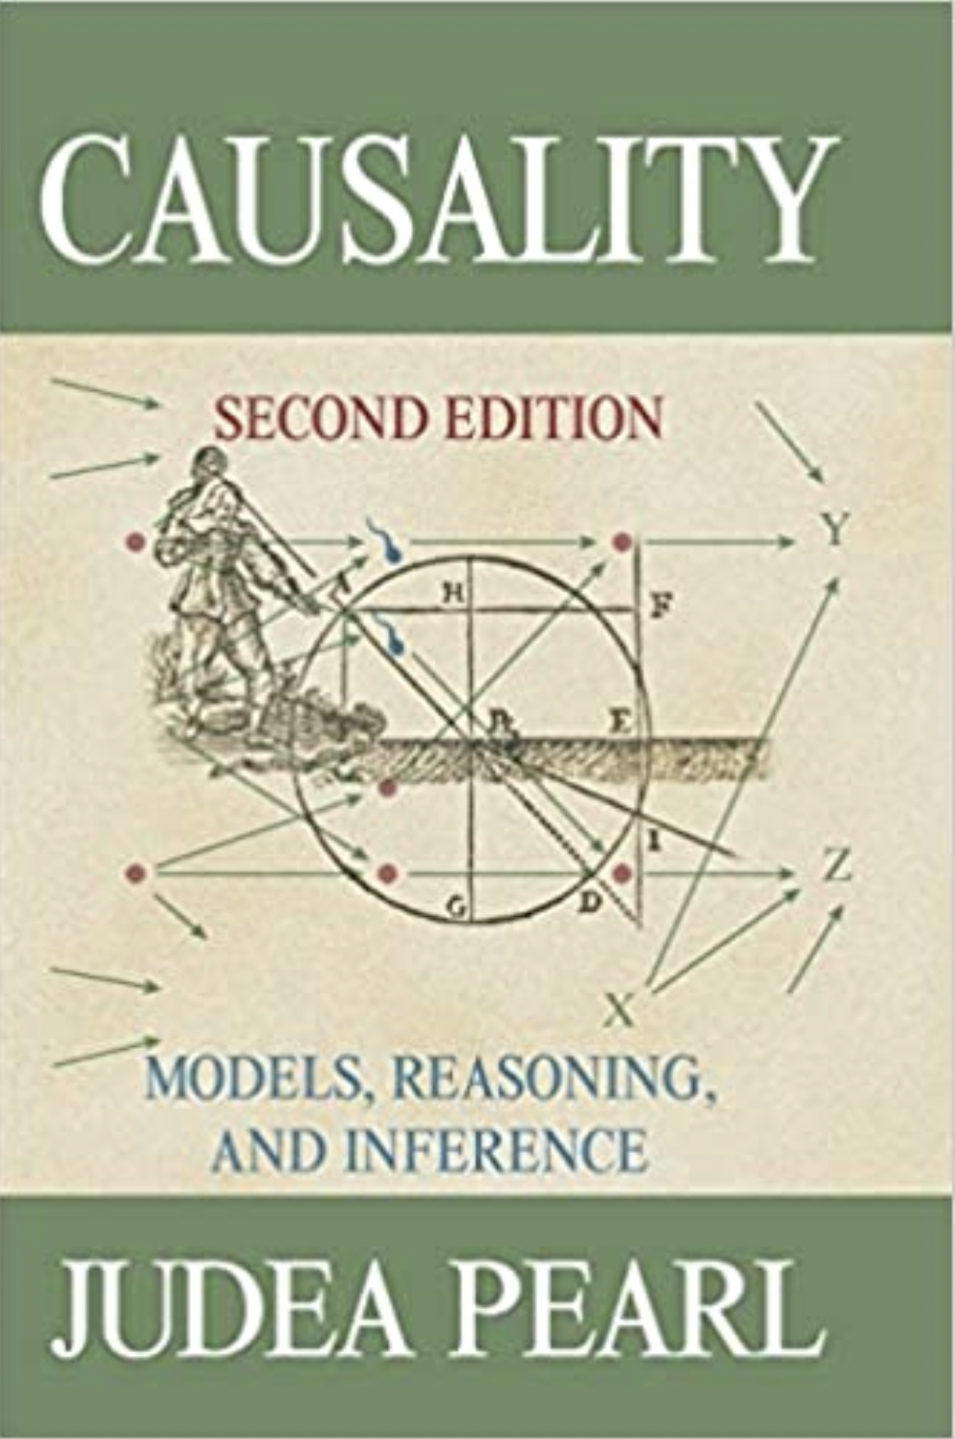
1987
2009
2009
2018
association
intervention & counterfactuals

Slide 6
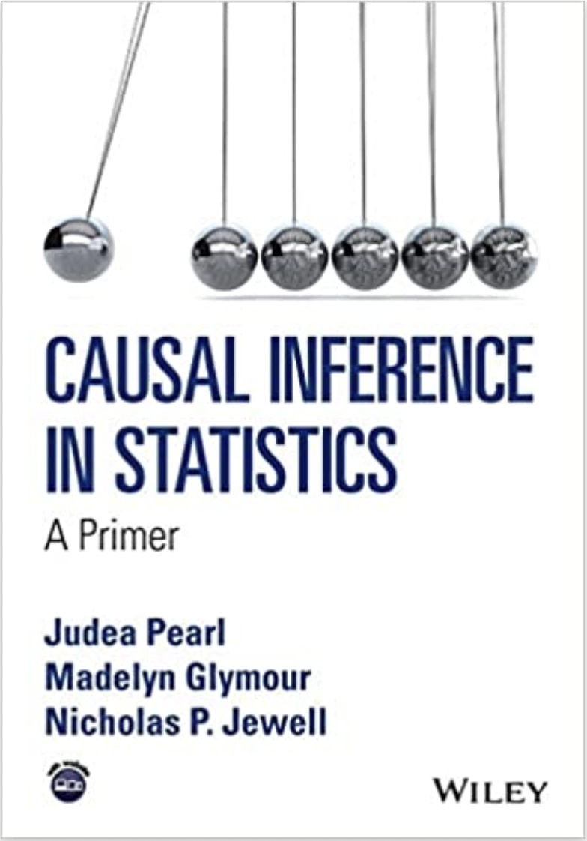
1987
2009
2016
2018
http://bayes.cs.ucla.edu/PRIMER/
association
intervention & counterfactuals

Slide 7
The Information Hierarchy
Associational reasoning: Bayesian network
Interventional reasoning: Causal Bayesian network (causal graph)
Counterfactual reasoning: Functional Bayesian network (functional dependencies)
Functional Bayesian networks ~ Structural causal models (SCM)

Slide 8
Notation

Slide 9
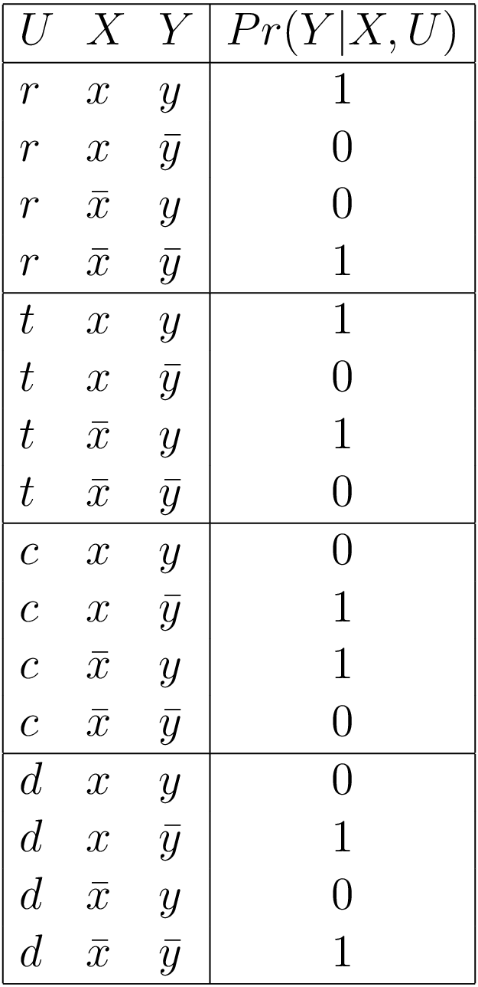
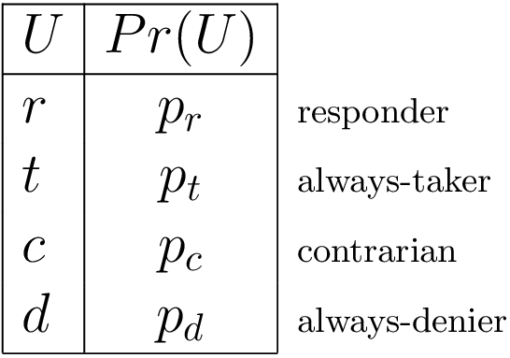
Functional Dependencies relationships
offer
Functional CPT (conditional probability table)
Y functionally depends on X, U
The CPT specifies a functional dependency
The CPT specifies a functional relationship
Functional relationships are normally
specified using equations
renew

Slide 10
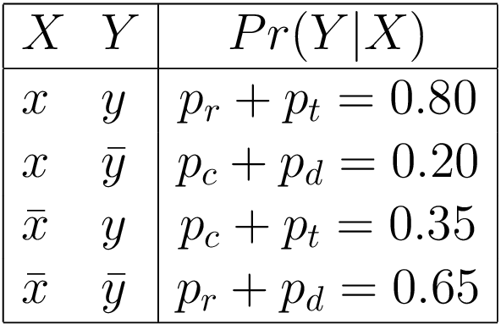
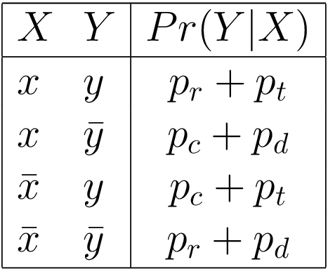
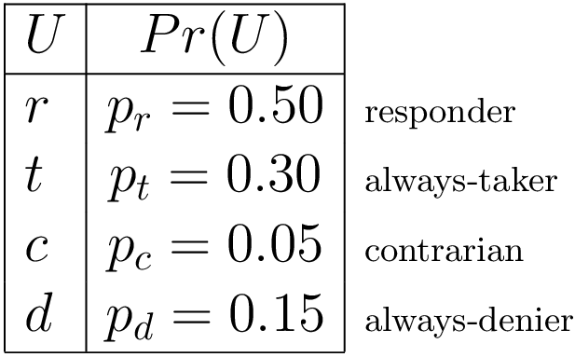
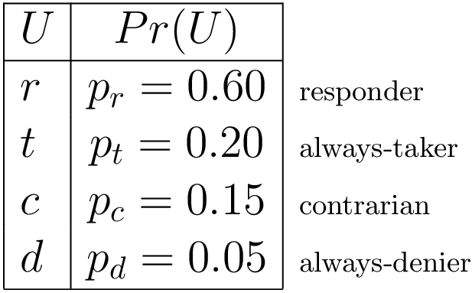
Why Functional Dependencies?
offer
sum out U
Section 5.3.4
renew
we lost critical information
Different distributions Pr(U) lead to the same distribution Pr(Y|X)

Slide 11
From Bayesian to Functional Networks
Always doable
Parameters of functional network not unique
Resulting networks are equivalent for interventional probabilities
Many values of U may have zero probability (can be omitted)

Slide 12
Functional Bayesian Networks
Distributions only on root nodes (called background variables)
Other nodes functionally depend on their parents
In practice:
Background variables are hidden
We do not require knowledge of what values they have
We assume that nodes functionally depend on their parents, but we do not require knowledge of the specific functions
Key questions: are counterfactuals identifiable and under what conditions?

Slide 13
Action/Observation Exchange do calculus
Exogeneity (more general definition later)

Slide 14
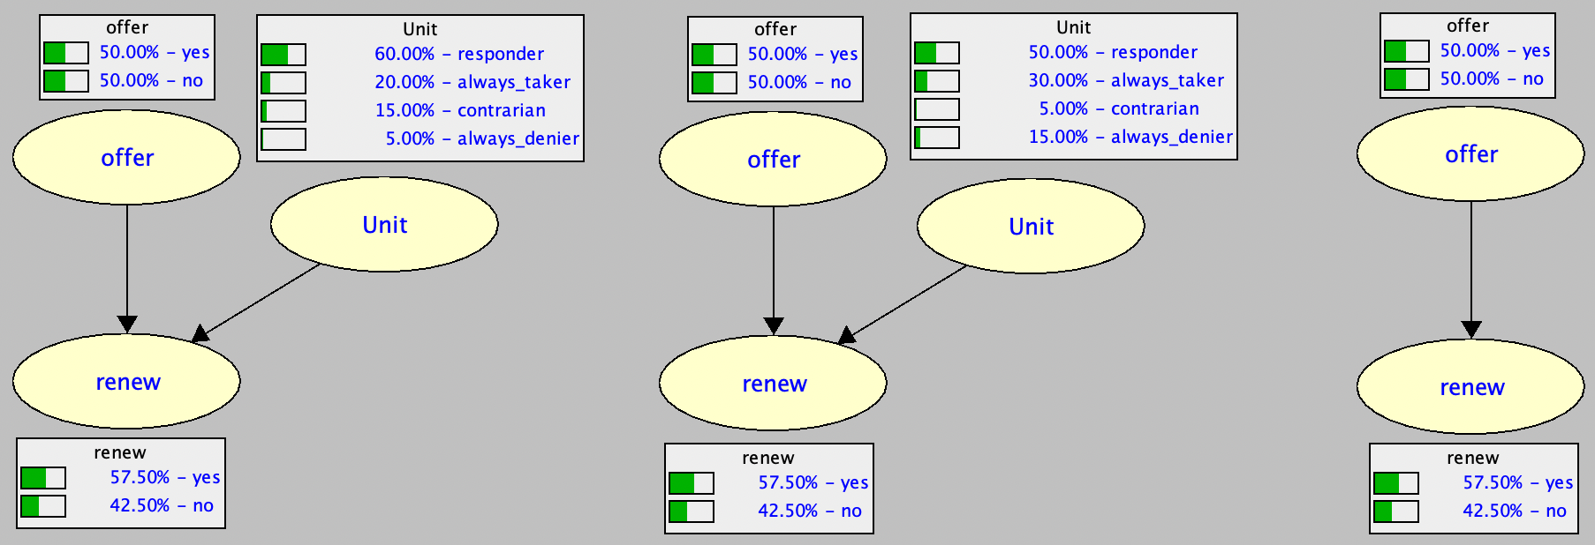
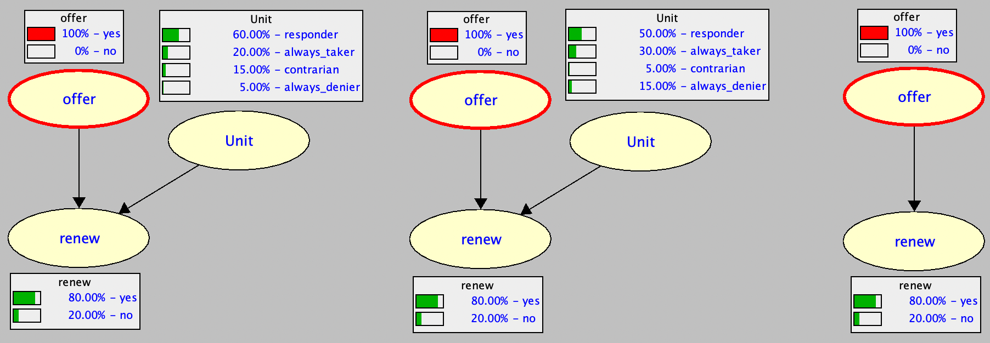
Counterfactual Reasoning examples
Both functional Bayesian networks induce the same
Bayesian network on X,Y
Example inference on X,Y
All networks are equivalent

Slide 15
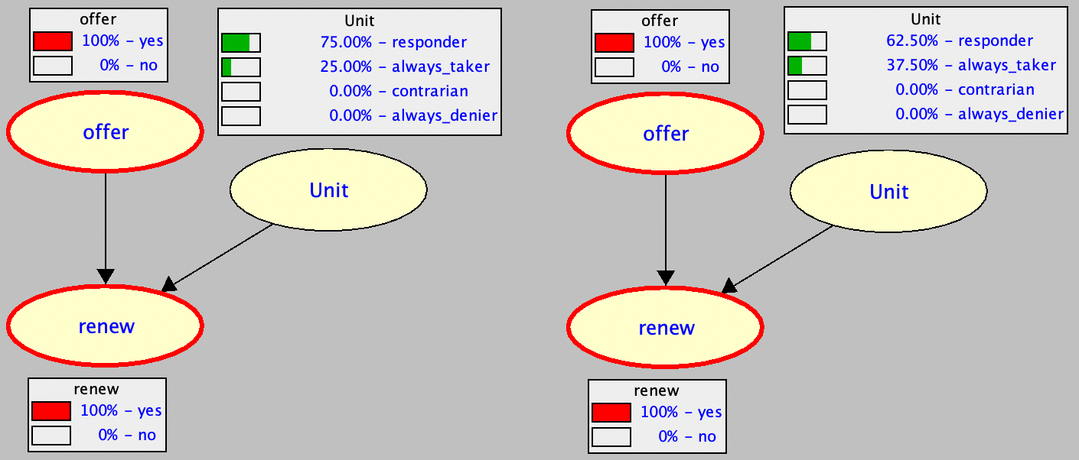
Counterfactual Reasoning examples
we made an offer to a customer and she renewed
probability of this observation is 40% in both models

Slide 16
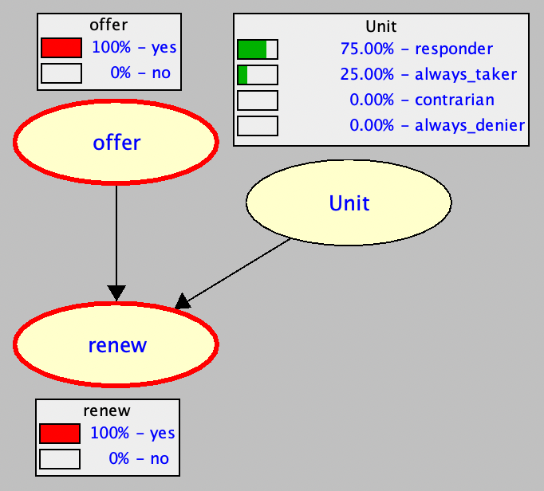
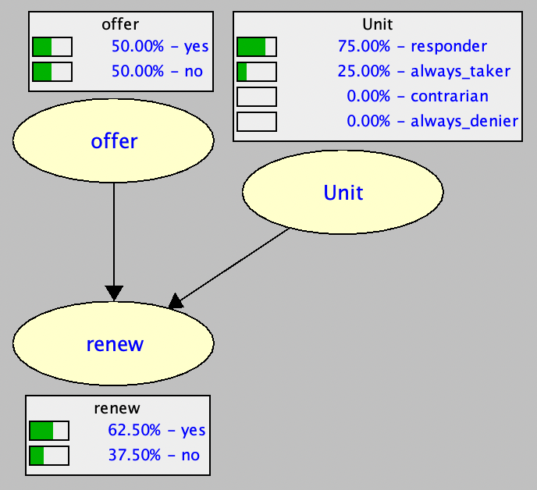
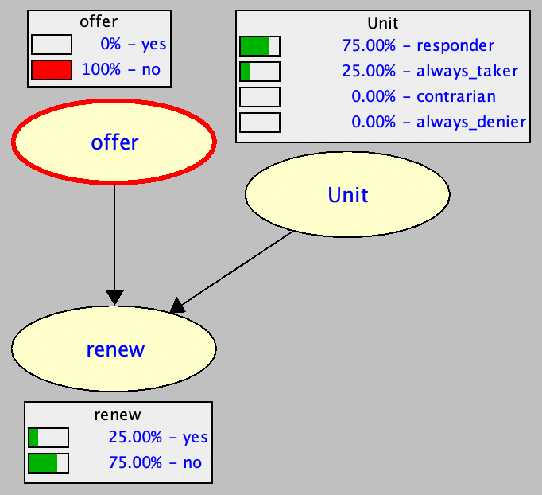
Counterfactual Reasoning examples
what is the probability she would not have renewed had we not made the offer?
model 1
real world
hypothetical world
Probability of Necessity (PN) = 75%

Slide 17
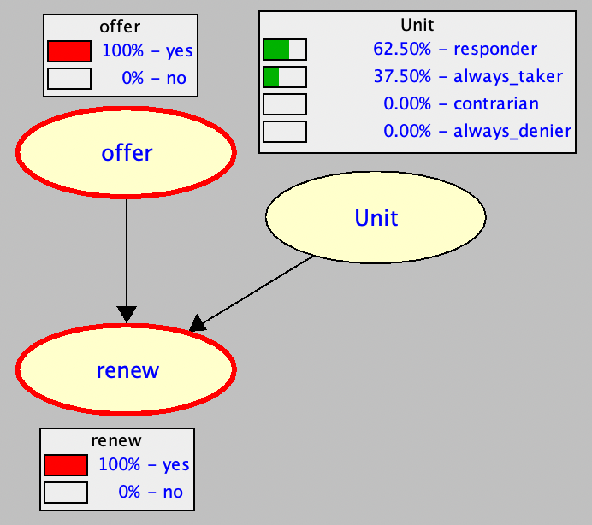
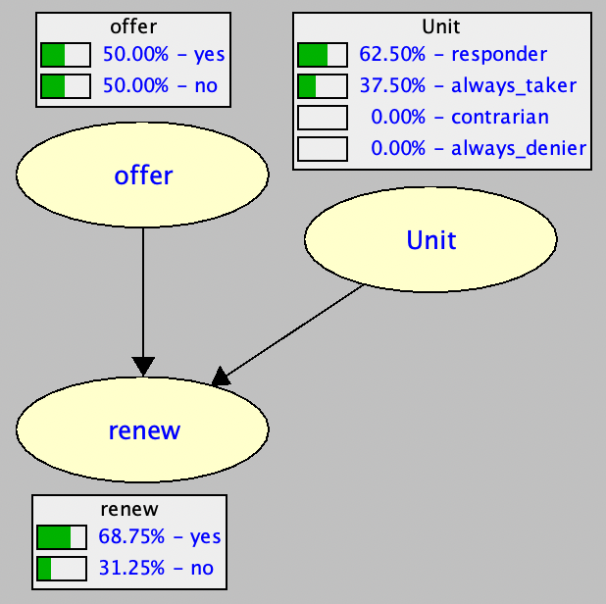
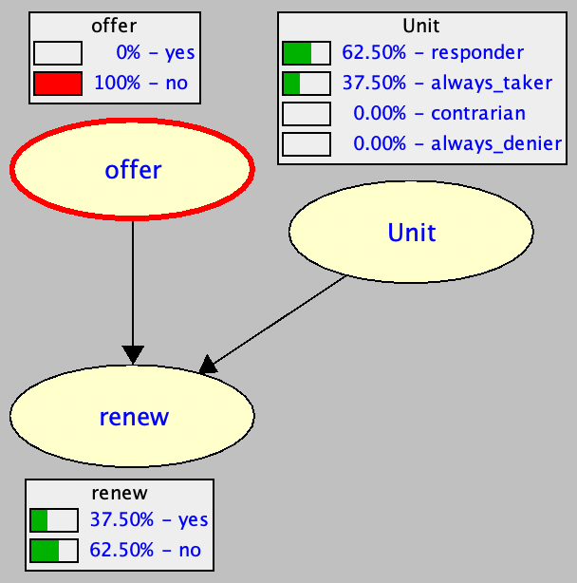
Counterfactual Reasoning examples
what is the probability she would not have renewed had we not made the offer?
model 2
Probability of Necessity (PN) = 62.5%

Slide 18
Counterfactual Reasoning examples
what is the probability she would have renewed had we not made the offer?
model 2
the two models have the same distribution over observables (offer, renew)
the two models have the same causal effect for offer on renew
the two models have different probability of necessity
Probability of Necessity (PN) = 37.5%

Slide 19
Probability of Necessity PN

Slide 20
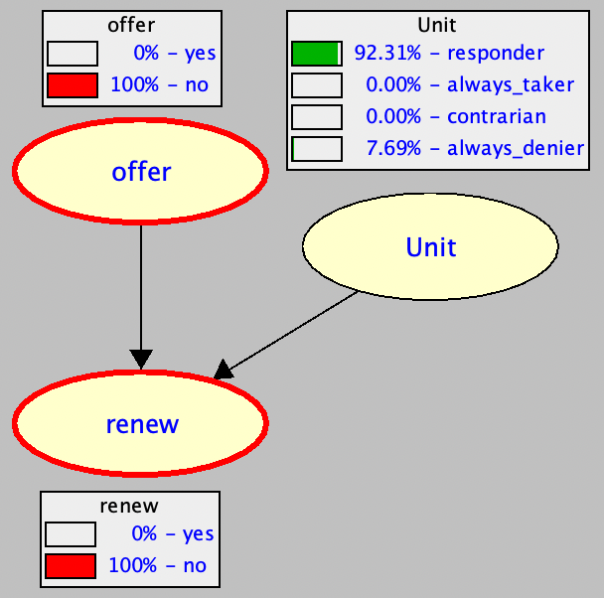
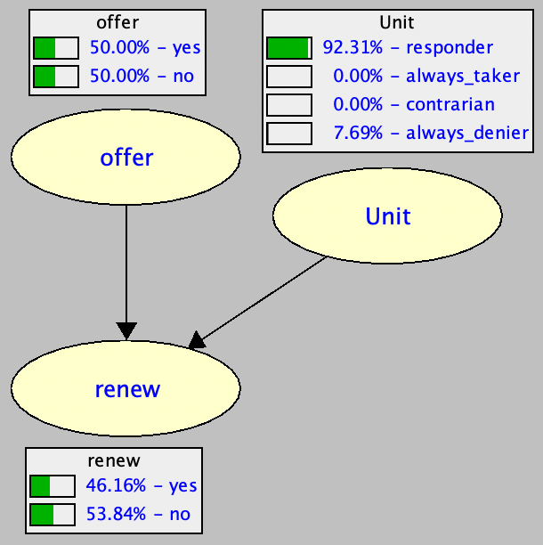
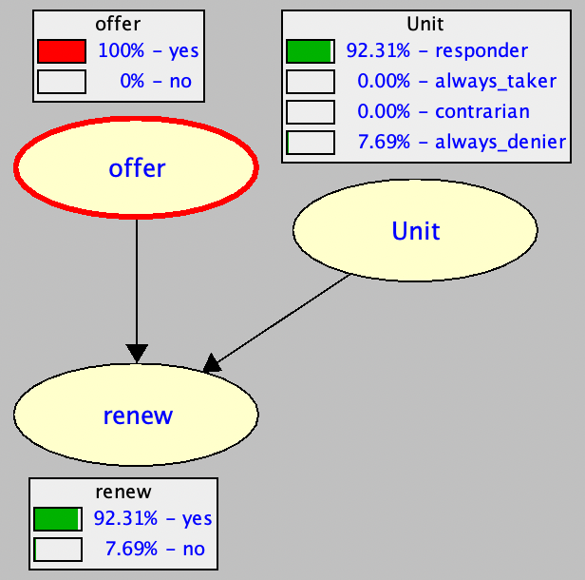
Probability of Sufficiency PS
Probability of Sufficiency (PS) = 92.31%

Slide 21
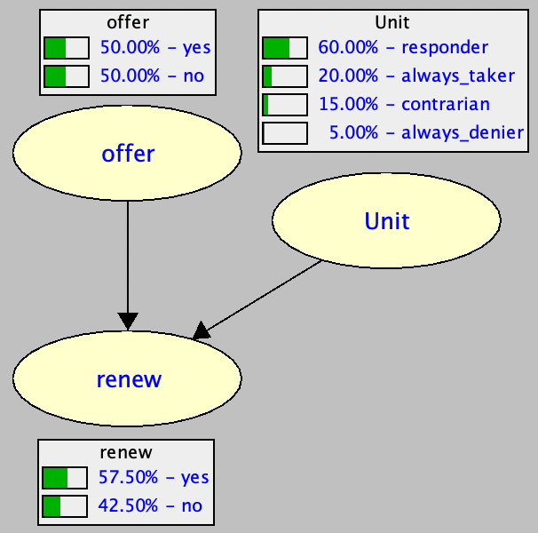
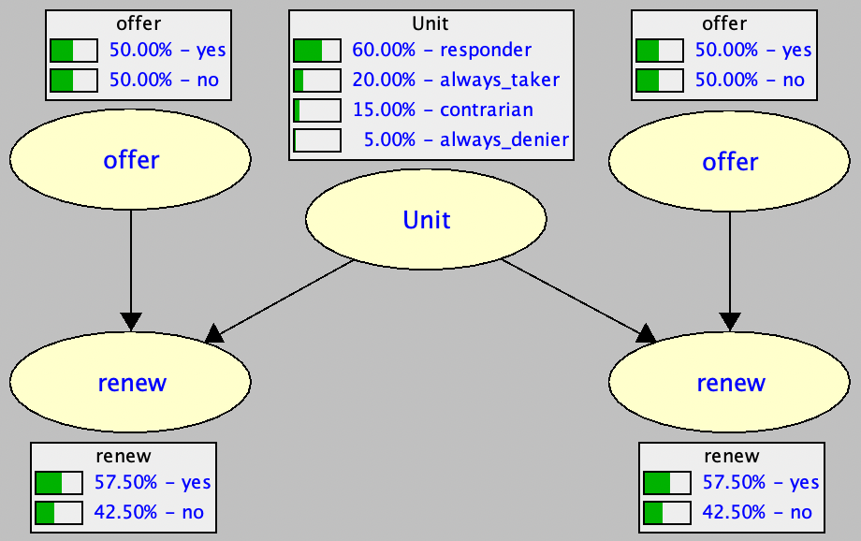
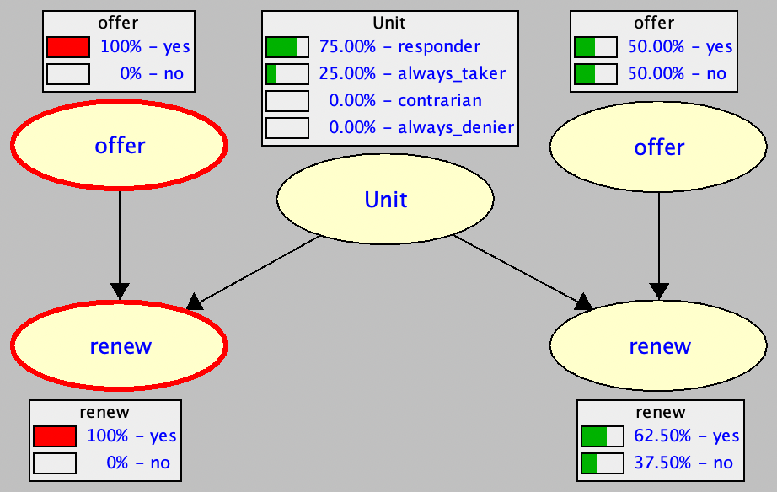
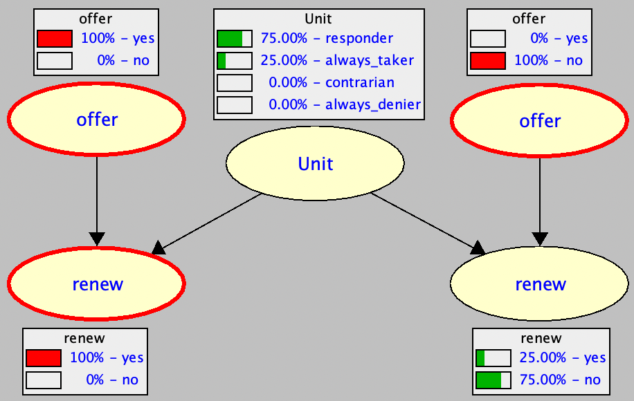
Twin Network Technique
network
twin
network
real
situation
hypothetical
situation
Probability of Necessity (PN) = 75%

Slide 22
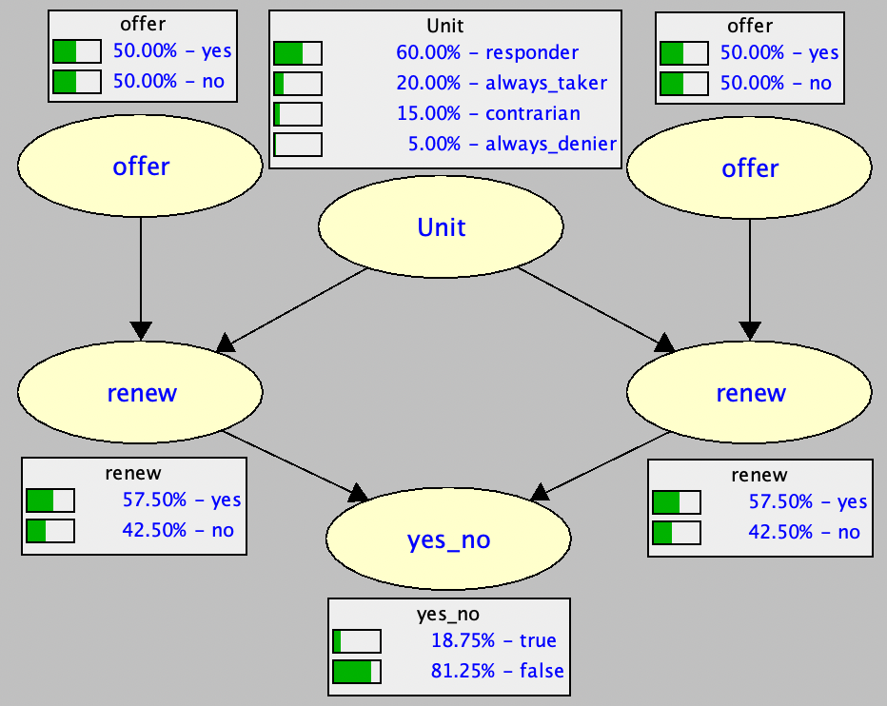
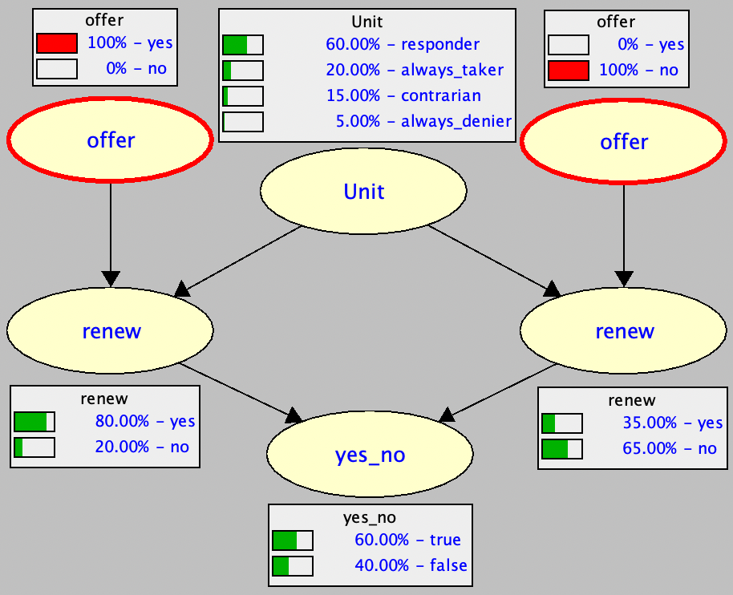
Probability of Necessity and Sufficiency PNS

Slide 23
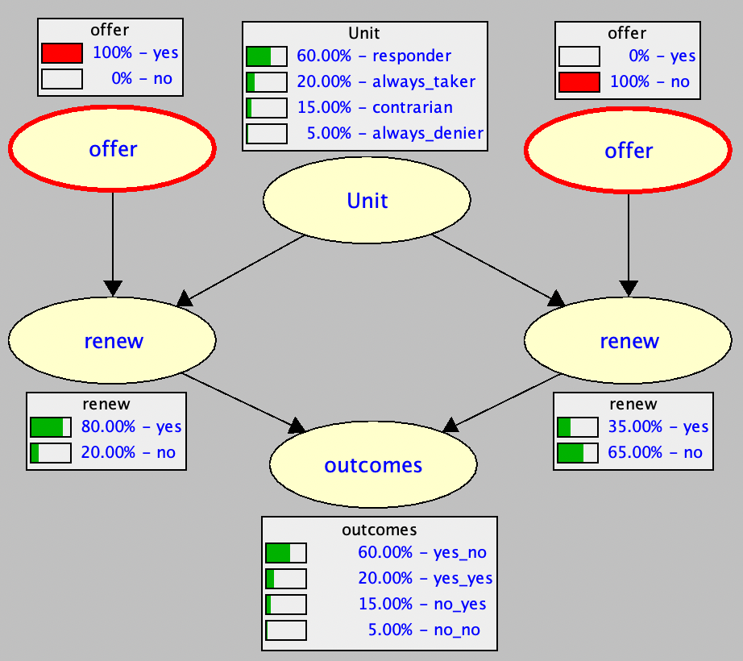
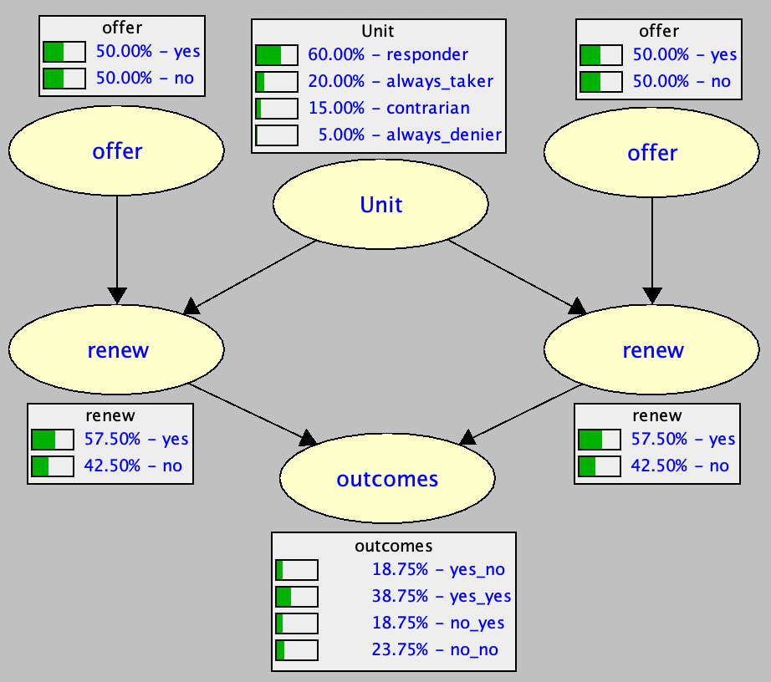
Key Insight behind counterfactual reasoning

Slide 24
Monotonicity intuitively
local version
= 0
no contrarians
no customers who will not renew if offered but will
renew if not offered
no patients who will die if they take drug but will survive if they don’t

Slide 25
Other Counterfactual Quantities

Slide 26
Interventional Reasoning may not be enough
Causal
Effect
CE = 50 %
Causal
Effect
CE = 50 %

Slide 27
Interventional Reasoning may not be enough
Causal
Effect
CE = 50 %
Causal
Effect
CE = 50 %
Probability of Necessity
PN = 100 %
Probability of Necessity
PN = 0 %

Slide 28
Local vs Global Counterfactuals
We focused so far on the simple case where X is a parent of Y
This facilitated the discussion of two pillars of counterfactual reasoning:
The extra information we need and why we need it
Transferring information from one situation into another (possibly conflicting one)
Counterfactual reasoning is not restricted to the simple case X → Y
We next provide a more general and formal treatment

Slide 29
The Information Hierarchy
Associational reasoning: Bayesian network
Interventional reasoning: Causal Bayesian network (causal graph)
Counterfactual reasoning: Functional Bayesian network (functional dependencies)
interventional reasoning does not require a functional Bayesian network
structural causal model (SCM) is normally used instead of a functional Bayesian network

Slide 30
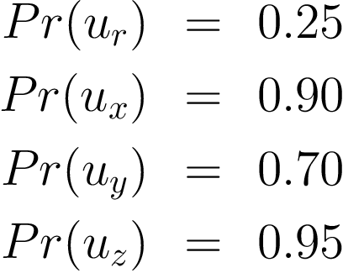
Structural Causal Model SCM
hidden
Exogenous Variables
Endogenous Variables
Example from: On Pearl’s hierarchy and the foundations of causal inference, Bareinboim el al.

Slide 31
Sub-Model interventions

Slide 32
Syntax & Semantics counterfactuals (and interventions)

Slide 33
Worlds
World: instantiation of exogenous variables
The states of endogenous variables are fixed in a world
Definitions from: Causal Inference with Tractable Circuits, Darwiche

Slide 34
Probabilities of Counterfactuals

Slide 35
Events observational, interventional, counterfactual

Slide 36
Satisfaction world satisfies event

Slide 37
Example

Slide 38
Example
1
0
1
1
1
1
1
1
1
1
0
1

Slide 39
Example

Slide 40
Exogeneity and Monotonicity revisited
strong vs weak exogeneity
more general condition

Slide 41
Beyond Prototypical Quantities

Slide 42
The Importance of Notation

Slide 43
Identifiability probability of necessity and sufficiency
using observational data

Slide 44
Identifiability probability of necessity and sufficiency
using observational data

Slide 45
Bounds on probability of necessity and sufficiency
using observational data
using interventional data

Slide 46
Bounds on probability of necessity and sufficiency
last few pages of Causality book
using experimental and nonexperimental data, no assumptions made
interventional
observational
using combined data (observational + interventional) has not been common traditionally

Slide 47
Tighter Bounds on probability of necessity and sufficiency
recent: Scott Mueller, Ang Li, Judea Pearl
using experimental and nonexperimental data, no assumptions made
Causality, p. 298

Slide 48
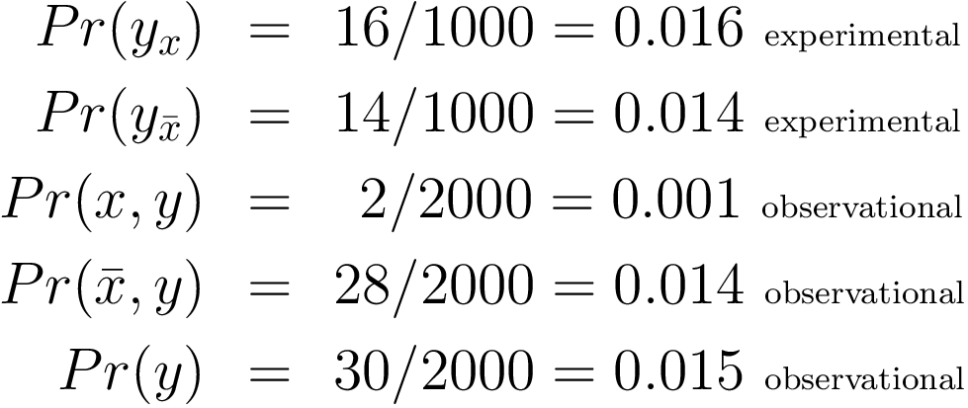
Combined Data example
estimates

Slide 49
Concluding Remarks

Slide 50
Concluding Remarks
The causal hierarchy has two dimensions:
Information: Bayesian network, Causal Bayesian Network, Functional Bayesian Network
Reasoning: associational, interventional, counterfactual
It is helpful to discuss causality in the idealized and practical settings
Interventional reasoning is not as refined as counterfactual reasoning (cannot unveil certain aspects of a situation)
Two pillars of counterfactual reasoning:
Functional relationships (causal mechanisms)
Transferring information between (conflicting) situations

Slide 51
Thank You!

