Slide 1
Causality Part I: Interventions
Adnan Darwiche
UCLA

Slide 2
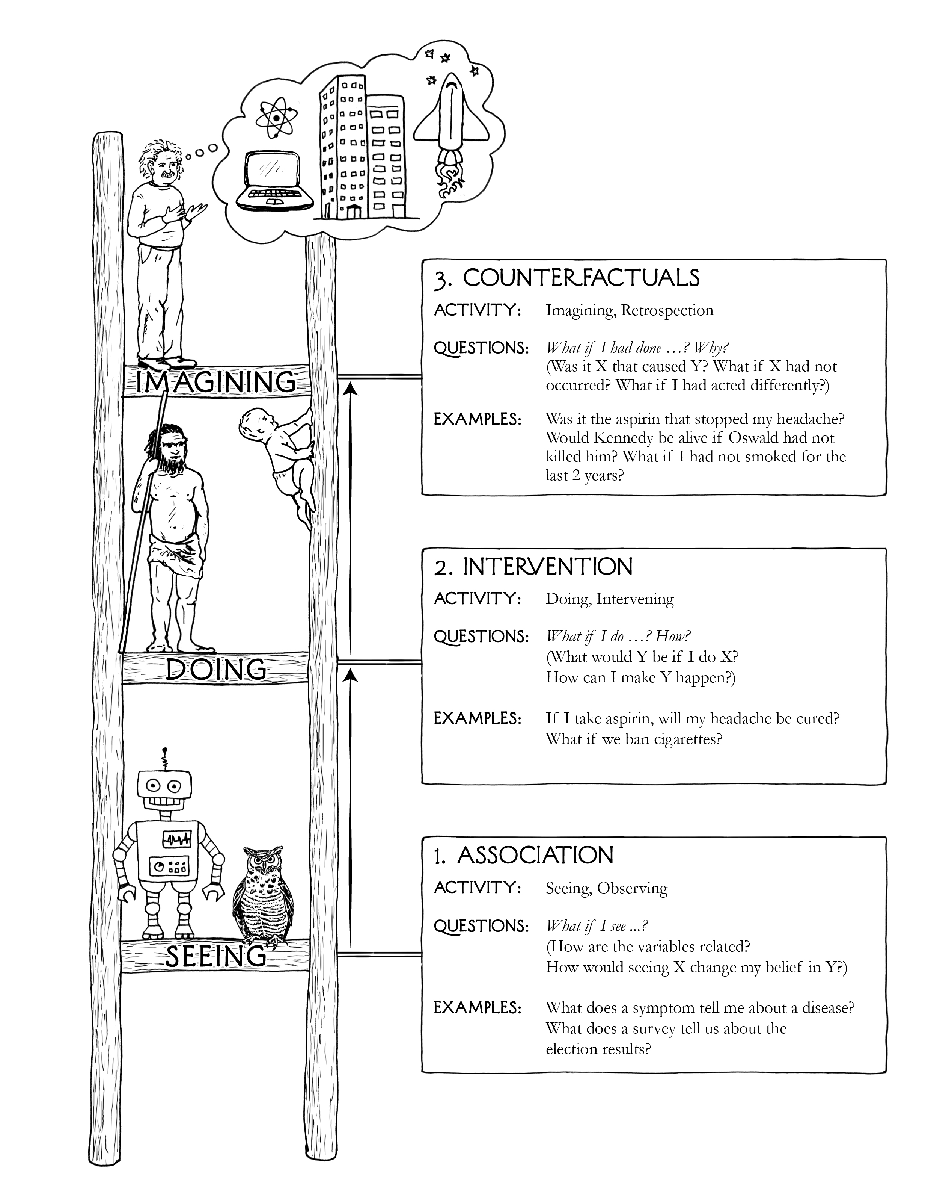
Why Causality?
layers/rungs of the causal hierarchy
Counterfactual reasoning
Interventional reasoning
Associational reasoning
next lecture
this lecture
class so far

Slide 3
Themes
layers/rungs of the causal hierarchy
Why do we need it?
What additional information do we need so we can do it?
How can we do it in an idealized setting? (complete model: causal graph + parameters)
How can we do it in a practical setting? (partial model: causal graph + data)
Causal inference using tractable circuits (recent results)
next lecture
this lecture
class so far

Slide 4
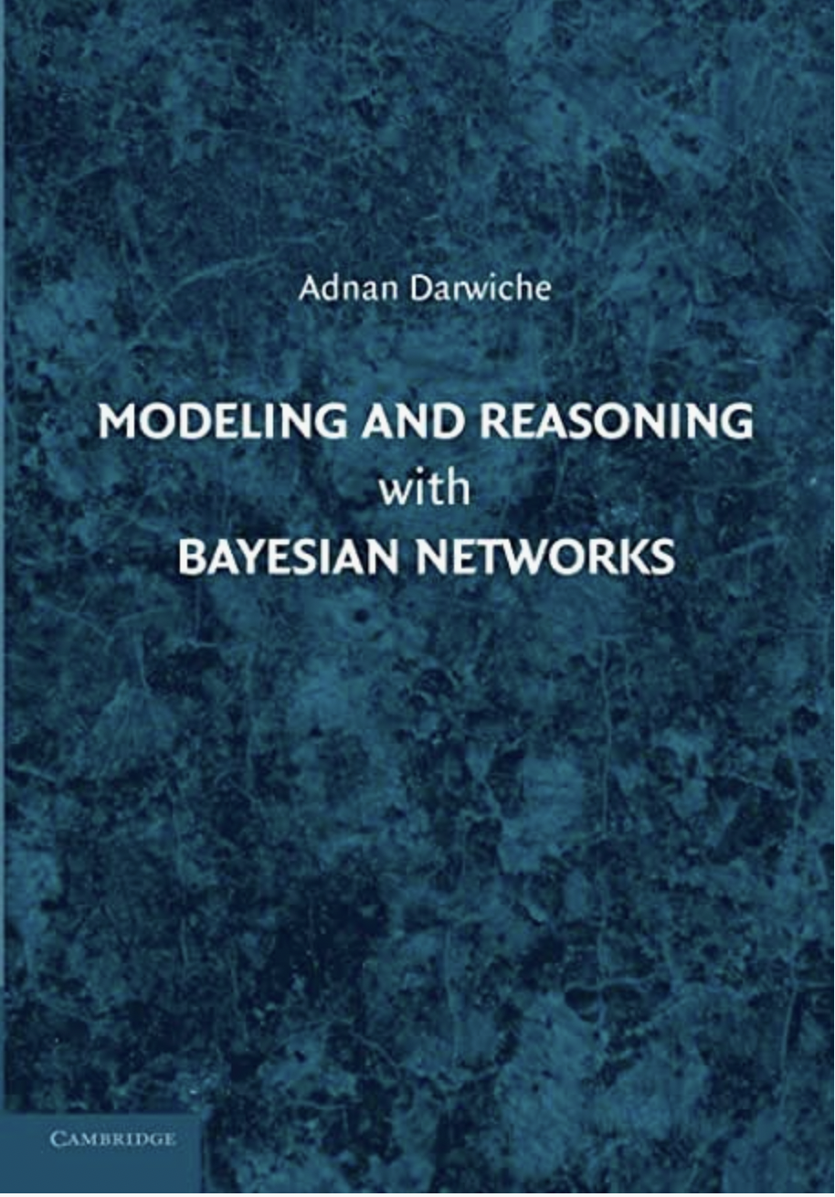
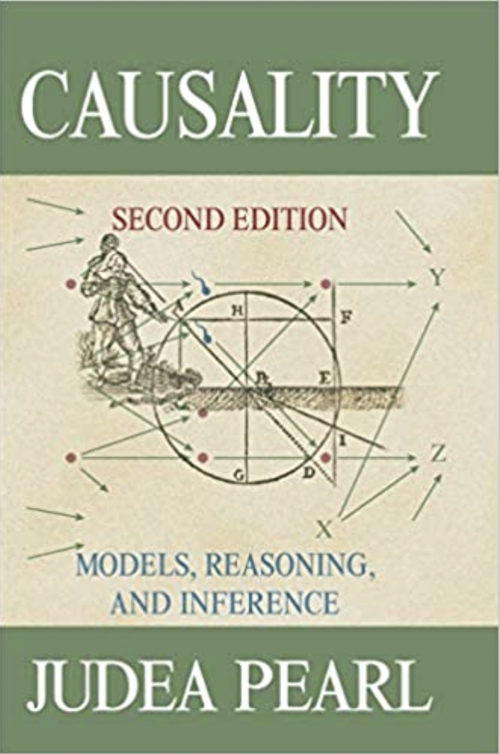
1987
2009
2009
2018
association
intervention & counterfactuals

Slide 5
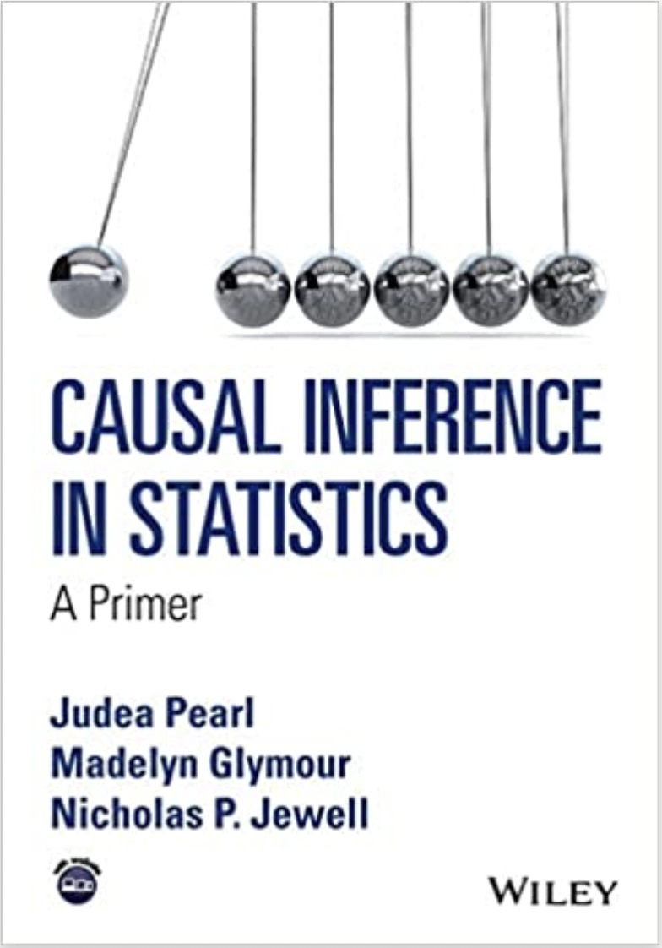
2016
2009
http://bayes.cs.ucla.edu/PRIMER/

Slide 6
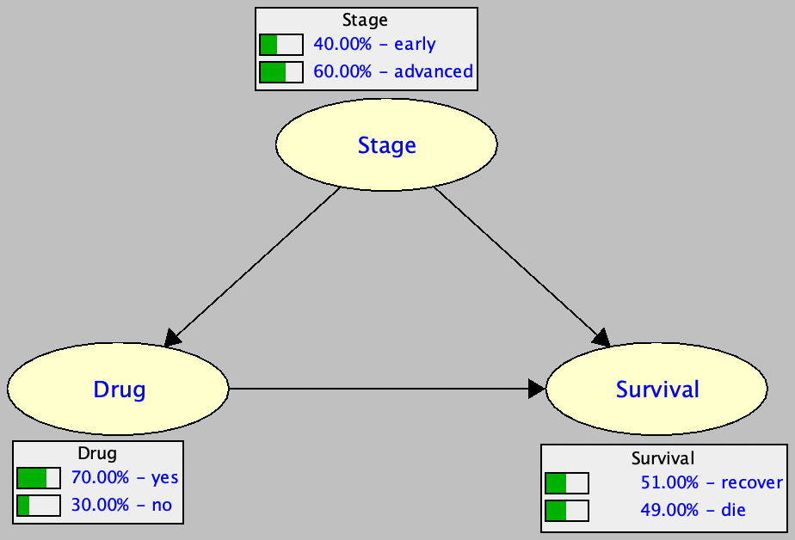
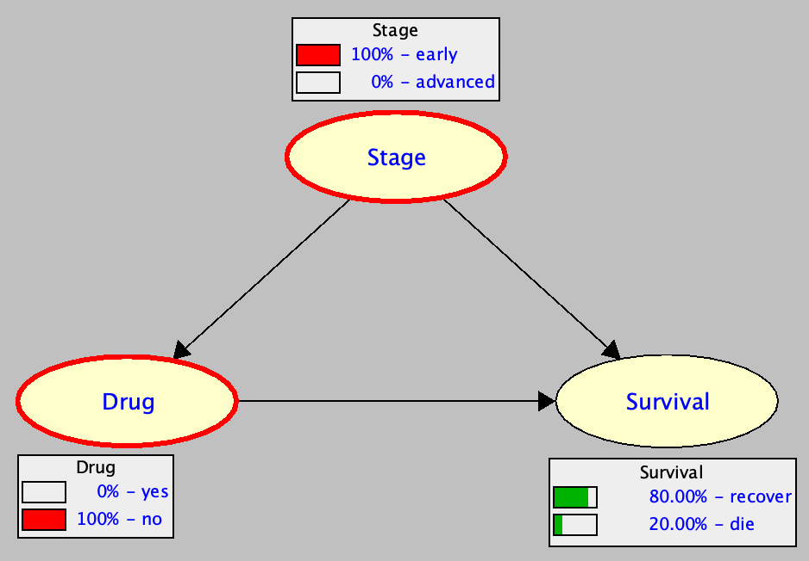
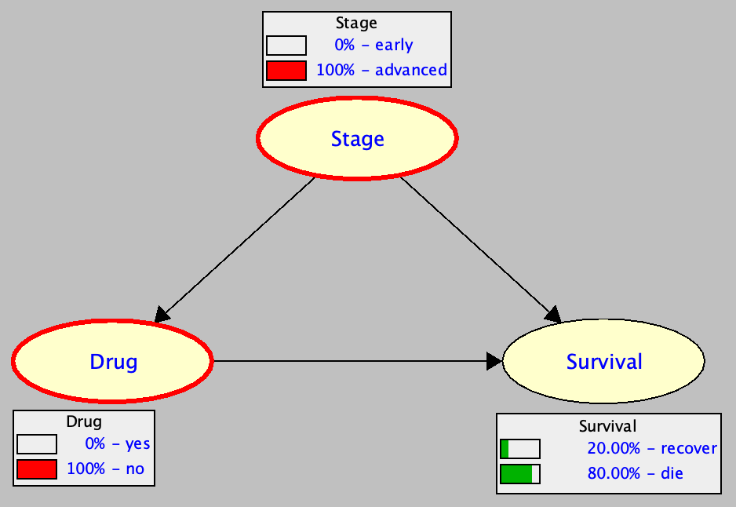
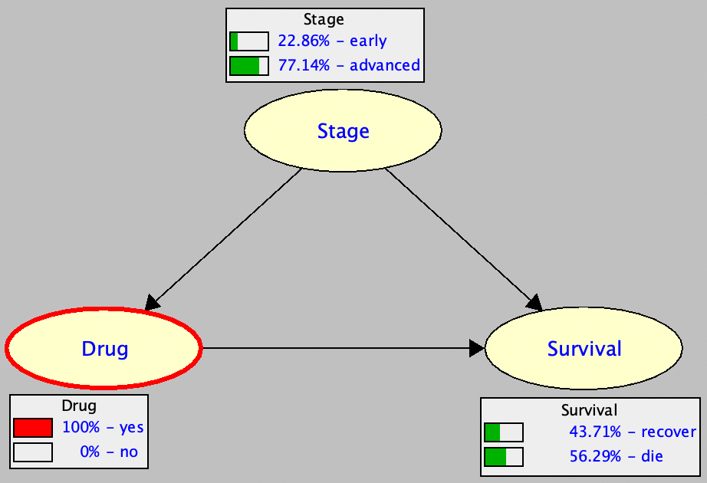
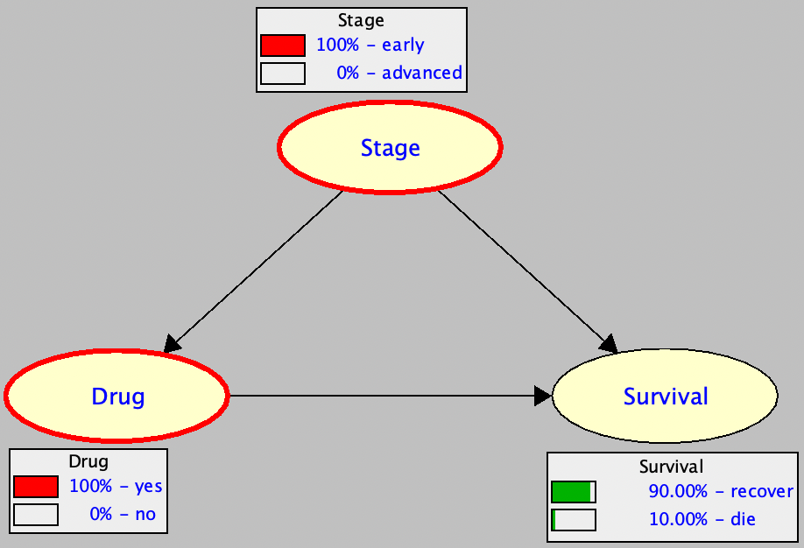
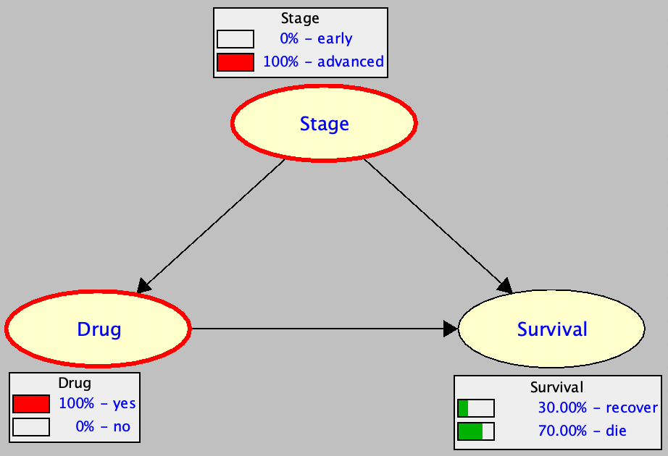
Why Do We Need It? causal effect
Drug is harmful
Drug helps
in early stage
Drug helps
in advanced stage
Simpson’s Paradox
http://reasoning.cs.ucla.edu/samiam/

Slide 7
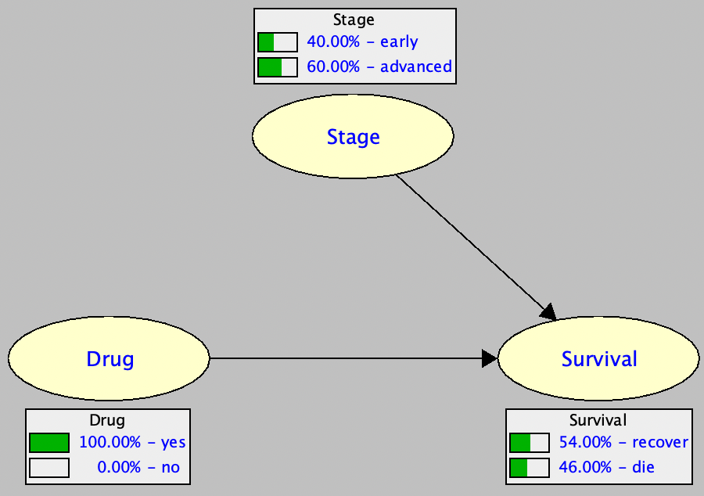
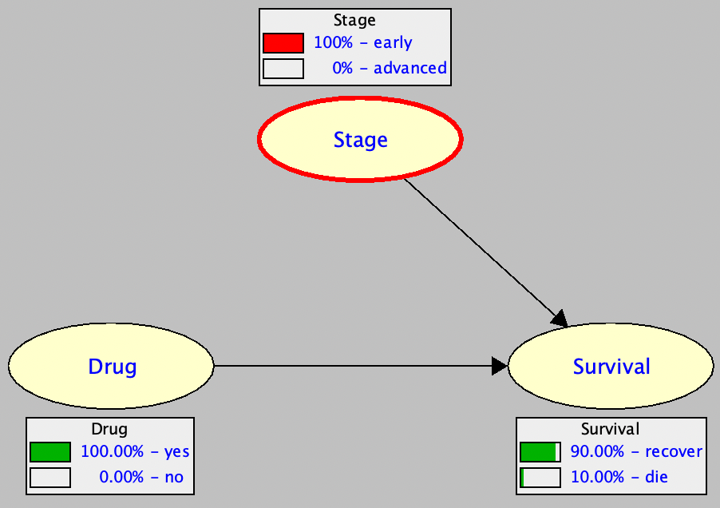
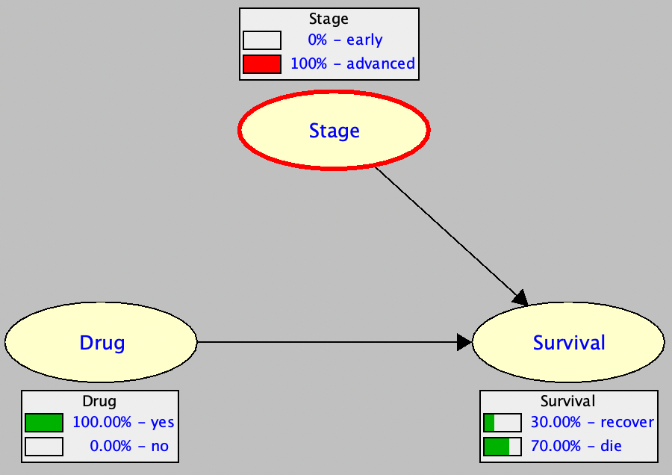
How Can We Do It? causal effect

Slide 8
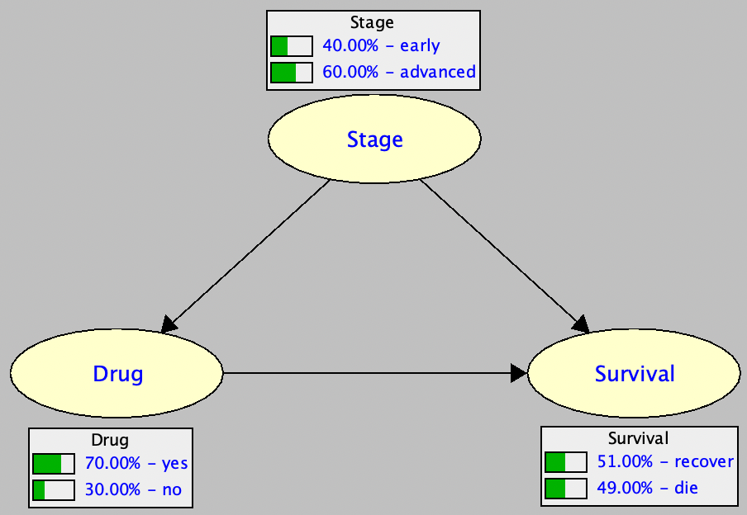
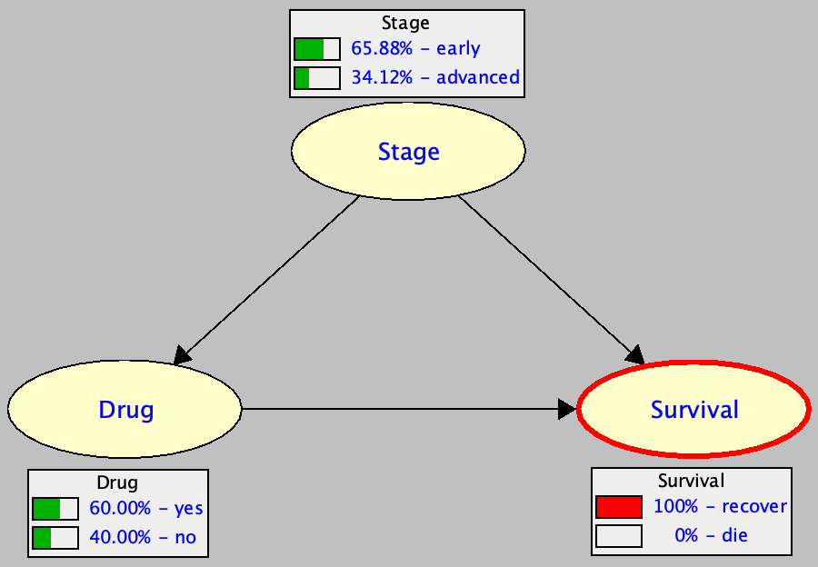
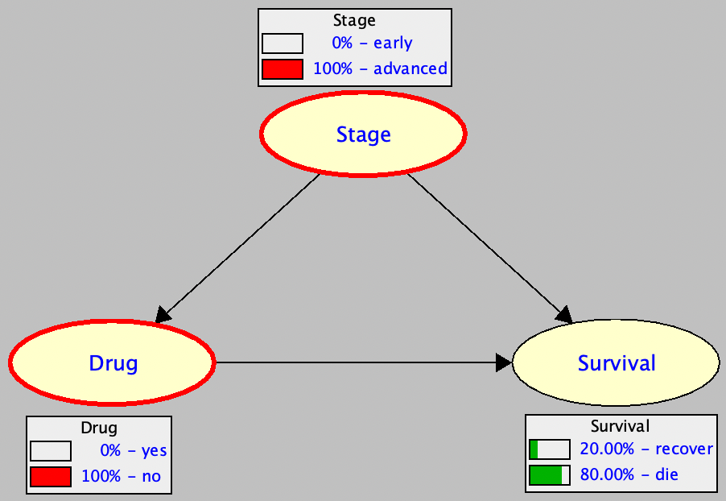
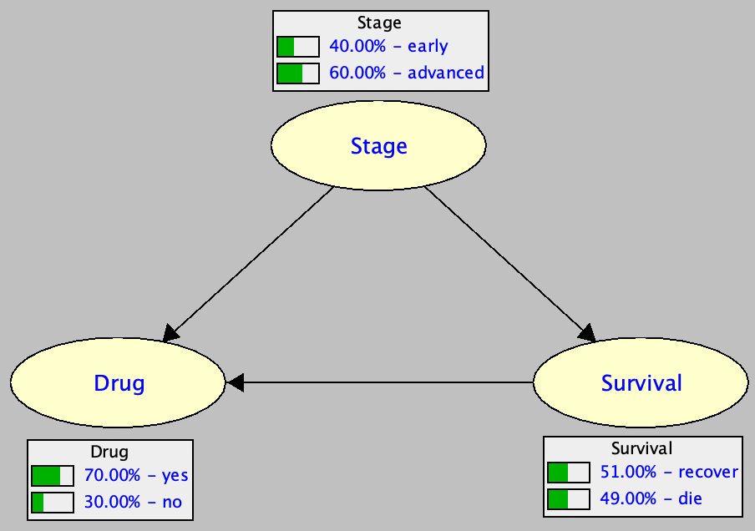
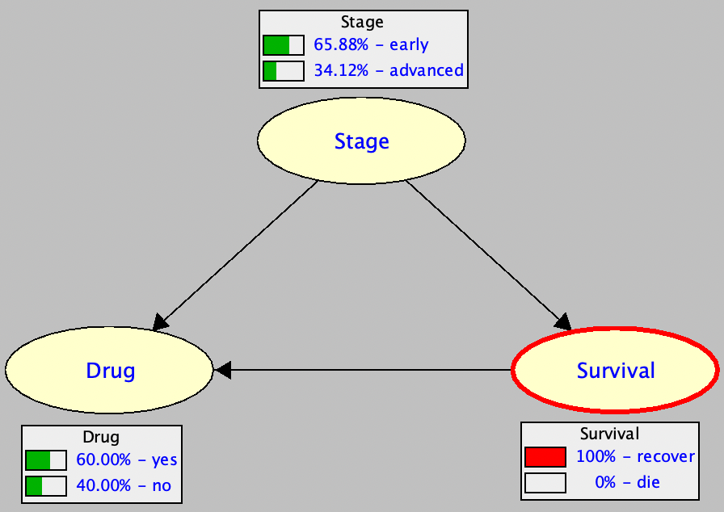
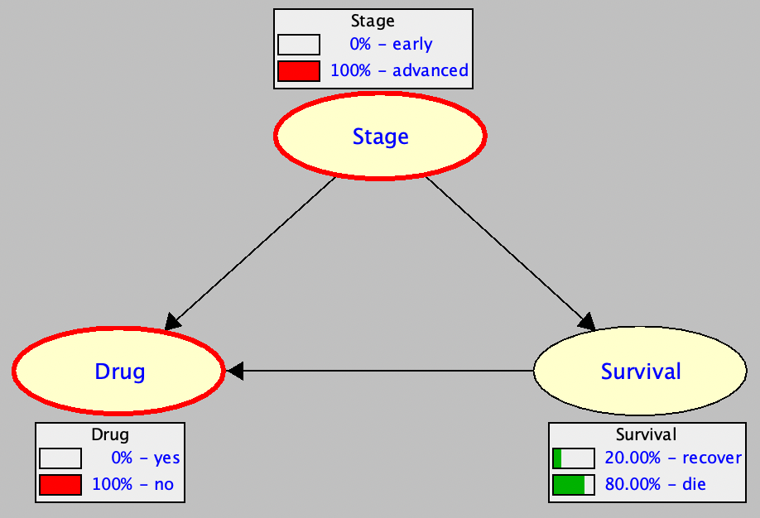
What Additional Information Do We Need?
model 1
model 2

Slide 9
What Additional Information Do We Need?
model 1
The two models specify the same distribution.
model 2
They are equivalent as far as answering associational queries.
They are not equivalent as far as answering interventional queries.

Slide 10
Data Is Not Enough!
The previous two models specify the same distribution
They will generate the same data
We cannot tell which model generated the data
Using data only, we cannot answer interventional queries
We need further information: The causal graph!
Model M₁
Data
Joint Distribution P
Model M₂

Slide 11
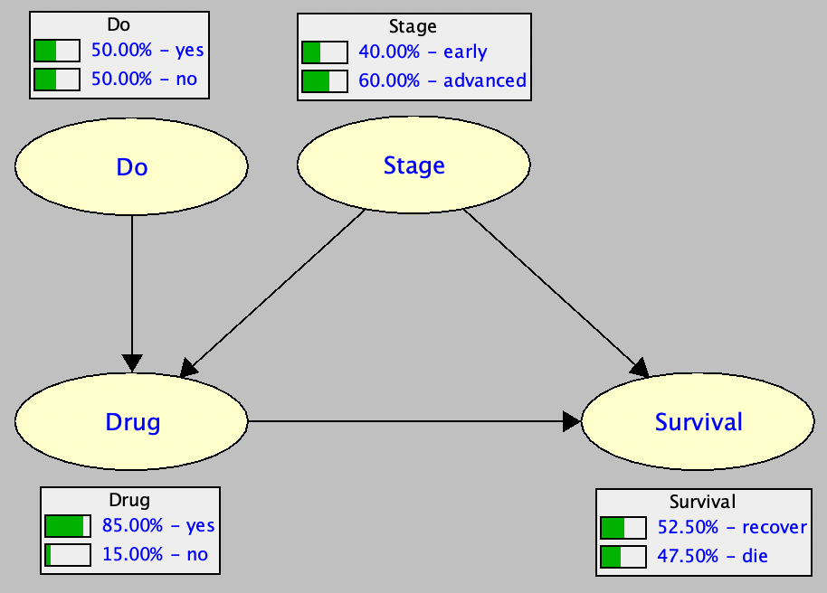
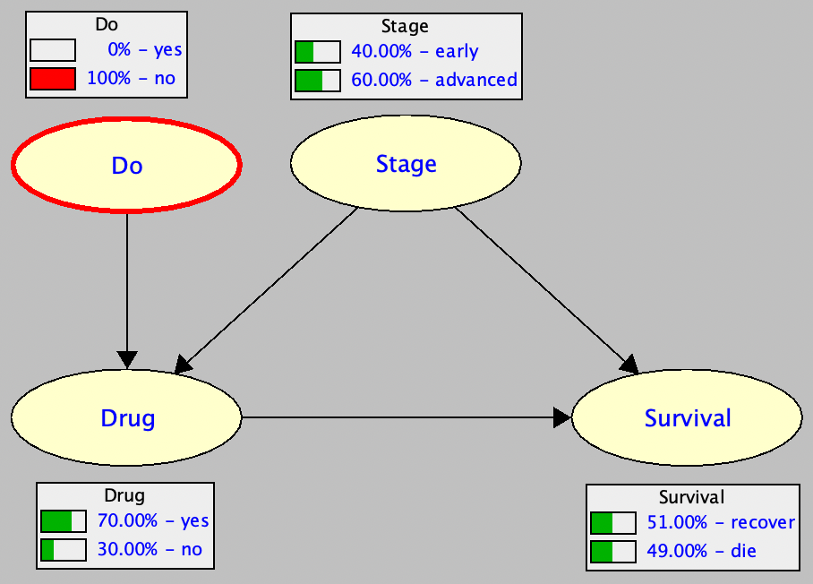
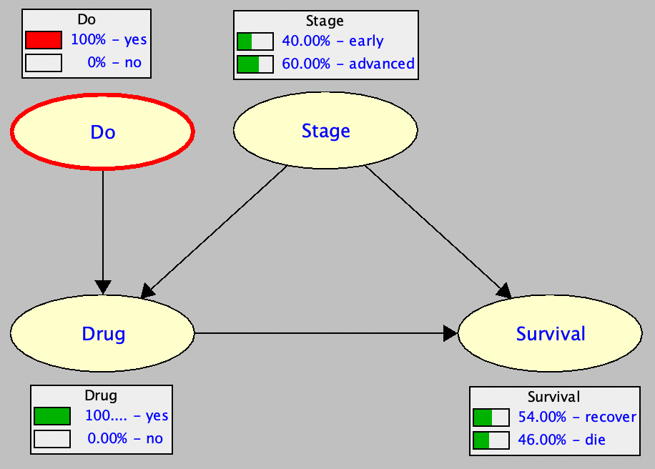
How Else Can We Do It? causal effect
method 1
method 2

Slide 12
How Else Can We Do It? an algebraic view
method 1

Slide 13
How Can We Do It? complete model
Surgery
Auxiliary do-node
Surgery
Auxiliary do-node
Truncated formula

Slide 14
Notation

Slide 15
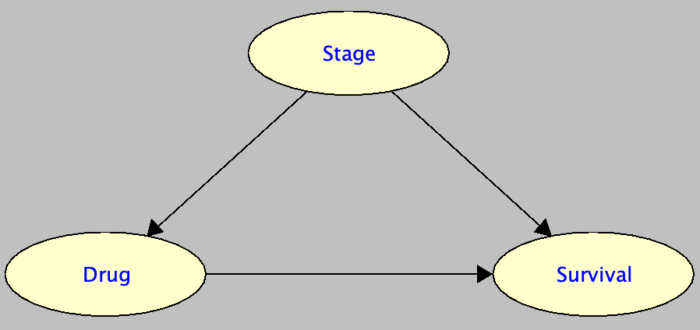
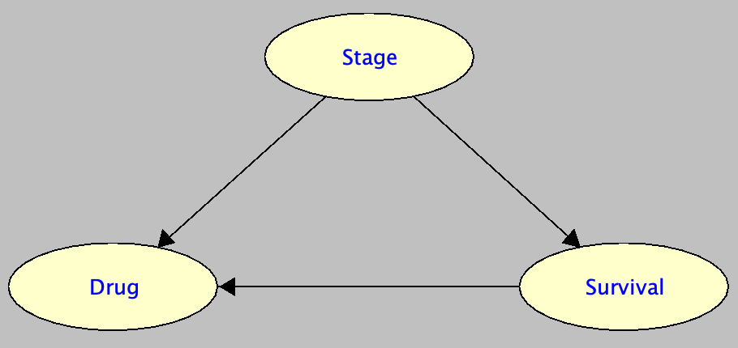
How Else Can We Do It?
expressing interventional probabilities using associational probabilities
catch: you need to know the parents of X

Slide 16
How Can We Do It? partial model + data
Input:
Causal graph (no parameters)
Data (observational)
Output:
Causal effect
Key observations:
This may not always be possible
When it is possible, we say the causal effect is identifiable
Identifiability depends on type of causal graph and available data
Several criteria for deciding identifiability: some are complete, some are not

Slide 17
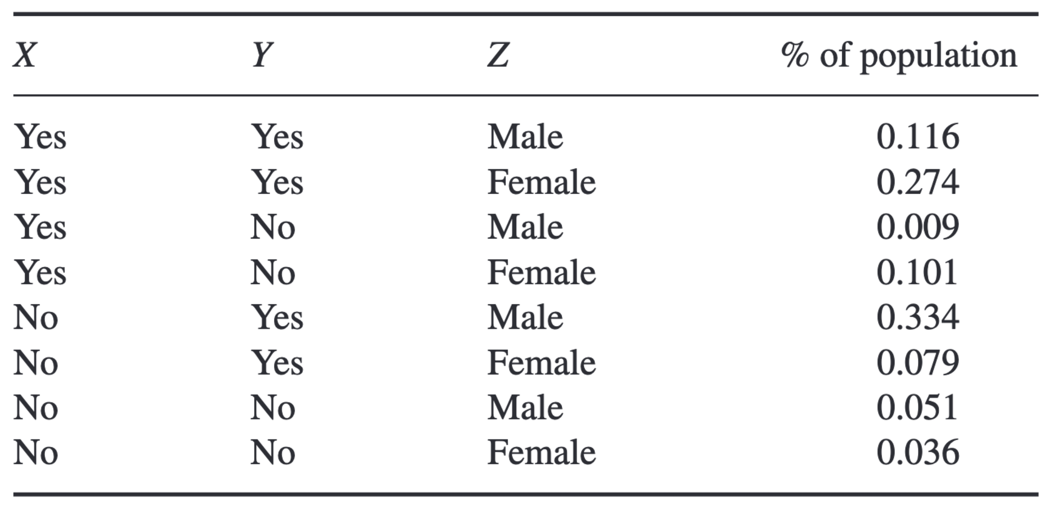
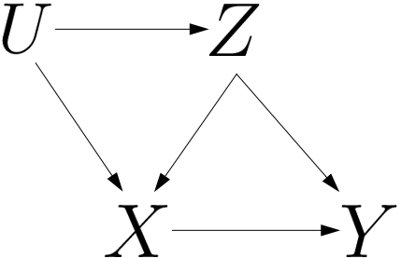
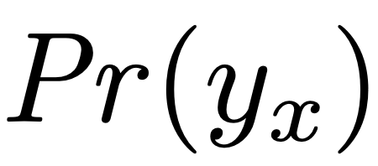
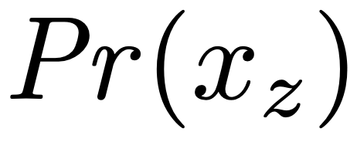
Example Input-Output
data
hidden
causal graph
input
notation
identifiable
output
not identifiable
variables U and U_{i} usually denote hidden variables

Slide 18
Types of Data
Observational data
Variables are either hidden or fully observed
Variables are either hidden, fully observed or partially observed
Interventional data
data
variable U is hidden

Slide 19
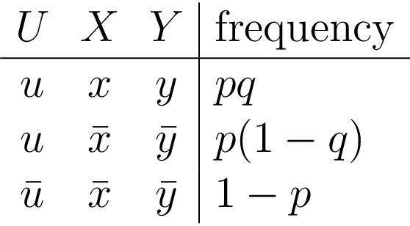
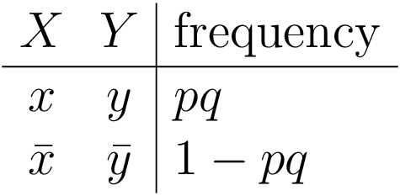
Why CE May Not Be Identifiable?
Consider the model
Causal effect (using truncated formula of interventional distribution)
Data generated by the model
If U is hidden, we see this data
Cannot recover the causal effect…
Example: if pq=.14 then p=.7, q=.2 and p=.2, q=.7 are solutions, but with different causal effects
If X and Y are off, cannot tell if X
turned off Y or if U turned off both
both p=.7, q=.2 and p=.2, q=.7 are maximum-likelihood parameters

Slide 20
Types of Causal Graphs hidden variables are roots
Markovian Model
Semi-Markovian Model
each hidden variable has at most one child
some hidden variable has more than one child
no hidden
confounders
identifiable
not identifiable
causal effect always identifiable
causal effect not always identifiable

Slide 21
Identifiability Criteria identifiability tests
Causal Effect Rule (incomplete)
Backdoor Criteria (incomplete)
Frontdoor Criteria (incomplete)
Do-Calculus (complete)
There are other criteria… some use additional information like context-specific independence

Slide 22
Causal Effect Rule

Slide 23
Example: Causal Effect Rule
hidden
cannot use CER
not identifiable
cannot use CER
identifiable

Slide 24
Backdoor Criteria d-separation review
Is the path blocked by variable Z ?
X
Y
collider
collider
Path between X and Y is blocked by Z iff:
some collider is not in Z, or
some non-collider is in Z

Slide 25
Backdoor Criteria
interventional
associational

Slide 26
Example: Backdoor
hidden
cannot use CER
identifiable
cannot use CER
not identifiable
Z is a backdoor
Paths Y ← Z → X and Y ← Z ← U → X are blocked by Z
no backdoor
Path Z ← U → X cannot be blocked by observed variables

Slide 27
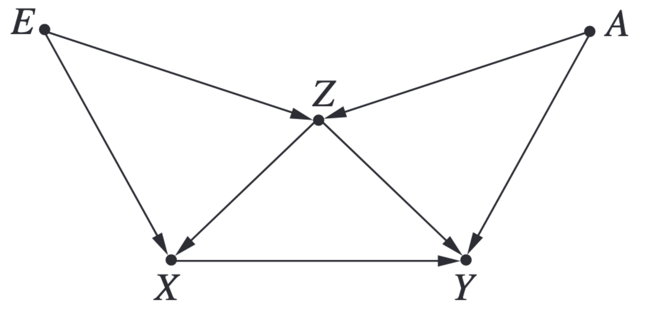
Example: Backdoor
find backdoor for causal effect of X on Y
all variables are observed (no hidden variables)

Slide 28
Example: Backdoor
backdoor 1: A, Z
backdoor 2: E, Z
backdoor 3: A, E, Z
enumerating backdoor paths

Slide 29
Frontdoor Criteria
interventional
associational

Slide 30
Incompleteness of Backdoor Criterion
Genotype (hidden)
Genotype (hidden)
Smoking
Cancer
Smoking
Tar
Cancer
no backdoor
no backdoor
causal effect is not identifiable
causal effect is identifiable!
causal effect of smoking on cancer

Slide 31
The Do-Calculus

Slide 32
The Do-Calculus: Example Derivation
G
T
is identifiable
there is a polytime algorithm for the do-calculus
S
C
Probability Axioms
Rule 2
Rule 2
Rule 3
Probability Axioms
Rule 2
Rule 3

Slide 33
Concluding Remarks
Causal hierarchy has three layers
Associational reasoning
Interventional reasoning
Counterfactual reasoning
A distribution is not enough for layers 2 and 3 (we need a causal graph)
Data is not enough for layers 2 and 3
Cross-layer inference is sometimes feasible (e.g., computing interventional probabilities using (partial) data + causal graph)

Slide 34
Thank You!

