Slide 1
Code Generation
Gülfem Savrun Yeniçeri
CS 142 (b)
02/26/2013

Slide 2
Code Generation
Translates intermediate representation into machine code
Generated code is target specific
x86
ARM

Slide 3
Code Generation
.class file
Parser
SSA Generator
Optimizations
Register Allocator
Code Generator
x86 code

Slide 4
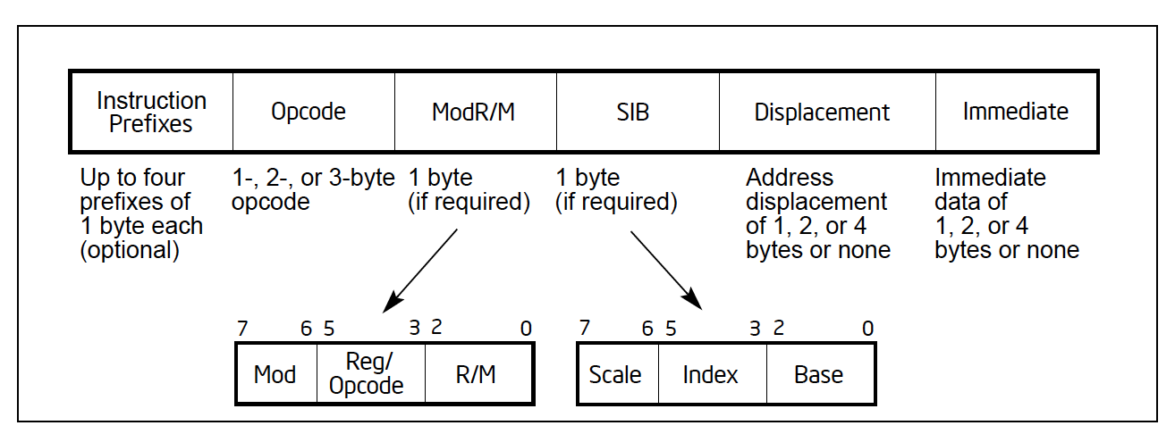
x86 Instruction Format

Slide 5
x86 Instruction Format
In project:
Opcode
ModR/M
Immediate

Slide 6
X86 Instructions
Instructions can reference different operands
Immediate
Register
Memory
MOV register, immediate
MOV register, register
MOV register, memory

Slide 7
Calling Convention
Protocol between the caller and the callee used during a function invocation
Which registers are saved by the caller
Which registers are saved by the callee
Where parameters and return values are placed

Slide 8
x86 Calling Convention
Caller-saved registers
EAX, ECX, EDX
Callee-saved registers
EBX, EDI, ESI

Slide 9
x86 Calling Convention
Caller’s frame
Caller-saved registers
Arguments
Return address
Saved frame pointer
Callee-saved registers
Callee’s frame

Slide 10
x86 Calling Convention
Caller:
– Saves caller-saved registers
– Pushes arguments on stack
– Executes call instruction

Slide 11
x86 Calling Convention
Callee:
Pushes caller’s frame pointer on stack
– Sets up callee’s frame pointer
– Saves callee-saved registers
– Allocates a frame
– Start executing callee’s code

