Slide 1
CS 295 – Memory Models
Harry Xu
Oct 1, 2013

Slide 2
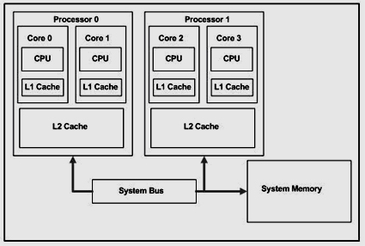
Multi-core Architecture
Core-local L1 cache
L2 cache shared by cores in a processor
All processors share system memory

Slide 3
Programming with Shared Memory
Single copy of shared data in memory
Threads communicate by reading/writing to a shared location
Shared memory correctness are intuitive at a hand-wave level
Subtle issues may arise in the presence of shared memory accesses
  What does it mean for a compiler optimization to be correct
  What does it mean for a hardware implementation to be correct
  What program behavior should a developer expect

Slide 4
Memory Correctness
Memory consistency models
  Rules about loads and stores
  How they act upon memory
Cache coherence
  A value written by a processor is eventually visible to reads by other processors
  two writes to the same location by two processors are seen in the same order by all processors
  Invisible to software

Slide 5
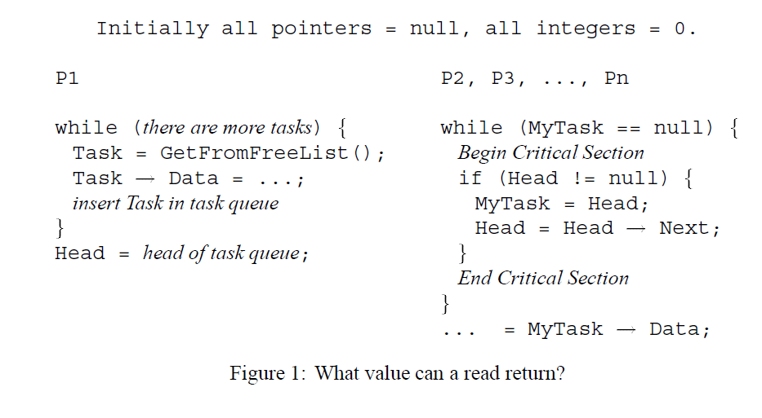
A Motivating Example

Slide 6
Memory Correctness
Intuitively, a read should return the value of the “last” write to the same memory location
  Enforced by program order in a single threaded program
  What does it mean for a write to be the last write if the read and the write are executed in different threads?
A classroom change example

Slide 7
Sequential Consistency
Making multiple threads run as if they were time-multiplexed on a single-core processor
  An interleaving of the sequential executions of each thread
Two constraints
  Maintain program order within each thread
  Maintain a single sequential order among operations from all processors

Slide 8
Relaxed Memory Models
Most memory orderings in strong models are unnecessary
Relaxed memory models seek to capture increased ordering flexibility to get higher performance or simpler implementation
For example, use of a FENCE instruction

Slide 9
Why Are Memory Models Important
Impact on hardware design
  Out-of-order processor cores
  Write buffers
  Prefetching
  Multiple cache banks
Impact on compiler design
  What kind of optimizations can be allowed
Impact on high-level development
  What program behavior should developers expect

Slide 10
This Class
Sequential consistency (SC) --- Khanh
TSO in x86 and SPARC --- Jianfei
Relaxed/weak memory models -- David
The Java memory model ---Peizhao
C++ memory model --- Kai
Adversarial memory --- Bharathram
DRFx --- Byron
SC-preserving compiler --- Lu
End-to-end sequential consistency --- Yutao

