Slide 1
DieHarder: Securing the Heap

Slide 2
Previously in DieHard…
Increase Reliability by random positioning of data
Replicated Execution detects invalid memory accesses
Because objects are randomly placed, buffer overflows are likely to hit unused space

Slide 3
Memory Management Errors
Heap overflow:
char* f = new char[10]; f[11] = 'x';
Heap underflow:
stack<int> mystack; mystack.pop();

Slide 4
Memory Management Errors
Dangling pointers:
char *dp = malloc(123); free(dp); dp[10] = 'a';
Double free:
char *foo = dp; free(dp); free(foo);

Slide 5
Memory Management Errors
Invalid free:
char *dp = malloc(123); free(dp[10]);
Uninitialized read:
char *foo = dp; puts(foo);
All of these attacks can be (and are) exploited!

Slide 6
The Allocator‘s fault?
Freelist-base allocators store metadata between the objects
Attackers can not only corrupt stored data, but also the free list, leading to arbitrary code execution
Solution: BiBOP (Big Bag of Pages) Allocators store metadata seperately
Some BiBOPs store metadata at the beginning of a page, allowing it to be overwritten (e.g. PHKmalloc)

Slide 7
OpenBSD‘s allocator
Based on PHKmalloc
Metadata is entirely stored in a different place
Pages are randomly mmap‘ed so that there are unmapped guard pages in between
If activated, freed objects are scrambled
Objects are placed randomly in the page
Reuse of freed objects is not predictable
Notes:
Blowfish puffy

Slide 8
Comparison

Slide 9
Threats
First, memory errors have to exist
To attack systems using randomized placement, the attack has to be repeatable
The higher the entropy, the longer it takes to attack specific memory areas
In some cases, the attacker has more tries than in others (server vs. client)

Slide 10
Previous Countermeasures
ASLR
Randomized Placement (see OpenBSD)
Guard Pages
Canaries
W^X / DEP
No headers

Slide 11
Analysis of DieHard
The probability of overwriting a specific target is in O(1/N) with N being the number of heap objects
Much better than OpenBSD‘s 4 bit entropy
Because M times more space than needed is allocated, the reuse entropy is in O(log N)
Better than 5.4 in OpenBSD

Slide 12
Changes to DieHard
Sparse Page Layout allocated pages all over the possible address space
While this decreases the allocation performance, it means that there are more guard pages in between
This also increases the size of the page table
Trade-Off between security and performance

Slide 13
Changes to DieHard
By randomizing reuse and overwriting deleted objects, the attacker cannot use this information for his attacks

Slide 14
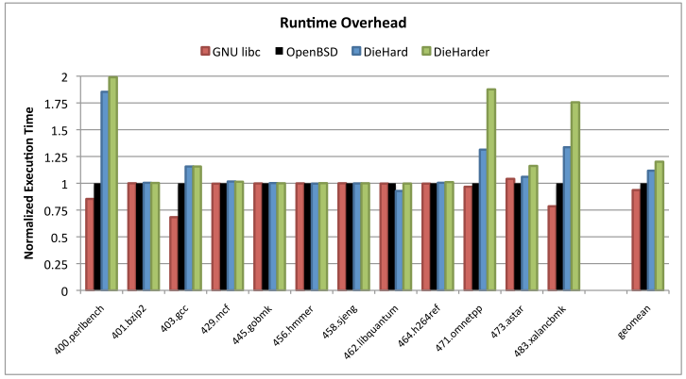
Evaluation

Slide 15
Windows 7: Fault-Tolerant Heap
The idea has been used to build the FTH in Windows 7
Because of the performance implications, FTH is only activated for crashing programs (by default, 3 crashes in 60 minutes)
This limits the repeatability of attacks drastically and can help to identify and fix problems

Slide 16
Questions?

