Slide 1
Low-Overhead Memory Leak Detection Using Adaptive Statistical Profiling
What’s the problem?
Contributions
Evaluation
Weakness and Future Works

Slide 2
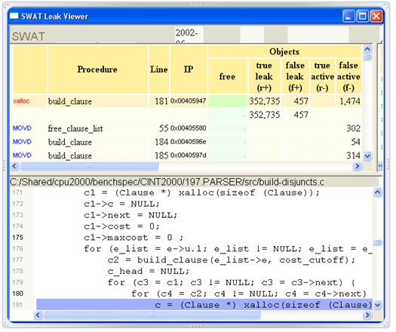
SWAT: a tool to predict whether an object is going to be accessed in the future
http://research.microsoft.com/en-us/um/people/trishulc/swatpresentation3.ppt

Slide 3
Intro
Novel: The authors coin the term “stale” objects ~ staleness. Staleness becomes the basis for several related works:
Bond and McKinley 2006 (last week)
Bond and McKinley 2009 Leak pruning,
Bond and McKinley 2008 Tolerating memory leaks
Tang et al 2008 Leak Survivor
Cons:
Identifies memory leak but not memory bloat (Xu and Rountev 2008; Xu and Bond 2011)
False Positives (Novark 2009)
A lot of work for programmers to find and fix the leak

Slide 4
What’s the Problem?
2 challenges to memory management
Bloat
Memory leak
SWAT uses a sample based approach for memory leak detection
An “educated guess” whether object O is leaked at time T
Notes:
2 challenges to memory management: 1) bloat is unnecessary memory consumption, and 2) memory leak is memory the program will never use again after some critical operation (you could draw last week’s dialog box). This paper presents SWAT: a tool that predicts whether an object is going to be accessed in the future given its past history of access i.e. a memory leak tool. The sample-based approach to memory leak detection described in this paper does not always provide the correct answer to the question whether object o is leaked at time t. It only provides an educated guess. But that guess can sometimes be even more useful than a correct conservative answer that often would be ‘unknown’(PDF 3).

Slide 5
Contribution
Captures leaks based on object access – staleness not reachability
Obstacles to staleness approach
Overhead of monitoring all heap access
Leaks reported can include false positives
Overcome obstacles
Adaptive bursty tracing: hot paths access hot objects and cold paths access cold objects
False positives may represent inefficient memory use
Notes:
The problem with previous works: Reachability vs. Staleness
The authors state that they “are not aware of any other automatic dynamic memory leak detection tool that captures leaks based on object accesses. Our approach can potentially capture leaked objects that are still reachable, and it does that with low enough overhead to be used in a deployed system.
Previous approaches have high runtime overhead (5-30x) which limits their use.
There are two significant obstacles to implementing this staleness policy within a practical memory leak tool. First, the overhead of monitoring all heap data accesses can be prohibitive. Next, the leaks reported could include a large number of false positives. Perhaps, for these reasons, no existing memory leak tool uses this ‘staleness’ approach.
Reduce instrumentation over-head by sampling. Bursty tracing continuously monitors a program with low overhead but it only captures frequently executed code segments while many program defects only manifest on rarely visited, code regions that sampling is likely to miss.
SWAT: uses a code sampling technique called adaptive bursty tracing. This technique samples code inversely proportional to its execution frequency. Infrequently executed code is traced nearly all the time, while frequently-executed code is rarely sampled. The underlying assumption is that hot code paths will access hot objects and the cold code paths access cold objects.
Pros: 1) Allows thorough tracing of code where bugs may lie, while avoiding the overhead of tracing well-tested hot code paths; 2) if a program accesses the same object frequently, then sampling will detect some references to it, thus correctly estimating staleness.
Bond 2006 last week paper Bell Bit Encoding used Adaptive Bursty Tracing: In this paper, they used adaptive bursty tracing sample code at a rate inversely proportional to its execution frequency which maintains bug coverage while reducing overhead by relying on the hypothesis that cold code contributes disproportionately to bugs.

Slide 6
Evaluation
SWAT used a sampling rate of .1% with a runtime overhead of less than 5%
False positives may indicate inefficient use of memory
Case Studies at Microsoft for 18 months
Notes:
Evaluation:
SWAT uses a sampling rate of .1% which entails a runtime overhead of less than 5% on average.
False positives are of interest since objects that have not been accessed for a long time often indicate inefficient use of memory.
The information is visualized through a GUI that includes a source code browser that highlights the last access to a leaked object. They report the last observed access and the allocation site for each object. “Further, we report all deallocation sites of objects that were allocated at the same site as the leaked object. This can further narrow down the region of code where the leaked object should have been deallocated.”
Runtime Overhead: less than 5% for most of the benchmarks.
Space Overhead: the average is around 10%.
Case Studies: used by several product groups at Microsoft for 18 months

Slide 7
Weakness and Future Works
Xu 2008; Xu and Bond 2011:
Unnecessary memory consumption AND staleness
Many normal objects can exhibit staleness and suspicious growth – need more detailed information without producing more memory and runtime overhead
Novark 2009: Adaptive Bursty Tracing uses .1% sampling then it will miss all but 1 reference out of every 1,000; it produces a lot of false positives
Our next paper will address some of the drawbacks to SWAT’s sampling approach

Slide 8
References
Bond and McKinley 2006 Bell: Bit-encoding online memory leak detection
Bond and McKinley 2009 Leak pruning
Bond and McKinley 2008 Tolerating memory leaks
Novark et al 2009 Efficiently and Precisely Locating Memory Leaks and Bloat
Tang et al 2008 Leak Survivor: Towards safely tolerating memory leaks for garbage collected languages
Xu and Rountev 2008 Precise Memory Leak Detection
Xu and Bond 2011 Leak Chaser

