Slide 1
Preferential Path Profiling: Compactly numbering interesting Paths

Slide 2
Bell Larus Profiling
Profiles Intra Procedural, Acyclic Paths
DAG G from the CFG
Idea: Assign weights to the edges of G s.t. the pathIds (which are the sums of the wts of the edges in the path), are Unique.
Given N paths, 0<= pathId(p) <= N-1 ➔ pathId| < N
p is the set of paths in G, paths(G).
A path in G is from S to T.
Hence, N also denotes the number of ways of reaching t.

Slide 3
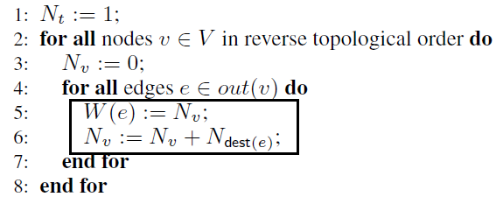
Numbering
S
Ns = Na + Nb + Nc = X+Y+Z
0
X
X+Y
Na = X
A
Nb = Y
B
Nc = Z
C
0
……
X-1
0
……
Y-1
0
……
Z-1
....
....
....
....
....
....
T

Slide 4
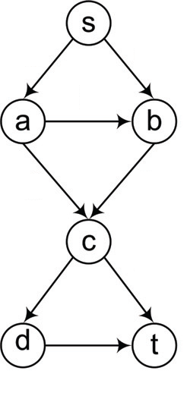
Example
Ns = Na + Nb = 6
0
4
Na = Nb +Nc =4
2
Nb = Nc = 2
0
0
Nc = Nd + Nt = 2
0
1
0
Nt = 1
Nd = Nt = 1

Slide 5
The Obvious Issue
Expect LARGE number of paths even in an average function.
Size of the Data Structure will have to super huge for sophisticated functions/procedures.
Arrays fail.
Resort to Hash Tables.

Slide 6
Interesting Paths
Sensitive to security
Likely candidates for bugs
Suffering from performance issues
Ideal case: array of size I, i.e. 0 to I-1

Slide 7
Preferential Path Profiling
Numbering::
UNIQUENESS
COMPACTNESS
Separation ➔ Perfect Assignment ➔ Compactness
Generalization of the Bell Larus Profiling (??)

Slide 8
Uniqueness
Critical Nodes and paths P and P’
P and P’:: different pids (partial identifiers) [Lemma4]
(Individual pids) v/s (Intervals of pids)
Interval (edge, prefix): [minPid, maxPid]

Slide 9
Nv = X+Y
V
0
X
[Lemma 5]
Na = X
A
Nb = Y
B
0
……
X-1
0
……
Y-1
Nv = X+Y
V
....
....
....
....
0
X -1
T
Na = X
A
Nb = Y
B
int(va,v) = [0,X-1]
int(vb,v) = [X,X+Y-1]
0
……
X-1
0
……
Y-1
....
....
....
....
T
int(va,v) = [0,X-1]
int(vb,v) = [X-1,X+Y-2]

Slide 10
Compactness
V
0
X
cumulative interval size ➔ cis
Na = X
A
B
Nb = Y
$$1≤i≤out(v)$$
i = 1,2
W(e1) = cis(0) – min(1) = 0 -0 = 0
W(e2) = cis(1) – min(2) = (X-1 – 0 +1) – 0 = X
0
……
X-1
0
……
Y-1
....
....
....
....
T
cis ➔ uniqueness
min(i) ➔ compactness
int(va,v) = [0,X-1]
int(vb,v) = [0,Y-1]
int(va,v) = [0,X-1]
int(vb,v) = [X-1,X+Y-1]

Slide 11
V
0
X
X+Y
All the paths are
interesting here.
Na = X
A
Nb = Y
B
Nc = Z
C
0
……
X-1
0
……
Y-1
0
……
Z-1
....
....
....
....
....
....
T
int(va,v) = [0,X-1]
int(vb,v) = [0,Y-1]
int(vc,v) = [0,Z-1]
int(va,v) = [0,X-1]
int(vb,v) = [X,X+Y-1]
int(vc,v) = [0,Z-1]
int(va,v) = [0,X-1]
int(vb,v) = [X,X+Y-1]
int(vc,v) = [X+Y, X+Y+Z-1]

Slide 12
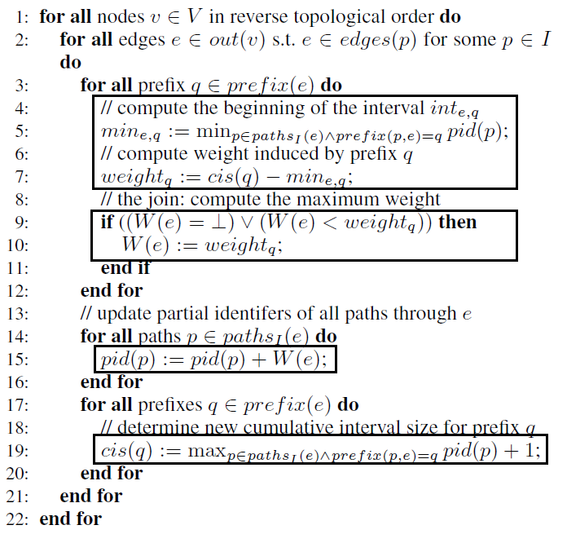
Algorithm
join

Slide 13
Questions for Discussion
How do you think cyclic graphs will limit this approach?
Can you apply the same/similar technique for an inter-procedural profiling of paths?

