Slide 1
Bug Isolation via Remote Sampling

Slide 2
Lemonade from Lemons
Bugs manifest themselves every where in deployed systems.
Each manifestation gives us the chance of inspection and hence the resolutions.
Deployment gives more test cases than the test suite.
But you need a feedback mechanism.
Feedback is expensive.
Most feedback requires Manual Inspection.

Slide 3
Feedback
[Client Performance]
Instrumentation Call backs
Assertion Checks
Logging
[Data Transmission]
Network Latency
Bandwidth

Slide 4
Make Feedback Cheaper
[Client Performance]
Sampling
Distributed Sampling
[Data Transmission]
Omit data
e.g. contextual information such as ordering of executions

Slide 5
Contributions
Framework for Sampling Execution information, in a distributed manner.
Examples of Data Analysis on different kinds of gathered Data
Bug Detection using Distributed Sampling
Detection of Deterministic Bugs
Detection of Non-Deterministic Bugs

Slide 6
Sampling
Biased Coin Tosses. [Bernoulli process]
Walk down the instrumented path if you get a head.
Walk the Fast path if you get a tail.
We can predict the occurrences of head because it is biased. [Geometric distribution]
Maintain a threshold.
If countdown less than threshold, it is a Heads and you walk down the instrumented path.

Slide 7
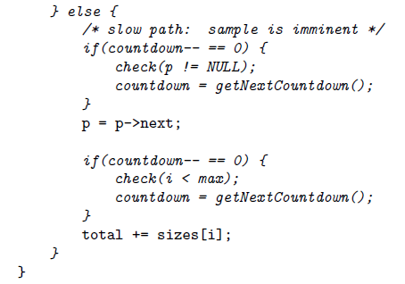
>4?
>3?

Slide 8
Transmission Losses
Why?
Client side storage
Network bandwidth
Central Storage need might not be scalable
Store only Predicate Observations
Predicate Vectors/Arrays (i^{th} value shows number of times is was true/false)
Completely ignores context. Has been left for future work.

Slide 9
Experiments (sample applications)
Sharing assertion costs
Debugging deterministic bugs
Debugging non-deterministic bugs

Slide 10
Distributed Assertion checks
Spread out the instrumentation.
Multiple exe’s. Each contains a sub-set of instrumentation
Sampling density 1/1000
230,258 runs for 90% confidence of observing an event.
MS Word produces those many runs every 19 mins.
Food for thought: how many mins would a web browser like Chrome or FireFox take?

Slide 11
Predicate based Bug Isolation
Observed the behavior of Predicates
Basically applied Elimination Strategies to eliminate those predicates which are not likely to be the cause of a failure/fault.
Eliminated predicates do not need to be checked. Hence, full instrumentation (not sampled) does fairly well also, in terms of performance.

Slide 12
Statistically finding Non-deterministic bugs
These bugs do not always fail when a predicate is true.
Machine learning technique to compute the probability that the program will fail given a subset of ‘interesting’ predicates are true.
If probability more than 0.5, then the program will fail. And those specific predicates and associated data values are examined.

Slide 13
Discussion
Even if statistics is really effective at telling us where the fault is, can it explain the fault?
How can we make it effective at telling us why the fault is there?

