Slide 1

Path Knowledge Discovery:
Association Mining Based on
Multi-Category Lexicons
Chen Liu, Wesley W. Chu, Fred Sabb, Stott Parker and Joseph Korpela

Slide 2
Outline
Motivation
Infrastructure
Path Mining: Discovering Sequences of Associations
Path Content Retrieval
Method Validation: Comparing to Traditional Meta Analysis Process
Conclusion

Slide 3
Motivation (1/2)
  Knowledge discovery
    Increasingly, scientific discovery requires the connection of concepts across disciplines
    Often there are no direct association between two given concepts in existing scientific literature
    In such situations, we must search for chains of associations
  How to search for chains of associations?
    Traditional search methods require researchers to manually review documents in a potential chain
    When searching a large corpus, a manual search of all returned documents becomes infeasible
    This can lead to biased or arbitrary methods of reduction

Slide 4
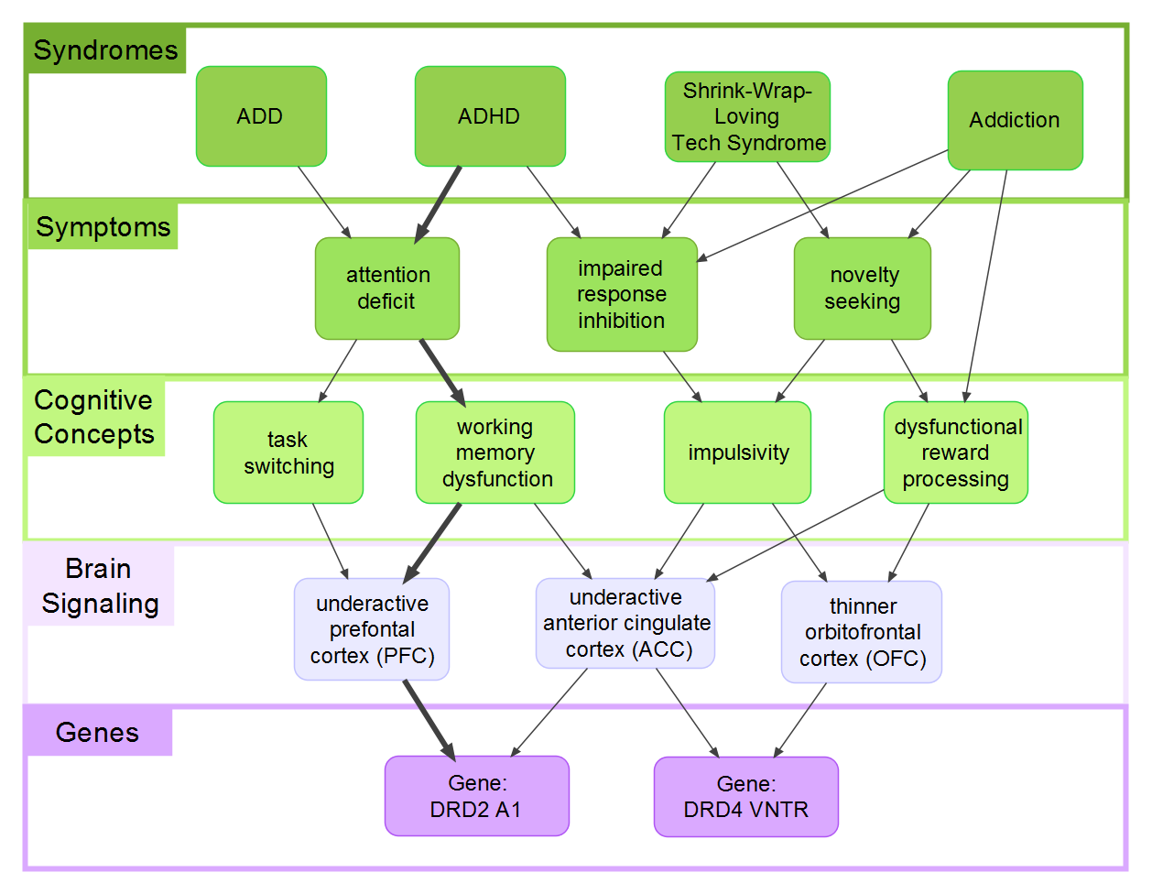
Motivation (2/2)
What GENES are associated with ADHD?
ADHD
DRD2 A1
ADHD
Attention Deficit
Working Memory Dysfunction
PFC
DRD2 A1

Slide 5
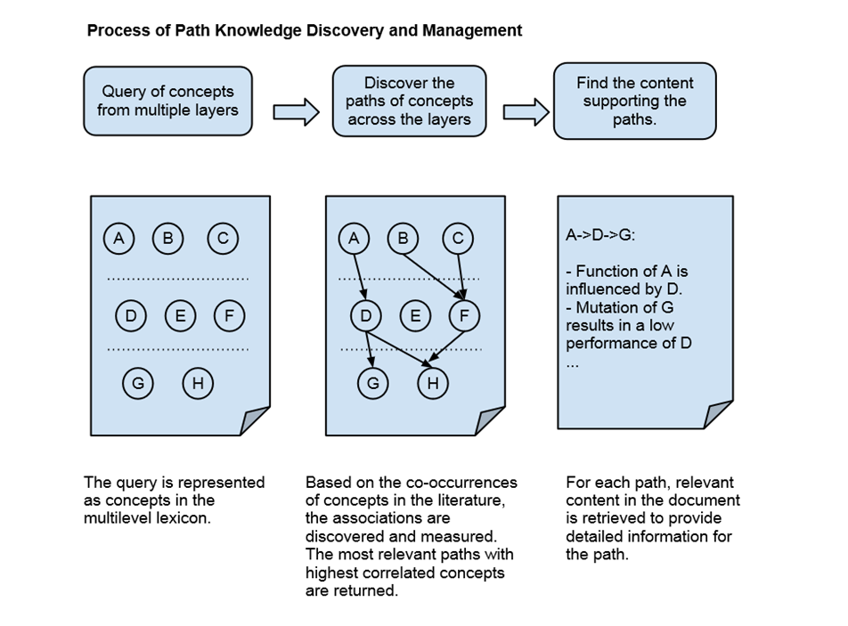
Path Knowledge Discovery

Slide 6
Infrastructure for Path Mining Discovery (1/2)
Sources of Knowledge
  Multilevel Lexicon
    Evolving concept hierarchy
    Concepts are mapped to specific domains/matched with synonyms
  Semi-Structured Corpus
    Distributed in HTML/XML format
    Maps concepts to documents at varying granularities
SYNDROME
ADHD
ADHD
ADD
Attention Deficit Disorder
Attention Deficit Hyperactivity Disorder
Bipolar Disorder
…
COGNITIVE CONCEPT
Declarative Memory
Declarative Memory
Episodic Memory
…
<document>
<paragraph id=“1”>
<sentence id=“1”>Content…</sentence>
<sentence id=“2”>Content…</sentence>
<figure id=“1” caption=“…”>…</figure>
…
</paragraph>
<paragraph id=“2”>
…
</paragraph>
…
</document>

Slide 7
Infrastructure for Path Mining Discovery (2/2)
Facilitating Knowledge Discovery
  Association index
    How frequently two concepts occur together in a paper
    Measures the strengths of relations
    Facilitates path mining
  Document element index
    In which documents the concepts occur
    Provides evidence of relations between concepts
    Facilitates path content retrieval

Slide 8
Path Mining
Given a query, find the sequences of associations among concepts between different domains of knowledge
Find the paths based on their occurrences in corpus (i.e. pair-wise associations)
Measure the strengths of the path
Path Ranking: Find the most relevant path for a query
Syndromes:
Shrink-Wrap-Loving Tech Syndrom
Symptoms:
Impaired Response Inhibition
Cognitive Concepts:
Impulsivity
Brain Signaling:
Thinner Orbitofrontal Cortex
Genes:
DRD4 VNTR

Slide 9
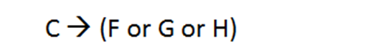
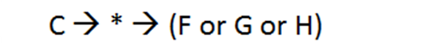
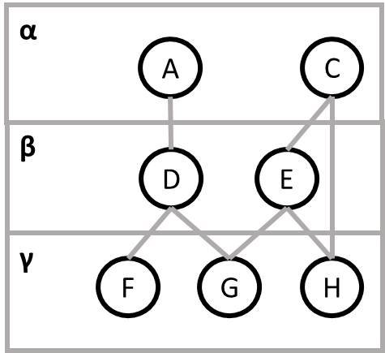
Using Wildcards in a Path Query
  Allow paths to match with any concept in a concept domain
    Example: Researcher is interested in paths connecting concept C to concepts from the γ domain, via any concept in domain β

Slide 10
Types of Associations in Path
Local Association
Global Association

Slide 11
Types of Associations in Path
Local Association Approach
Global Association Approach

Slide 12
Types of Associations in Path
Local Association Approach
Global Association Approach

Slide 13
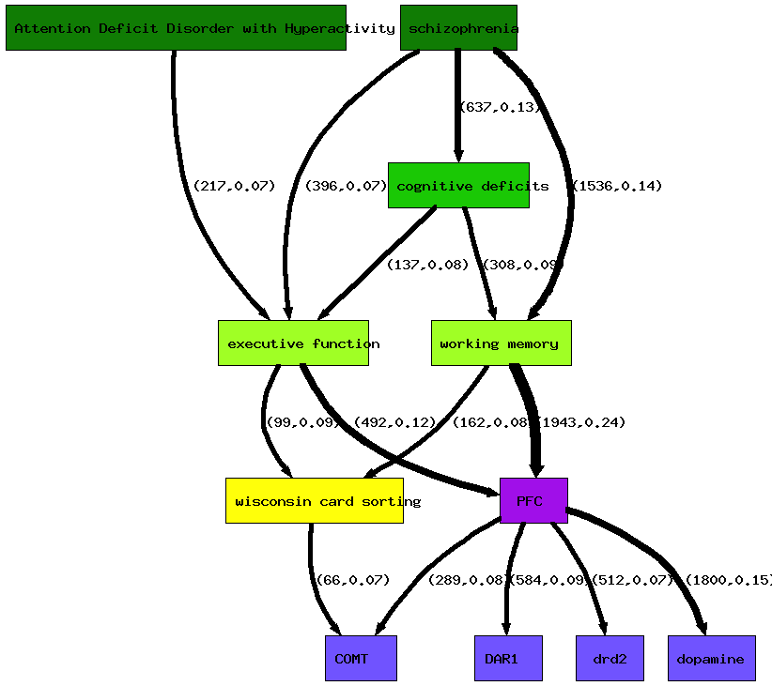
Phenograph: Aggregated Results of Path Mining
Combine the paths that satisfy the path query.

Slide 14
Path Ranking
Pick top K paths for a query
Weakest link approach
  For each path, use the strength of the weakest link as the strength of the whole path
  Among all paths, pick the top K paths with highest strengths

Slide 15
Path Content Retrieval
Content is important for understanding the interrelations specified by the paths
Differences from traditional information retrieval:
  Query is a set of relations instead of query terms
  Retrieved content should be in fine granularity so that it can explicitly explain the relations
  Specific types of content may be required (e.g. quantitative results from experiments, tables, etc.)

Slide 16
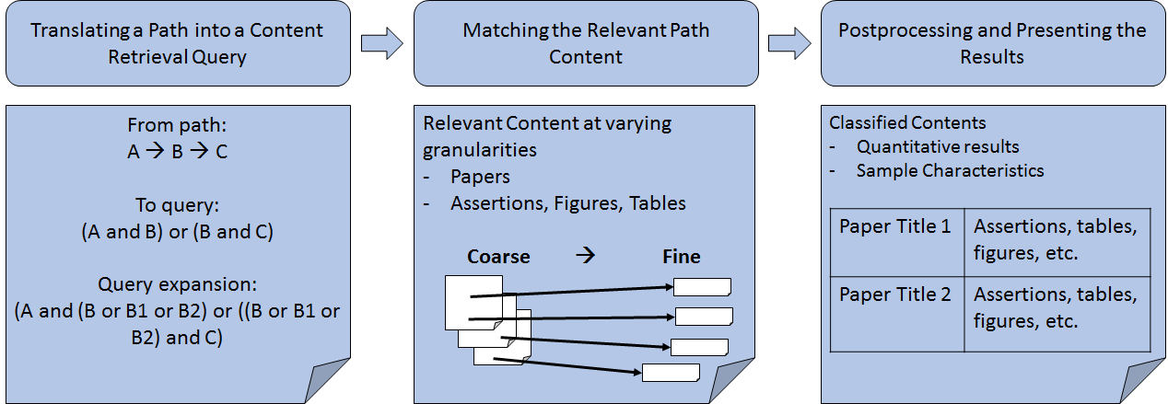
Process Flow of Path Content Retrieval

Slide 17
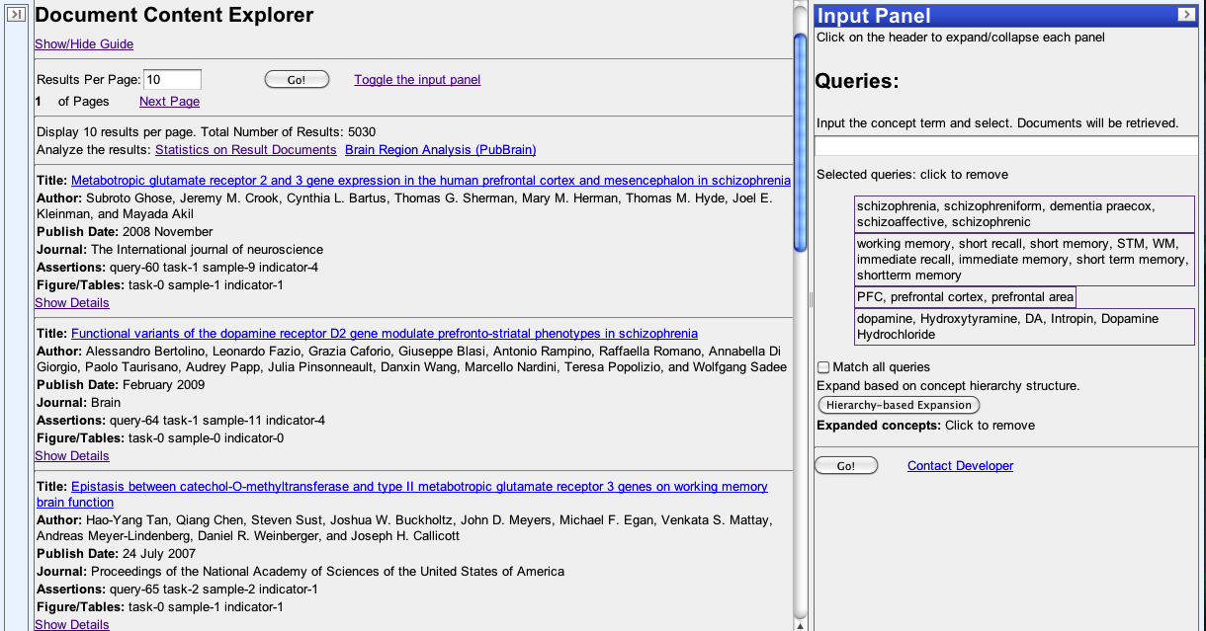
Path Content Retrieval Example:
Document Content Explorer (1/2)
Facilitates Path Content Retrieval
  Coarse Granularity: Displays list of papers returned using the user-defined query
Papers listed with summary data

Slide 18
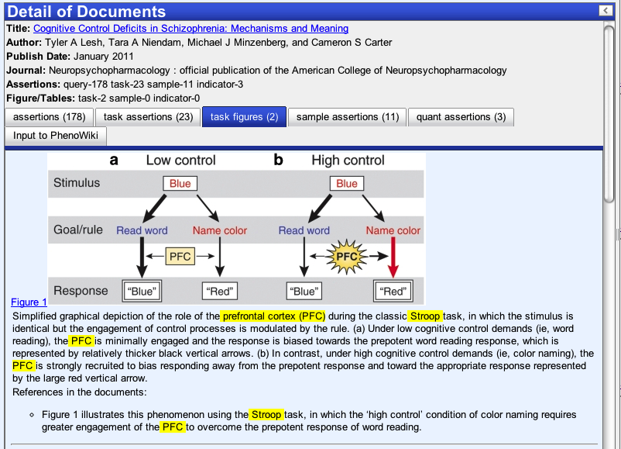
Path Content Retrieval Example:
Document Content Explorer (2/2)
  Fine Granularity: Content from paper is displayed with relevant material highlighted for easier viewing
Different type of contents in corresponding tabs
Concepts are highlighted in the matching content

Slide 19
Method Validation: Applying
Path Knowledge Discovery to Phenomics Research
Mined corpus of 9000 papers
  Retrieved from PubMed Central using query designed by domain experts
Searched for data supporting the heritability of cognitive control
Cognitive control
  Complex process that involves different phenotype components
  Each phenotype component is measured by different behavioral tasks
  Heritability of these behavioral tasks are reported in scientific publications

Slide 20
Traditional Manual Approach: Meta-Analysis
Search corpus to find “relevant” publications
  Publications retrieved using a literature search engine
  Researcher manually reviews the publications to determine which are relevant
  Researcher determines which publications form a chain of associations
Using content found, extract the measures of cognitive tasks (e.g. heritability) and their corresponding cognitive processes
Combine the heritability measures for different cognitive processes to compute the heritability of “cognitive control”
Problems of the manual approach:
  Reading papers, digesting the content, and picking the numbers manually is time consuming, biased and not scalable.

Slide 21
Automated Approach:
Path Knowledge Discovery (1/2)
Path mining:
  Searched for paths connecting cognitive control with indicators
Path content retrieval:
  Found relevant quantitative results in those publications
Meta-Analysis:
  Researchers then reviewed those results to perform the meta-analysis
cognitive control
sub-processes
cognitive tasks

Slide 22
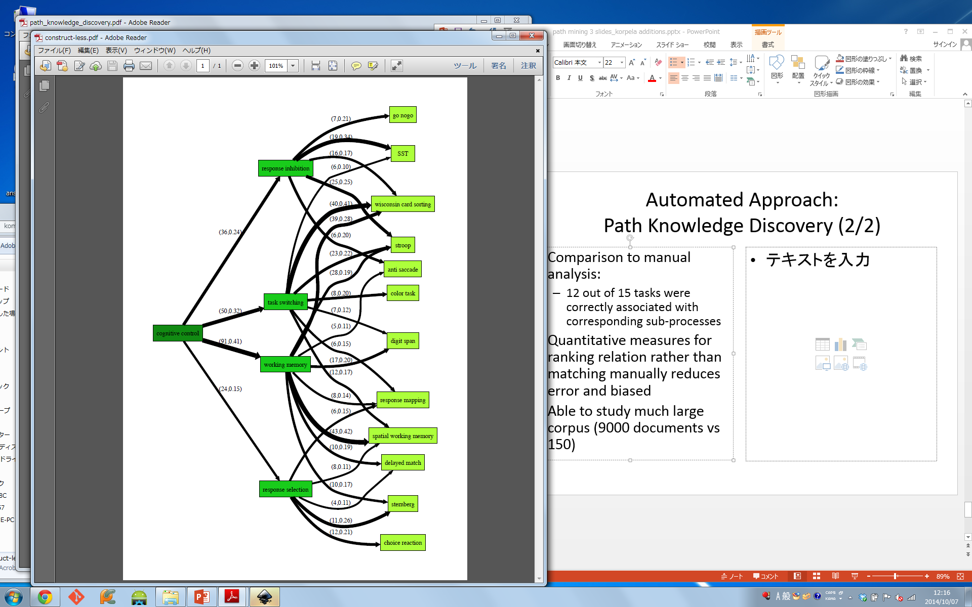
Automated Approach:
Path Knowledge Discovery (2/2)
Comparison to manual analysis:
  12 out of 15 tasks were correctly associated with corresponding sub-processes
  Increased corpus size:
    150 (manual) << 9000 (automated)
Able to use quantitative measures for ranking relation rather than matching manually
  Reduces error and bias

Slide 23
Conclusion
Path Knowledge Discovery
  Identifies and measures a path of knowledge
  Retrieves relevant coarse- and fine-granularity content describing the relations specified in the path
Validated the methodology using the heritability example in cognitive control
Significantly increases the scalability and efficiency of conducting complex cross-discipline analysis

Slide 24
Back up slides

Slide 25
Path Content Retrieval
Query processing
  Translate the path to queries digestible by search systems
Example
  Schizophrenia -> working memory -> PFC
  Translate to:
  (schizophrenia AND working memory) OR (working memory AND PFC)

Slide 26
Lexicon-Based Query Expansion
  Expand according to the synonyms:
  Expand according to concepts/sub-concepts:
    ADHD AND impaired response inhibition
    (attention deficit hyperactivity disorder OR
    attention deficit disorder OR ADHD OR ADD)
    AND impaired response inhibition
    underactive prefrontal cortex AND dopamine receptors
    underactive prefrontal cortex AND (DRD1 OR DRD2 OR D5-like)

Slide 27
Path Content Retrieval
Retrieve relevant path content
  Vector space model
Multi-granularity content
  First rank by coarse-granularity content
    Documents
    Sections
  For each item of coarse-granularity content, rank its fine-granularity content
    Assertions (sentences)
    Figures
    Tables

