Slide 1
Yuanlu Xu
merayxu@gmail.com
http://vision.sysu.edu.cn/people/yuanluxu.html
Human Re-identification: A Survey

Slide 2
Chapter 1
Introduction

Slide 3
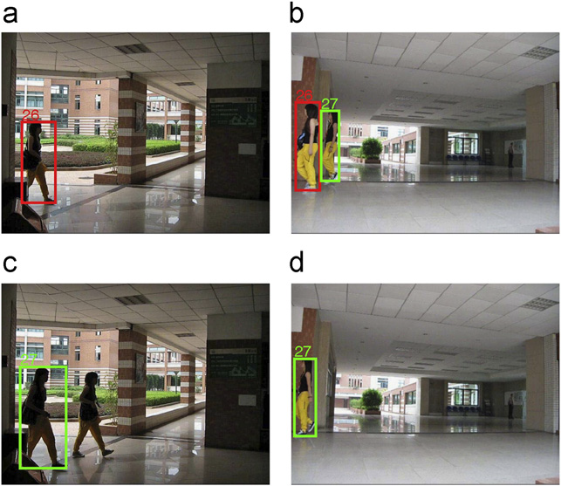
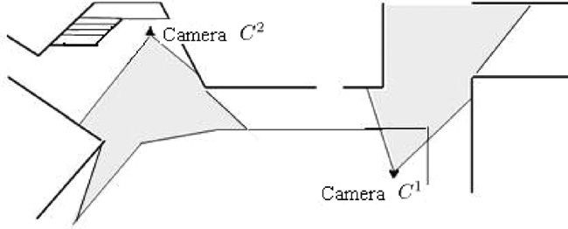
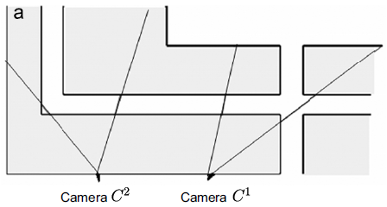
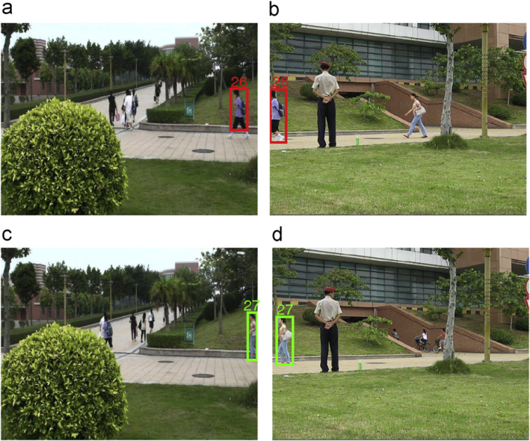
Problem
In non-overlapping camera networks, matching the same individuals across multiple cameras.

Slide 4
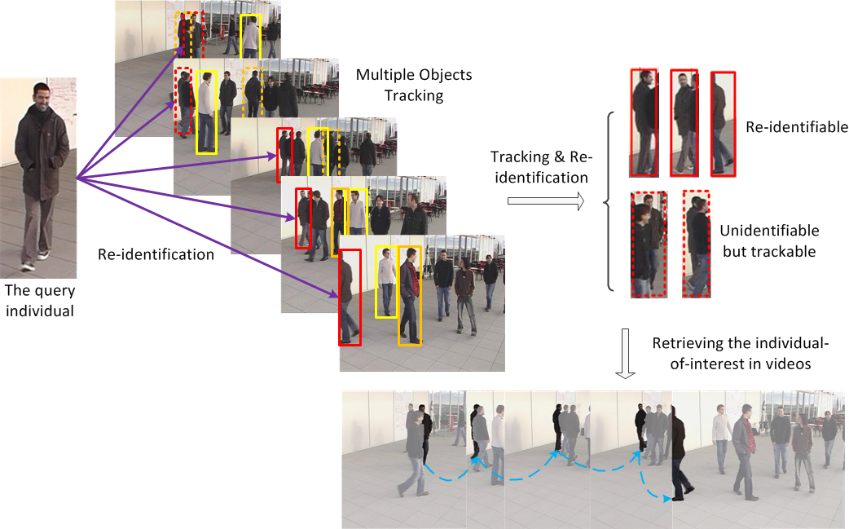
Application

Slide 5
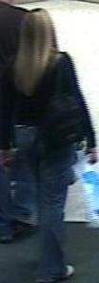
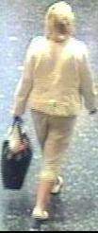
Setting
S vs. S
M vs. S
M vs. M

Slide 6
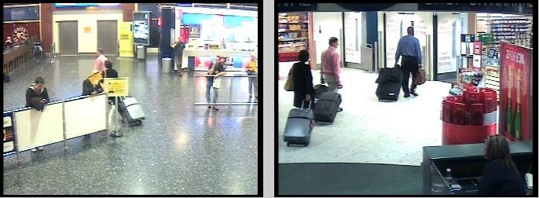
Difficulty
Non-overlapping Camera Views
Irrelevant negative samples, difficult to train classifiers

Slide 7
Difficulty
View/Pose Changes

Slide 8
Difficulty
Occlusions
Carried objects occlude the person appearance

Slide 9
Difficulty
Illumination Changes
Need illumination-invariant features or light-amending process

Slide 10
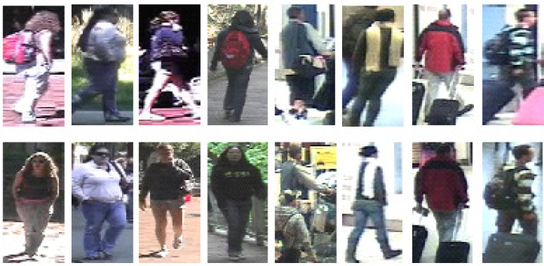
Difficulty
Difficulty
Large Intra-class Variations & Limited Samples for Learning

Slide 11
Chapter 2
Literature Review

Slide 12
Literature Review
How to perform re-identification?
Finding corresponding local patches/parts/regions of two persons.
M. Farenzena et al., CVPR10 – by segmentation
D.S. Cheng et al., BMVC11 – by detection
R. Zhao et al., CVPR13 – by salience
Decreasing the intra-class difference caused by view, pose, illumination changes. - Learning transformation among cameras.
W.S. Zheng et al., BMVC10, CVPR11, TPAMI12 – by projection basis pursuit
W. Li et al., ACCV12 – by selected training samples
W. Li et al., CVPR13 – by gating network
Features and distance measurement.
Datasets.

Slide 13
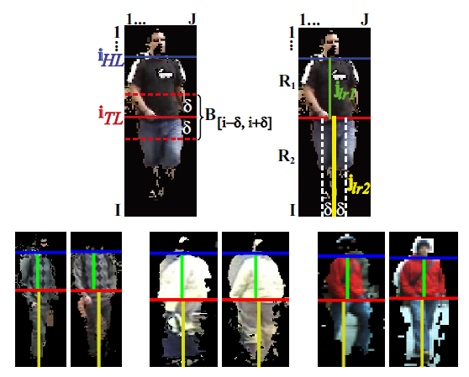
Literature Review: Finding Correspondence by Segmentation
Foreground Mask:
N. Jojic et al. “Component Analysis: Modeling Spatial Correlations in Image Class Structure”. CVPR 2009.
X-Axis of Asymmetry:
This separates regions that strongly differ in area and places, e.g., head/shoulder.
M. Farenzena et al., “Person Re-Identification by Symmetry-Driven Accumulation of Local Features”, CVPR 2010.

Slide 14
Literature Review: Finding Correspondence by Segmentation
X-Axis of Symmetry:
This separates regions with strongly different appearance and similar area, e.g., t-shirt/pants.
Y-Axis of Symmetry:
This separates regions with similar appearance and area.

Slide 15
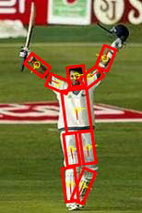
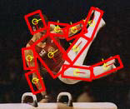
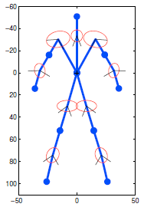
Literature Review: Finding Correspondence by Detection
Characteristics:
1. The body is decomposed into a set of parts, their configuration $L=\left\{l_{0},l_{1},..l_{N}\right\}$.
2. Each part $l_{i}=\{x_{i}, y_{i}, θ_{i}, s_{i}\}$, position, orientation and scale, respectively.
3. The distribution over configurations can be factorized as:
and the part relation is modeled as a Gaussian in the transformed space:
D.S. Cheng, M. Cristani, et al., “Custom pictorial structures for re-identification”, BMVC 2011.

Slide 16
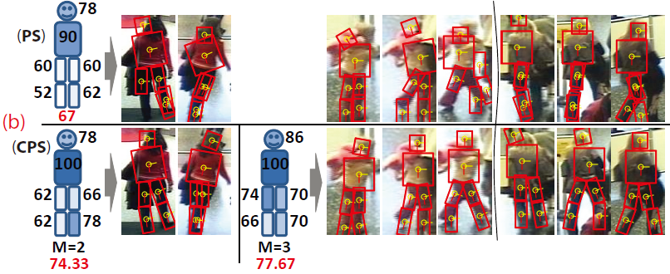
Literature Review: Finding Correspondence by Detection
Framework:
1. Constructing pictorial structures model for every image.
2. Extracting features from each part.
3. Re-id by part-to-part comparison.

Slide 17
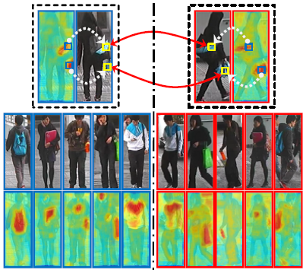
Literature Review: Finding Correspondence by Salience
Intuition:
Recognizing person identities based on
some small salient regions.
Salient regions:
1. Discriminative in making a person standing out from their companions.
2. Reliable in finding the same person across different views.
R. Zhao et al., "Unsupervised Salience Learning for Person Re-identification “, CVPR 2013.

Slide 18
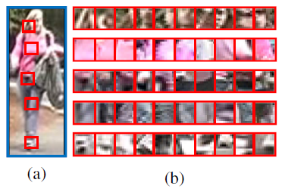
Literature Review: Finding Correspondence by Salience
Adjacency Constrained Search:
Restricting the search range for each image patch.
Similarity Score:
$d(x,y)$: Euclidean distance between patch feature x and y.

Slide 19
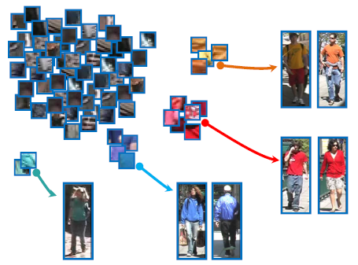
Literature Review: Finding Correspondence by Salience
Salience for person re-ID:
salient patches are those possess uniqueness property among a specific set.
K-Nearest Neighbor Salience:
$D_{k}(X_{nn}(⋅))$: the distance between the patch and its k-th nearest neighbor.
The salient patches can only find limited number of visually similar neighbors.

Slide 20
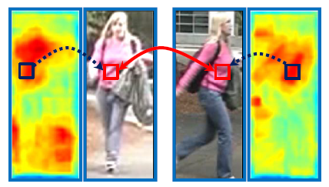
Literature Review: Finding Correspondence by Salience
Matching Similarity:
For each patch from image A, searching for nearest neighbor in B:
Similarity is measured by the difference
in salience score, the similarity between two patches:

Slide 21
Literature Review: Learning Transformation
Distance:
x: difference vector
Intuition:
Maximizing the probability of a pair of true match having a smaller distance than that of a pair of related wrong match.
True match difference
False match difference
Objective Function:
W.S. Zheng et al., "Person re-identification by support vector ranking ", BMVC 2010.
W.S. Zheng et al., "Person Re-identification by Probabilistic Relative Distance Comparison", CVPR 2011.
W.S. Zheng et al., “Re-identification by Probabilistic Relative Distance Comparison”, TPAMI 2012.

Slide 22
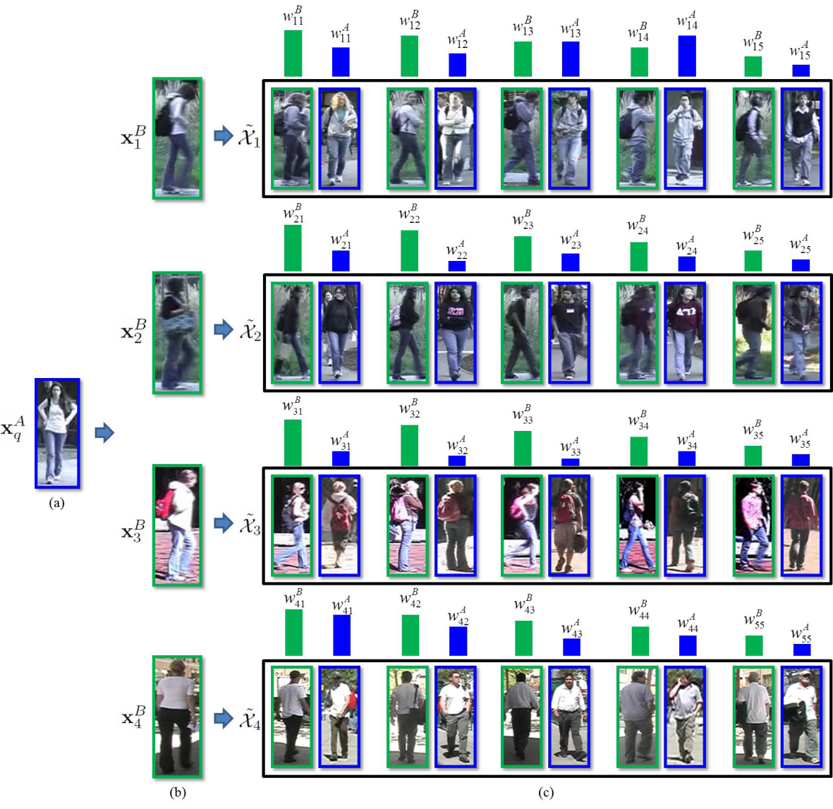
Literature Review: Learning Transformation
Distance:
Intuition:
Training samples is different from test samples. To learn the optimal metric, weights of training samples need to be adjusted.
Objective:
Learn generic metric $M_{0}$ from whole training set and learn adaptive metrics $M$ from training samples similar to the test sample.
W. Li et al., "Human Re-identification with Transferred Metric Learning“, ACCV 2012.

Slide 23
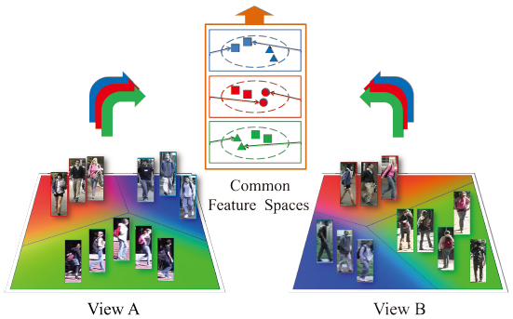
Literature Review: Learning Transformation
Intuition:
1. Jointly partitions the image spaces of two camera views into different configurations according to the similarity of cross-view transforms.
2. The features optimal for recognizing identities are different from those for clustering cross-view transforms.
W. Li et al., "Locally Aligned Feature Transforms across Views “, CVPR 2013.

Slide 24
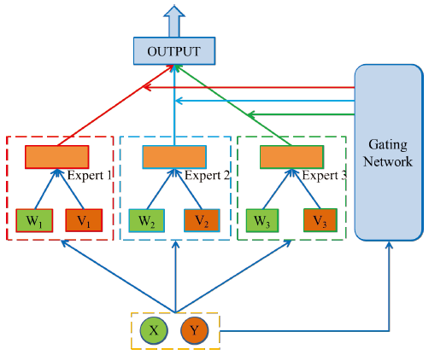
Literature Review: Learning Transformation
Gating Network:
Gating function:
Local Expert:

Slide 25
Literature Review: Features and Distance Measures
M. Farenzena et al., CVPR10.
HSV histogram, weighted by distance to Y symmetry axis.
Maximally Stable Color Regions (MSCR).
Recurrent High-Structured Patches (RHSP), replaced to LBP in the public code.
Distance:
D.S. Cheng et al., BMVC11.
HSV histogram, distinct count for the full black color, different weight for different part.
Maximally Stable Color Region(MSCR).
R. Zhao et al., CVPR13.
Segmented a person image into local patches.
Lab histogram, SIFT.
W.S. Zheng et al., BMVC10, CVPR11, TPAMI12.
Divided a person image into six horizontal stripes.
RGB, YCbCr, HSV histograms, Schmid and Gabor.
W. Li et al., ACCV12, CVPR13.
Segmented a person image into local patches.
HSV, LBP histogram, HOG and Gabor.

Slide 26
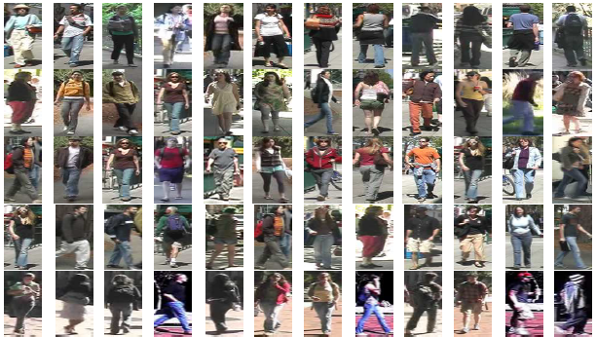
Literature Review: Datasets
VIPeR
632 person, 2 images per person.
Occlusions.
Pose/View changes, shot by two cameras.
Heavy illumination changes.
D. Gray et al., "Viewpoint Invariant Pedestrian Recognition with an Ensemble of Localized Features”, ECCV 2008.

Slide 27
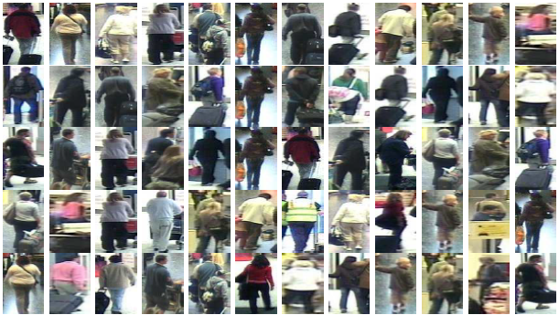
Literature Review: Datasets
i-LIDS
119 person, total 476 images.
Occlusions, conjunctions.
Pose/View changes, shot by multiple cameras.
Moderate illumination changes.
W.S. Zheng et al., "Person Re-identification by Probabilistic Relative Distance Comparison", CVPR 2011.

Slide 28
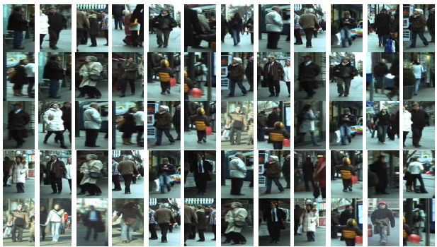
Literature Review: Datasets
ETHZ
146 person, total 8555 images.
Occlusions, conjunctions.
No view changes.
A. Ess et al., "Depth and Appearance for Mobile Scene Analysis", ICCV 2007.

Slide 29
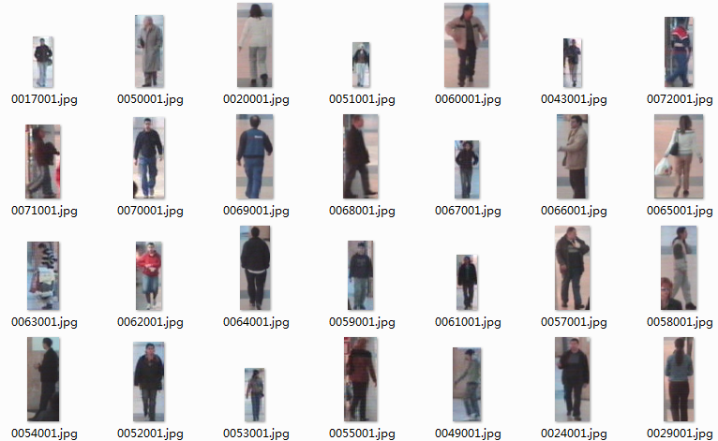
Literature Review: Datasets
CAVIAR4REID
72 person, total 1220 images.
Scale changes.
Limited view changes.
D.S. Cheng et al., "Custom Pictorial Structures for Re-identification", BMVC 2011.

Slide 30
Literature Review: Datasets
EPFL
30 person, total 70 reference images, 294 query images and 80 group shots.
Limited occlusions and conjunctions.
multiple view/pose changes.
Limited illumination changes.
Y. Xu et al., "Human Re-identification by Matching Compositional Template with Cluster Sampling", ICCV 2011, under review.

Slide 31
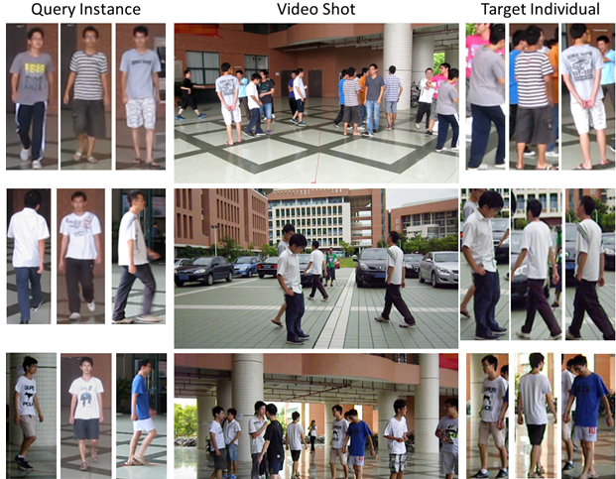
Literature Review: Datasets
CAMPUS-Human
74 person, 5 reference images per person, total 1519 query images and 213 group shots.
Occlusions, conjunctions.
multiple view/pose changes.
Limited illumination changes.
Y. Xu et al., "Human Re-identification by Matching Compositional Template with Cluster Sampling", ICCV 2011, under review.

Slide 32
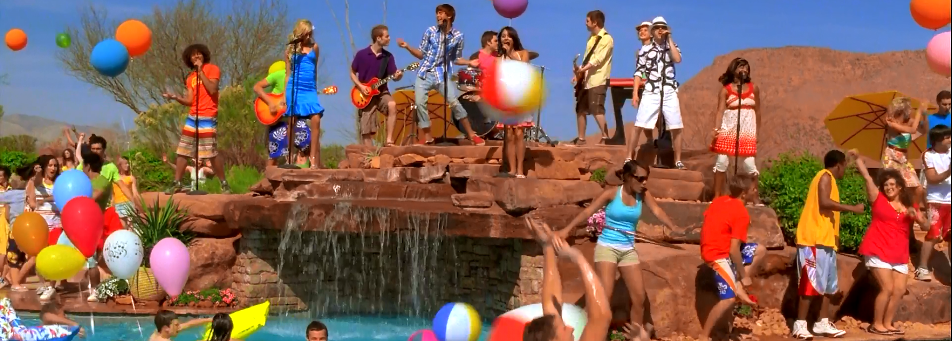
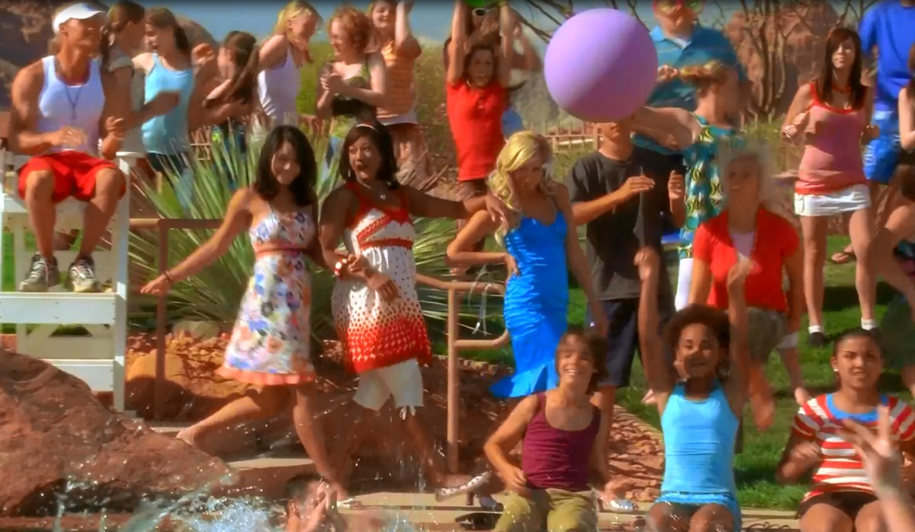
Vista
How about something more challenging?
Retrieving a character in music videos.

Slide 33
Questions?

Slide 34
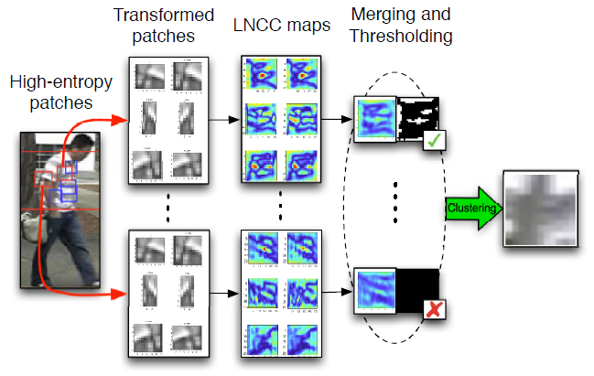
Literature Review: Features and Distance Measures
Feature:
Weighted Color Histogram.
HSV histogram
weighted by distance to Y symmetry axis.
Maximally Stable Color Regions (MSCR).
Recurrent High-Structured Patches (RHSP).
replaced to LBP in the public code.
Distance:
M. Farenzena et al., “Person Re-Identification by Symmetry-Driven Accumulation of Local Features”, CVPR 2010.

Slide 35
Literature Review: Features and Distance Measures
Framework:
Constructing pictorial model for every image.
Extracting features from each part.
Maximally Stable Color Region(MSCR).
HSV histogram. - Distinct count for the full black color, different weight for different part.
Re-id by part-to-part comparison.
D.S. Cheng, M. Cristani, et al., “Custom pictorial structures for re-identification”, BMVC 2011.

Slide 36
Literature Review: Learning Transformation
Objective Function:
Constraining the distance matrix M:
W.S. Zheng et al., "Person re-identification by support vector ranking ", BMVC 2010.
W.S. Zheng et al., "Person Re-identification by Probabilistic Relative Distance Comparison", CVPR 2011.
W.S. Zheng et al., “Re-identification by Probabilistic Relative Distance Comparison”, TPAMI 2012.

Slide 37
Literature Review: Learning Transformation
Objective Function:
Weight of training sample
the distance between samples of different persons.
the distance between samples of the same person.
W. Li et al., "Human Re-identification with Transferred Metric Learning“, ACCV 2012.

Slide 38
Literature Review: Learning Transformation
Gating Network:
Parameters:
1. $(φ_{k}, ψ_{k})$ is the gating parameters to partition samples into different configurations.
2. $(W_{k},V_{k})$ is the alignment matrix pair for expert k, which projecting the two samples into a common feature space.
W. Li et al., "Locally Aligned Feature Transforms across Views “, CVPR 2013.

