Slide 1
CS6220: Data Mining Techniques
Chapter 2: Getting to Know Your Data
Instructor: Yizhou Sun
yzsun@ccs.neu.edu
January 7, 2013

Slide 2
Chapter 2: Getting to Know Your Data
Data Objects and Attribute Types
Basic Statistical Descriptions of Data
Data Visualization
Measuring Data Similarity and Dissimilarity
Summary

Slide 3
Types of Data Sets
Record
  Relational records
  Data matrix, e.g., numerical matrix, crosstabs
  Document data: text documents: term-frequency vector
  Transaction data
Graph and network
  World Wide Web
  Social or information networks
  Molecular Structures
Ordered
  Video data: sequence of images
  Temporal data: time-series
  Sequential Data: transaction sequences
  Genetic sequence data
Spatial, image and multimedia:
  Spatial data: maps
  Image data:
  Video data:
Notes:
May we categorize data along the following dimensions?
- structured, semi-structured, and unstructured
- numeric and categorical
- static and dynamic (temporal?)
- by application

Slide 4
Data Objects
Data sets are made up of data objects.
A data object represents an entity.
Examples:
  sales database: customers, store items, sales
  medical database: patients, treatments
  university database: students, professors, courses
Also called samples , examples, instances, data points, objects, tuples.
Data objects are described by attributes.
Database rows -> data objects; columns ->attributes.

Slide 5
Attributes
Attribute (or dimensions, features, variables): a data field, representing a characteristic or feature of a data object.
  E.g., customer _ID, name, address
Types:
  Nominal
  Binary
  Ordinal
  Numeric: quantitative
    Interval-scaled
    Ratio-scaled

Slide 6
Attribute Types
Nominal: categories, states, or “names of things”
  Hair_color = {auburn, black, blond, brown, grey, red, white}
  marital status, occupation, ID numbers, zip codes
Binary
  Nominal attribute with only 2 states (0 and 1)
  Symmetric binary: both outcomes equally important
    e.g., gender
  Asymmetric binary: outcomes not equally important.
    e.g., medical test (positive vs. negative)
    Convention: assign 1 to most important outcome (e.g., HIV positive)
Ordinal
  Values have a meaningful order (ranking) but magnitude between successive values is not known.
  Size = {small, medium, large}, grades, army rankings

Slide 7
Numeric Attribute Types
Quantity (integer or real-valued)
Interval
    Measured on a scale of equal-sized units
    Values have order
      E.g., temperature in C˚or F˚, calendar dates
    No true zero-point
    We can evaluate the difference of two values, but one value cannot be a multiple of another
Ratio
    Inherent zero-point
    We can speak of values as being an order of magnitude larger than the unit of measurement (10 K˚ is twice as high as 5 K˚).
      e.g., temperature in Kelvin, length, counts, monetary quantities

Slide 8
Discrete vs. Continuous Attributes
Discrete Attribute
  Has only a finite or countably infinite set of values
    E.g., zip codes, profession, or the set of words in a collection of documents
  Sometimes, represented as integer variables
  Note: Binary attributes are a special case of discrete attributes
Continuous Attribute
  Has real numbers as attribute values
    E.g., temperature, height, or weight
  Practically, real values can only be measured and represented using a finite number of digits
  Continuous attributes are typically represented as floating-point variables

Slide 9
Chapter 2: Getting to Know Your Data
Data Objects and Attribute Types
Basic Statistical Descriptions of Data
Data Visualization
Measuring Data Similarity and Dissimilarity
Summary

Slide 10
Basic Statistical Descriptions of Data
Central Tendency
Dispersion of the Data
Graphic Displays

Slide 11
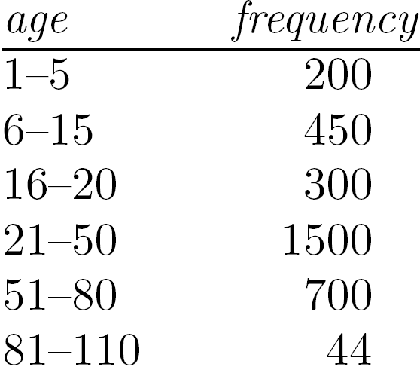
Measuring the Central Tendency
Mean (algebraic measure) (sample vs. population):
  Note: n is sample size and N is population size.
  Weighted arithmetic mean:
  Trimmed mean: chopping extreme values
Median:
  Middle value if odd number of values, or average of the middle two values otherwise
  Estimated by interpolation (for grouped data):
Mode
  Value that occurs most frequently in the data
  Unimodal, bimodal, trimodal
  Empirical formula:

Slide 12
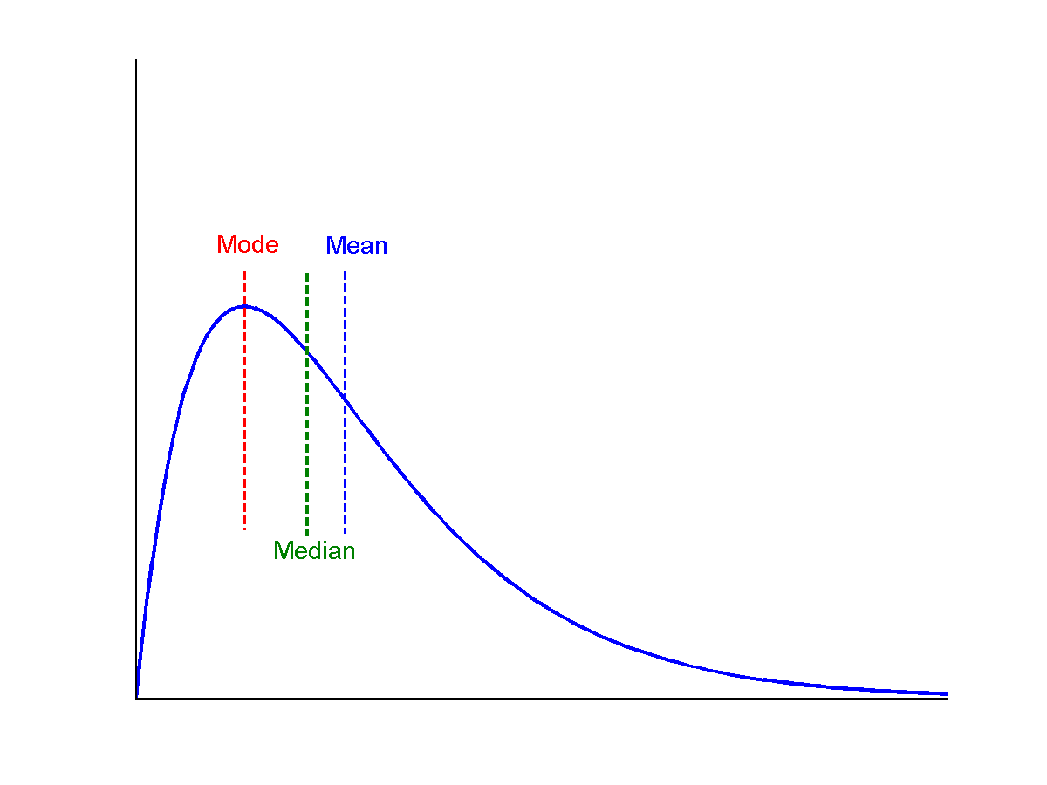
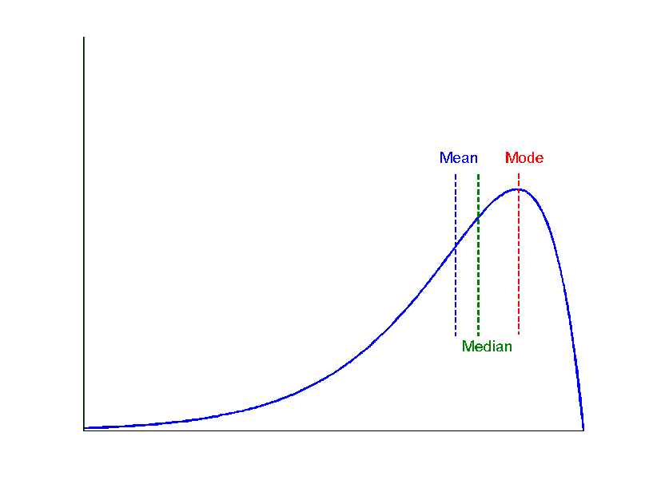
Symmetric vs. Skewed Data
Median, mean and mode of symmetric, positively and negatively skewed data
symmetric
positively skewed
negatively skewed

Slide 13
Measuring the Dispersion of Data
Quartiles, outliers and boxplots
  Quartiles: Q₁ (25th percentile), Q₃ (75th percentile)
  Inter-quartile range: IQR = Q₃ – Q₁
  Five number summary: min, Q₁, median, Q₃, max
  Boxplot: ends of the box are the quartiles; median is marked; add whiskers, and plot outliers individually
  Outlier: usually, a value higher/lower than 1.5 x IQR
Variance and standard deviation (sample: s, population: σ)
  Variance: (algebraic, scalable computation)
  Standard deviation s (or σ) is the square root of variance s² ⁽or σ²⁾

Slide 14
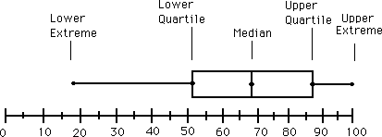
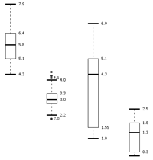
Boxplot Analysis
Five-number summary of a distribution
  Minimum, Q1, Median, Q3, Maximum
Boxplot
  Data is represented with a box
  The ends of the box are at the first and third quartiles, i.e., the height of the box is IQR
  The median is marked by a line within the box
  Whiskers: two lines outside the box extended to Minimum and Maximum
  Outliers: points beyond a specified outlier threshold, plotted individually
Notes:
Redraw the boxplot! Yes, we need a more real boxplot graph!

Slide 15
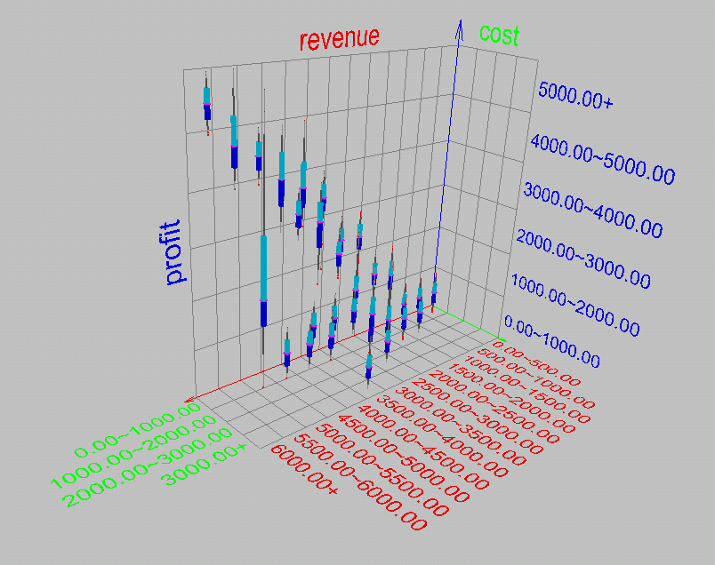
Visualization of Data Dispersion: 3-D Boxplots

Slide 16
Properties of Normal Distribution Curve
The normal (distribution) curve
  From μ–σ to μ+σ: contains about 68% of the measurements (μ: mean, σ: standard deviation)
  From μ–2σ to μ+2σ: contains about 95% of it
  From μ–3σ to μ+3σ: contains about 99.7% of it

Slide 17
Graphic Displays of Basic Statistical Descriptions
Boxplot: graphic display of five-number summary
Histogram: x-axis are values, y-axis repres. frequencies
Quantile plot: each value x_{i} is paired with f_{i} indicating that approximately 100 f_{i} % of data are ≤ x_{i}
Quantile-quantile (q-q) plot: graphs the quantiles of one univariant distribution against the corresponding quantiles of another
Scatter plot: each pair of values is a pair of coordinates and plotted as points in the plane
Notes:
JH: Maybe we can remove Loess curve

Slide 18
Histogram Analysis
Histogram: Graph display of tabulated frequencies, shown as bars
It shows what proportion of cases fall into each of several categories
Differs from a bar chart in that it is the area of the bar that denotes the value, not the height as in bar charts, a crucial distinction when the categories are not of uniform width
The categories are usually specified as non-overlapping intervals of some variable. The categories (bars) must be adjacent
Notes:
JH: A better and BASIC histogram figure --- because this one overlaps with a later one!

Slide 19
Histograms Often Tell More than Boxplots
The two histograms shown in the left may have the same boxplot representation
  The same values for: min, Q1, median, Q3, max
But they have rather different data distributions

Slide 20
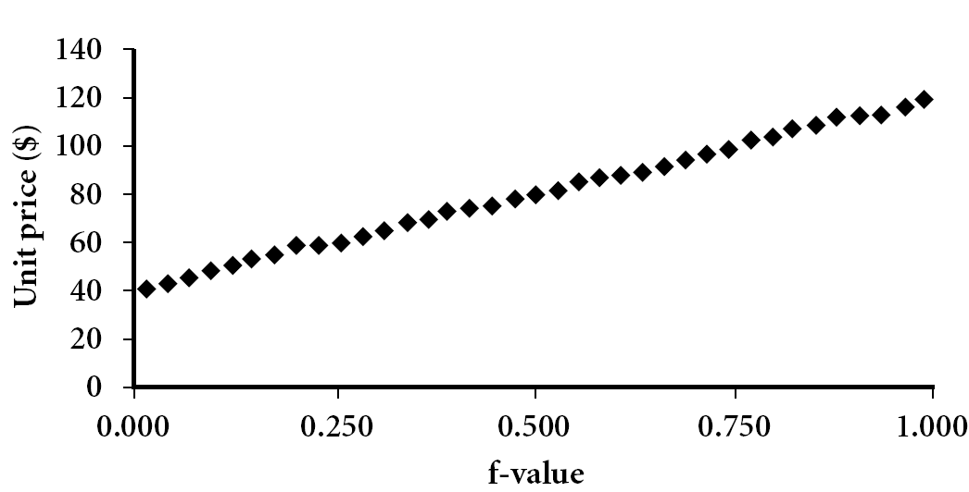
Quantile Plot
Displays all of the data (allowing the user to assess both the overall behavior and unusual occurrences)
Plots quantile information
  For a data x_{i} data sorted in increasing order, f_{i} indicates that approximately 100 f_{i}% of the data are below or equal to the value x_{i}

Slide 21
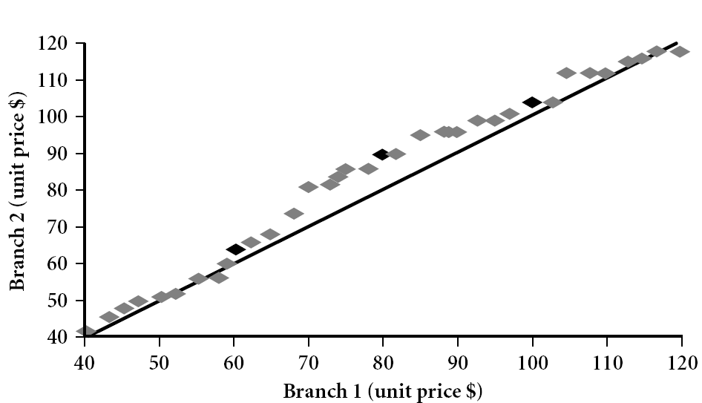
Quantile-Quantile (Q-Q) Plot
Graphs the quantiles of one univariate distribution against the corresponding quantiles of another
View: Is there is a shift in going from one distribution to another?
Example shows unit price of items sold at Branch 1 vs. Branch 2 for each quantile. Unit prices of items sold at Branch 1 tend to be lower than those at Branch 2.
Notes:
Note: We need to label the dark plotted points as Q1, Median, Q3 – that would help in understanding this graph.
Tell audience: There is a shift in distribution of branch 1 WRT branch 2 in that the unit prices of items sold at branch 1 tend to be lower than those at branch 2.

Slide 22
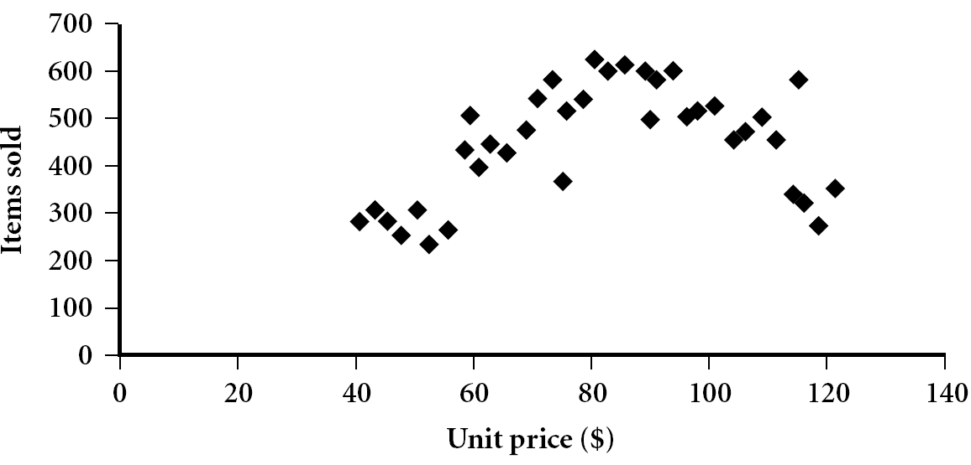
Scatter plot
Provides a first look at bivariate data to see clusters of points, outliers, etc
Each pair of values is treated as a pair of coordinates and plotted as points in the plane
Notes:
Need a better and more MEANINGFUL scatter plot! -JH

Slide 23
Positively and Negatively Correlated Data
The left half fragment is positively correlated
The right half is negative correlated

Slide 24
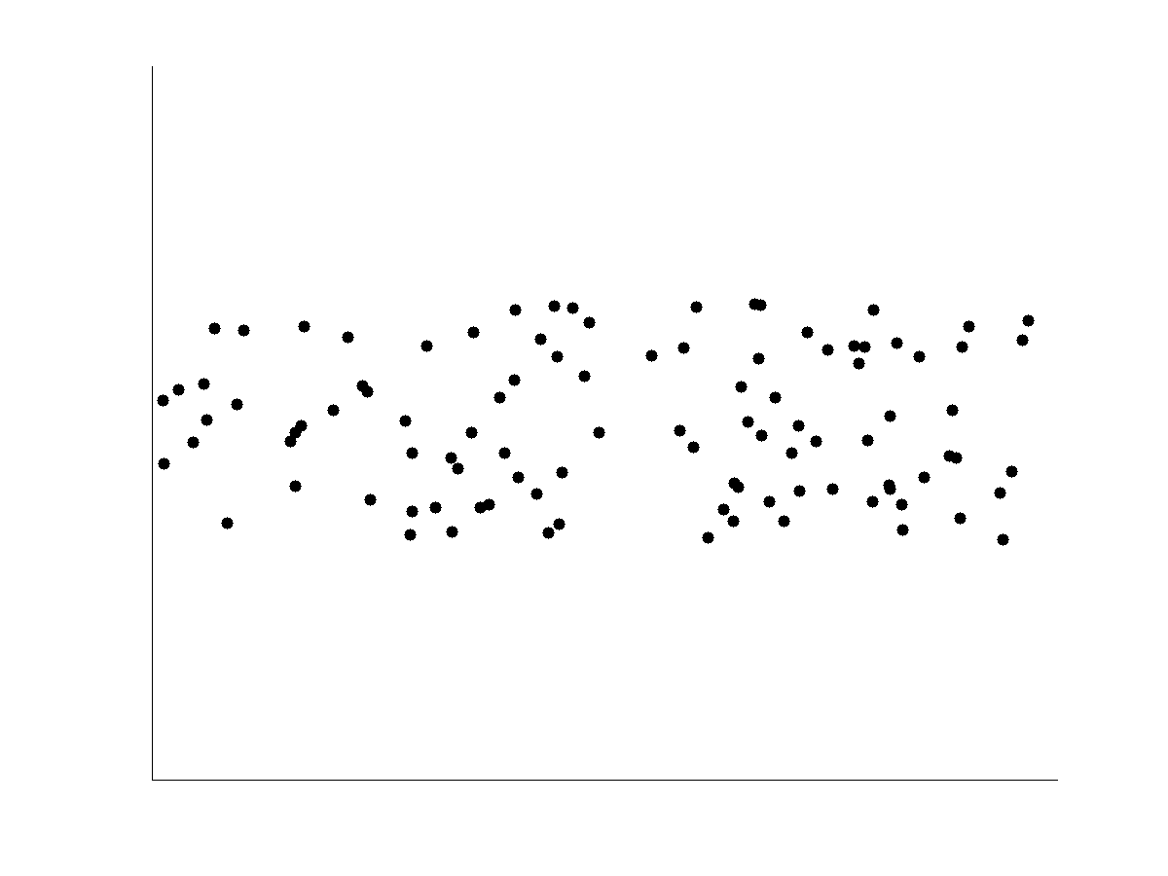
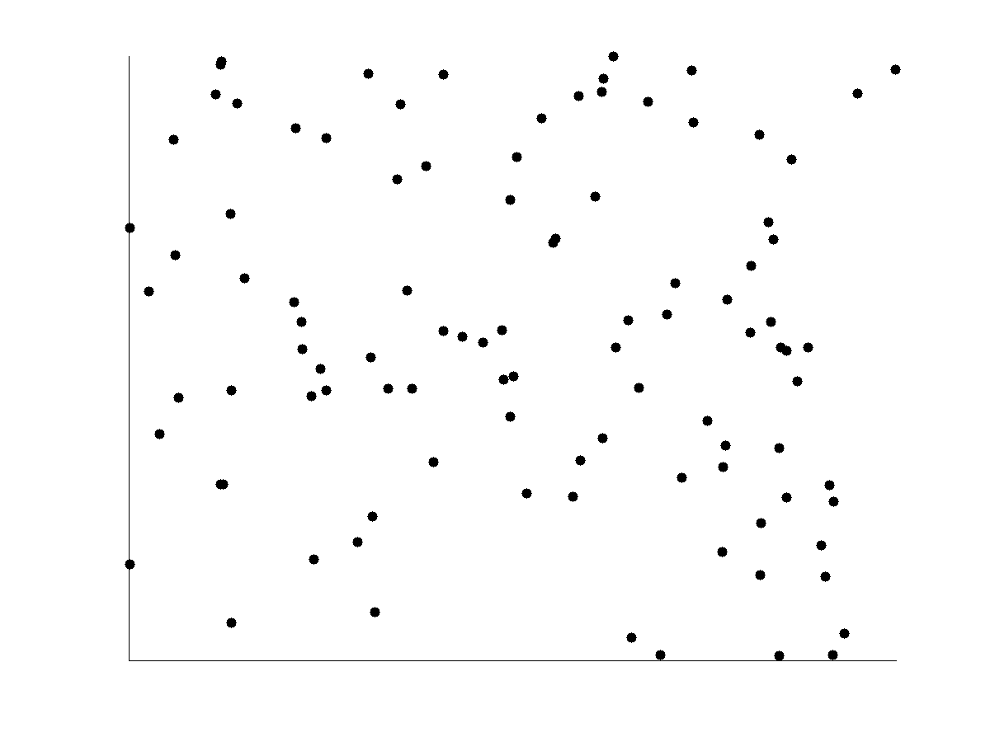
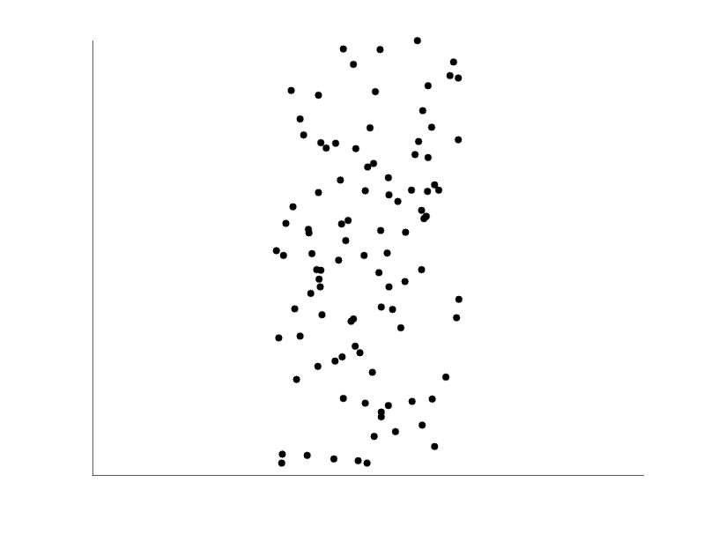
Uncorrelated Data

Slide 25
Chapter 2: Getting to Know Your Data
Data Objects and Attribute Types
Basic Statistical Descriptions of Data
Data Visualization
Measuring Data Similarity and Dissimilarity
Summary

Slide 26
Data Visualization
Why data visualization?
  Gain insight into an information space by mapping data onto graphical primitives
  Provide qualitative overview of large data sets
  Search for patterns, trends, structure, irregularities, relationships among data
  Help find interesting regions and suitable parameters for further quantitative analysis
  Provide a visual proof of computer representations derived
Notes:
CC (conference call) 08.11.02: Need to check Wiki to update references.

Slide 27
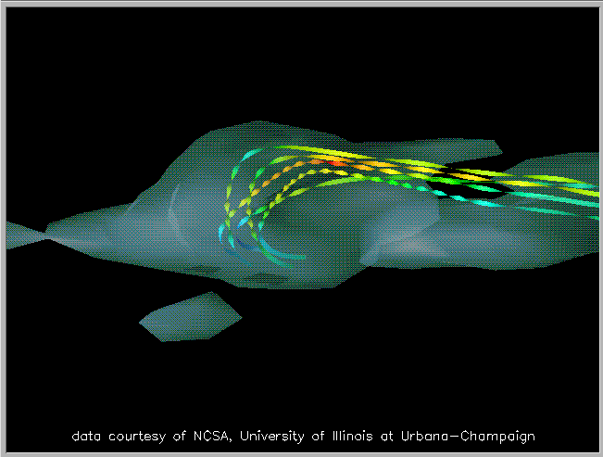
Direct Data Visualization
Ribbons with Twists Based on Vorticity
Notes:
http://books.elsevier.com/companions/1558606890/pictures/Chapter_01/fig1-6b.gif

Slide 28
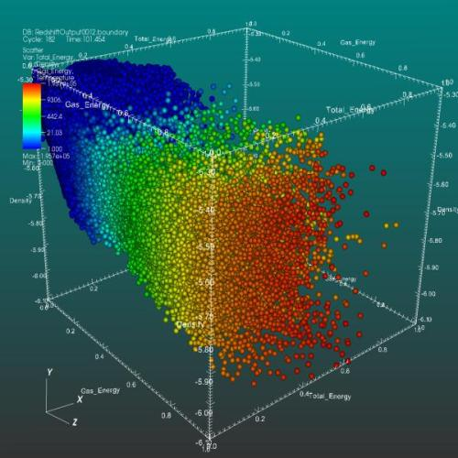
3D Scatter Plot

Slide 29
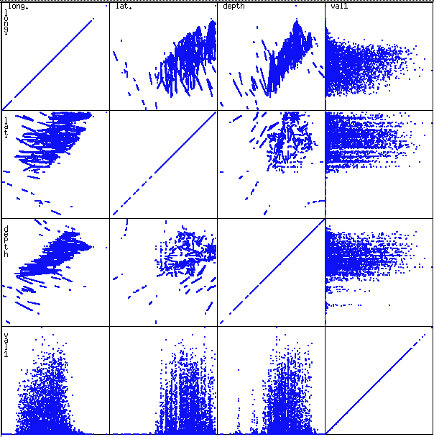
Scatterplot Matrices
Used by ermission of M. Ward, Worcester Polytechnic Institute
Matrix of scatterplots (x-y-diagrams) of the k-dim. data [total of (k2/2-k) scatterplots]

Slide 30
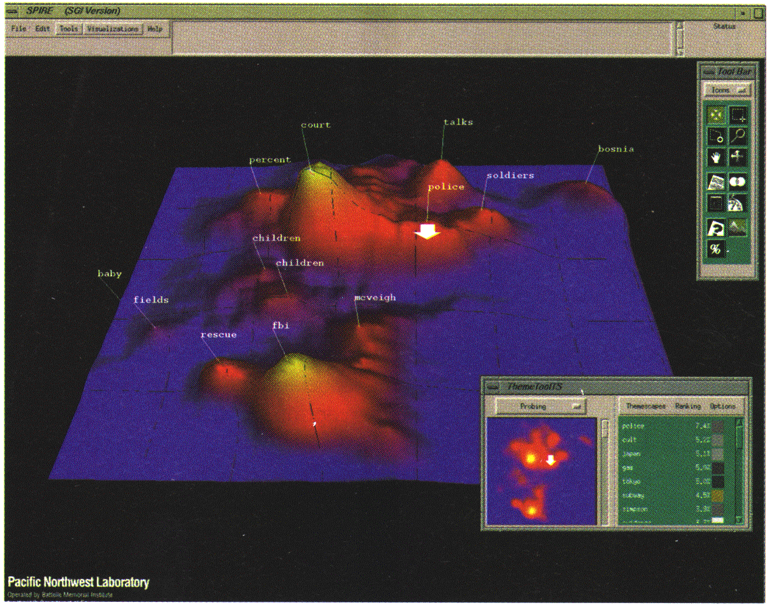
Landscapes
news articles
visualized as
a landscape
Used by permission of B. Wright, Visible Decisions Inc.
Visualization of the data as perspective landscape
The data needs to be transformed into a (possibly artificial) 2D spatial representation which preserves the characteristics of the data

Slide 31
Parallel Coordinates
n equidistant axes which are parallel to one of the screen axes and correspond to the attributes
The axes are scaled to the [minimum, maximum]: range of the corresponding attribute
Every data item corresponds to a polygonal line which intersects each of the axes at the point which corresponds to the value for the attribute

Slide 32
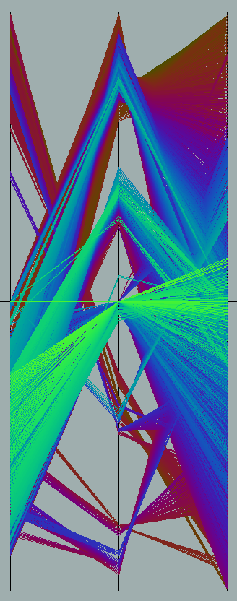
Parallel Coordinates of a Data Set

Slide 33
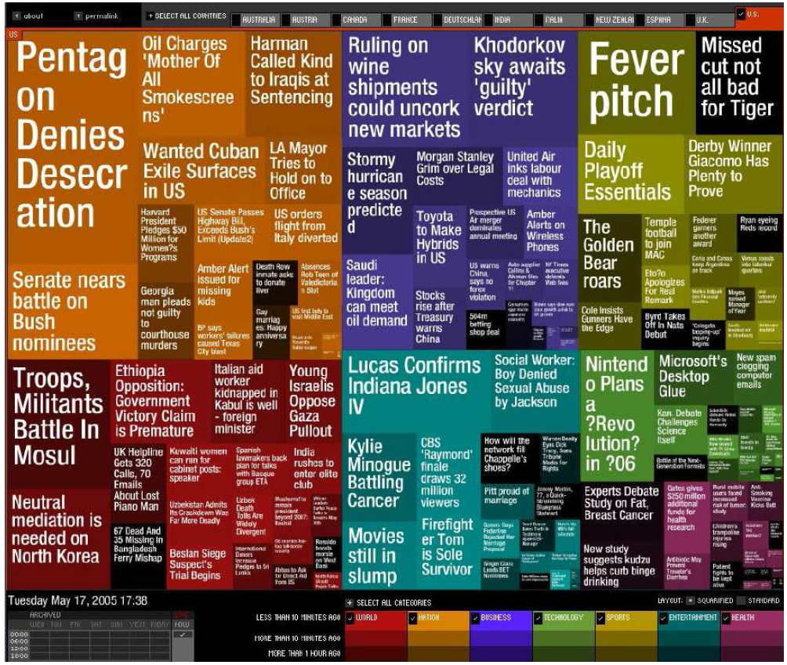
Visualizing Text Data
Tag cloud: visualizing user-generated tags
  The importance of tag is represented by font size/color
Newsmap: Google News Stories in 2005

Slide 34
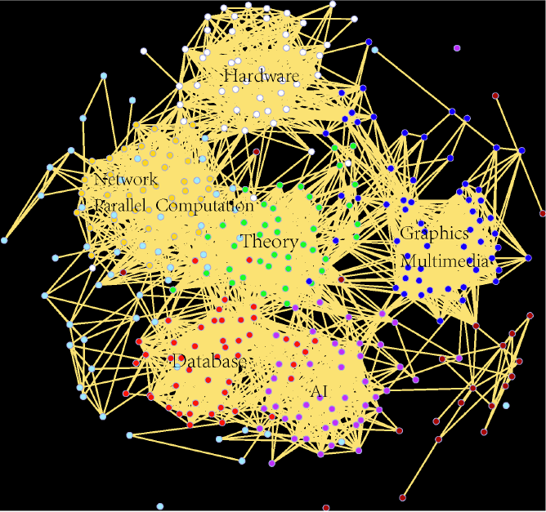
Visualizing Social/Information Networks
Computer Science Conference Network

Slide 35
Chapter 2: Getting to Know Your Data
Data Objects and Attribute Types
Basic Statistical Descriptions of Data
Data Visualization
Measuring Data Similarity and Dissimilarity
Summary

Slide 36
Similarity and Dissimilarity
Similarity
  Numerical measure of how alike two data objects are
  Value is higher when objects are more alike
  Often falls in the range [0,1]
Dissimilarity (e.g., distance)
  Numerical measure of how different two data objects are
  Lower when objects are more alike
  Minimum dissimilarity is often 0
  Upper limit varies
Proximity refers to a similarity or dissimilarity
Notes:
Keep here because keeping it in clustering chapter seems far away. 08.11.02

Slide 37
Data Matrix and Dissimilarity Matrix
Data matrix
  n data points with p dimensions
  Two modes
Dissimilarity matrix
  n data points, but registers only the distance
  A triangular matrix
  Single mode
Notes:
Distance is just once way of measuring dissimilarity (wiki). Changed “register only the distance” to “registers only the difference” or “dissimiarity”?

Slide 38
Proximity Measure for Nominal Attributes
Can take 2 or more states, e.g., red, yellow, blue, green (generalization of a binary attribute)
Method 1: Simple matching
  m: # of matches, p: total # of variables
Method 2: Use a large number of binary attributes
  creating a new binary attribute for each of the M nominal states

Slide 39
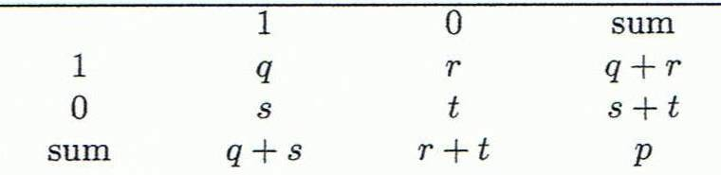
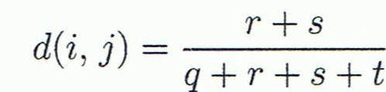
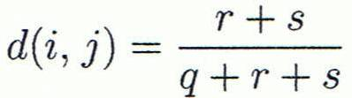

Proximity Measure for Binary Attributes
Object j
A contingency table for binary data
Distance measure for symmetric binary variables:
Distance measure for asymmetric binary variables:
Jaccard coefficient (similarity measure for asymmetric binary variables):
Object i
Note: Jaccard coefficient is the same as “coherence”:
Notes:
MK: I tried to change equations so as to match notation in book, but each time I try to install the equation editor, it fails! Agh!

Slide 40
Dissimilarity between Binary Variables
Example
  Gender is a symmetric attribute
  The remaining attributes are asymmetric binary
  Let the values Y and P be 1, and the value N 0

Slide 41
Standardizing Numeric Data
Z-score:
  X: raw score to be standardized, μ: mean of the population, σ: standard deviation
  the distance between the raw score and the population mean in units of the standard deviation
  negative when the raw score is below the mean, “+” when above
An alternative way: Calculate the mean absolute deviation
  where
  standardized measure (z-score):
Using mean absolute deviation is more robust than using standard deviation
Notes:
MK: For lecture, this may be OK here, but I think discussion of standardization/normalization is better kept all together in Chapter 3

Slide 42
Example:
Data Matrix and Dissimilarity Matrix
Data Matrix
Dissimilarity Matrix
(with Euclidean Distance)

Slide 43
Distance on Numeric Data: Minkowski Distance
Minkowski distance: A popular distance measure
  where i = (x_{i1}, x_{i2}, …, x_{ip}) and j = (x_{j1}, x_{j2}, …, x_{jp}) are two p-dimensional data objects, and h is the order (the distance so defined is also called L-h norm)
Properties
  d(i, j) > 0 if i ≠ j, and d(i, i) = 0 (Positive definiteness)
  d(i, j) = d(j, i) (Symmetry)
  d(i, j) ≤ d(i, k) + d(k, j) (Triangle Inequality)
A distance that satisfies these properties is a metric

Slide 44
Special Cases of Minkowski Distance
h = 1: Manhattan (city block, L₁ norm) distance
  E.g., the Hamming distance: the number of bits that are different between two binary vectors
h = 2: (L₂ norm) Euclidean distance
h → ∞. “supremum” (L_{max} norm, L∞ norm) distance.
  This is the maximum difference between any component (attribute) of the vectors

Slide 45
Example: Minkowski Distance
Dissimilarity Matrices
Manhattan (L₁)
Euclidean (L₂)
Supremum

Slide 46
Ordinal Variables
An ordinal variable can be discrete or continuous
Order is important, e.g., rank
Can be treated like interval-scaled
  replace x_{if} by their rank
  map the range of each variable onto [0, 1] by replacing i-th object in the f-th variable by
  compute the dissimilarity using methods for interval-scaled variables

Slide 47
Attributes of Mixed Type
A database may contain all attribute types
  Nominal, symmetric binary, asymmetric binary, numeric, ordinal
One may use a weighted formula to combine their effects
  f is binary or nominal:
    d_{ij}^{(f)} = 0 if x_{if} = x_{jf} , or d_{ij}^{(f)} = 1 otherwise
  f is numeric: use the normalized distance
  f is ordinal
    Compute ranks r_{if} and
    Treat z_{if} as interval-scaled

Slide 48
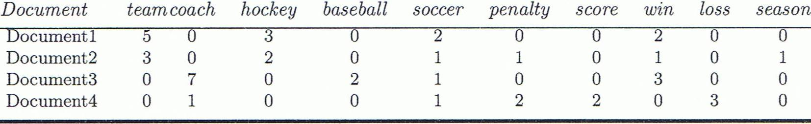
Cosine Similarity
A document can be represented by thousands of attributes, each recording the frequency of a particular word (such as keywords) or phrase in the document.
Other vector objects: gene features in micro-arrays, …
Applications: information retrieval, biologic taxonomy, gene feature mapping, ...
Cosine measure: If d₁ and d₂ are two vectors (e.g., term-frequency vectors), then
cos(d₁, d₂) = (d₁ • d₂) /||d₁|| ||d₂|| ,
  where • indicates vector dot product, ||d||: the length of vector d
Notes:
MK: Machine learning used the term “feature VECTORS” > I made some changes to the wording of this slide because it implied that our previous data were not vectors, but they were all feature vectors. I also changed the example since the one used was from Tan’s book (see next slide).
Chapter 3: Statistics Methods
Co-variance distance
K-L divergence

Slide 49
Example: Cosine Similarity
cos(d₁, d₂) = (d₁ • d₂) /||d₁|| ||d₂|| ,
  where • indicates vector dot product, ||d|: the length of vector d
Ex: Find the similarity between documents 1 and 2.
  d₁ = (5, 0, 3, 0, 2, 0, 0, 2, 0, 0)
  d₂ = (3, 0, 2, 0, 1, 1, 0, 1, 0, 1)
  d₁•d₂ = 5*3+0*0+3*2+0*0+2*1+0*1+0*1+2*1+0*0+0*1 = 25
  ||d₁||= (5*5+0*0+3*3+0*0+2*2+0*0+0*0+2*2+0*0+0*0)^{0.5}=(42)^{0.5} = 6.481
  ||d₂||= (3*3+0*0+2*2+0*0+1*1+1*1+0*0+1*1+0*0+1*1)^{0.5}=(17)^{0.5} = 4.12
  cos(d₁, d₂ ) = 0.94
Notes:
09/09/25MK: New example (previous one was from Tan’s book).
Chapter 3: Statistics Methods
Co-variance distance
K-L divergence

Slide 50
Chapter 2: Getting to Know Your Data
Data Objects and Attribute Types
Basic Statistical Descriptions of Data
Data Visualization
Measuring Data Similarity and Dissimilarity
Summary

Slide 51
Summary
Data attribute types: nominal, binary, ordinal, interval-scaled, ratio-scaled
Many types of data sets, e.g., numerical, text, graph, Web, image.
Gain insight into the data by:
  Basic statistical data description: central tendency, dispersion, graphical displays
  Data visualization: map data onto graphical primitives
  Measure data similarity
Above steps are the beginning of data preprocessing.
Many methods have been developed but still an active area of research.
Notes:
08/10/23: This slide was out of date. Draft of new version above.
Cut out the following:
Data description, data exploration, and measure data similarity set the basis for quality data preprocessing
A lot of methods have been developed but data preprocessing still an active area of research

Slide 52
References
W. Cleveland, Visualizing Data, Hobart Press, 1993
T. Dasu and T. Johnson. Exploratory Data Mining and Data Cleaning. John Wiley, 2003
U. Fayyad, G. Grinstein, and A. Wierse. Information Visualization in Data Mining and Knowledge Discovery, Morgan Kaufmann, 2001
L. Kaufman and P. J. Rousseeuw. Finding Groups in Data: an Introduction to Cluster Analysis. John Wiley & Sons, 1990.
H. V. Jagadish et al., Special Issue on Data Reduction Techniques. Bulletin of the Tech. Committee on Data Eng., 20(4), Dec. 1997
D. A. Keim. Information visualization and visual data mining, IEEE trans. on Visualization and Computer Graphics, 8(1), 2002
D. Pyle. Data Preparation for Data Mining. Morgan Kaufmann, 1999
S. Santini and R. Jain,” Similarity measures”, IEEE Trans. on Pattern Analysis and Machine Intelligence, 21(9), 1999
E. R. Tufte. The Visual Display of Quantitative Information, 2nd ed., Graphics Press, 2001
C. Yu et al., Visual data mining of multimedia data for social and behavioral studies, Information Visualization, 8(1), 2009
Notes:
MK 08.11.02: This needs to be updated to reflect changes.

