Slide 1
CS6220: Data Mining Techniques
Chapter 8&9: Classification: Part 4
Instructor: Yizhou Sun
yzsun@ccs.neu.edu
March 17, 2013

Slide 2
Chapter 8&9. Classification: Part 4
  Frequent Pattern-based Classification
Ensemble Methods
Other Topics
Summary

Slide 3
Associative Classification
Associative classification: Major steps
  Mine data to find strong associations between frequent patterns (conjunctions of attribute-value pairs) and class labels
  Association rules are generated in the form of
      P₁ ^ p₂ … ^ p_{l} → “A_{class} = C” (conf, sup)
  Organize the rules to form a rule-based classifier
Why effective?
  It explores highly confident associations among multiple attributes and may overcome some constraints introduced by decision-tree induction, which considers only one attribute at a time
  Associative classification has been found to be often more accurate than some traditional classification methods, such as C4.5

Slide 4
General Framework for Associative Classification
Step 1:
  Mine frequent itemsets in the data, which are typically attribute-value pairs
    E.g., age = youth
Step 2:
  Analyze the frequent itemsets to generate association rules per class
Step 3:
  Organize the rules to form a rule-based classifier

Slide 5
Typical Associative Classification Methods
CBA (Classification Based on Associations: Liu, Hsu & Ma, KDD’98)
  Mine possible association rules in the form of
    Cond-set (a set of attribute-value pairs) → class label
  Build classifier: Organize rules according to decreasing precedence based on confidence and then support
CMAR (Classification based on Multiple Association Rules: Li, Han, Pei, ICDM’01)
  Classification: Statistical analysis on multiple rules
CPAR (Classification based on Predictive Association Rules: Yin & Han, SDM’03)
  Generation of predictive rules (FOIL-like analysis) but allow covered rules to retain with reduced weight
  Prediction using best k rules
  High efficiency, accuracy similar to CMAR
5

Slide 6
Discriminative Frequent Pattern-Based Classification
H. Cheng, X. Yan, J. Han, and C.-W. Hsu, “Discriminative Frequent Pattern Analysis for Effective Classification”, ICDE'07
  Use combined features instead of single features
    E.g., age = youth and credit = OK
Accuracy issue
  Increase the discriminative power
  Increase the expressive power of the feature space
Scalability issue
  It is computationally infeasible to generate all feature combinations and filter them with an information gain threshold
  Efficient method (DDPMine: FPtree pruning): H. Cheng, X. Yan, J. Han, and P. S. Yu, "Direct Discriminative Pattern Mining for Effective Classification", ICDE'08

Slide 7
Discriminative Frequent Pattern-Based Classification
H. Cheng, X. Yan, J. Han, and C.-W. Hsu, “Discriminative Frequent Pattern Analysis for Effective Classification”, ICDE'07
Accuracy issue
  Increase the discriminative power
  Increase the expressive power of the feature space
Scalability issue
  It is computationally infeasible to generate all feature combinations and filter them with an information gain threshold
  Efficient method (DDPMine: FPtree pruning): H. Cheng, X. Yan, J. Han, and P. S. Yu, "Direct Discriminative Pattern Mining for Effective Classification", ICDE'08
7
Notes:
7

Slide 8
Frequent Pattern vs. Single Feature
  The discriminative power of some frequent patterns is higher than that of single features.
(a) Austral
(b) Cleve
(c) Sonar
Fig. 1. Information Gain vs. Pattern Length
8
Notes:
8

Slide 9
Empirical Results
(a) Austral
(b) Breast
(c) Sonar
Fig. 2. Information Gain vs. Pattern Frequency
9
Notes:
9

Slide 10
Feature Selection
10
Given a set of frequent patterns, both non-discriminative and redundant patterns exist, which can cause overfitting
We want to single out the discriminative patterns and remove redundant ones
The notion of Maximal Marginal Relevance (MMR) is borrowed
  A document has high marginal relevance if it is both relevant to the query and contains minimal marginal similarity to previously selected documents
Notes:
10

Slide 11
General Framework for Discriminative Frequent Pattern-based Classification
Step 1:
  Find the frequent patterns for the data set D, which are considered as feature candidates
Step 2:
  Select the best set of features by feature selection, and prepare the transformed data set D’ with new features
Step 3:
  Build classification models based on the transformed data set

Slide 12
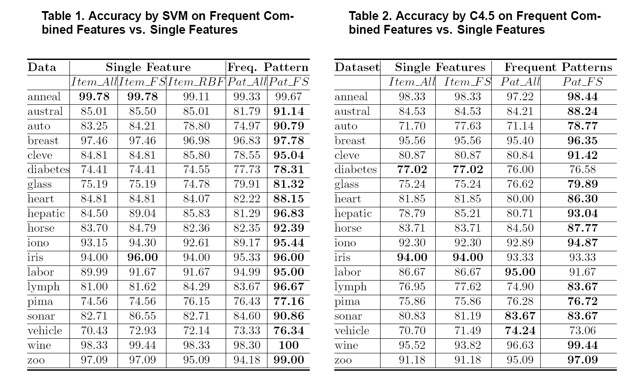
Experimental Results
12
12
Notes:
12

Slide 13
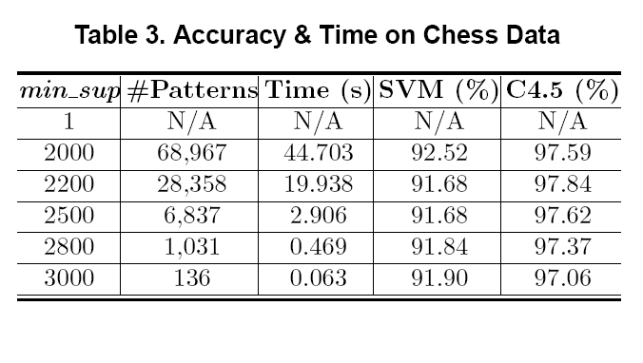
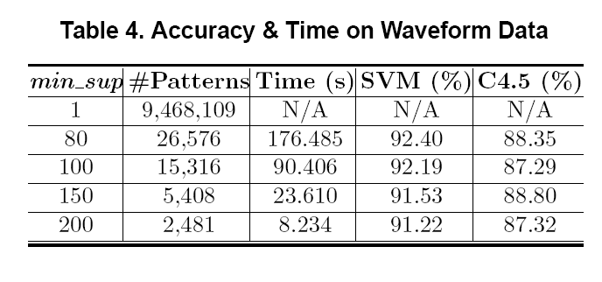
Scalability Tests
13
Notes:
13

Slide 14
Chapter 8&9. Classification: Part 4
  Frequent Pattern-based classification
Ensemble Methods
Other Topics
Summary

Slide 15
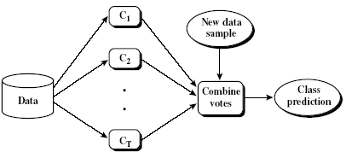
Ensemble Methods: Increasing the Accuracy
Ensemble methods
  Use a combination of models to increase accuracy
  Combine a series of k learned models, M₁, M₂, …, M_{k}, with the aim of creating an improved model M*
Popular ensemble methods
  Bagging: averaging the prediction over a collection of classifiers
  Boosting: weighted vote with a collection of classifiers
15

Slide 16
Bagging: Boostrap Aggregation
Analogy: Diagnosis based on multiple doctors’ majority vote
Training
  Given a set D of d tuples, at each iteration i, a training set D_{i} of d tuples is sampled with replacement from D (i.e., bootstrap)
  A classifier model M_{i} is learned for each training set D_{i}
Classification: classify an unknown sample X
  Each classifier M_{i} returns its class prediction
  The bagged classifier M* counts the votes and assigns the class with the most votes to X
Prediction: can be applied to the prediction of continuous values by taking the average value of each prediction for a given test tuple
16

Slide 17
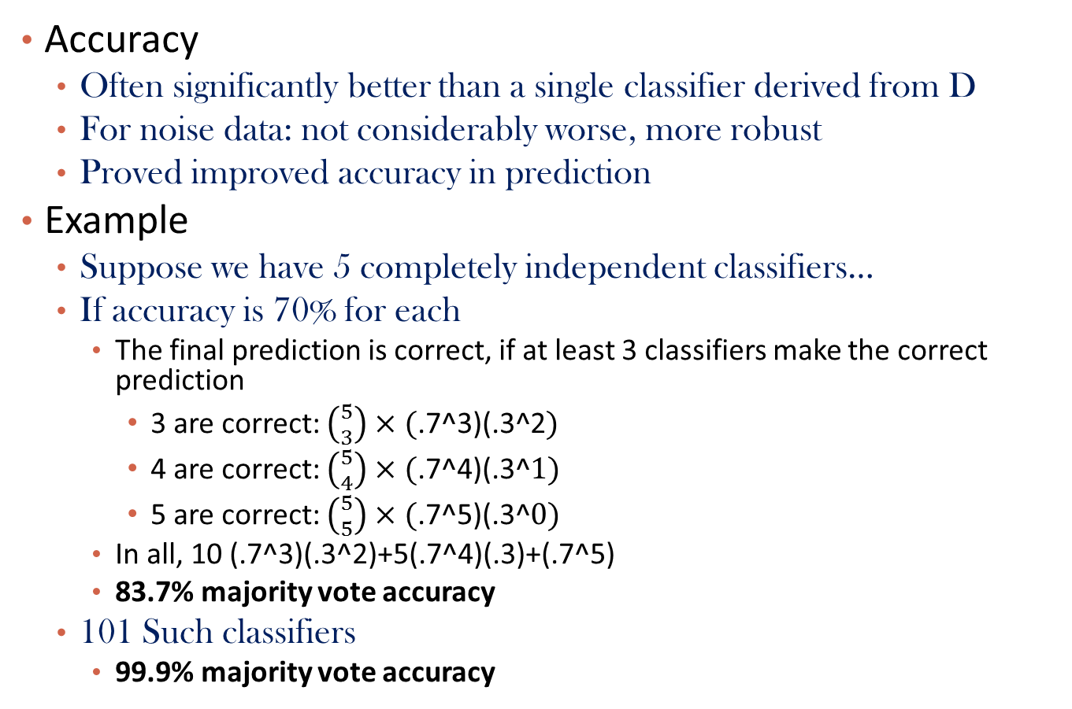
Performance of Bagging
Accuracy
  Often significantly better than a single classifier derived from D
  For noise data: not considerably worse, more robust
  Proved improved accuracy in prediction
Example
  Suppose we have 5 completely independent classifiers…
  If accuracy is 70% for each
    The final prediction is correct, if at least 3 classifiers make the correct prediction
      3 are correct: $\left({5 \atop 3}\right)×(\text{.7^3}\text{)}\text{(.3^2})$
      4 are correct: $\left({5 \atop 4}\right)×(\text{.7^}\text{4}\text{)}\text{(.3^}1)$
      5 are correct: $\left({5 \atop 5}\right)×(\text{.7^}\text{5}\text{)}\text{(.3^}0)$
    In all, 10 (.7^3)(.3^2)+5(.7^4)(.3)+(.7^5)
    83.7% majority vote accuracy
  101 Such classifiers
    99.9% majority vote accuracy

Slide 18
Boosting
Analogy: Consult several doctors, based on a combination of weighted diagnoses—weight assigned based on the previous diagnosis accuracy
How boosting works?
  Weights are assigned to each training tuple
  A series of k classifiers is iteratively learned
  After a classifier M_{t} is learned, the weights are updated to allow the subsequent classifier, M_{t+1}, to pay more attention to the training tuples that were misclassified by M_{t}
  The final M* combines the votes of each individual classifier, where the weight of each classifier's vote is a function of its accuracy
Boosting algorithm can be extended for numeric prediction
Comparing with bagging: Boosting tends to have greater accuracy, but it also risks overfitting the model to misclassified data
18

Slide 19
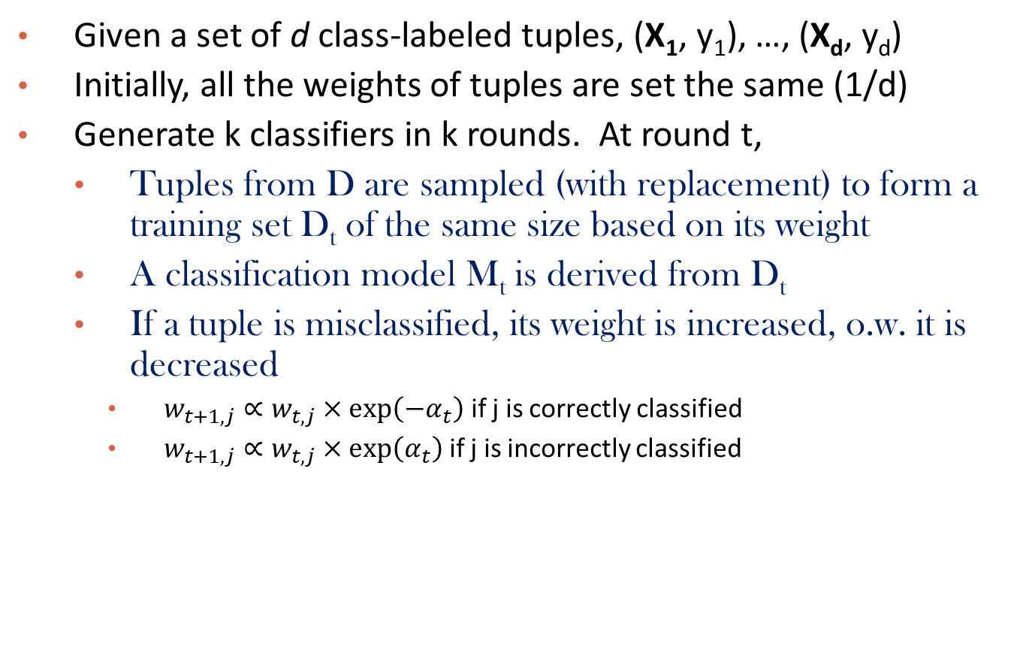
Adaboost (Freund and Schapire, 1997)
Given a set of d class-labeled tuples, (X₁, y₁), …, (X_{d}, y_{d})
Initially, all the weights of tuples are set the same (1/d)
Generate k classifiers in k rounds. At round t,
  Tuples from D are sampled (with replacement) to form a training set D_{t} of the same size based on its weight
  A classification model M_{t} is derived from D_{t}
  If a tuple is misclassified, its weight is increased, o.w. it is decreased
    $w_{t+1,j}∝w_{t,j}×\exp\left({−α}_{t}\right)$ if j is correctly classified
    $w_{t+1,j}∝w_{t,j}×\exp\left(α_{t}\right)$ if j is incorrectly classified
$$α_{t}:weight forclassifier t , the higher the better$$

Slide 20
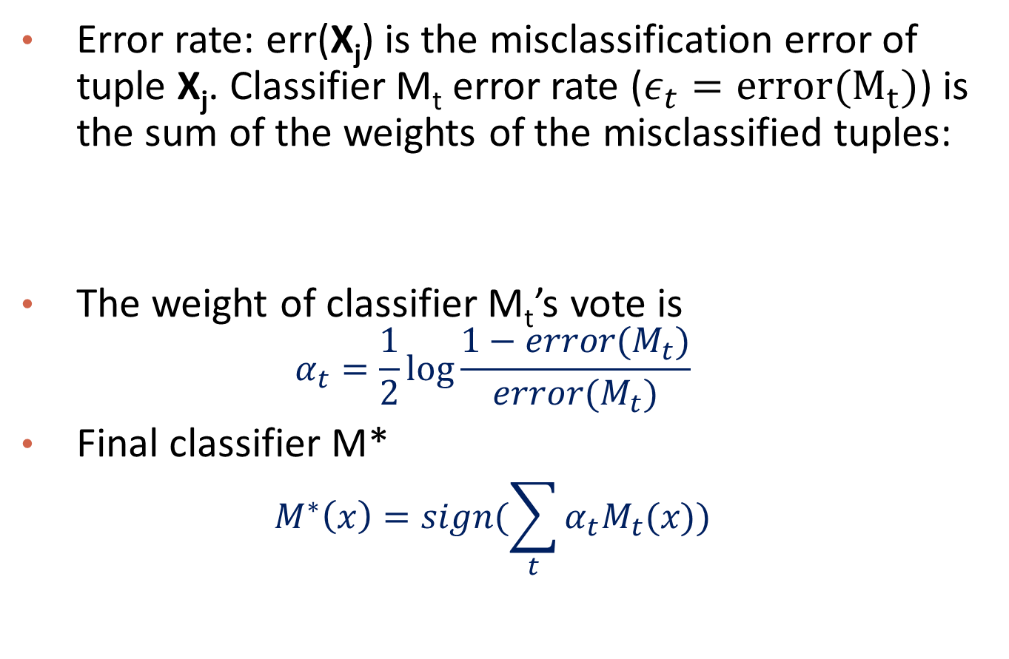
AdaBoost
Error rate: err(X_{j}) is the misclassification error of tuple X_{j}. Classifier M_{t} error rate ($ε_{t}=error(M_{t})$) is the sum of the weights of the misclassified tuples:
The weight of classifier M_{t}’s vote is
  $$α_{t}=\frac{1}{2}log\frac{1−error(M_{t})}{error(M_{t})}$$
Final classifier M*
  $$M^{∗}\left(x\right)=sign(\sum_{t}{α_{t}M_{t}(x)})$$

Slide 21
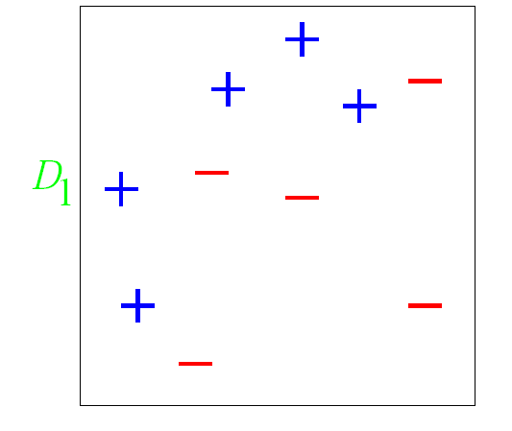

AdaBoost Example
From “A Tutorial on Boosting”
  By Yoav Freund and Rob Schapire
Note they use $h_{t}$to represent classifier instead of $M_{t}$

Slide 22
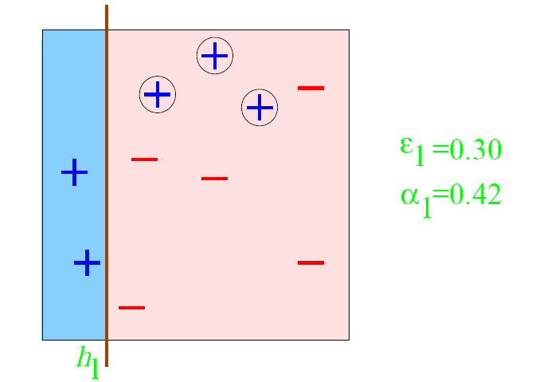
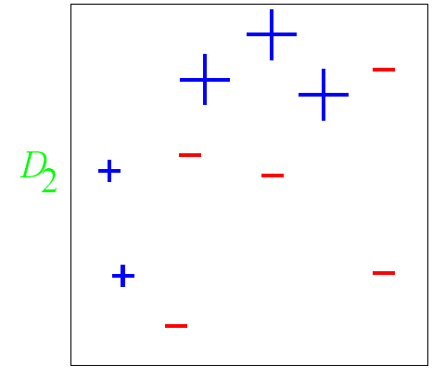
Round 1

Slide 23
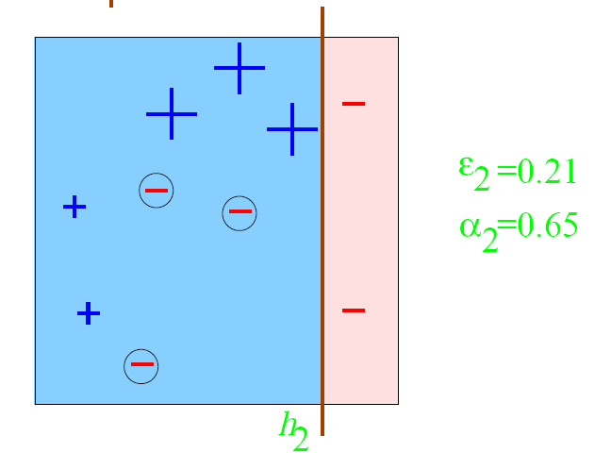
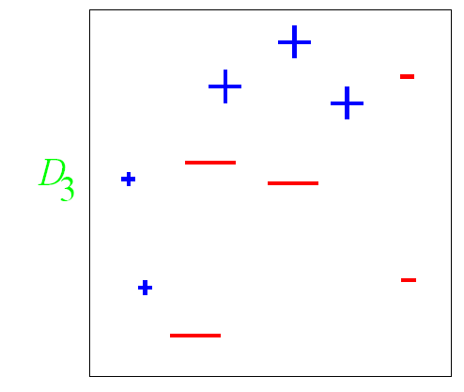
Round 2

Slide 24
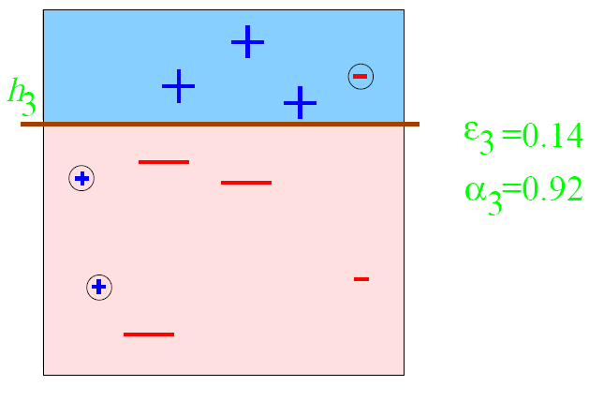
Round 3

Slide 25
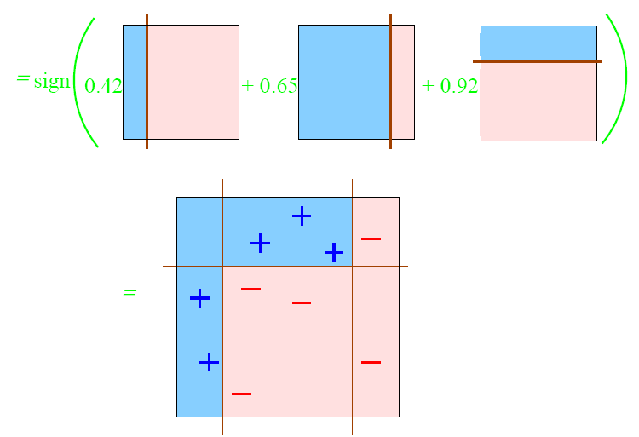

Final Model
$$M^{∗}$$

Slide 26
Random Forest (Breiman 2001)
Random Forest:
  Each classifier in the ensemble is a decision tree classifier and is generated using a random selection of attributes at each node to determine the split
  During classification, each tree votes and the most popular class is returned
Two Methods to construct Random Forest:
  Forest-RI (random input selection): Randomly select, at each node, F attributes as candidates for the split at the node. The CART methodology is used to grow the trees to maximum size
  Forest-RC (random linear combinations): Creates new attributes (or features) that are a linear combination of the existing attributes (reduces the correlation between individual classifiers)
Comparable in accuracy to Adaboost, but more robust to errors and outliers
Insensitive to the number of attributes selected for consideration at each split, and faster than bagging or boosting
26

Slide 27
Chapter 8&9. Classification: Part 4
  Frequent Pattern-based classification
Ensemble Methods
Other Topics
Summary

Slide 28
Classification of Class-Imbalanced Data Sets
Class-imbalance problem: Rare positive example but numerous negative ones, e.g., medical diagnosis, fraud, oil-spill, fault, etc.
Traditional methods assume a balanced distribution of classes and equal error costs: not suitable for class-imbalanced data
Typical methods for imbalance data in 2-class classification:
  Oversampling: re-sampling of data from positive class
  Under-sampling: randomly eliminate tuples from negative class
  Threshold-moving: moves the decision threshold, t, so that the rare class tuples are easier to classify, and hence, less chance of costly false negative errors
  Ensemble techniques: Ensemble multiple classifiers introduced above
Still difficult for class imbalance problem on multiclass tasks
28

Slide 29
Multiclass Classification
Classification involving more than two classes (i.e., > 2 Classes)
Method 1. One-vs.-all (OVA): Learn a classifier one at a time
  Given m classes, train m classifiers: one for each class
  Classifier j: treat tuples in class j as positive & all others as negative
  To classify a tuple X, the set of classifiers vote as an ensemble
Method 2. All-vs.-all (AVA): Learn a classifier for each pair of classes
  Given m classes, construct m(m-1)/2 binary classifiers
  A classifier is trained using tuples of the two classes
  To classify a tuple X, each classifier votes. X is assigned to the class with maximal vote
Comparison
  All-vs.-all tends to be superior to one-vs.-all
  Problem: Binary classifier is sensitive to errors, and errors affect vote count
29

Slide 30
Error-Correcting Codes for Multiclass Classification
Originally designed to correct errors during data transmission for communication tasks by exploring data redundancy
Example
  A 7-bit codeword associated with classes 1-4
Class | Error-Corr. Codeword
C₁ | 1 | 1 | 1 | 1 | 1 | 1 | 1
C₂ | 0 | 0 | 0 | 0 | 1 | 1 | 1
C₃ | 0 | 0 | 1 | 1 | 0 | 0 | 1
C₄ | 0 | 1 | 0 | 1 | 0 | 1 | 0
  Given a unknown tuple X, the 7-trained classifiers output: 0001010
  Hamming distance: # of different bits between two codewords
  H(X, C₁) = 5, by checking # of bits between [1111111] & [0001010]
  H(X, C₂) = 3, H(X, C₃) = 3, H(X, C₄) = 1, thus C₄ as the label for X
Error-correcting codes can correct up to (h-1)/h 1-bit error, where h is the minimum Hamming distance between any two codewords
If we use 1-bit per class, it is equiv. to one-vs.-all approach, the code are insufficient to self-correct
When selecting error-correcting codes, there should be good row-wise and col.-wise separation between the codewords
30

Slide 31
Semi-Supervised Classification
+
unlabeled
labeled
̶
Semi-supervised: Uses labeled and unlabeled data to build a classifier
Self-training:
  Build a classifier using the labeled data
  Use it to label the unlabeled data, and those with the most confident label prediction are added to the set of labeled data
  Repeat the above process
  Adv: easy to understand; disadv: may reinforce errors
Co-training: Use two or more classifiers to teach each other
  Each learner uses a mutually independent set of features of each tuple to train a good classifier, say f₁
  Then f₁ and f₂ are used to predict the class label for unlabeled data X
  Teach each other: The tuple having the most confident prediction from f₁ is added to the set of labeled data for f₂, & vice versa
Other methods, e.g., joint probability distribution of features and labels
31

Slide 32
Active Learning
Class labels are expensive to obtain
Active learner: query human (oracle) for labels
Pool-based approach: Uses a pool of unlabeled data
  L: a small subset of D is labeled, U: a pool of unlabeled data in D
  Use a query function to carefully select one or more tuples from U and request labels from an oracle (a human annotator)
  The newly labeled samples are added to L, and learn a model
  Goal: Achieve high accuracy using as few labeled data as possible
Evaluated using learning curves: Accuracy as a function of the number of instances queried (# of tuples to be queried should be small)
Research issue: How to choose the data tuples to be queried?
  Uncertainty sampling: choose the least certain ones
  Reduce version space, the subset of hypotheses consistent w. the training data
  Reduce expected entropy over U: Find the greatest reduction in the total number of incorrect predictions
32

Slide 33
Transfer Learning: Conceptual Framework
Transfer learning: Extract knowledge from one or more source tasks and apply the knowledge to a target task
Traditional learning: Build a new classifier for each new task
Transfer learning: Build new classifier by applying existing knowledge learned from source tasks
Traditional Learning Framework
Transfer Learning Framework
33

Slide 34
Transfer Learning: Methods and Applications
Applications: Especially useful when data is outdated or distribution changes, e.g., Web document classification, e-mail spam filtering
Instance-based transfer learning: Reweight some of the data from source tasks and use it to learn the target task
TrAdaBoost (Transfer AdaBoost)
  Assume source and target data each described by the same set of attributes (features) & class labels, but rather diff. distributions
  Require only labeling a small amount of target data
  Use source data in training: When a source tuple is misclassified, reduce the weight of such tupels so that they will have less effect on the subsequent classifier
Research issues
  Negative transfer: When it performs worse than no transfer at all
  Heterogeneous transfer learning: Transfer knowledge from different feature space or multiple source domains
  Large-scale transfer learning
34

Slide 35
Chapter 8&9. Classification: Part 4
  Frequent Pattern-based classification
Ensemble Methods
Other Topics
Summary

Slide 36
Summary
  Frequent Pattern-based classification
  Associative classification
  Discriminative frequent pattern-based classification
Ensemble Methods
  Bagging; Boosting; AdaBoost
Other Topics
  Class imbalanced data; multi-class classification; semi-supervised learning; active learning; transfer learning

