Slide 1
CS7280: Special Topics in Data Mining Information/Social Networks
1: Introduction
Instructor: Yizhou Sun
yzsun@ccs.neu.edu
January 6, 2014

Slide 2
Course Information
Course homepage: http://www.ccs.neu.edu/home/yzsun/classes/2014Spring_CS7280/index.html
Class schedule
Slides
Announcement
Paper presentation sign-up
…
Piazza: https://piazza.com/northeastern/spring2014/cs7280/home

Slide 3
Meeting Time and Location
When
Tuesdays 11:45-1:25pm, Thursdays 2:50-4:30pm
Change?
Where
Snell Library 115

Slide 4
Instructor Information
Instructor: Yizhou Sun
Homepage: http://www.ccs.neu.edu/home/yzsun/
Email: yzsun@ccs.neu.edu
Office: 320 WVH
Office hour: Tuesdays 2:30-4:30pm

Slide 5
Goal of the Course
The goal of the course is to
learn the most cutting-edge topics, models and algorithms in information and social network mining, and to solve real problems on real-world large-scale information/social network data using these techniques.
The students are expected to read and present research papers, and work on a research project related to this topic.

Slide 6
Prerequisites
No official prerequisites
However, this is a research-driven seminar course
The students are expected to have knowledge in data structures, algorithms, basic linear algebra, and basic statistics.
It will be a plus if you have already had some background in data mining, machine learning, and related courses.

Slide 7
Grading
Paper presentation: 40%
Research project: 50%
Participation: 10%

Slide 8
Grading: Paper Presentation
Paper Presentation (40%):
Everyone is asked to register 2 research topics
Each research topic has 2-3 slots (2-3 papers)
The students in charge of the research topic need to read all the papers and discuss with each other
Make presentations of all the papers in that topic (e.g., each one leads one paper)
Answer questions from the audience
Lead the discussion
The papers are given, but you can choose other papers with my consent two weeks before your presentation

Slide 9
Grading: Research Project
Research project: 50%
Group project (2 people for one group)
We now have 9 PhD students and 5 MS students
It is a research project
A new problem?
A new method?
Improvement of an existing method?
You need to
Form group (By Jan 16.)
Proposal submission (By Feb. 6)
Midterm report (By Mar. 13)
Presentation (April 17/24)
Final report (April 24) (hopefully it can be turned to a conference paper submission)

Slide 10
Grading: Participation
Participation (10%)
This is a seminar course, so everyone needs to read the papers in advance and ask questions in class
You can also raise and answer questions online (e.g., Piazza)
Mendeley

Slide 11
CS 6220 Data Mining Course Review
By data types:
matrix data
set data
sequence data
time series
graph and network
By functions:
Classification
Clustering
Frequent pattern mining
Prediction
Similarity search
Ranking

Slide 12
Multi-Dimensional View of Data Mining
Data to be mined
Database data (extended-relational, object-oriented, heterogeneous, legacy), data warehouse, transactional data, stream, spatiotemporal, time-series, sequence, text and web, multi-media, graphs & social and information networks
Knowledge to be mined (or: Data mining functions)
Characterization, discrimination, association, classification, clustering, trend/deviation, outlier analysis, etc.
Descriptive vs. predictive data mining
Multiple/integrated functions and mining at multiple levels
Techniques utilized
Data-intensive, data warehouse (OLAP), machine learning, statistics, pattern recognition, visualization, high-performance, etc.
Applications adapted
Retail, telecommunication, banking, fraud analysis, bio-data mining, stock market analysis, text mining, Web mining, etc.

Slide 13
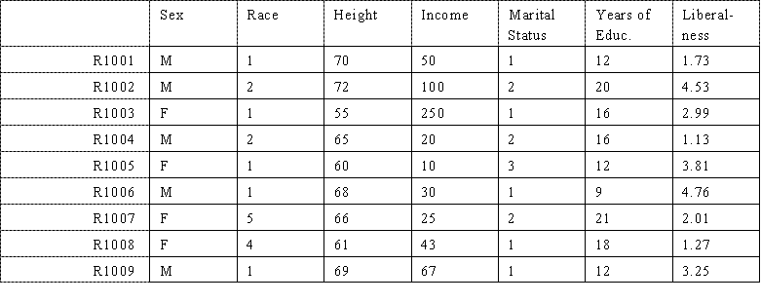
Matrix Data
Notes:
Sources:http://www.analytictech.com/networks/kindsofmatrices.htm

Slide 14
Set Data

Slide 15
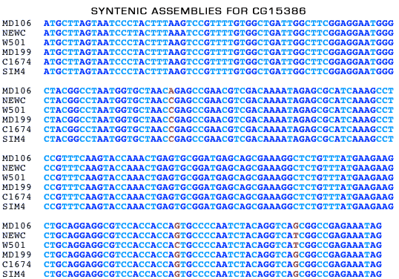
Sequence Data
Notes:
Source: http://www.dpgp.org/syntenic_assembly/

Slide 16
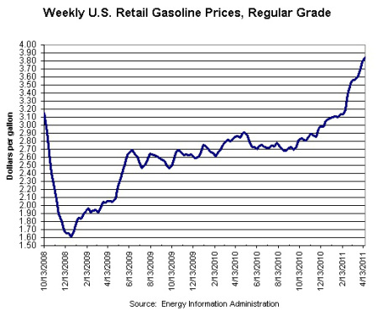
Time Series
Notes:
Source: http://swampland.time.com/2011/04/25/obamas-pump-problem-why-gas-prices-could-swing-a-close-election/

Slide 17
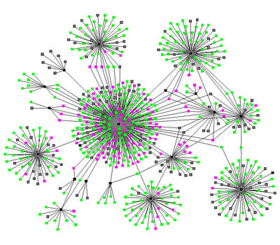
Graph / Network
Notes:
Source: http://www.thenetworkthinkers.com/2008/06/birds-of-feather-grow-fat-together.html

Slide 18
Course Overview
Overview
Ranking for infonet
Clustering / community detection
Matrix factorization and Blockmodel
Classification / label propagation / node or link profiling
Probabilistic models for infonets
Similarity search
Diffusion / Influence maximization
Recommendation
Link / relationship prediction
Trustworthy analysis
Large graph computation

Slide 19
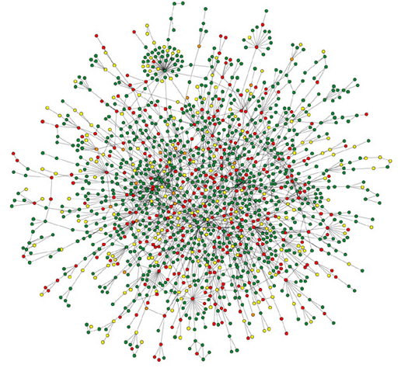
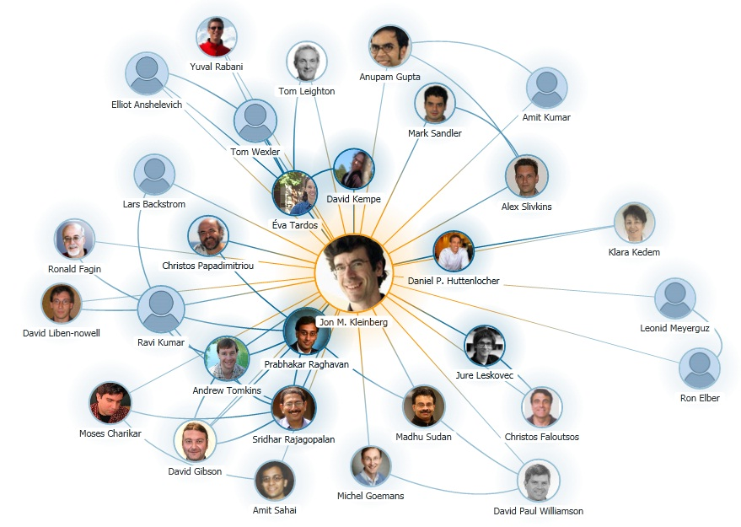
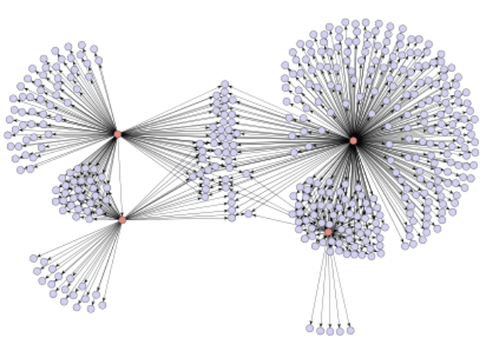
Information Networks Are Everywhere
Social Networking Websites
Biological Network: Protein Interaction
Research Collaboration Network
Product Recommendation Network via Emails

Slide 20
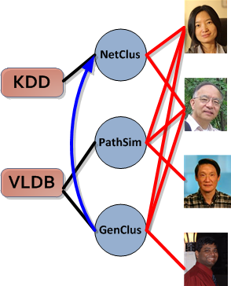
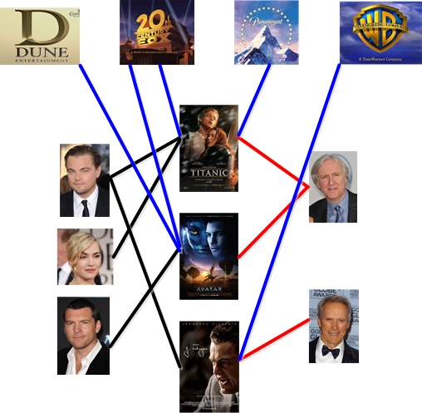
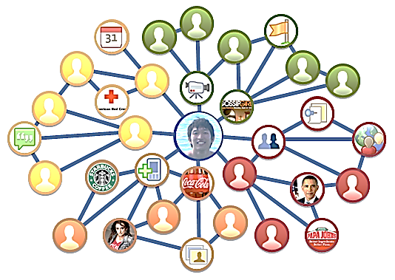
Movie
Studio
Venue
Paper
Author
Actor
Director
Movie
DBLP Bibliographic Network
The IMDB Movie Network
The Facebook Network

Slide 21
Some Concepts
Graph
Social Network
Information Network
Homogeneous information network
Heterogeneous information network

Slide 22
Ranking for Infonet
PageRank
HITS

Slide 23
Clustering
SCAN
Spectral Clustering
Matrix Factorization
Blockmodel

Slide 24
Classification
Collective classification
Label propagation
Link sign prediction

Slide 25
Probabilistic models
Markov Random Field
Conditional Random Field
Factor graph

Slide 26
Similarity Search
SimRank
P-Rank
PathSim

Slide 27
Diffusion / Influence maximization
Information diffusion through blogspace
Influence maximization

Slide 28
Recommendation
M. Jamali and M. Ester. A matrix factorization technique with trust propagation for recommendation in social networks. (KDD’10)
Personalized Entity Recommendation: A Heterogeneous Information Network Approach (WSDM‘14)

Slide 29
Link / relationship prediction
Link prediction
Citation prediction
Relationship prediction

Slide 30
Trustworthy analysis
X. Yin and W. Tan, Semi-Supervised Truth Discovery, WWW’11
B. Zhao, B. Rubinstein, J. Gemmell, and J. Han, A Bayesian approach to discovering truth from conflicting sources for data integration, VLDB’12

Slide 31
Large Graph Computation
GraphChi
PEGASUS: Peta-Scale Graph Mining System

