Slide 1
Hinge Loss Markov Random Fields : Convex Inference for Structured prediction
Stephen H. Bach, Bert Huang, Ben London, Lise Getoor
Presented BY :
Swati Arora, Twinkle Gupta, Shikhar Malhotra

Slide 2
Outline
Machine Learning
Relational Data
Statistical Relational Learning
Discriminative Models
Probabilistic Soft Logic
Markov Random Fields
Hinge Loss Function
MPE
Weight Learning Methods
Experimental Results

Slide 3





Machine Learning
Classic machine learning tasks:
Classification
Regression
Clustering
X₂
X₁

Slide 4
Machine Learning
Algorithms generally designed for data that are
Independent
Identically distributed
IDEAL CASE
Independent: Knowing one label doesn’t tell anything about any other labels
X₂
Identically distributed : from the same distribution as all the other points!
X₁

Slide 5













Machine Learning
A lot of real world data is not independent and identically distributed
Sometimes machine learning tries to predict small, independent structures:
Again not always the case !

Slide 6
What type of data is there ?

Slide 7
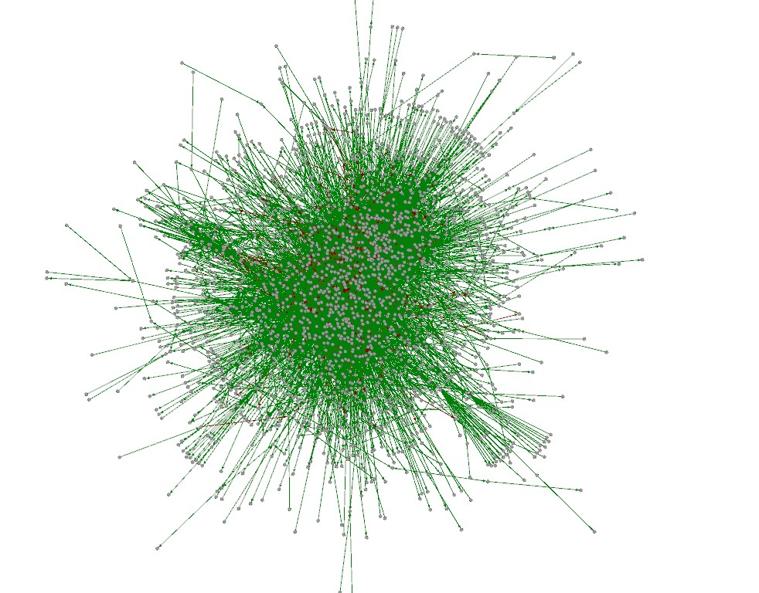
Relational Data
Entities
Relations
Also called:
  Structured data
  Network data

Slide 8


Relational Data
The Web
Social Network

Slide 9
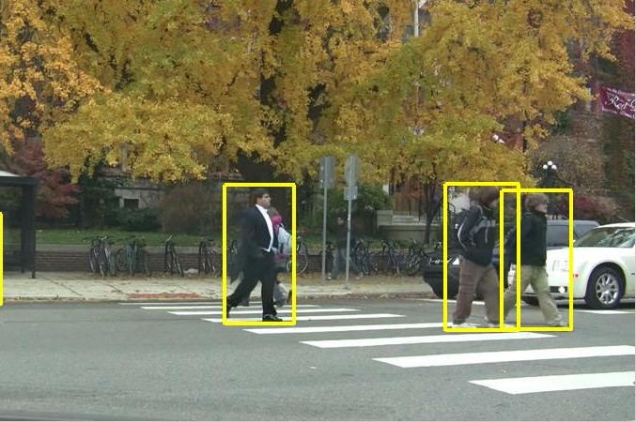
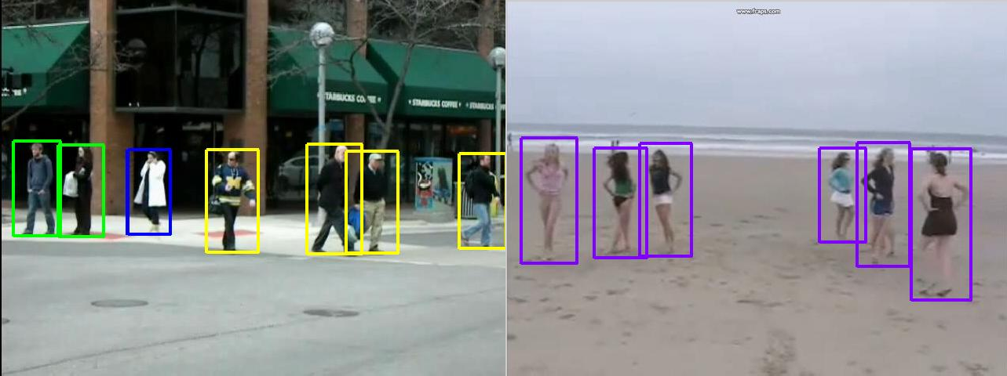
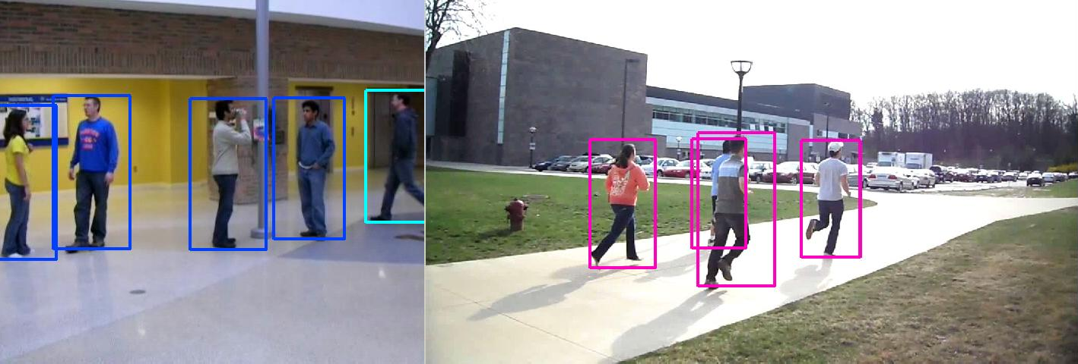
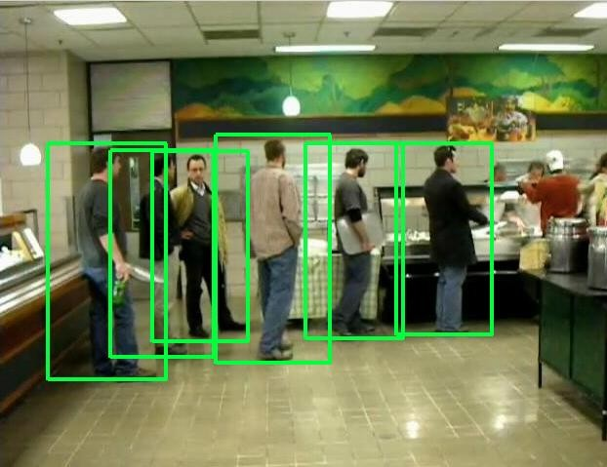
Relational Data
crossing
waiting
queueing
walking
talking
dancing
jogging

Slide 10
How to model such a data?

Slide 11
Statistical Relational Learning
Learning probabilistic models from such a relational data is called Statistical Relational Learning
Goals
  Combining logic and probability into single language
  Develop efficient inference algorithms and learning models
  Apply to real-world applications

Slide 12


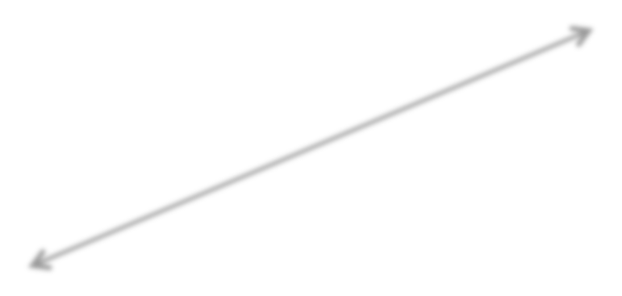
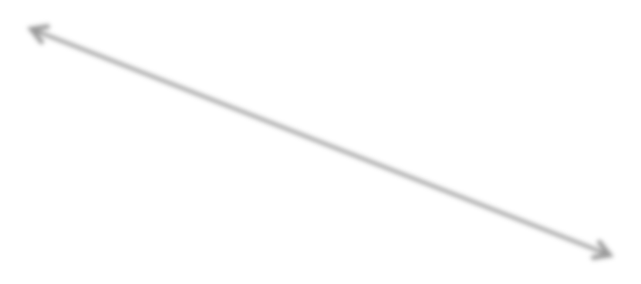







RelationalDependencies
Some joint configurations are more probable than others
Most Probable
Less Probable
Friends

Slide 13


Relational Dependencies
Some joint configurations are more probable than others
less probable
Friends

Slide 14
Relational Dependencies
Some joint configurations are more probable than others
more probable
Friends

Slide 15
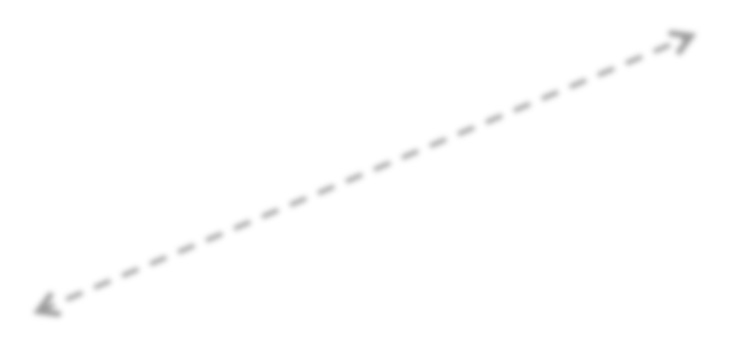
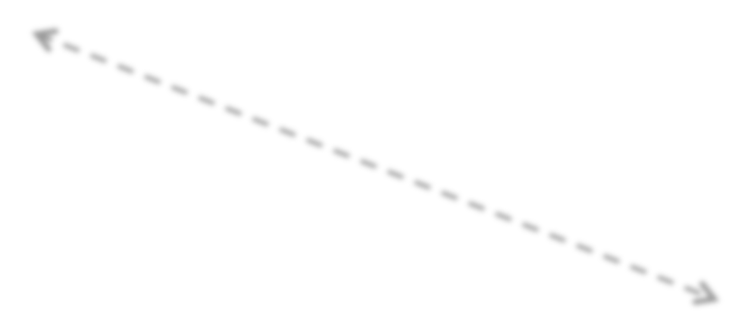
Statistical Relational Learning
Model relational dependencies
Learn to predict unknowns jointly
?
How do we build statistical relational models?
?
?
Friends?

Slide 16
How to build such models?

Slide 17
Two classes of models
Generative models: directed models
  Example : Bayesian Networks
Discriminative models: undirected models
  Example : Markov random models

Slide 18
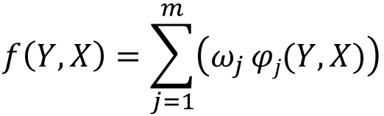
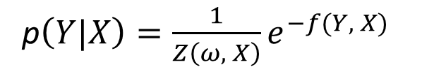
Discriminative Models
Model over unknowns only
Discriminant function
$$f\left(Y, X\right)=\sum_{j=1}^{m}{\left(ω_{j }φj(Y, X)\right)}$$
Common probabilistic interpretation
p$\left(Y|X\right)={\frac{1}{Z\left(ω, X\right)}e^{−f(Y, X)}}_{}$
Example:
  Markov Random Field

Slide 19
Discriminative Models
Easy to define
One-size-fits-all algorithms
May have limited scalability

Slide 20
Framework for SRL: Probabilistic Soft Logic

Slide 21
Probabilistic Soft Logic (PSL)
A framework to describe Statistical Relational Learning problems.
PSL uses first order logic rules as a template language for graphical models over random variables with soft truth values from the interval [0,1].
Predicate: relationship or property
  e.g., Friends(A,B)
Atom: Predicate combined with continuous random variable
  e.g., Friends(Steve, Jay)
Rule: capture dependency or constraint
  e.g., 3.0 : Friends(A, B) & Friends(B, C) ➔ Friends(A, C)
PSL = Rules + Input data

Slide 22
Link Prediction
⓪
Entities
  People, Emails
Attributes
  Words in emails
Relationships
  communication, work relationship
Goal: Identify work relationships
  Supervisor, subordinate, colleague


①

⓪
 
①

Slide 23
Link Prediction
⓪
Use rules to express evidence
“If email content suggests type Y, it is of type Y.”


①
⓪
“If B sends deadline emails to A, then B is the supervisor of A.”
“If B is the supervisor of A, and B is the supervisor of C, then A and C are colleagues.”
 
①

Slide 24
Link Prediction
 ⓪
Use rules to express evidence
“If email content suggests type X, it is of type X.”
complete by

①
due
⓪
“If A sends deadline emails to B, then A is the supervisor of B.”
“If A is the supervisor of B, and A is the supervisor of C, then B and C are colleagues.”
 
1.0 : Contains(E, “due”)
=> HasType(E, “deadline”)
①

Slide 25
Link Prediction
 ⓪
Use rules to express evidence
“If email content suggests type X, it is of type X.”

①
⓪
“If A sends deadline emails to B, then A is the supervisor of B.”
“If A is the supervisor of B, and A is the supervisor of C, then B and C are colleagues.”
 
2.0 : Sent(A, B, E) & HasType(E, “deadline”)
=> Supervisor(A, B)
①

Slide 26
Link Prediction
 ⓪
Use rules to express evidence
“If email content suggests type X, it is of type X.”

①
⓪
“If A sends deadline emails to B, then A is the supervisor of B.”
“If B is the supervisor of A, and B is the supervisor of C, then A and C are colleagues.”
 
1.5 : Supervisor(B, A) & Supervisor(B, C)
=> Colleagues(A, C)
①

Slide 27




Collective Classification
1.0 : Mentioned(A, “Barack Obama”)
=> Votes(A, “Democrat”)
5.0 : Donated(A, “Republican”) => Votes(A, “Republican”)
?
$①$
Status
Tweet

Slide 28

Collective Classification
1.0 : Votes(A, P) & Friends(A, B)=> Votes(B, P)
⓪
①
①
spouse
friend
colleague
friend
friend
spouse
①colleague
⓪
friend
⓪
5.0 : Votes(A, P) & Spouse(A, B)=> Votes(B, P)
spouse

Slide 29


Rules
Atoms
H₁(X) ∨... ∨ H_{m}(X) ← B₁(X) ∧ … ∧ B_{n} (X)
Will be instantiated for everyx X in the input
Atoms are real valued
Interpretation I, atom A: I(A) [0,1]
We will omit the interpretation and write A [0,1]

Slide 30




Combination Functions
∨, ∧: [0,1]^{n} →[0,1]
Rules will behave like Boolean logic
If body is low, rule is always “happy”
Friends(Jay, Steve)∧Friends(Steve, Ben) → Friends(Jay, Ben)
Friends(Jay, Steve)∧Friends(Steve, Ben) → Friends(Jay, Ben)

Slide 31

Combination Functions
∨, ∧: [0,1]^{n} →[0,1]
Rules will behave like Boolean logic
If body is high, rule only “happy” if head is high
Friends(Jay, Steve)∧Friends(Steve, Ben) → Friends(Jay, Ben)
Friends(Jay, Steve)∧Friends(Steve, Ben) → Friends(Jay, Ben)

Slide 32
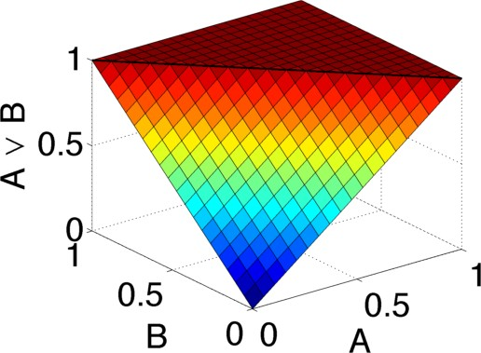
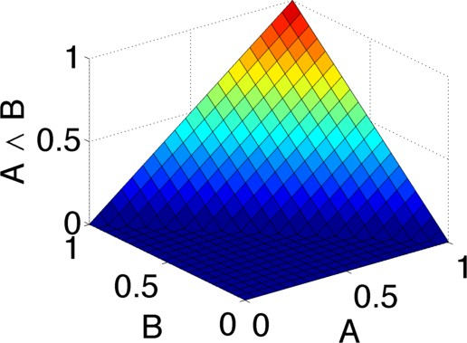
Combination Functions
∨, ∧: [0,1]^{n} →[0,1]
Here, we use Lukasiewicz T-norm
A ∨ B = min(1, A + B)
A ∧ B = max(0, A + B – 1)

Slide 33


H₁(X) ←
Rule Satisfaction
B₁(X)∧ B₂(X)
Establish Satisfaction
≥0.5 H₁(x) ← B₁(x):0.7 ∧ B₂(x):0.8

Slide 34

H₁(X) ∨... ∨ H_{m}(X) ← B₁(X) ∧ … ∧ B_{n}(X)
Distance to Satisfaction
Distance to Satisfaction
Max(∧(B₁(X) ,..,B_{n}(X)) - ∨(H₁(X) ,..,H_{m}(X)), 0)
H₁(x):0.7 ←
H₁(x):0.2 ←
B₁(x):0.7 ∧ B₂(x):0.8
B₁(x):0.7 ∧ B₂(x):0.8
0.0
0.3

Slide 35
Distance to Satisfaction
H₁(X) ∨... ∨ H_{m}(X) ← B₁(X) ∧ … ∧ B_{n}(X)
Distance to Satisfaction
Max(∧(B₁(X) ,..,B_{n}(X)) - ∨(H₁(X) ,..,H_{m}(X)), 0)
Weighted Rules
W_{r}: H₁(X)∨... H_{m}(X) ← B₁(X) ∧ … ∧ B_{n}(X)
Weighted Distance to Satisfaction
W_{r} * max(∧(B₁(x),..,B_{n}(x))-∨(H₁(x),..,H_{m}(x)), 0)

Slide 36
Probabilistic Graphical Models: Markov Random Field

Slide 37
Markov Random Fields
Markov random field is a set of random variables having a Markov property described by an undirected graph.
Markov property refers to the memoryless property of a stochastic process i.e. if the conditional probability distribution of future states of the process depends only upon the present state, not on the sequence of events that preceded it.

Slide 38
Markov Random Fields

Slide 39
Markov Random Fields
https://www.youtube.com/watch?v=EqUfuT3CC8s

Slide 40

Probabilistic Model
Rule’s weight
Rule’s distance to satisfaction
Probability density over interpretation I
Distance exponent in {1, 2}
Normalization constant
Set of ground rules

Slide 41
Hinge Loss Function

Slide 42
Hinge Loss Function
Let Y = (Y₁ , Y₂ , Y₃ , ….. Y_{n} ) be a vector of n variables and
X = (X₁ , X₂ , X₃ , ….. X_{n’}) be a vector of n’ variables
Both Y and X are in domain [0,1]
  Joint domain (D) = [0,1]^{n+n’}
Let be m continuous potentials defined as
Where is linear combination of Y and X
And {1,2}

Slide 43
Hinge Loss Function
Let C = (C₁ , C₂ , ……. C_{r} ) be constraint functions associated with equality and inequality constraints
Where is the new domain
Weights are defined as
Hinge loss function is defined as:

Slide 44
Hinge loss Markov Random Field
Hinge loss Markov Random Field (P) over random variables Y and conditioned on random variables X is defined as:
If , then
If , then
Where

Slide 45
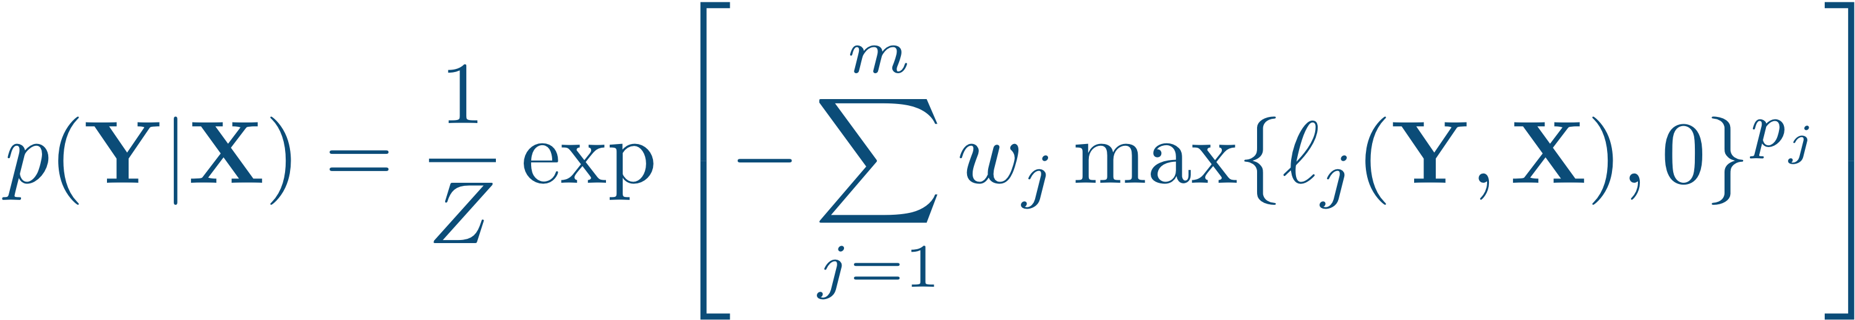
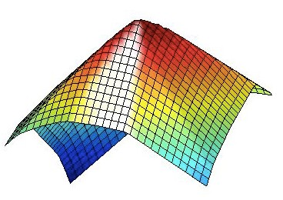
Hinge-loss Markov Random Fields
Continuous variables in [0,1]
Potentials are hinge-loss functions
Log-concave

Slide 46
Example

Slide 47
An Example: A Social Network
A's Interests: Photography Monster Truck Rallies
B's Interests: Photography Nature Walks
C’s Interests: Photography Geocaching
D’s Interests: Photography Geocaching
References : http://stephenbach.net/files/bach-uai13.pdf

Slide 48
An Example: A Social Network
A's Interests: Photography Monster Truck Rallies
B's Interests: Photography Nature Walks
C’s Interests: Photography Geocaching
D’s Interests: Photography Geocaching

Slide 49
An Example: A Social Network
A's Interests: Photography Monster Truck Rallies
B's Interests: Photography Nature Walks
RULES:
2.0 Interest(P1, I) & Interest(P2, I) ➔ Friends(P1, P2)
2.5 Friends(P1, P2) & Friends(P2, P3) ➔ Friends(P1, P3)
5.0 Interest(P1, Monster Truck Rallies) & Interest(P2, Nature Walks) ➔ ! Friends(P1,P2)
1.0 !Friends(P1,P2)
C’s Interests: Photography Geocaching
D’s Interests: Photography Geocaching

Slide 50
Constructing a HL-MRF
1) Ground out all rules according to data

Slide 51
Example Groundings
Interest(P1, I) & Interest(P2, I) ➔ Friends(P1, P2)
Interest(A, Photography) & Interest(B, Photography) ➔ Friends(A, B)
Interest(C, Photography) & Interest(D Photography) ➔ Friends(C, D)
Interest(C,, Geocaching) & Interest(D Geocaching) ➔ Friends(C, D)
etc.
Interest(P1, M.T.R.) & Interest(P2, N.W.) ➔ !Friends(P1, P2)
Interest(A, M.T.R.) & Interest(B, N.W.) ➔! Friends(A, B)
Friends(P1, P2) & Friends(P2, P3) ➔ Friends(P1, P3)
Friends(A, B) & Friends(B D) ➔ Friends(A, D)
etc.

Slide 52
Constructing a HL-MRF
1) Ground out all rules
2) Convert ground rules to hinge-loss functions
Hinge loss potential = 1 – truth value of the ground rule

Slide 53
Example : hinge-loss function
Start with a ground rule
Friends(A, B) & Friends(B, D) ➔ Friends(A, D)
Map atoms to random variables
Friends(A, B) = X₁
Friends(B, D) = X₂
Friends(A, D) = Y₃
Interpret with t-norm
min{2 – X₁ – X₂ + Y₃, 1}

Slide 54
Example hinge-loss function
Subtract from 1 to find distance to satisfaction
1 – min{2 – X₁ – X₂ + Y₃, 1}
= max{X₁ + X₂ – Y₃ – 1, 0}
l_{j} (X,Y)
Hinge Loss Function

Slide 55
Constructing a HL-MRF
1) Ground out all rules
2) Convert ground rules to hinge-loss functions
3) Weight hinge-loss functions and embed in HL-MRF

Slide 56
INFERENCE

Slide 57
Making Predictions
Want to find a most probable explanation (MPE) : Find the most probable setting of Y, given X

Slide 58
Why MPE?
Best scoring assignment to unknown variables
But it’s continuous valued!
How do we interpret continuous values?
Round
Treat as ranking

Slide 59
Convex Optimization
MPE inference is a convex optimization problem
Best general methods have O(n^{3.5}) time complexity

Slide 60
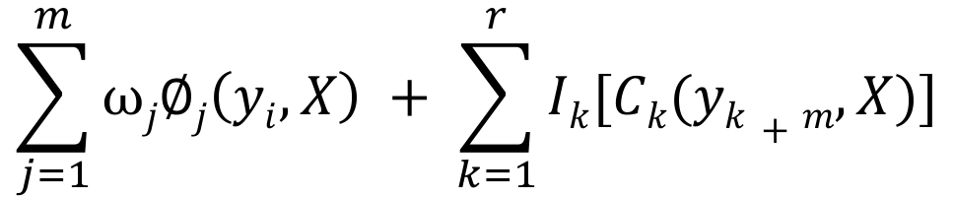

What are we optimizing
Indicator function =
{ 0 , when constraint is satisfied and ∞ when not.}
f(Y,X)
$$\sum_{j=1}^{m}{⍵j∅j\left(yi,X\right) + \sum_{k=1}^{r}{Ik[Ck(yk+m,X)]}}$$
$${\arg{min}}_{yi ∈\left[0,1\right]n}$$
Constraint functions
i^{th} copy of Y
Each minimization problem considered as individual sub problem

Slide 61
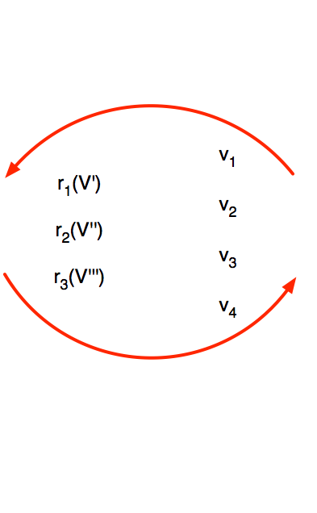







Alternating Direction Method of Multipliers
Perform inference with ADMM framework
Optimize subproblems (hinge losses and constraints) independently, in parallel
Auxiliary variables (Lagrange multipliers) ensure consensus reached across subproblems
Bach et al., NIPS 2012

Slide 62
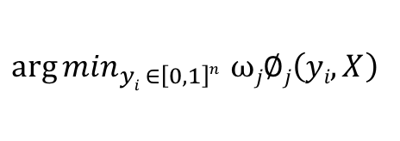
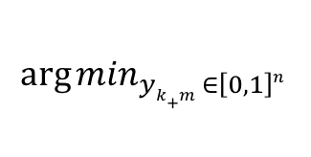
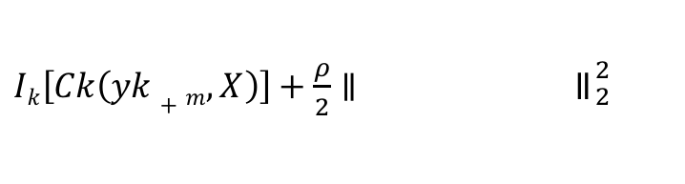
Consensus Optimization
Initialize y_{j} as copies of the variables of Y that appear in Φ_{j}, j = 1,...,m.
Initialize y_{k+m} as copies of the variables of Y that appear in C_{k}, k = 1,...,r
Until convergence do
3a. Solve for each y_{j}
3b. Solve for each y_{k+m}
3c. Set each variable in Y to the average of its copies
${\arg{min}}_{yi ∈\left[0,1\right]n} ⍵j∅j\left(yi,X\right)$
$${\arg{min}}_{yk+m ∈\left[0,1\right]n}$$
$Ik\left[Ck\left(yk+m,X\right)\right]+\frac{ρ}{2}∥$ ॥${}_{2}^{2}{}$

Slide 63
How can we improve ?
No need to solve for constraint equation minimization
Simply independently optimize potentials and project resulting values of Y_{j} to the constraints’ feasible region.
Do not push constraints during optimization
Running time reduces excessively

Slide 64
How can we improve ?
Optimize only the weighted potentials, not the constraint equations
Take average and clip values to [0,1]
Project values to the constraints’ feasible region

Slide 65
Why do we need to improve?
Need to learn weights of each potential function.
Weight learning often requires performing inference many times with different weights

Slide 66
Weight Learning

Slide 67
Weight Learning
Learn from training data
No need to hand-code rule-weights
Various methods:
approximate maximum likelihood estimation
Broecheler, Mihalkova, Getoor, UAI 2010
maximum pseudo-likelihood estimation
        J. Besag. JRSS. 1975
large-margin estimation
        Bach, Huang, London, Getoor, UAI 2013

Slide 68
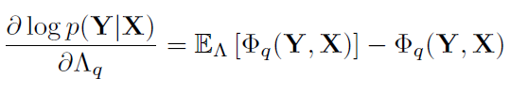
Maximum-Likelihood Estimation
Approximates the gradient of log-likelihood
To learn parameters of the model, we maximize the log-likelihood of training data
where E is the expectation under the distribution defined by Λ
Voted perceptron algorithm

Slide 69
Maximum-Likelihood Estimation
Computing the expectation is intractable
Approximation: the values of the potential functions at the most probable setting of Y with the current parameters
The method of maximum likelihood corresponds to many well-known estimation methods in statistics

Slide 70
Maximum-Likelihood Estimation
Example -
Objective: Heights of penguins
The mean and variance can be estimated with MLE while only knowing the heights of some sample

Slide 71
Maximum-PseudoLikelihood Estimation
Maximizes the likelihood of each variable conditioned on all other variables
Does not require inference and takes time linear in the size of Y.
May either provide
  A computationally simpler problem for estimation
  A way of obtaining explicit estimates of model parameters.

Slide 72
Maximum-PseudoLikelihood Estimation
Can apply MPLE when constraints are not too interdependent
For linear equality constraints over disjoint groups of variables, we can block-sample the constrained variables by sampling uniformly.

Slide 73
Large Margin Estimation
Shifts the goal of learning from producing accurate probabilistic models to producing accurate MPE predictions
The ground-truth state should have energy lower than any alternate state by a large margin
Cutting Plane algorithm - Greedily grow a set K of constraints by iteratively adding the worst-violated constraint, then updating Λ subject to those constraints

Slide 74
Large Margin Estimation
Large-margin criterion requires a little slack for squared HL-MRFs
Trade off between the margin criterion and the learned quadratic energy function

Slide 75
Experimental Results

Slide 76
Experiments
Four diverse learning tasks:
  Collective classification
  Social-trust prediction
  Preference prediction
  Image reconstruction
Bach et al., UAI 2013

Slide 77
Experiments
  Collective classification and Social Trust prediction – discrete MRFs (MC-Sat and MaxWalkSat)
M. Richard et. al.,2006
  Preference prediction - Bayesian probabilistic matrix factorization
                R. Salakhutdinov et al., ICML 2008
  Image reconstruction – setup as Poon and Domingos
                Poon and Domingos., UAI 2011
Bach et al., UAI 2013

Slide 78

Experiments: Collective Classification
Given a networked collection of documents
Observe some labels
Predict remaining labels using link structure
For each category Ci, we have two separate rules for each direction of citation:
Bach et al., UAI 2013

Slide 79
Experiments: Collective Classification

A
 | Citeseer | Cora
HL-MRF-Q (MLE) | 0.729 | 0.816
HL-MRF-Q (MPLE) | 0.729 | 0.818
HL-MRF-Q (LME) | 0.683 | 0.789
HL-MRF-L (MLE) | 0.724 | 0.802
HL-MRF-L (MPLE) | 0.729 | 0.808
HL-MRF-L (LME) | 0.695 | 0.789
MRF (MLE) | 0.686 | 0.756
MRF (MPLE) | 0.715 | 0.797
MRF (LME) | 0.687 | 0.783
? 

? 

Table 1: Average accuracy of classification by HL-MRFs and discrete MRFs. Scores statistically equivalent to the best scoring method are typed in bold.
B
Bach et al., UAI 2013

Slide 80
Experiments: Social Trust Prediction
Given a social network
Observe some trust links
Predict remaining trust links using structural balance
Model based on the social theory of structural balance

Slide 81

















Experiments: Social Trust Prediction
 | ROC | P-R (+) | P-R (-)
HL-MRF-Q (MLE) | 0.822 | 0.978 | 0.452
HL-MRF-Q (MPLE) | 0.832 | 0.979 | 0.482
HL-MRF-Q (LME) | 0.814 | 0.976 | 0.462
HL-MRF-L (MLE) | 0.765 | 0.965 | 0.357
HL-MRF-L (MPLE) | 0.757 | 0.963 | 0.333
HL-MRF-L (LME) | 0.783 | 0.967 | 0.453
MRF (MLE) | 0.655 | 0.942 | 0.270
MRF (MPLE) | 0.725 | 0.963 | 0.298
MRF (LME) | 0.795 | 0.973 | 0.441
Table 1: Average area under ROC and precision-recall curves of social-trust prediction by HL-MRFs and discrete MRFs. Scores statistically equivalent to the best scoring method by metric are typed in bold.
Bach et al., UAI 2013

Slide 82
HL-MRF Scalability
 | Citeseer | Cora | Epinions
HL-MRF-Q | 0.42 | 0.70 | 0.32
HL-MRF-L | 0.46 | 0.50 | 0.28
MRF | 110.96 | 184.32 | 212.36
Variables | 10K | 10K | 1K
Potentials and Constraints | 14K | 19K | 18K
Table 1: Average inference times (reported in seconds) of single-threaded HL- MRFs and discrete MRFs.
Bach et al., UAI 2013

Slide 83

Experiments: Preference Prediction
Inferring users’ attitudes towards a set of items
Collaborative filtering
Jester dataset – ratings from 24,983 users on a set of 100 jokes
Bach et al., UAI 2013

Slide 84
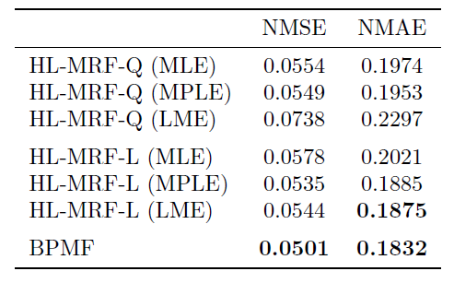
Experiments: Preference Prediction
Table 1. Normalized mean squares/absolute error for preference prediction using the Jester dataset
Bach et al., UAI 2013

Slide 85
Experiments: Image Reconstruction
Understand how pixels relate to each other
Encode agreement or disagreement between neighboring pixels
Bach et al., UAI 2013

Slide 86
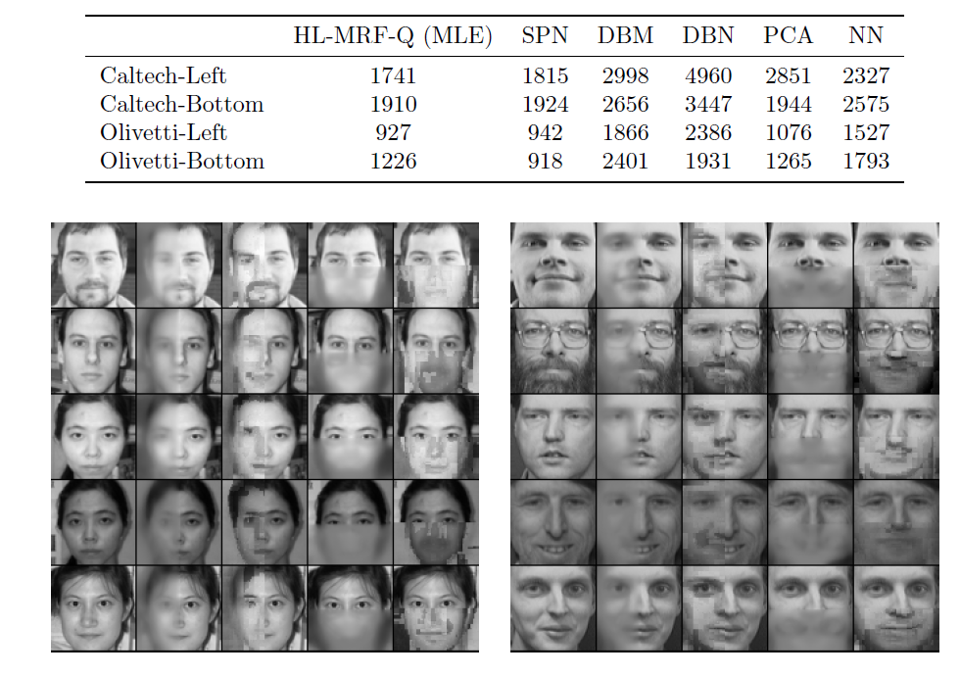
Experiments: Image Reconstruction
Bach et al., UAI 2013

Slide 87
Conclusion
HL-MRFs are flexible and interpretable class of models
The MPE inference algorithm introduced is applicable to the full class of HL-MRFs.
The natural mapping between hinge-loss potentials and logic rules makes HL-MRFs easy to interpret

Slide 88
References
S. Bach, M. Broecheler, L. Getoor, and D. O'Leary. Scaling MPE inference for constrained continuous Markov random fields with consensus optimization. In Neural Information Processing Systems, 2012.
J. Besag. Statistical analysis of non-lattice data. Journal of the Royal Statistical Society, 24(3): 179{195, 1975.
S. Boyd, N. Parikh, E. Chu, B. Peleato, and J. Eckstein. Distributed optimization and statistical learning via the alternating direction method of multipliers. Foundations and Trends in Machine Learning, 3(1), 2011.

Slide 89
References
M. Broecheler, L. Mihalkova, and L. Getoor. Probabilistic similarity logic. In Uncertainty in Artificial Intelligence, 2010.
B. Huang, A. Kimmig, L. Getoor, and J. Golbeck. A flexible framework for probabilistic models of social trust. In Conference on Social Computing, Behavioral-Cultural Modeling, & Prediction, 2013.
H. Poon and P. Domingos. Sum-product networks: A new deep architecture. In Uncertainty in Artificial Intelligence, 2011.

Slide 90
References
M. Richardson and P. Domingos. Markov logic networks. Machine Learning, 62(1-2):107-136, 2006.
R. Salakhutdinov and A. Mnih. Bayesian probabilistic matrix factorization using Markov chain Monte Carlo. In International Conference on Machine Learning, 2008.
A. Kimmig, S. Bach, M. Broecheler, B. Huang, and L. Getoor. A short introduction to probabilistic soft logic. In NIPS Workshop on Probabilistic Programming: Foundations and Applications, 2012.

Slide 91

Thank You !

