Slide 1
Variational Inference
David Lee, Jiaxin Su, Shuwen (Janet) Qiu
CS 249 – 3
Feb 11th, 2020

Slide 2
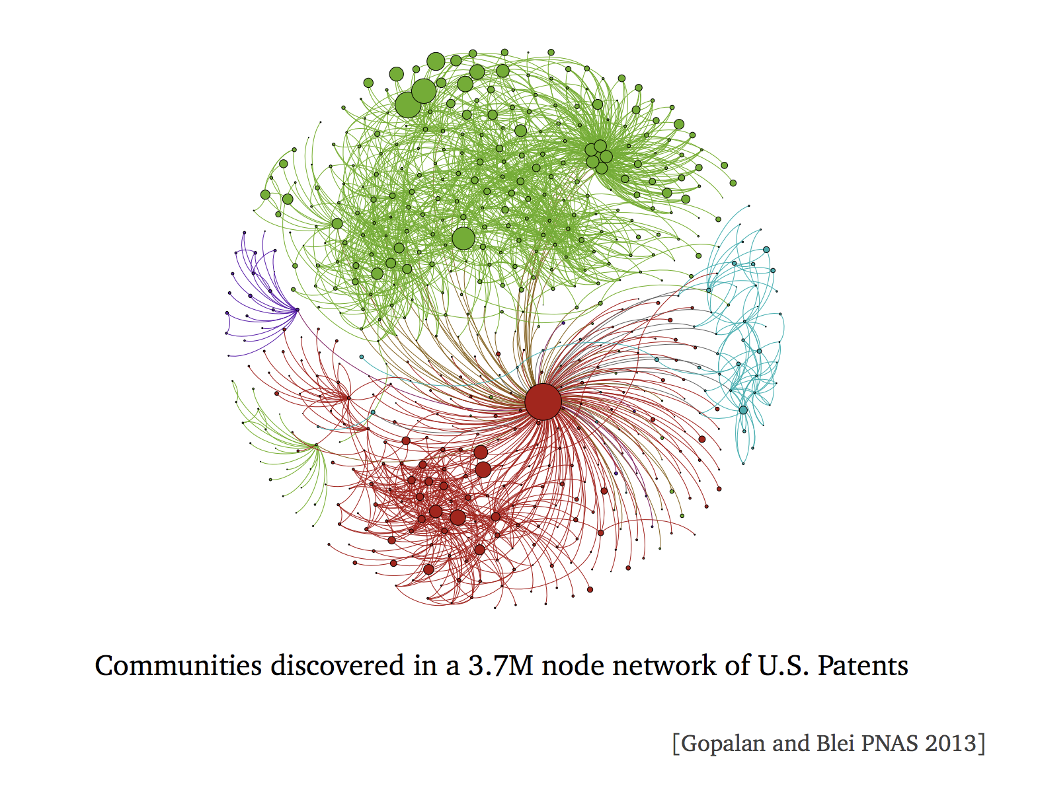

Slide 3
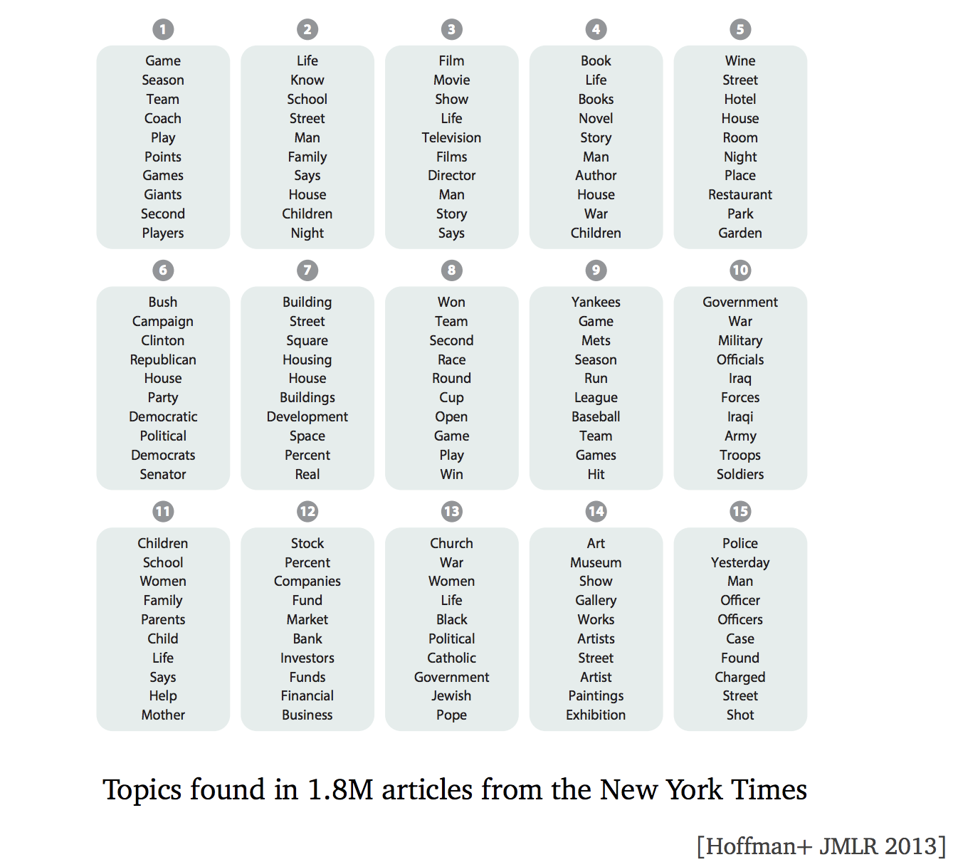

Slide 4
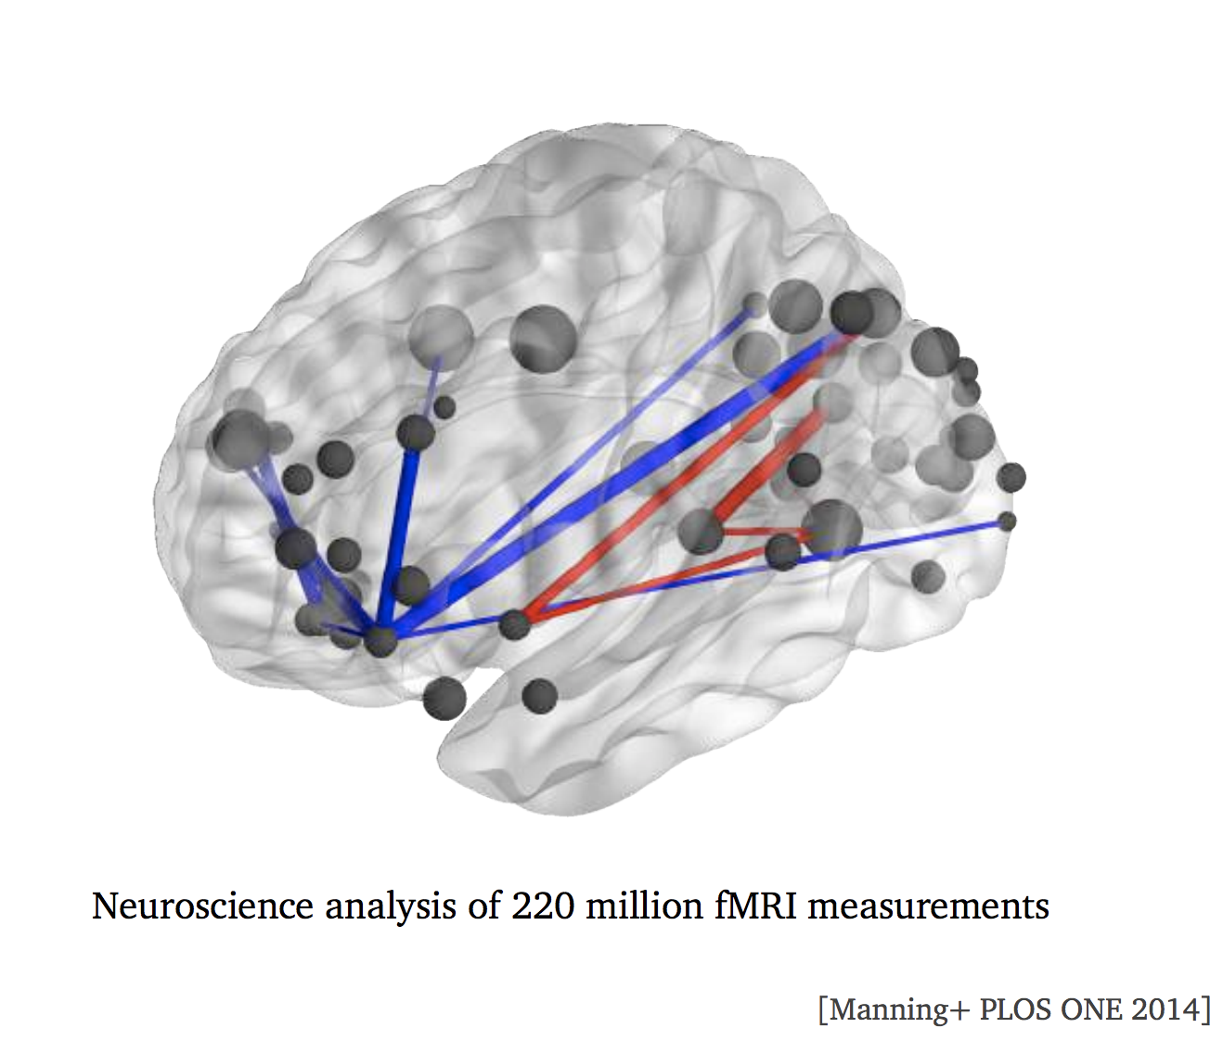

Slide 5
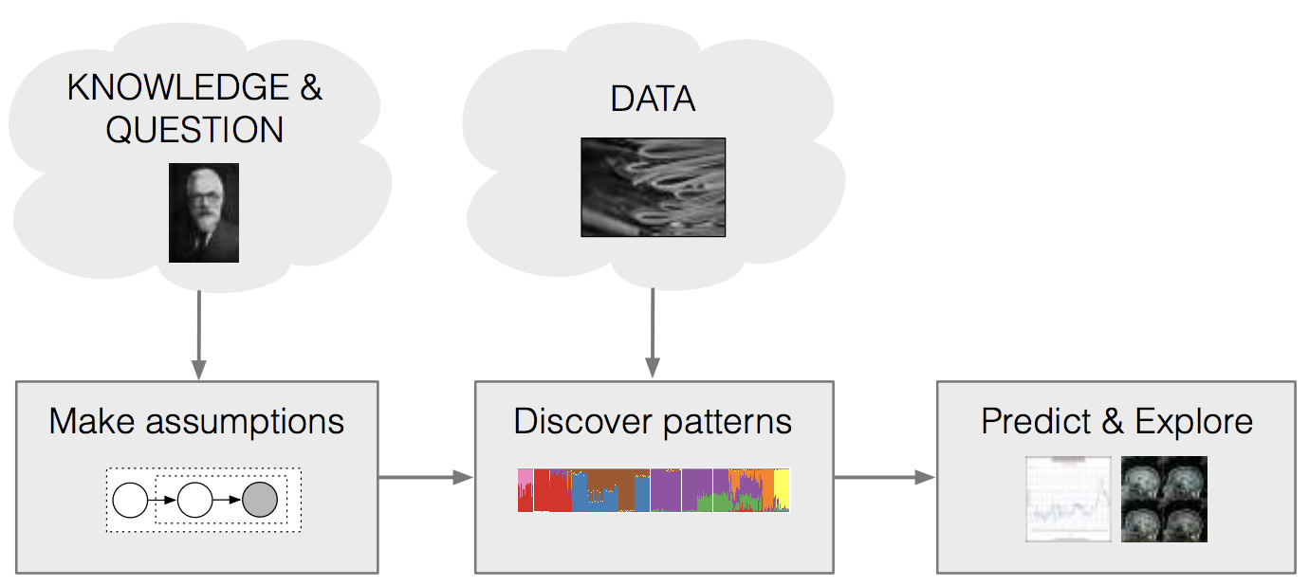
The Probabilistic Pipeline
Customized data analysis is important to many fields
Pipeline separate assumption, computations, applications
Eases collaborative solutions to machine learning problems

Slide 6
The Probabilistic Pipeline
Posterior inference is the key algorithm problem
What does this model say about this data?
Want: general and scalable approaches to posterior inference

Slide 7
Probabilistic Machine Learning

Slide 8
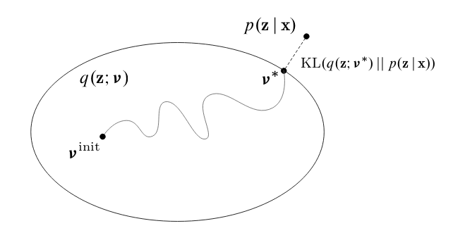
Variational Inference
VI solves inference with optimization (Contrast this with MCMC)
Posit a variational family of distributions over the latent variables,
q(z; v)
Fit the variational parameters v to be close (in KL) to the exact posterior

Slide 9
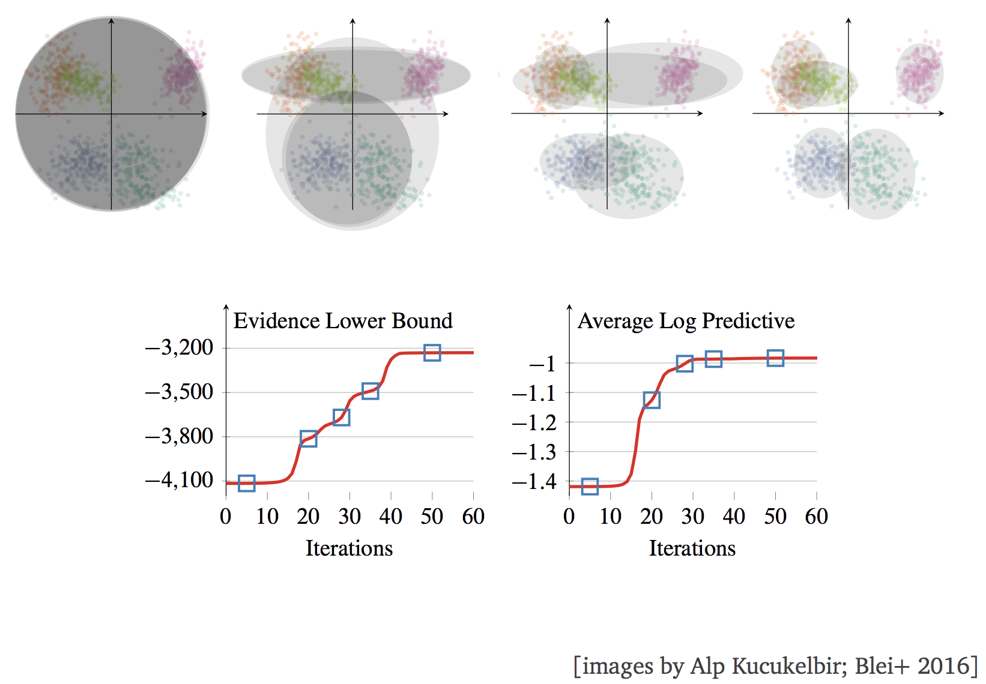
Ex: Mixture of Gaussians

Slide 10
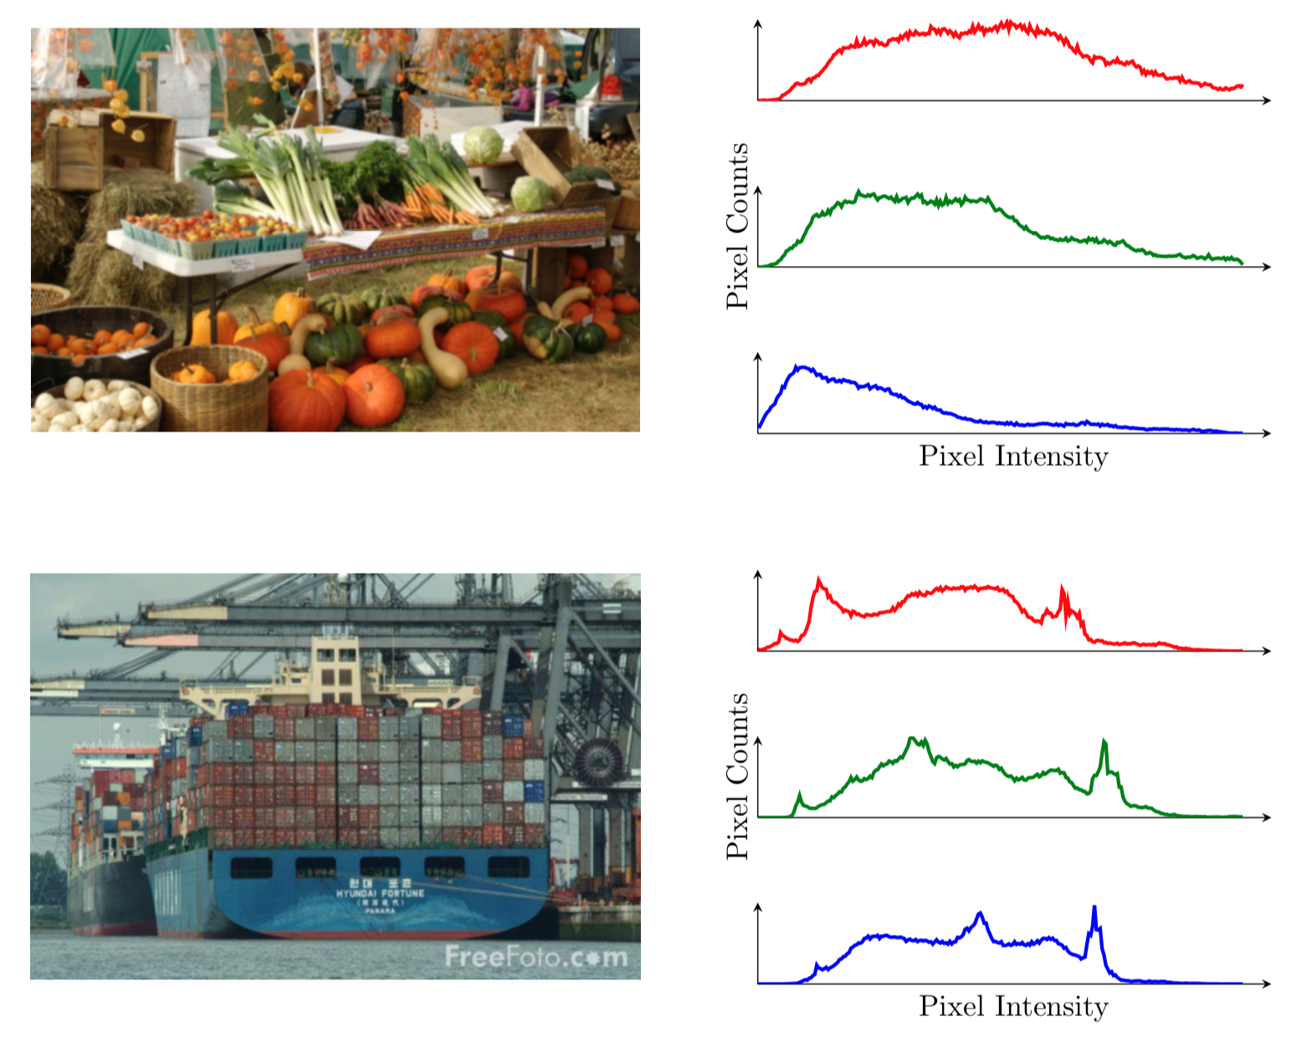
Ex: Mixture of Gaussians
Consider a real-world example: classify pictures category based on their color histograms.

Slide 11
Ex: Mixture of Gaussians
Formulation:
For each data point $i$, we first assign a category, $c_{i} \sim Categorical\left(\frac{1}{K}, …,\frac{1}{K}\right) i=1, …, n$
In each category $k$, the histogram follows a Gaussian distribution $μ_{k} \sim 𝒩\left(0, σ^{2}\right) k=1, …, K$
Therefore, each data point is drawn from a Gaussain distribution $x_{i}|c_{i}, μ\sim 𝒩\left(c_{i}^{T}μ, 1\right) i=1, …, n$
What we want to compute
$$p(μ, c|x)$$

Slide 12
Mean-field Variational Inference

Slide 13
The KL divergence
The KL divergence between two distributions is
It is non-negative,
$KL(q|\left|p\right)≥0$ (equals 0 when q = p)
It is not symmetric,
$$KL(q|\left|p\right)≠KL(p|\left|q\right)$$
Our objective is

Slide 14
The Evidence Lower Bound (ELBO)
Define
When we expand the KL divergence, we see
Maximizing the ELBO minimizes the KL divergence
Rearrange to write the log evidence as
The ELBO is a lower bound for the log evidence

Slide 15
So Far…
Our new objective:
Now we need to specify the form of the variational family

Slide 16
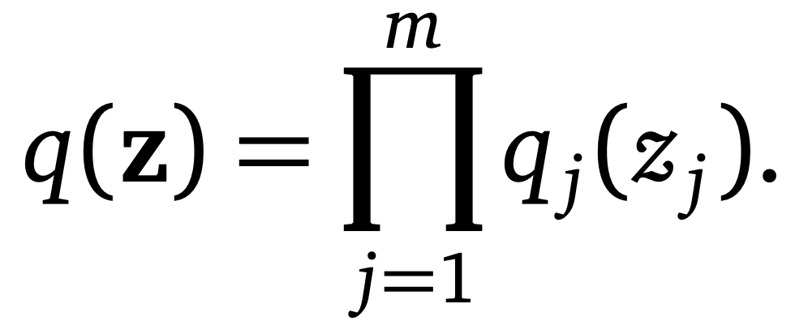
Mean-field Variational Inference
A generic member of the mean-field family is
Properties:
Latent variables mutually independent. Can be fully factorized
Each latent variable governed by a distinct variational factor $q_{j}\left(z_{j}\right)$ in the variational density q$\left(z\right)$

Slide 17
Mean-field Variational Inference
Our problem is now fully specified
Our new objective
Specified $q(z)$ to be in the mean-field family
General strategy for optimizing the ELBO:
Maximize with respect to each of the variational factors $q_{j}\left(z_{j}\right)$ at a time, holding all others fixed
i.e. coordinate ascent

Slide 18
Mean-field Variational Inference

Slide 19
Mean-field Variational Inference
We find the updates for the variational factors
Special case if each complete conditional $\log{p\left(z_{j}\right|z_{−j}, x)}$ is in the exponential family, i.e.
Then,
Each factor is from the same exponential family as the complete conditional
Can easily read updates to the parameters for the variational factors

Slide 20
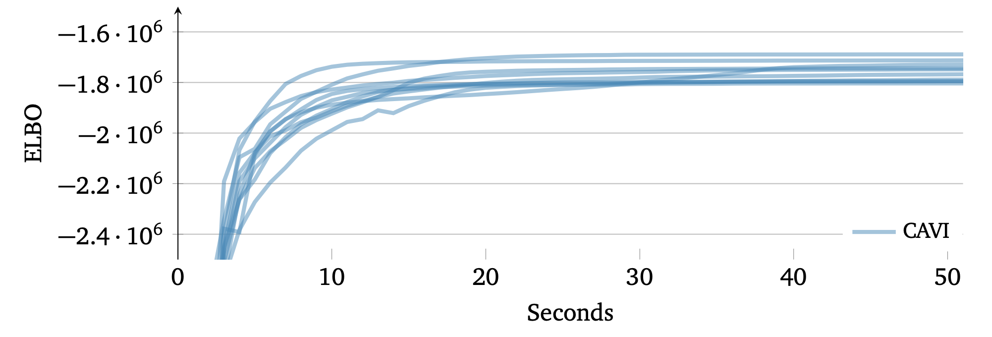
Caveats
ELBO is generally non-convex

Slide 21
Caveats
Coordinate ascent requires iterating through entire data set at each iteration;
Does not scale to massive data

Slide 22
Stochastic Variational Inference
Stochastic gradient-based optimization
With noisy gradients, update:
Requires unbiased gradients,
If done right, guaranteed to converge to local optimum

Slide 23
A Complete Example:
Mixture of Gaussians

Slide 24
VI to the Mixture of Gaussian Example
Recap the model
$$μ_{k} \sim 𝒩\left(0, σ^{2}\right) k=1, …, K$$
$$c_{i} \sim Categorical\left(\frac{1}{K}, …,\frac{1}{K}\right) i=1, …, n$$
$$x_{i}|c_{i}, μ\sim 𝒩\left(c_{i}^{T}μ, 1\right) i=1, …, n$$
What we want to compute
$$p(μ, c|x)$$

Slide 25
Write the ELBO
Mean-field: considering the latent variables are independent with each other
$$q\left(μ, c\right)=\prod_{k=1}^{K}{q(μ_{k};m_{k}, s_{k}^{2}})\prod_{i=1}^{n}{q(c_{i};φ_{i})}$$
ELBO
Considering $p\left(μ, c, x\right)=p\left(μ\right)\prod_{i=1}^{n}{p\left(c_{i}\right)p(x_{i}|c_{i}, μ)}$
$$ELBO\left(q\right)=E\left[\log{p\left(z,x\right)}\right]−E\left[logq\left(z\right)\right]$$
$$=\sum_{k=1}^{K}{E\left[logp\left(μ_{k}\right);m_{k}, s_{k}^{2}\right]+\sum_{i=1}^{n}{\left(E\left[logp\left(c_{i}\right);φ_{i}\right]+E\left[logp\left(x_{i} | c_{i}, μ\right);φ_{i}, m, s^{2}\right]\right)−\sum_{i=1}^{n}{E\left[logq\left(c_{i}, φ_{i}\right)\right]−\sum_{k=1}^{K}{E[logq\left(μ_{k};m_{k}, s_{k}^{2}\right)]}}}}$$
Notes:
How to compute p(z,x) in general case

Slide 26
Applying Algorithm
Applying the previous result
$$q_{j}^{∗}\left(z_{j}\right)∝exp⁡\{E_{−j}[\log{p\left(z_{j}, z_{−j}, x\right)}\}$$
$$q^{∗}\left(c_{i};φ_{i}\right)∝\exp\left\{logp\left(c_{i}\right)+E\left[\log{p\left(x_{i} | c_{i}, μ\right)};m, s^{2}\right]\right\}$$
$$p\left(x_{i} | c_{i}, μ\right)=\prod_{k=1}^{K}{{p(x_{i}|μ_{k})}^{c_{ik}}}$$
$$E[logp\left(x_{i} | c_{i}, μ\right)=\sum_{k}{c_{ik}E[\log{p\left(x_{i} | μ_{k}\right);m_{k},s_{k}^{2}]}}$$
Notes:
Logp(c_i)

Slide 27
Applying Algorithm
Compute parameters for categorical distribution
$$E[logp\left(x_{i} | c_{i}, μ\right)]=\sum_{k}{c_{ik}E[\log{p\left(x_{i} | μ_{k}\right);m_{k},s_{k}^{2}]}}$$
$$=\sum_{k}{c_{ik}E\left[−\frac{{\left(x_{i}−μ_{k}\right)}^{2}}{2};m_{k}, s_{k}^{2}\right]+const}$$
$$=\sum_{k}{c_{ik}E\left[μ_{k};m_{k},s_{k}^{2}\right]x_{i}−E[μ_{k}^{2};m_{k}, s_{k}^{2}]/2)+const}$$
$$φ_{ik}∝exp⁡\{E\left[μ_{k};m_{k}, s_{k}^{2}\right]x_{i}−\frac{E\left[μ_{k}^{2};m_{k}, s_{k}^{2}\right]}{2}\}$$
Notes:
How to compute E[]

Slide 28
Applying Algorithm
Applying the previous result
$$q_{j}^{∗}\left(z_{j}\right)∝exp⁡\{E_{−j}[\log{p\left(z_{j}, z_{−j}, x\right)}\}$$
$$q^{∗}\left(μ_{k}\right)∝\exp{\{logp\left(μ_{k}\right)+\sum_{i=1}^{n}{E[logp\left(x_{i} | c_{i}, μ\right);φ_{i}, m_{−k}, s_{k}^{2}]\}}}$$
$$logp\left(μ_{k}\right)=−\frac{μ_{k}^{2}}{2σ^{2}}+const$$

Slide 29
Applying Algorithm
Computing parameters in Gaussian distribution
$$\sum_{i=1}^{n}{E[logp\left(x_{i} | c_{i}, μ\right);φ_{i}, m_{−k}, s_{k}^{2}]\}}=\sum_{i}{E[logp\left(x_{i} | c_{i}, μ\right);φ_{i}, m_{−k}, s_{−k}^{2}]}$$
$$=\sum_{i}{E[c_{ik}\log{p\left(x_{i} | μ_{k}\right)};φ_{i}]}$$
$$=\sum_{i}{φ_{ik}(−\frac{{\left(x_{i}−μ_{k}\right)}^{2}}{2})}$$
$$logq\left(μ_{k}\right)=(\sum_{i}{φ_{ik}x_{i})μ_{k} −(\frac{1}{2}σ^{2}+\sum_{i}{φ_{ik}/2)μ_{k}^{2}}}+const$$

Slide 30
Applying Algorithm
Computing parameters in Gaussian distribution
$$logq\left(μ_{k}\right)=(\sum_{i}{φ_{ik}x_{i})μ_{k} −(\frac{1}{2}σ^{2}+\sum_{i}{φ_{ik}/2)μ_{k}^{2}}}+const$$
$q\left(μ_{k}\right)$ forms a Gaussian distribution
$$μ_{k}= \frac{\sum_{i}{φ_{ik}x_{i}}}{\frac{1}{σ^{2}}+\sum_{i}{φ_{ik}}} , s_{k}^{2}= \frac{1}{\frac{1}{σ^{2}}+\sum_{i}{φ_{ik}}}$$

Slide 31
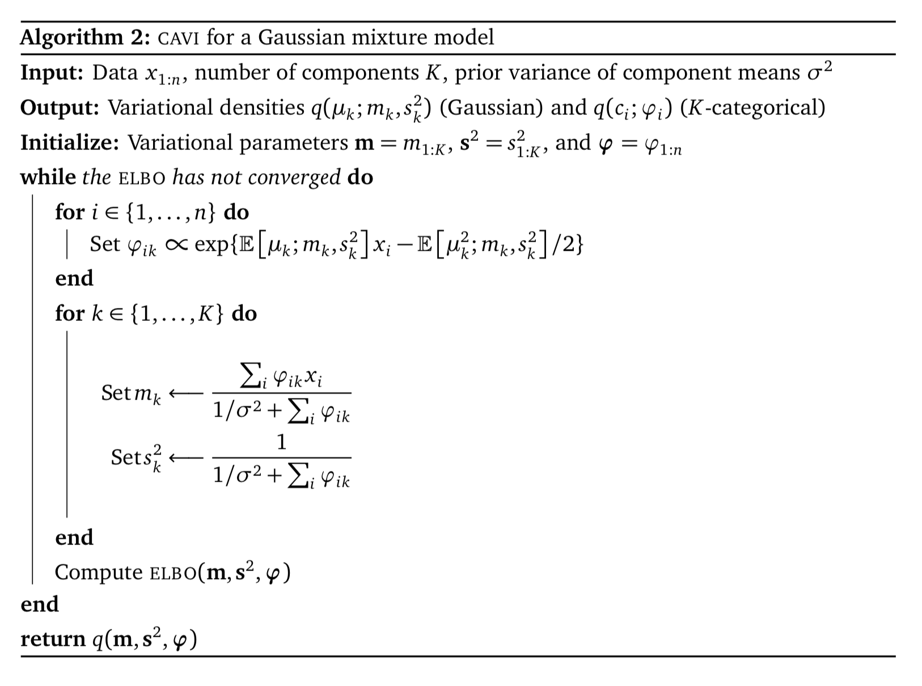
Summary

Slide 32
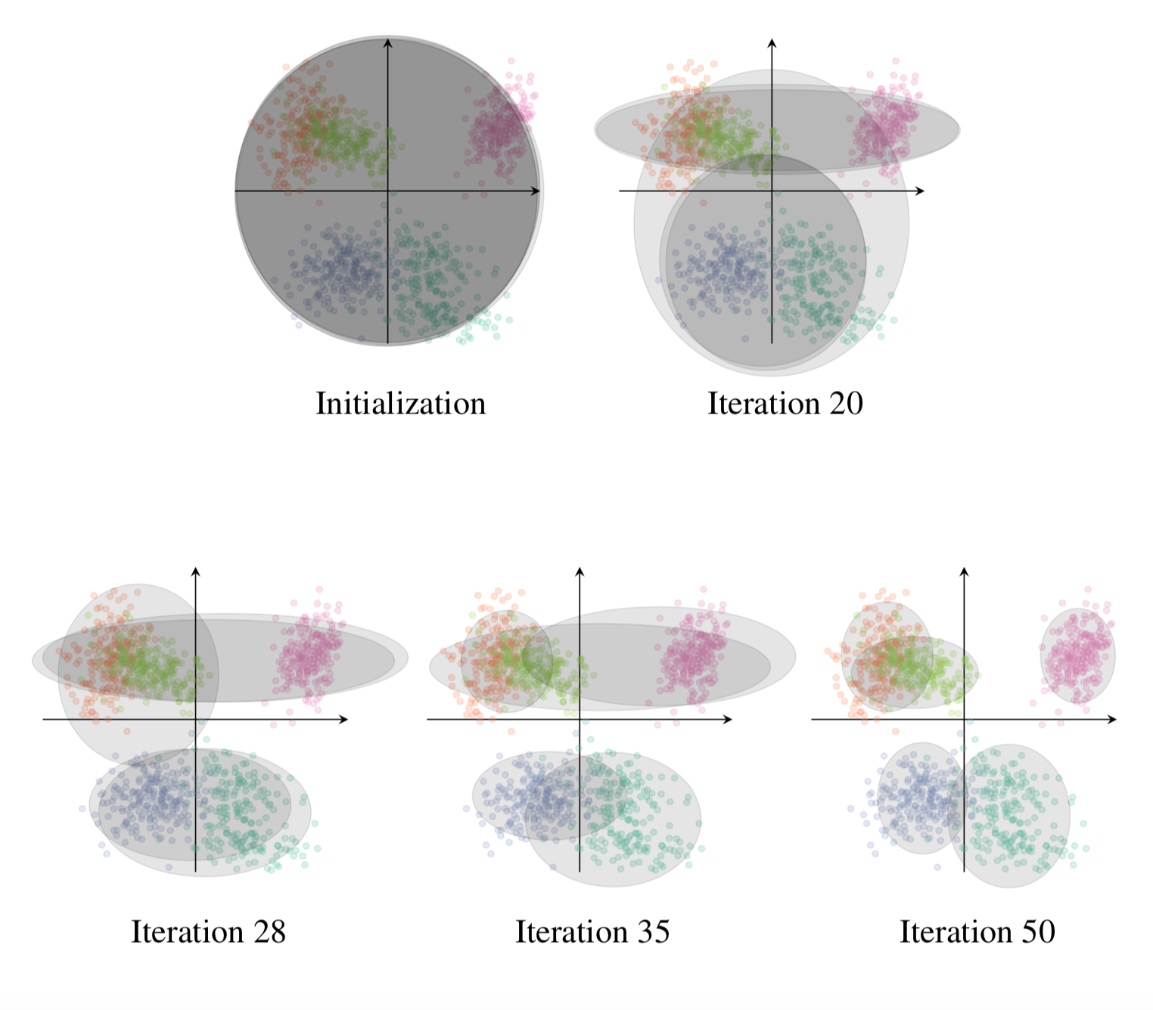
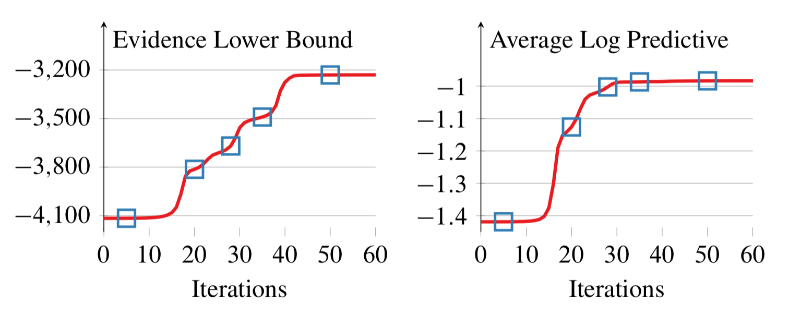
Empirical Study

Slide 33
Limitations
Mean-field family makes strong independence assumptions
Help with scalable optimization
Limit the expressibility of the variational family
Exacerbate issues with local optima of the objectives
Underestimate posterior variance
The interface between VI and MCMC is relatively unexplored
The statistical properties of VI are not yet well-understood, in contrast to the rich analysis of MCMC techniques

Slide 34
Credits
Variational Inference: A Review for Statisticians
https://arxiv.org/abs/1601.00670
Variational Inference: Foundations and Innovations
https://econ.columbia.edu/wp-content/uploads/sites/41/2019/07/Blei_VI_tutorial-compressed.pdf

Slide 35
Thank You!

Slide 36
Problems
In your own words, describe the motivation and intuition underlying variational inference. Then, describes the steps for using mean-field variational inference to approximate a distribution.
Write the coordinate ascent update $q_{j}{\left(z_{j}\right)}^{∗}$ if each complete conditional $p(z_{j}|z_{−j}, x)$ is in the exponential family. (i.e. $p\left(z_{j} | z_{−j}, x\right)=h\left(z_{j}\right)\exp\left\{η{\left(θ\right)}^{T}T\left(z_{j}\right)−A\left(η(θ)\right)\right\})$
Compare and contrast variational inference with the EM algorithm.

