Slide 1
Markov Logic Network
Team: Panda
Karen Quadros
Purit Punyawiwat
Srishti Majumdar

Slide 2
Markov Logic Networks
Components : Markov Networks + First Order Logic
Markov Networks: Undirected graphical model describing a set of variables satisfying the Markov property. As a probabilistic graphical model, it enables efficient handling of uncertainty.
First Order Logic: Enables compact representation of a wide
variety of knowledge.
Notes:
Weighted first order logic : syntax
Formulas treated as Templates for markov nets: semantics
Markov networks:
Smoking - Cancer-Asthma +COughing
Graph gives structure
Params give potential fns phi (xi) =1/Z (Pi over phi c (Xi) )
Z=Sum over all c
phi(s,c) cover t,f cases for smoking cancer dependency [potential state of smoking cancer relation]
probability of state of world is product of all potential fns normalised (if clique size large intractable.)
if size large can use log linear form of function, exp(sum over i wifi) weight of feature (not smoking or cancer) fi=1 if 0
provides compact representations.
0.51 do and see

Slide 3
Markov Networks
Smoking
Smoking | Cancer | Ф(S,C)
False | False | 4.5
False | True | 4.5
True | False | 2.7
True | True | 4.5
Cancer

Slide 4
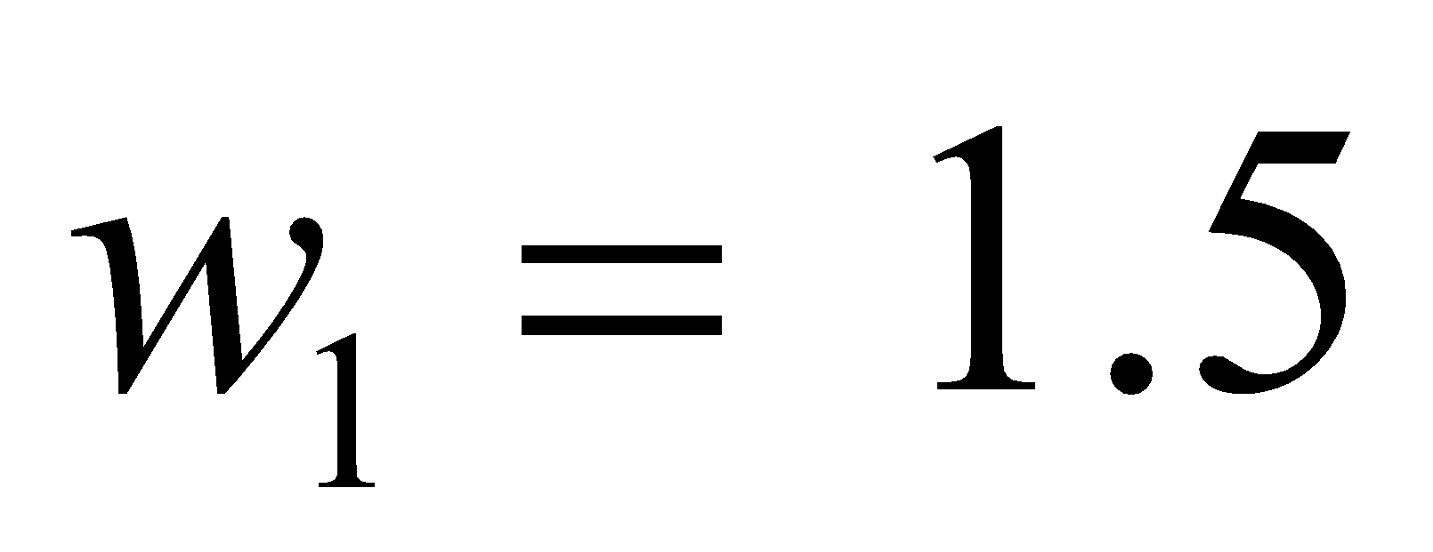
Markov Networks
Log Linear Model:
Smoking
Weight of Feature i
Feature i
Cancer

Slide 5
First Order Logic
Constants, variables, functions, predicates
E.g.: Anna, x, MotherOf(x), Friends(x,y)
Grounding: Replace all variables by constants
E.g.: Friends (Anna, Bob)
World (model, interpretation): Assignment of truth values to all ground predicates
Notes:
Operations like conjunctions disjunctions quantifiers
predicates properties+relations
Wrld possible world assigning truth values to all ground values over possible worlds
first-order logic (like natural language) assumes the world contains • Objects: people, houses, numbers, theories, Ronald McDonald, colors, baseball games, wars, centuries . . . • Relations: red, round, bogus, prime, multistoried . . ., is the brother of, is bigger than, is inside, is part of, has color, occurred after, owns, comes between, . . . • Functions: father of, best friend, third inning of, one more than, end of

Slide 6
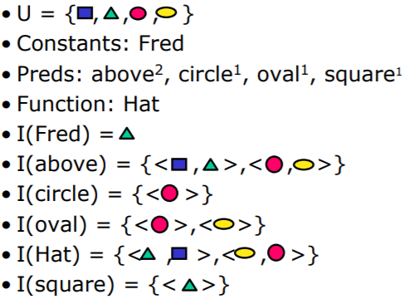
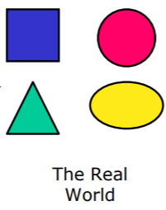
First Order Logic
Notes:
square (fred) true
above (fred, hat(fred)) false

Slide 7
Motivation
Many Applications like social network analysis, object classification, etc can benefit from the use of MN and FOL together.
MLN benefits the Markov network by allowing a compact language to describe very large networks and integrate a lot of domain knowledge.
MLN benefits FOL applications by incorporating a robust method to handle uncertainty and soften constraints.
Notes:
loA gical KB is a set of hard constraints on the set of possible worlds
Let’s make them soft constraints When a world violates a formula It becomes less probable, not impossible
Give each formula a weight
Applications: Information extraction* Link prediction Collective classification Web mining Natural language processing
Eg in social network analysis all friends have similar smoking habits
for all x,y friends(x,y) implies (bi implication of smokes(x) and smokes(y))

Slide 8
Definition
A Markov Logic Network (MLN) is a set of pairs (F, w) where
F is a formula in first-order logic
w is a real number
Together with a set of constants C, it defines a Markov network with
One node for each grounding of each predicate in the MLN
One feature for each grounding of each formula F in the MLN, with the corresponding weight w

Slide 9
Markov Logic Networks
A logical KB is a set of hard constraints on the set of possible worlds
Let’s make them soft constraints: When a world violates a formula, it becomes less probable, not impossible
Give each formula a weight: Higher weight ⇒ Stronger constraint

Slide 10
Example: Friends & Smokers

Slide 11
Example: Friends & Smokers

Slide 12
Example: Friends & Smokers

Slide 13
Example: Friends & Smokers
Two constants: Anna (A) and Bob (B)

Slide 14
Example: Friends & Smokers
Two constants: Anna (A) and Bob (B)
Smokes(A)
Smokes(B)
Cancer(A)
Cancer(B)

Slide 15
Example: Friends & Smokers
Two constants: Anna (A) and Bob (B)
Friends(A,B)
Friends(A,A)
Smokes(A)
Smokes(B)
Friends(B,B)
Cancer(A)
Cancer(B)
Friends(B,A)

Slide 16
Example: Friends & Smokers
Two constants: Anna (A) and Bob (B)
Friends(A,B)
Friends(A,A)
Smokes(A)
Smokes(B)
Friends(B,B)
Cancer(A)
Cancer(B)
Friends(B,A)

Slide 17
Example: Friends & Smokers
Two constants: Anna (A) and Bob (B)
Friends(A,B)
Friends(A,A)
Smokes(A)
Smokes(B)
Friends(B,B)
Cancer(A)
Cancer(B)
Friends(B,A)

Slide 18
Factor Graph
Two constants: Anna (A) and Bob (B)
Friends(A,B)
Friends(A,B)
Friends(A,A)
Smokes(A)
Smokes(B)
Friends(B,B)
Friends(A,A)
Smokes(A)
Cancer(A)
Cancer(B)
Cancer(A)
Friends(B,A)

Slide 19
Probability Distribution Over World X
w_{i}(x) = the weight of the formula
n_{i}(x) = number of true grounding in formula i
x_{{i}} = the truth value of atoms appearing in formula i

Slide 20
Assumptions Made With MLN
Assumption 1- Unique names.
Different names refer to different objects.
Assumption 2- Domain closure.
The only objects in the domain are those representable using the constant and function symbols in (L,C).
Assumption 3- Known functions.
For each function appearing in L, the value of that function applied to every possible tuple of arguments is known, and is an element of C.
We can remove these assumptions in case we want to, but in general, these assumption do make sense.

Slide 21
Removing Assumption 1
Introduce equality predicate Equals(x,y) or x=y
Adding necessary axioms (reflexive, symmetric, and transitive)
For each unary predicate P,
This allows us to make equality of two constants which will be useful in using it for object detection.
Assumption 1- Unique names
Different names refer to different objects.

Slide 22
Removing Assumption 2
Assumption 2- Domain closure
The only objects in the domain are those representable using the constant and function symbols in (L,C).
Number of u unknown object is known; we can remove it by introducing u new constants.
Number of u unknown object is unknown but finite; we can introduce a distribution over u, grounding the MLN with each number of unknown objects, and computing the probability of a formula F as

Slide 23
Removing Assumption 3
Assumption 3- Known functions
For each function appearing in L, the value of that function applied to every possible tuple of arguments is known, and is an element of C.
Let H_{L,C} be the set of all ground terms constructible from the function symbols in L and the constants in C.
We can remove this by treating elements in H_{L,c} as an additional constant.
Eg.: Function G(x) and constant A,B. G(A) = A, G(A) = B
We will have infinite number of new constants. However, we can limit the number of nesting.

Slide 24
FOL As A Special Case of MLN
First Order Logic (with assumptions 1-3) is the special case of MLNs obtained when all weights are equal and tend to infinity!
Let KB be a satisfiable knowledge base, L be the MLN obtained by assigning weight w to every formula in KB, C be the set of constants appearing in the KB, P_{w}(x) be the probability assigned to a (set of) possible worlds(s) x by M_{L,C}, X_{KB} be the set of worlds that satisfy KB, and F be an arbitrary formula in first order logic, then:

Slide 25
Implications of FOL as a Special Case of MLN
In the limit of all equal infinite weights, the MLN represents a uniform distribution over the worlds that satisfy the KB, and all entailment queries can be answered by computing the probability of the query formula and checking whether it is 1.
Even when weights are finite, first-order logic is “embedded” in MLNs.

Slide 26
Example: How MLNs Generalize FOL
Consider an MLN containing the single formula ∀x S(x) => C(x) with weight w, and C = {A}.
This leads to four possible worlds:
Smokes(A) | Cancer(A) | f_{i}(S(A),C(A))
￢S(A) | ￢C(A) | T
￢S(A) | C(A) | T
S(A) | ￢C(A) | F
S(A) | C(A) | T

Slide 27
From Equation 3,
we obtain P({ S(A),￢C(A)}) = 1/(3e^{w} + 1)
Thus, if w>0, the effect of the MLN is to make the world that is inconsistent with ∀x S(x) => C(x) less likely than the other three.
If we try to compute the conditional
P(C(A)|S(A)) = P( S(A) ^ C(A) )/∑_{C(A),￢C(A)}P( S(A) , . )
= 1/(1+e^{-w})
In the limiting case when w->∞ , P(C(A)|S(A)) = 1/(1+e^{-w}), evaluates to 1.
Thus we recover thee logical entailment.

Slide 28
Conditional Inference
P(Formula|MLN,C) = ?
MCMC: Sample worlds, check formula holds
P(Formula1|Formula2,MLN,C) = ?
If Formula2 = Conjunction of ground atoms
First construct min subset of network necessary to answer query (generalization of KBMC)
Then apply MCMC

Slide 29
Example Grounding
Friends(A,B)
Friends(A,A)
Smokes(A)
Smokes(B)
Friends(B,B)
Cancer(A)
Cancer(B)
Friends(B,A)
P( Cancer(B) | Smokes(A), Friends(A,B), Friends(B,A))

Slide 30
Example Grounding
Friends(A,B)
Friends(A,A)
Smokes(A)
Smokes(B)
Friends(B,B)
Cancer(A)
Cancer(B)
Friends(B,A)
P( Cancer(B) | Smokes(A), Friends(A,B), Friends(B,A))

Slide 31
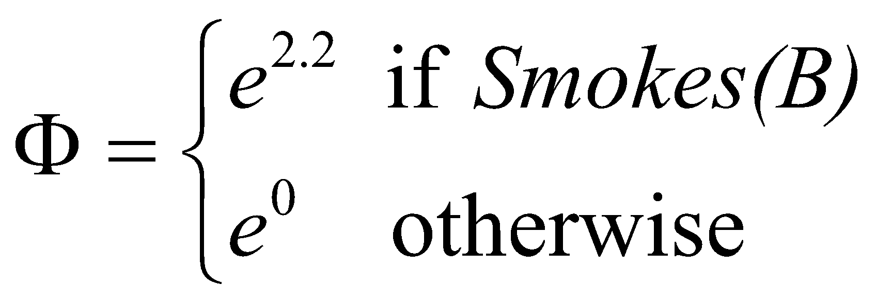
Example Grounding
Friends(A,B)
Friends(A,A)
Smokes(A)
Smokes(B)
Friends(B,B)
Cancer(A)
Cancer(B)
Friends(B,A)
P( Cancer(B) | Smokes(A), Friends(A,B), Friends(B,A))

Slide 32
Gibbs Sampling
After we get the subset of our network to answer the inference problem, we perform gibbs sampling on that graph.
Steps of gibbs sampling:
Initially assign things to nodes
Sample one node given the markov blanket
Repeat
Use samples to compute P(X)

Slide 33
Gibbs Sampling
The final probability becomes this formula:
Where f_{i} is 1 or 0 based on whether the formula evaluates to true or not.
F_{l} corresponds to the set of ground formulas X_{l} appears in.

Slide 34
Learning
Data is a relational database
Closed world assumption
Learning structure
Corresponds to feature induction in Markov nets
Learn / modify clauses
Learning parameters (weights)

Slide 35
Learning Weights
Like Markov nets, except with parameter tying over groundings of same formula
∂ log P_{w}(X = x) = n_{i}(x) - ∑_{x’}P_{w}(X = x’)n_{i}(x’)
∂w_{i}
1st term: # true groundings of formula in DB
2nd term: inference required, as before (slow!)
Feature count according to data
Feature count according to model

Slide 36
Pseudo-Likelihood [Besag, 1975]
Likelihood of each ground atom given its Markov blanket in the data
Does not require inference at each step

Slide 37
Experimental Setup
University of Washington CSE Dept.
12 first-order predicates: Professor, Student, TaughtBy, AuthorOf, AdvisedBy, etc.
2707 constants divided into 10 types: Person (442), Course (176), Pub. (342), Quarter (20), etc.
4.1 million ground predicates

Slide 38
Systems Compared
Hand-built knowledge base (KB)
ILP: CLAUDIEN [De Raedt & Dehaspe, 1997]
Markov logic networks (MLNs)
Using KB
Using CLAUDIEN
Using KB + CLAUDIEN
Bayesian network learner [Heckerman et al., 1995]
Naïve Bayes [Domingos & Pazzani, 1997]

Slide 39
Sample Clauses in KB
Students are not professors
Each student has only one advisor
If a student is an author of a paper, so is her advisor
Advanced students only TA courses taught by their advisors
At most one author of a given paper is a professor

Slide 40
Results

Slide 41
Future Works
Inference
Develop more efficient ways to do inference rather than MCMC
Lifted inference (Most of the new works uses this with MLN)
Learning
Develop algorithms for learning and revising the structures of MLNs by directly optimizing pseudo likelihood
Applications
Apply it to other areas including NLP, social network analysis, computational biology, etc.

Slide 42
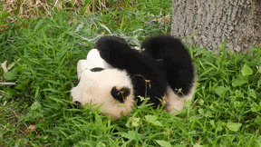
Conclusion
MLN combines probability and first order logic together.
MLN provides a template for a Markov Network.
Inference is done by only taking the neighbors and performing Gibbs sampling on that network.
Learning is done by optimizing a pseudo likelihood measure.

Slide 43
Our Insights

Slide 44
Reference
https://homes.cs.washington.edu/~pedrod/papers/mlj05.pdf
https://ocw.mit.edu/courses/electrical-engineering-and-computer-science/6-825-techniques-in-artificial-intelligence-sma-5504-fall-2002/lecture-notes/Lecture5FinalPart1Save.pdf
https://www.powershow.com/view4/528bc5-ZGYwN/Unifying_Logical_and_Statistical_AI_powerpoint_ppt_presentation
Markov Logic Network Powerpoint from Pedros Domingos

Slide 45
Questions

