Slide 1
Probabilistic Logic Neural Network for Reasoning
Presenters: Zijie Huang, Roshni Iyer, Alex Wang

Slide 2
Agenda
Background
KG, Rule-based methods, Embedding model
Motivation
Problem definition and solutions
Model Description
Framework Overview
E-step
M-step
Optimization
Experiment (Settings & Results)
Conclusions & Future Work
References
Questions

Slide 3
KeyWords
Embedding Model
Knowledge Graph
Markov Logic Network
First-Order Logic

Slide 4
1.
Background

Slide 5
What is a Knowledge Graph? (KG)
“
“
A knowledge graph acquires and integrates information into an ontology and applies a reasoner to derive new knowledge.

Slide 6
From KB to KG
Isa(Lily, Person).
Isa(DaVinci, Person).
Isa(James, Person).
IsInterestedIn(Lily, DaVinci).
Painted(DaVinci, Mona Lisa).
likes(James, Mona Lisa).
IsaFriendOf(Lily, James).
……
https://yashuseth.blog/2019/10/08/introduction-question-answering-knowledge-graphs-kgqa/

Slide 7
More on KG
KB: Ontology
formal naming and definition of the types, properties, and relationships of the entities that really or fundamentally exist for a particular domain
KG is more extensive
Graph structure
Natural language way to represent relationships
Easy to infer new relationships (infer new knowledge)

Slide 8
More on KG
Each relationship can be expressed as a triplet = (h, r, t)
Meaning entity h has relation r to entity t
However, in most cases, knowledge graphs can be sparse, meaning that there are a lot of triplets that are not observed
It becomes important to leverage the limited observed triplets to infer the unobserved triplets, such as:
Missing Entities: (h, r, ?) or (?, r, t).
Link Prediction: (h, ?, t)
Reasoning: (h, r, t) = confidence score

Slide 9
Problem Definition
For a given KG denoted (E, R, O) where E is a set of entities, R is a set of relations, and O is a set of observed triplets (h, r, t). The problem can be formulated in a probabilistic way as the following:
Each triplet (h, r, t) has a binary indicator variable v _{(h, r, t)} , where v _{(h, r, t)} = 1 indicates (h, r, t) is true, and 0 otherwise
The goal is that given some true facts O
We aim to predict the labels of hidden triplets H

Slide 10
Two Main Approaches
Rule-based approach
Model using logic rules and conditional random fields
Embedding approach
Model through the operation of vectors, representing the entities and relations, in a vector space

Slide 11
Rule-Based Approach (MLN)
Incorporating domain knowledge by first-order logic
Composition Rules
Inverse Rules
Symmetric Rules
Subrelation Rules

Slide 12
Recap: Markov Logic Network

Slide 13
Recap: Markov Logic Network
Tried to model the probabilities so that it can predict whether a particular world (consists of a set of facts) is satisfied in a KB
A logical KB is a set of hard constraints on the set of possible worlds
It uses sampling method in order to perform inference
Markov Chain Monte Carlo (MCMC)
In this paper, we are modeling the probabilities of a Knowledge Graph, which can be viewed as a graph representation of the facts in a KB

Slide 14
Rule-Based Approach (MLN)
Predicting missing triplets by inferring the posterior distribution
Using MCMC or Loopy Belief Propagation

Slide 15
Embedding Approach
Each entity e ∈ E and relation r ∈ R is associated with an embedding xe and xr
The joint distribution of all triplets can be defined as:
Where f( . , . , . ) is the scoring function on the entity and relation embeddings that computes the probability of the triplet (h, r, t) being true
Ex: the f used in TransE (a KG embedding model) is formulated as:

Slide 16
Embedding Approach
Idea is to map both entities and relations into a common lower dimensional vector space
The embeddings represented entities and relations capture the semantics behind them, such that their relationship is preserved through translations of vectors, for example
There are a many KG embedding models, though the fundamental concept is the same. The difference is how the define the relationships between the embeddings in the vector space

Slide 17
Motivation
Rule-based methods
Pros: Ability to combine domain knowledge
Cons: Inference is inefficient
Embedding-based methods
Pros: Fast Inference
Cons: Cannot utilize domain knowledge
Proposes the combination of both methods

Slide 18
2.
Model Description

Slide 19
Framework Overview
Method Overview: pLogicNet formulates the joint distribution of all triplets with a Markov logic network, which is trained with the variational EM algorithm.
In E-step, a KGE model infers missing triplets. Knowledge preserved by logic rules can be effectively distilled into the learned embeddings.
In M-step, the weights of the logic rules are updated based on both the observed triplets and those inferred by KGE model. Therefore, KGE model provides extra supervision for weight learning

Slide 20
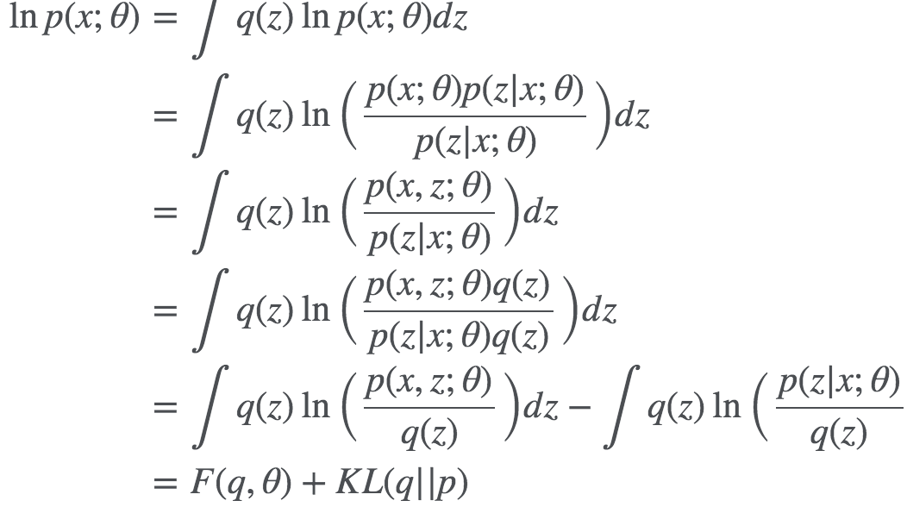
Variational EM
Why Variational EM: The model can be trained by maximizing the log-likelihood of the observed indicator variables log pw(V_{O}). However, directly optimizing the objective is infeasible, as we need to integrate over all the hidden indicator variables v_{H}.
How to approximate log pw(vO):
Comments: 1. Equation holds when
2. When using as q (E-step), we get a tight bound of as KL is 0; In variational EM, we approximate q with for example, mean-field distribution.

Slide 21
Variational EM
E-step: Finding .
Fix pw (weights of each logic rules), update to minimize KL divergence between and (equivalently, maximize ELBO).
M-step: Update pw (weights for each logic rule).
Fix and update pw to maximize the log-likelihood function of all triples.

Slide 22
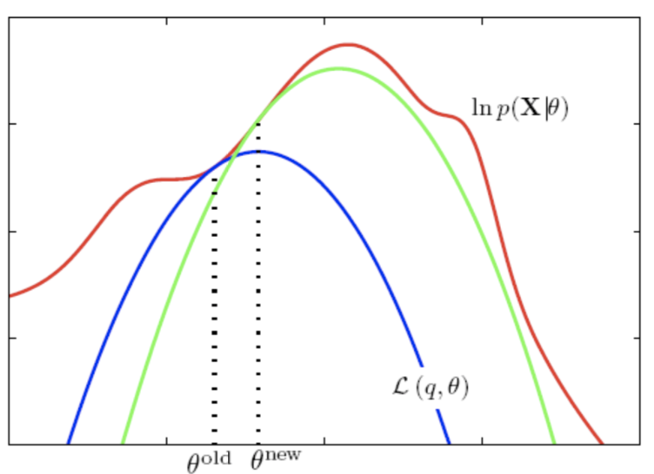
Variational EM
E-step: Finding .
Fix p_{w} (weights of each logic rules), update to minimize KL divergence between and (equivalently, maximize ELBO).
M-step: Update pw (weights for each logic rule).
Fix and update p_{w} to maximize the log-likelihood function of all triples.

Slide 23
E-step: Inference Procedure
Goal: Fix pw (weights of each logic rules), update to minimize KL divergence between and (or maximize ELBO).
Step 1: Select q to approximate the true posterior distribution with a mean-field distribution.
Step 2: Parameterize with a knowledge graph embedding(KGE) model.

Slide 24
E-step: Inference Procedure
Step 3: By minimize KL divergence between and (or maximize ELBO), optimal is given by a fixed-point condition.
Updates for variational factors in the general case, as introduced in [1].
With Markov Logic Network (MLN), the posterior distribution of each variational factor, is only related to its Markov Blanket:
Source: Variational Inference by Group1, page 19.
https://d1b10bmlvqabco.cloudfront.net/attach/k58ous8s1tj6ud/k17a6ll4v2f5wn/k6gyhbpsh4ti/VI_Slides_Final_Draft.pdf

Slide 25
E-step: Inference Procedure
Step 4: Using stochastic variational inference[1] to find the optimal
Why? Optimal must satisfy the equation below.
But is hard to compute. To simplify the condition, they follow stochastic variational inference to estimate the expectation with a sample
Source: M. D. Hoffman, D. M. Blei, C. Wang, and J. Paisley. Stochastic variational inference. The Journal of Machine Learning Research, 2013.

Slide 26
E-step: Inference Procedure
Step 4: Using stochastic variational inference[1] to find the optimal
How to do? For observed triples, set ; For unobserved triples,
Optimal :

Slide 27
E-step: Inference Procedure
Step 5: Learning optimal based on
Understanding: for each triple (h, r, t), the knowledge graph embedding model predicts through the entity and relation embeddings ;
The logic rules make the prediction by utilizing the triples connected with it.
Then, the optimal KGE model should reach a consensus with the logic rules on the distribution for each triple, i.e:

Slide 28
E-step: Inference Procedure
Step 5: Learning optimal based on
How to learn : compute with current , then update to minimize the reverse KL divergence of and
In this way, the knowledge captured by logic rules can be effectively distilled into the KGE model

Slide 29
M-step: Learning Procedure
Updates weights associated with logical rules
Weight updates utilize both information from:
observed triplets
unobserved triplets that are inferred from the knowledge graph embedding model
the knowledge graph embedding model provides extra supervision for weight learning

Slide 30
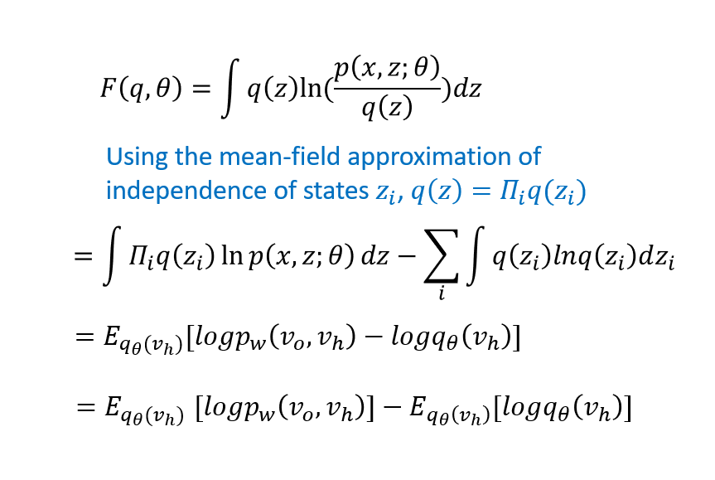
M-step: Learning Procedure
From Variational EM, we see that ELBO :
$$x=v_{o},θ=v_{h},$$
$z=$ latent variable we integrate over
(M-Step)
(E-Step)
Optimization produces tight lower bound

Slide 31
Reasoning about Optimization w/ ELBO
Why does optimization produce a tight lower bound?
Observe:
$$minKL\left(∙\right)=0⇒ q_{θ}\left(v_{h}\right)=p_{w}\left(v_{h} | v_{o}\right)$$
$$⇒logp_{w}\left(v_{o}\right)≥E_{q_{θ}(v_{h})}[logp_{w}\left(v_{o},v_{h}\right)]−E_{q_{θ}\left(v_{h}\right)}[logq_{θ}\left(v_{h}\right)]$$
$$=logp_{w}\left(v_{o}\right)≥E_{q_{θ}(v_{h})}[logp_{w}\left(v_{o},v_{h}\right)]−E_{q_{θ}\left(v_{h}\right)}[logp_{w}\left(v_{h} | v_{o}\right)]$$
$$=logp_{w}\left(v_{o}\right)≥E_{q_{θ}(v_{h})}[logp_{w}\left(v_{o},v_{h}\right)]−E_{q_{θ}\left(v_{h}\right)}[log\frac{p_{w}(v_{o},v_{h})}{p_{w}(v_{o})}]$$
$$=logp_{w}\left(v_{o}\right)≥E_{q_{θ}\left(v_{h}\right)}\left[logp_{w}\left(v_{o},v_{h}\right)\right]−E_{q_{θ}\left(v_{h}\right)}\left[logp_{w}\left(v_{o},v_{h}\right)\right]+E_{q_{θ}\left(v_{h}\right)}\left[logp_{w}(v_{o})\right]$$
= 0
$$=logp_{w}\left(v_{o}\right)≥E_{q_{θ}\left(v_{h}\right)}\left[logp_{w}(v_{o})\right]$$
Optimization produces tight lower bound
If $minKL\left(∙\right)≠0$, we still obtain a tight lower bound through
M-step maximization $E_{q_{θ}\left(v_{h}\right)}\left[logp_{w}\left(v_{o},v_{h}\right)\right]$

Slide 32
M-step: Learning Procedure
Step 1: We will fix and update weights of logical rules by maximizing the log-likelihood function:
We know that:
Is the partition function of the state of variables of the clique set:
Implies that
Source: M. Richardson and P. Domingos. Markov logic networks. Machine learning, 2006.

Slide 33
Motivation for Pseudo-likelihood

Slide 34
M-step: Learning Procedure
Therefore we maximize the pseudo-likelihood function:
Step 2: By the independence property of MLN,
Step 3: Then optimize the weights for the logical rules through the gradient descent algorithm

Slide 35
Weight Optimization
Compute the gradient as follows:
If (h, r, t) is observed:
If (h, r, t) is hidden, it is the KG embedding model’s prediction of the triple being observed:
is a sample from the KGE model, choosing N data points uniformly at random
Intuitively, y represents the confidence we have learned (observation + KGE) of observing a triplet
As such, the KGE model, provides extra supervision to benefit learning the weights of logical rules
Note: $∇_{w}f\left(x\right)=0$ for maximization/minimization
keep our logic rule prediction consistent with observations + KGE

Slide 36
Optimization and Prediction
Step 4: Iteratively perform E-step and M-step until convergence
There are a huge number of possible hidden triplets so handling
all during optimization is impractical (HW question)
Solution: only include small number of triplets using brute force search
An unobserved triplet (h, r, t) is added to H if we can find a grounding
[premise] ⇒ [hypothesis], where the hypothesis is (h, r, t) and the premise only contains triplets in the observed set O.
Although we try to encourage the consensus of p_w and q_θ during training, they may still give different predictions as different information is used (so utilize both for evaluation)
hyperparameter

Slide 37
Optimization and Prediction
In practice, we also expect to infer the plausibility of the triplets outside the subset of
hidden triplets selected
Observe that we can still compute
to infer the how likely it is to actually observe the hidden triple since we have
already learned the embeddings associated with the entities and relations
Observe that there exist hidden triples which logical rules cannot model (see next slide). As such, we cannot make predictions with the logical rules. So p of MLN is replaced with 0.5

Slide 38
Hidden triples logic rules cannot model
Working assumptions:
(1) Hidden triples H can only be inferred by observed triples O.
(2) H $∩$ O = $∅$
Example:
Consider O = {(Mary, is a friend of, Jane); (Jane, is a friend of, Cathy); (Cathy, is a friend of, Kate)}
Valid logic rule (transitivity):
(Mary, is a friend of, Jane) $∧$ (Jane, is a friend of, Cathy) $⇒$ (Mary, is a friend of, Cathy)
Invalid logic rule:
(Mary, is a friend of, Cathy) $∧$ (Cathy, is a friend of, Kate) $⇒$ (Mary, is a friend of, Kate)
hidden triple
observed triples
hidden triple
observed triple
hidden triple

Slide 39
3.
Experiment

Slide 40
Experiment Settings
Dataset Statistics
Tasks: For each triplet, the head or tail entity is masked and the masked entity is predicted
Evaluation Metrics:
Mean Rank (MR), the mean of all ranks
Hit@K (H@K), top K results
Mean Reciprocal Rank (MRR)

Slide 41
Results

Slide 42
Results
KG embedding models: TransE, DistMult, HolE, ComplEx, ConvE
Logical Rule Based models: BLP, MLN
Other hybrid methods that combine knowledge graph embedding and logic rules (RUGE, NNE-AER)
pLogicNet: uses only q for evaluation
pLogicNet*: uses both p and q for evaluation
pLogicNet
pLogicNet*

Slide 43
4.
Conclusion & Future Work

Slide 44
Conclusion & Future Work
pLogicNet is a novel approach that integrates MLN and KG embedding methods for better
learning and inference of KGs
pLogicNet is efficiently optimized using the Variational EM algorithm:
E-step: a knowledge graph embedding model is used to infer the hidden triplets and is enhanced by learning from logical rules
M-step: the weights of rules are updated based on the observed and inferred triplets and is enhanced by learning from the KG embedding model
Future Work: Exploring relational Graph Convolutional Networks and RotatE (a KGE model that uses relational rotation in complex space to form embeddings)

Slide 45
5.
References

Slide 46
References
Meng Qu and Jian Tang. Probabilistic logic neural networks for reasoning. Neural Information Processing Systems (NeurIPS), 2019.
M. D. Hoffman, D. M. Blei, C. Wang, and J. Paisley. Stochastic variational inference. The Journal of Machine Learning Research, 2013.
Matthew Richardson and Pedro Domingos. Markov logic networks. Machine learning, 62(1-2): 107–136, 2006.
M. Schlichtkrull, T. N. Kipf, P. Bloem, R. Van Den Berg, I. Titov, and M. Welling. Modeling relational data with graph convolutional networks. In European Semantic Web Conference, 2018.
Z. Sun, Z.-H. Deng, J.-Y. Nie, and J. Tang. Rotate: Knowledge graph embedding by relational rotation in complex space. ICLR, 2019.
A. Bordes, N. Usunier, A. Garcia-Duran, J. Weston, and O. Yakhnenko. Translating embeddings for modeling multi-relational data. In NeurIPS, 2013.

Slide 47
Thanks!
Any questions?

Slide 48
6.
In-Class HWs

Slide 49
Questions
Describe the motivation of combining MLN and KGE, and how the authors make their model flexible in this paper.
Write down the cardinality |H| (size) of the set of hidden triplets H
(Hint: in terms of |E|, |R|, |O|)
(bonus) In E-step, part of the objective function is to optimize the q_{θ} for the unobserved triplets. In the optimization, we set a threshold for the posterior.
If the inferred posterior is greater than this value, then we treat the tripet is a positive sample. There is another possible way to determine whether we treat the triplet as a positive sample, which is:
Describe whether the first method is better.
(Hint: Think about the dataset input, and that 𝜏_{triplet} is a hyperparameter)

