Slide 1
Efficient Probabilistic Logic Reasoning with Graph Neural Networks
Yuyu Zhang, Xinshi Chen, Yuan Yang, Arun Ramamurthy, Bo Li, Yuan Qi & Le Song
Presented by Hengda Shi, Gaohong Liu and Jian Weng

Slide 2
Background
01
Motivation
02
Model
TABLE OF CONTENTS
04
Model Comparison
03
Experiment
05
Conclusion
06
Knowledge Graph
Markov Logic Networks
GNN as Inference Network
Problem Definition and Solutions
Overview
E-step
M-step
v.s. pLogicNet
Setting
Result
And homework

Slide 3
01
Background

Slide 4
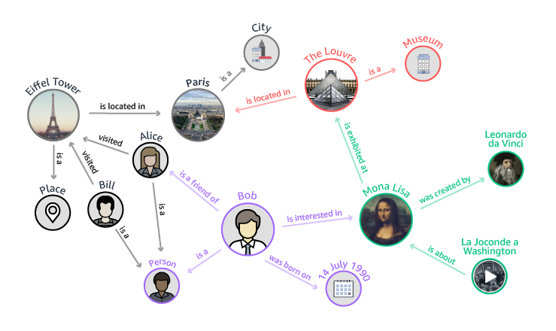
Knowledge Graph
Knowledge Graph. A knowledge graph is a tuple consisting of a set $K=(C,R,O)$. consisting of a set $C=\{c_{1},…,c_{M}\}$ of $M$ entities, a set $R= \left\{r_{1},…,r_{N}\right\}$ of $N$ relations, and a collection $O=\left\{o_{1},…,o_{L}\right\}$ of $L$ observed facts $r(c,c^{′})$. The goal is to infer the missing triplets by reasoning with the observed triplets.

Slide 5
Knowledge Graph (CONT’D)
Each relationship can be expressed as triplet r$\left(c,c^{′}\right)$
Entity $c$ has relation $r$ to entity $c^{′}$
That’s just (h, r, t) in pLogicNet
Terminology
Relation $≡$ Predicate
Entity $≡$ Constant
A predicate with assign entities $≡$ A ground predicate
Each ground predicate $≡$ Binary Random Variable
There are $M^{d}$ ways to ground a d-ary predicate

Slide 6
Terminology for KG
We denote an assignment $a_{r}=(c,c^{′})$
We can then write a ground predicate $r\left(c,c^{′}\right)$ as $r(a_{r})$
Each observed fact in KB in a truth value {0,1}
An observed fact $o$ can be $[L\left(c,c^{′}\right)=1]$
Usually, the number of observed facts is much smaller than that of unobserved facts.
Finally, unobserved facts $≡$ latent variables

Slide 7
Terminology for KG (cont.)
We represent the knowledge base $K$ by a bipartite graph $𝒢_{K}=(C,O,ℇ)$, where nodes on one side correspond to constants C and the other side correspond to observed facts O, which is also called factor.
$ℇ=\{e_{1},…,e_{T}\}$ is the set of edges connecting constants and observed facts
An edge $e=(c,o,i)$ between node $c$ and $o$ exists, if the grounding predicate in $o$ uses $c$ as its argument in $i$-th position

Slide 8
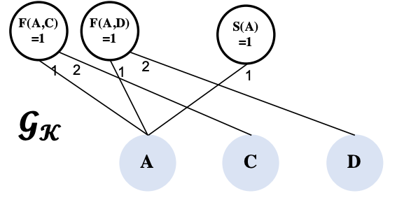
Example of Knowledge Graph

Slide 9
Markov Logic Networks (MLN)
MLNs use logic formulae to define potential functions in undirected graphical models.
A logical formula is a binary function defined via composition of few predicates
$f\left(⋅\right):$C$×…×$C$↦\{0,1\}$
An instance of logic formula of $f(c,c′)$ can be
$$Smoke\left(c\right)∧Friend\left(c,c^{′}\right)⇒Smoke\left(c^{′}\right)⟺¬Smoke\left(c\right)∨¬Friend\left(c,c^{′}\right)∨Smoke(c^{′})$$

Slide 10
MLN (CONT’D)
Denote the entire collection of the assignment as $A_{f}=\{a_{f}^{1},a_{f}^{2},…\}$
Given these logic representations, MLN can be defined as a joint distribution over all observed facts O and unobserved facts H where $Z(W)$ is the partition function
$$P_{w}\left(O,H\right)≔\frac{1}{Z\left(w\right)}\exp{(\sum_{f∈F}{w_{f}\sum_{a_{f}∈A_{f}}{φ(a_{f})}})}$$
$w_{f}$ can be viewed as the confidence score of formula $f$

Slide 11
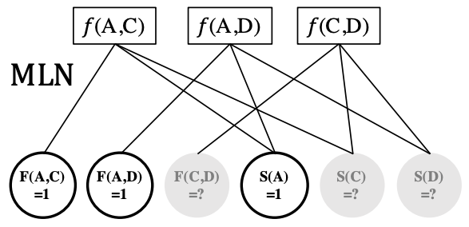
Example of Markov Logic Networks

Slide 12
Difference between KG and MLN
Although MLN is defined on top of knowledge graphs, their topology are very different
KG are typically sparse, and the number of edges (observed relations) is linear in the number of entities
MLN is much denser, and the number of nodes can be quadratic or more in the number of entities. The number of edges is also high-order polynomial in the number of entities

Slide 13
02
Motivation

Slide 14
Motivation
Markov Logic Network
Pros:
1) Logic rules incorporate prior knowledge
2) Allow MLN to generalize in tasks with small amount of labeled data
Cons:
1) Inference in MLN in computationally intensive
2) Logic rules can only cover a small part of the possible combinations of knowledge graph relations

Slide 15
Motivation
Graph Neural Network
Pros:
1) Efficiency – GNN directly works on KG.
2) Compactness – GNN with shared parameters can be memory efficient.
3) Expressiveness – GNN can capture structure knowledge encoded in the KG, and tunable embeddings can encode entity-specific information
Cons:
GNNs do not explicitly incorporate prior logic rules into the models and may require many labeled examples for a target task.

Slide 16
03
Model Comparison

Slide 17
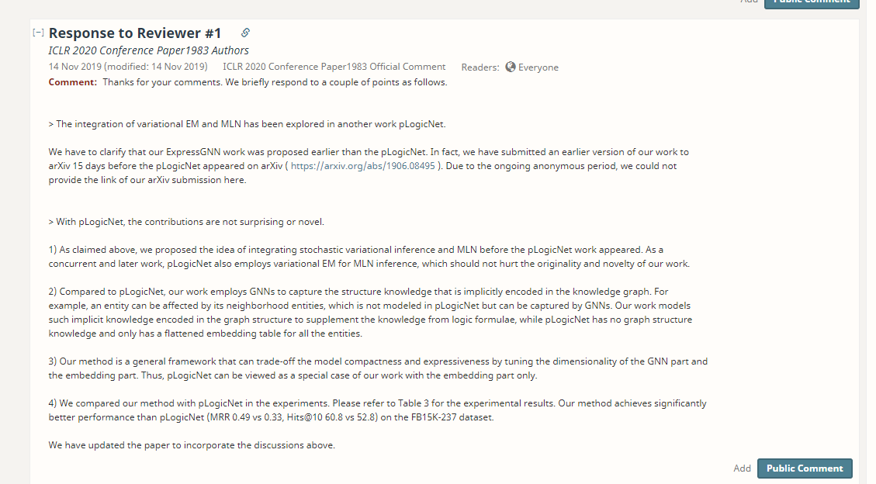
Why not pLogicNet

Slide 18
Why not pLogicNet
Major answers:
1. ExpressGNN is submitted to arXiv 15 days early

Slide 19
Why not pLogicNet
Major answers:
1. ExpressGNN is submitted to arXiv 15 days early
2. ExpressGNN uses GCN to generate structure knowledge rather than using knowledge graph embedding
3. ExpressGNN has significantly better performance than pLogicNet
4. ExpressGNN uses GNN which could tradeoff between the model compactness and expressiveness

Slide 20
04
Model

Slide 21
Model
Overview
Variational EM for MLN
E step: Inference
M step: Learning
Inference Network Design: ExpressGNN

Slide 22
Overview
Similar to pLogicNet, ExpressGNN also uses variational EM algorithm for MLN inference and learning
The difference is that ExpressGNN uses GNN to construct the inference network whereas pLogicNet uses KGE methods.

Slide 23
Variational EM for MLN
MLN model the joint probabilistic distribution of all observed and latent variables.
$$P_{w}\left(O,H\right)≔\frac{1}{Z\left(w\right)}\exp{(\sum_{f∈F}{w_{f}\sum_{a_{f}∈A_{f}}{φ(a_{f})}})}$$
It can be trained by maximizing the log likelihood of all observed facts $logP_{w}(O)$. i.e. ${\hat{θ}}_{ML}=\underset{θ}{argmax}\ln{P_{w}(O)}$
Due to intractability, instead of optimizing the log likelihood $ln P_{w}(O)$, we optimize the evidence lower bound (ELBO) s.t.
$ln P_{w}\left(O\right)≥L_{ELBO}(Q_{θ},P_{w})$

Slide 24
E step: Inference
Infer the posterior distribution of the latent variables, where $P_{w}$ is fixed and $Q_{θ}$ is optimized to minimize the KL divergence between $Q_{θ}(H|O)$ and $P_{w}(H|O)$
Approximate the true posterior with a mean-field distribution.
In mean-field variational distribution, each unobserved ground predicate $r\left(a_{r}\right)∈H$ is independently inferred as:
$Q_{θ}\left(H | O\right)≔\prod_{r\left(a_{r}\right)∈H}{Q_{θ}(r\left(a_{r}\right))}$
Each $Q_{θ}(r\left(a_{r}\right))$ follows Bernoulli distribution
Parameterize $Q_{θ}$ with GNN

Slide 25
E step: Inference
With the mean-field approximation, $L_{ELBO}(Q_{θ},P_{w})$ can be reorganized as:
$$L_{ELBO}\left(Q_{θ},P_{w}\right)=𝔼_{Q_{θ}(H|O)}\left[\log{P_{w}\left(O,H\right)}\right]−𝔼_{Q_{θ}\left(H | O\right)}\left[\log{Q_{θ}\left(H|O\right)}\right]=𝔼_{Q_{θ}(H|O)}\left[log\left(\frac{1}{Z\left(w\right)}\exp\left(\sum_{f∈F}{w_{f}}\sum_{a_{f}∈A_{f}}{∅_{f}\left(a_{f}\right)}\right)\right)\right]−𝔼_{Q_{θ}\left(H | O\right)}\left[\log{\prod_{r\left(a_{r}\right)∈H}{Q_{θ}\left(r\left(a_{r}\right)\right)}}\right]=𝔼_{Q_{θ}(H|O)}\left[\sum_{f∈F}{w_{f}}\sum_{a_{f}∈A_{f}}{∅_{f}\left(a_{f}\right)}−log\left(Z(w)\right)\right]−𝔼_{Q_{θ}\left(H | O\right)}\left[\sum_{r\left(a_{r}\right)∈H}{\log{Q_{θ}\left(r\left(a_{r}\right)\right)}}\right]=\sum_{f∈F}{w_{f}}\sum_{a_{f}∈A_{f}}{𝔼_{Q_{θ}(H|O)}\left[∅_{f}\left(a_{f}\right)\right]}−log\left(Z\left(w\right)\right)−\sum_{r\left(a_{r}\right)∈H}{𝔼_{Q_{θ}\left(H | O\right)}[log{Q_{θ}\left(r\left(a_{r}\right)\right)]}}$$

Slide 26
E step: Inference
The term $\sum_{f∈F}{w_{f}}\sum_{a_{f}∈A_{f}}{𝔼_{Q_{θ}(H|O)}\left[∅_{f}\left(a_{f}\right)\right]}$ sums over all possible logic formulae and all possible assignments to each formula
The term $\sum_{r\left(a_{r}\right)∈H}{𝔼_{Q_{θ}\left(H | O\right)}[log{Q_{θ}\left(r\left(a_{r}\right)\right)]}}$ sums over all possible latent variables
Therefore, both terms in the objective function cause intractable computational cost

Slide 27
E step: Inference
How do we deal with this problem?
The author uses mini-batches of ground formulae to break down the exponential summations.
In each optimization iteration, a batch of ground formulae will be sampled
For each formula in sampled batch, compute the w.r.t. involved latent variables

Slide 28
E step: Inference
If the task has sufficient labeled data, a supervised learning objective will be added to enhance the inference network
$$L_{label}\left(Q_{θ}\right)=\sum_{r\left(a_{r}\right)∈O}{logQ_{θ}(r\left(a_{r}\right))}$$
It is complementary to ELBO on predicates that are not well covered by logic rules but have enough observed facts
Therefore, the E step objective function that combines knowledge in logic rules and supervision from labeled data would be ($λ$ is a hyperparameter):
$$L_{θ}=L_{ELBO}\left(Q_{θ},P_{w}\right)+λL_{label}(Q_{θ})$$

Slide 29
M step: Learning
In M step, the weights of logic formulae in MLN will be learned with the variational posterior $Q_{θ}(H|O)$ being fixed
The partition function $Z(w)$ is not a constant anymore
Due to exponential number of terms in $Z(w)$, pseudo-log-likelihood needs to be adopted as an alternative objective for optimization
Recall the pseudo-log-likelihood
$$\log{P_{w}(O)≈\sum_{i}{\log{P_{w}\left(o_{i}|o_{N(i)}\right)}}}$$

Slide 30
Pseudo-Likelihood
$$P_{w}^{∗}\left(O,H\right)≔𝔼_{Q_{θ}\left(H | O\right)}\left[\sum_{r\left(a_{r}\right)∈H}{\log{P_{w}\left(r(a_{r})|MB_{r(a_{r})})\right)}}\right]$$
$$∇_{w_{i}}𝔼_{Q_{θ}(H|O)}\left[\sum_{r\left(a_{r}\right)∈H}{logP_{w}(r(a_{r})|MB_{r(a_{r})})}\right]≃y_{r\left(a_{r}\right)}−P_{w}(r(a_{r})|MB_{r(a_{r})})$$
where $y_{r(a_{r})}=0 or 1$ if $r\left(a_{r}\right)$ is an observed fact
or $y_{r(a_{r})}=Q_{θ}(r\left(a_{r}\right))$ otherwise
$MB_{r(a_{r})}$ is the Markov blanket of the ground predicate $r(a_{r})$, i.e., the set of ground predicates that appear in some grounding of a formula with $r(a_{r})$

Slide 31
Sampling Scheme for M step
Computationally intractable to use all possible ground predicates to compute the gradients
The solution is to only consider all the ground formulae with at most one latent predicate and pick up the ground predicate if its truth value determines the formula’s truth value
Using this sampling scheme, only a small subset of ground predicates is kept and each of which can directly determine the truth value of a ground formula in MLN.

Slide 32
Inference Network Design: ExpressGNN
ExpressGNN is the inference network to model the posterior
It has three part:
Vanilla Graph Neural Network (GNN)
Tunable Embeddings
Define posterior using embeddings

Slide 33
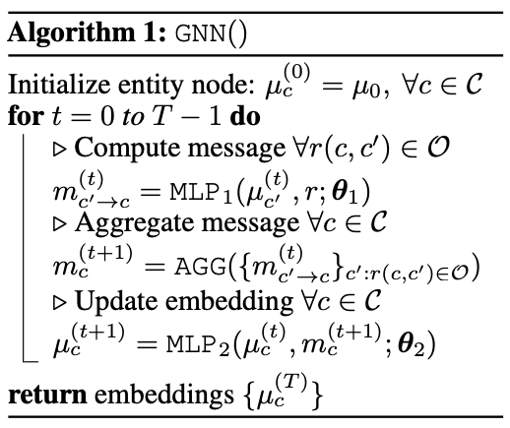
Vanilla GNN
Vanilla GNN is built on knowledge graph $𝒢_{K}$, which is much smaller than the ground graph of MLN
GNN parameters $θ_{1}$ and $θ_{2}$ are independent of number of entities
There are $O(d^{2})$ parameters given $d$ dimensional embeddings, $μ_{c}∈ℝ^{d}$

Slide 34
Tunable Embeddings
For each entity in the KG, we then augment its GNN embedding with a tunable embedding $w_{c}∈ℝ^{k}$ as $\hat{μ}=[μ_{c},w_{c}]$
The tunable embeddings increase the expressiveness of the model
As there are M entities, the number of parameters in tunable embeddings is $O(kM)$

Slide 35
Define Variational Posterior
Finally, we can define the variational posterior with augmented embeddings of $c_{1}$ and $c_{2}$
We specifically define the posterior $Q_{θ}(r\left(c_{1},c_{2}\right))$ as:
$$Q_{θ}\left(r\left(c_{1},c_{2}\right)\right)=σ\left(MLP_{3}\left({\hat{μ}}_{c_{1}},{\hat{μ}}_{c_{2}},r;θ_{3}\right)\right)$$
where $σ\left(⋅\right)$ is the sigmoid function that returns a value between 0 and 1
The number of parameters in $θ_{3}$ is $O(d+k)$

Slide 36
Summary of ExpressGNN
In summary, ExpressGNN can be viewed as two-level encoding of entities:
First two MLPs assign similar embeddings to similar entities in the KG
Expressive tunable embeddings provide additional model capacity to encode entity information beyond graph structures
By tuning $d$ and $k$, ExpressGNN can trade-off between model compactness and expressiveness
When $M$ is large, ExpressGNN can reduce $k$ to save parameters

Slide 37
Why is tunable embedding needed?
It seems weird that ExpressGNN adds a tunable embedding after its vanilla GNN framework
It turns out that GNN would produce the same embedding for some nodes that should be distinguished

Slide 38
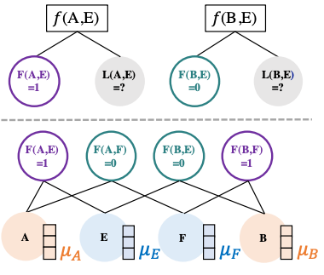
Example of Indistinguishable Embeddings
Four entities: (A, B, E, F)
Two predicates: Friend: $F(⋅)$ and Like: $L(⋅)$
Entity A and B have opposite relations with E, i.e., $F\left(A, E\right)=1$ versus $F\left(B, E\right)=0$ in the KG
Running vanilla GNN would result in the same embeddings for A and B, i.e., $μ_{A}=μ_{B}$
$L(A,E)$ and $L(B,E)$ have different posteriors. However, using vanilla GNN, $Q_{θ}\left(L\left(A,E\right)\right)=σ(MLP_{3}\left(μ_{A},μ_{E},L\right))$ $≡$ $Q_{θ}\left(L\left(B,E\right)\right)=σ(MLP_{3}(μ_{B},μ_{E},L))$

Slide 39
05
Experiment

Slide 40
Evaluation Methodology
Datasets
UW-CSE, Cora, Synthetic Kinship, and FB15K-237
General Settings
Intel Xeon 4116 @2.100GHz with 256GB RAM
Competitor Models
MCMC, Belief Propagation, Lifted BP, MC-SAT, and HL-MRF

Slide 41
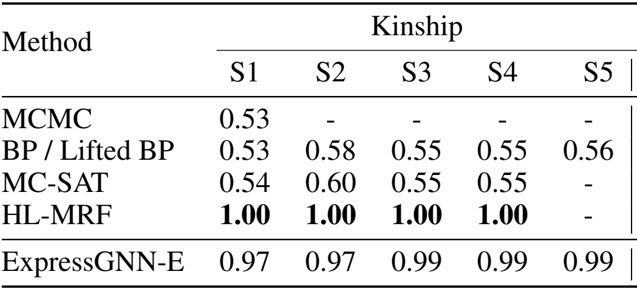
Accuracy

Slide 42
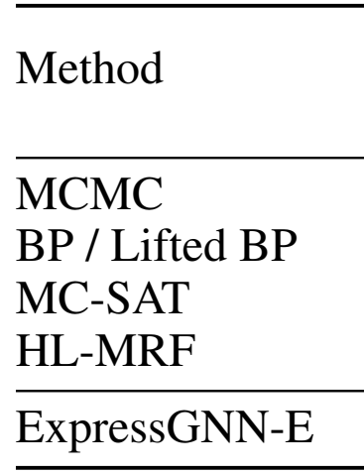
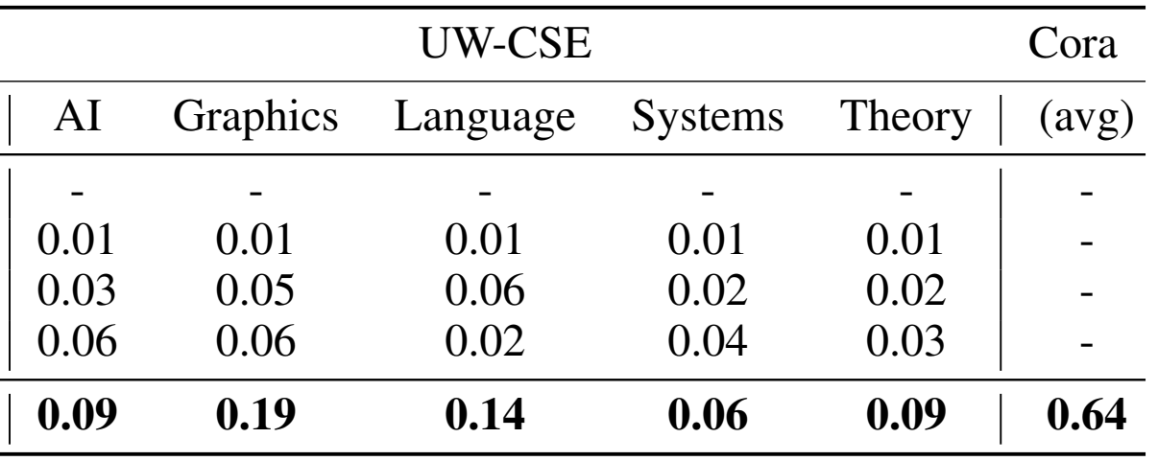
Accuracy (CONT’D)

Slide 43
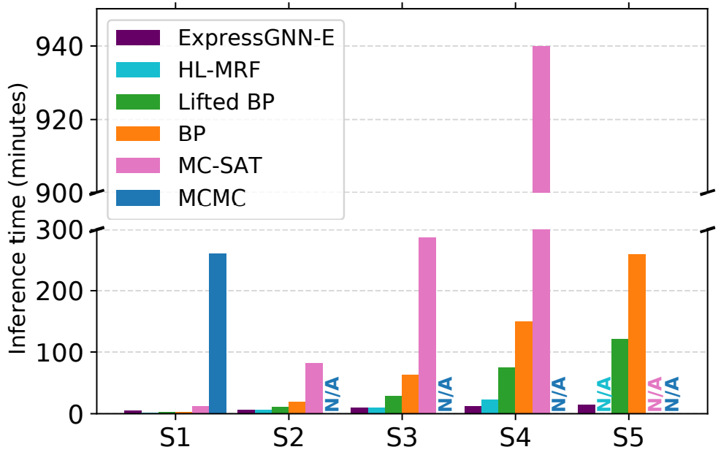
Inference Time

Slide 44
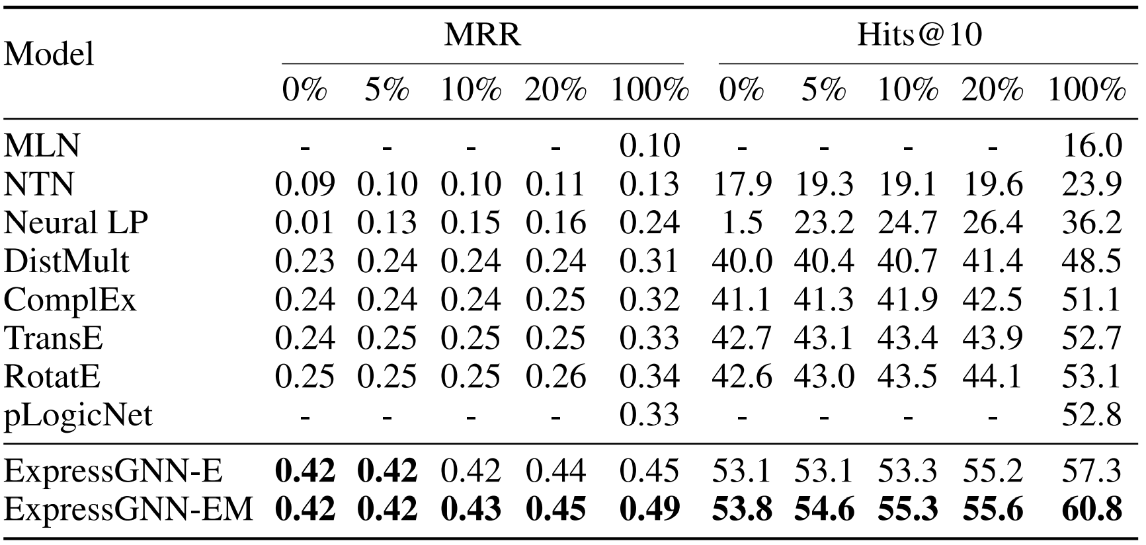
Data Efficiency

Slide 45
06
Conclusion

Slide 46
Conclusion
This paper studies probabilistic logic reasoning problem and proposes ExpressGNN to combine the advantages of MLN in logic reasoning and GNN in graph representation learning.
It addresses the scalability issue of MLN with stochastic training in variational EM and employs GNNs to capture structure knowledge to serve as supplement to the knowledge from logic formulae

Slide 47
Interesting Facts
The author claimed that the original version of this paper appeared 15 days earlier than pLogicNet on arXiv
This paper received two weak rejects and one reject from reviewers, but managed to get accepted by the chair

Slide 48
THANKS
Any Questions?

Slide 49
References
Yuyu Zhang, Xinshi Chen, Yuan Yang, Arun Ramamurthy, Bo Li, Yuan Qi, Le Song, "Efficient Probabilistic Logic Reasoning with Graph Neural Networks", ICLR 2020.
Matthew Richardson and Pedro Domingos. Markov Logic Networks. Machine learning, 62(1- 2): 107–136, 2006.
Thomas N Kipf and Max Welling. Semi-supervised classification with graph convolutional networks. In ICLR, 2017.
Meng Qu, Yoshua Bengio, and Jian Tang. GMNN: Graph Markov neural networks. In Proceedings of the 36th International Conference on Machine Learning, pp. 5241–5250, Long Beach, California, USA, 09–15 Jun 2019. PMLR.

Slide 50
Homework
What is the main difference between ExpressGNN and pLogicnet?
What is the total number of trainable parameter in ExpressGNN in Big-O notation?
Why isn’t vanilla GNN enough for embedding?

