Slide 1
Composing Graphical Models with Neural Networks for Structured Representations and Fast Inference
Matthew J. Johnson, David Duvenaud, Alexander B. Wiltschko, Sandeep R. Datta, Ryan P. Adams
Presented by Meet Taraviya, Joe Halabi, Derek Xu

Slide 2
Motivation

Slide 3
Fitting Spiral Data
Notes:
Our problem: we have a dataset that we would like to classify using unsupervised learning. We can use GMMs, but they don’t capture the true meaning correctly. We can use NN, but no inherent sense of clustering. We want to propose a model that has clustering and non-linearity.

Slide 4
Compare two approaches
Probabilistic Graphical Models
+ Structured representations
+ Priors and uncertainty
+ Data and computational efficiency
- Rigid assumptions
- Feature engineering
Deep Learning
+ Flexible
+ Feature learning
- Not interpretable
- Difficult parameterization
- Requires a lot of data
Notes:
Let’s compare the two standard approaches towards modelling data.

Slide 5
Notes:
The paper proposes this new idea: let’s use PGM to model latent variables while using NN to produce the observations from the latent variables.

Slide 6
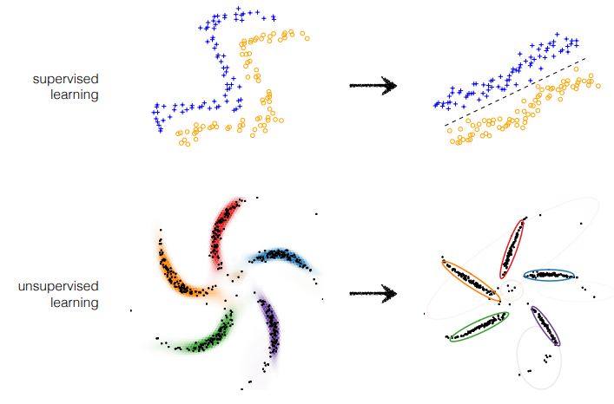
Notes:
Supervised learning with NN: learn features so we can make the two classes linearly separable. In our version of unsupervised learning, we’re trying to learn the features that make our data manifold be separable by GMMs.

Slide 7
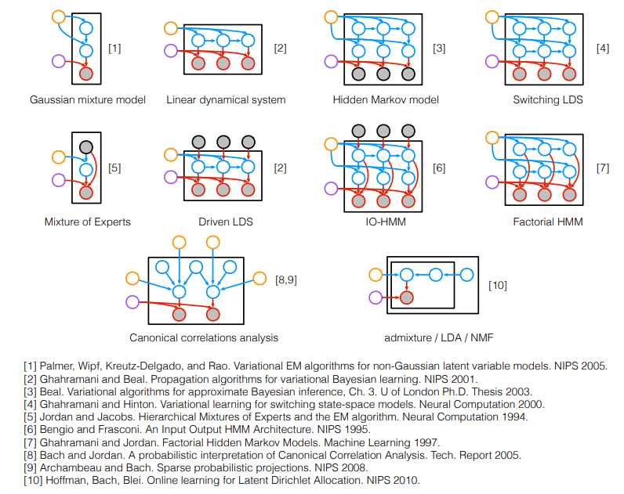
Notes:
We’ve seen graphical models before. Here are a variety of different models within the literature. Notice that the local latent variables are in blue, the global latent variables (the priors) and in yellow, and the observations are in the grey (fed by their own parameters in red).

Slide 8
Proposal

Slide 9
SVAE: Combining PGMs with VAEs
Use probabilistic graphical models (PGMs) for representing structured probability distributions over latent variables.
Use variational autoencoders (VAEs) to learn the non-linear observations.
Thoroughly describe the inference and learning procedures for these models.

Slide 10
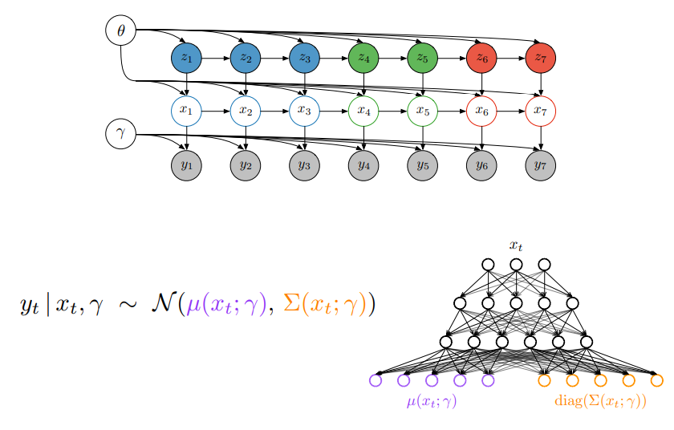
Notes:
The paper’s new model. A mix of PGM and a NN for the observations. The NN here is a variational autoencoder. Thus, we can have a sense of internal structure with a non-linear mapping from that structure.

Slide 11
Background

Slide 12
Exponential family
Recall: CRF/MRF are special cases of the exponential family

Slide 13
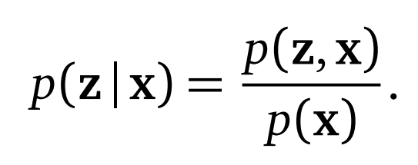
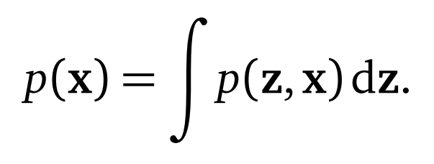
Variational Inference
← Intractable!
Notes:
How to avoid computing the marginal? Define a family of PDFs over the latent variables and try to find the distribution that minimizes the KL divergence between the distribution and the true posterior.

Slide 14
Variational Inference - Derivation
Notes:
The ELBO is the negative of KL divergence + log(p(x)), which is a constant with respect to q(z). Thus, maximizing the ELBO is equivalent to minimizing the KL divergence.

Slide 15
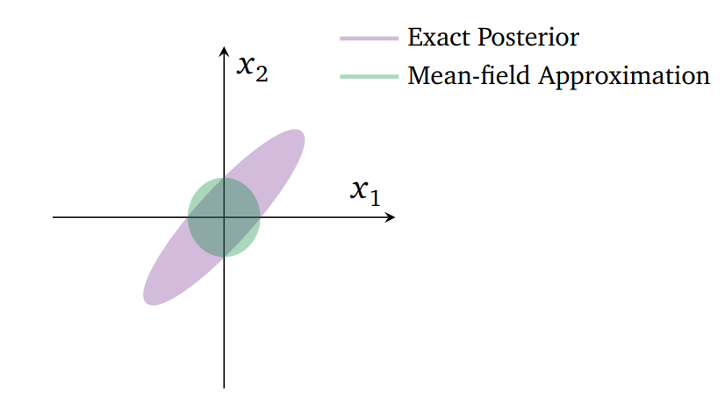
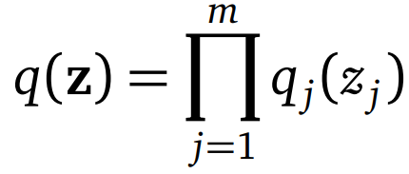
Mean-field Variational Inference
Notes:
To complete the optimization, we have to specify what this Q distribution is. Here, we assume each latent variable has its own distribution that is independent of the rest.

Slide 16
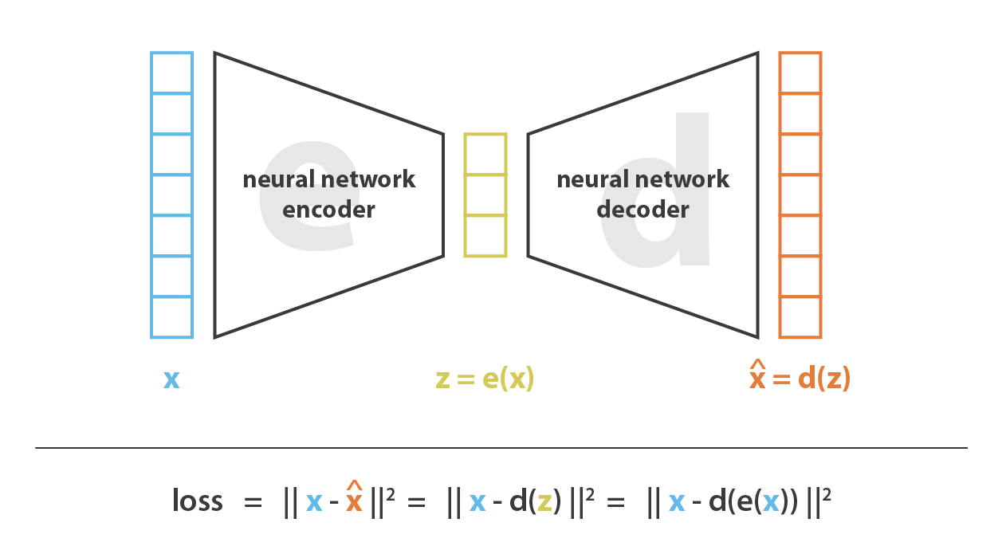
Autoencoder
Notes:
Here is an autoencoder. It’s main purpose is dimension reduction while retaining information structure.

Slide 17
Can we generate new data from an autoencoder?
Notes:
The latent space is irregular. Choosing a random point will not guarantee a good output. The encoder/decoder pair will generate meaningless data, especially if it overfits.

Slide 18
Variational Autoencoder
Notes:
Adds regularity to the latent space.

Slide 19
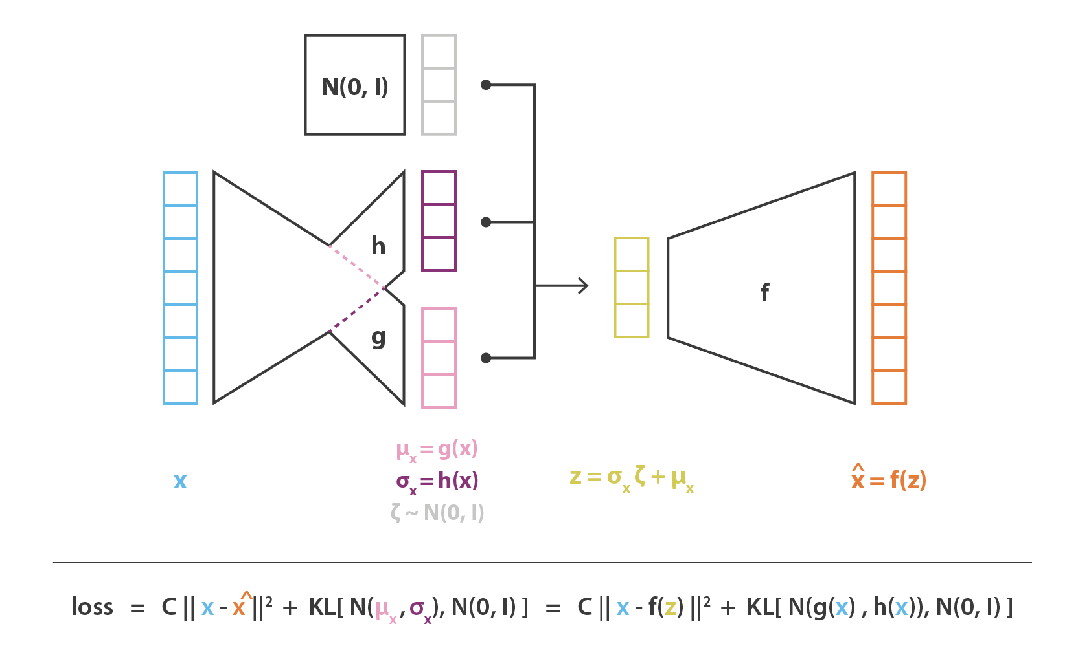
Notes:
High level overview of the autoencoder. It consists of one neural network called the encoder. This produces two vectors: one for the mean, one for the covariance. These parameters are added with a standard normal random node to produce a latent variable that is then passed to the decoder.

Slide 20
Back to the proposal

Slide 21
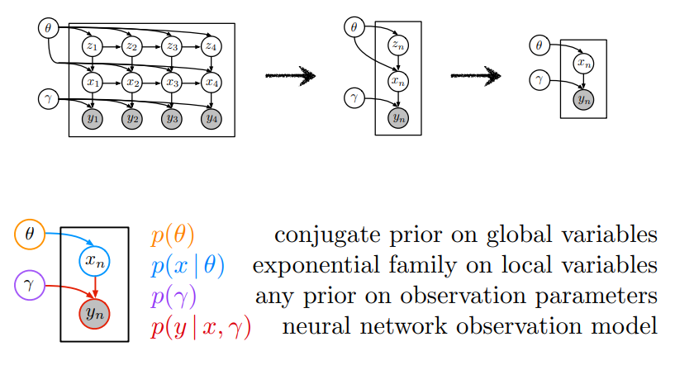
conjugate prior on global variables
exponential family on local variables
exponential prior on observation parameters
neural network observation model
Notes:
This is the model.

Slide 22
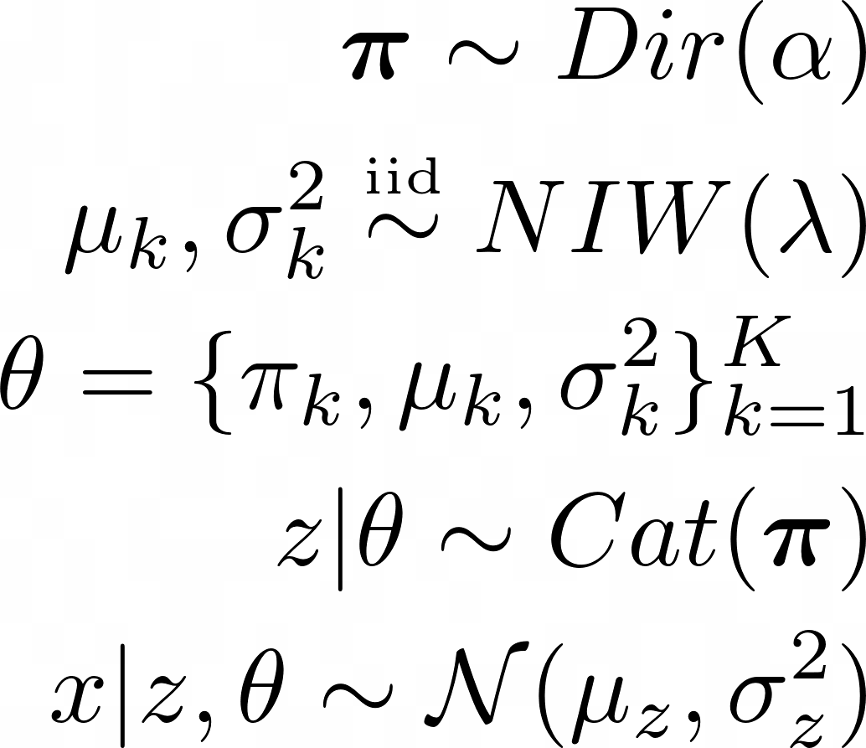
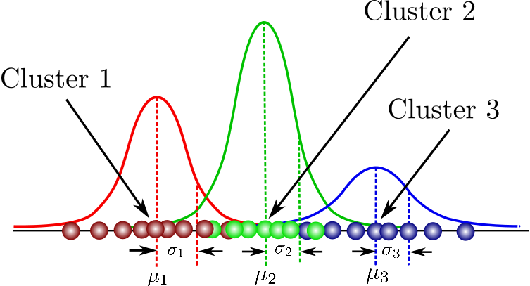
Example: 1-dimensional GMM with K clusters

Slide 23
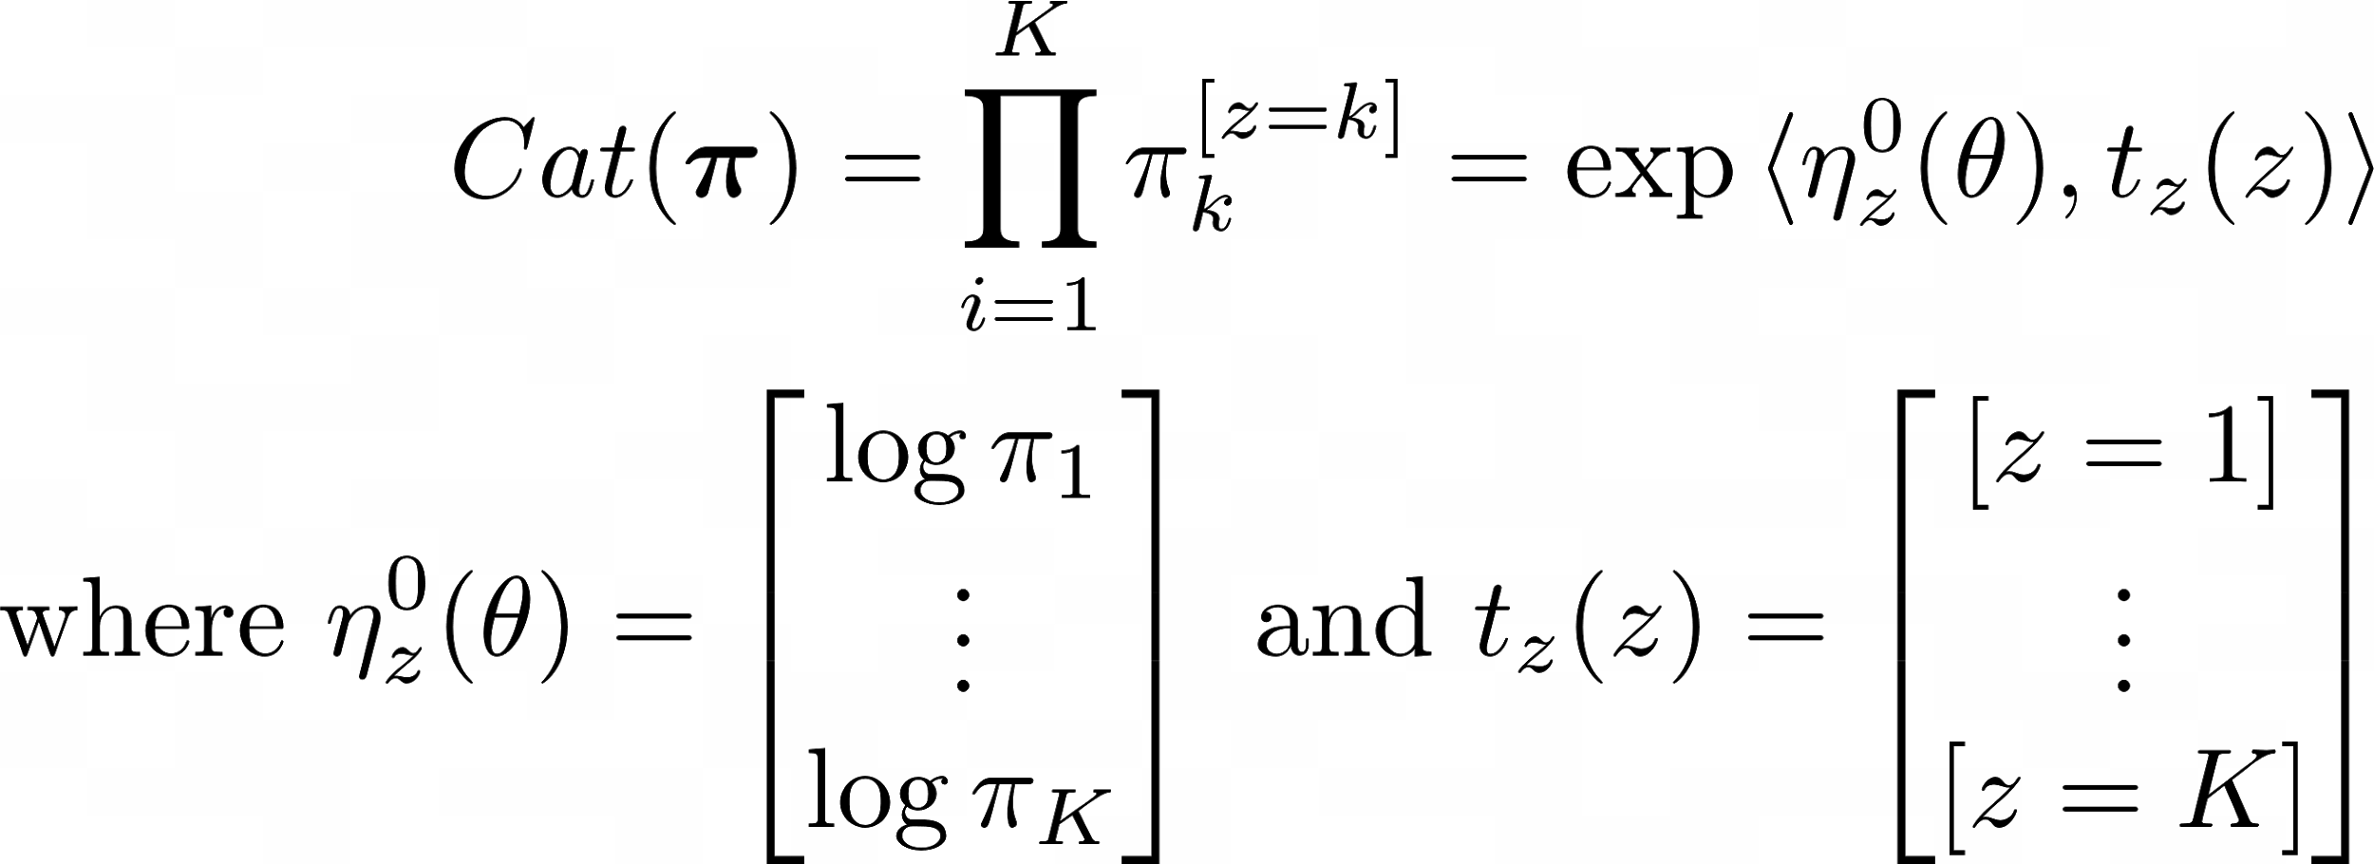
How are these exponential distributions?
Notes:
f(z | \boldsymbol{\pi})=Cat(\boldsymbol\pi)=\prod_{i=1}^{K} \pi_{k}^{[z=k]} = \exp\{\sum_{k=1}^K (\log{\pi_k})[z=k]\} = \exp{\langle \eta^0_z(\theta), t_z(z) \rangle}\\
\text{where }\eta^0_z(\theta) = \begin{bmatrix}\log{\pi_1}\\ \vdots \\ \log{\pi_K}\end{bmatrix} \text{ and } t_z(z) = \begin{bmatrix} [z=1] \\ \vdots \\ [z=K]\end{bmatrix}
f(x | \mu_z, \sigma^2_z)=\mathcal{N}(\mu_z,\sigma^2_z)=\frac{1}{\sigma_z \sqrt{2 \pi}} e^{-\frac{1}{2}\left(\frac{x-\mu_z}{\sigma_z}\right)^{2}} = \exp{\{\langle \eta^0_x(z,\theta), t_x(x) \rangle - \log{Z_x(\eta^0_x(z, \theta))}\}}\\
\text{where } \eta^0_x(z, \theta) = \begin{bmatrix}
\frac{\mu_z}{\sigma_z^{2}} \\
-\frac{1}{2 \sigma_z^{2}} \end{bmatrix} \text{ and } t_x(x) = \begin{bmatrix}
x\\ x^2 \end{bmatrix} \text{ and } \log{Z_x(\eta^0_x(z, \theta))} = \frac{\mu_z^{2}}{2 \sigma_z^{2}}+\log \sigma_z

Slide 24
Generalizing to all graphical models
conjugate prior of p(x|θ)
exponential families
recognition network

Slide 25
Generalizing to all graphical models
conjugate prior of p(x|θ)
exponential families
Why?
recognition network

Slide 26
Inference and Learning

Slide 27
Problem: Inference and Learning
Variational inference does not work because of the nonlinearities introduced by generalizing p(y|x,γ), which is assumed to be an arbitrary distribution, causes difficulties in finding the other distributions.
Mean-field Variational Inference Objective (ELBO):
Questions:
How can we find p(y|x,γ), if it is any general distribution?
How can we exploit p(x|θ), p(y|x,γ) to improve variational inference?
Notes:
make sure to explain what this is
we are assuming we can represent the latent variables with q

Slide 28
Solution: Overview
“Why?” is answered by how we perform inference and learning
“How can we find p(y|x,γ), if it is any general distribution?”
Extension of Variational Autoencoder (VAE)
Conclusion:
“How can we exploit p(x|θ), p(y|x,γ) to improve variational inference?”
Extension of Variational Inference (VI)
Conclusion:

Slide 29
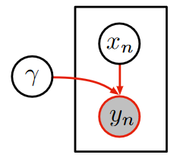
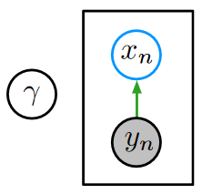
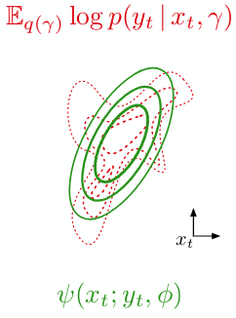
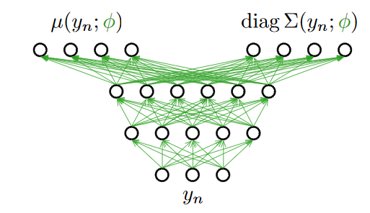
Solution: VAE Recognition Networks
Intuition:

Slide 30
Solution: VAE Recognition Networks
Use a recognition network to estimate the solution to the problem
Estimate this complicated p(y|x,gamma) with a “simpler” exponential distribution
Formally: estimate using a CRF with same sufficient statistics as x:

Slide 31
Solution: VAE Recognition Networks
Use a recognition network to estimate the solution to the problem
Estimate this complicated p(y|x,gamma) with a “simpler” exponential distribution
Formally: estimate using a CRF with same sufficient statistics as x:
Why?

Slide 32
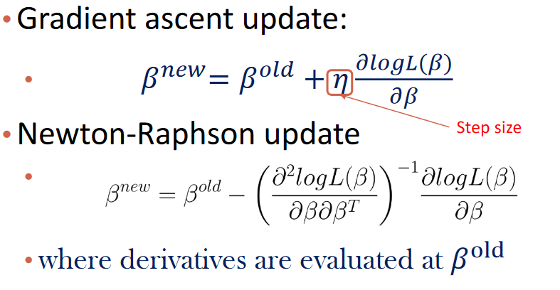
Solution: VI Extension
Intuition:
The local variational parameters have a closed-form solution; the global variational parameters have a natural gradient (which can be computed from the optimal local variational parameters)

Slide 33
Solution: VI Extension
Concretely:
Step 1: find optimal local variational parameters
Step 2: find natural gradients of global variational parameters (Newton’s Method)
“Hold my beer as we do some optimization.”

Slide 34
Solution: VI Extension (Step 1)
Proof: How can we find the optimal q(x)? [1/2]

Slide 35
Solution: VI Extension (Step 1)
Proof: How can we find the optimal q(x)? [2/2]
In our case,

Slide 36
Solution: VI Extension (Step 2)
Proof: Why does partial optimization give us the natural gradients? [1/2]

Slide 37
Solution: VI Extension (Step 2)
Proof: Why does partial optimization give us the natural gradients? [2/2]
i.e. Newton’s Method
Notes:
Faster to compute and faster convergences

Slide 38
Solution: VI Extension (Step 2)
Reparameterization trick to find the recognition model parameters: [1/1]
Notes:
Details in variational autoencoders

Slide 39
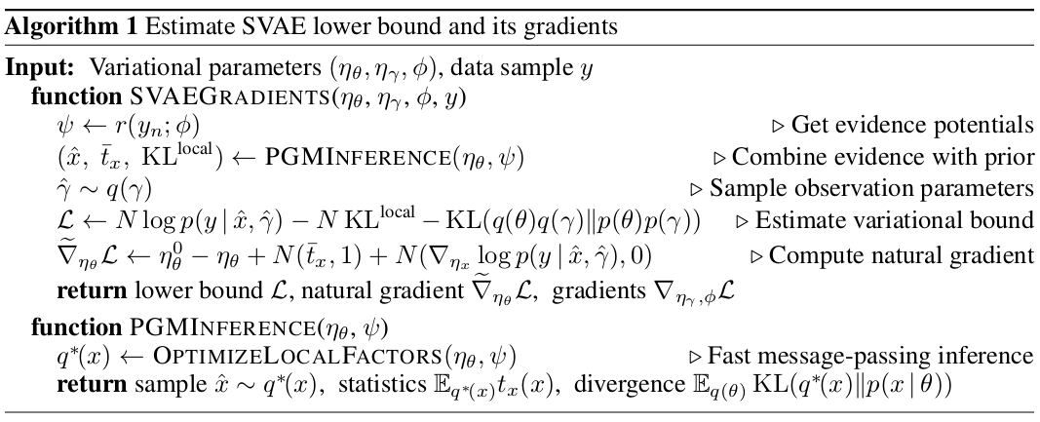
Overall Algorithm

Slide 40
Experiments

Slide 41
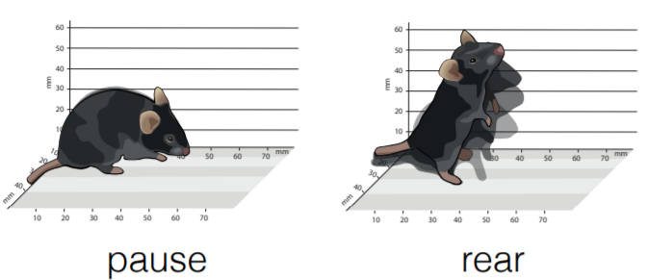
Modelling behaviour of mice
Discrete latent variables z_{n}: MC to describe the “state”, eg dart/pause/rear
Continuous latent variables x_{n}: LDS to describe motion in a particular state
Observed y_{n}: Depth images of the mouse

Slide 42
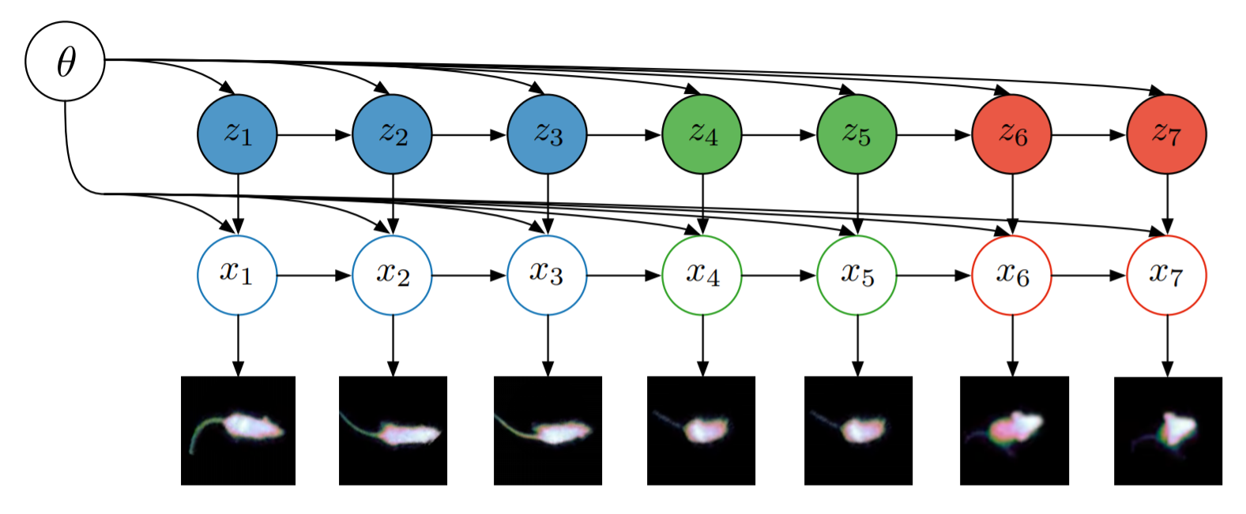
Latent switching linear dynamic system (SLDS)

Slide 43
Generating new frames

Slide 44
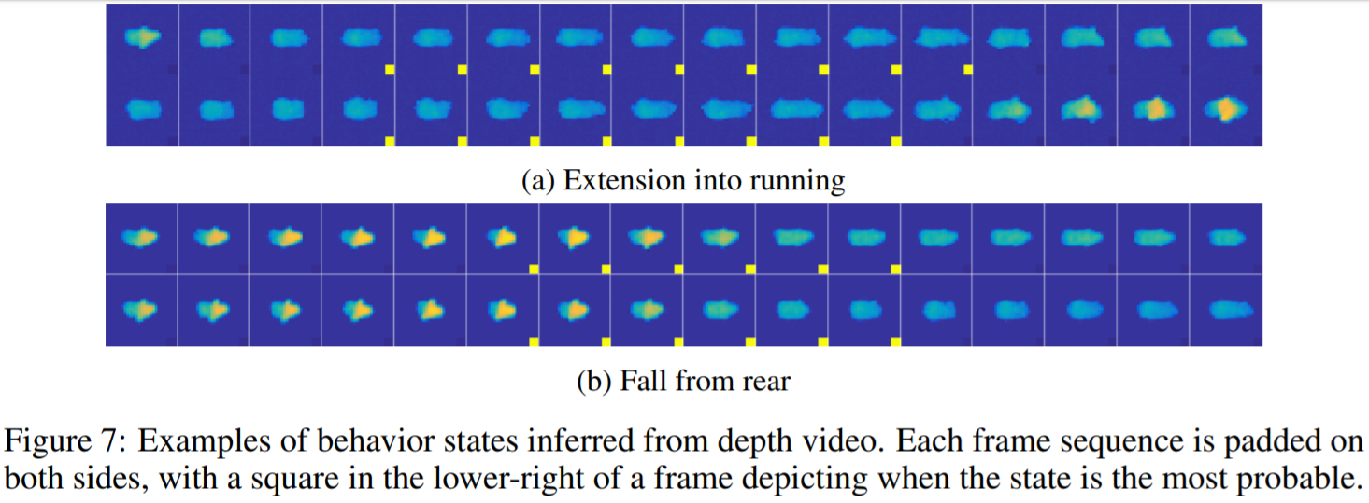
Predicting frames corresponding to a given state

Slide 45
Conclusions
Structured variational autoencoders provide a general framework that combines some of the strengths of probabilistic graphical models and deep learning methods.
Graphical models for latent structure and fast inference.
Neural networks for non-linear observation models.

Slide 46
Questions

Slide 47
Questions
Why do we want to combine probabilistic graphical models and variational autoencoders?
How many neural networks does SVAE have?
Why can we not just use variational inference for the model?

Slide 48
References
https://towardsdatascience.com/understanding-variational-autoencoders-vaes-f70510919f73
Blei, David M., Alp Kucukelbir, and Jon D. McAuliffe. “Variational Inference: A Review for Statisticians.” Journal of the American Statistical Association 112.518 (2017): 859–877. Crossref. Web.
https://simons.berkeley.edu/sites/default/files/docs/6626/berkeley.pdf
Johnson, Matthew J., et al. "Composing graphical models with neural networks for structured representations and fast inference." Advances in neural information processing systems. 2016.

