Slide 1
CS247: Advanced Data Mining
1: Introduction
Instructor: Yizhou Sun
yzsun@cs.ucla.edu
January 6, 2024

Slide 2
Course Information
Course homepage: https://github.com/yichousun/Winter2024_CS247_AdvDM/
Class Schedule
  Slides
  Assignments
  Course projects
  …
Piazza: https://piazza.com/ucla/winter2024/cs247

Slide 3
Prerequisites
  Required prerequisite courses: CS 145 or CS 146 or equivalent.
  You are expected to have background knowledge in data structures, algorithms, basic linear algebra, and basic statistics.
  You are expected to know basic knowledge in data mining and machine learning.
  You will also need to be familiar with at least one programming language, and have programming experiences.

Slide 4
Meeting Time and Location
When
  M&W, 10-11:50pm
Where
  BOELTER 4760

Slide 5
Instructor and TA Information
Instructor: Yizhou Sun
  Homepage: http://web.cs.ucla.edu/~yzsun/
  Email: yzsun@cs.ucla.edu
  Office: 3531F
  Office hour: Tuesdays 4:45-6:15pm
  TA:
    Fred Xu (fredxu at cs.ucla.edu), office hours: Monday 4-5PM and Wednesday 4-5PM
    Yanqiao Zhu (yzhu at cs.ucla.edu), office hours: Monday 8-9PM (Zoom) and Tuesday in person 10-11am
    TA Office: BH 3256S

Slide 6
Grading
Homework: 40%
Course project: 30%
Exam:25%
Participation: 5%

Slide 7
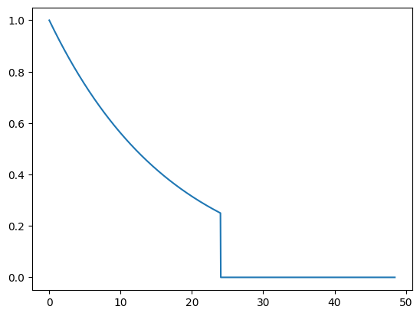
Grading: Homework
Homework: 40%
  6 assignments (highest 5 scores will be picked)
  Bonus questions might be included, which can be carried over to the final score
  Deadline: 11:59pm of the indicated due date via Bruinlearn system
    Late submission policy: get original score*
    if you are t hours late.
  No copying or sharing of homework!
    But you can discuss general challenges and ideas with others
    Suspicious cases will be reported to The Office of the Dean of Students

Slide 8
Grading: Course Project
Course project: 30%
  Group project (4-5 people for one group)
  Goal: Solve an open data mining problem, related to text, graph/networks, or recommender systems
  You are expected to present your project to the class, and submit a project report and your code at the end of the quarter
  Warning: private peer review will be collected in the end, and free rider will receive a significant lower score

Slide 9
Grading: Exam
Midterm for in-person sessions: around the Evening of Feb. 22
Midterm for MSOL: Feb. 10
Optional Final: March 22, 2024 Friday 11:30am-2:30pm
Optional Final for MSOL: Saturday, March
Exam score = max(midterm, final)

Slide 10
Grading: Participation
Participation: 5%
  Popup In-class quizzes
    For Session LEC 1:
      In Class
    For Session LEC 80:
      No
  Piazza
    Bonus if you are very active

Slide 11
Q&A

Slide 12
Goals of the Course
  Review and understand fundamentals of basic data mining techniques
  Learn recent data mining techniques on several advanced data types
  Develop skills to apply data mining algorithms to solve real-world applications
  Gain initial experience in conducting research on data mining

Slide 13
Content to be Covered
Part I: Basics of data mining
Part II: Text mining
Part III: Graphs/Network mining
Part IV: Recommender systems

Slide 14
Part I: Basics of data mining (~2 weeks)
Basics of Probabilistic Models
K-means and mixture models
Neural networks and deep learning

Slide 15
Part II: Text mining (~2 weeks)
Topic Models
Word Embedding
Transformers

Slide 16
Text Data
“Text mining, also referred to as text data mining, roughly equivalent to text analytics, refers to the process of deriving high-quality information from text. High-quality information is typically derived through the devising of patterns and trends through means such as statistical pattern learning. Text mining usually involves the process of structuring the input text (usually parsing, along with the addition of some derived linguistic features and the removal of others, and subsequent insertion into a database), deriving patterns within the structured data, and finally evaluation and interpretation of the output. 'High quality' in text mining usually refers to some combination of relevance, novelty, and interestingness. Typical text mining tasks include text categorization, text clustering, concept/entity extraction, production of granular taxonomies, sentiment analysis, document summarization, and entity relation modeling (i.e., learning relations between named entities).” –from wiki

Slide 17
Text Data – Topic Modeling

Slide 18
Text Data – Word Embedding
king - man + woman = queen
Notes:
Google ads

Slide 19
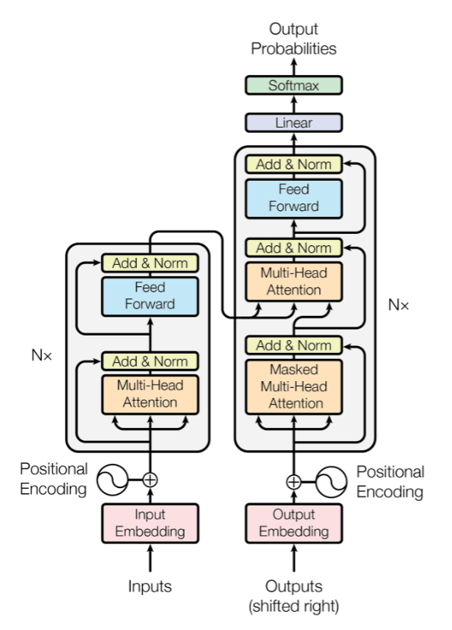
Text Data - Transformers

Slide 20
Part III: Graphs/Network mining (~2.5 weeks)
Spectral clustering
Label propagation
Graph/Network shallow embedding
Knowledge graph embedding
Graph Neural Networks

Slide 21
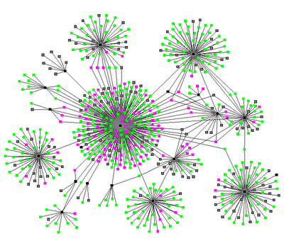
Graph / Network
Notes:
Source: http://www.thenetworkthinkers.com/2008/06/birds-of-feather-grow-fat-together.html

Slide 22
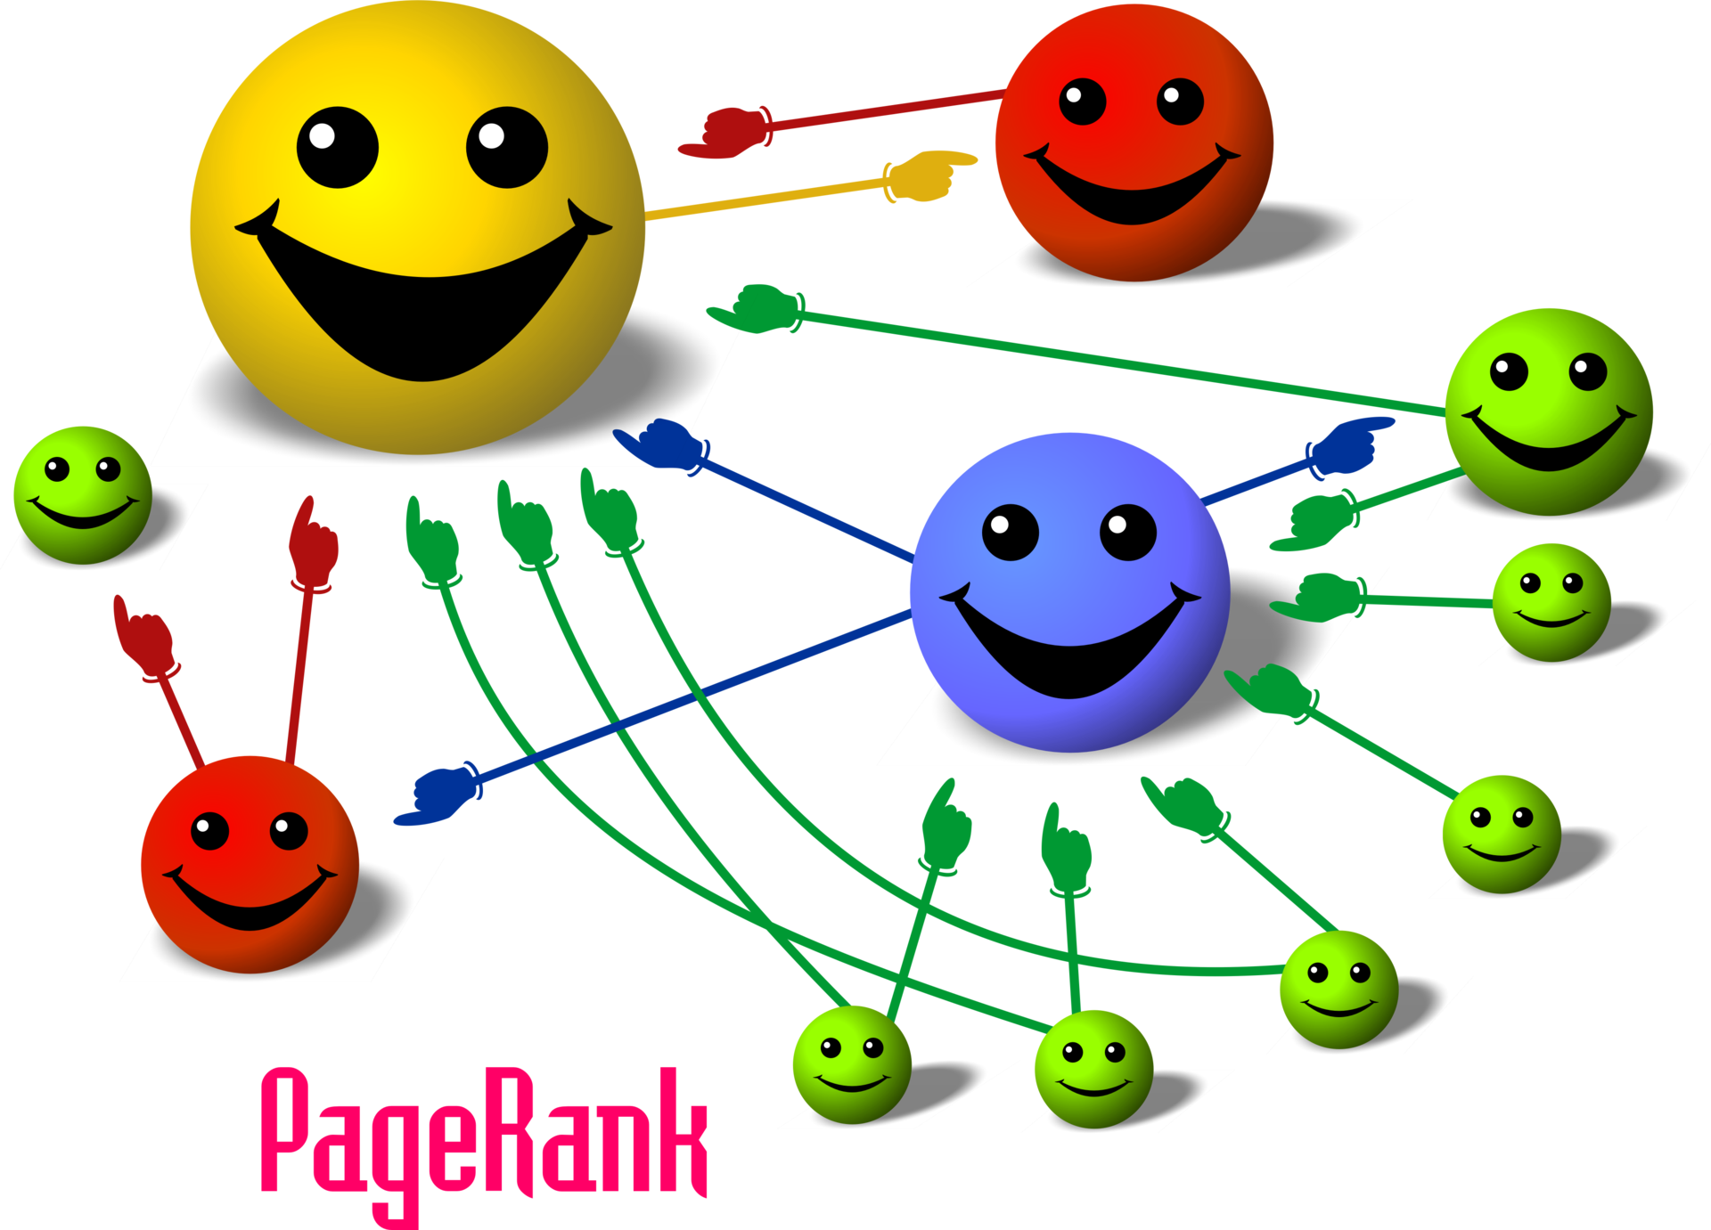
PageRank
Source: wikipedia
Notes:
Source: wikipedia

Slide 23
Community Detection

Slide 24
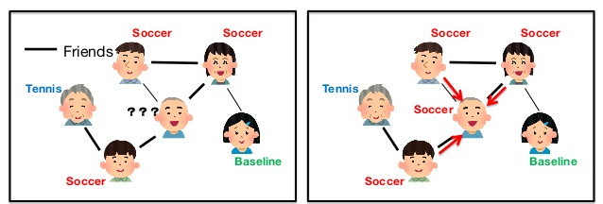
Label Propagation
Baseball
Baseball
Source: https://www.slideshare.net/yamaguchiyuto/when-does-label-propagation-fail-a-view-from-a-network-generative-model

Slide 25
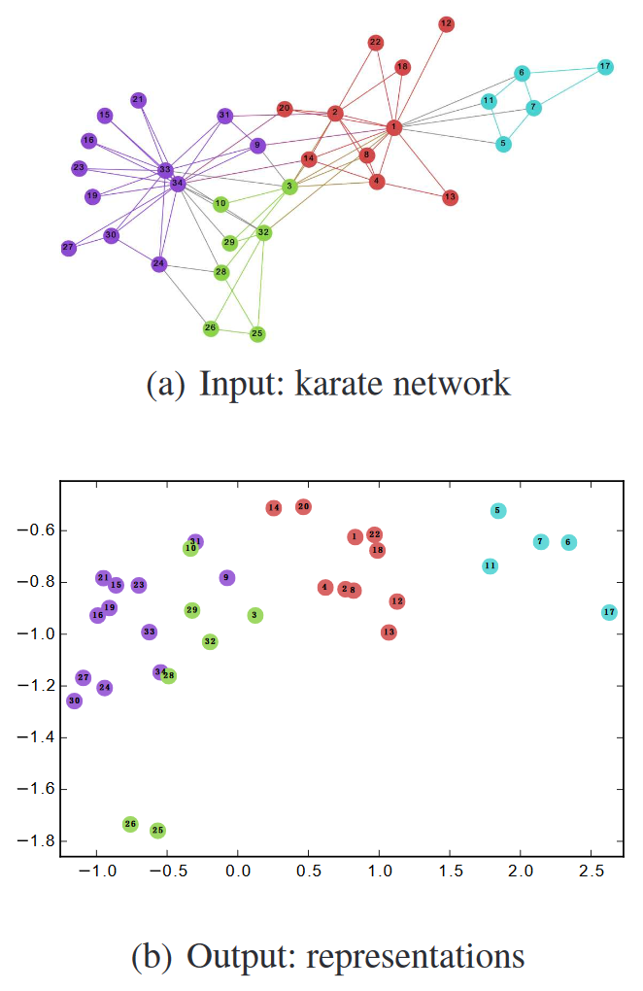
Network Embedding
Source: DeepWalk

Slide 26
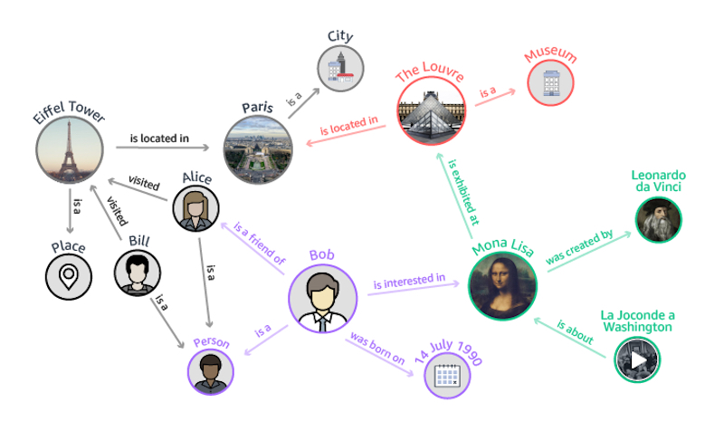
Knowledge Graph
https://geomarketing.com/amazons-neptune-database-will-expand-the-knowledge-graph-heres-how/amazon-neptune-knowledge-graph

Slide 27
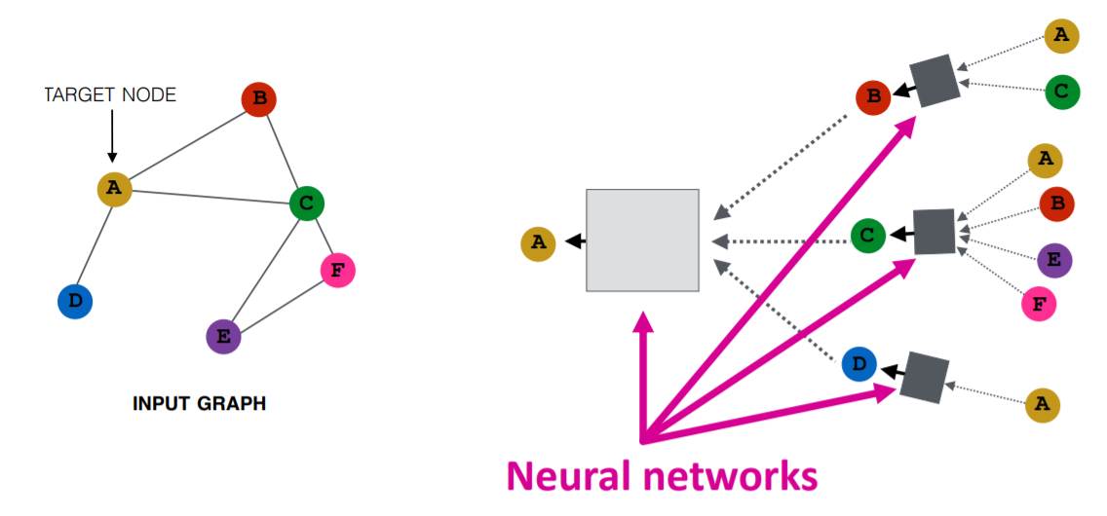
Graph Neural Networks

Slide 28
Part IV: Recommender systems (~2 weeks)
Collaborative filtering, matrix factorization, Bayesian personalized ranking
Factorization machine and deep collaborative filtering
Recommendation from graph perspective

Slide 29
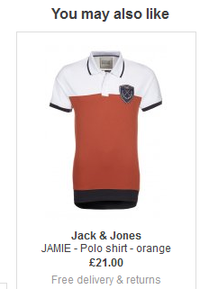

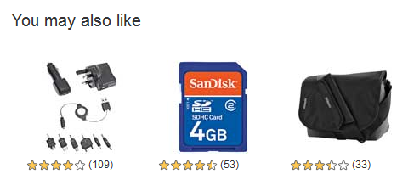
Recommender systems

Slide 30
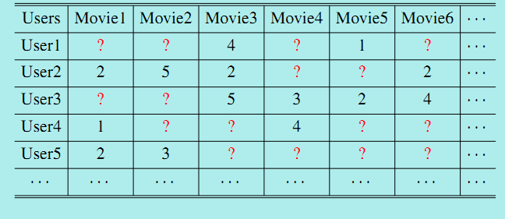
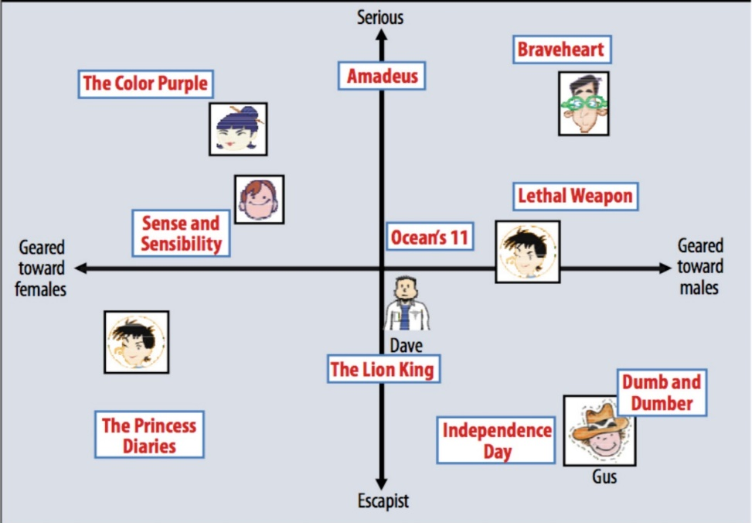
A Matrix Representation View

Slide 31
Summary: Methods to Learn
Part I: Basics of data mining (~2 weeks)
  Naïve Bayes, Logistic regression, K-Means, mixture models, ANN
Part II: Text mining (~ 2 weeks)
  Topic Models: pLSA, LDA
  Word embedding
  Transformers
Part III: Graphs/Network mining (~2.5 weeks)
  spectral clustering, graph embedding, label propagation, knowledge graph embedding, GNNs
Part IV: Recommender systems (~ 2 weeks)
  Collaborative filtering, matrix factorization, Bayesian personalized ranking
  Factorization machine, neural collaborative filtering
  Recommendation as link prediction

Slide 32
Where to Find References? DBLP, CiteSeer, Google
Data mining and KDD (SIGKDD: CDROM)
  Conferences: ACM-SIGKDD, IEEE-ICDM, SIAM-DM, PKDD, PAKDD, etc.
  Journal: Data Mining and Knowledge Discovery, KDD Explorations, ACM TKDD
Database systems (SIGMOD: ACM SIGMOD Anthology—CD ROM)
  Conferences: ACM-SIGMOD, ACM-PODS, VLDB, IEEE-ICDE, EDBT, ICDT, DASFAA
  Journals: IEEE-TKDE, ACM-TODS/TOIS, JIIS, J. ACM, VLDB J., Info. Sys., etc.
AI & Machine Learning
  Conferences: AAAI, IJCAI, COLT (Learning Theory), CVPR, ICML, NIPS, ICLR etc.
  Journals: Machine Learning, Artificial Intelligence, Knowledge and Information Systems, IEEE-PAMI, etc.
NLP
  ACL, EMNLP, NAACL, etc.
Web and IR
  Conferences: SIGIR, WWW, CIKM, etc.
  Journals: WWW: Internet and Web Information Systems,
Statistics
  Conferences: Joint Stat. Meeting, etc.
  Journals: Annals of statistics, etc.
Visualization
  Conference proceedings: CHI, ACM-SIGGraph, etc.
  Journals: IEEE Trans. visualization and computer graphics, etc.

Slide 33
Textbook
Recommended: Jiawei Han, Micheline Kamber, and Jian Pei. Data Mining: Concepts and Techniques, 3rd edition, Morgan Kaufmann, 2011
References
  "Data Mining: The Textbook" by Charu Aggarwal (http://www.charuaggarwal.net/Data-Mining.htm)
  “Neural Networks and Deep Learning” (https://www.springer.com/us/book/9783319944623)
  "Data Mining" by Pang-Ning Tan, Michael Steinbach, and Vipin Kumar (http://www-users.cs.umn.edu/~kumar/dmbook/index.php)
  "Machine Learning" by Tom Mitchell (http://www.cs.cmu.edu/~tom/mlbook.html)
  "Introduction to Machine Learning" by Ethem ALPAYDIN (http://www.cmpe.boun.edu.tr/~ethem/i2ml/)
  "Pattern Classification" by Richard O. Duda, Peter E. Hart, David G. Stork (http://www.wiley.com/WileyCDA/WileyTitle/productCd-0471056693.html)
  "The Elements of Statistical Learning: Data Mining, Inference, and Prediction" by Trevor Hastie, Robert Tibshirani, and Jerome Friedman (http://www-stat.stanford.edu/~tibs/ElemStatLearn/)
  "Pattern Recognition and Machine Learning" by Christopher M. Bishop (http://research.microsoft.com/en-us/um/people/cmbishop/prml/)

Slide 34
Q&A

