Slide 1
CS247: Advanced Data Mining
02: Basics: Probabilistic Classifiers
Instructor: Yizhou Sun
yzsun@cs.ucla.edu
January 9, 2024

Slide 2
Content
Probabilistic Models
Naïve Bayes
Logistic Regression
Generative Models and Discriminative Models
Summary

Slide 3
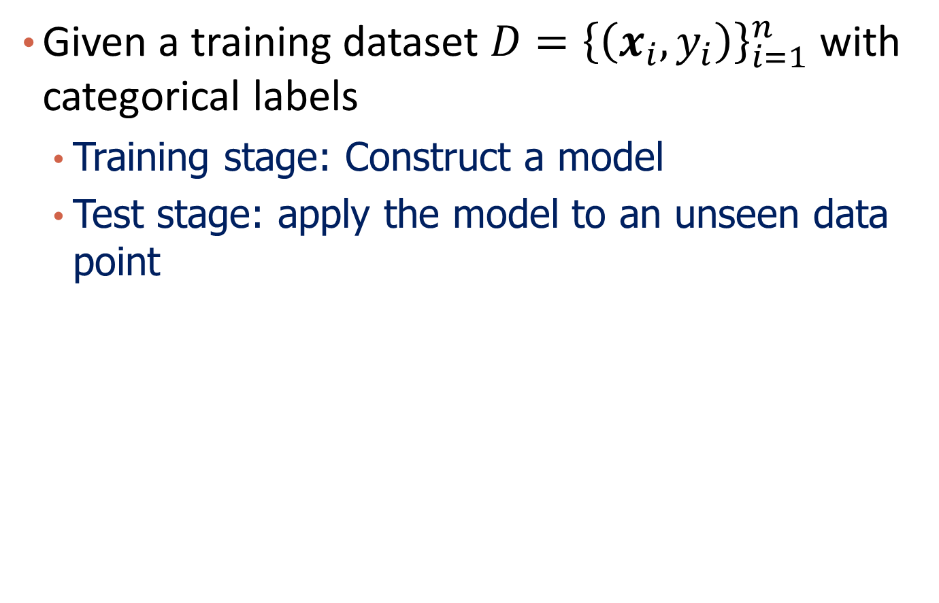
Recap: Classification
Given a training dataset $D={\left\{\left(x_{i},y_{i}\right)\right\}}_{i=1}^{n}$ with categorical labels
Training stage: Construct a model
Test stage: apply the model to an unseen data point

Slide 4
Example: Tabular data classification
Heart disease diagnosis
Age | Sex | ChestPain | RestBP | Chol | Fbs | RestECG | MaxHR | ExAng | Oldpeak | Slope | Ca | Thal | AHD
63 | 1 | typical | 145 | 233 | 1 | 2 | 150 | 0 | 2.3 | 3 | 0.0 | fixed | No
67 | 1 | asymptomatic | 160 | 286 | 0 | 2 | 108 | 1 | 1.5 | 2 | 3.0 | normal | Yes
67 | 1 | asymptomatic | 120 | 229 | 0 | 2 | 129 | 1 | 2.6 | 2 | 2.0 | reversable | Yes
37 | 1 | nonanginal | 130 | 250 | 0 | 0 | 187 | 0 | 3.5 | 3 | 0.0 | normal | No
41 | 0 | nontypical | 130 | 204 | 0 | 2 | 172 | 0 | 1.4 | 1 | 0.0 | normal | No

Slide 5


Example: Text Classification
Spam detection
Sentiment analysis
From: airak@medicana.com.tr
Subject: Loan Offer
Do you need a personal or business loan urgent that can be process within 2 to 3 working days? Have you been frustrated so many times by your banks and other loan firm and you don't know what to do? Here comes the Good news Deutsche Bank Financial Business and Home Loan is here to offer you any kind of loan you need at an affordable interest rate of 3% If you are interested let us know.

Slide 6


Join at slido.com #146811
ⓘ Start presenting to display the joining instructions on this slide.

Slide 7

Write down the classification algorithms that you've learned
ⓘ Start presenting to display the poll results on this slide.

Slide 8
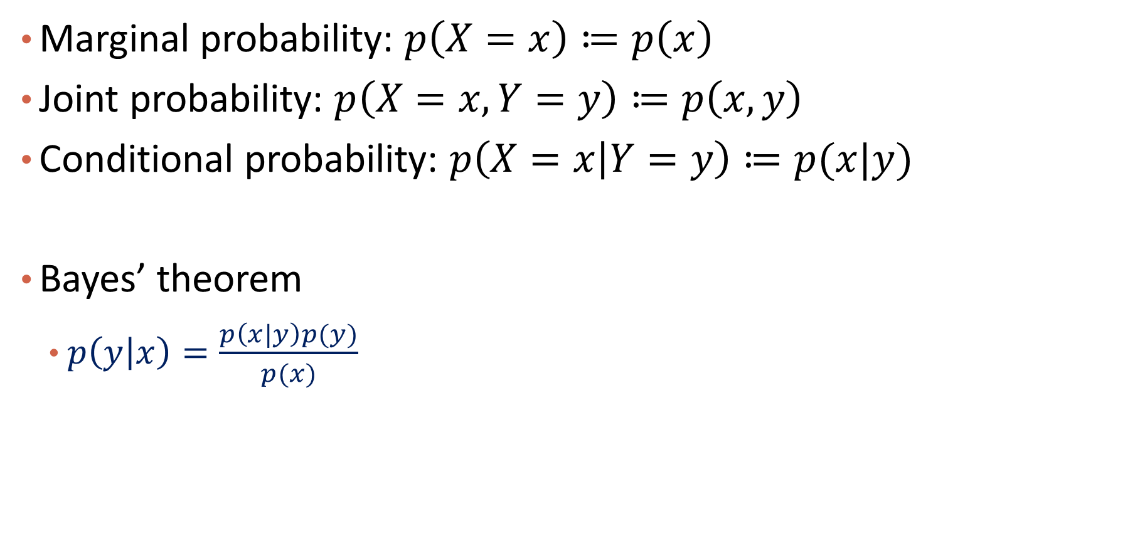
Recap: Probability and Bayes’ Theorem
Marginal probability: $p\left(X=x\right)≔p\left(x\right)$
Joint probability: $p\left(X=x,Y=y\right)≔p\left(x,y\right)$
Conditional probability: $p\left(X=x | Y=y\right)≔p(x|y)$
Bayes’ theorem
$p\left(y | x\right)=\frac{p\left(x|y\right)p(y)}{p(x)}$

Slide 9
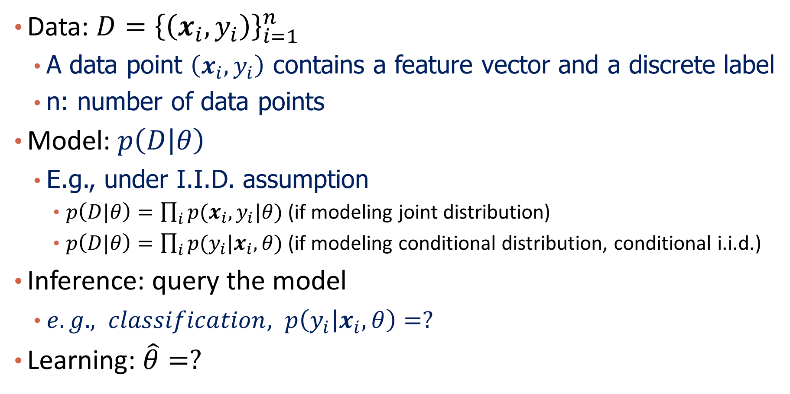
Probabilistic Models for Classification
Data: $D={\left\{\left(x_{i},y_{i}\right)\right\}}_{i=1}^{n}$
A data point $\left(x_{i},y_{i}\right)$ contains a feature vector and a discrete label
n: number of data points
Model: $p\left(D | θ\right)$
E.g., under I.I.D. assumption
$p\left(D|θ\right)=\prod_{i}{p(x_{i},y_{i}|θ)}$ (if modeling joint distribution)
$p\left(D|θ\right)=\prod_{i}{p(y_{i}|x_{i},θ)}$ (if modeling conditional distribution, conditional i.i.d.)
Inference: query the model
$e.g., classification, p\left(y_{i} | x_{i},θ\right)=?$
Learning: $\hat{θ}=?$

Slide 10
Content
Probabilistic Models
Naïve Bayes
Logistic Regression
Generative Models and Discriminative Models
Summary

Slide 11
Take text classification as an example
Spam detection
From: airak@medicana.com.tr
Subject: Loan Offer
Do you need a personal or business loan urgent that can be process within 2 to 3 working days? Have you been frustrated so many times by your banks and other loan firm and you don't know what to do? Here comes the Good news Deutsche Bank Financial Business and Home Loan is here to offer you any kind of loan you need at an affordable interest rate of 3% If you are interested let us know.

Slide 12
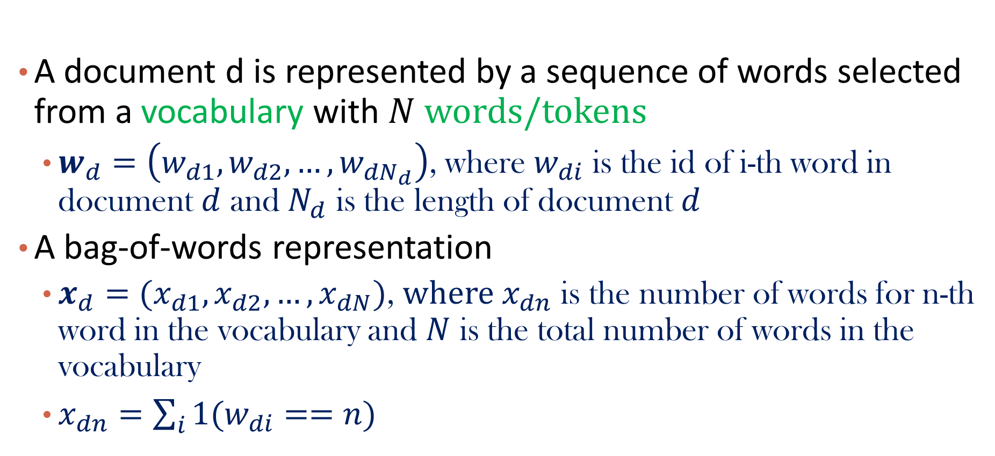
Represent A Document
Ex: “Do you need a personal or business loan urgent?”
A document d is represented by a sequence of words selected from a vocabulary with $N$ words/tokens
$w_{d}=\left(w_{d1},w_{d2},…,w_{dN_{d}}\right)$, where $w_{di}$ is the id of i-th word in document $d$ and $N_{d}$ is the length of document $d$
A bag-of-words representation
$x_{d}=(x_{d1},x_{d2},…,x_{dN})$, $where x_{dn}$ is the number of words for n-th word in the vocabulary and $N$ is the total number of words in the vocabulary
$x_{dn}=\sum_{i}{1(w_{di}==n)}$

Slide 13
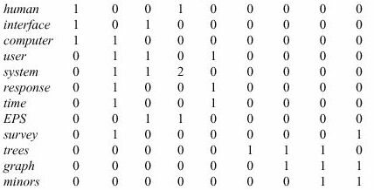
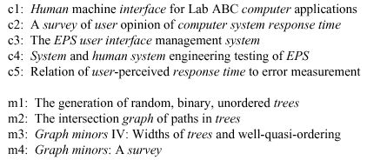

Example of Bag-of-Words Representation
c1 c2 c3 c4 c5 m1 m2 m3 m4
$$x_{d}$$

Slide 14
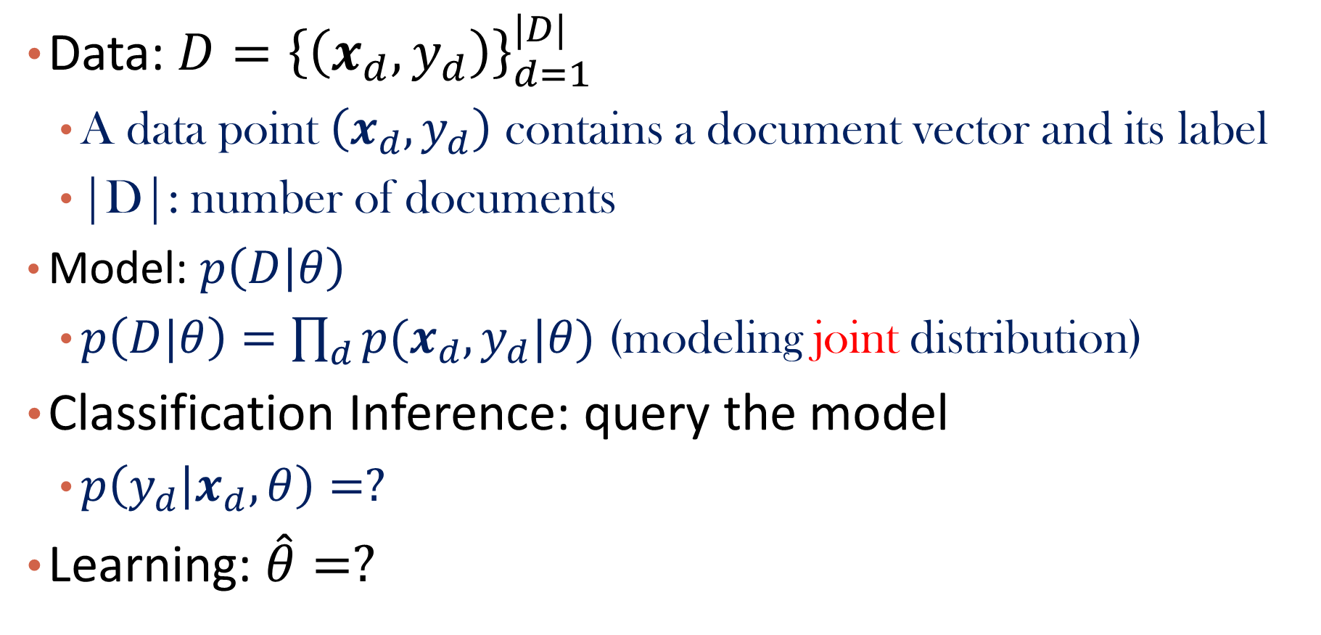
Problem formalization
Data: $D={\left\{\left(x_{d},y_{d}\right)\right\}}_{d=1}^{|D|}$
A data point $\left(x_{d},y_{d}\right)$ contains a document vector and its label
|D|: number of documents
Model: $p\left(D | θ\right)$
$p\left(D|θ\right)=\prod_{d}{p(x_{d},y_{d}|θ)}$ (modeling joint distribution)
Classification Inference: query the model
$p\left(y_{d} | x_{d},θ\right)=?$
Learning: $\hat{θ}=?$

Slide 15
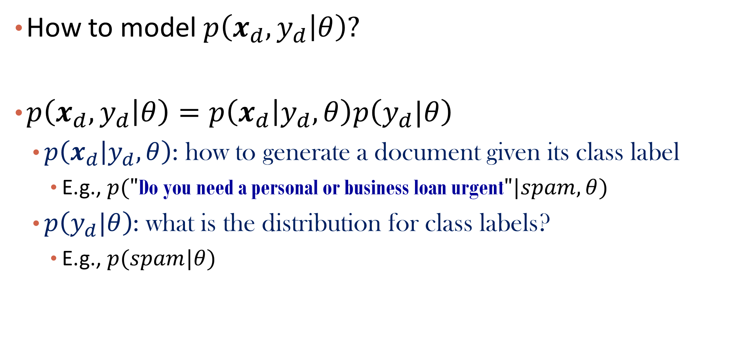
The Key Problem
How to model $p\left(x_{d},y_{d} | θ\right)?$
$p\left(x_{d},y_{d} | θ\right)=p\left(x_{d} | y_{d},θ\right)p\left(y_{d}|θ\right)$
$p\left(x_{d} | y_{d},θ\right)$: how to generate a document given its class label
E.g., $p("\text{Do} \text{you} \text{need} \text{a} \text{personal} \text{or} \text{business} \text{loan} \text{urgent}"|spam,θ)$
$p\left(y_{d}|θ\right)$: what is the distribution for class labels?
E.g., $p(spam|θ)$

Slide 16


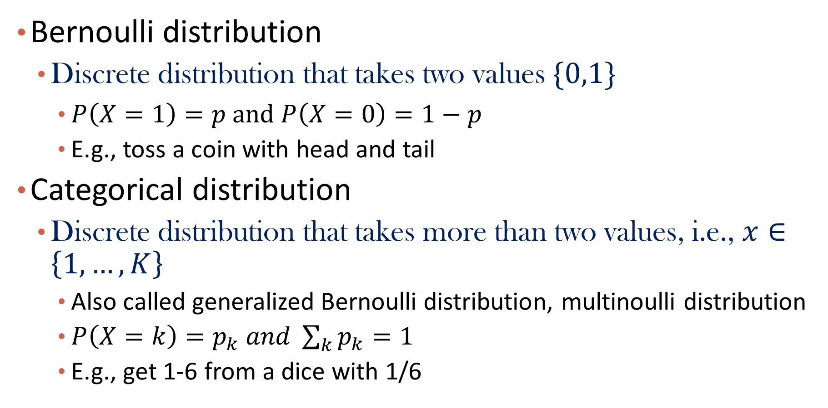
Recap: Bernoulli and Categorical Distribution
Bernoulli distribution
Discrete distribution that takes two values $\{0,1\}$
$P\left(X=1\right)=p and P\left(X=0\right)=1−p$
E.g., toss a coin with head and tail
Categorical distribution
Discrete distribution that takes more than two values, i.e., $x∈\left\{1,…,K\right\}$
Also called generalized Bernoulli distribution, multinoulli distribution
$P\left(X=k\right)=p_{k} and \sum_{k}{p_{k}}=1$
E.g., get 1-6 from a dice with 1/6

Slide 17
Please write down words that you are going to use for a healthcare article. (write down one word each time)
ⓘ Start presenting to display the poll results on this slide.

Slide 18
Please write down words that you are going to use for a sports article. (write down one word each time)
ⓘ Start presenting to display the poll results on this slide.

Slide 19
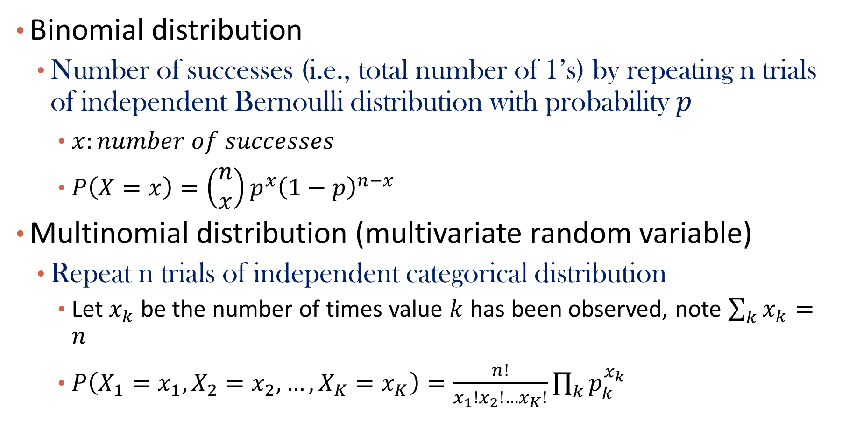
Binomial and Multinomial Distribution
Binomial distribution
Number of successes (i.e., total number of 1’s) by repeating n trials of independent Bernoulli distribution with probability $p$
$x:number of successes$
$P\left(X=x\right)=\left(\begin{matrix}n \\ x\end{matrix}\right)p^{x}{\left(1−p\right)}^{n−x}$
Multinomial distribution (multivariate random variable)
Repeat n trials of independent categorical distribution
Let $x_{k}$ be the number of times value $k$ has been observed, note $\sum_{k}{x_{k}}=n$
$P\left(X_{1}=x_{1}, X_{2}=x_{2},…,X_{K}=x_{K}\right)=\frac{n!}{x_{1}!x_{2}!…x_{K}!}\prod_{k}{p_{k}^{x_{k}}}$

Slide 20
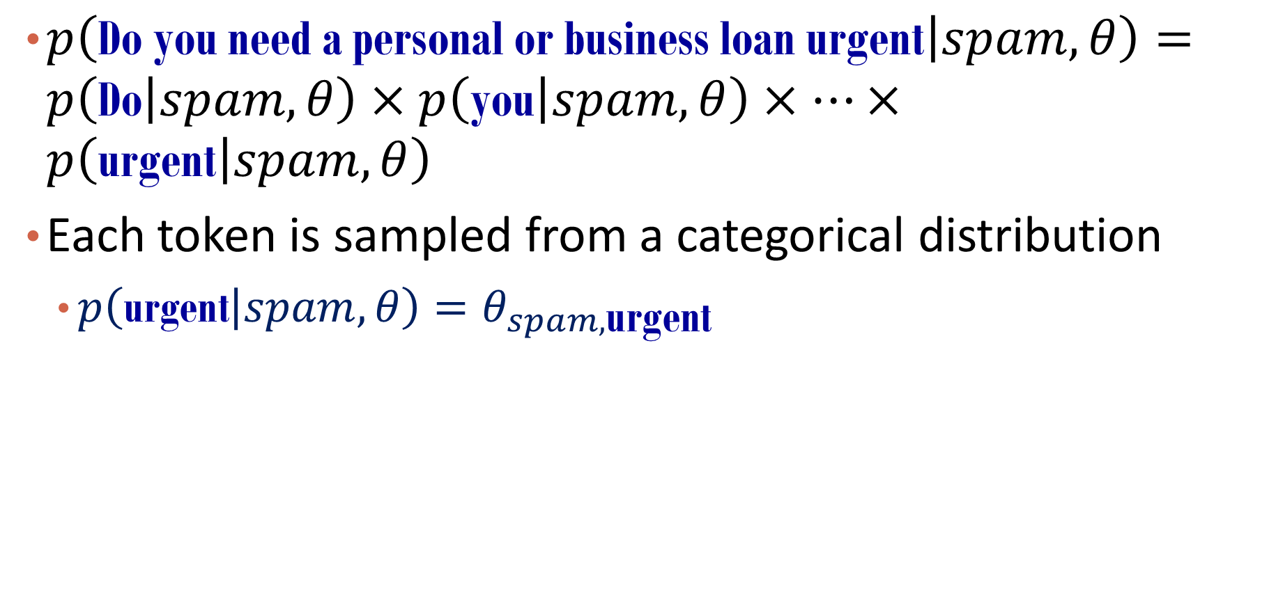
Conditional Independence Assumption
$p\left(\text{Do} \text{you} \text{need} \text{a} \text{personal} \text{or} \text{business} \text{loan} \text{urgent} | spam,θ\right)=p\left(\text{Do} | spam,θ\right)×p\left(\text{you} | spam,θ\right)×…×p\left(\text{urgent} | spam,θ\right)$
Each token is sampled from a categorical distribution
$p\left(\text{urgent} | spam,θ\right)=θ_{spam,\text{urgent}}$

Slide 21
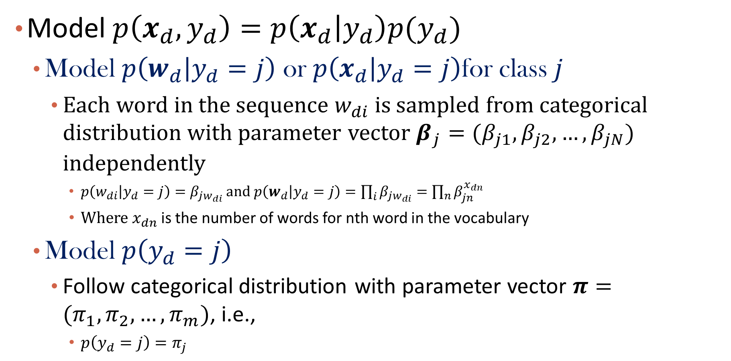
Now Come to Modeling
Model $p\left(x_{d},y_{d}\right)=p\left(x_{d} | y_{d}\right)p(y_{d})$
Model $p\left(w_{d} | y_{d}=j\right)$ or $p\left(x_{d} | y_{d}=j\right)$for class $j$
Each word in the sequence $w_{di}$ is sampled from categorical distribution with parameter vector $β_{j}=(β_{j1},β_{j2},…,β_{jN})$ independently
$p\left(w_{di} | y_{d}=j\right)=β_{jw_{di}}$ and $p\left(w_{d} | y_{d}=j\right)=\prod_{i}{β_{jw_{di}}}=\prod_{n}{β_{jn}^{x_{dn}}}$
Where $x_{dn}$ is the number of words for nth word in the vocabulary
Model $p\left(y_{d}=j\right)$
Follow categorical distribution with parameter vector $π=(π_{1},π_{2},…,π_{m})$, i.e.,
$p\left(y_{d}=j\right)=π_{j}$

Slide 22
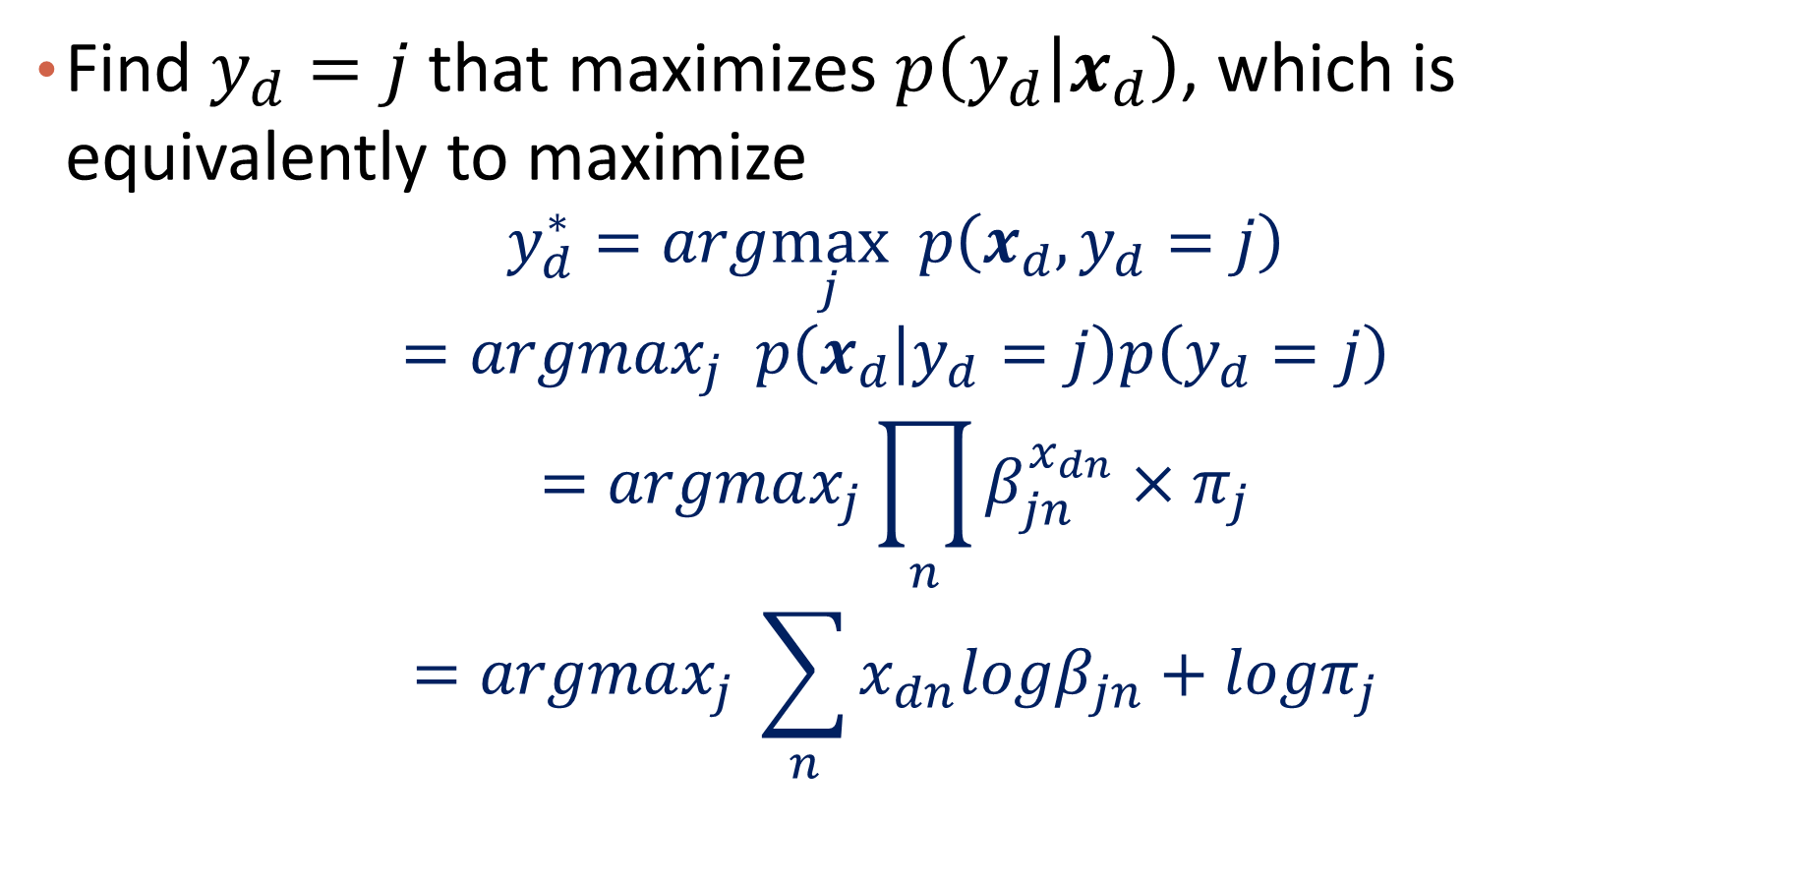
Classification Process Assuming Parameters are Given: Inference
Find $y_{d}=j$ that maximizes $p\left(y_{d} | x_{d}\right)$, which is equivalently to maximize
$$y_{d}^{∗}=arg\max_{j} p\left(x_{d},y_{d}=j\right)$$
$$=argmax_{j} p\left(x_{d} | y_{d}=j\right)p\left(y_{d}=j\right)$$
$$=argmax_{j}\prod_{n}{β_{jn}^{x_{dn}}}×π_{j}$$
$$=argmax_{j} \sum_{n}{x_{dn}logβ_{jn}}+logπ_{j}$$
Notes:
A1 + b1 > a2 + b2
2a1 + b1 ? 2a2 + b2? (a1, a2?)

Slide 23
Announcement
Three sessions have been combined in BruinLearn
Everyone could access Echo360 for recordings
Slides will be updated in course website
Please join Piazza if not yet
About PTE
I will enroll students in waitlist
Can at most give out 5 more PTEs if no one is dropping
Will keep monitoring the number of enrollment

Slide 24
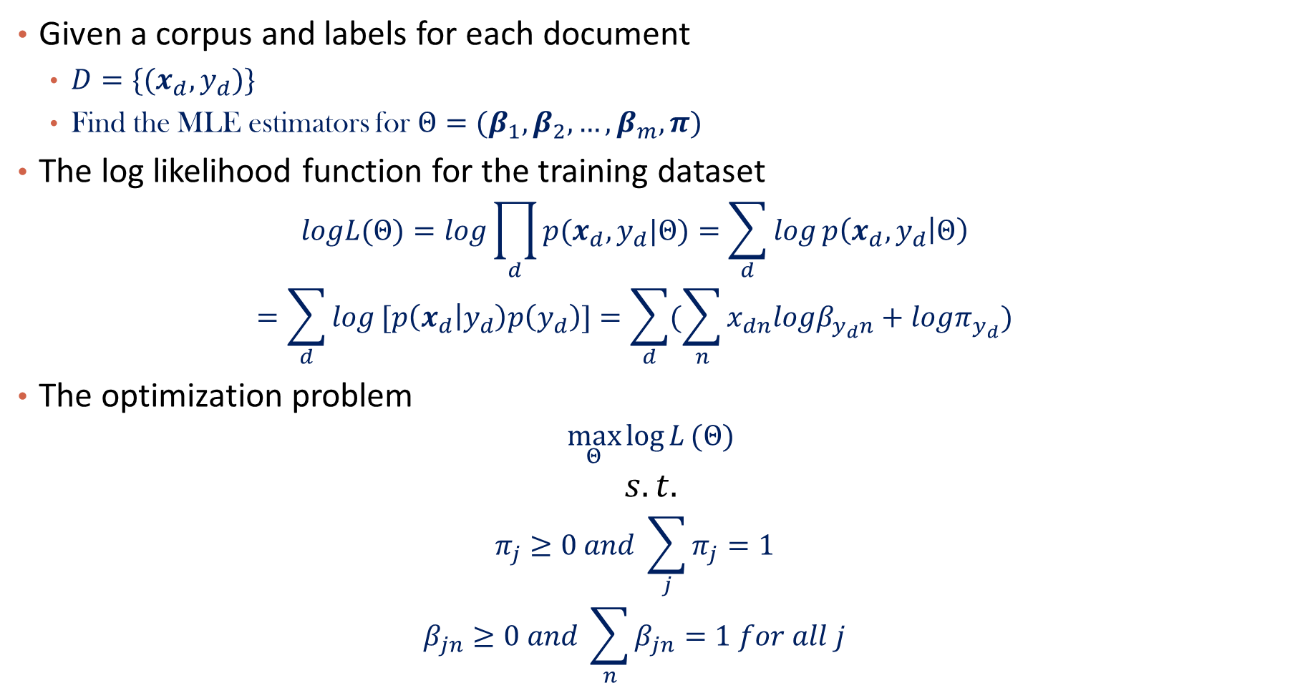
Parameter Estimation via MLE: Learning
Given a corpus and labels for each document
$D=\{(x_{d}, y_{d})\}$
Find the MLE estimators for ${Θ=(β}_{1},β_{2},…,β_{m},π)$
The log likelihood function for the training dataset
$$logL(Θ)=log\prod_{d}{p(x_{d},y_{d}|Θ)}=\sum_{d}{log}p\left(x_{d},y_{d} | Θ\right)$$
$$=\sum_{d}{log}[p\left(x_{d} | y_{d}\right)p\left(y_{d}\right)]=\sum_{d}{(\sum_{n}{x_{dn}logβ_{y_{d}n}}+logπ_{y_{d}})}$$
The optimization problem
$$\max_{Θ}{\log{L}}(Θ)$$
$$s.t.$$
$$π_{j}≥0 and \sum_{j}{π_{j}=1}$$
$$β_{jn}≥0 and \sum_{n}{β_{jn}}=1 for all j$$

Slide 25

Question from Baotao from last lecture
How the length of the document affect the parameter learning?
Hint: repeating a document 10 times => $x_{d}$ becomes ?

Slide 26
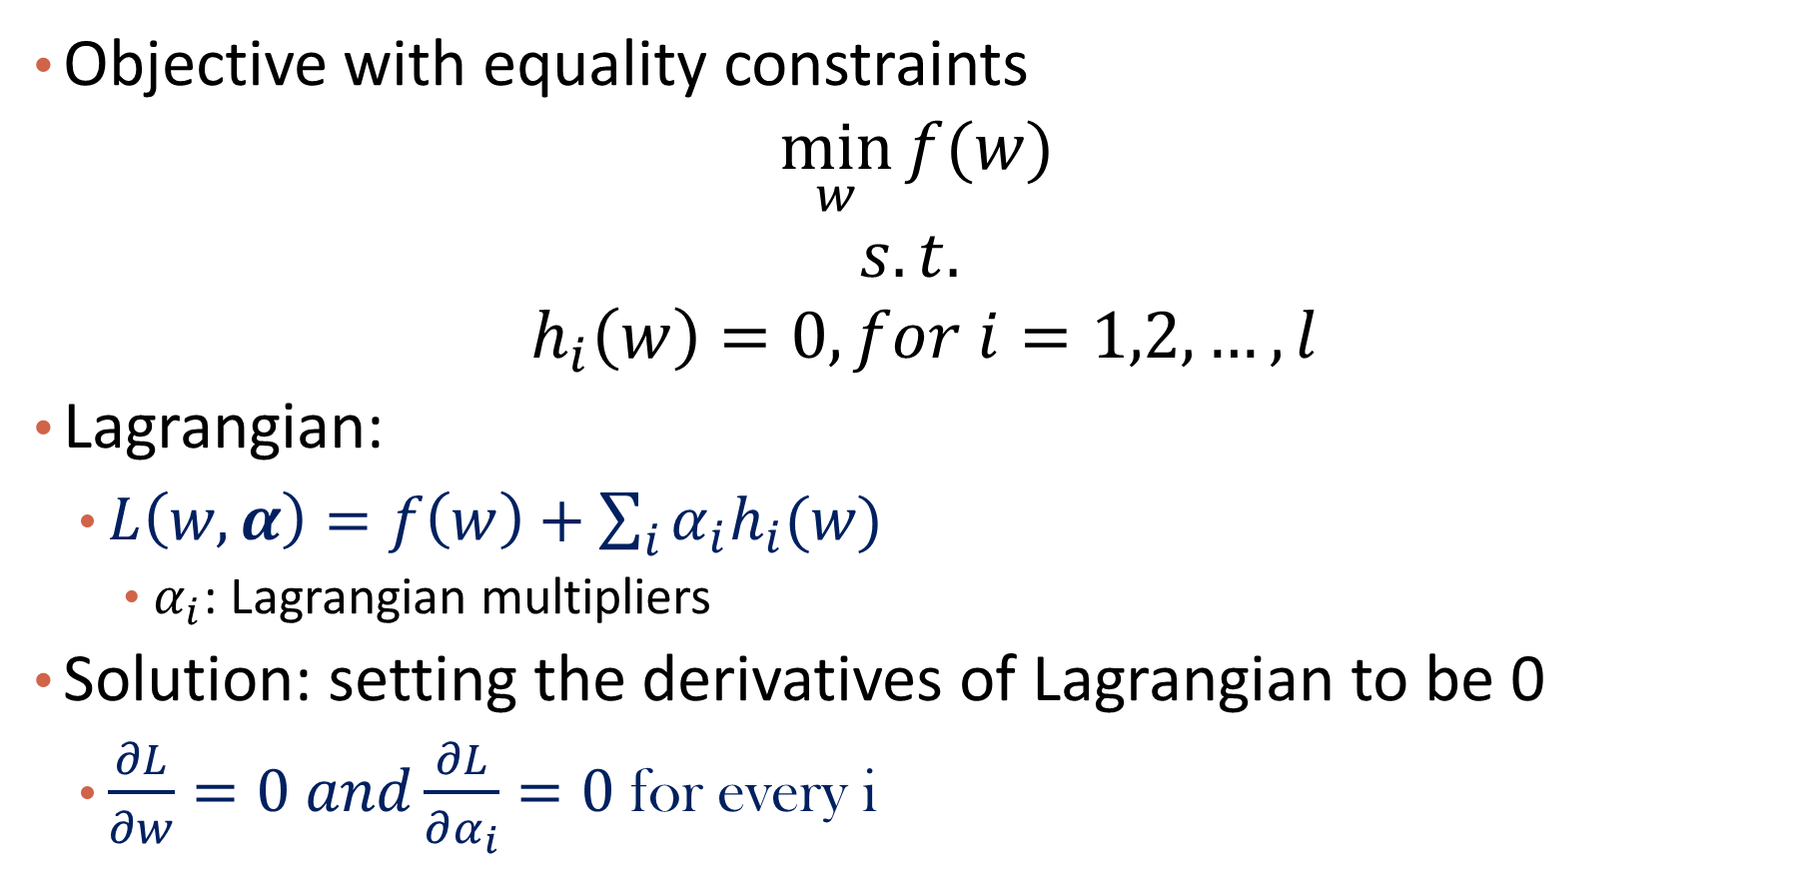
Recap: Lagrangian
Objective with equality constraints
$$\min_{w}{f(w)}$$
$$s.t.$$
$${ h}_{i}\left(w\right)=0, for i=1,2,…,l$$
Lagrangian:
$L\left(w,α\right)=f\left(w\right)+\sum_{i}{α_{i}h_{i}(w)}$
$α_{i}$: Lagrangian multipliers
Solution: setting the derivatives of Lagrangian to be 0
$\frac{∂L}{∂w}=0 and\frac{∂L}{∂α_{i}}=0$ for every i

Slide 27

Solve the Optimization Problem
$$\max_{Θ}{\sum_{d}{(\sum_{n}{x_{dn}logβ_{y_{d}n}}+logπ_{y_{d}})}{}}$$
$$s.t.$$
$$π_{j}≥0 and \sum_{j}{π_{j}=1}$$
$$β_{jn}≥0 and \sum_{n}{β_{jn}}=1 for all j$$
Use the Lagrange multiplier method

Slide 28
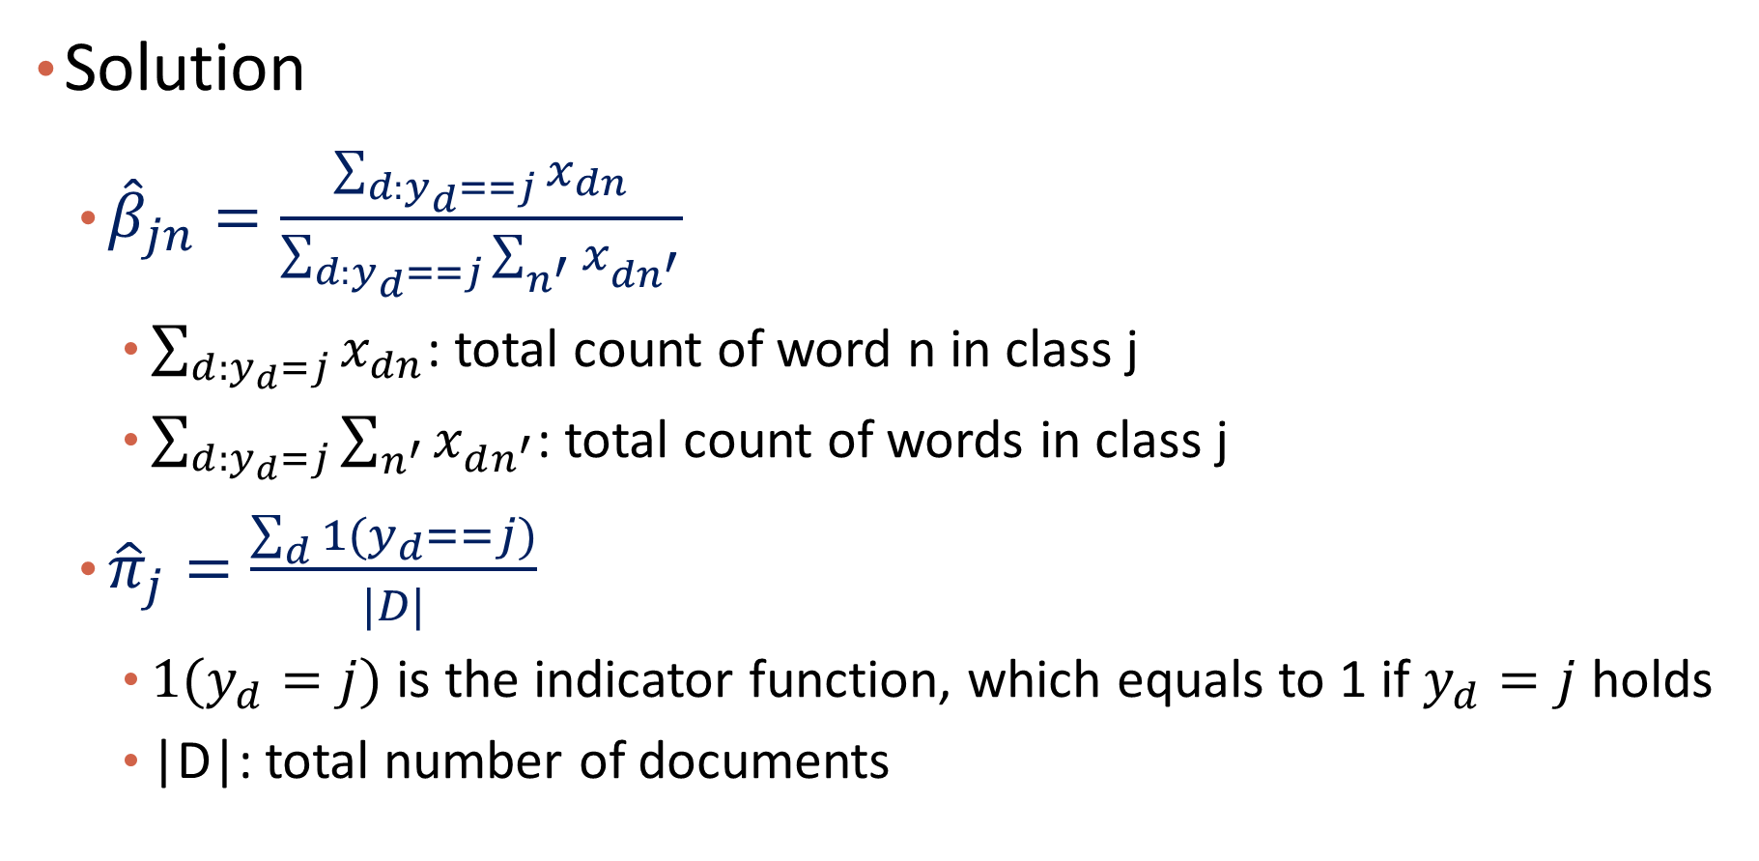
Solve the Optimization Problem
Solution
${\hat{β}}_{jn}=\frac{\sum_{d:y_{d}==j}{x_{dn}}}{\sum_{d:y_{d}==j}{\sum_{n^{′}}{x_{dn^{′}}}}}$
$\sum_{d:y_{d}=j}{x_{dn}}$: total count of word n in class j
$\sum_{d:y_{d}=j}{\sum_{n^{′}}{x_{dn^{′}}}}$: total count of words in class j
${\hat{π}}_{j}=\frac{\sum_{d}{1(y_{d}==j)}}{|D|}$
$1(y_{d}=j)$ is the indicator function, which equals to 1 if $y_{d}=j$ holds
|D|: total number of documents

Slide 29
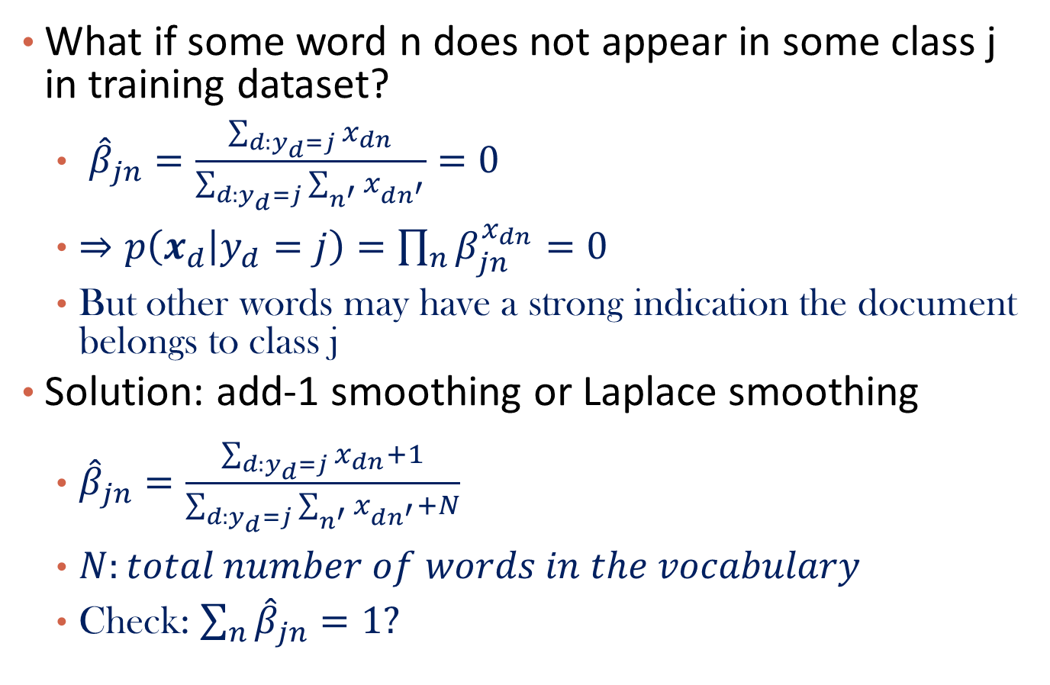
Smoothing
What if some word n does not appear in some class j in training dataset?
${\hat{β}}_{jn}=\frac{\sum_{d:y_{d}=j}{x_{dn}}}{\sum_{d:y_{d}=j}{\sum_{n^{′}}{x_{dn^{′}}}}}=0$
$⇒p\left(x_{d} | y_{d}=j\right)=\prod_{n}{β_{jn}^{x_{dn}}}=0$
But other words may have a strong indication the document belongs to class j
Solution: add-1 smoothing or Laplace smoothing
${\hat{β}}_{jn}=\frac{\sum_{d:y_{d}=j}{x_{dn}}+1}{\sum_{d:y_{d}=j}{\sum_{n^{′}}{x_{dn^{′}}+N}}}$
$N:total number of words in the vocabulary$
Check: $\sum_{n}{{\hat{β}}_{jn}}=1?$

Slide 30



Example
Data:
Vocabulary:
Learned parameters (with smoothing):
Index | 1 | 2 | 3 | 4 | 5 | 6
Word | Chinese | Beijing | Shanghai | Macao | Tokyo | Japan
$${\hat{β}}_{c1}=\frac{5+1}{8+6}=\frac{3}{7}$$
$${\hat{β}}_{c2}=\frac{1+1}{8+6}=\frac{1}{7}$$
$${\hat{β}}_{c3}=\frac{1+1}{8+6}=\frac{1}{7}$$
$${\hat{β}}_{c4}=\frac{1+1}{8+6}=\frac{1}{7}$$
$${\hat{β}}_{c5}=\frac{0+1}{8+6}=\frac{1}{14}$$
$${\hat{β}}_{c6}=\frac{0+1}{8+6}=\frac{1}{14}$$
$${\hat{β}}_{j1}=\frac{1+1}{3+6}=\frac{2}{9}$$
$${\hat{β}}_{j2}=\frac{0+1}{3+6}=\frac{1}{9}$$
$${\hat{β}}_{j3}=\frac{0+1}{3+6}=\frac{1}{9}$$
$${\hat{β}}_{j4}=\frac{0+1}{3+6}=\frac{1}{9}$$
$${\hat{β}}_{j5}=\frac{1+1}{3+6}=\frac{2}{9}$$
$${\hat{β}}_{j6}=\frac{1+1}{3+6}=\frac{2}{9}$$
$${\hat{π}}_{c}=\frac{3}{4}$$
$${\hat{π}}_{j}=\frac{1}{4}$$

Slide 31
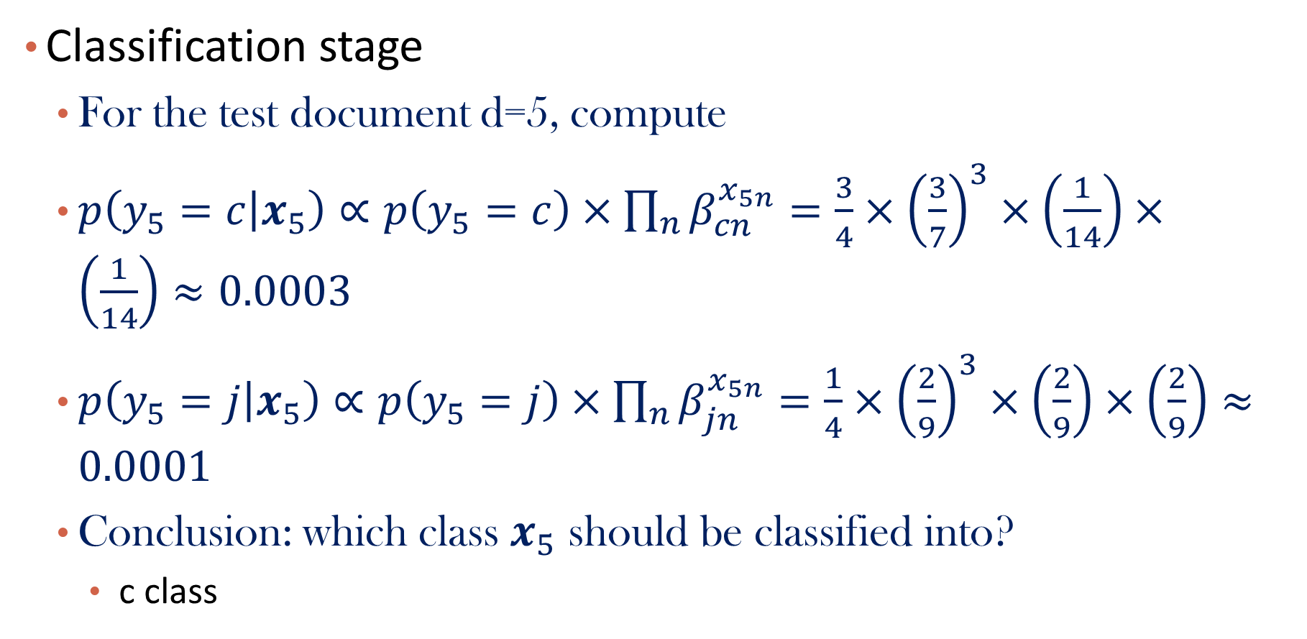
Example (Continued)
Classification stage
For the test document d=5, compute
$p\left(y_{5}=c | x_{5}\right)∝p\left(y_{5}=c\right)×\prod_{n}{β_{cn}^{x_{5n}}}=\frac{3}{4}×{\left(\frac{3}{7}\right)}^{3}×\left(\frac{1}{14}\right)×\left(\frac{1}{14}\right)≈0.0003$
$p\left(y_{5}=j | x_{5}\right)$ $∝p\left(y_{5}=j\right)×\prod_{n}{β_{jn}^{x_{5n}}}=\frac{1}{4}×{\left(\frac{2}{9}\right)}^{3}×\left(\frac{2}{9}\right)×\left(\frac{2}{9}\right)≈0.0001$
Conclusion: which class $x_{5}$ should be classified into?
c class

Slide 32
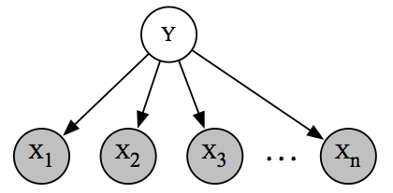
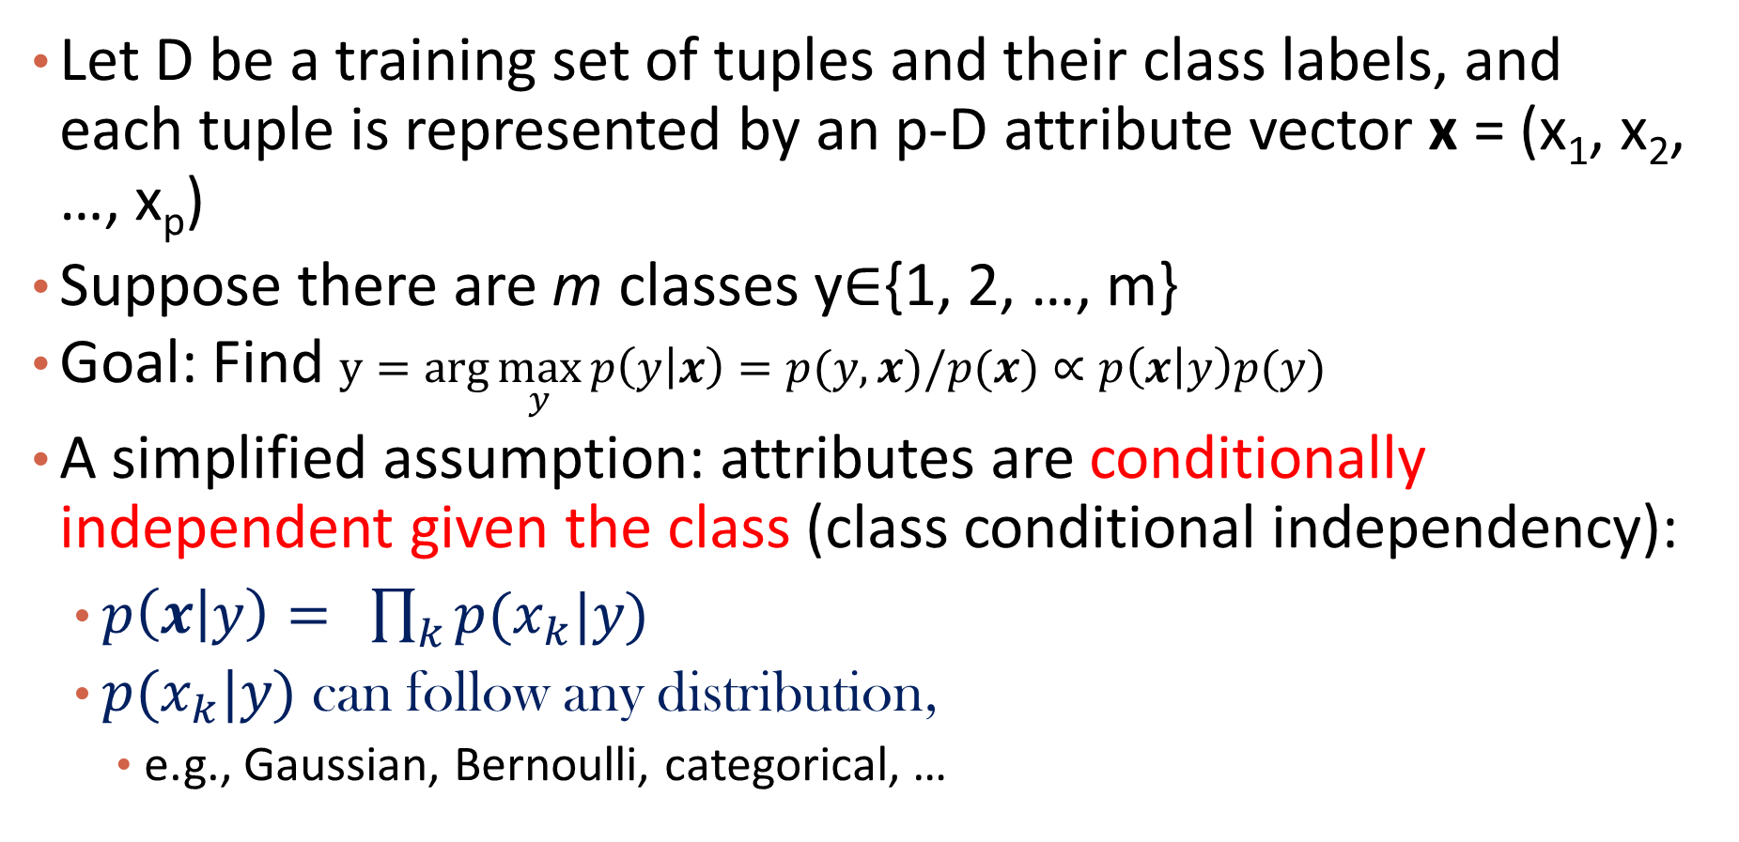
A More General Naïve Bayes Framework
Let D be a training set of tuples and their class labels, and each tuple is represented by an p-D attribute vector x = (x₁, x₂, …, x_{p})
Suppose there are m classes y$∈${1, 2, …, m}
Goal: Find $y=arg\max_{y}{p\left(y | x\right)=p(y,x)/p(x)∝p\left(x | y\right)p(y)}$
A simplified assumption: attributes are conditionally independent given the class (class conditional independency):
$p\left(x | y\right)= \prod_{k}{p(x_{k}|y)}$
$p(x_{k}|y)$ can follow any distribution,
e.g., Gaussian, Bernoulli, categorical, …

Slide 33
Content
Probabilistic Models for I.I.D. Data
Naïve Bayes
Logistic Regression
Generative Models and Discriminative Models
Summary

Slide 34
Q&A

Slide 35
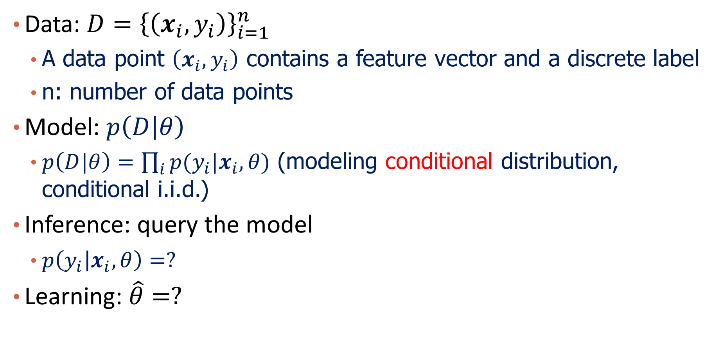
Problem Formalization
Data: $D={\left\{\left(x_{i},y_{i}\right)\right\}}_{i=1}^{n}$
A data point $\left(x_{i},y_{i}\right)$ contains a feature vector and a discrete label
n: number of data points
Model: $p\left(D | θ\right)$
$p\left(D|θ\right)=\prod_{i}{p(y_{i}|x_{i},θ)}$ (modeling conditional distribution, conditional i.i.d.)
Inference: query the model
$p\left(y_{i} | x_{i},θ\right)=?$
Learning: $\hat{θ}=?$

Slide 36

The Key Problem
How to model $p\left(y_{i} | x_{i},θ\right)?$
$p\left(y_{i} | x_{i},θ\right):$what is the distribution for class labels given the current feature vector?

Slide 37
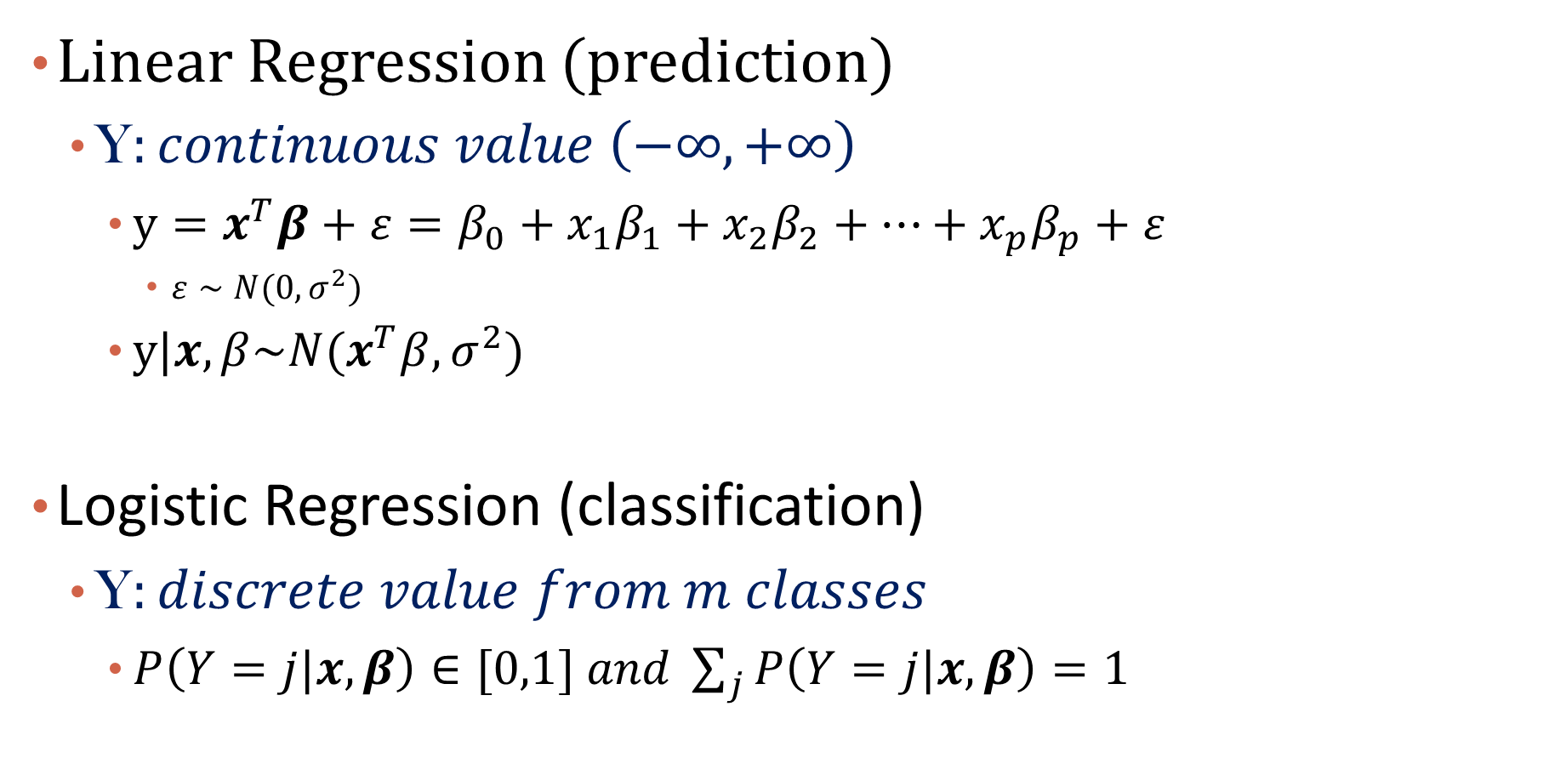

Model: Linear Regression VS. Logistic Regression
Linear Regression (prediction)
Y$:continuous value \left(−∞,+∞\right)$
$y=x^{T}β+ε={β_{0}+x}_{1}β_{1}+x_{2}β_{2}+…+x_{p}β_{p}+ε$
$ε∼N(0,σ^{2})$
$y|x,β\sim N(x^{T}β,σ^{2})$
Logistic Regression (classification)
Y$:discrete value from m classes$
$P\left(Y=j|x,β\right)∈[0,1] and \sum_{j}{P\left(Y=j|x,β\right)}=1$
Note: add additional constant feature 1 to original $x$ to accommodate bias term

Slide 38
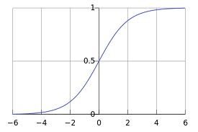
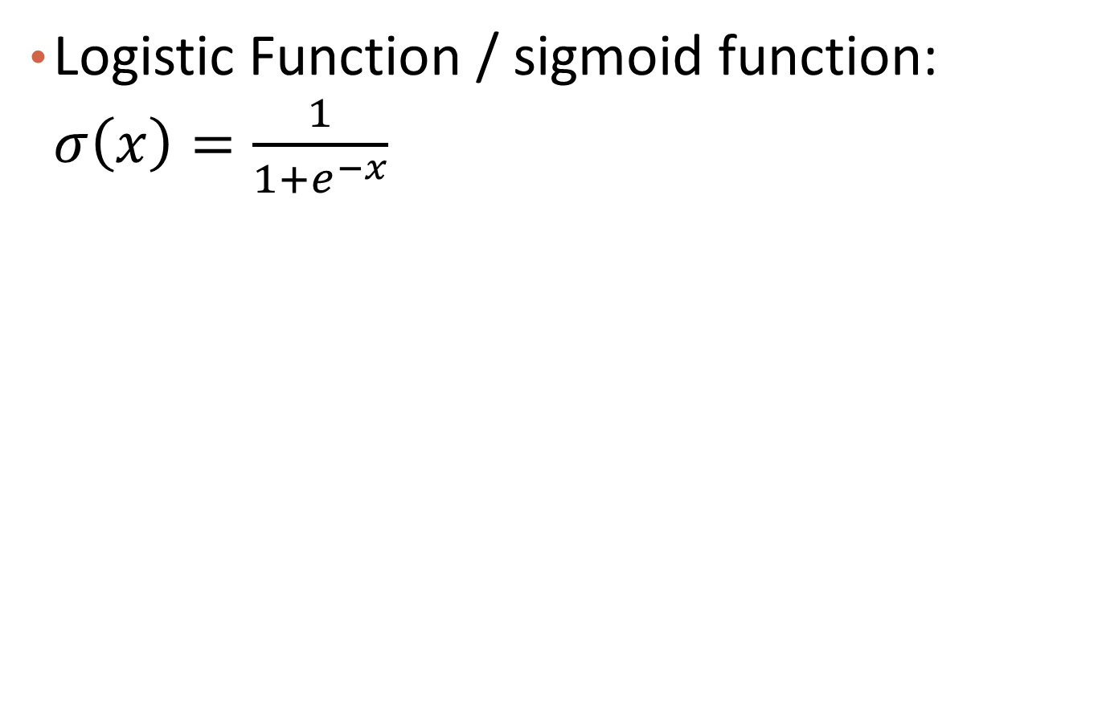

Logistic Function
Logistic Function / sigmoid function: $σ\left(x\right)=\frac{1}{1+e^{−x}}$
$$Note:σ^{′}\left(x\right)=σ(x)(1−σ(x))$$
Notes:
Discussion session. Derivation

Slide 39
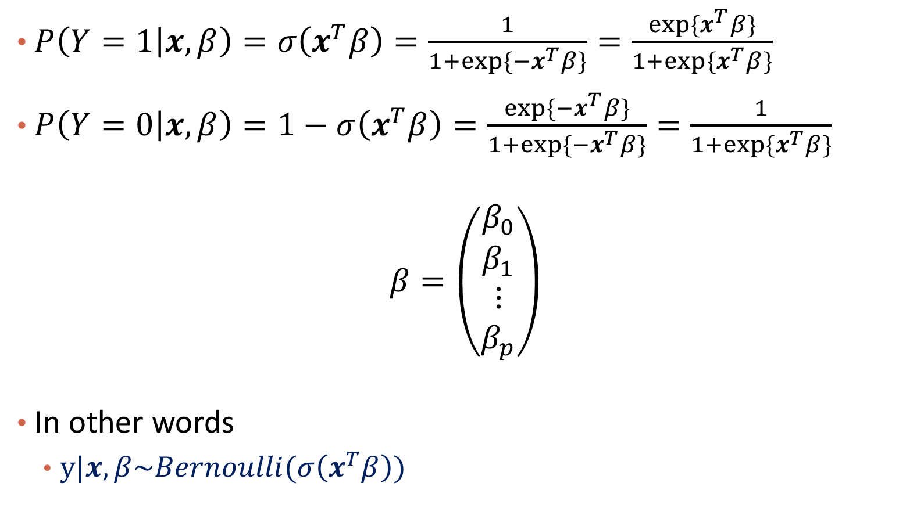
Modeling Probabilities of Two Classes
$P\left(Y=1 | x,β\right)=σ\left(x^{T}β\right)=\frac{1}{1+exp⁡\{{−x}^{T}β\}}=\frac{exp⁡\{x^{T}β\}}{1+exp⁡\{x^{T}β\}}$
$P\left(Y=0 | x,β\right)=1−σ\left(x^{T}β\right)=\frac{exp⁡\{{−x}^{T}β\}}{1+exp⁡\{{−x}^{T}β\}}=\frac{1}{1+exp⁡\{x^{T}β\}}$
$$β=\left(\begin{matrix}β_{0} \\ β_{1} \\ \begin{aligned}⋮ \\ β_{p}\end{aligned}\end{matrix}\right)$$
In other words
$y|x,β\sim Bernoulli(σ\left(x^{T}β\right))$

Slide 40
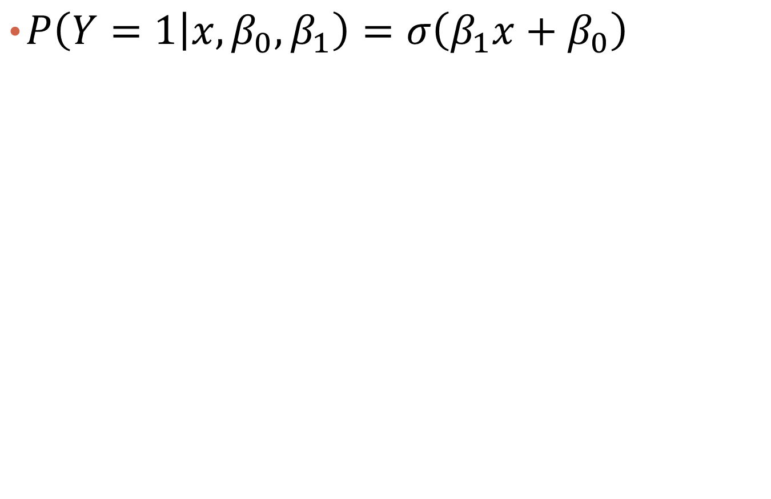
The 1-d Situation
$P\left(Y=1 | x,β_{0},β_{1}\right)=σ\left(β_{1}x+β_{0}\right)$

Slide 41
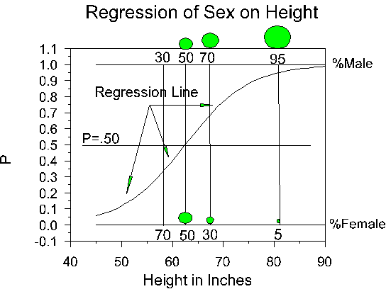

Example
Q: I$s β_{0} positive or negative$ here?
Notes:
http://faculty.cas.usf.edu/mbrannick/regression/Logistic.html
A: a negative value

Slide 42
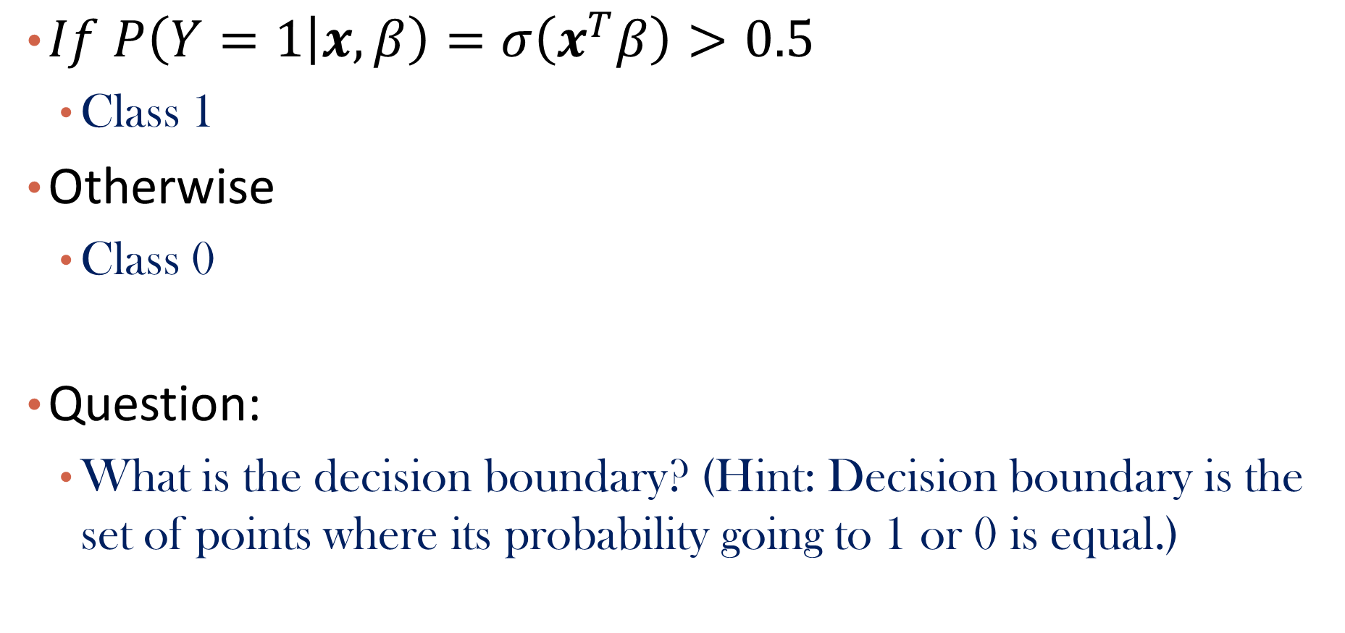
Classification Assuming Parameters are Given: Inference
$If P\left(Y=1 | x,β\right)=σ\left(x^{T}β\right)>0.5$
Class 1
Otherwise
Class 0
Question:
What is the decision boundary? (Hint: Decision boundary is the set of points where its probability going to 1 or 0 is equal.)

Slide 43
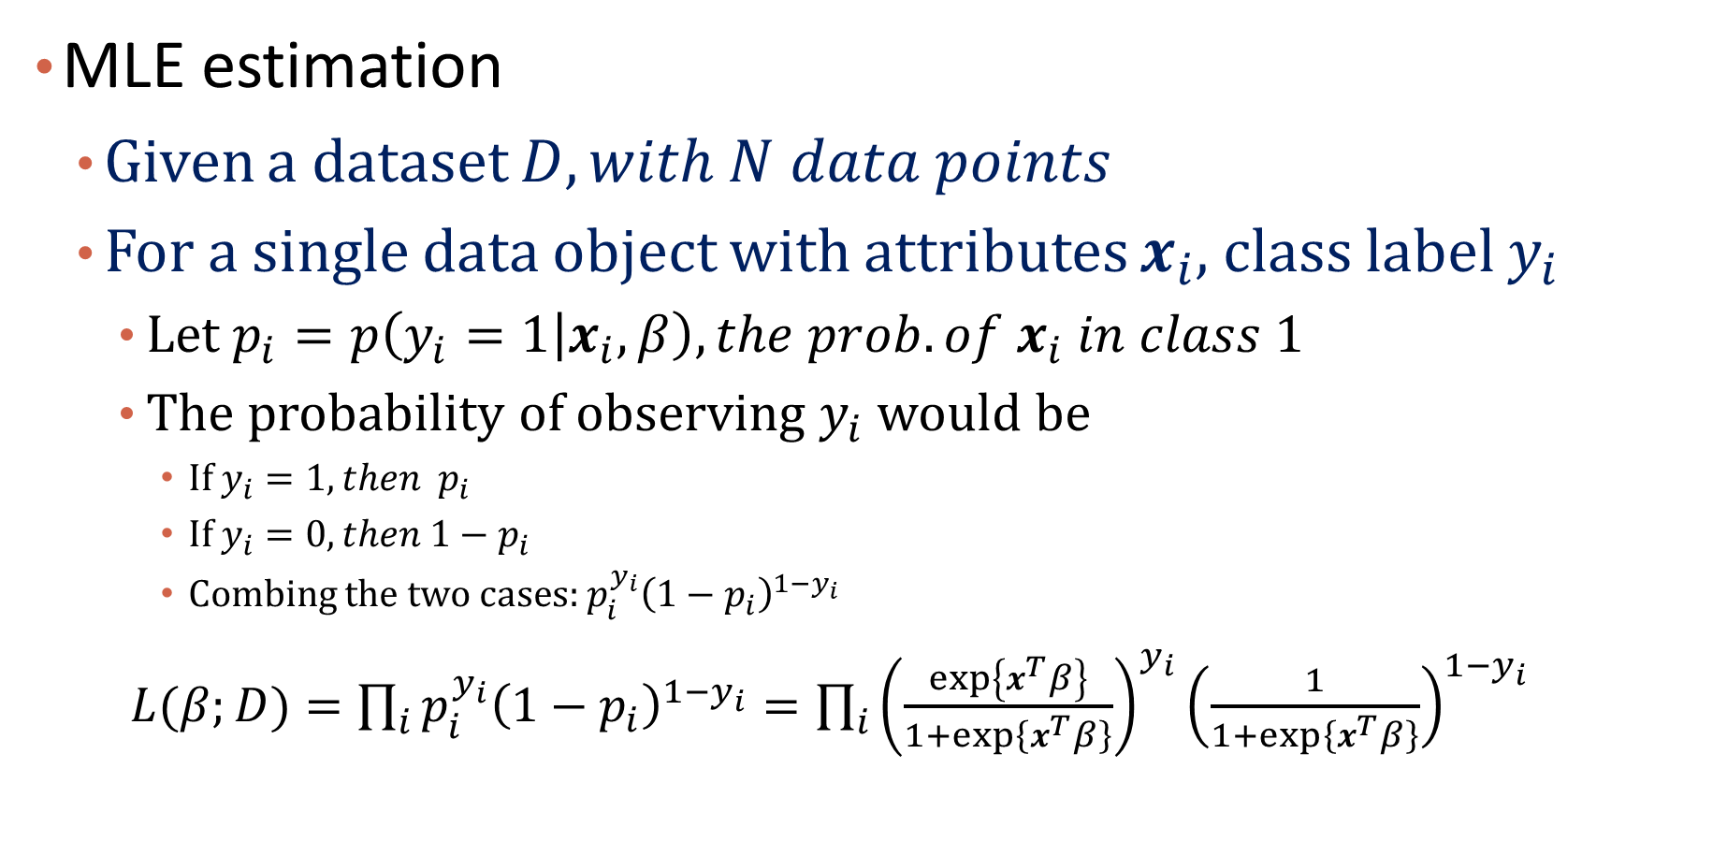
Parameter Estimation: Learning
MLE estimation
Given a dataset $D, with N data points$
For a single data object with attributes $x_{i}$, class label $y_{i}$
Let $p_{i}=p\left(y_{i}=1 | x_{i},β\right), the prob. of x_{i} in class 1$
The probability of observing $y_{i}$ would be
If $y_{i}=1, then$ $p_{i}$
If $y_{i}=0, then 1−p_{i}$
Combing the two cases: $p_{i}^{y_{i}}{\left(1−p_{i}\right)}^{1−y_{i}}$
$L(β;D)=\prod_{i}{p_{i}^{y_{i}}{\left(1−p_{i}\right)}^{1−y_{i}}}=\prod_{i}{{\left(\frac{\exp\left\{x^{T}β\right\}}{1+\exp\left\{x^{T}β\right\}}\right)}^{y_{i}}{\left(\frac{1}{1+\exp\left\{x^{T}β\right\}}\right)}^{1−y_{i}}}$

Slide 44

Optimization
Equivalent to maximize log likelihood
$logL=\sum_{i}{y_{i}x_{i}^{T}β}−\sum_{i}{log\left(1+exp\left\{x_{i}^{T}β\right\}\right)}$
Show proof:
Notes:
\beta^{new}=\beta^{old}-\biggl(\frac{\partial^2logL(\beta)}{\partial\beta\partial\beta^T}\biggr)^{-1}\frac{\partial logL(\beta)}{\partial\beta}

Slide 45
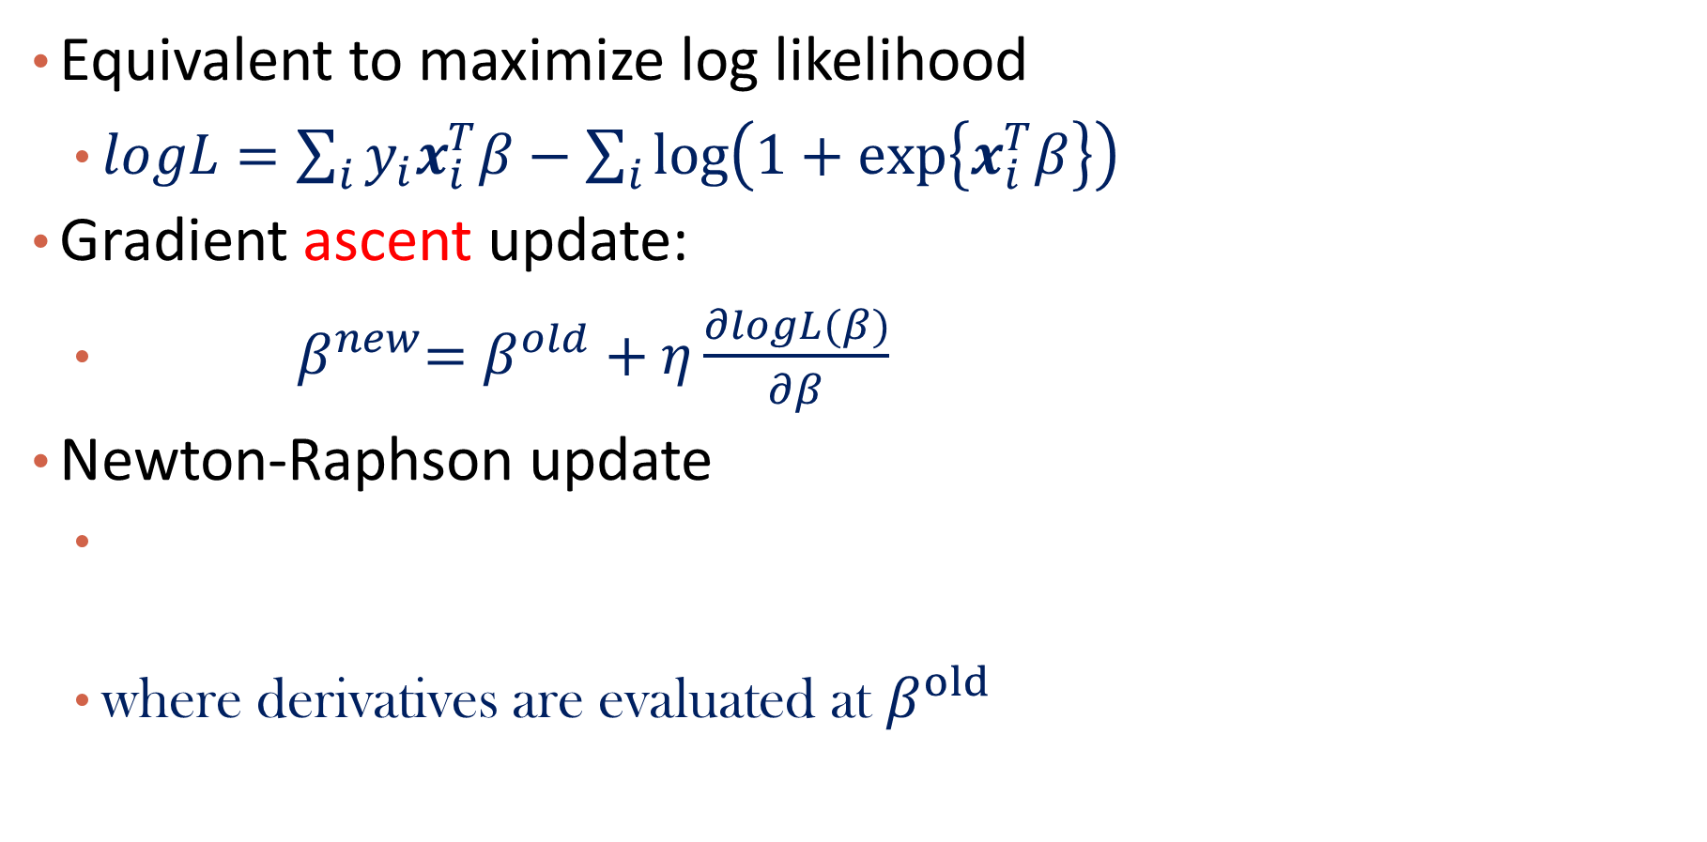
Optimization
Equivalent to maximize log likelihood
$logL=\sum_{i}{y_{i}x_{i}^{T}β}−\sum_{i}{log\left(1+exp\left\{x_{i}^{T}β\right\}\right)}$
Gradient ascent update:
${ β}^{new}=β^{old}+η\frac{∂logL(β)}{∂β}$
Newton-Raphson update
where derivatives are evaluated at $β^{old}$
Step size
Notes:
\beta^{new}=\beta^{old}-\biggl(\frac{\partial^2logL(\beta)}{\partial\beta\partial\beta^T}\biggr)^{-1}\frac{\partial logL(\beta)}{\partial\beta}

Slide 46

Show calculation
$\frac{∂logL(β)}{∂β}$, where $logL=\sum_{i}{y_{i}x_{i}^{T}β}−\sum_{i}{log\left(1+exp\left\{x_{i}^{T}β\right\}\right)}$

Slide 47

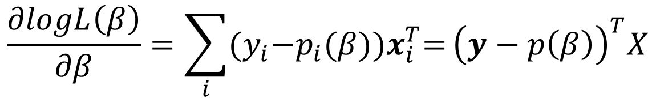

First Derivative
It is a (p+1) vector, with jth element as
$$p_{i}\left(β\right)=σ(β^{T}x_{i})$$
For j = 0, 1, …, p
Matrix form:
$$\frac{∂logL\left(β\right)}{∂β}=\sum_{i}{{(y}_{i}{−p_{i}(β))x}_{i}^{T}=}{\left(y−p\left(β\right)\right)}^{T}X$$
$$note X∈R^{N×(p+1)}$$
Notes:
\frac{\partial logL(\beta)}{\partial \beta_j} &= \sum_{i=1}^{N}y_ix_{ij}-\sum_{i=1}^N\frac{x_{ij}e^{\beta^T\mathbf{x}_i}}{1+e^{\beta^T\mathbf{x}_i}}\\
& = \sum_{i=1}^{N}y_ix_{ij}-\sum_{i=1}^{N}p_i(\beta)x_{ij}\\
&= \sum_{i=1}^{N}x_{ij}(y_i-p_i(\beta))

Slide 48
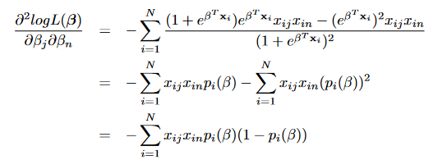
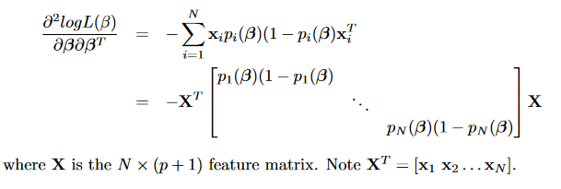
Second Derivative
It is a (p+1) by (p+1) matrix, Hessian Matrix, with jth row and nth column as
For j,n = 0, 1, …, p
Matrix form:
Notes:
For an object i, the higher the variance (closer to 0.5), the bigger learning rate
\frac{\partial^2 logL(\beta)}{\partial \beta_j\partial \beta_n} &= -\sum_{i=1}^{N}\frac{(1+e^{\beta^T\mathbf{x}_i})e^{\beta^T\mathbf{x}_i}x_{ij}x_{in}-(1+e^{\beta^T\mathbf{x}_i})^2x_{ij}x_{in}}{(1+e^{\beta^T\mathbf{x}_i})^2}\\
& = -\sum_{i=1}^{N}x_{ij}x_{in}p_i(\beta)-\sum_{i=1}^{N}x_{ij}x_{in}(p_i(\beta))^2\\
&= -\sum_{i=1}^{N}x_{ij}x_{in}p_i(\beta)(1-p_i(\beta))

Slide 49
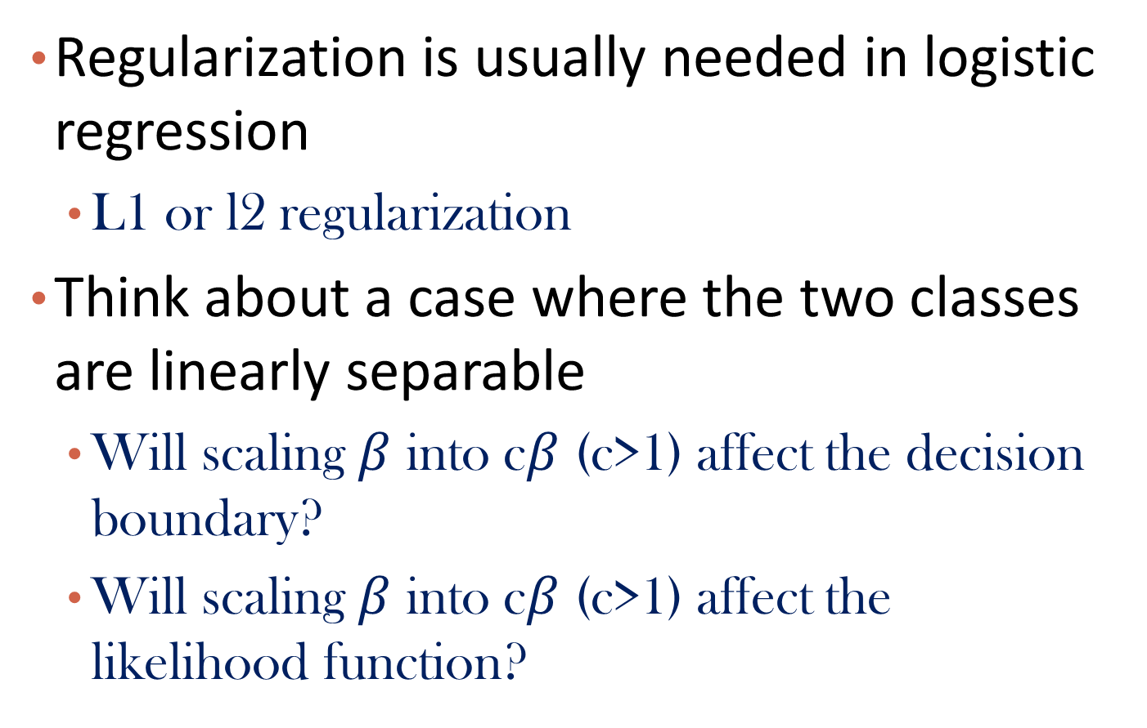
Tips
Regularization is usually needed in logistic regression
L1 or l2 regularization
Think about a case where the two classes are linearly separable
Will scaling $β$ into c$β$ (c>1) affect the decision boundary?
Will scaling $β$ into c$β$ (c>1) affect the likelihood function?

Slide 50
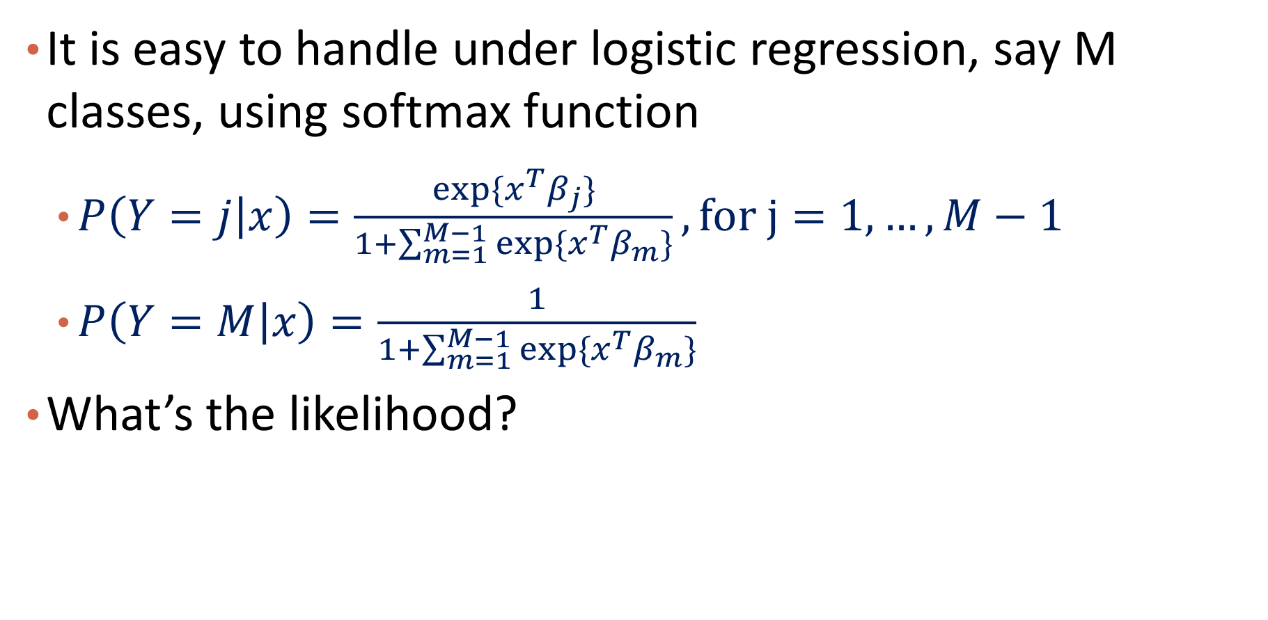
What about Multiclass Classification?
It is easy to handle under logistic regression, say M classes, using softmax function
$P\left(Y=j | x\right)=\frac{exp⁡\{x^{T}β_{j}\}}{1+\sum_{m=1}^{M−1}{exp⁡\{x^{T}β_{m}\}}}, for j=1,…,M−1$
$P\left(Y=M | x\right)=\frac{1}{1+\sum_{m=1}^{M−1}{exp⁡\{x^{T}β_{m}\}}}$
What’s the likelihood?

Slide 51
Q&A

Slide 52
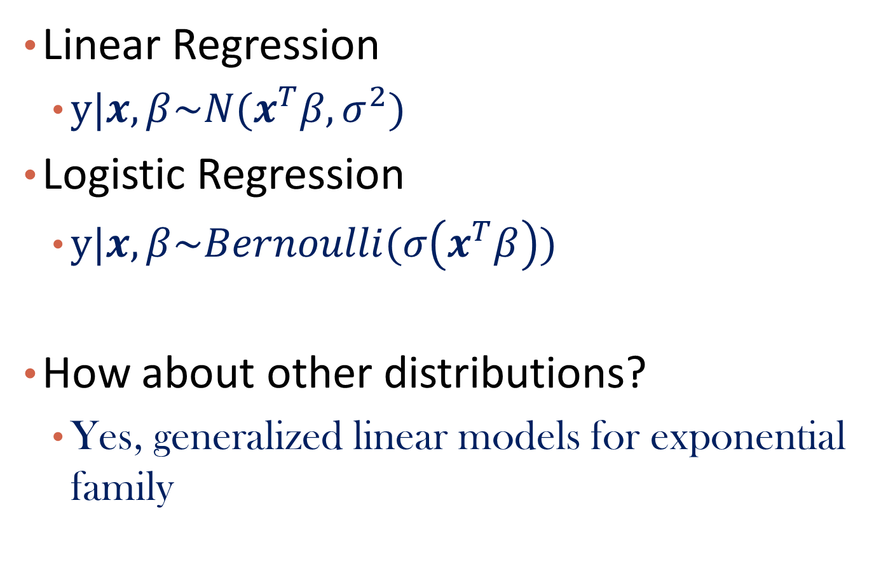
Recall Linear Regression and Logistic Regression
Linear Regression
$y|x,β\sim N(x^{T}β,σ^{2})$
Logistic Regression
$y|x,β\sim Bernoulli(σ\left(x^{T}β\right))$
How about other distributions?
Yes, generalized linear models for exponential family

Slide 53
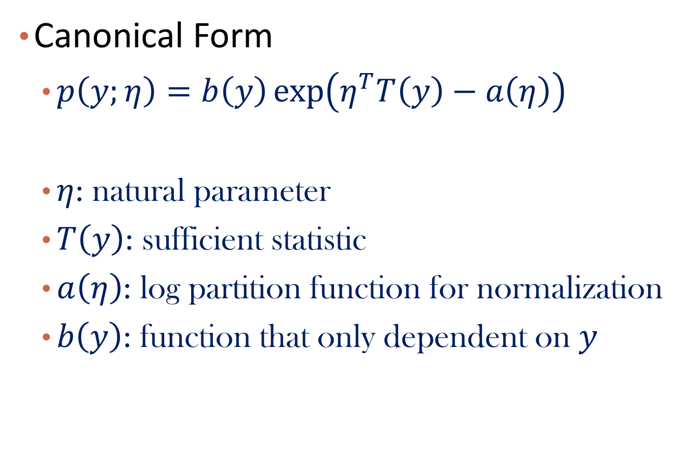
*Exponential Family
Canonical Form
$p\left(y;η\right)=b\left(y\right)\exp\left(η^{T}T\left(y\right)−a\left(η\right)\right)$
$η$: natural parameter
$T\left(y\right)$: sufficient statistic
$a\left(η\right)$: log partition function for normalization
$b\left(y\right)$: function that only dependent on $y$

Slide 54

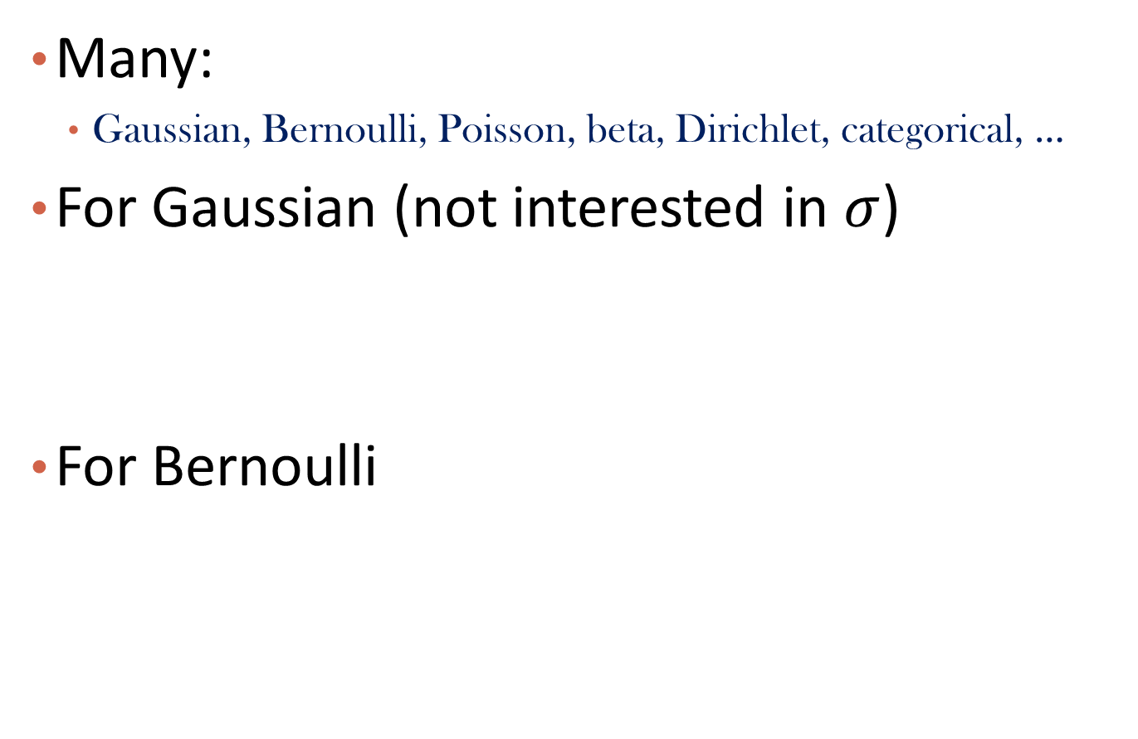

*Examples of Exponential Family
Many:
Gaussian, Bernoulli, Poisson, beta, Dirichlet, categorical, …
For Gaussian (not interested in $σ$)
For Bernoulli
$$p\left(y;η\right)=b\left(y\right)\exp\left(η^{T}T\left(y\right)−a\left(η\right)\right)$$
$$η$$

Slide 55
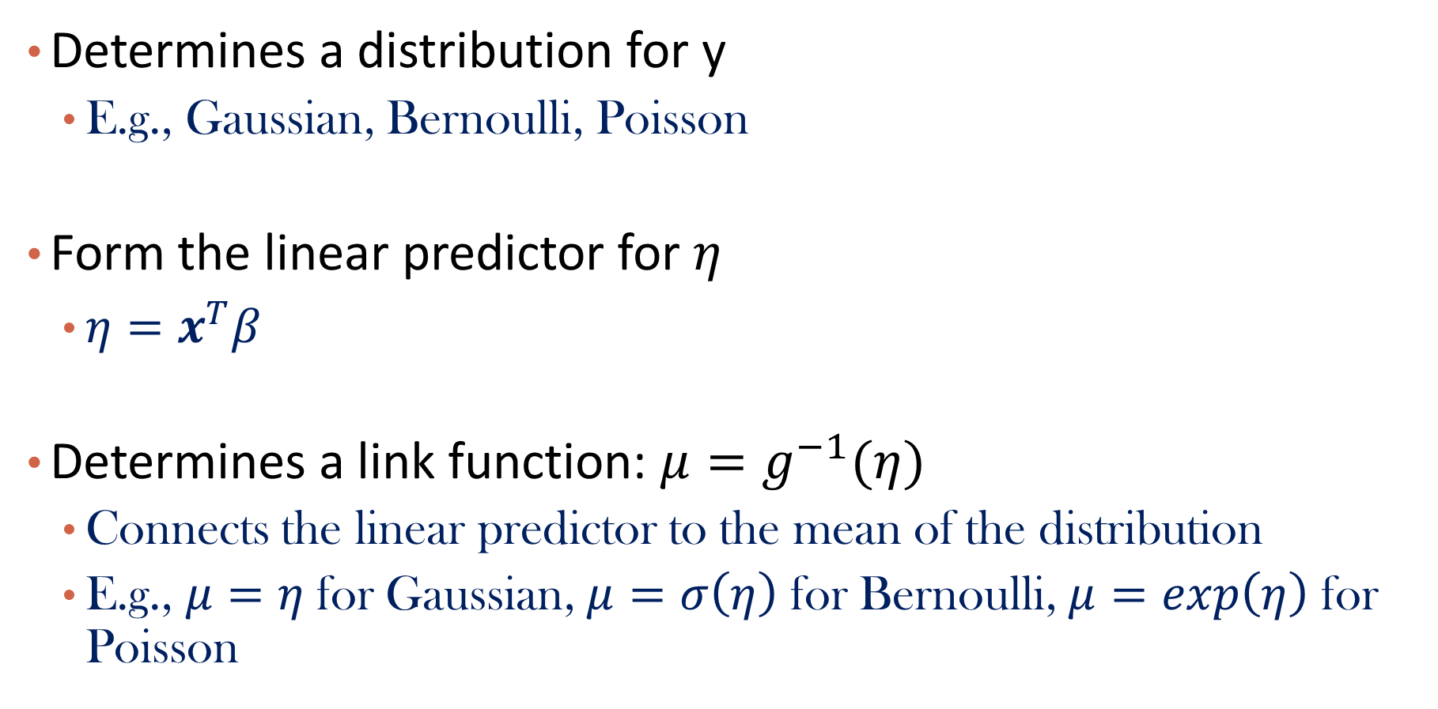
*Recipe of GLMs
Determines a distribution for y
E.g., Gaussian, Bernoulli, Poisson
Form the linear predictor for $η$
$η=x^{T}β$
Determines a link function: $μ=g^{−1}(η)$
Connects the linear predictor to the mean of the distribution
E.g., $μ=η$for Gaussian, $μ=σ\left(η\right)$ for Bernoulli, $μ=exp\left(η\right)$ for Poisson

Slide 56
Content
Probabilistic Models
Naïve Bayes
Logistic Regression
Generative Models and Discriminative Models
Summary

Slide 57
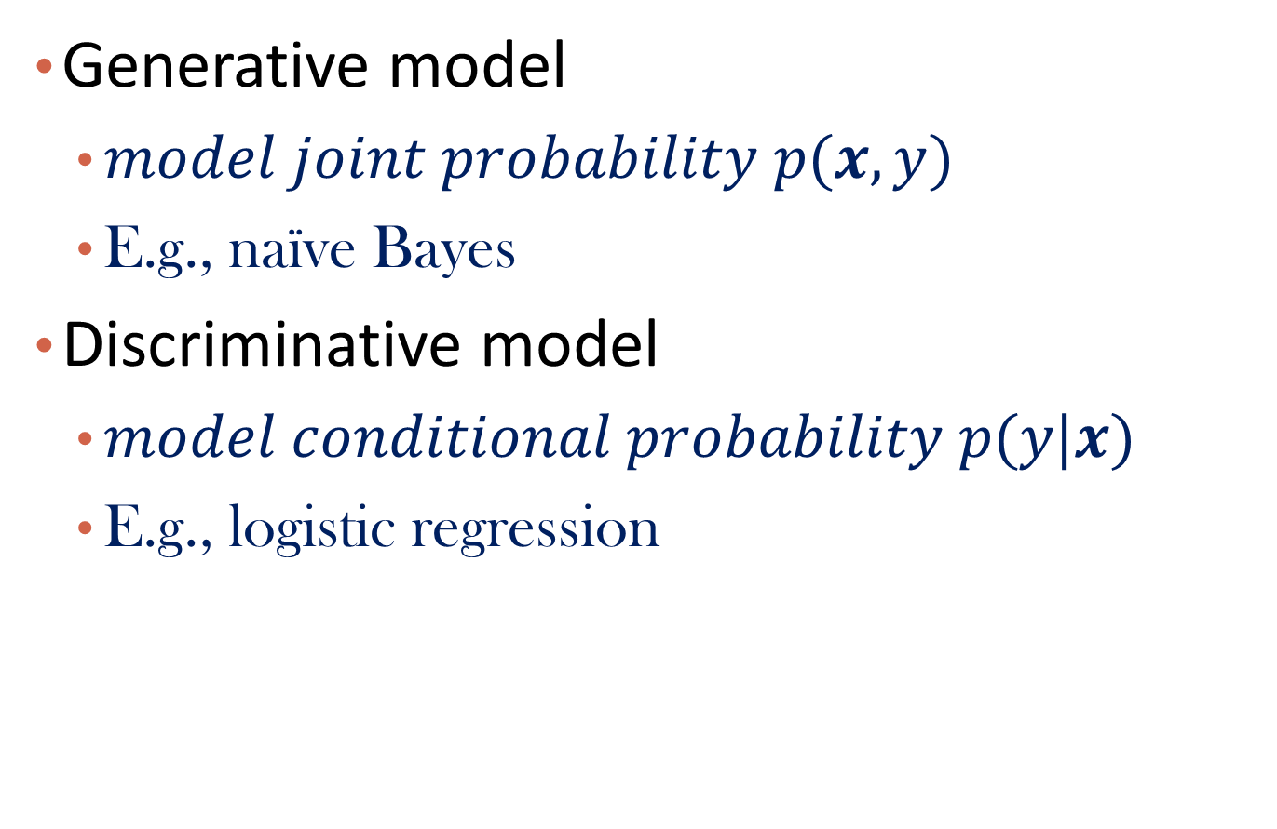
Generative Models vs. Discriminative Models
Generative model
$model joint probability p(x,y)$
E.g., naïve Bayes
Discriminative model
$model conditional probability p(y|x)$
E.g., logistic regression

Slide 58
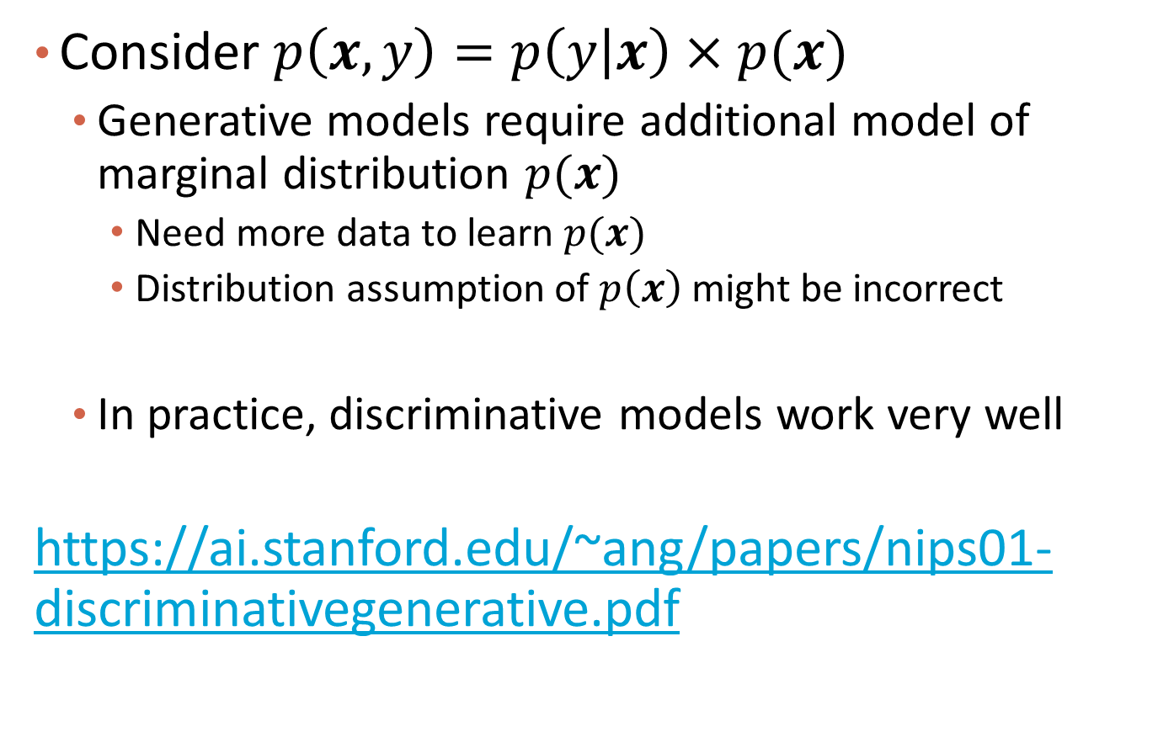
Which One is Better?
Consider $p\left(x,y\right)=p\left(y | x\right)×p(x)$
Generative models require additional model of marginal distribution $p(x)$
Need more data to learn $p(x)$
Distribution assumption of $p\left(x\right)$ might be incorrect
In practice, discriminative models work very well
https://ai.stanford.edu/~ang/papers/nips01-discriminativegenerative.pdf

Slide 59
Content
Probabilistic Models for I.I.D. Data
Naïve Bayes
Logistic Regression
Generative Models and Discriminative Models
Summary

Slide 60
Summary
Probabilistic Models
I.I.D. assumption enables joint distribution of data as a product of probability of single data points
Naïve Bayes
Assuming independence among features
Logistic Regression
Assuming conditional distribution follows Bernoulli distribution
Generative Models and Discriminative Models
Modeling joint distribution vs. conditional distribution

Slide 61
Q&A

Slide 62
References
http://pages.cs.wisc.edu/~jerryzhu/cs769/nb.pdf
http://cs229.stanford.edu/notes/cs229-notes1.pdf
https://ai.stanford.edu/~ang/papers/nips01-discriminativegenerative.pdf

Slide 63
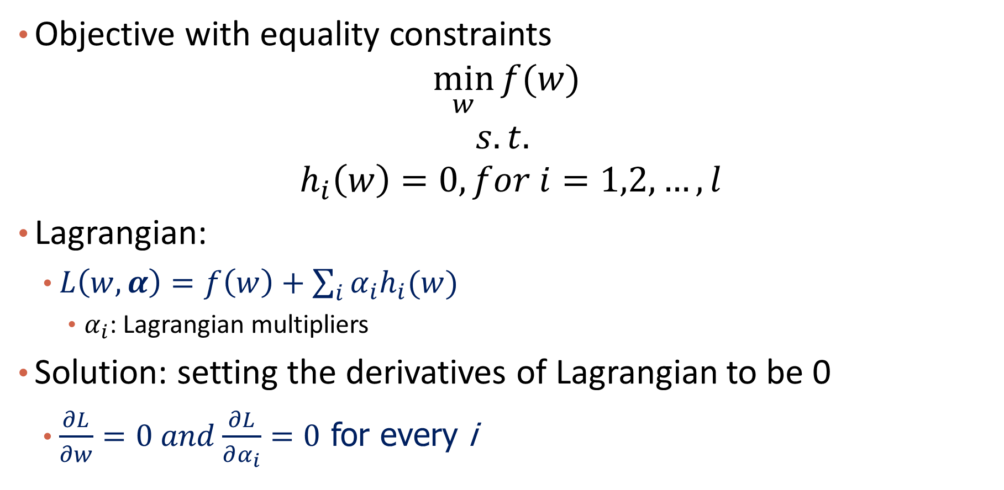
More about Lagrangian
Objective with equality constraints
$$\min_{w}{f(w)}$$
$$s.t.$$
$${ h}_{i}\left(w\right)=0, for i=1,2,…,l$$
Lagrangian:
$L\left(w,α\right)=f\left(w\right)+\sum_{i}{α_{i}h_{i}(w)}$
$α_{i}$: Lagrangian multipliers
Solution: setting the derivatives of Lagrangian to be 0
$\frac{∂L}{∂w}=0 and\frac{∂L}{∂α_{i}}=0$ for every i

Slide 64

Generalized Lagrangian
Objective with both equality and inequality constraints
$$\min_{w}{f(w)}$$
$$s.t.$$
$${ h}_{i}\left(w\right)=0, for i=1,2,…,l$$
$${ g}_{j}\left(w\right)≤0, for j=1,2,…,k$$
Lagrangian
$L\left(w,α, β\right)=f\left(w\right)+\sum_{i}{α_{i}h_{i}(w)}+\sum_{j}{β_{j}g_{j}(w)}$
$α_{i}$: Lagrangian multipliers
$β_{j}≥0$: Lagrangian multipliers

Slide 65

Why It Works
Consider function
$$θ_{p}\left(w\right)=\max_{α,β:β_{j}≥0}{L(w,α, β)}$$
$θ_{p}\left(w\right)=\left\{\begin{aligned}f\left(w\right), if w satisfies all constraints \\ ∞, if w doesn^{′}t satisfy constraints\end{aligned}\right.$
Therefore, $\operatorname{minimize}{f\left(w\right)}$with constraints is equivalent to minimize $θ_{p}\left(w\right)$

Slide 66

Lagrange Duality
The primal problem
$$p^{∗}=\min_{w}{\max_{α,β:β_{j}≥0}{L(w,α, β)}}$$
The dual problem
$$d^{∗}=\max_{α,β:β_{j}≥0}{\min_{w}{L(w,α, β)}}$$
According to max-min inequality
$$p^{∗}≥d^{∗}$$
When does equation hold?

Slide 67

Primal = Dual
$p^{∗}=d^{∗}$, under some proper condition (Slater conditions)
$f, g_{j}$ convex, $h_{i}$ affine
Exists $w$, such that all $g_{j}\left(w\right)<0$
$\left(w^{∗},α^{∗},β^{∗}\right)$ need to satisfy KKT conditions
$\frac{∂L}{∂w}=0$
$β_{j}g_{j}\left(w\right)=0$
${{ h}_{i}\left(w\right)=0, g}_{j}\left(w\right)≤0, β_{j}≥0$
https://cs.stanford.edu/people/davidknowles/lagrangian_duality.pdf

