Slide 1
CS247: Advanced Data Mining
3: Basics: K-Means and Mixture Model
Instructor: Yizhou Sun
yzsun@cs.ucla.edu
January 10, 2024

Slide 2
Announcement
Midterm time and location is still pending
Evening exam might not be approved
If that is the case, we need to take an in-class exam on 2/21
Schedule needs to be slightly adjusted
HW1 will be out today, due in 1 week
Start working early!

Slide 3
Question from last lecture
In logistic regression, what if we change the class labels? Will that affect the model?

Slide 4
Clustering
Clustering
K-means
Mixture Model and EM algorithm
Summary

Slide 5
What is Cluster Analysis?
Cluster: A collection of data objects
similar (or related) to one another within the same group
dissimilar (or unrelated) to the objects in other groups
Cluster analysis (or clustering, data segmentation, …)
Finding similarities between data according to the characteristics found in the data and grouping similar data objects into clusters
Unsupervised learning: no predefined classes (i.e., learning by observations vs. learning by examples: supervised)
Typical applications
As a stand-alone tool to get insight into data distribution
As a preprocessing step for other algorithms

Slide 6

Problem Formalization
Given a dataset $D={\left\{x_{i}\right\}}_{i=1}^{N}$
Output the latent clustering structure $p(z_{i}|x_{i})$

Slide 7


Join at slido.com #584205
ⓘ Start presenting to display the joining instructions on this slide.

Slide 8

Write down the clustering algorithms that you have learned.
ⓘ Start presenting to display the poll results on this slide.

Slide 9
Applications of Cluster Analysis
Data reduction
Summarization: Preprocessing for regression, PCA, classification, and association analysis
Compression: Image processing: vector quantization
Prediction based on groups
Cluster & find characteristics/patterns for each group
E.g., build a recommendation model for each subgroup of customers.
Finding K-nearest Neighbors
Localizing search to one or a small number of clusters
Outlier detection: Outliers are often viewed as those “far away” from any cluster

Slide 10
Clustering
Clustering
K-means
Mixture Model and EM algorithm
Summary

Slide 11
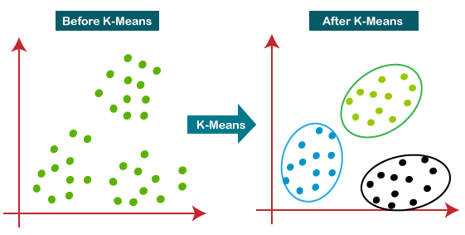
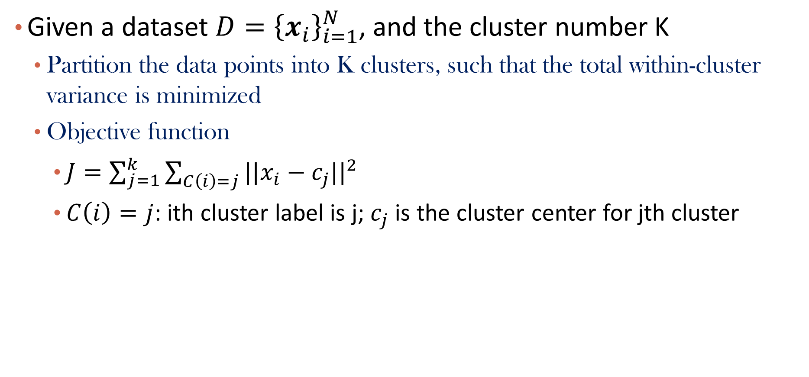
Recall K-Means
Given a dataset $D={\left\{x_{i}\right\}}_{i=1}^{N}$, and the cluster number K
Partition the data points into K clusters, such that the total within-cluster variance is minimized
Objective function
$J=\sum_{j=1}^{k}{\sum_{C\left(i\right)=j}{{||x_{i}−c_{j}||}^{2}}}$
$C\left(i\right)=j$: ith cluster label is j; $c_{j}$ is the cluster center for jth cluster

Slide 12
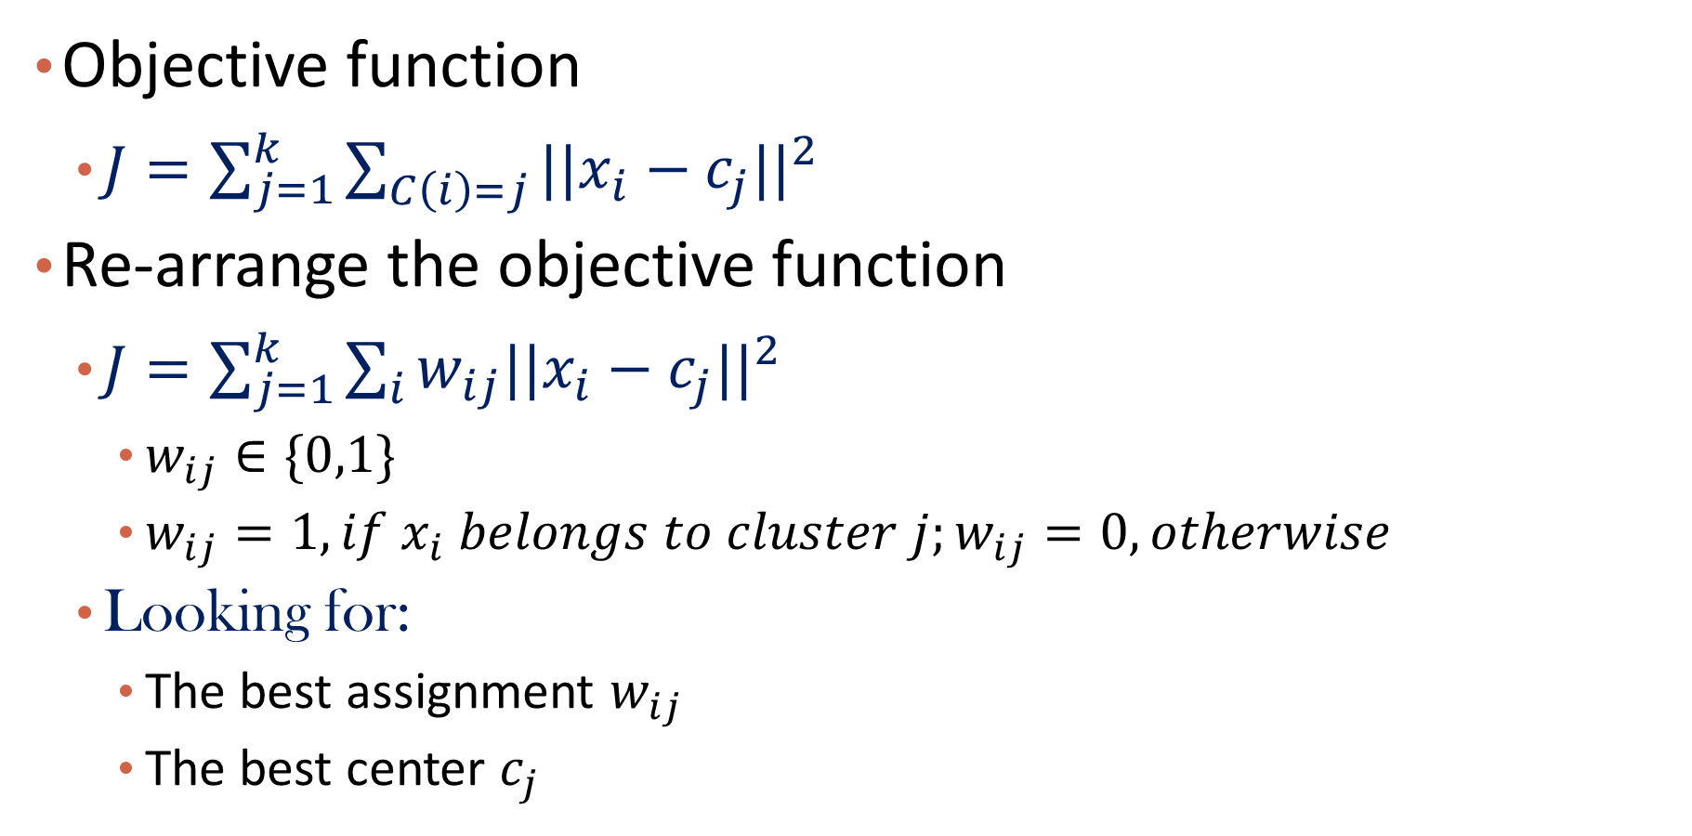
Re-arrange the objective function
Objective function
$J=\sum_{j=1}^{k}{\sum_{C\left(i\right)=j}{{||x_{i}−c_{j}||}^{2}}}$
Re-arrange the objective function
$J=\sum_{j=1}^{k}{\sum_{i}{{w_{ij}||x_{i}−c_{j}||}^{2}}}$
$w_{ij}∈\{0,1\}$
$w_{ij}=1, if x_{i} belongs to cluster j;w_{ij}=0, otherwise$
Looking for:
The best assignment $w_{ij}$
The best center $c_{j}$

Slide 13
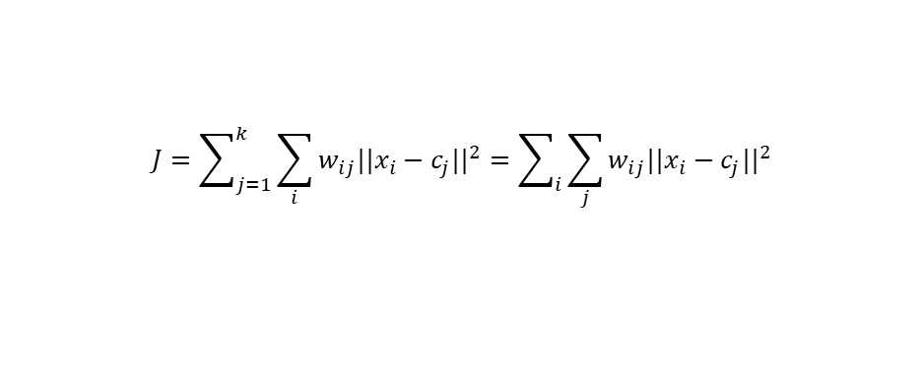
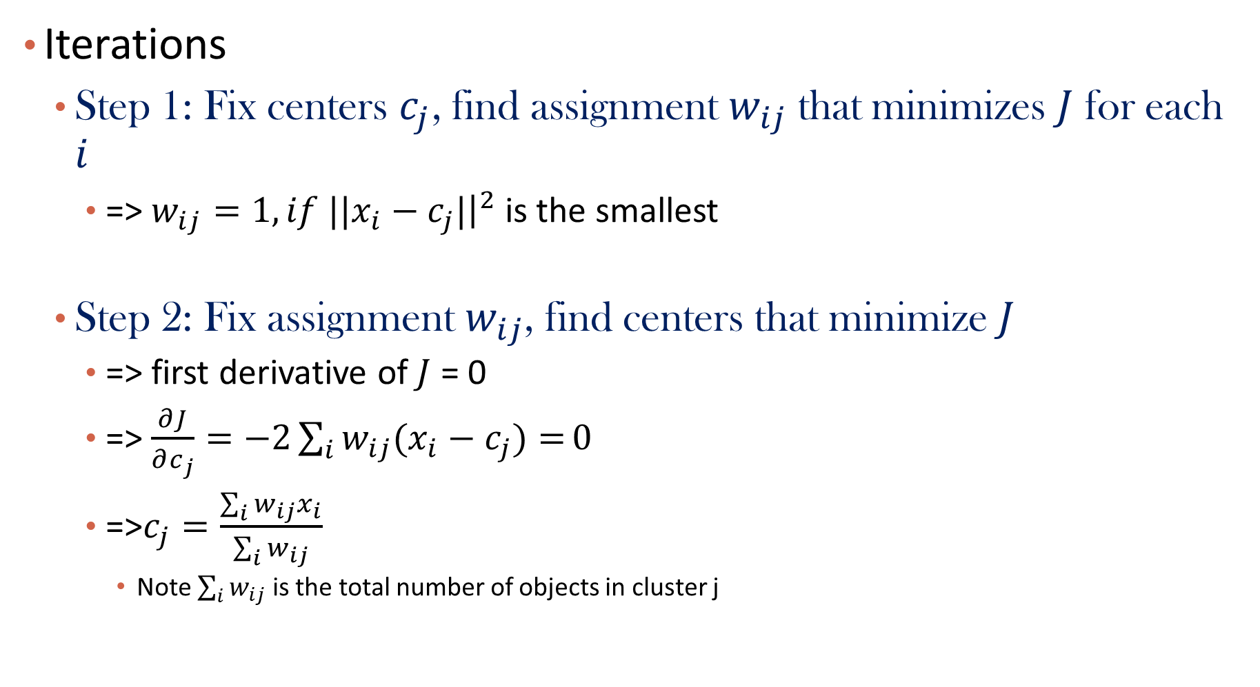
Solution of K-Means
$$J=\sum_{j=1}^{k}{\sum_{i}{{w_{ij}||x_{i}−c_{j}||}^{2}}}=\sum_{i}{\sum_{j}{{w_{ij}||x_{i}−c_{j}||}^{2}}}$$
Iterations
Step 1: Fix centers $c_{j}$, find assignment $w_{ij}$ that minimizes $J$ for each $i$
=> $w_{ij}=1, if {||x}_{i}−c_{j}|{\left.​\right|}^{2}$ is the smallest
Step 2: Fix assignment $w_{ij}$, find centers that minimize $J$
=> first derivative of $J$ = 0
=> $\frac{∂J}{∂c_{j}}=−2\sum_{i}{w_{ij}(x_{i}−c_{j})=}0$
=>$c_{j}=\frac{\sum_{i}{w_{ij}x_{i}}}{\sum_{i}{w_{ij}}}$
Note $\sum_{i}{w_{ij}}$ is the total number of objects in cluster j

Slide 14
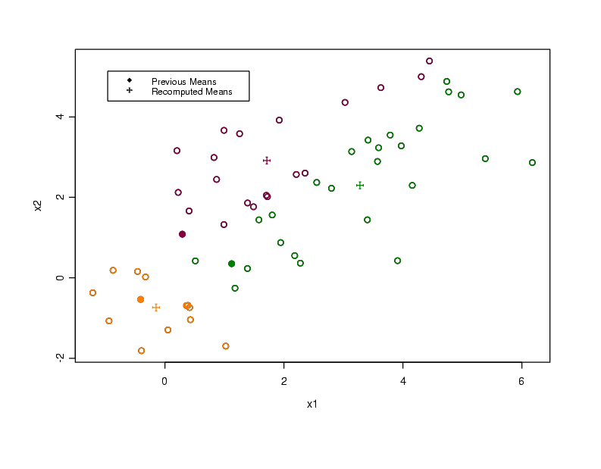

Slide 15
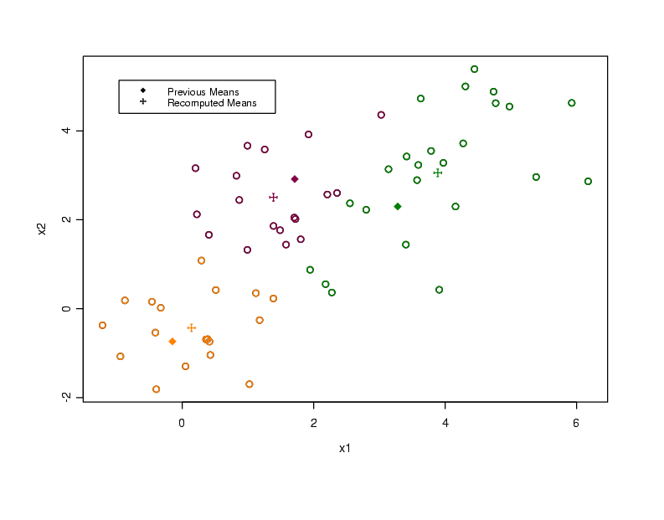

Slide 16
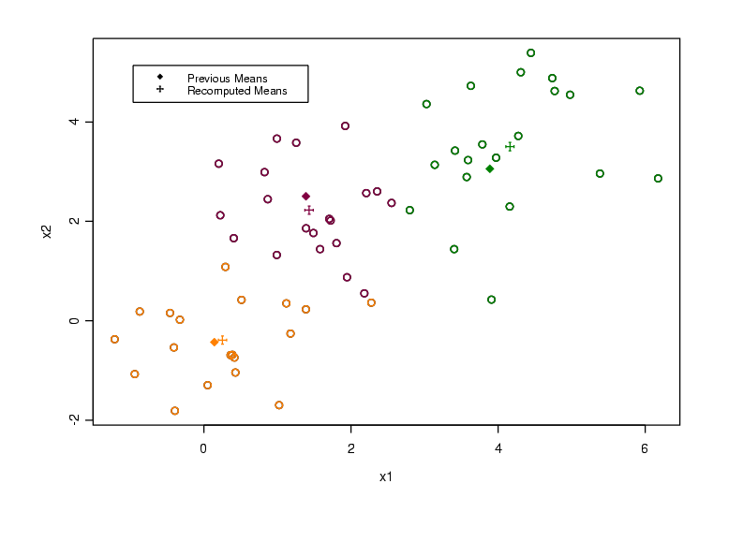

Slide 17


Slide 18
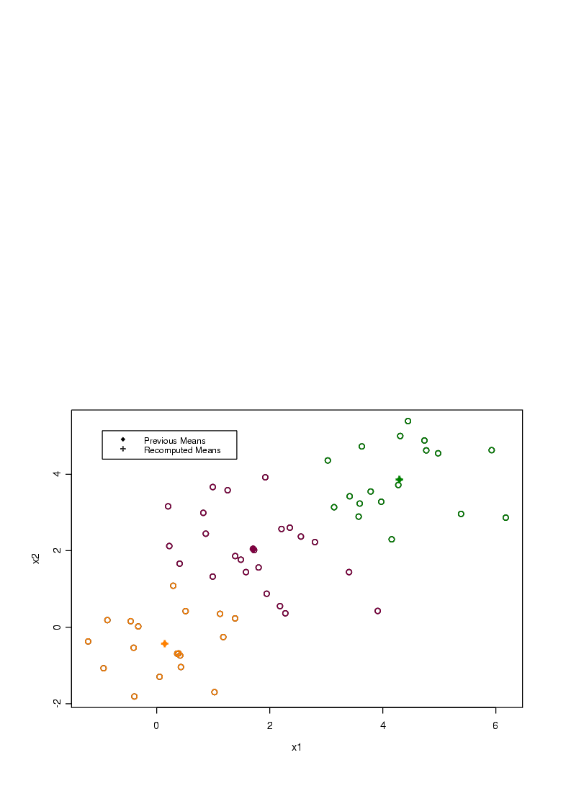

Slide 19
Converges! Why?

Slide 20
Q&A

Slide 21
Limitations of K-Means
K-means has problems when clusters are of
Non-Spherical Shapes
Different Sizes and density

Slide 22
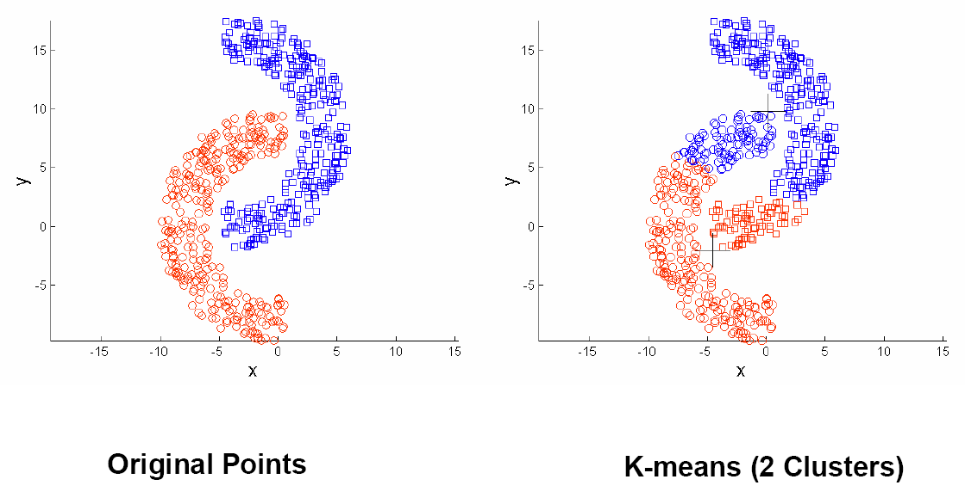
Limitations of K-Means: Non-Spherical Shapes

Slide 23
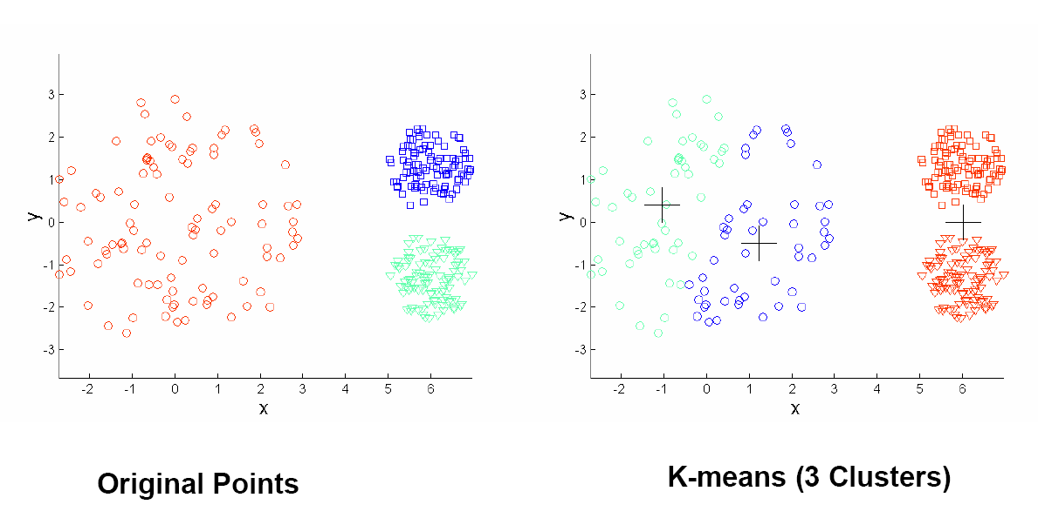
Limitations of K-Means: Different Sizes and Variances

Slide 24
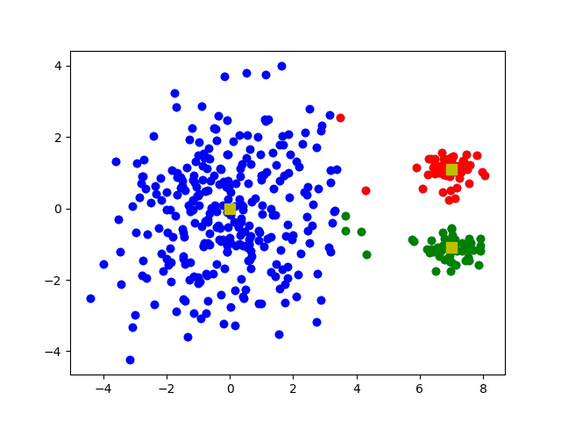
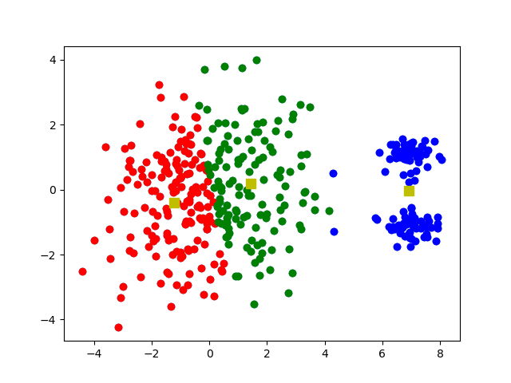
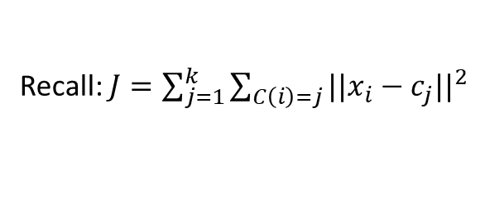
Example
Consider the cost of K-means in two cases
Cost: J = 1560.86
Cost: J = 1147.42
Recall: $J=\sum_{j=1}^{k}{\sum_{C\left(i\right)=j}{{||x_{i}−c_{j}||}^{2}}}$

Slide 25
Connections of K-means to Other Methods
K-means
Kernel K-means
Gaussian Mixture Model

Slide 26
Clustering
Clustering
K-means
Mixture Model and EM algorithm
Summary

Slide 27
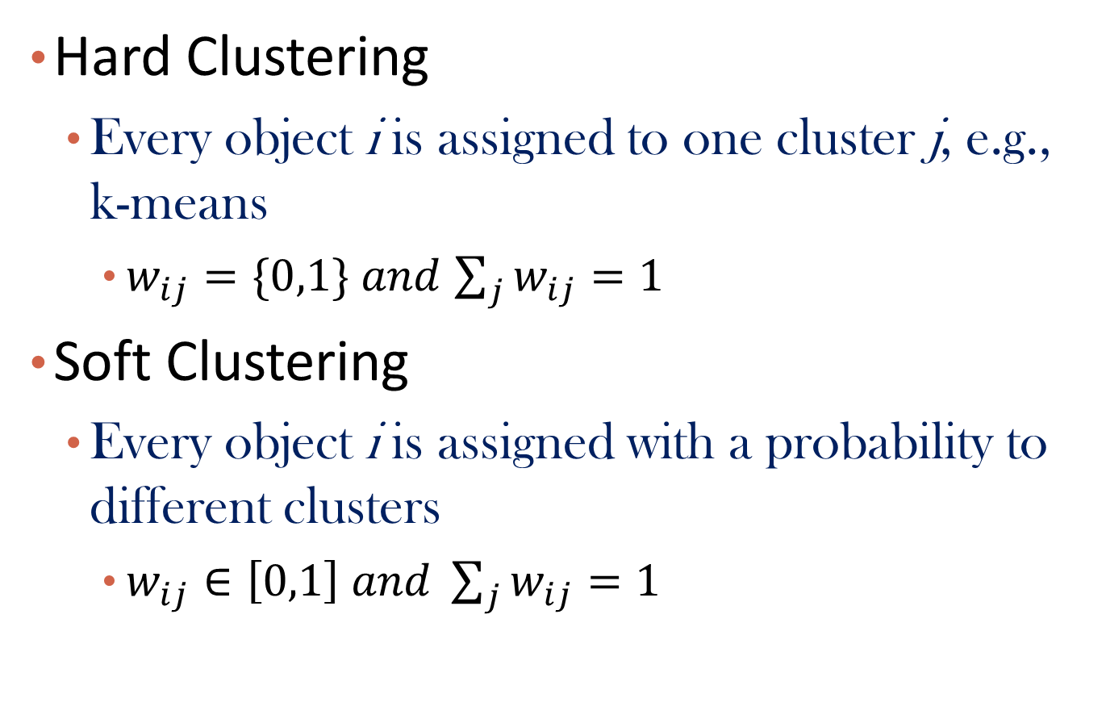
Hard Clustering vs. Soft Clustering
Hard Clustering
Every object i is assigned to one cluster j, e.g., k-means
$w_{ij}=\{0,1\}$ $and$ $\sum_{j}{w_{ij}=1}$
Soft Clustering
Every object i is assigned with a probability to different clusters
$w_{ij}∈\left[0,1\right] and \sum_{j}{w_{ij}=1}$

Slide 28
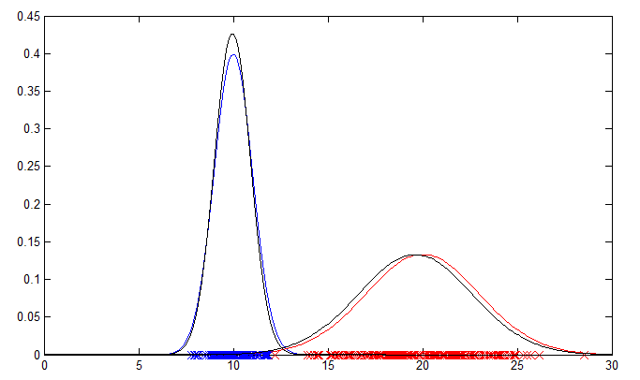
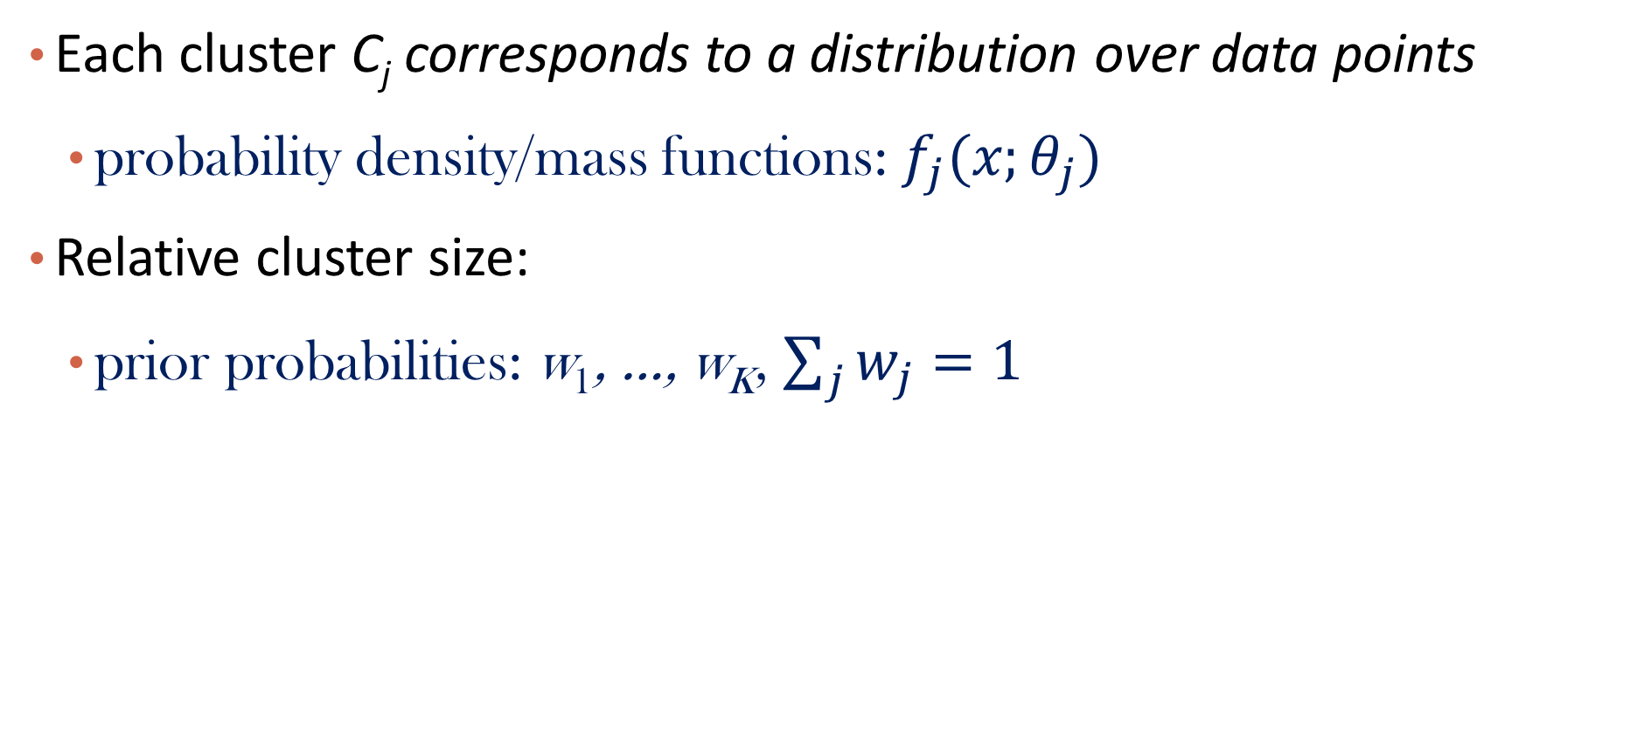


Mixture Model-Based Clustering
Each cluster C_{j} corresponds to a distribution over data points
probability density/mass functions: $f_{j}(x;θ_{j})$
Relative cluster size:
prior probabilities: w₁, …, w_{K}, $\sum_{j}{w_{j}}=1$
$$f_{1}(x)$$
$$f_{2}(x)$$

Slide 29
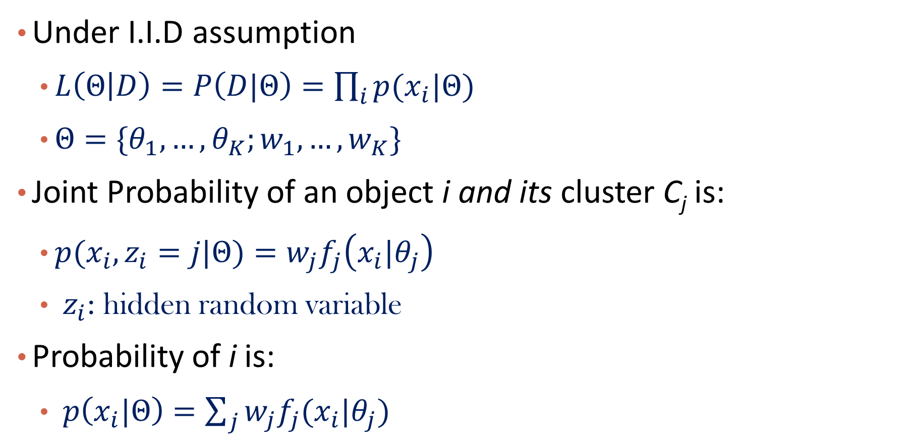


Likelihood of the dataset
Under I.I.D assumption
$L\left(Θ | D\right)=P\left(D|Θ\right)=\prod_{i}{p(x_{i}|Θ)}$
$Θ=\{θ_{1},…,θ_{K};w_{1},…,w_{K}\}$
Joint Probability of an object i and its cluster C_{j} is:
${p(x}_{i}, z_{i}=j|Θ)=w_{j}f_{j}\left(x_{i}|θ_{j}\right)$
$z_{i}$: hidden random variable
Probability of i is:
$p\left(x_{i}|Θ\right)=\sum_{j}{w_{j}f_{j}(x_{i}|θ_{j})}$
$$f_{1}(x)$$
$$f_{2}(x)$$

Slide 30
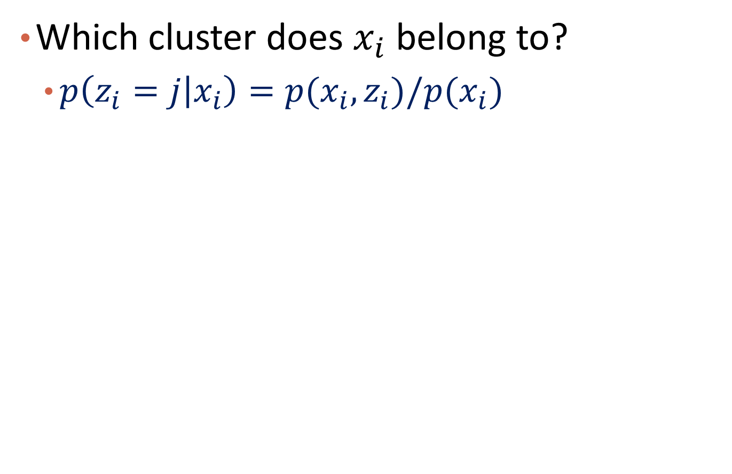
The inference problem
Which cluster does $x_{i}$ belong to?
$p\left(z_{i}=j | x_{i}\right)=p(x_{i}, z_{i})/p(x_{i})$

Slide 31
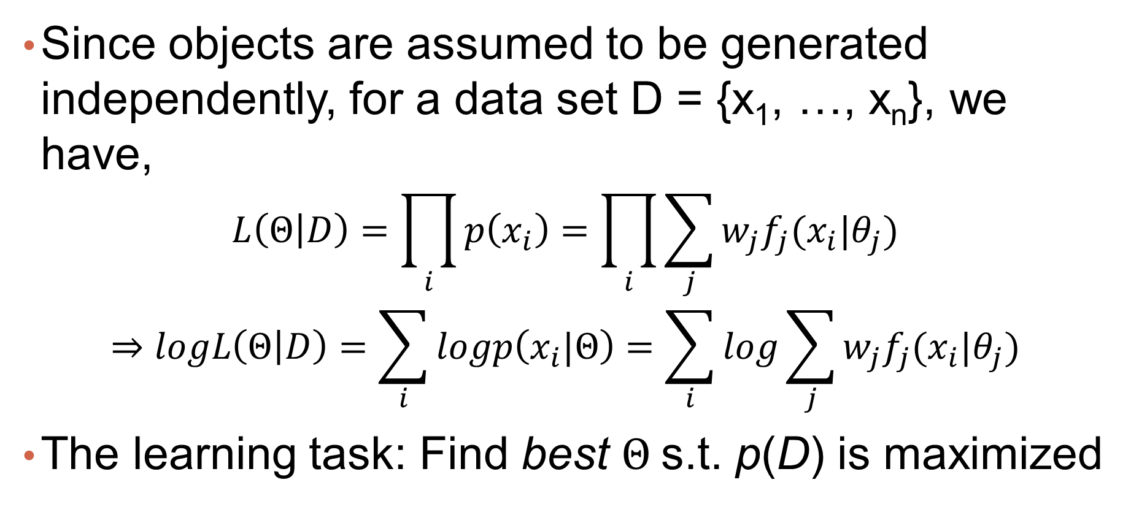
Maximum Likelihood Estimation
Since objects are assumed to be generated independently, for a data set D = {x₁, …, x_{n}}, we have,
$$L\left(Θ | D\right)=\prod_{i}{p\left(x_{i}\right)=\prod_{i}{\sum_{j}{w_{j}f_{j}(x_{i}|θ_{j})}}}$$
$$⇒logL\left(Θ | D\right)=\sum_{i}{logp\left(x_{i}|Θ\right)=\sum_{i}{log\sum_{j}{w_{j}f_{j}(x_{i}|θ_{j})}}}$$
The learning task: Find best $Θ$s.t. p(D) is maximized

Slide 32

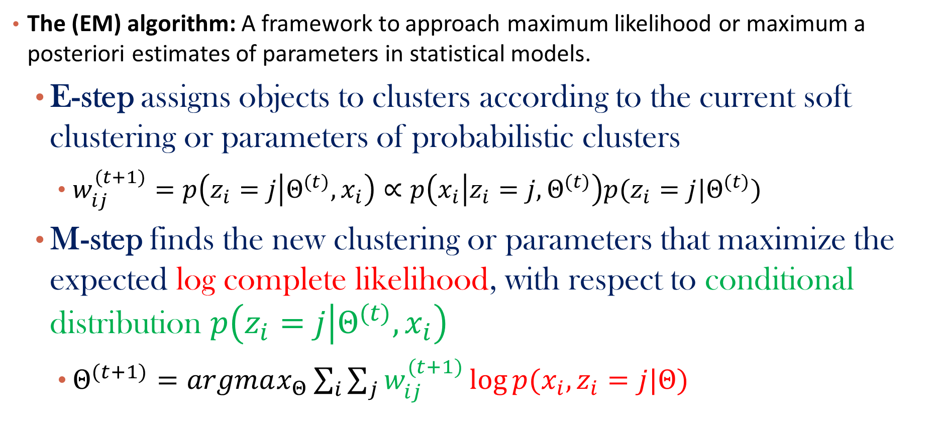

The EM (Expectation Maximization) Algorithm
The (EM) algorithm: A framework to approach maximum likelihood or maximum a posteriori estimates of parameters in statistical models.
E-step assigns objects to clusters according to the current soft clustering or parameters of probabilistic clusters
$w_{ij}^{(t+1)}=p\left(z_{i}=j | Θ^{(t)},x_{i}\right)∝p\left(x_{i} | z_{i}=j,Θ^{(t)}\right)p(z_{i}=j|Θ^{(t)})$
M-step finds the new clustering or parameters that maximize the expected log complete likelihood, with respect to conditional distribution $p\left(z_{i}=j | Θ^{(t)},x_{i}\right)$
$Θ^{(t+1)}=argmax_{Θ}\sum_{i}{\sum_{j}{w_{ij}^{(t+1)}\log{p(x_{i},z_{i}=j|Θ)}}}$
$$f_{j}(x_{i})$$
$$w_{j}$$

Slide 33
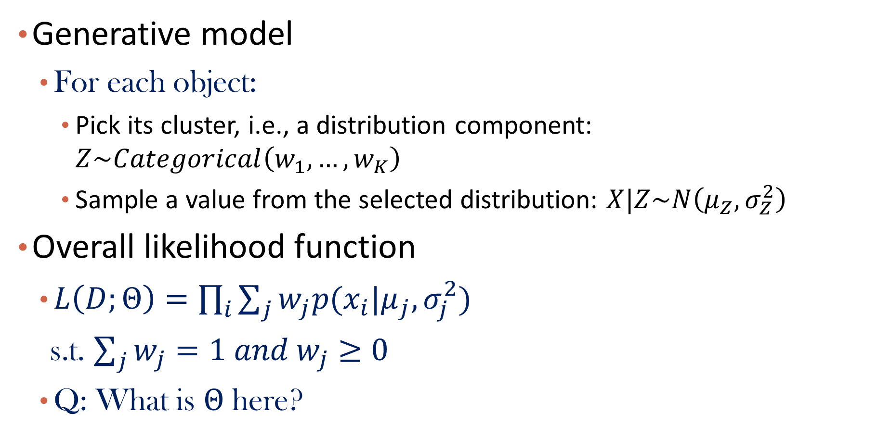
Gaussian Mixture Model
Generative model
For each object:
Pick its cluster, i.e., a distribution component: $Z\sim Categorical\left(w_{1}, …,w_{K}\right)$
Sample a value from the selected distribution: $X|Z\sim N\left(μ_{Z},σ_{Z}^{2}\right)$
Overall likelihood function
$L\left(D;Θ\right)=\prod_{i}{\sum_{j}{w_{j}p(x_{i}|μ_{j},σ_{j}^{2})}}$
s.t. $\sum_{j}{w_{j}}=1 and w_{j}≥0$
Q: What is $Θ$ here?

Slide 34

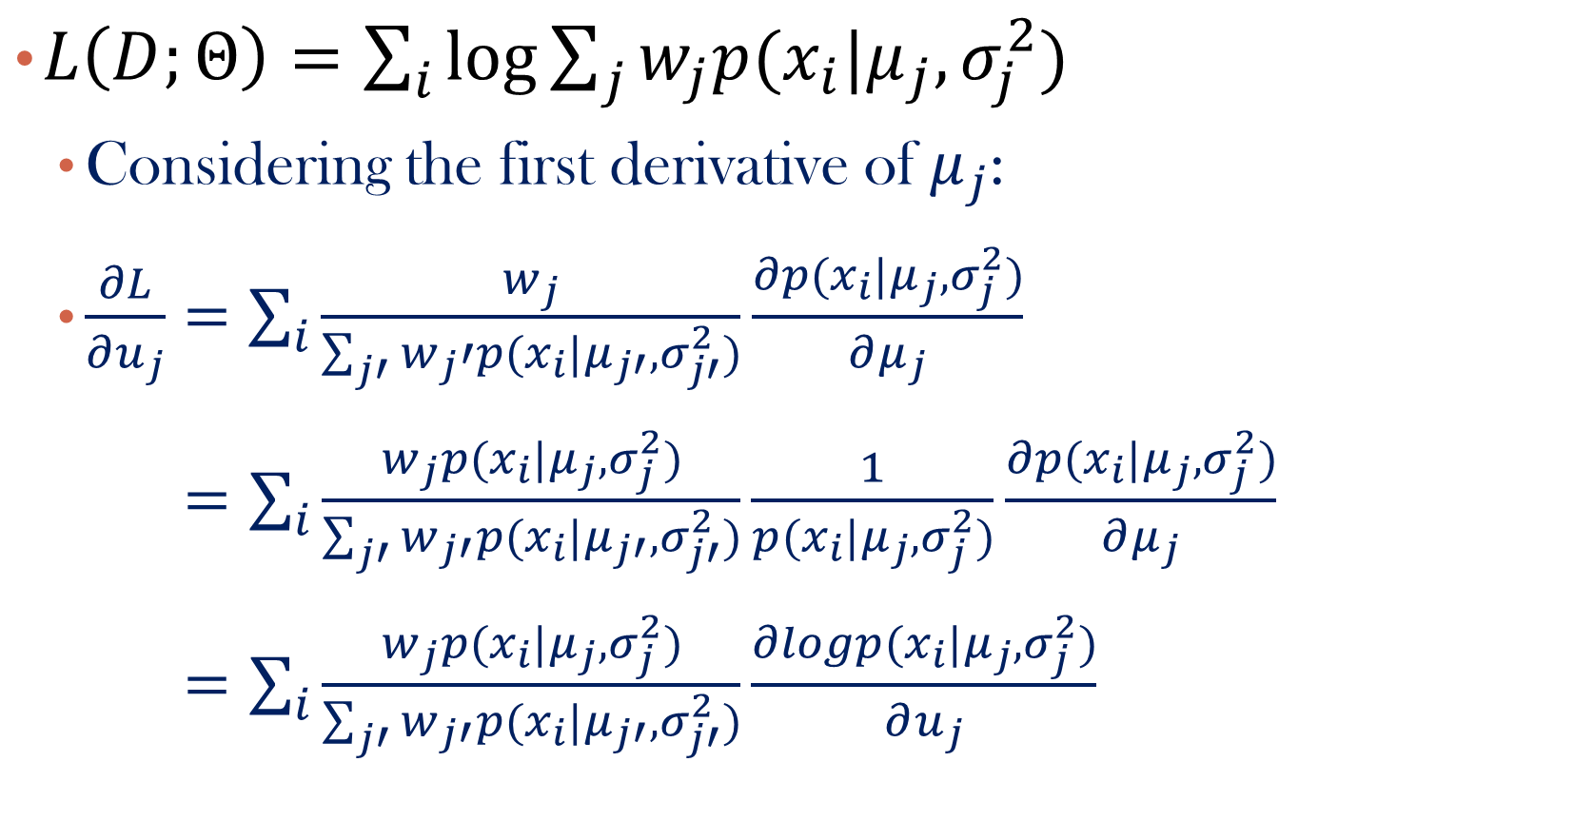

Estimating Parameters
$L\left(D;Θ\right)=\sum_{i}{\log{\sum_{j}{w_{j}p(x_{i}|μ_{j},σ_{j}^{2})}}}$
Considering the first derivative of${ μ}_{j}$:
$\frac{∂L}{∂u_{j}}=\sum_{i}{\frac{w_{j}}{\sum_{j′}{w_{j}′p(x_{i}|μ_{j′},σ_{j′}^{2})}}}\frac{∂p(x_{i}|μ_{j},σ_{j}^{2})}{∂μ_{j}}$
$=\sum_{i}{\frac{w_{j}p(x_{i}|μ_{j},σ_{j}^{2})}{\sum_{j′}{w_{j′}p(x_{i}|μ_{j′},σ_{j′}^{2})}}}\frac{1}{p(x_{i}|μ_{j},σ_{j}^{2})}\frac{∂p(x_{i}|μ_{j},σ_{j}^{2})}{∂μ_{j}}$
$=\sum_{i}{\frac{w_{j}p(x_{i}|μ_{j},σ_{j}^{2})}{\sum_{j′}{w_{j′}p(x_{i}|μ_{j′},σ_{j′}^{2})}}}\frac{∂logp(x_{i}|μ_{j},σ_{j}^{2})}{∂u_{j}}$
Like weighted likelihood estimation;
But the weight is determined by the parameters!
$$w_{ij}=P(Z=j|X=x_{i},θ)$$
$∂l(x_{i})/∂μ_{j}$

Slide 35
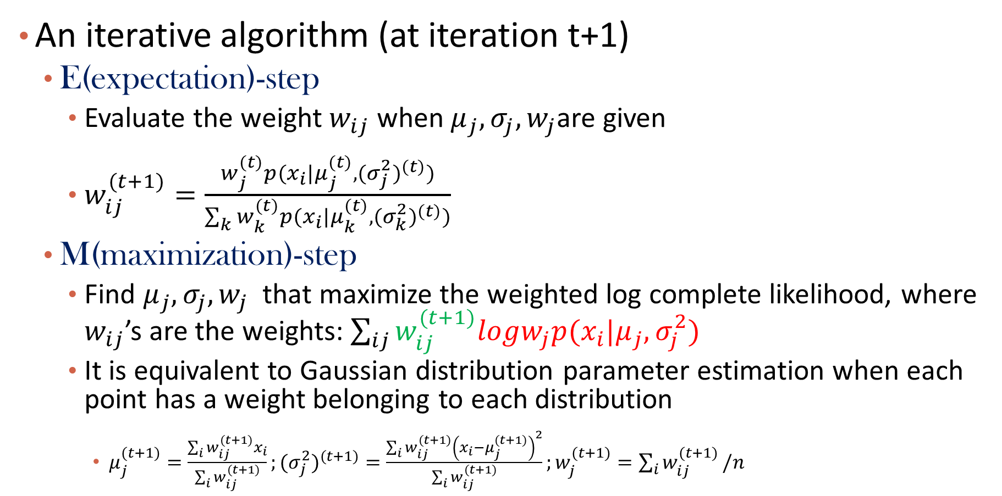

Apply EM algorithm: 1-d
An iterative algorithm (at iteration t+1)
E(expectation)-step
Evaluate the weight $w_{ij}$ when $μ_{j},σ_{j},w_{j}$are given
$w_{ij}^{(t+1)}=\frac{w_{j}^{(t)}p(x_{i}|μ_{j}^{(t)},{{(σ}_{j}^{2})}^{(t)})}{\sum_{k}{w_{k}^{(t)}p(x_{i}|μ_{k}^{(t)},{{(σ}_{k}^{2})}^{(t)})}}$
M(maximization)-step
Find $μ_{j},σ_{j},w_{j}$ that maximize the weighted log complete likelihood, where $w_{ij}$’s are the weights: $\sum_{ij}{w_{ij}^{(t+1)}logw_{j}p(x_{i}|μ_{j},σ_{j}^{2})}$
It is equivalent to Gaussian distribution parameter estimation when each point has a weight belonging to each distribution
$μ_{j}^{(t+1)}=\frac{\sum_{i}{w_{ij}^{(t+1)}x_{i}}}{\sum_{i}{w_{ij}^{(t+1)}}};{{(σ}_{j}^{2})}^{(t+1)}=\frac{\sum_{i}{w_{ij}^{(t+1)}{\left(x_{i}−μ_{j}^{(t+1)}\right)}^{2}}}{\sum_{i}{w_{ij}^{(t+1)}}};w_{j}^{(t+1)}=\sum_{i}{w_{ij}^{(t+1)}}/n$
$$f_{j}^{(t)}(x_{i})$$

Slide 36
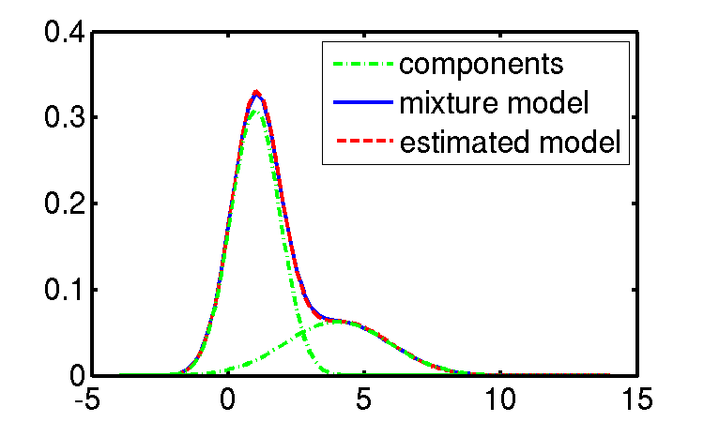
Example: 1-D GMM
Blue curve: ground truth distribution
Sample data points from blue curve
Red curve: estimated distribution
https://www.mathworks.com/matlabcentral/fileexchange/24867-gaussian_mixture_model-m
Notes:
http://www.maths.adelaide.edu.au/matthew.roughan/code.html

Slide 37
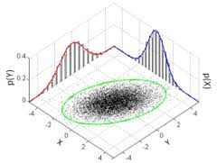
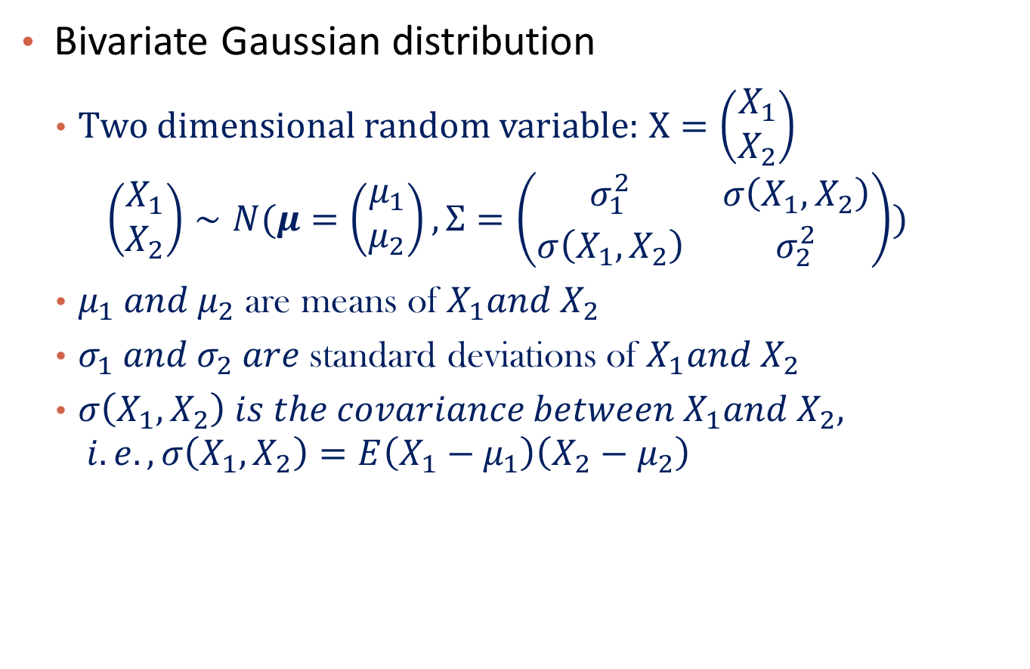
2-d Gaussian
Bivariate Gaussian distribution
Two dimensional random variable: $X=\left(\begin{matrix}X_{1} \\ X_{2}\end{matrix}\right)$
$$\left(\begin{matrix}X_{1} \\ X_{2}\end{matrix}\right)∼N(μ=\left(\begin{matrix}μ_{1} \\ μ_{2}\end{matrix}\right),Σ=\left(\begin{matrix}σ_{1}^{2} & σ\left(X_{1},X_{2}\right) \\ σ\left(X_{1},X_{2}\right) & σ_{2}^{2}\end{matrix}\right))$$
$μ_{1} and μ_{2}$ are means of $X_{1}and X_{2}$
$σ_{1} and σ_{2} are$ standard deviations of $X_{1}and X_{2}$
$σ\left(X_{1},X_{2}\right) is the covariance between{ X}_{1}and X_{2}, i.e.,σ\left(X_{1},X_{2}\right)=E\left(X_{1}−μ_{1}\right)\left(X_{2}−μ_{2}\right)$

Slide 38
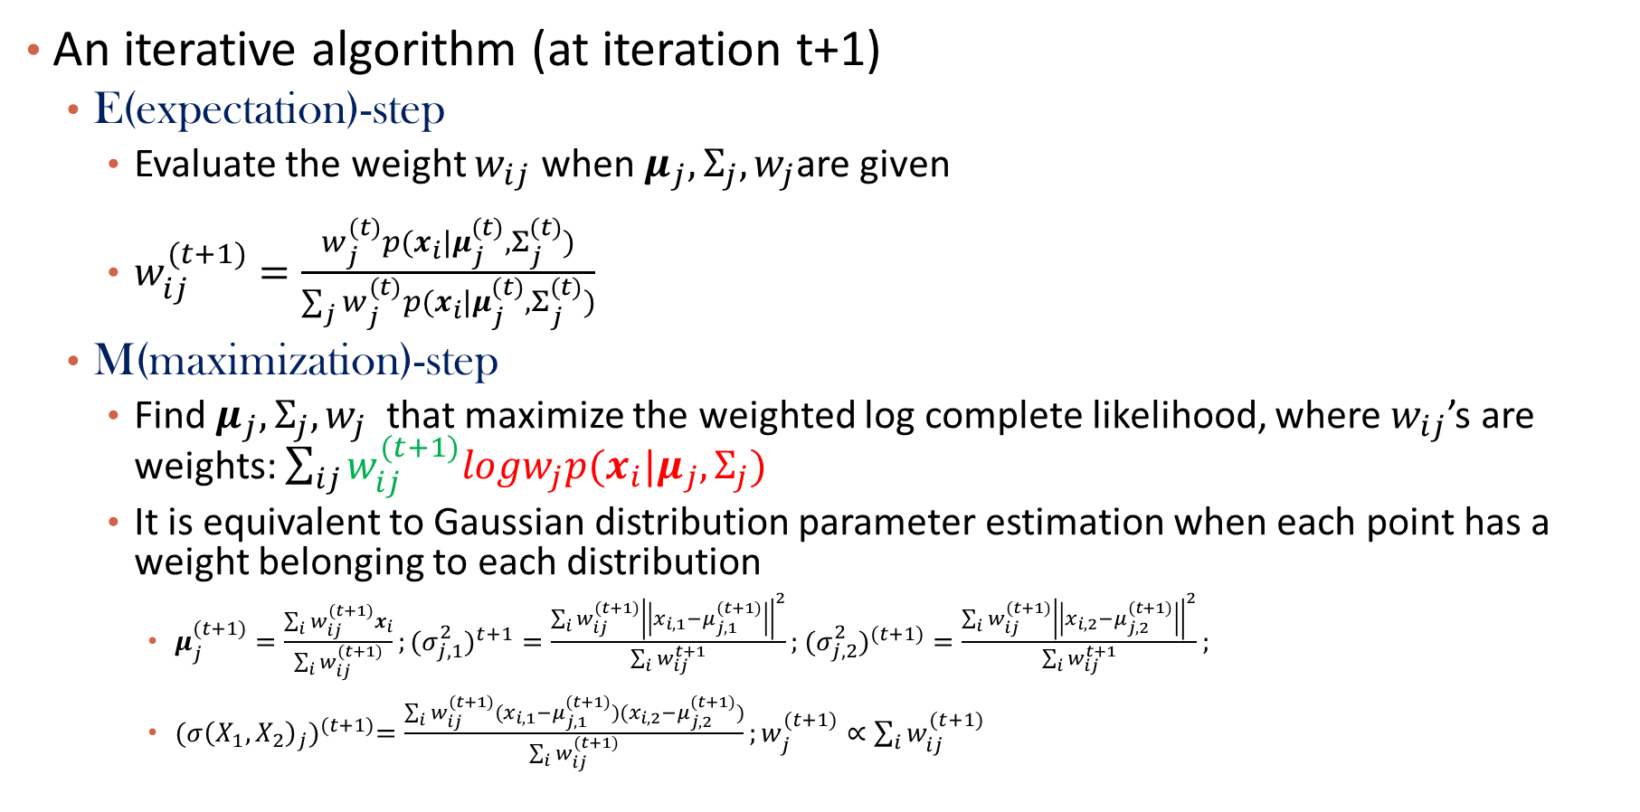
Apply EM algorithm: 2-d
An iterative algorithm (at iteration t+1)
E(expectation)-step
Evaluate the weight $w_{ij}$ when $μ_{j},Σ_{j},w_{j}$are given
$w_{ij}^{(t+1)}=\frac{w_{j}^{(t)}p(x_{i}|μ_{j}^{(t)},Σ_{j}^{(t)})}{\sum_{j}{w_{j}^{(t)}p(x_{i}|μ_{j}^{(t)},Σ_{j}^{(t)})}}$
M(maximization)-step
Find $μ_{j},Σ_{j},w_{j}$ that maximize the weighted log complete likelihood, where $w_{ij}$’s are weights: $\sum_{ij}{w_{ij}^{(t+1)}logw_{j}p(x_{i}|μ_{j},Σ_{j})}$
It is equivalent to Gaussian distribution parameter estimation when each point has a weight belonging to each distribution
$μ_{j}^{(t+1)}=\frac{\sum_{i}{w_{ij}^{(t+1)}x_{i}}}{\sum_{i}{w_{ij}^{(t+1)}}};{{(σ}_{j,1}^{2})}^{t+1}=\frac{\sum_{i}{w_{ij}^{(t+1)}{\left|\left|x_{i,1}−μ_{j,1}^{(t+1)}\right|\right|}^{2}}}{\sum_{i}{w_{ij}^{t+1}}};$ ${{(σ}_{j,2}^{2})}^{(t+1)}=\frac{\sum_{i}{w_{ij}^{(t+1)}{\left|\left|x_{i,2}−μ_{j,2}^{(t+1)}\right|\right|}^{2}}}{\sum_{i}{w_{ij}^{t+1}}};$
${{(σ{\left(X_{1},X_{2}\right)}_{j})}^{(t+1)}=\frac{\sum_{i}{w_{ij}^{(t+1)}(x_{i,1}−μ_{j,1}^{(t+1)})(x_{i,2}−μ_{j,2}^{(t+1)})}}{\sum_{i}{w_{ij}^{(t+1)}}};w}_{j}^{(t+1)}∝\sum_{i}{w_{ij}^{(t+1)}}$

Slide 39
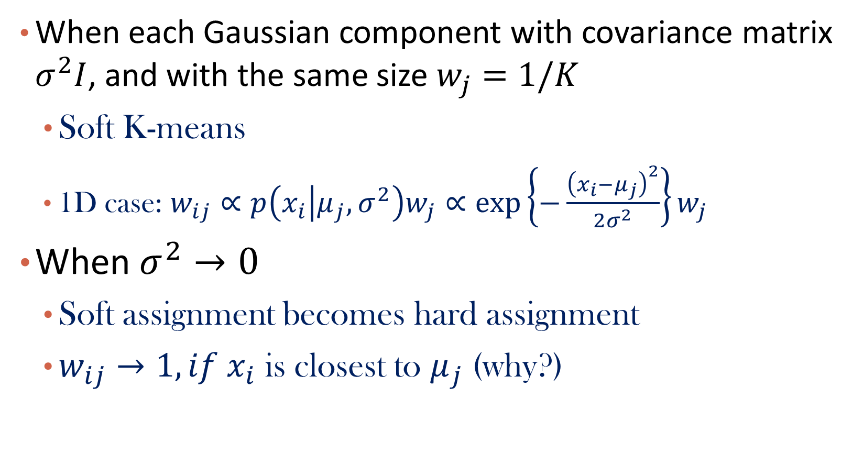
K-Means: A Special Case of Gaussian Mixture Model
When each Gaussian component with covariance matrix $σ^{2}I$, and with the same size $w_{j}=1/K$
Soft K-means
1D case: $w_{ij}∝p\left(x_{i} | μ_{j},σ^{2}\right)w_{j}∝\exp\left\{−\frac{{\left(x_{i}−μ_{j}\right)}^{2}}{2σ^{2}}\right\}w_{j}$
When $σ^{2}→0$
Soft assignment becomes hard assignment
$w_{ij}→1, if x_{i}$ is closest to $μ_{j}$ (why?)
Distance!

Slide 40
Q&A

Slide 41
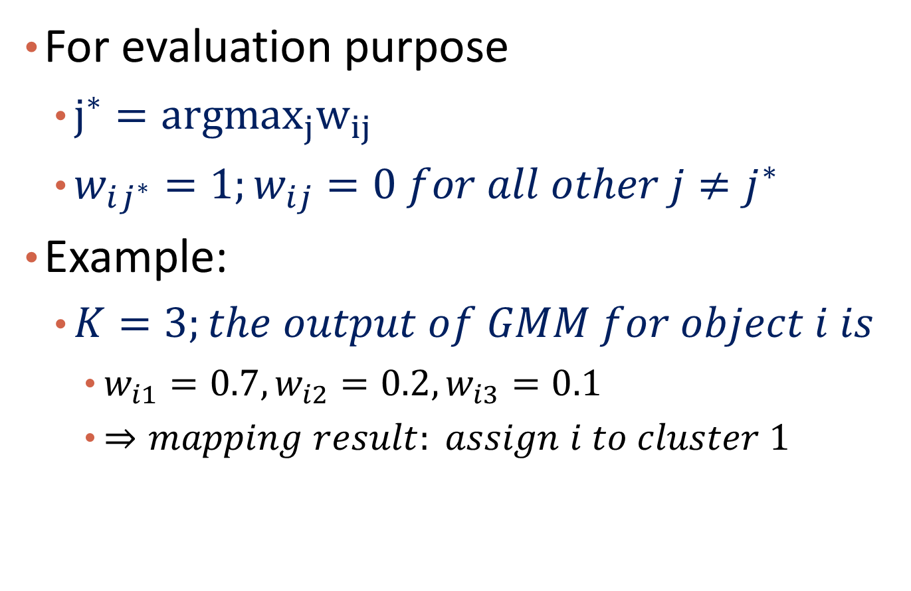
Mapping Soft Clustering to Hard Clustering
For evaluation purpose
$j^{∗}={argmax}_{j}w_{ij}$
$w_{ij^{∗}}=1;w_{ij}=0 for all other j≠j^{∗}$
Example:
$K=3;the output of GMM for object i is$
$w_{i1}=0.7, w_{i2}=0.2, w_{i3}=0.1$
$⇒mapping result: assign i to cluster 1$

Slide 42
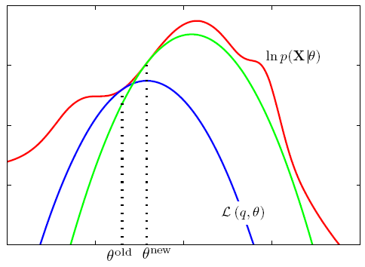
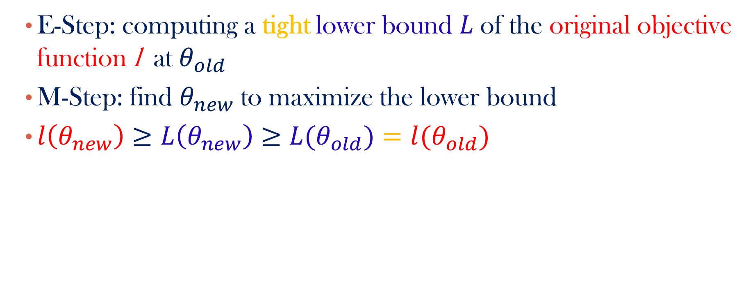
Why EM Works?
E-Step: computing a tight lower bound $L$of the original objective function l at $θ_{old}$
M-Step: find $θ_{new}$to maximize the lower bound
${l\left(θ_{new}\right)≥L\left(θ_{new}\right)≥L(θ}_{old})=l(θ_{old})$
Notes:
http://www.lems.brown.edu/~au/courses.html

Slide 43
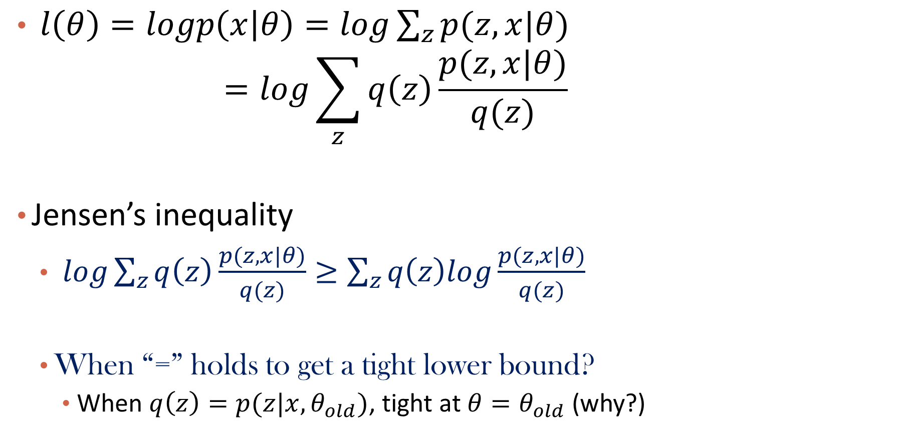


How to Find a Tight Lower Bound?
$l\left(θ\right)=logp\left(x | θ\right)=log{\sum_{z}{p(z,x|θ)}}$
$$=log\sum_{z}{q\left(z\right)}\frac{p(z,x|θ)}{q(z)}$$
Jensen’s inequality
$log\sum_{z}{q\left(z\right)}\frac{p(z, x|θ)}{q(z)}≥\sum_{z}{q\left(z\right)log}\frac{p(z,x|θ)}{q(z)}$
When “=” holds to get a tight lower bound?
When $q\left(z\right)=p(z|x,θ_{old})$, tight at ${θ=θ}_{old}$(why?)
$$q\left(z\right):a distribution defined over z$$
$$the key to tight lower bound we want to get$$
$$a lower bound of l(θ)$$
Notes:
Both sides equal to log(d|\theta)

Slide 44
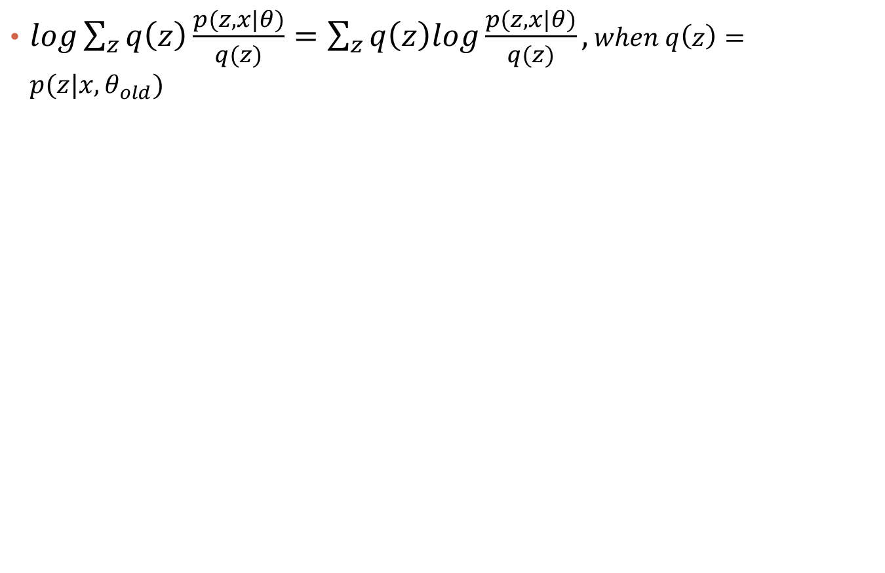
Derivation
$log\sum_{z}{q\left(z\right)}\frac{p(z, x|θ)}{q(z)}=\sum_{z}{q\left(z\right)log}\frac{p(z,x|θ)}{q(z)}, when q\left(z\right)=p(z|x,θ_{old})$

Slide 45



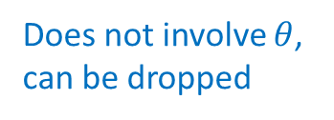
In GMM Case
$$l\left(D;θ\right)=\sum_{i}{\log{\sum_{j}{w_{j}p(x_{i}|μ_{j},σ_{j}^{2})}}}$$
$$≥\sum_{i}{\sum_{j}{w_{ij}(log{w_{j}p\left(x_{i} | μ_{j},σ_{j}^{2}\right)−logw_{ij})}}}$$
$$q\left(z_{i}\right)=p(z_{i}|x_{i},θ_{old})$$
$$\log{p(x_{i},z_{i}=j|θ)}$$
Does not involve $θ$,
can be dropped

Slide 46
Q&A

Slide 47
Advantages and Disadvantages of GMM
Strength
Mixture models are more general than partitioning: different densities and sizes of clusters
Clusters can be characterized by a small number of parameters
The results may satisfy the statistical assumptions of the generative models
Weakness
Converge to local optimal (overcome: run multi-times w. random initialization)
Computationally expensive if the number of distributions is large
Hard to estimate the number of clusters
Can only deal with spherical clusters

Slide 48
Clustering
Clustering
K-means
Kernel K-means
Summary

Slide 49
Summary
Revisit k-means
Objective function, Limitations
Mixture models
Gaussian mixture model; EM algorithm; Connection to k-means

