Slide 1
CS247: Advanced Data Mining
04: Basics: Neural Network and Deep Learning
Instructor: Yizhou Sun
yzsun@cs.ucla.edu
January 22, 2024

Slide 2
Neural Network
Introduction
Connection to Shallow Machine Learning Algorithms
Multi-Layer Feed-Forward Neural Network
Deep Learning
Summary

Slide 3
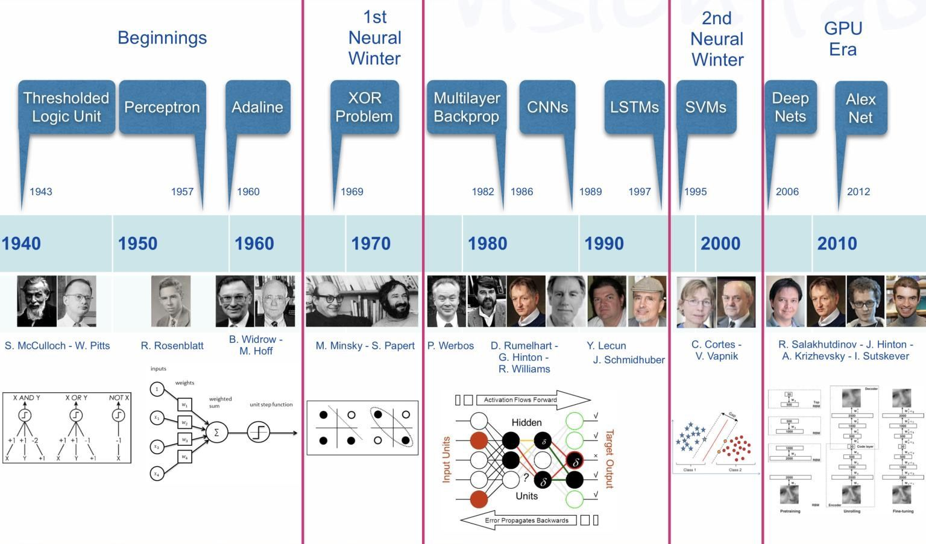
A little bit of History
https://i.pinimg.com/originals/6a/f0/3c/6af03c5026bb680ebe6d8db4bdbb8428.jpg

Slide 4
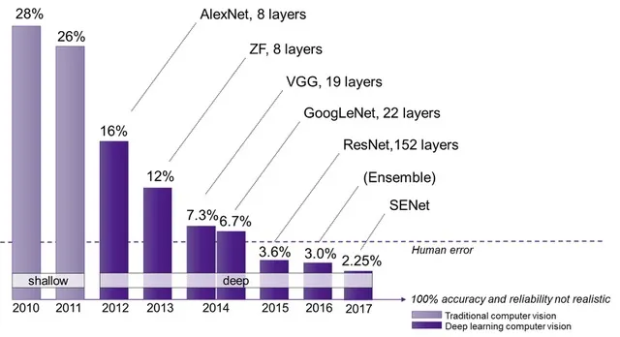
ImageNet Challenge
https://semiengineering.com/new-vision-technologies-for-real-world-applications/

Slide 5
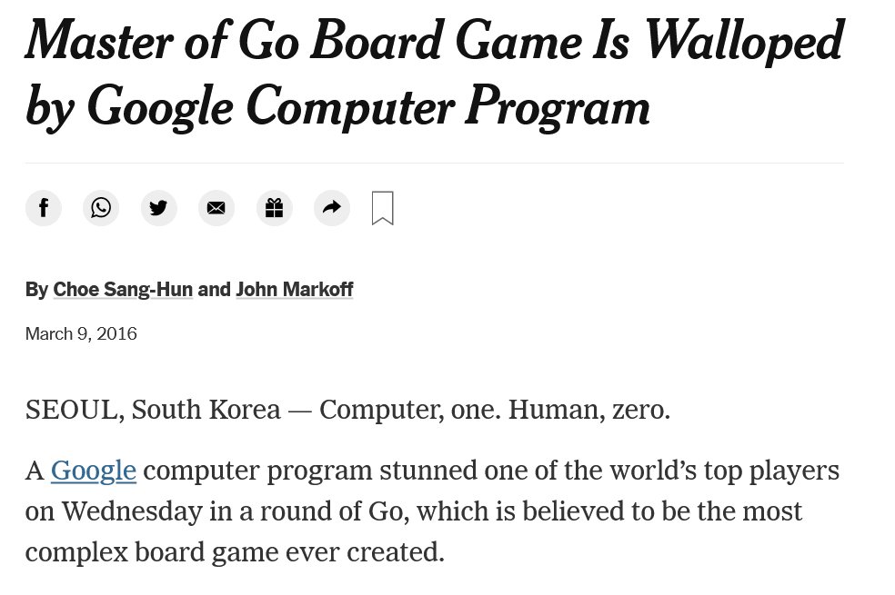
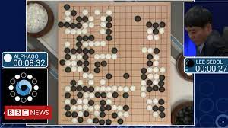
AlphaGo

Slide 6
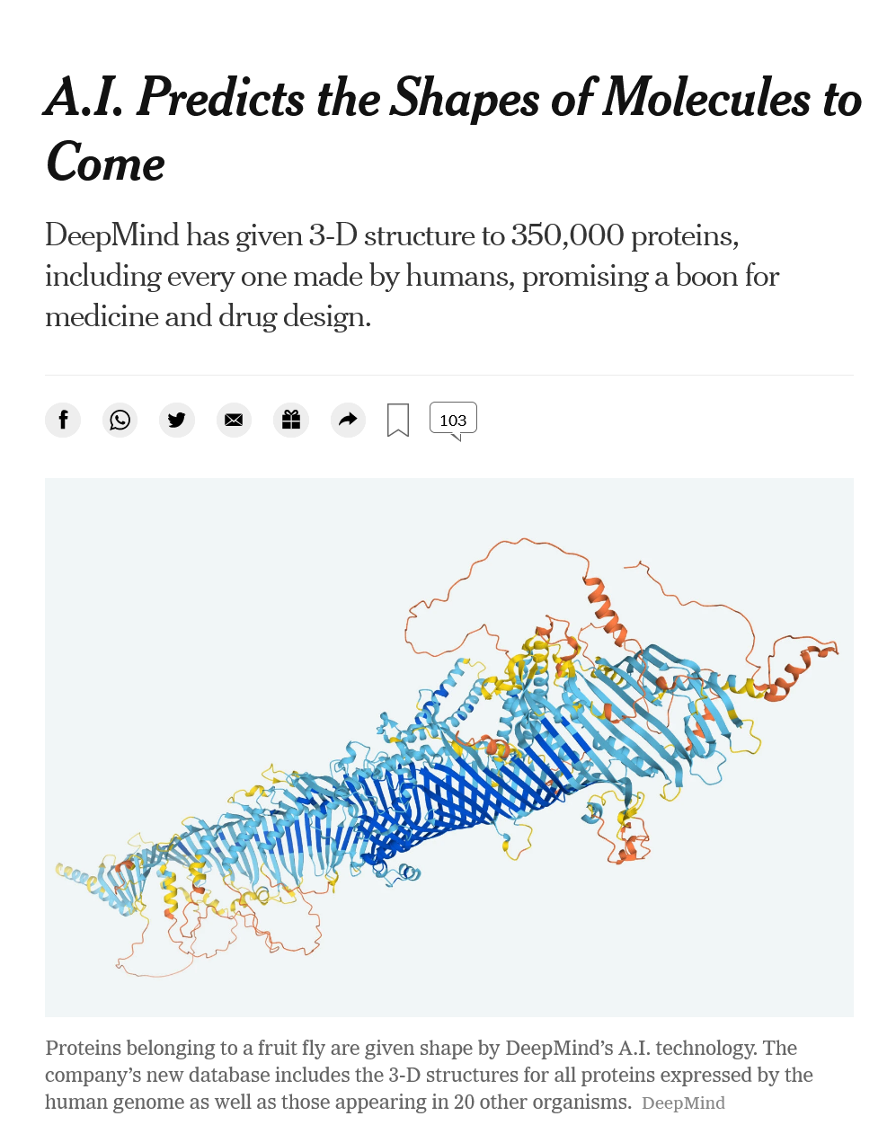
AlphaFold

Slide 7

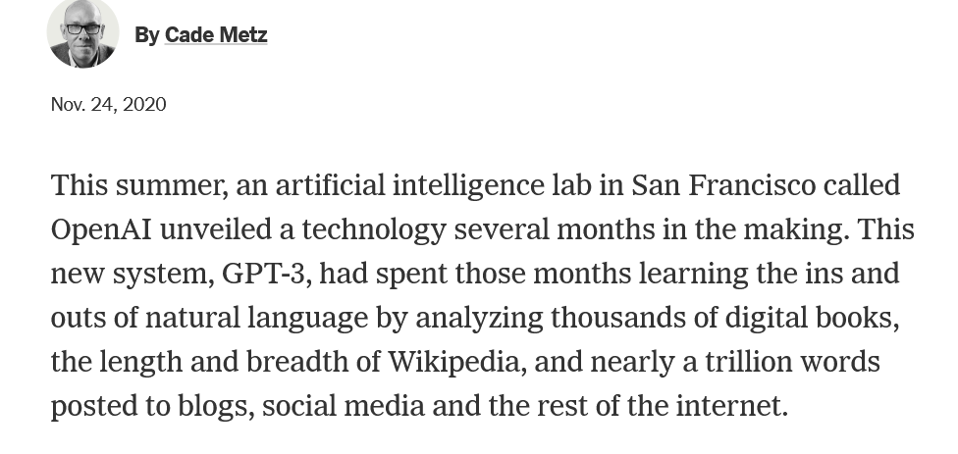
GPT-3

Slide 8
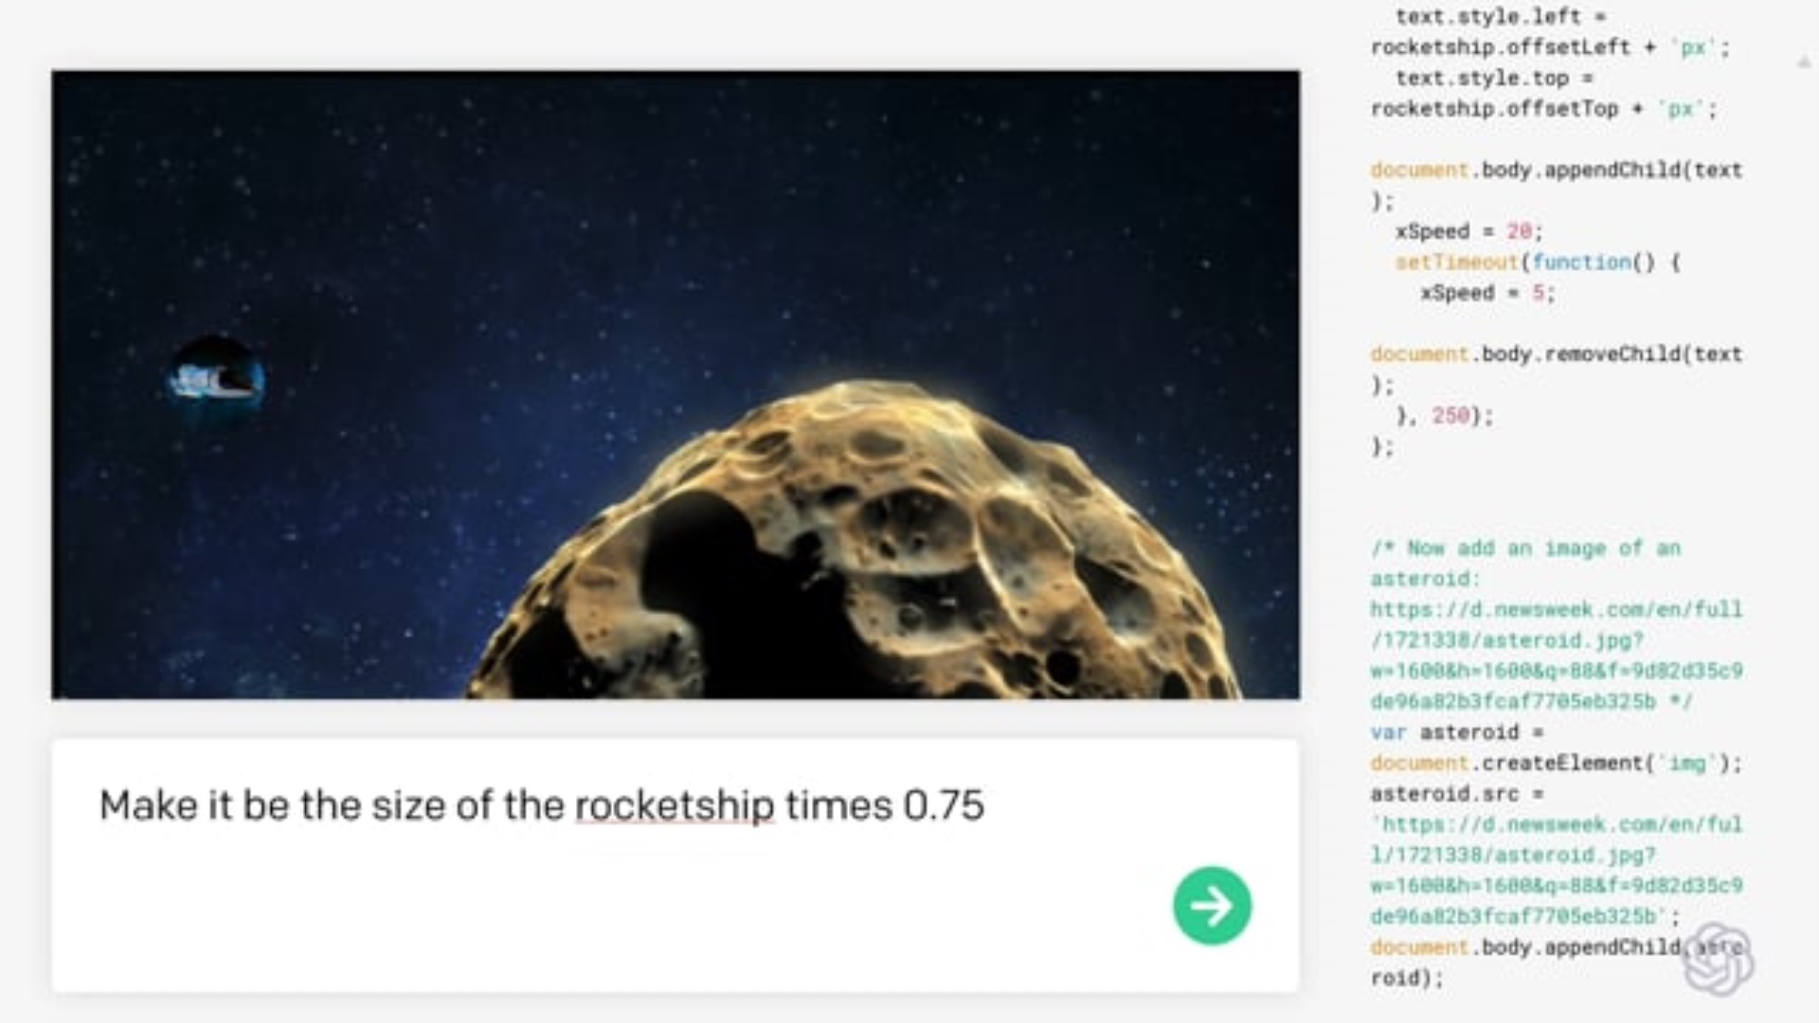
OpenAI: Codex

Slide 9
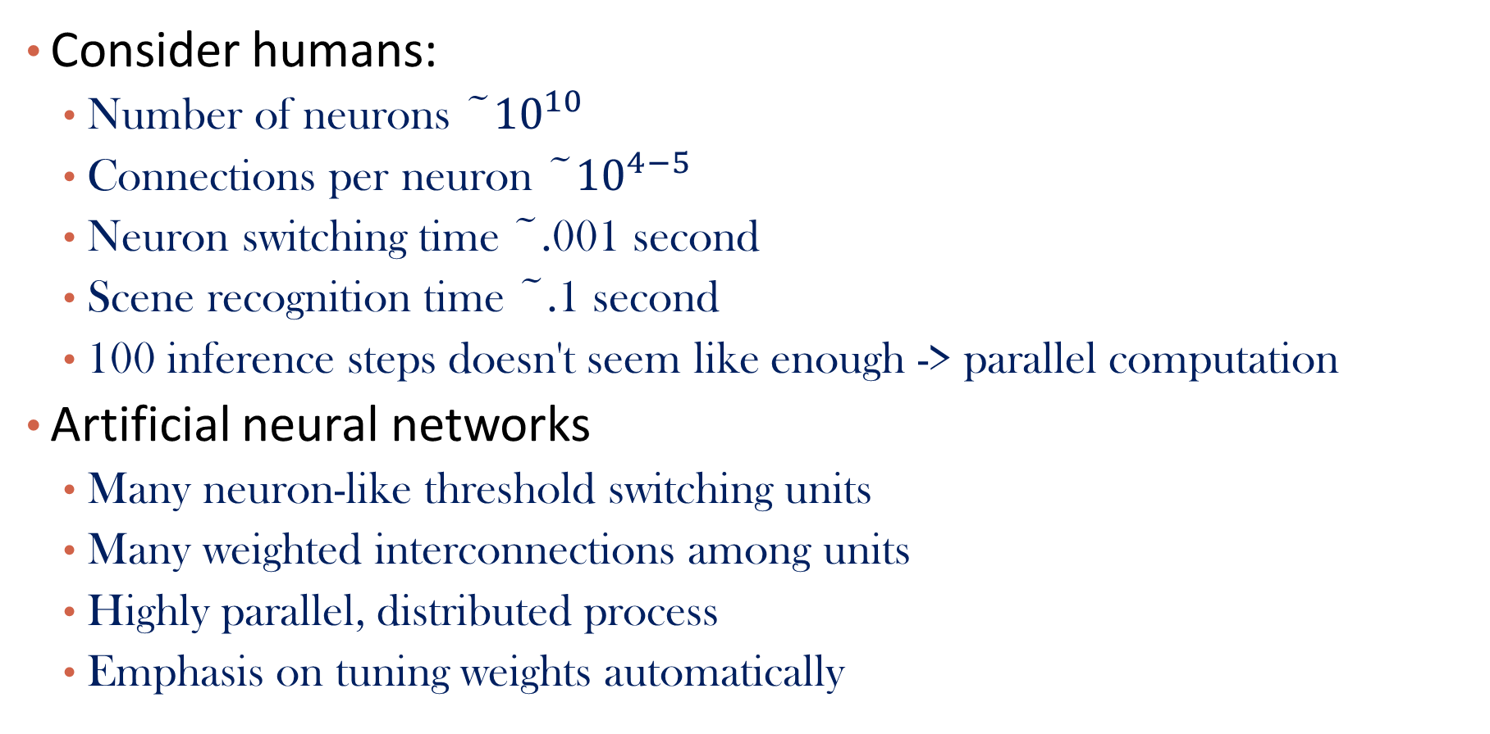
Artificial Neural Networks
Consider humans:
Number of neurons ~${10}^{10}$
Connections per neuron ~${10}^{4−5}$
Neuron switching time ~.001 second
Scene recognition time ~.1 second
100 inference steps doesn't seem like enough -> parallel computation
Artificial neural networks
Many neuron-like threshold switching units
Many weighted interconnections among units
Highly parallel, distributed process
Emphasis on tuning weights automatically

Slide 10

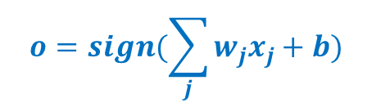
Single Unit: Perceptron
Bias: $b$
x₁
w₁
x₂
w₂
∑
f
output o
x_{p}
w_{p}
$$o=sign(\sum_{j}{{w_{j}x}_{j}}+b)$$
Input
vector x
weight
vector w
weighted
sum
Activation
function

Slide 11
Important Concepts
Architecture
Activation function
Loss function
Optimization
Regularization

Slide 12
Architecture
Decide the network topology:
Specify # of units in the input layer, # of hidden layers (if > 1), # of units in each hidden layer, the unit types, connection between layers, and # of units in the output layer
Architecture specifies the function that maps input to output, which contains parameters to be learned

Slide 13
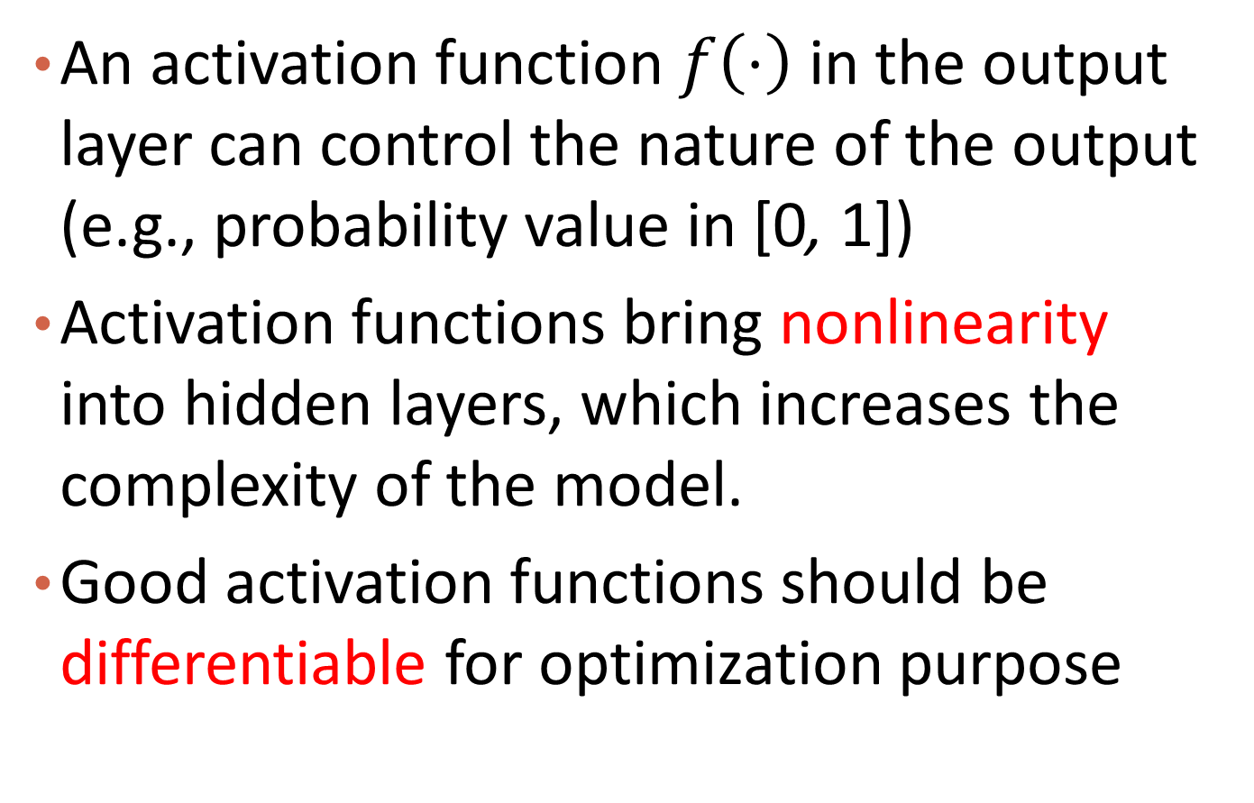
Activation function
An activation function $f\left(⋅\right)$ in the output layer can control the nature of the output (e.g., probability value in [0, 1])
Activation functions bring nonlinearity into hidden layers, which increases the complexity of the model.
Good activation functions should be differentiable for optimization purpose

Slide 14
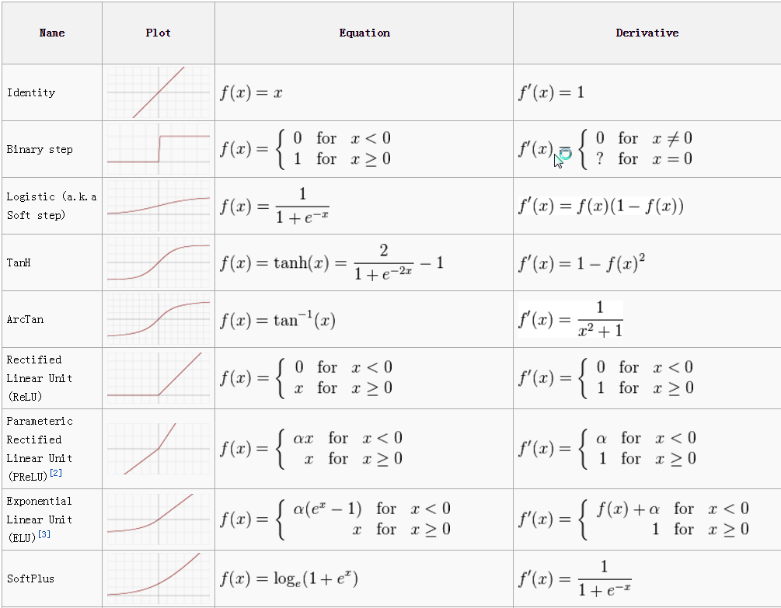
Examples of Activation Functions

Slide 15
Q&A

Slide 16
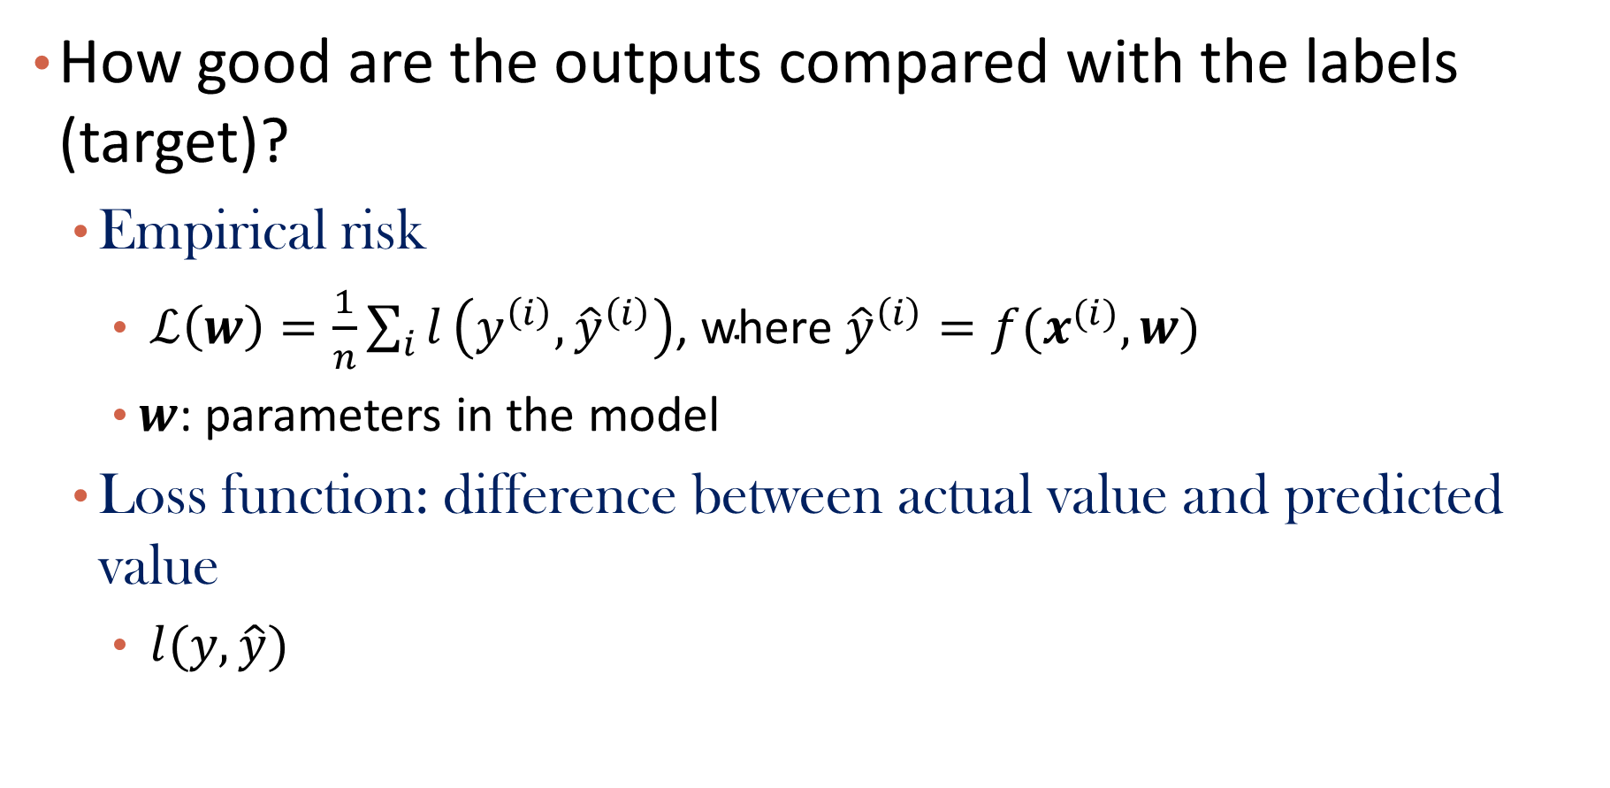
Loss Functions
How good are the outputs compared with the labels (target)?
Empirical risk
$ℒ\left(w\right)=\frac{1}{n}\sum_{i}{l}\left(y^{\left(i\right)},{\hat{y}}^{\left(i\right)}\right)\text{, }\text{where} {\hat{y}}^{\left(i\right)}=f(x^{(i)},w)$
$w$: parameters in the model
Loss function: difference between actual value and predicted value
$l(y,\hat{y})$

Slide 17
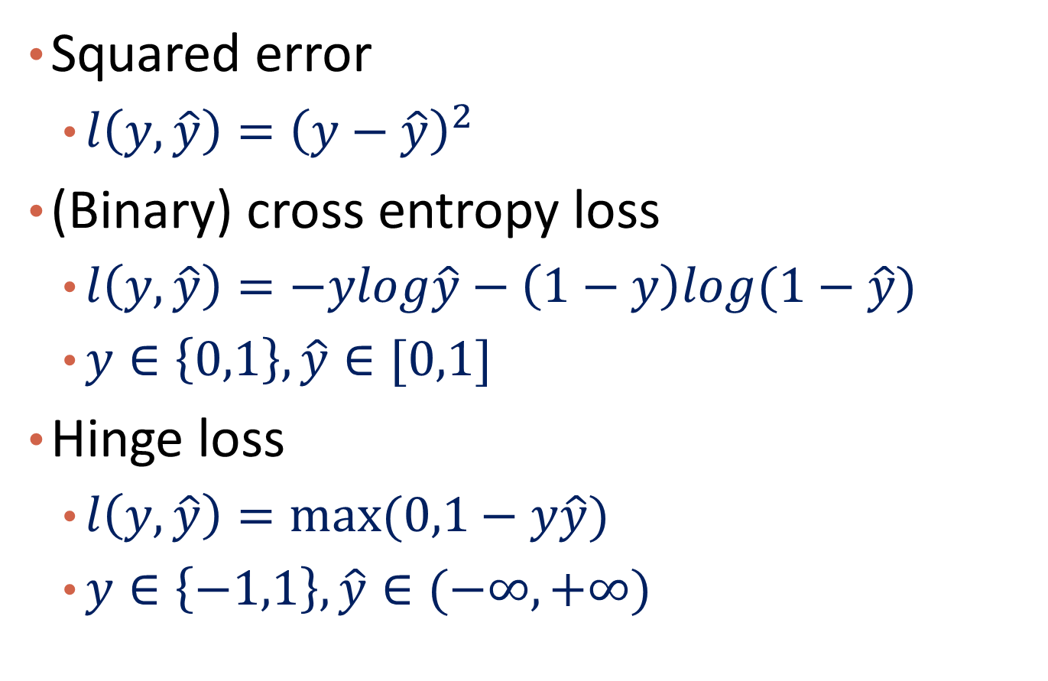
Example of Loss Functions
Squared error
$l\left(y,\hat{y}\right)={\left(y−\hat{y}\right)}^{2}$
(Binary) cross entropy loss
$l\left(y,\hat{y}\right)=−ylog\hat{y}−\left(1−y\right)log⁡(1−\hat{y})$
$y∈\left\{0,1\right\}, \hat{y}∈[0,1]$
Hinge loss
$l\left(y,\hat{y}\right)=max⁡(0,1−y\hat{y})$
$y∈\left\{−1,1\right\},\hat{y}∈(−∞,+∞)$

Slide 18
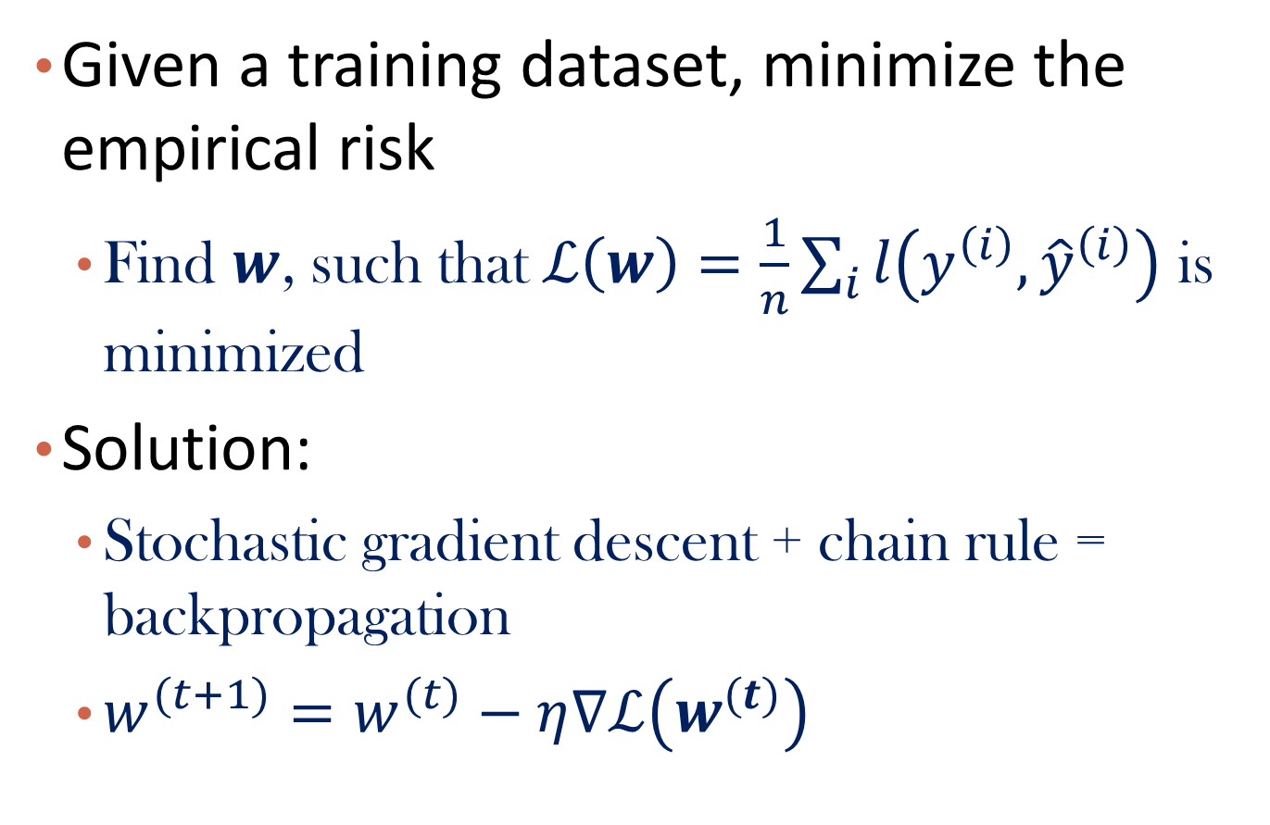
Optimization
Given a training dataset, minimize the empirical risk
Find $w$, such that$ℒ\left(w\right)=\frac{1}{n}\sum_{i}{l\left(y^{\left(i\right)},{\hat{y}}^{\left(i\right)}\right)}$ is minimized
Solution:
Stochastic gradient descent + chain rule = backpropagation
$w^{(t+1)}=w^{(t)}−η∇ℒ\left(w^{(t)}\right)$

Slide 19
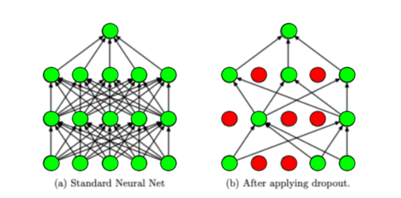
Regularization
Avoid overfitting
Techniques
L2/L1 regularization
Dropout
Early stopping
…
https://medium.com/analytics-vidhya/a-simple-introduction-to-dropout-regularization-with-code-5279489dda1e

Slide 20
Neural Network
Introduction
Connection to Shallow Machine Learning Algorithms
Multi-Layer Feed-Forward Neural Network
Deep Learning
Summary

Slide 21
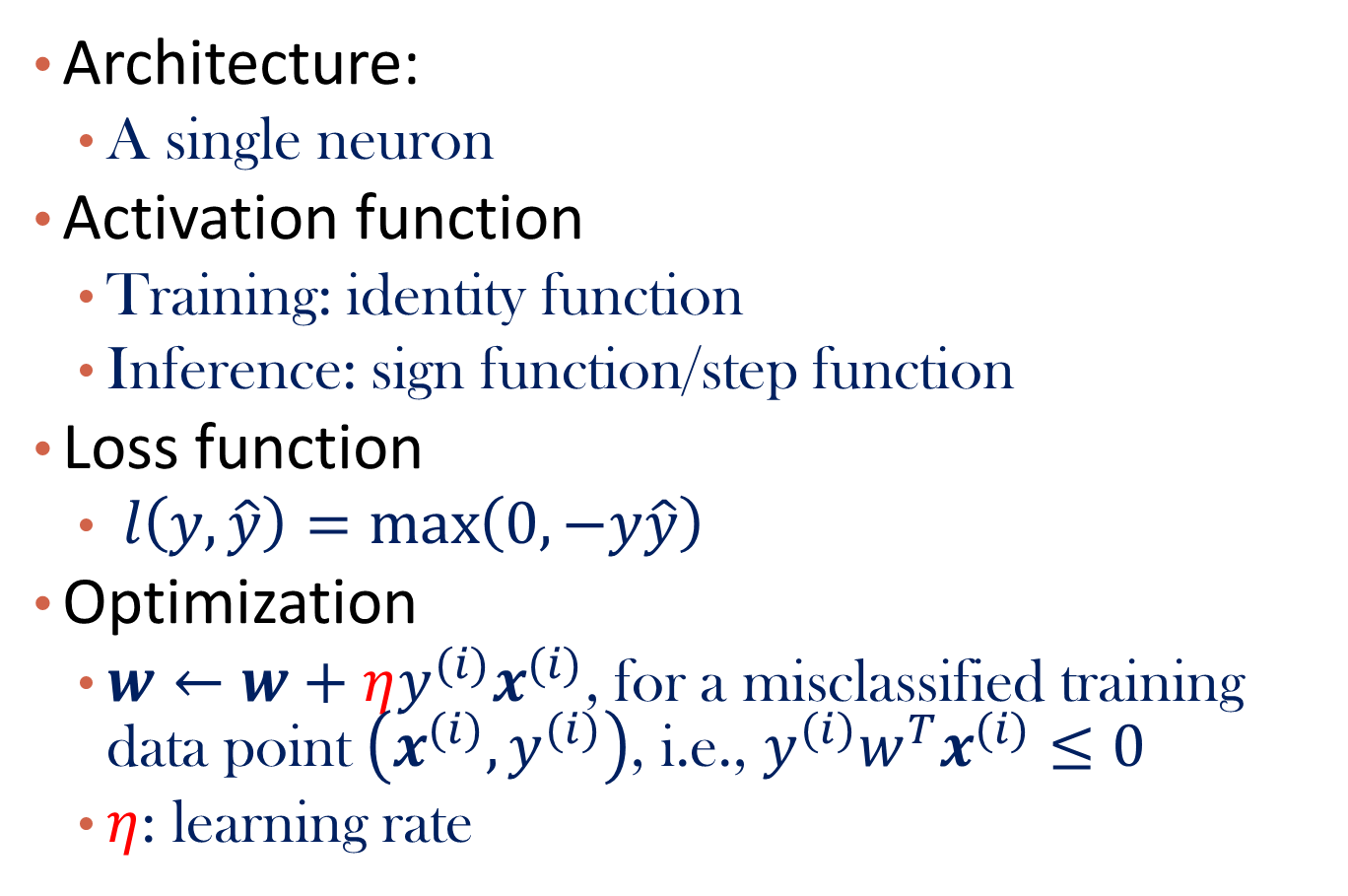
Perceptron
Architecture:
A single neuron
Activation function
Training: identity function
Inference: sign function/step function
Loss function
$l\left(y,\hat{y}\right)=\max\left(0,−y\hat{y}\right)$
Optimization
$w←w+ηy^{(i)}x^{(i)}$, for a misclassified training data point $\left(x^{(i)},y^{(i)}\right)$, i.e., $y^{(i)}w^{T}x^{(i)}≤0$
$η$: learning rate

Slide 22
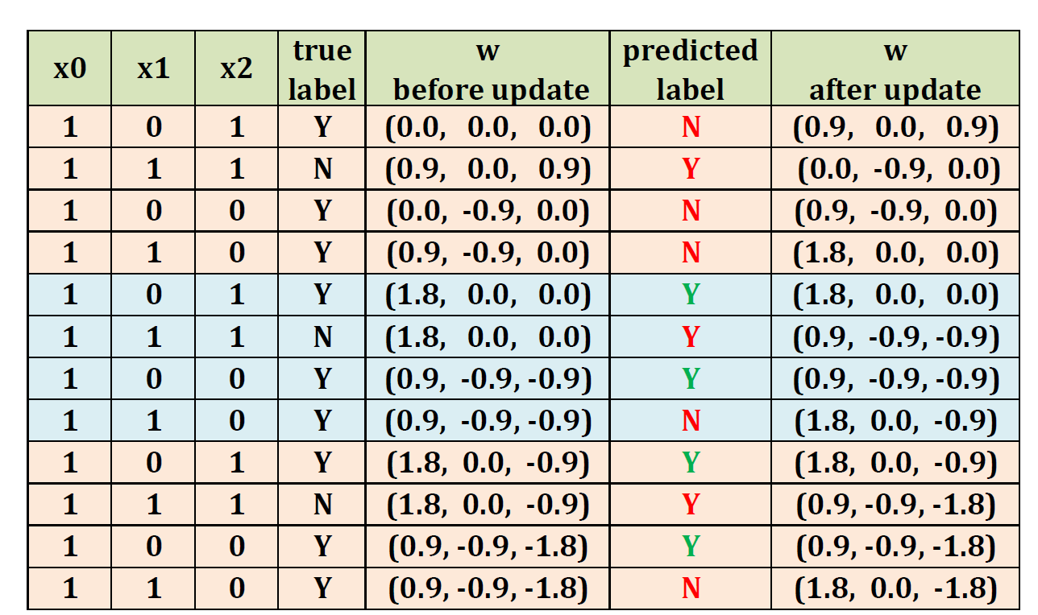

Example: 1 for “Y” and -1 for “N”; $η=0.9$
Notes:
\alpha = 0.9

Slide 23
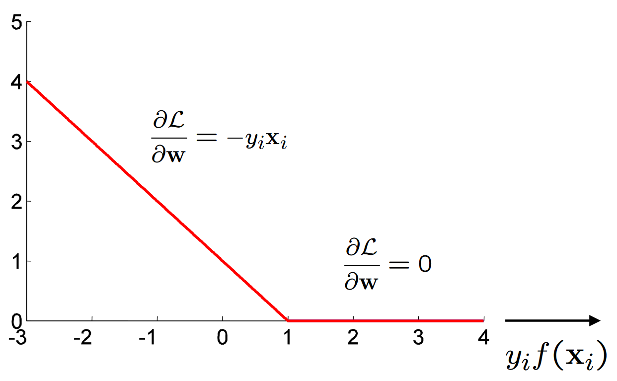
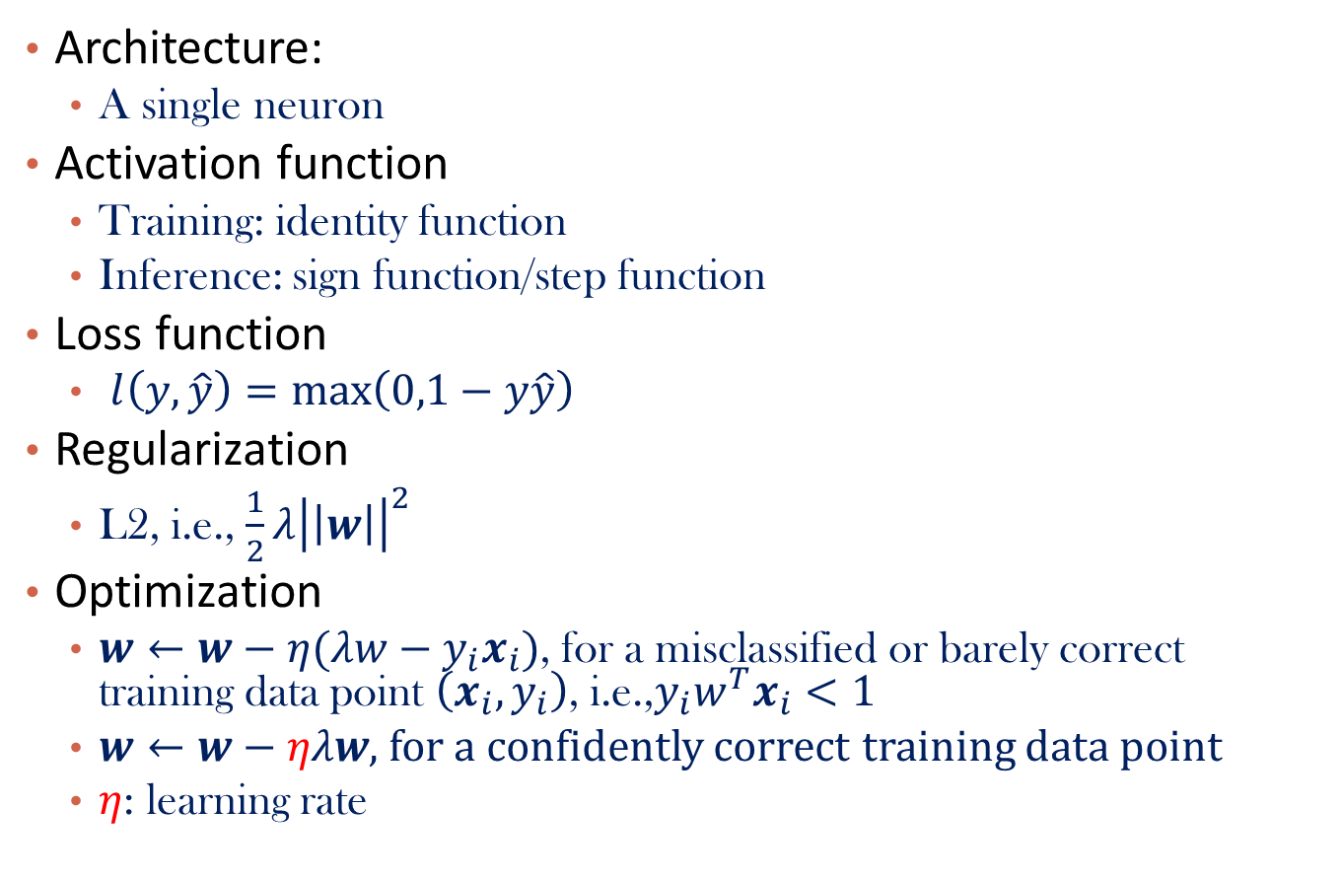
Linear SVM
Architecture:
A single neuron
Activation function
Training: identity function
Inference: sign function/step function
Loss function
$l\left(y,\hat{y}\right)=\max\left(0,1−y\hat{y}\right)$
Regularization
L2, i.e., $\frac{1}{2}λ{\left|\left|w\right|\right|}^{2}$
Optimization
$w←w−η(λw−y_{i}x_{i})$, for a misclassified or barely correct training data point $\left(x_{i},y_{i}\right)$, i.e.,$y_{i}w^{T}x_{i}<1$
$w←w−ηλw$, for a confidently correct training data point
$η$: learning rate

Slide 24
Perceptron V.S. Linear SVM
Source: http://www.charuaggarwal.net/neural.htm

Slide 25
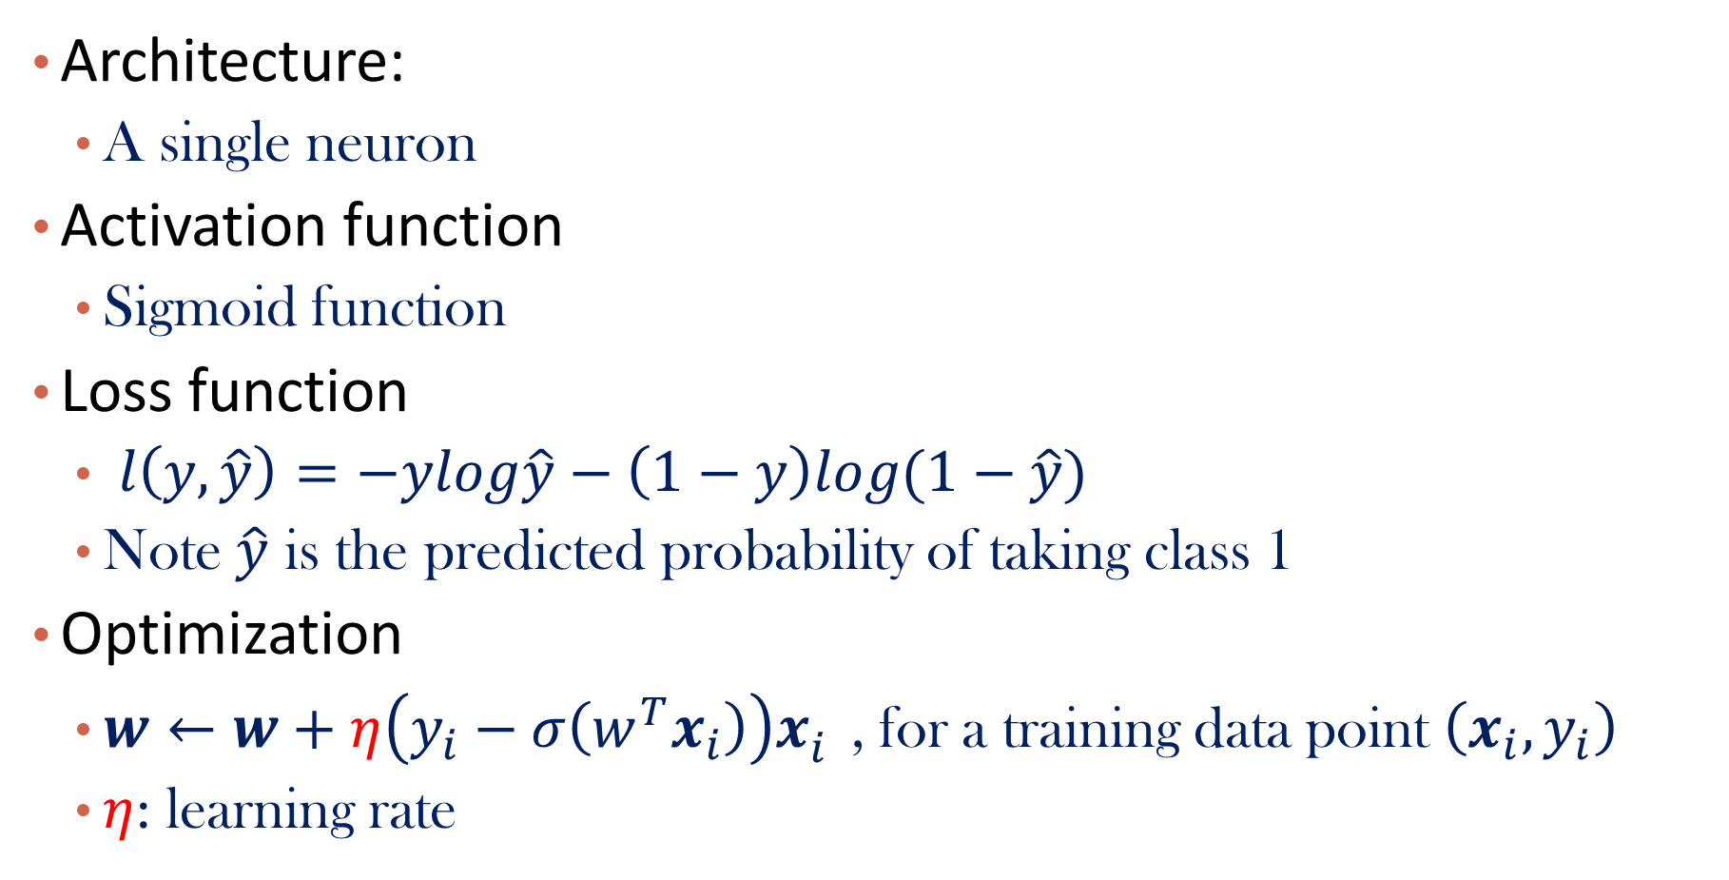
Logistic Regression
Architecture:
A single neuron
Activation function
Sigmoid function
Loss function
$l\left(y,\hat{y}\right)=−ylog\hat{y}−\left(1−y\right)log⁡(1−\hat{y})$
Note $\hat{y}$ is the predicted probability of taking class 1
Optimization
$w←w+η{\left(y_{i}−σ\left(w^{T}x_{i}\right)\right)x}_{i}^{}$, for a training data point $\left(x_{i},y_{i}\right)$
$η$: learning rate

Slide 26
Question
For logistic regression, is minimizing the cross-entropy loss function equivalent to maximizing the log-likelihood function introduced in Lecture 2?

Slide 27
Question
How to view multivariate logistic regression in the neural network setting?

Slide 28
Neural Network
Introduction
Connection to Shallow Machine Learning Algorithms
Multi-Layer Feed-Forward Neural Network
Deep Learning
Summary

Slide 29



A Multi-Layer Feed-Forward Neural Network
A two-layer network
Output vector
Output layer
$$o=g(W^{\left(2\right)}h+b^{(2)})$$
Hidden layer
$$h=f(W^{\left(1\right)}x+b^{(1)})$$
Bias term
Input layer
Weight matrix: $d^{(1)}∗d^{(0)}$
Nonlinear transformation,
e.g. sigmoid transformation
Input vector: x
Notes:
MK: Note – different notation than used in book. Will have to standardize notation.
Ting: add major formula

Slide 30
How A Multi-Layer Neural Network Works
The inputs to the network correspond to the attributes measured for each training tuple
Inputs are fed simultaneously into the units making up the input layer
They are then weighted and fed simultaneously to a hidden layer
The number of hidden layers is arbitrary
The weighted outputs of the last hidden layer are input to units making up the output layer, which emits the network's prediction
The network is feed-forward: None of the weights cycles back to an input unit or to an output unit of a previous layer
From a math point of view, networks perform nonlinear regression: Given enough hidden units and enough training samples, they can closely approximate any continuous function
Notes:
Ting: modify “approximate any function” => “approximate any continuous function” according to Universal approximation theorem

Slide 31
Learning by Backpropagation
Iteratively process a set of training tuples & compare the network's prediction with the actual known target value
For each training tuple, the weights are modified to minimize the loss function between the network's prediction and the actual target value, say mean squared error
Stochastic gradient descent + chain rule
Modifications are made in the “backwards” direction: from the output layer, through each hidden layer down to the first hidden layer, hence “backpropagation”

Slide 32
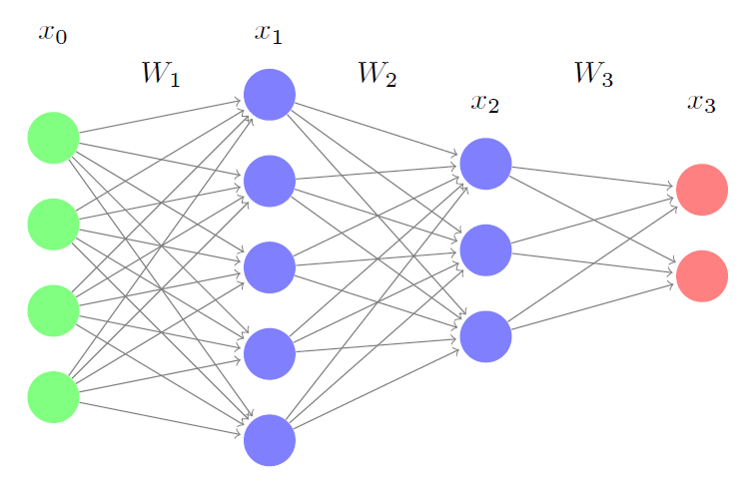

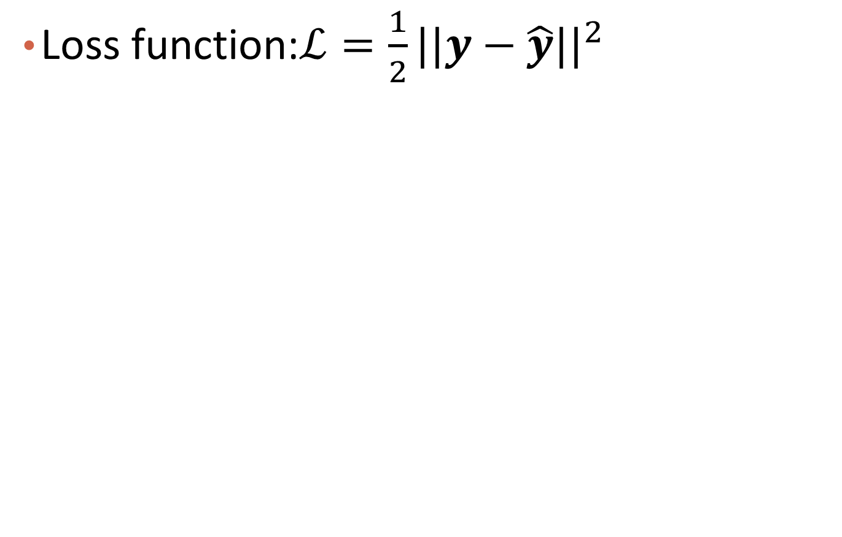







Example
Loss function:$ℒ=\frac{1}{2}{||y−\hat{y}||}^{2}$
$$x^{(1)}$$
$$x^{(0)}$$
$$W^{(1)}$$
$$W^{(2)}$$
$$W^{(3)}$$
$$x^{(2)}$$
$$x^{(3)}$$
i
j
$$z^{(l)}=W^{(l)}x^{(l−1)}+b^{(l)}$$
$$x^{(l)}=f^{(l)}\left(z^{(l)}\right)$$
$$ℒ=\frac{1}{2}{\left|\left|y−x^{(3)}\right|\right|}^{2}$$
s
k

Slide 33
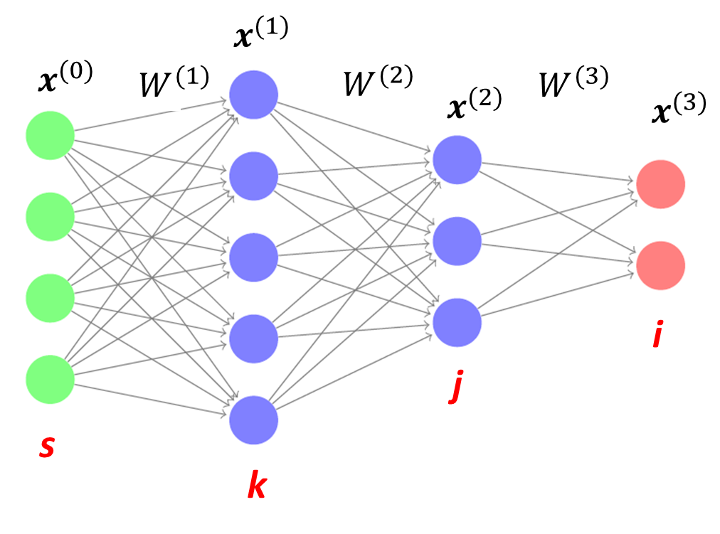
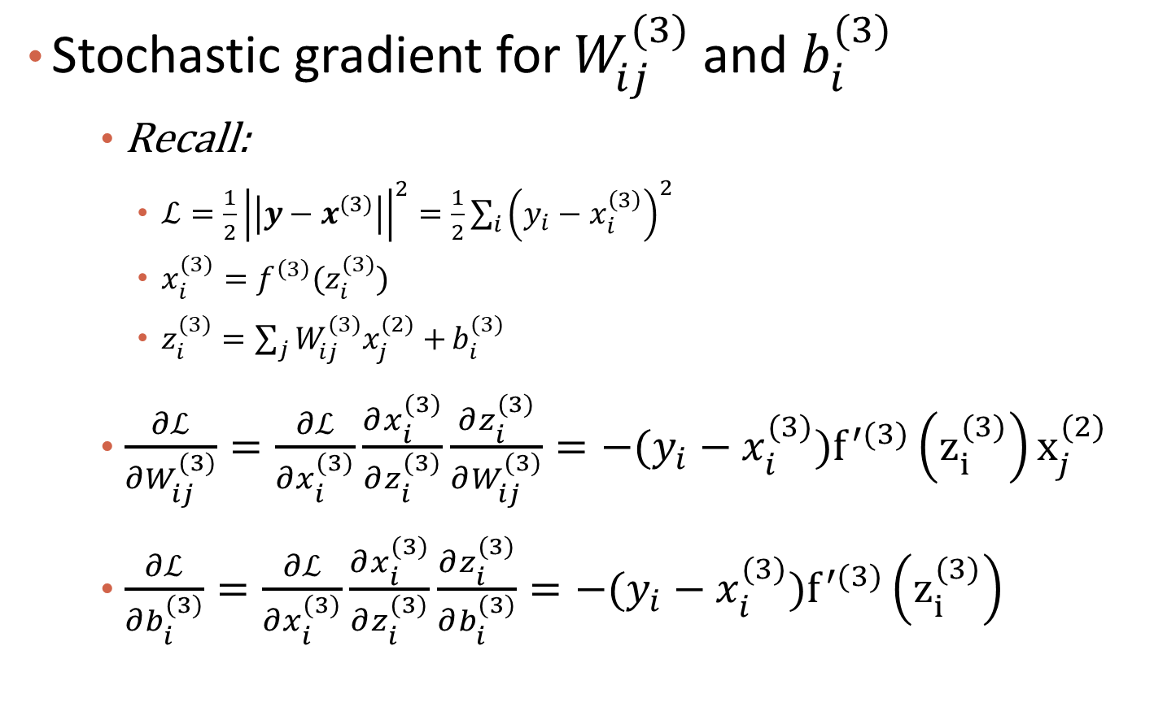

Gradient for Layer 3 (Last Layer)
Stochastic gradient for $W_{ij}^{(3)}$ and $b_{i}^{(3)}$
Recall:
$ℒ={\frac{1}{2}\left|\left|y−x^{(3)}\right|\right|}^{2}=\frac{1}{2}\sum_{i}{{\left(y_{i}−x_{i}^{\left(3\right)}\right)}^{2}}$
$x_{i}^{(3)}=f^{\left(3\right)}(z_{i}^{(3)})$
$z_{i}^{(3)}=\sum_{j}{W_{ij}^{(3)}x_{j}^{(2)}+}b_{i}^{(3)}$
$\frac{∂ℒ}{∂W_{ij}^{(3)}}=\frac{∂ℒ}{∂x_{i}^{(3)}}\frac{∂x_{i}^{(3)}}{∂z_{i}^{(3)}}\frac{∂z_{i}^{(3)}}{∂W_{ij}^{(3)}}=−(y_{i}−x_{i}^{(3)})f^{′(3)}\left(z_{i}^{(3)}\right)x_{j}^{(2)}$
$\frac{∂ℒ}{∂b_{i}^{(3)}}=\frac{∂ℒ}{∂x_{i}^{(3)}}\frac{∂x_{i}^{(3)}}{∂z_{i}^{(3)}}\frac{∂z_{i}^{(3)}}{∂b_{i}^{(3)}}=−(y_{i}−x_{i}^{(3)})f^{′(3)}\left(z_{i}^{(3)}\right)$
$$δ_{i}^{(3)}$$
Notes:
Hadamard product

Slide 34
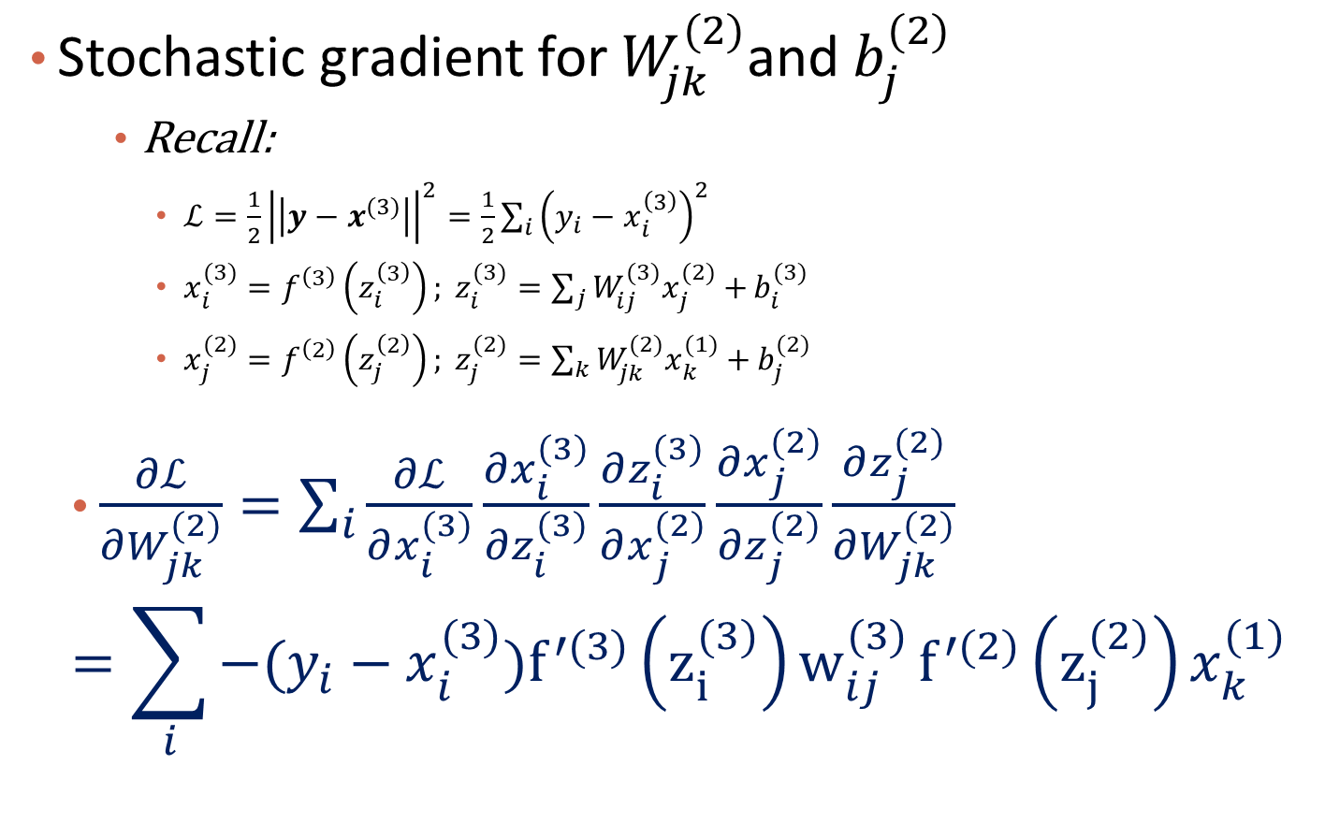


Gradient for Layer 2
Stochastic gradient for $W_{jk}^{(2)}$and $b_{j}^{(2)}$
Recall:
$ℒ={\frac{1}{2}\left|\left|y−x^{(3)}\right|\right|}^{2}=\frac{1}{2}\sum_{i}{{\left(y_{i}−x_{i}^{\left(3\right)}\right)}^{2}}$
$x_{i}^{(3)}=f^{\left(3\right)}\left(z_{i}^{\left(3\right)}\right); z_{i}^{(3)}=\sum_{j}{W_{ij}^{(3)}x_{j}^{(2)}+}b_{i}^{(3)}$
$x_{j}^{(2)}=f^{\left(2\right)}\left(z_{j}^{\left(2\right)}\right); z_{j}^{(2)}=\sum_{k}{W_{jk}^{(2)}x_{k}^{(1)}+}b_{j}^{(2)}$
$\frac{∂ℒ}{∂W_{jk}^{(2)}}=\sum_{i}{\frac{∂ℒ}{∂x_{i}^{(3)}}\frac{∂x_{i}^{(3)}}{∂z_{i}^{(3)}}\frac{∂z_{i}^{(3)}}{∂x_{j}^{(2)}}\frac{∂x_{j}^{(2)}}{∂z_{j}^{(2)}}\frac{∂z_{j}^{(2)}}{∂W_{jk}^{(2)}}}$
$$=\sum_{i}{−(y_{i}−x_{i}^{(3)})f^{′(3)}\left(z_{i}^{(3)}\right)w_{ij}^{(3)}}f^{′(2)}\left(z_{j}^{(2)}\right)x_{k}^{(1)}$$
$$δ_{i}^{(3)}$$
$$δ_{j}^{(2)}$$

Slide 35
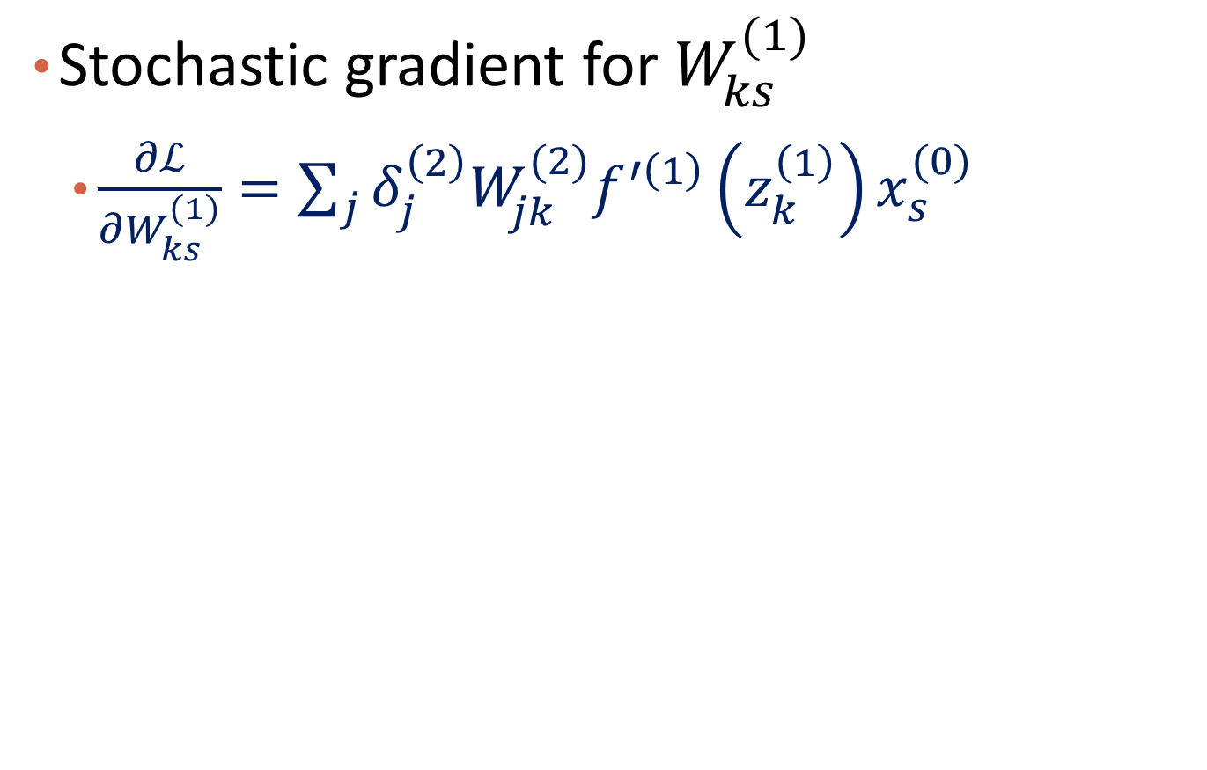
Gradient for Layer 1
Stochastic gradient for $W_{ks}^{(1)}$
$\frac{∂ℒ}{∂W_{ks}^{(1)}}=\sum_{j}{δ_{j}^{\left(2\right)}W_{jk}^{(2)}f^{′\left(1\right)}\left(z_{k}^{\left(1\right)}\right)x_{s}^{(0)} }$

Slide 36
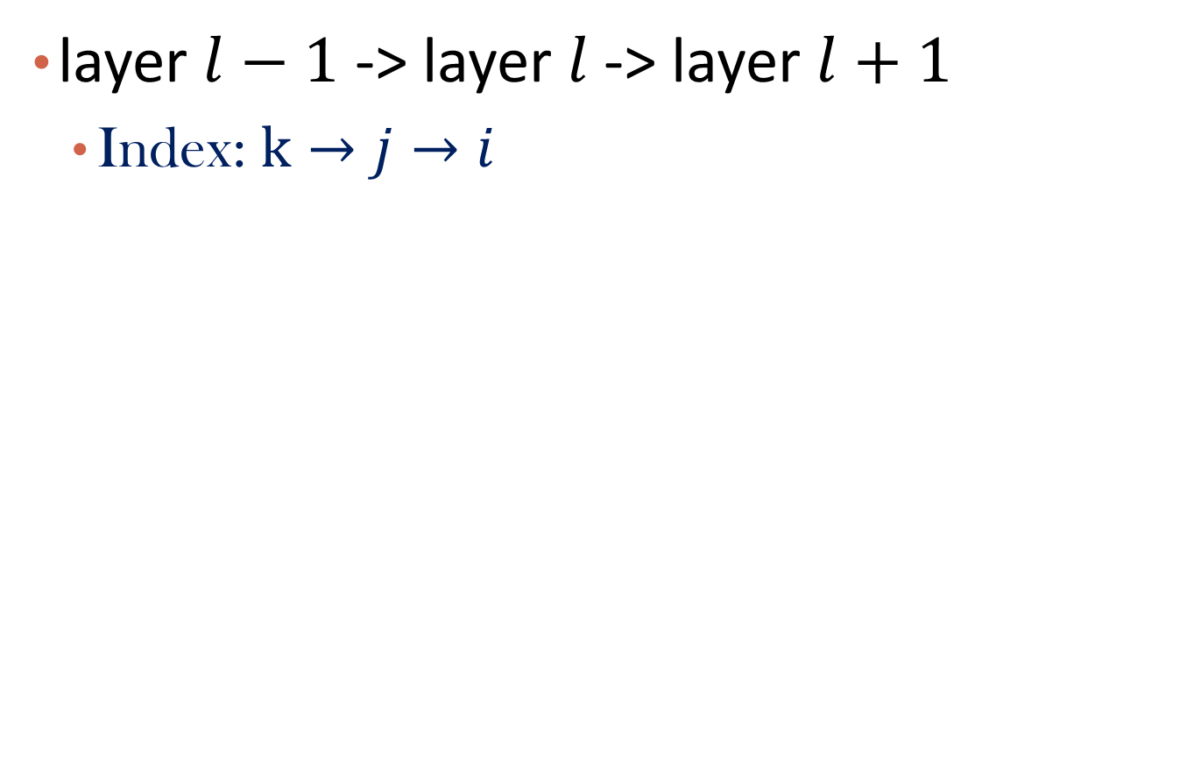


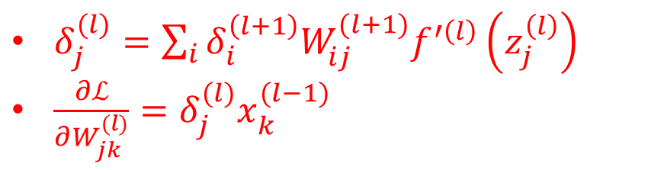
Question: General form
layer $l−1$ -> layer $l$-> layer $l+1$
Index: $k→j→i$
$$W^{(l)}$$
$$W^{(l+1)}$$
i
k
j
$δ_{j}^{(l)}=\sum_{i}{δ_{i}^{\left(l+1\right)}W_{ij}^{(l+1)}f^{′\left(l\right)}\left(z_{j}^{\left(l\right)}\right) }$
$\frac{∂ℒ}{∂W_{jk}^{(l)}}=δ_{j}^{(l)}x_{k}^{(l−1)}$
Notes:
$$\frac{∂ℒ}{∂W_{kj}^{(l)}}=\sum_{i}{δ_{i}^{\left(l+1\right)}W_{ji}^{(l+1)}f^{′\left(l\right)}\left(z_{j}^{\left(l\right)}\right)x_{k}^{(l−1)} }$$

Slide 37
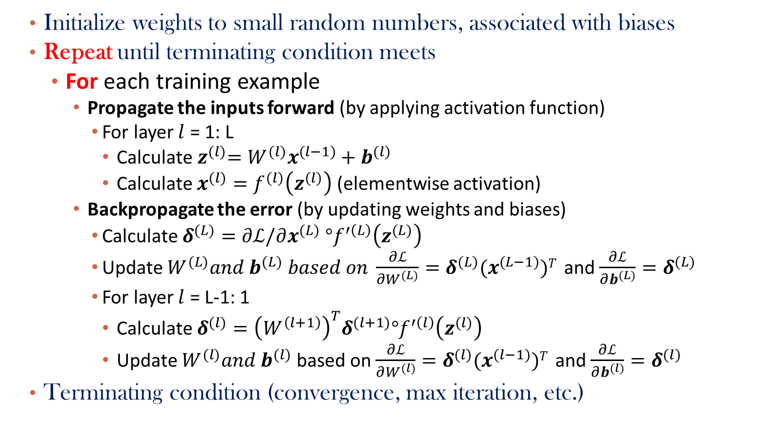
Backpropagation Steps to Learn Weights
Initialize weights to small random numbers, associated with biases
Repeat until terminating condition meets
For each training example
Propagate the inputs forward (by applying activation function)
For layer $l$ = 1: L
Calculate${ z}^{(l)}=W^{(l)}x^{(l−1)}+b^{(l)}$
Calculate $x^{(l)}=f^{(l)}\left(z^{(l)}\right)$ (elementwise activation)
Backpropagate the error (by updating weights and biases)
Calculate $δ^{(L)}=∂ℒ/∂x^{(L)} °f^{′\left(L\right)}\left(z^{(L)}\right)$
Update $W^{(L)}and{ b}^{(L)} based on \frac{∂ℒ}{∂W^{(L)}}=δ^{(L)}{(x}^{(L−1)})T$ and $\frac{∂ℒ}{∂b^{(L)}}=δ^{(L)}$
For layer $l$ = L-1: 1
Calculate $δ^{(l)}={{\left(W^{\left(l+1\right)}\right)}^{T}δ}^{(l+1)}°f^{′\left(l\right)}\left(z^{(l)}\right)$
Update $W^{(l)}and{ b}^{(l)}$ based on $\frac{∂ℒ}{∂W^{(l)}}=δ^{(l)}{(x}^{(l−1)})T$ and $\frac{∂ℒ}{∂b^{(l)}}=δ^{(l)}$
Terminating condition (convergence, max iteration, etc.)
$°$: Hadamard product (element wise product)
Notes:
https://towardsdatascience.com/deriving-the-backpropagation-equations-from-scratch-part-1-343b300c585a

Slide 38
Q&A

Slide 39
Neural Network as a Classifier
Weakness
Long training time
Require a number of hyper-parameters typically best determined empirically, e.g., the network topology or “structure.”
Poor interpretability: Difficult to interpret the symbolic meaning behind the learned weights and of “hidden units” in the network
Strength
High tolerance to noisy data
Successful on an array of real-world data, e.g., hand-written letters
Algorithms are inherently parallel
Techniques have recently been developed for the extraction of rules from trained neural networks
Deep neural network is powerful

Slide 40
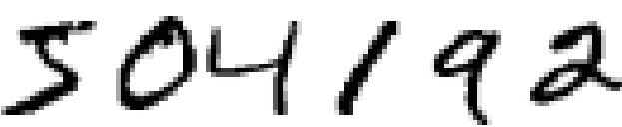

Digits Recognition Example
Obtain sequence of digits by segmentation
Recognition (our focus)
5

Slide 41
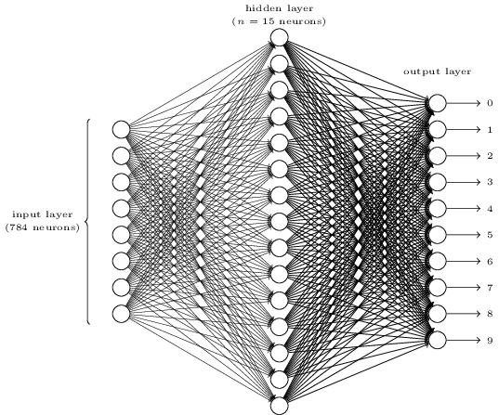
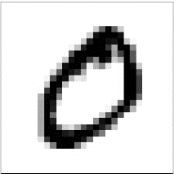

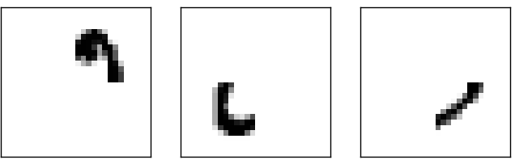
Digits Recognition Example
The architecture of the used neural network
What each neurons are doing?
0
Input image
Activated neurons detecting image parts
Predicted number

Slide 42
Neural Network
Introduction
Connection to Shallow Machine Learning Algorithms
Multi-Layer Feed-Forward Neural Network
Deep Learning
Summary

Slide 43
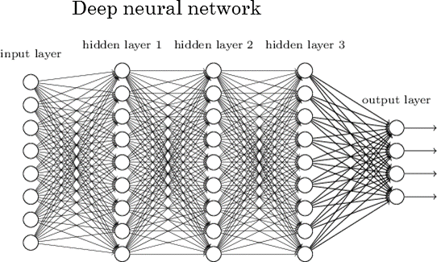
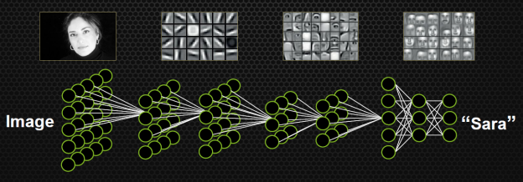
Towards Deep Learning

Slide 44
Popular Deep NNs
Deep layers and parameter sharing
Convolutional Neural Network
Applications to: Images, NLP, Graph
Recurrent Neural Network
Applications to: Sequence data
Variational autoencoder
Deep generative models

Slide 45
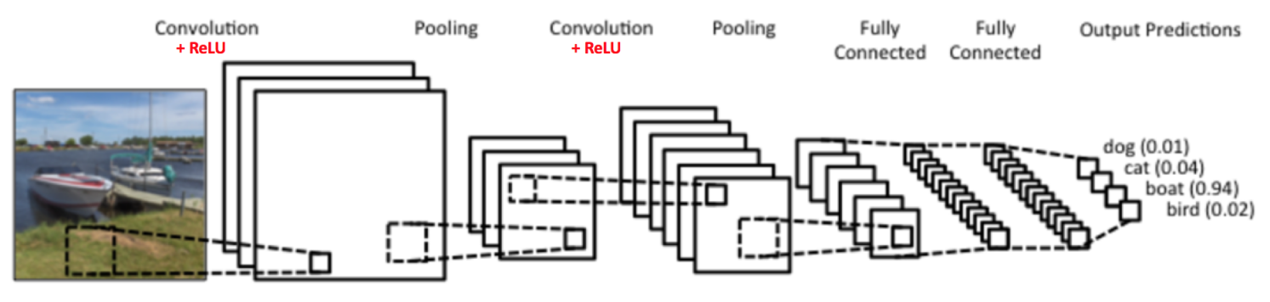
Convolutional Neural Network
The LeNet Architecture (By Yann LeCun et al.)
Source: https://ujjwalkarn.me/2016/08/11/intuitive-explanation-convnets/

Slide 46
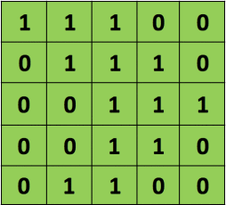
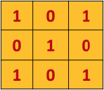
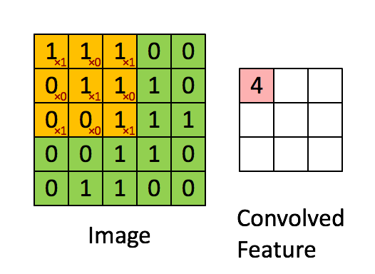
Convolution
*
Filter
Input
Convolution operator: weighted sum where weights are from filter matrix

Slide 47
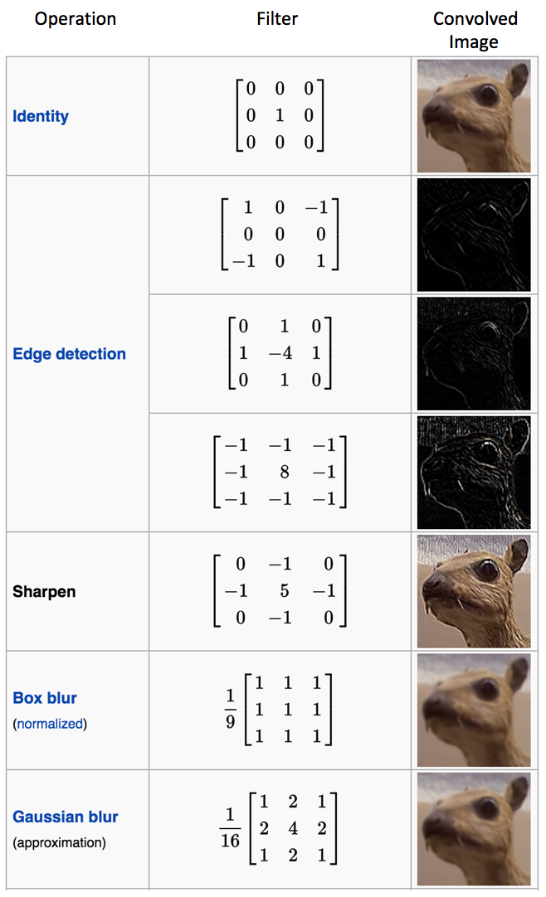
Effects of Different Filters
Source: https://en.wikipedia.org/wiki/Kernel_(image_processing)

Slide 48
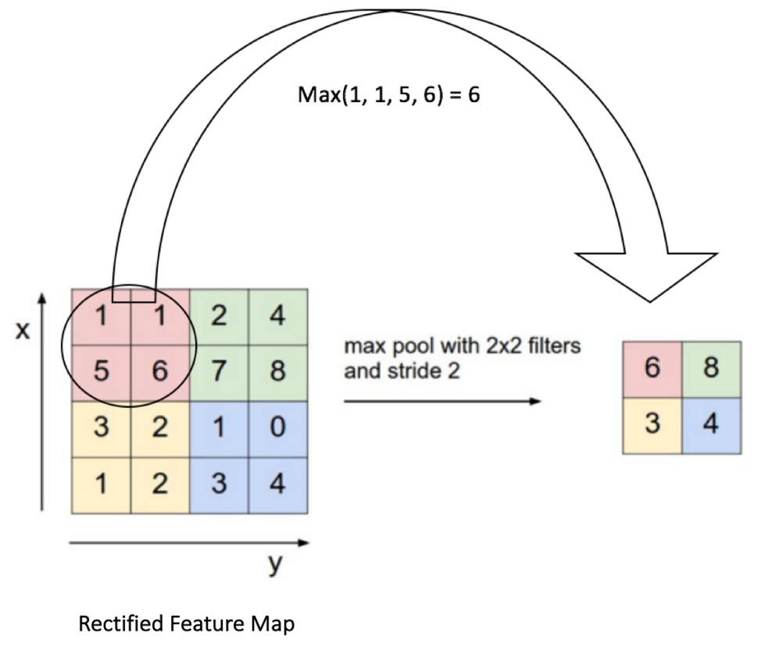
Pooling
Source: http://cs231n.github.io/convolutional-networks/

Slide 49
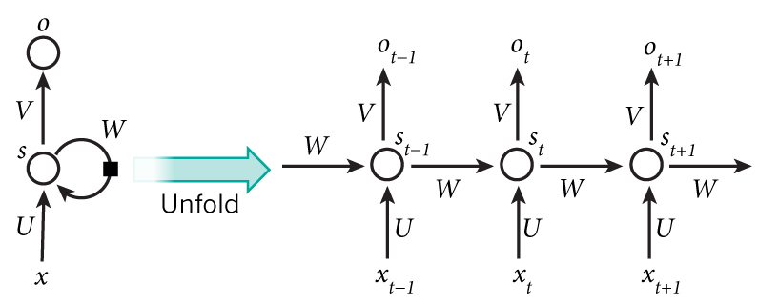
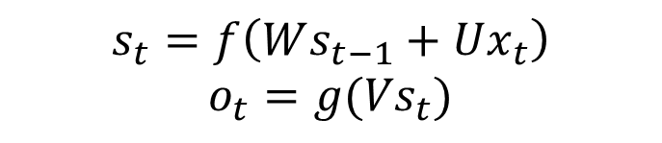

Recurrent Neural Network
Model sequential information
$$x_{t}:input vector at time t$$
$$s_{t}:hidden state at time t$$
$$o_{t}:output vector at time t$$
$$s_{t}=f\left(Ws_{t−1}+Ux_{t}\right)$$
$$o_{t}=g({Vs}_{t})$$

Slide 50
Application of Machine Translation
Seq2Seq model

Slide 51
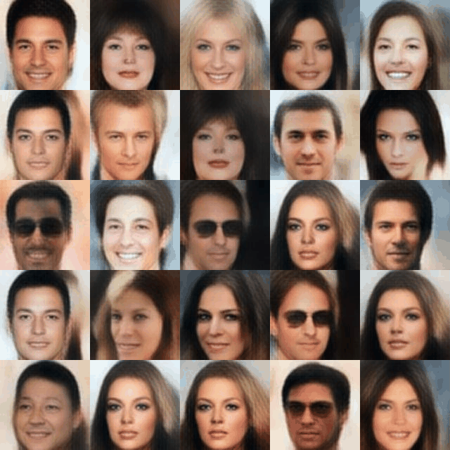
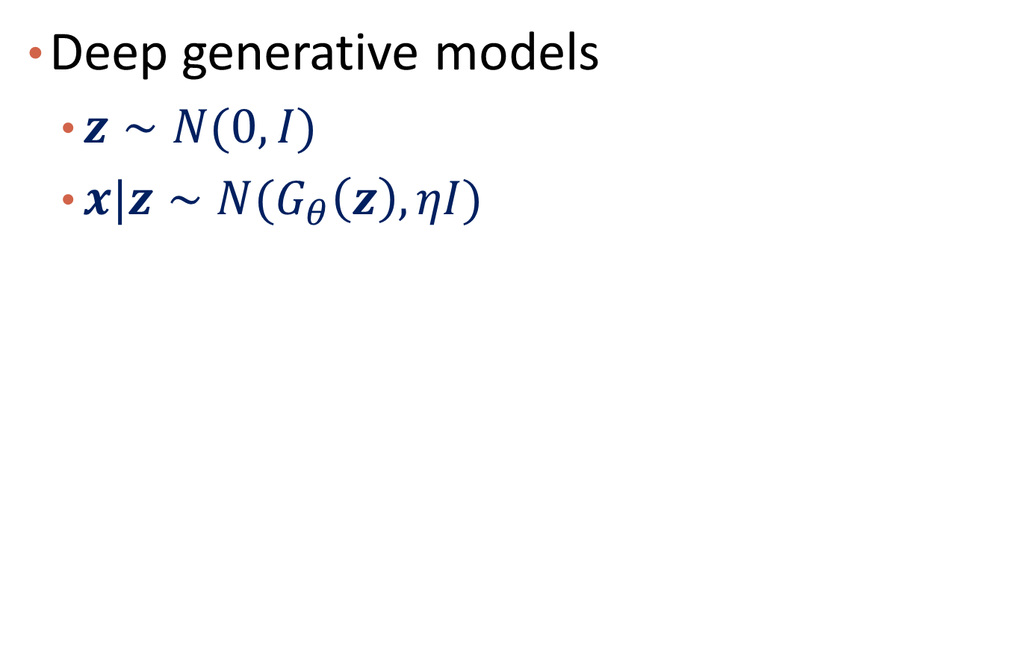
Variational Autoencoder
Deep generative models
$z∼N(0, I)$
$x|z∼{N(G}_{θ}\left(z\right), ηI)$
https://houxianxu.github.io/assets/project/dfcvae

Slide 52
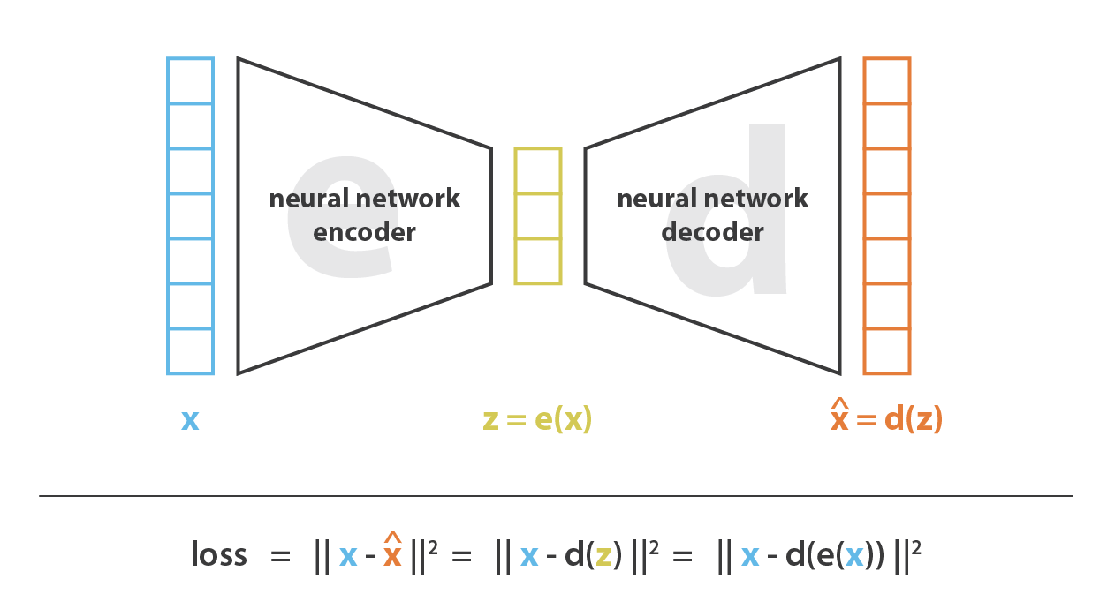
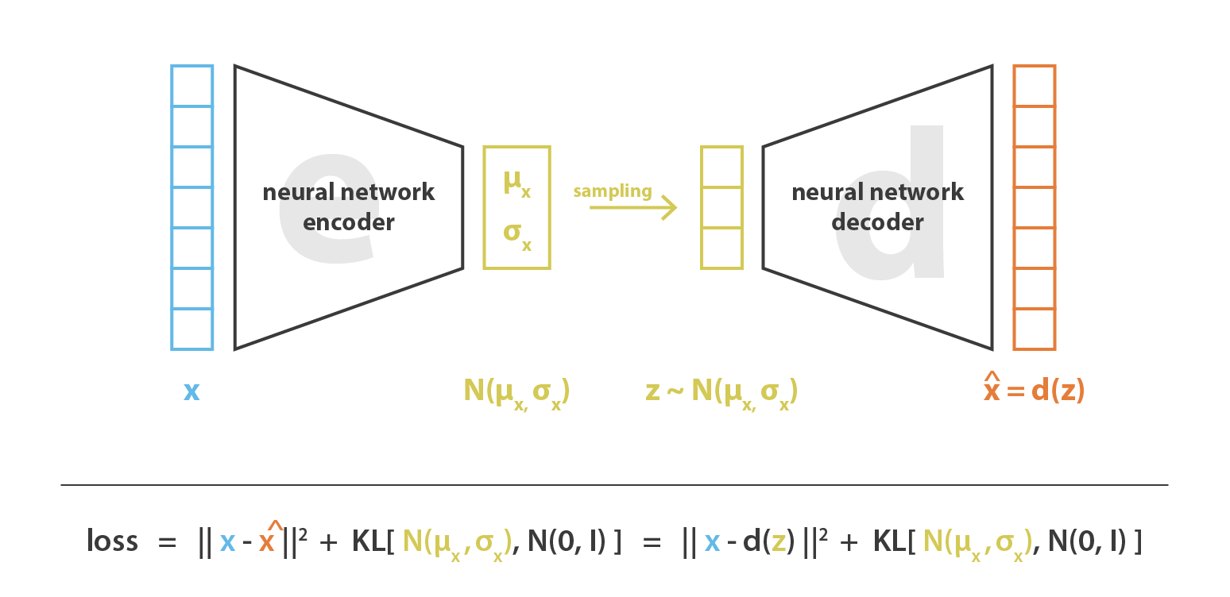


Variational Autoencoder
$$regular autoencoder$$
$$variational autoencoder$$
https://towardsdatascience.com/understanding-variational-autoencoders-vaes-f70510919f73

Slide 53
Other resources for variational autoencoder
https://www.youtube.com/watch?v=c27SHdQr4lw by Paul Hand, 2020
https://arxiv.org/pdf/1906.02691.pdf, by Kingma and Welling, 2019 (An introduction to variational autoencoders)
Stanford course: https://deepgenerativemodels.github.io/notes/vae/

Slide 54
Q&A

Slide 55
Implementation
Define architecture
Define loss
Training
Define optimizer
Define training schedule
Hyper parameter tuning
…
Inference

Slide 56
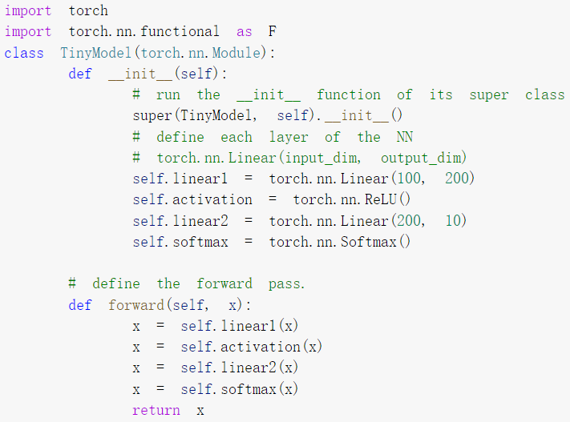
Build a MLP with Pytorch
Output
10
Input
100
Hidden layer
200

Slide 57

Build a CNN with Pytorch
Can you draw the architecture of this CNN?

Slide 58

Build a CNN with Pytorch

Slide 59

Train the Neural Network with Pytorch
Do the forward pass and compute the loss function
Zero out the previous gradients
Do the backward propagation
Do the optimizer step

Slide 60

Test the Neural Network with Pytorch

Slide 61
Neural Network
Introduction
Connection to Shallow Machine Learning Algorithms
Multi-Layer Feed-Forward Neural Network
Deep Learning
Summary

Slide 62
Summary
Neural Network
Architecture; activation function; loss function; backpropagation
Existing shallow machine learning algorithms can be represented in NN
Multilayer feedforward NN
Deep learning

Slide 63
Q&A

Slide 64
Further References
3Blue1Brown NN series: https://www.youtube.com/watch?v=aircAruvnKk&list=PLZHQObOWTQDNU6R1_67000Dx_ZCJB-3pi
Deep Learning
http://neuralnetworksanddeeplearning.com/
http://www.deeplearningbook.org/
http://www.charuaggarwal.net/neural.htm
http://d2l.ai/index.html

