Slide 1
CS247: Advanced Data Mining
05: Text Data: Topic Models
Instructor: Yizhou Sun
yzsun@cs.ucla.edu
January 31, 2024

Slide 2
Text Data: Topic Models
Text Data and Topic Models
Multinomial Mixture Model
Probabilistic Latent Semantic Analysis (pLSA)
Latent Dirichlet Allocation (LDA)
Summary

Slide 3
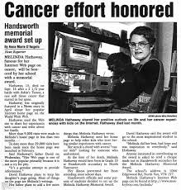

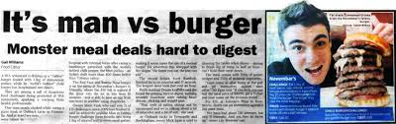
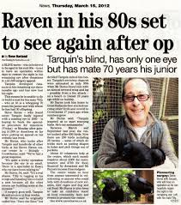
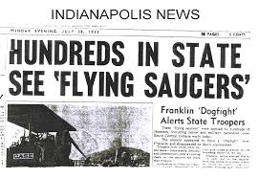
Text Data
Word/term
Document
  A sequence of words
Corpus
  A collection of
  documents

Slide 4
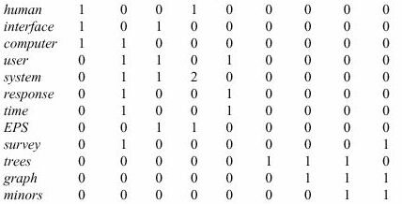
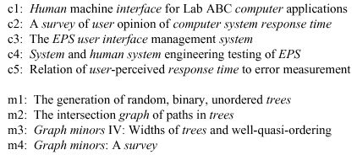
Represent a Document
Most common way: Bag-of-Words
  Ignore the order of words
  keep the count
c1 c2 c3 c4 c5 m1 m2 m3 m4
Vector space model

Slide 5
More Details
Represent the doc as a vector where each entry corresponds to a different word and the number at that entry corresponds to how many times that word was present in the document (or some function of it)
  Number of words is huge
  Select and use a smaller set of words that are of interest
  E.g. uninteresting words: ‘and’, ‘the’ ‘at’, ‘is’, etc. These are called stop-words
  Stemming: remove endings. E.g. ‘learn’, ‘learning’, ‘learnable’, ‘learned’ could be substituted by the single stem ‘learn’
  Other simplifications can also be invented and used
  The set of different remaining words is called dictionary or vocabulary. Fix an ordering of the terms in the dictionary so that you can operate them by their index.
  Can be extended to bi-gram, tri-gram, or so

Slide 6
Limitations of Vector Space Model
Dimensionality
  High dimensionality
Sparseness
  Most of the entries are zero
Shallow representation
  The vector representation does not capture semantic relations between words
  D1: I love romantic movies.
  D2: Kate Winslet is my favorite actress.

Slide 7
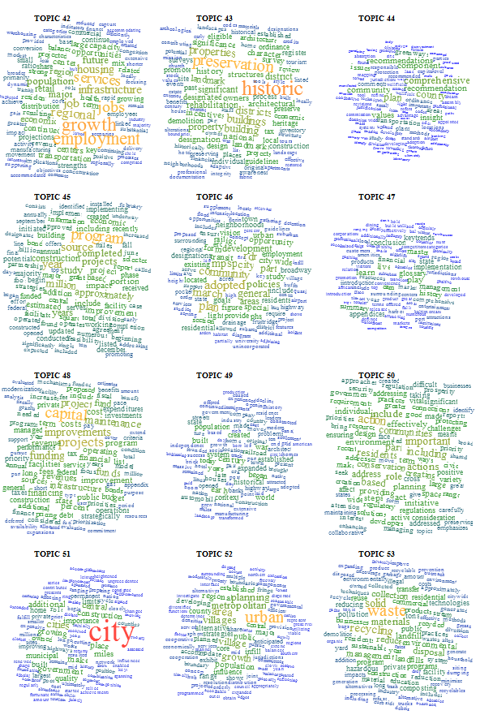
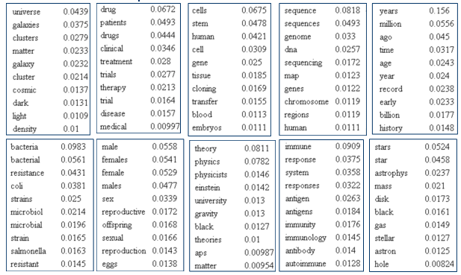
Topics
Topic
  A topic is represented by a word distribution
  Relate to an issue

Slide 8
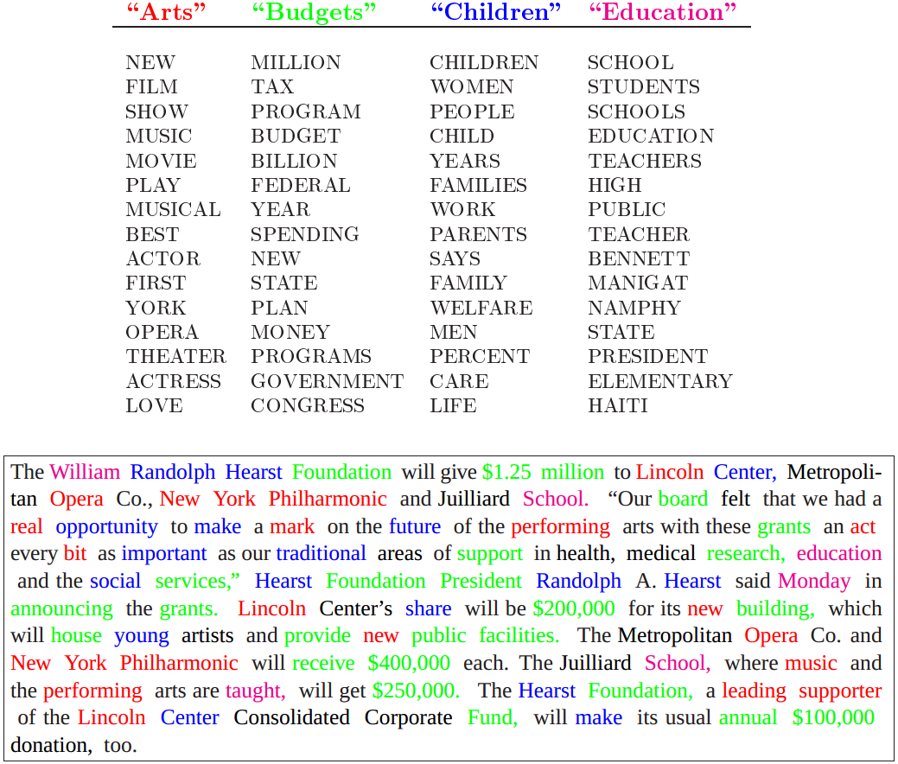
Topic Models
Topic modeling
  Get topics automatically from a corpus
  Assign documents to topics automatically
Most frequently used topic models
  pLSA
  LDA

Slide 9
Text Data: Topic Models
Text Data and Topic Models
Multinomial Mixture Model
Probabilistic Latent Semantic Analysis (pLSA)
Latent Dirichlet Allocation (LDA)
Summary

Slide 10
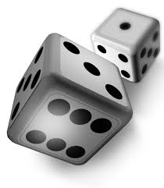

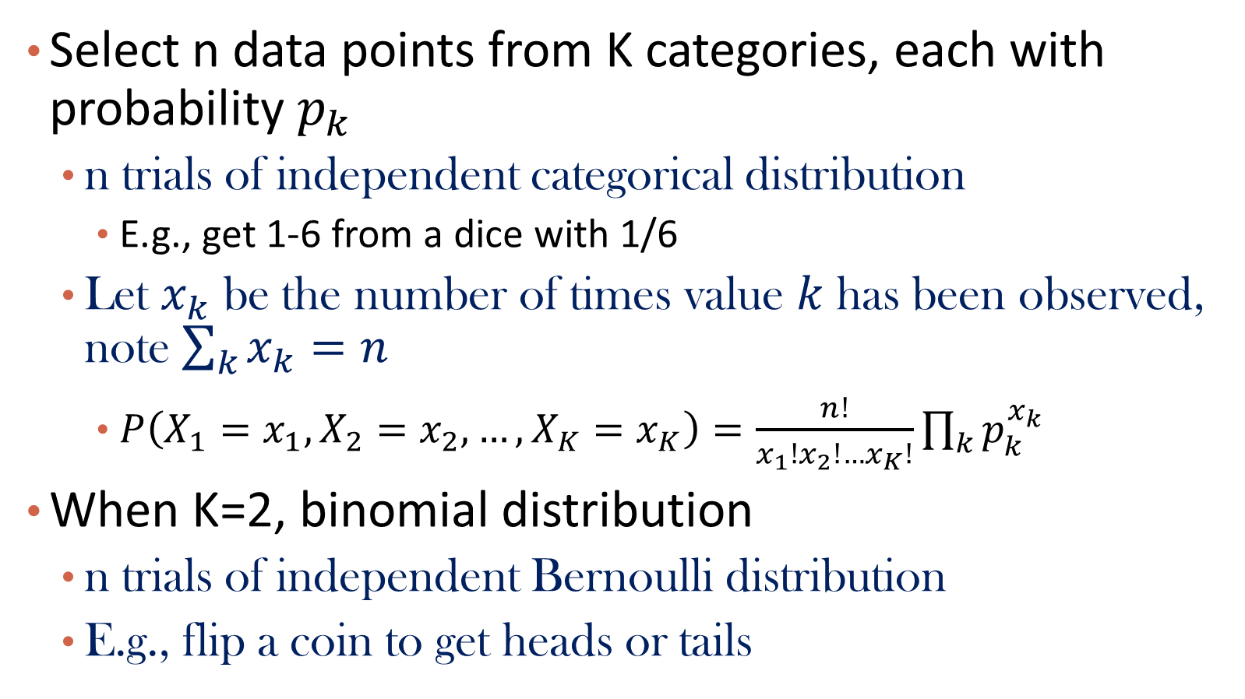
Recap of Multinomial Distribution
Select n data points from K categories, each with probability $p_{k}$
  n trials of independent categorical distribution
    E.g., get 1-6 from a dice with 1/6
  Let $x_{k}$ be the number of times value $k$ has been observed, note $\sum_{k}{x_{k}}=n$
    $P\left(X_{1}=x_{1}, X_{2}=x_{2},…,X_{K}=x_{K}\right)=\frac{n!}{x_{1}!x_{2}!…x_{K}!}\prod_{k}{p_{k}^{x_{k}}}$
When K=2, binomial distribution
  n trials of independent Bernoulli distribution
  E.g., flip a coin to get heads or tails

Slide 11
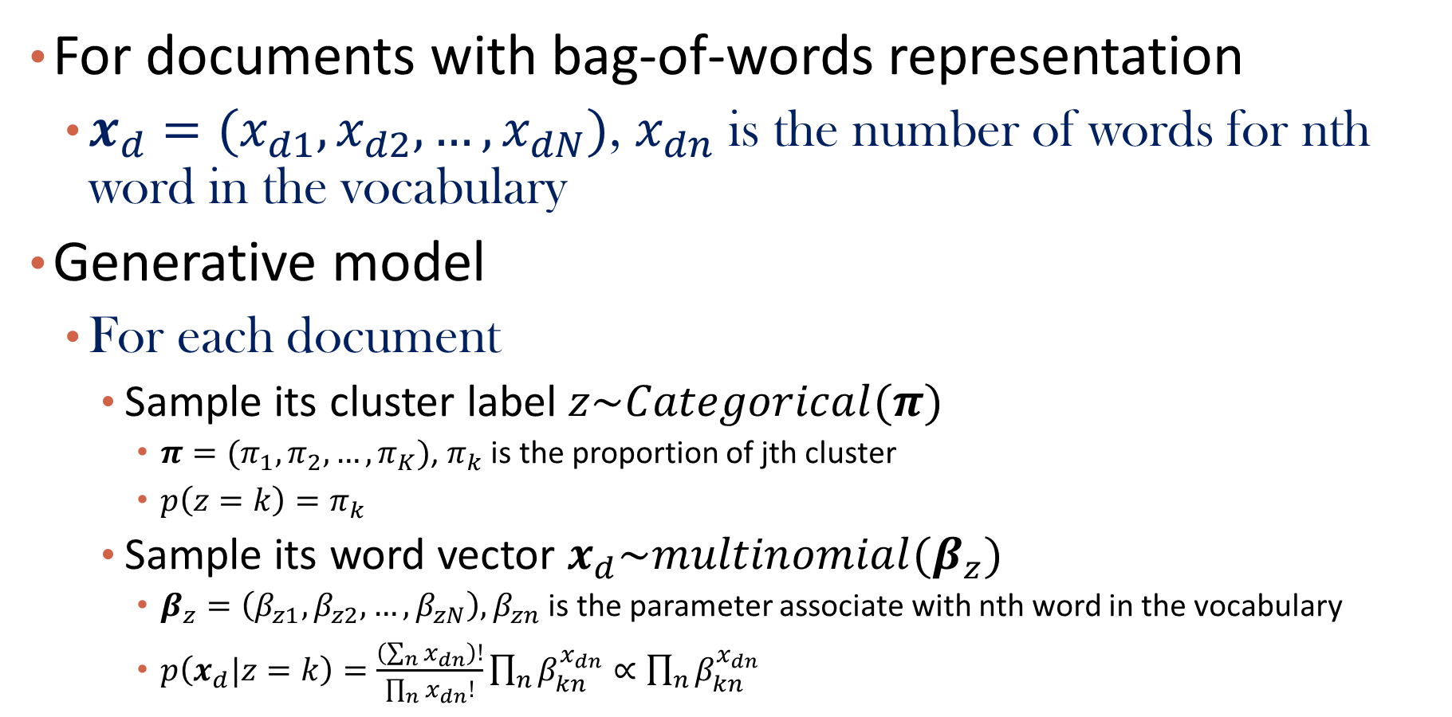
Multinomial Mixture Model
For documents with bag-of-words representation
  $x_{d}=(x_{d1},x_{d2},…,x_{dN})$, $x_{dn}$ is the number of words for nth word in the vocabulary
Generative model
  For each document
    Sample its cluster label $z\sim Categorical(π)$
      $π=(π_{1}, π_{2},…,π_{K})$, $π_{k}$ is the proportion of jth cluster
      $p\left(z=k\right)=π_{k}$
    Sample its word vector $x_{d}\sim multinomial(β_{z})$
      $β_{z}=\left(β_{z1},β_{z2},…,β_{zN}\right), β_{zn}$ is the parameter associate with nth word in the vocabulary
      $p\left(x_{d}|z=k\right)=\frac{\left(\sum_{n}{x_{dn}}\right)!}{\prod_{n}{x_{dn}!}}\prod_{n}{β_{kn}^{x_{dn}}∝\prod_{n}{β_{kn}^{x_{dn}}}}$

Slide 12
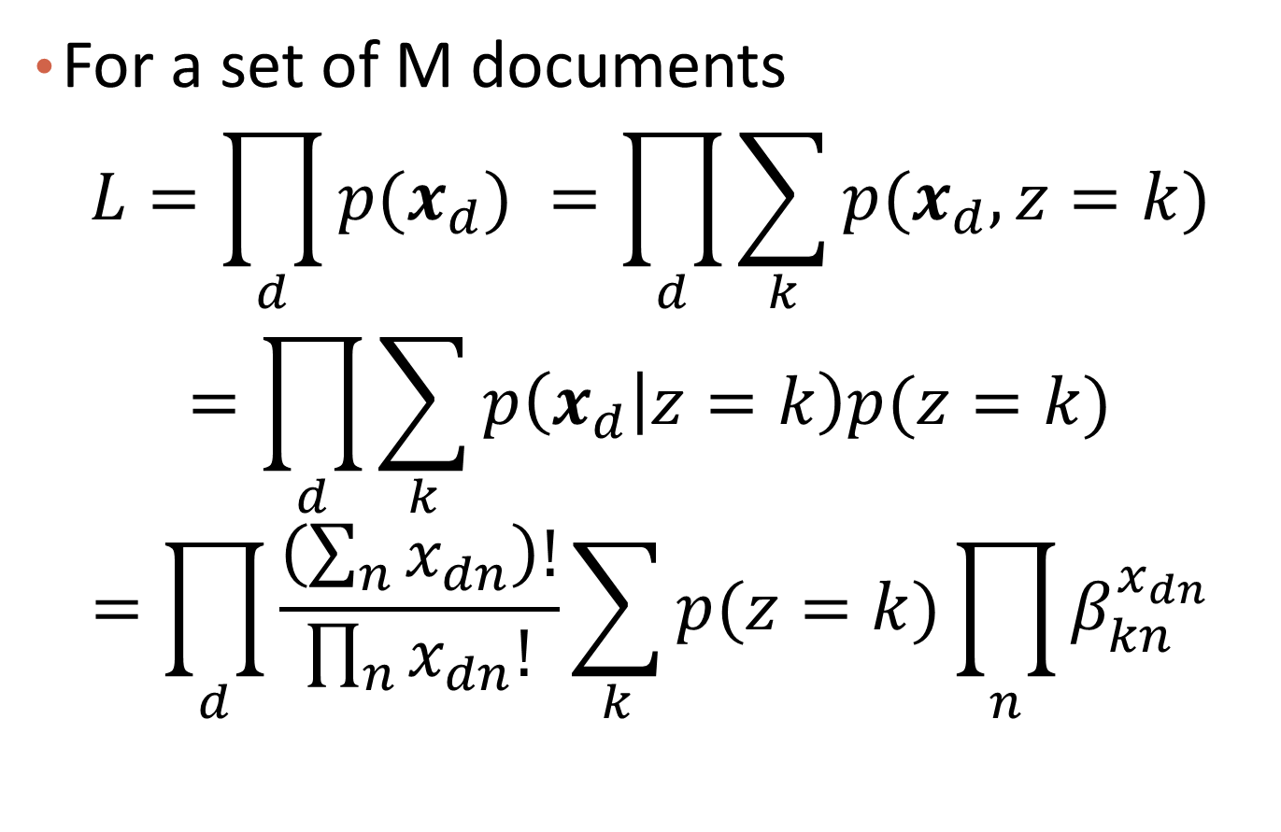
Likelihood Function
For a set of M documents
$$L=\prod_{d}{p(x_{d}) }=\prod_{d}{\sum_{k}{p(x_{d},z=k)}}$$
$$=\prod_{d}{\sum_{k}{p\left(x_{d} | z=k\right)p(z=k)}}$$
$$=\prod_{d}{\frac{\left(\sum_{n}{x_{dn}}\right)!}{\prod_{n}{x_{dn}!}}\sum_{k}{p(z=k)\prod_{n}{β_{kn}^{x_{dn}}}}}$$

Slide 13
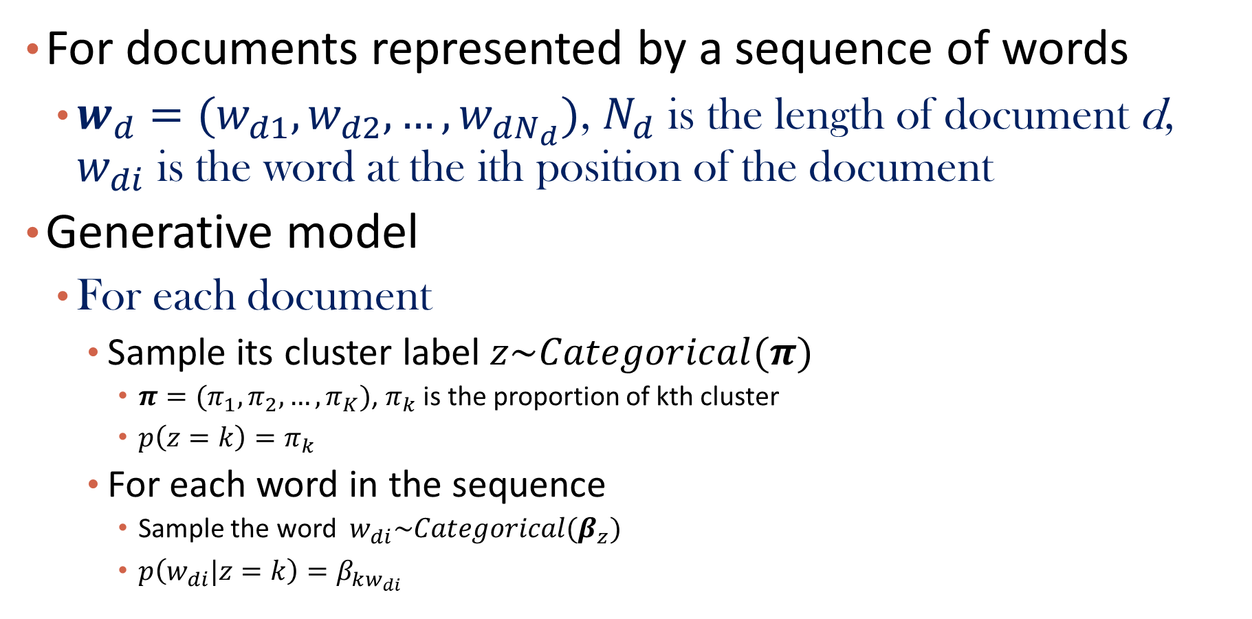
Mixture of Unigrams
For documents represented by a sequence of words
  $w_{d}=(w_{d1},w_{d2},…,w_{dN_{d}})$, $N_{d}$ is the length of document d, $w_{di}$ is the word at the ith position of the document
Generative model
  For each document
    Sample its cluster label $z\sim Categorical(π)$
      $π=(π_{1}, π_{2},…,π_{K})$, $π_{k}$ is the proportion of kth cluster
      $p\left(z=k\right)=π_{k}$
    For each word in the sequence
      Sample the word $w_{di}\sim Categorical(β_{z})$
      $p\left(w_{di}|z=k\right)=β_{kw_{di}}$

Slide 14
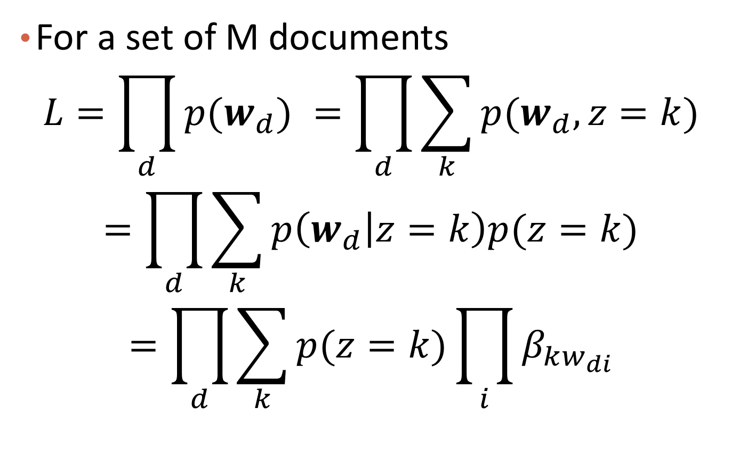
Likelihood Function
For a set of M documents
$$L=\prod_{d}{p(w_{d}) }=\prod_{d}{\sum_{k}{p(w_{d},z=k)}}$$
$$=\prod_{d}{\sum_{k}{p\left(w_{d} | z=k\right)p(z=k)}}$$
$$=\prod_{d}{\sum_{k}{p(z=k)\prod_{i}{β_{kw_{di}}}}}$$

Slide 15
Question
Are multinomial mixture model and mixture of unigrams model equivalent? Why?

Slide 16
Question
How to conduct EM algorithm on mixture of unigrams?

Slide 17


Are multinomial mixture model and mixture of unigrams model equivalent?
ⓘ Start presenting to display the poll results on this slide.

Slide 18
Text Data: Topic Models
Text Data and Topic Models
Multinomial Mixture Model
Probabilistic Latent Semantic Analysis (pLSA)
Latent Dirichlet Allocation (LDA)
Summary

Slide 19
Issues of Mixture of Unigrams
All the words in the same documents are sampled from the same topic
  In practice, people switch topics during their writing

Slide 20
Illustration of pLSA

Slide 21
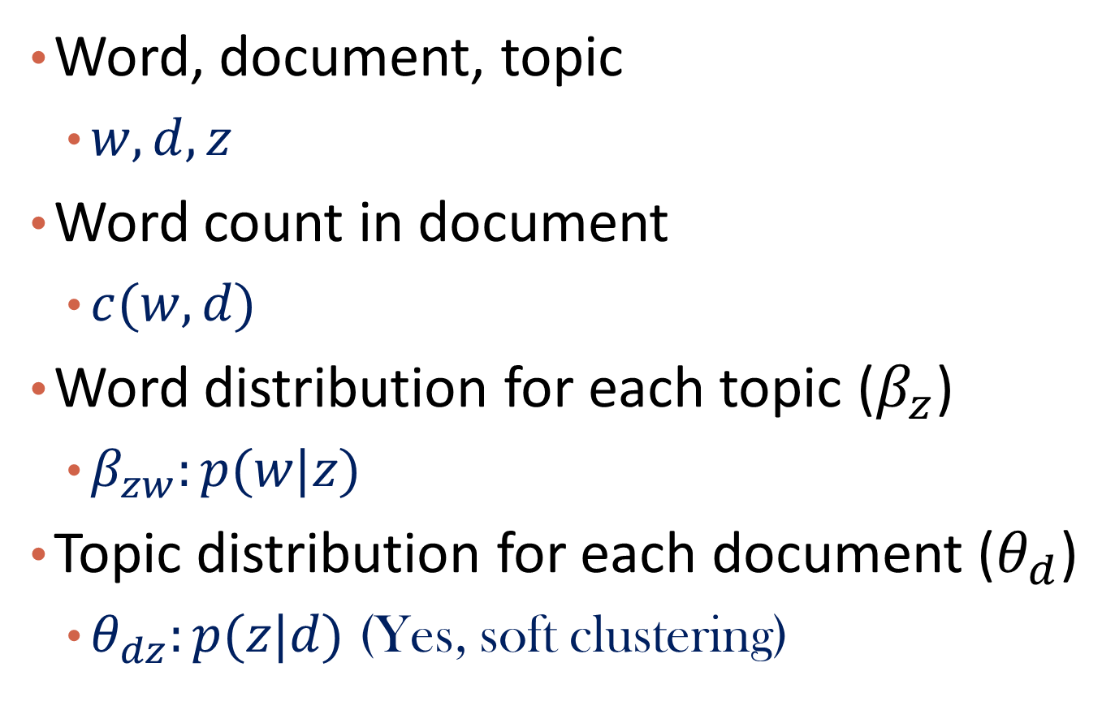
Notations
Word, document, topic
  $w,d,z$
Word count in document
  $c(w,d)$
Word distribution for each topic ($β_{z}$)
  $β_{zw}:p(w|z)$
Topic distribution for each document ($θ_{d}$)
  $θ_{dz}:p(z|d)$ (Yes, soft clustering)

Slide 22
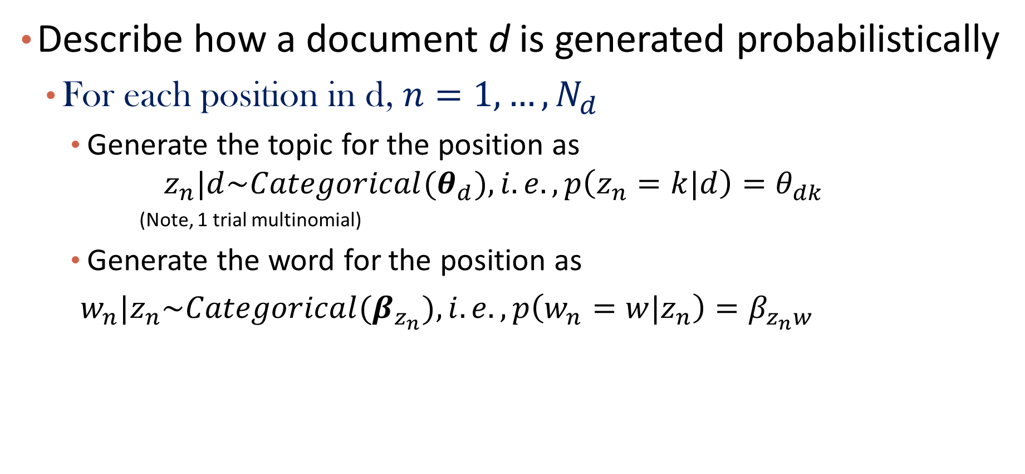
Generative Model for pLSA
Describe how a document d is generated probabilistically
  For each position in d, $n=1,…,N_{d}$
    Generate the topic for the position as
    $$z_{n}|d\sim Categorical(θ_{d}), i.e., p\left(z_{n}=k|d\right)=θ_{dk}$$
    (Note, 1 trial multinomial)
    Generate the word for the position as
    $w_{n}|z_{n}\sim Categorical(β_{z_{n}}), i.e., p\left(w_{n}=w|z_{n}\right)=β_{z_{n}w}$

Slide 23
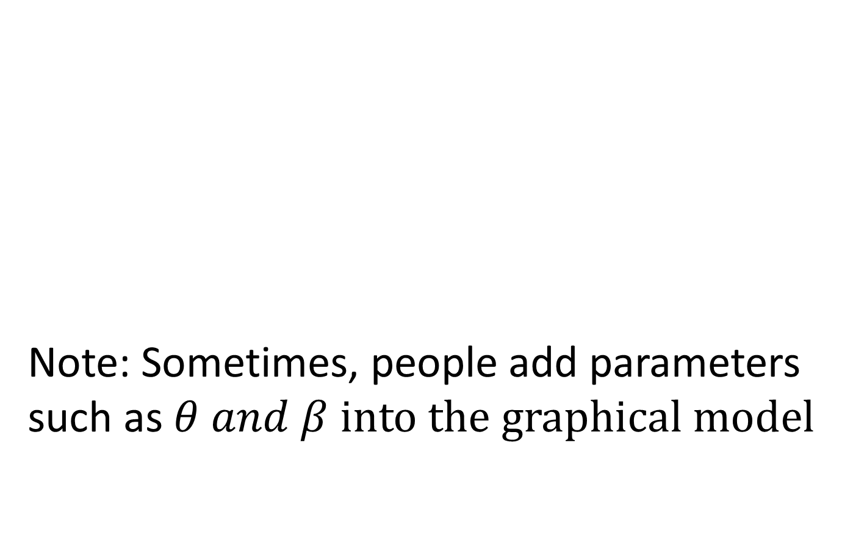
Graphical Model
Note: Sometimes, people add parameters such as $θ and β$ $into the graphical model$

Slide 24
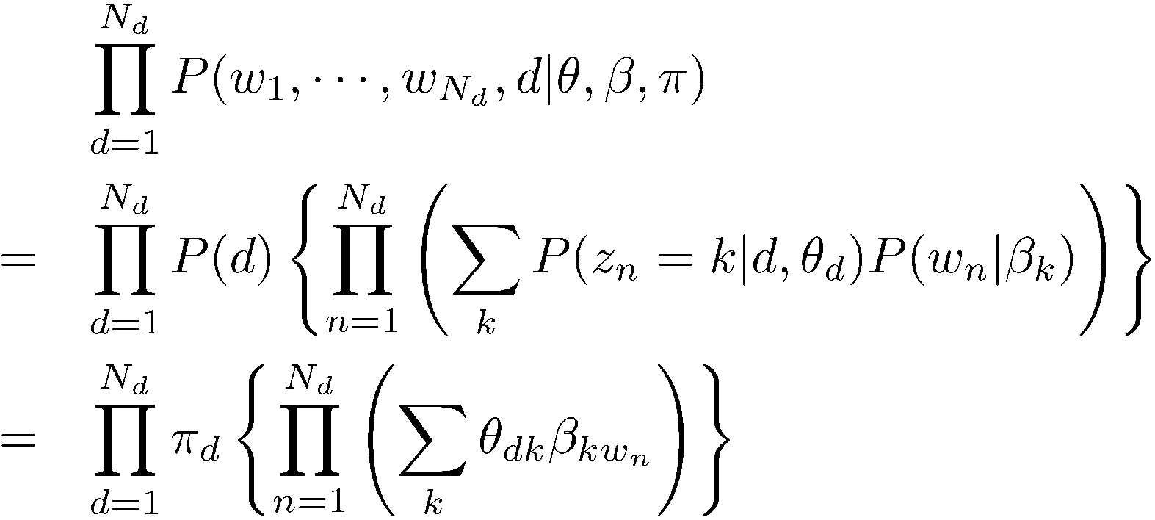
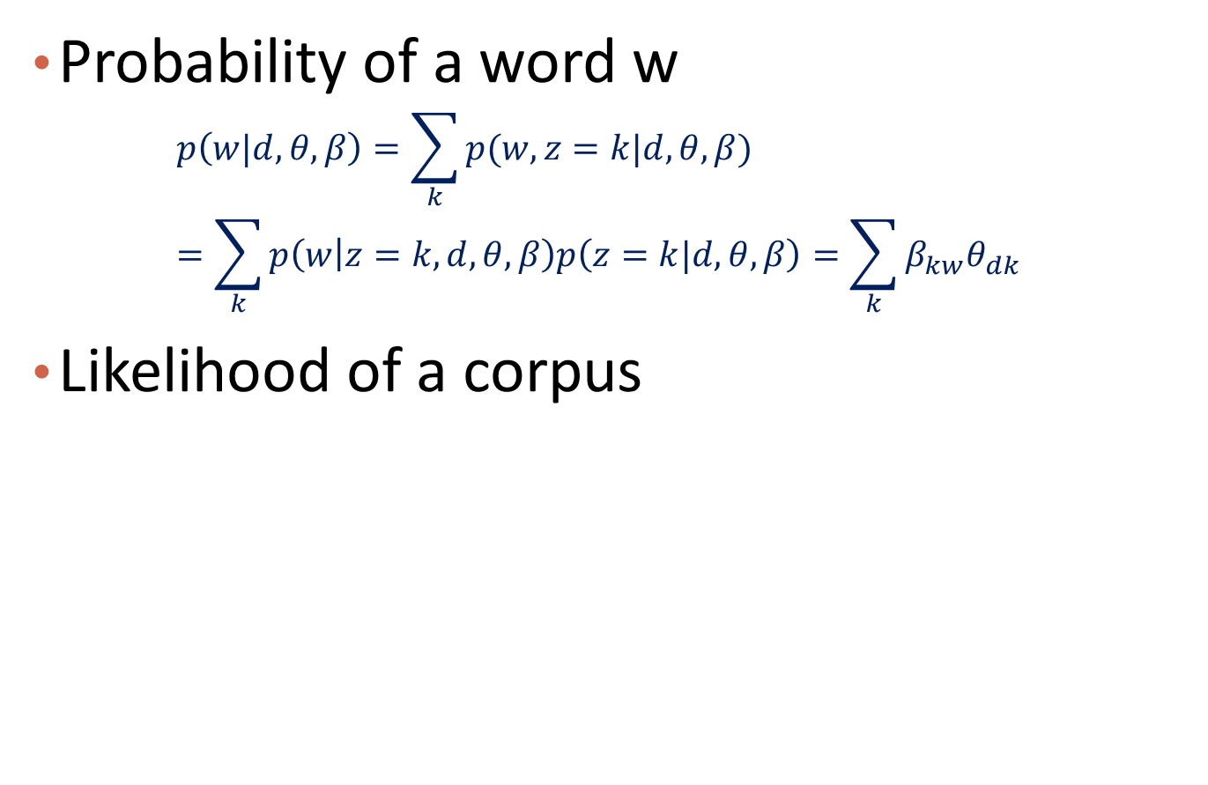

The Likelihood Function for a Corpus
Probability of a word w
  $$p\left(w|d,θ,β\right)=\sum_{k}{p(w,z=k|d,θ,β)}=\sum_{k}{p\left(w | z=k,d,θ,β\right)p\left(z=k|d,θ,β\right)=\sum_{k}{β_{kw}θ_{dk}}}$$
Likelihood of a corpus
$π_{d} is usually considered as uniform$, i.e., 1/M

Slide 25
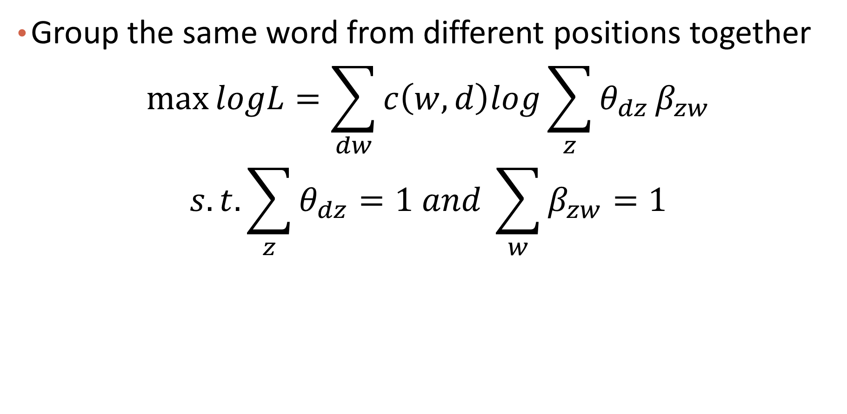
Re-arrange the Likelihood Function
Group the same word from different positions together
$$\max{logL=\sum_{dw}{c\left(w,d\right)log}\sum_{z}{θ_{dz}}β_{zw}}$$
$$s.t. \sum_{z}{θ_{dz}}=1 and \sum_{w}{β_{zw}}=1$$

Slide 26
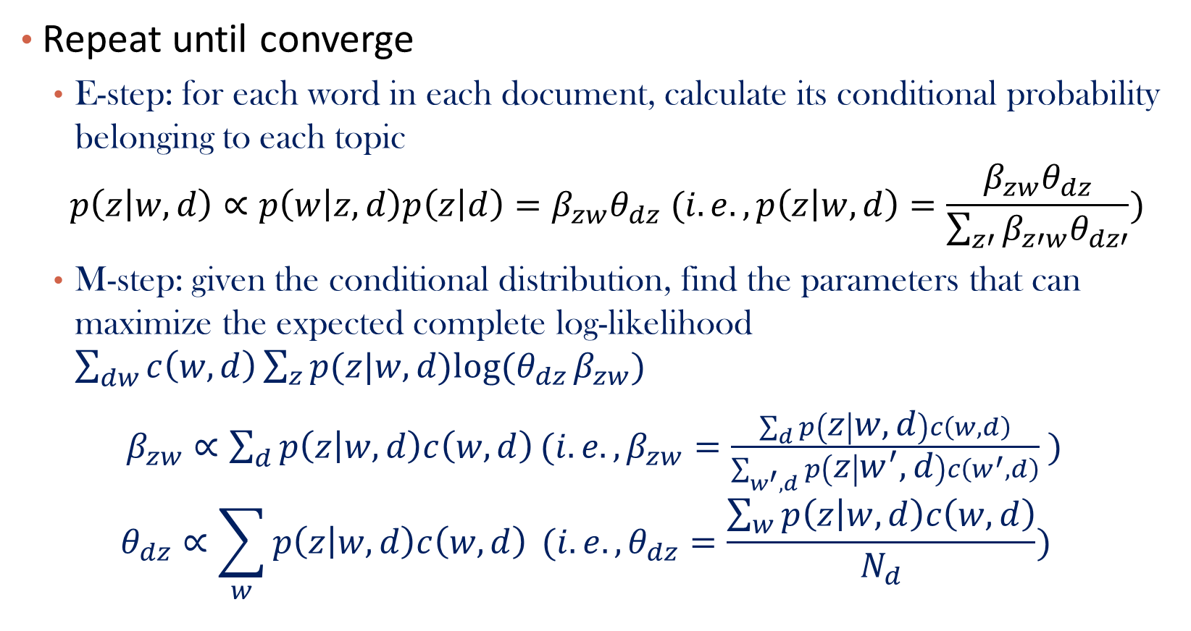
Optimization: EM Algorithm
Repeat until converge
  E-step: for each word in each document, calculate its conditional probability belonging to each topic
    $$p\left(z | w,d\right)∝p\left(w | z,d\right)p\left(z | d\right)=β_{zw}θ_{dz} (i.e., p\left(z | w,d\right)=\frac{β_{zw}θ_{dz}}{\sum_{z′}{β_{z′w}θ_{dz′}}})$$
  M-step: given the conditional distribution, find the parameters that can maximize the expected complete log-likelihood $\sum_{dw}{c\left(w,d\right)\sum_{z}{p(z|w,d)log⁡(θ_{dz}}}β_{zw})$
  $β_{zw}∝\sum_{d}{p\left(z | w,d\right)c\left(w,d\right)}(i.e., β_{zw}=\frac{\sum_{d}{p\left(z | w,d\right)c\left(w,d\right)}}{\sum_{w^{′},d}{p\left(z | w^{′},d\right)c\left(w^{′},d\right)}} )$
  $$θ_{dz}∝\sum_{w}{p\left(z | w,d\right)c\left(w,d\right)} (i.e., θ_{dz}=\frac{\sum_{w}{p\left(z | w,d\right)c\left(w,d\right)}}{N_{d}})$$

Slide 27
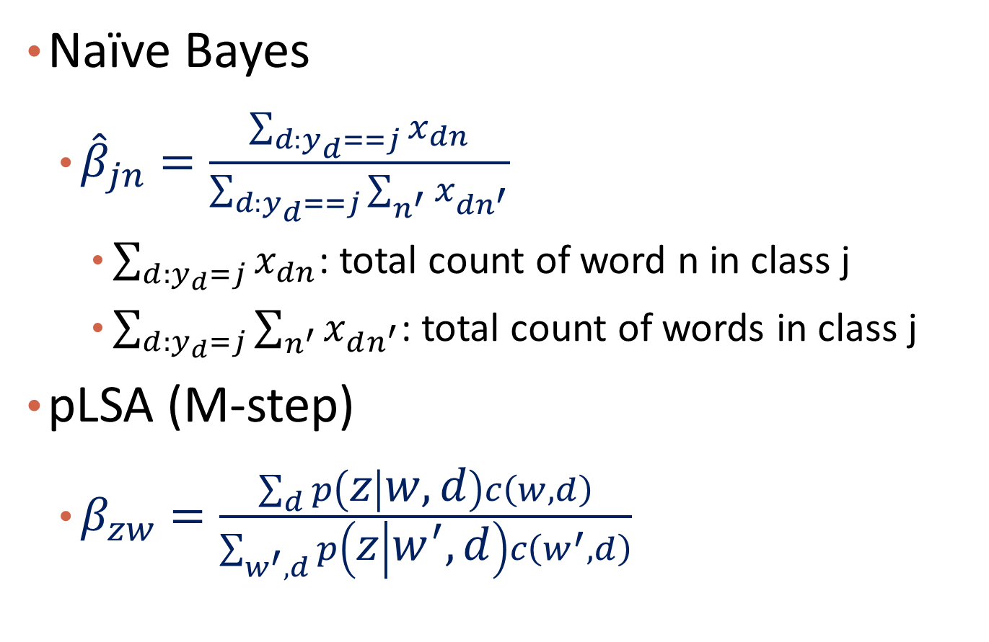
Comparison to Naïve Bayes
Naïve Bayes
  ${\hat{β}}_{jn}=\frac{\sum_{d:y_{d}==j}{x_{dn}}}{\sum_{d:y_{d}==j}{\sum_{n^{′}}{x_{dn^{′}}}}}$
    $\sum_{d:y_{d}=j}{x_{dn}}$: total count of word n in class j
    $\sum_{d:y_{d}=j}{\sum_{n^{′}}{x_{dn^{′}}}}$: total count of words in class j
pLSA (M-step)
  $β_{zw}=\frac{\sum_{d}{p\left(z | w,d\right)c\left(w,d\right)}}{\sum_{w^{′},d}{p\left(z | w^{′},d\right)c\left(w^{′},d\right)}}$

Slide 28
Example
Two documents, two topics
  Vocabulary: {1: data, 2: mining, 3: frequent, 4: pattern, 5: web, 6: information, 7: retrieval}
  At some iteration of EM algorithm, E-step

Slide 29



Example (Continued)
$$β_{11}=\frac{0.8∗5+0.5∗2}{11.8+5.8}=5/17.6$$
$$β_{12}=\frac{0.8∗4+0.5∗3}{11.8+5.8}=4.7/17.6$$
$$β_{13}=3/17.6$$
$$β_{14}=1.6/17.6$$
$$β_{15}=1.3/17.6$$
$$β_{16}=1.2/17.6$$
$$β_{17}=0.8/17.6$$
$$θ_{11}=\frac{11.8}{17}$$
$$θ_{12}=\frac{5.2}{17}$$
  M-step
Also, $β_{21},β_{22}, …,β_{27}$; $θ_{21},θ_{22}$

Slide 30
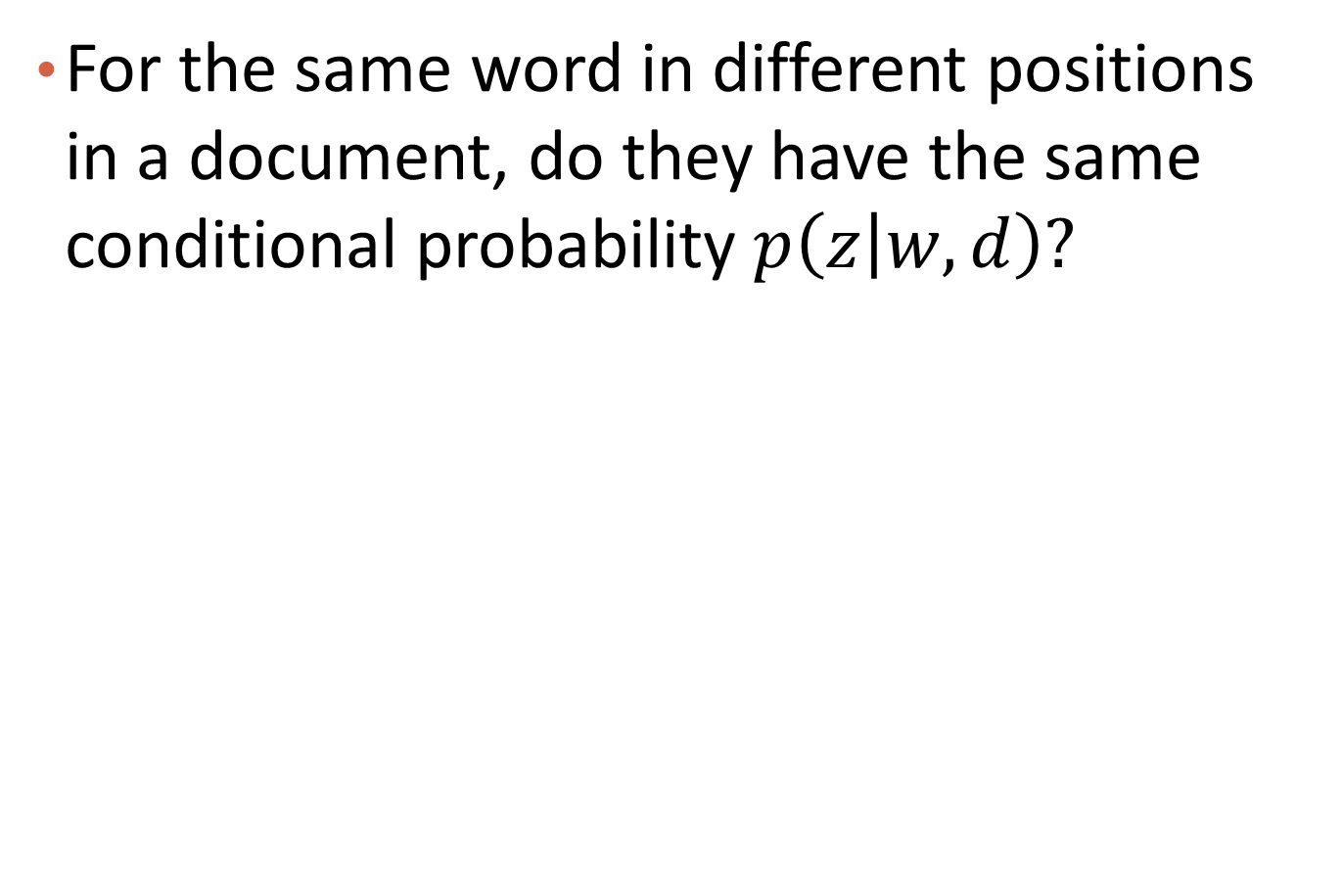
Question
For the same word in different positions in a document, do they have the same conditional probability $p\left(z | w,d\right)?$

Slide 31

Audience Q&A Session
ⓘ Start presenting to display the audience questions on this slide.

Slide 32
Text Data: Topic Models
Text Data and Topic Models
Multinomial Mixture Model
Probabilistic Latent Semantic Analysis (pLSA)
Latent Dirichlet Allocation (LDA)
Summary

Slide 33
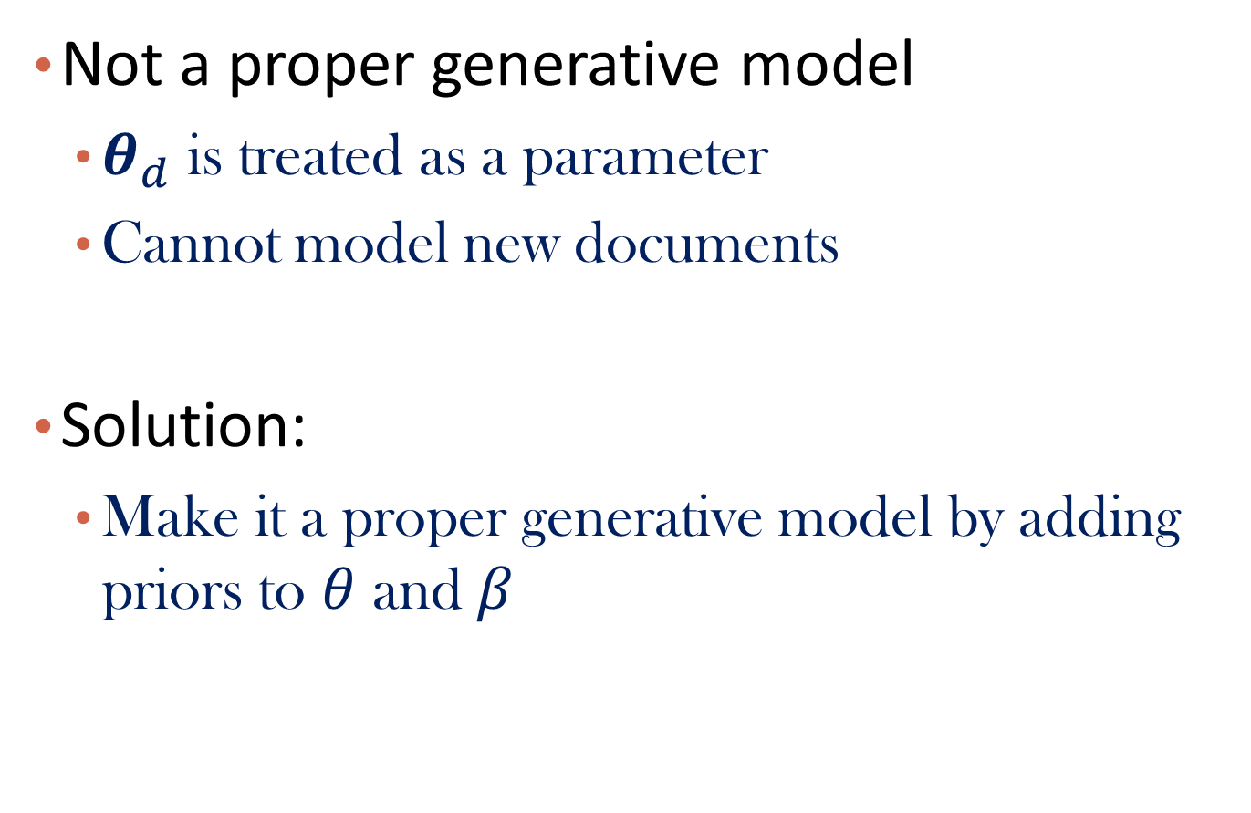
Limitations of pLSA
Not a proper generative model
  $θ_{d}$ is treated as a parameter
  Cannot model new documents
Solution:
  Make it a proper generative model by adding priors to $θ$ and $β$

Slide 34
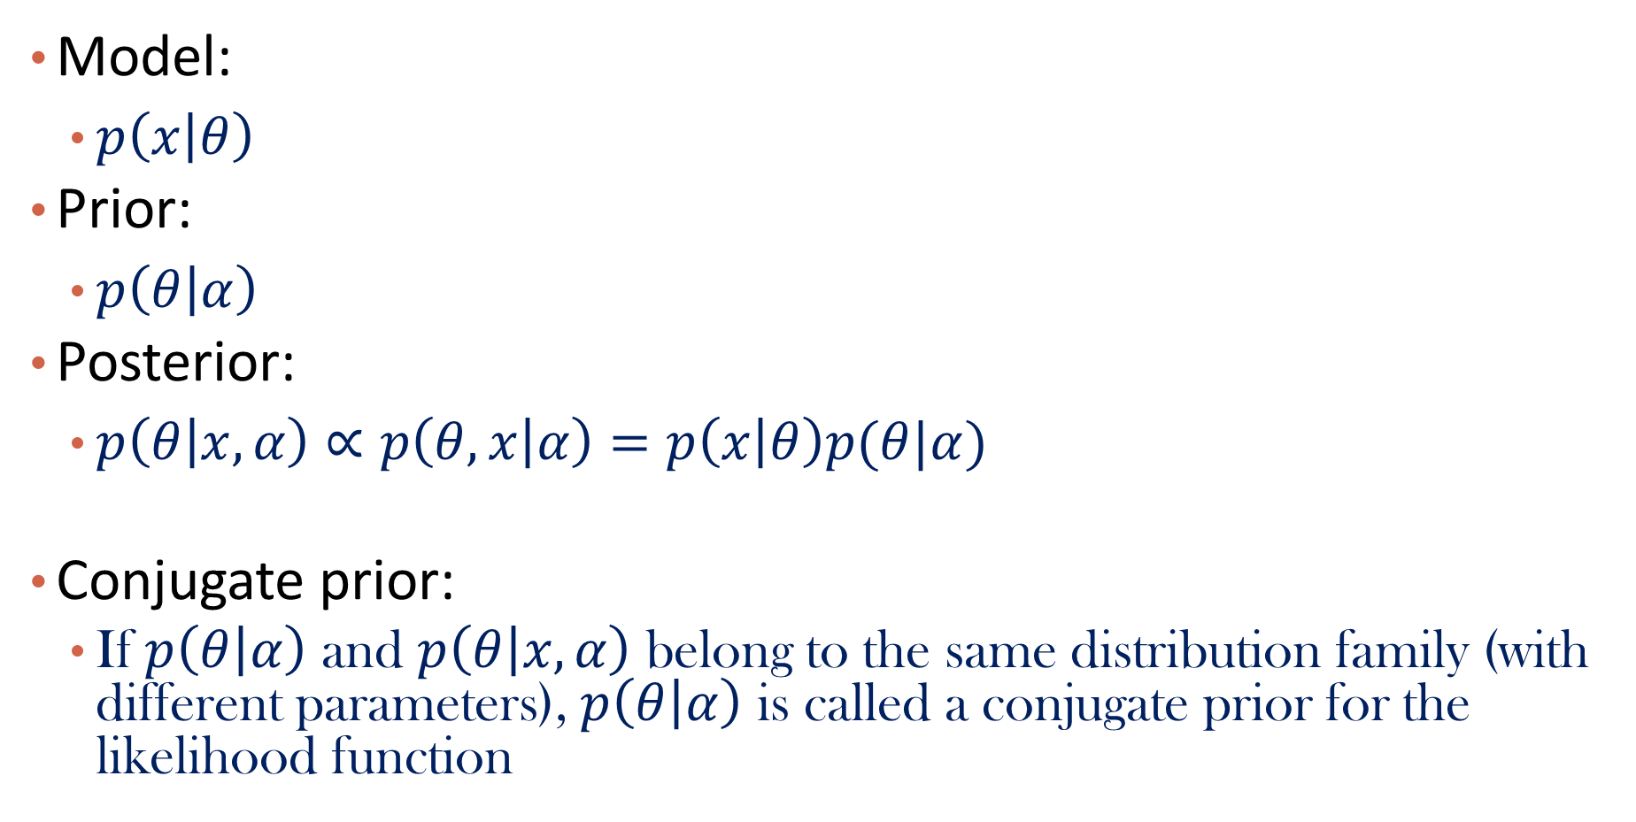
Review of Conjugate Prior
Model:
  $p\left(x | θ\right)$
Prior:
  $p\left(θ | α\right)$
Posterior:
  $p\left(θ | x,α\right)∝p\left(θ,x | α\right)=p\left(x | θ\right)p(θ|α)$
Conjugate prior:
  If $p\left(θ | α\right)$ and $p\left(θ | x,α\right)$ belong to the same distribution family (with different parameters), $p\left(θ | α\right)$ is called a conjugate prior for the likelihood function

Slide 35
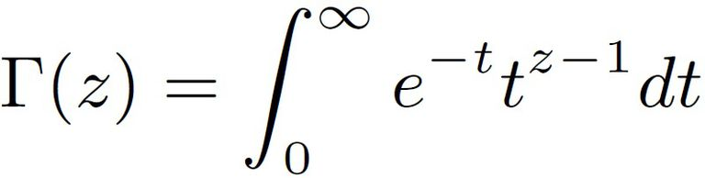
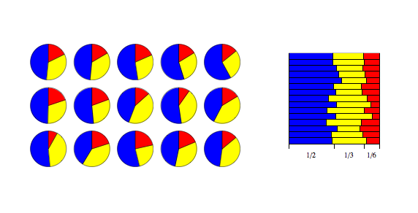

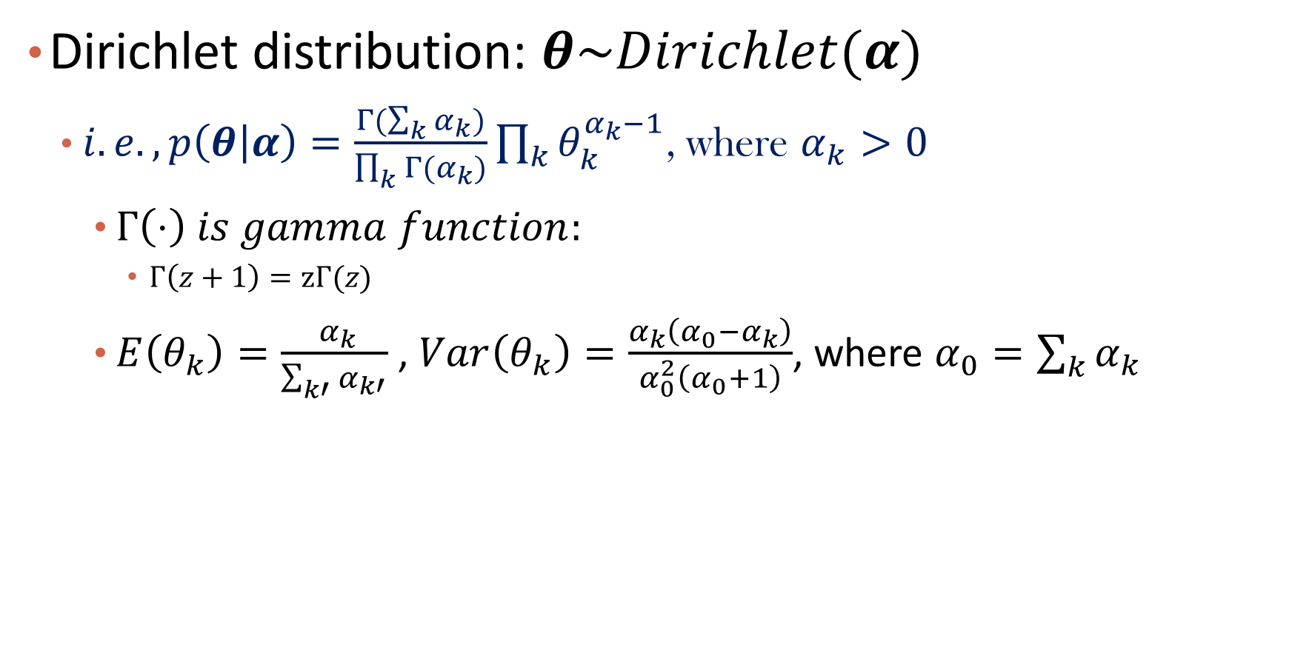
Dirichlet Distribution
Dirichlet distribution: $θ\sim Dirichlet(α)$
  $i.e., p\left(θ | α\right)=\frac{Γ(\sum_{k}{α_{k}})}{\prod_{k}{Γ(α_{k})}}\prod_{k}{θ_{k}^{α_{k}−1}}$, where $α_{k}>0$
    $Γ\left(⋅\right) is gamma function:$
      $Γ\left(z+1\right)=zΓ(z)$
    $E\left(θ_{k}\right)=\frac{ α_{k}}{\sum_{k′}{α_{k′}}}$ , $Var\left(θ_{k}\right)=\frac{α_{k}\left(α_{0}−α_{k}\right)}{α_{0}^{2}\left(α_{0}+1\right)}$, where $α_{0}=\sum_{k}{α_{k}}$
$$Example:θ\sim Dirichlet\left(α\right), where α/α_{0}=(\frac{1}{2},\frac{1}{3},\frac{1}{6})$$
Notes:
\alpha_k psudo count

Slide 36
More Examples

Slide 37
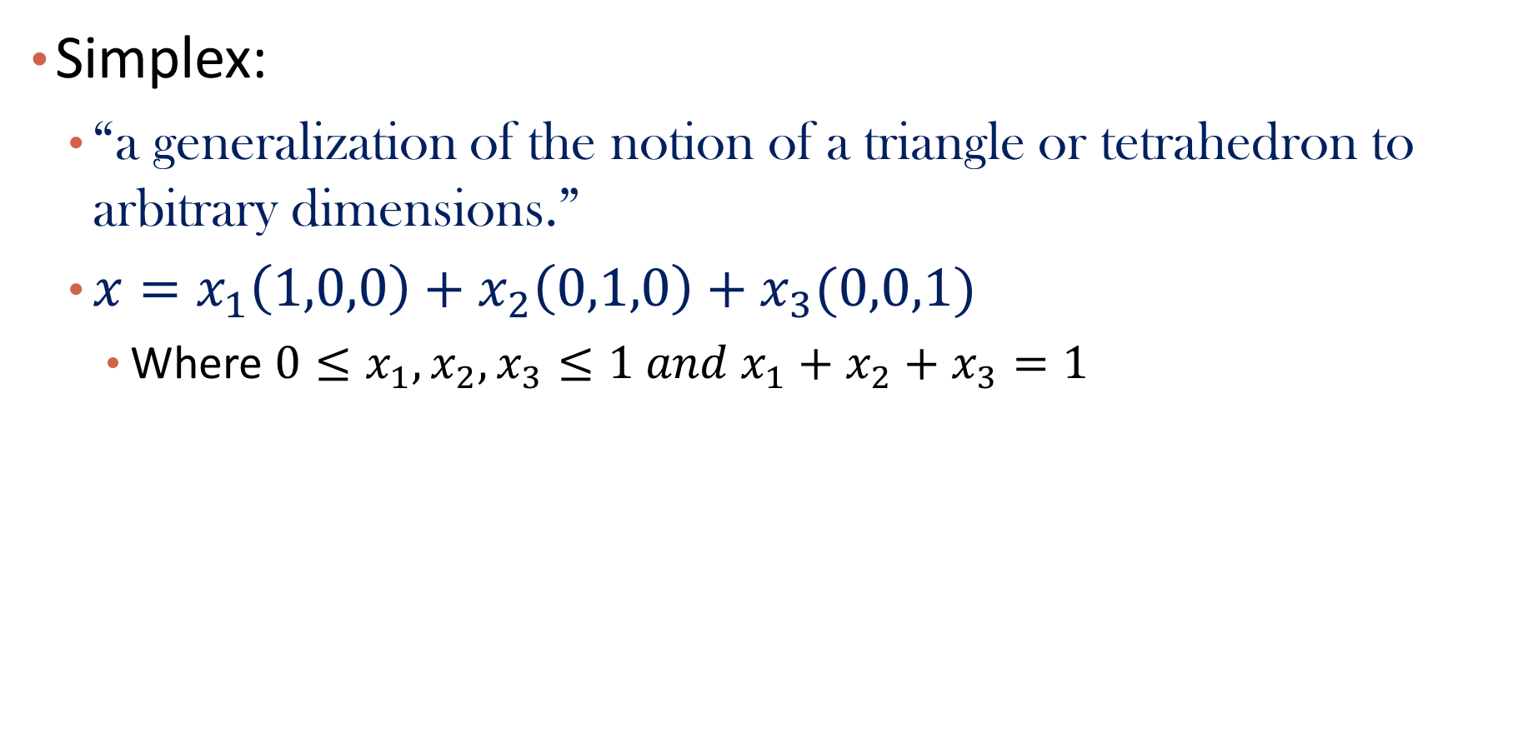

Simplex View
Simplex:
  “a generalization of the notion of a triangle or tetrahedron to arbitrary dimensions.”
  $x=x_{1}\left(1,0,0\right)+x_{2}\left(0,1,0\right)+x_{3}(0,0,1)$
    Where ${0≤x}_{1},x_{2},x_{3}≤1 and x_{1}+x_{2}+x_{3}=1$
$$x|α\sim Dir\left(α\right),α=(2,3,4)$$

Slide 38
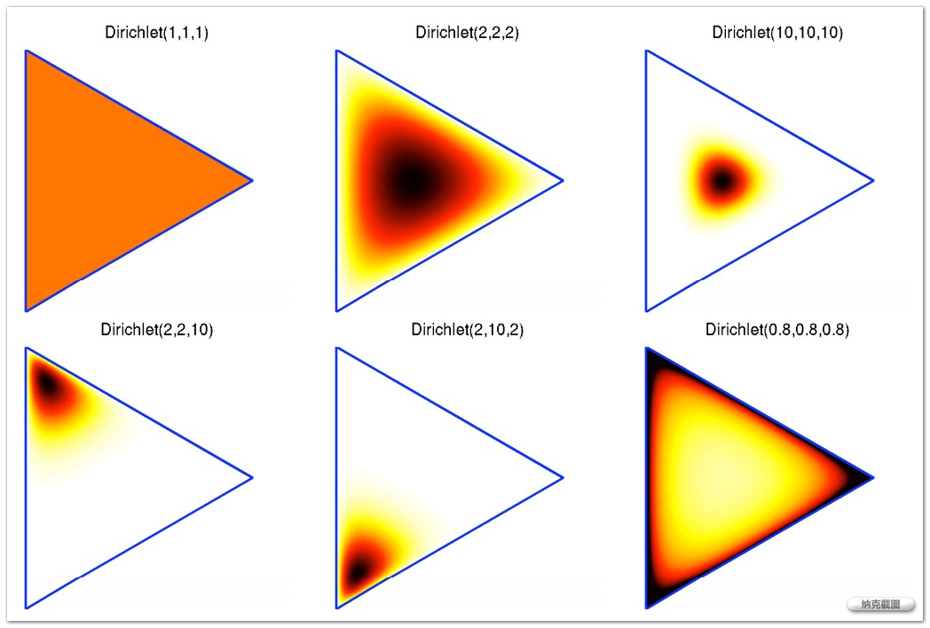
More Examples in the Simplex View

Slide 39
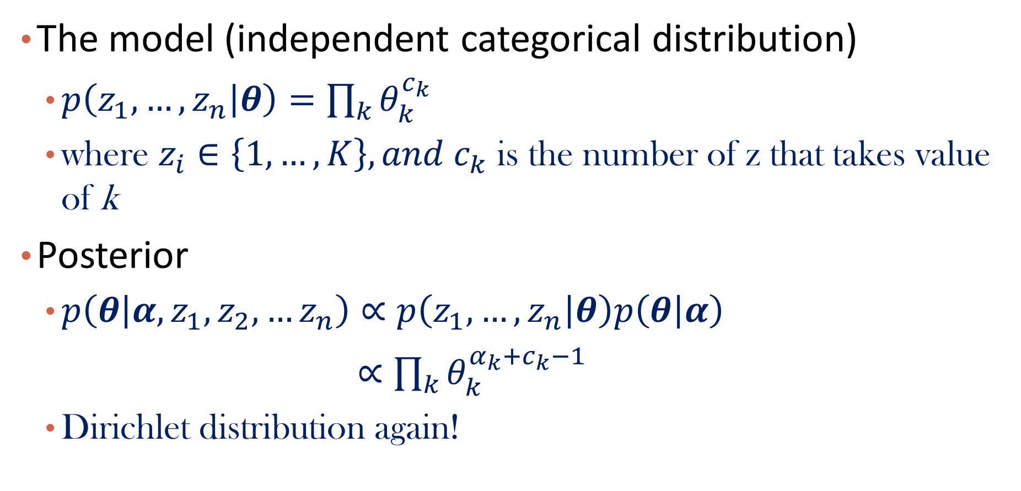
Dirichlet-Multinomial/Categorical Conjugate
The model (independent categorical distribution)
  $p\left(z_{1},…,z_{n} | θ\right)=\prod_{k}{θ_{k}^{c_{k}}}$
  where $z_{i}∈\left\{1,…,K\right\}, {and c}_{k}$ is the number of z that takes value of k
Posterior
  $p\left(θ | α,z_{1},z_{2},…z_{n}\right)∝p\left(z_{1},…,z_{n} | θ\right)p\left(θ | α\right)$
  $∝\prod_{k}{θ_{k}^{α_{k}+c_{k}−1}}$
  Dirichlet distribution again!

Slide 40
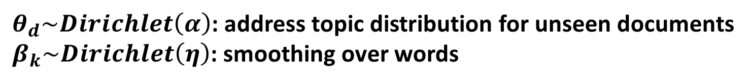
The Graphical Model of LDA
$θ_{d}\sim Dirichlet\left(α\right)$: address topic distribution for unseen documents
$β_{k}\sim Dirichlet\left(η\right)$: smoothing over words

Slide 41
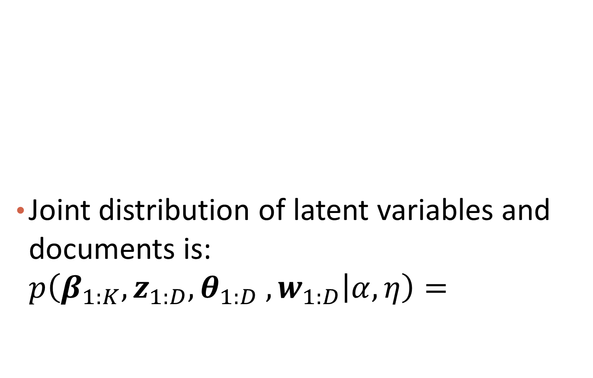
Joint Distribution for LDA
Joint distribution of latent variables and documents is: $p\left(β_{1:K},z_{1:D},θ_{1:D} ,w_{1:D} | α,η\right)=$

Slide 42


Posterior Inference
Posterior of the latent variables
Solutions
  Gibbs sampling [Griffiths et al., Finding Scientific Topics, PNAS (2004)]
  Variational inference [Blei et al., Latent Dirichlet Allocation, JLMR (2003)]
$$=$$
$$marginal p\left(w\right) is intractable!$$

Slide 43
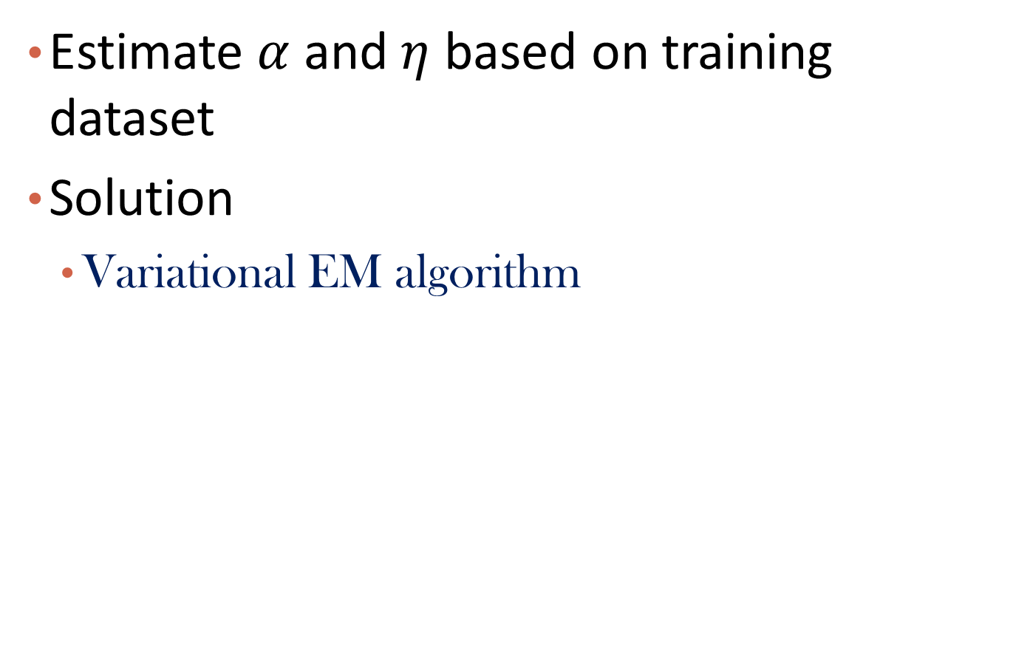
Parameter Estimation
Estimate $α$ and $η$ based on training dataset
Solution
  Variational EM algorithm

Slide 44

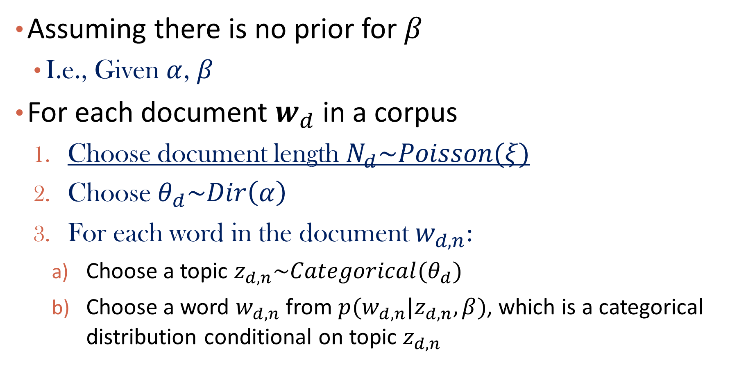
Generative Process of A Simplified LDA
Assuming there is no prior for $β$
  I.e., Given $α$, $β$
For each document $w_{d}$ in a corpus
  Choose document length $N_{d}\sim Poisson(ξ)$
  Choose $θ_{d}\sim Dir\left(α\right)$
  For each word in the document $w_{d,n}$:
    Choose a topic $z_{d,n}\sim Categorical(θ_{d})$
    Choose a word $w_{d,n}$ from $p(w_{d,n}|z_{d,n},β)$, which is a categorical distribution conditional on topic $z_{d,n}$
$Not$ essential, and can be ignored

Slide 45
Graphical Model and Joint Distribution
Graphical model
Joint distribution for a single document

Slide 46
Marginal Distribution and Likelihood
Marginal distribution of a document
  Question: Why can we push summation of z inside?

Slide 47
Likelihood of a corpus

Slide 48
Inference
Compute the posterior distribution of the hidden variables given a document
Joint distribution computation: Easy
Marginal distribution computation: intractable

Slide 49
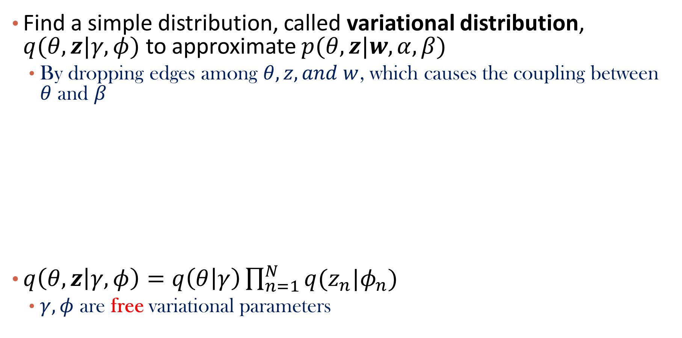
Variational Inference
Find a simple distribution, called variational distribution, $q(θ,z|γ, φ)$ to approximate $p(θ,z|w,α,β)$
  By dropping edges among $θ, z, and w$, which causes the coupling between $θ$ and $β$
$q\left(θ,z | γ, φ\right)=q\left(θ | γ\right)\prod_{n=1}^{N}{q(z_{n}|φ_{n})}$
  $γ, φ$ are free variational parameters
Notes:
Dirichlet distribution and categorical distribution

Slide 50
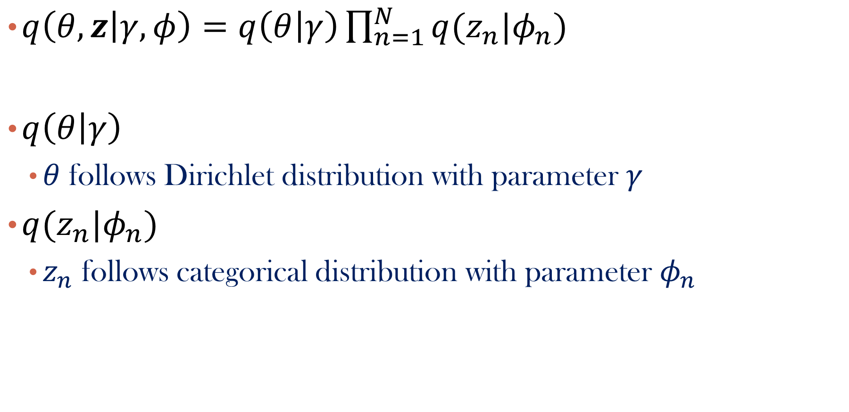
More about the variational distribution
$q\left(θ,z | γ, φ\right)=q\left(θ | γ\right)\prod_{n=1}^{N}{q(z_{n}|φ_{n})}$
$q\left(θ | γ\right)$
  $θ$ follows Dirichlet distribution with parameter $γ$
$q(z_{n}|φ_{n})$
  $z_{n}$ follows categorical distribution with parameter $φ_{n}$

Slide 51
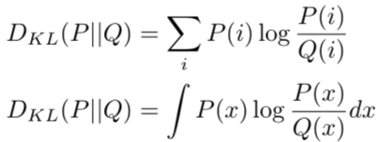
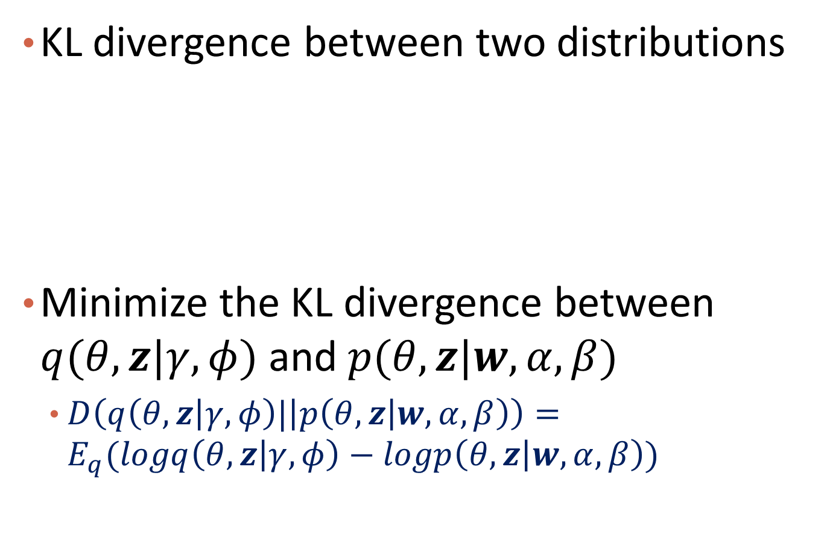
The Criterion to Choose q
KL divergence between two distributions
Minimize the KL divergence between $q(θ,z|γ, φ)$ and$p(θ,z|w,α,β)$
  $D\left(q\left(θ,z | γ, φ\right)\text{|} | p\left(θ,z | w,α,β\right)\right)=E_{q}(logq\left(θ,z | γ, φ\right)−logp\left(θ,z | w,α,β\right))$

Slide 52
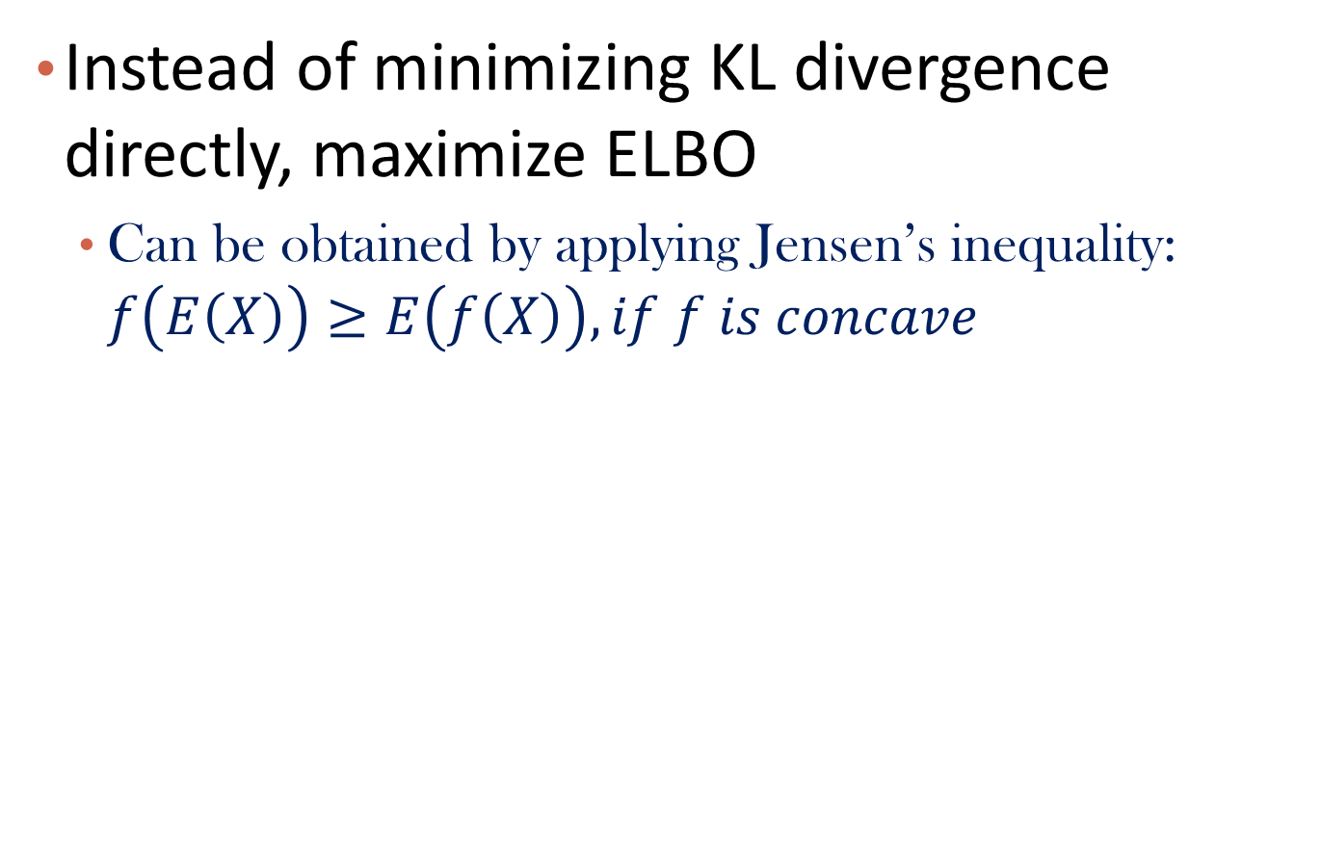

ELBO: Evidence Lower Bound
Instead of minimizing KL divergence directly, maximize ELBO
  Can be obtained by applying Jensen’s inequality: $f\left(E\left(X\right)\right)≥E\left(f\left(X\right)\right), if f is concave$
ELBO, denoted as $L(γ,φ;α,β)$

Slide 53
Why?
$$L\left(γ,φ;α,β\right)=$$
ELBO + KL-divergence = Constant

Slide 54

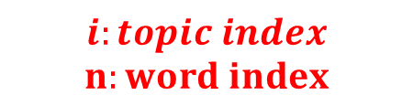
ELBO Optimization
Coordinate ascent
  Iteratively optimizing each variational parameter holding the others fixed
$$i:topic index$$
$$n:word index$$
$$Ψ\left(x\right):first derivative of logΓ(x)$$

Slide 55
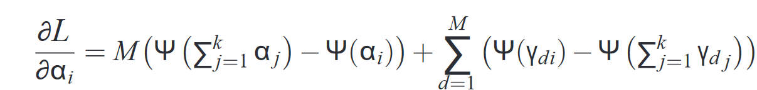
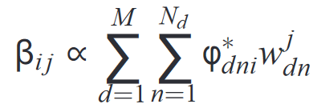

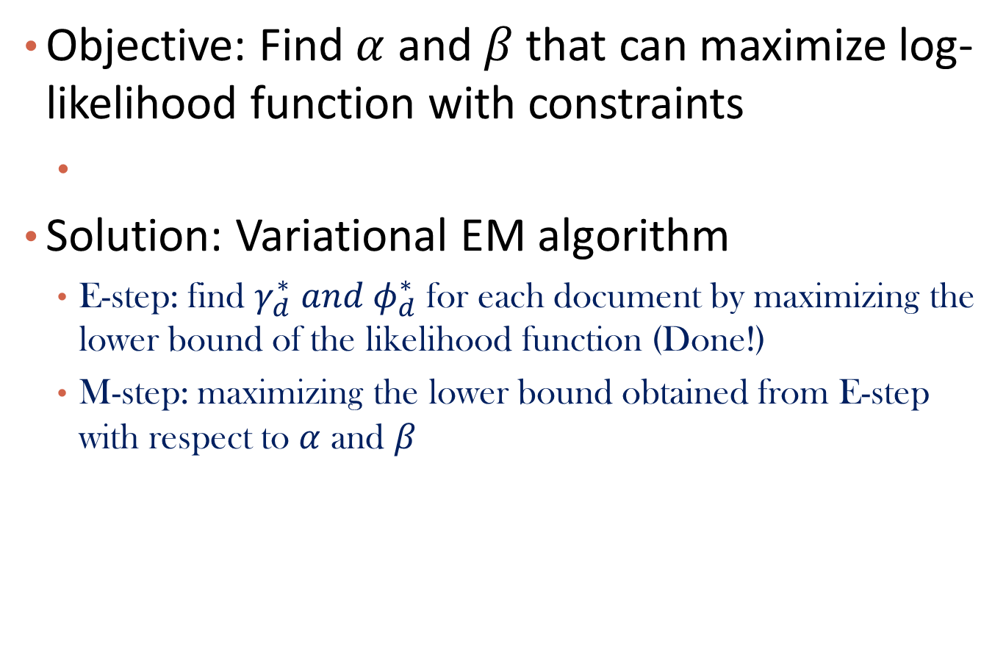

Parameter Estimation
Objective: Find $α$ and $β$ that can maximize log-likelihood function with constraints
Solution: Variational EM algorithm
  E-step: find $γ_{d}^{∗} and φ_{d}^{∗}$ for each document by maximizing the lower bound of the likelihood function (Done!)
  M-step: maximizing the lower bound obtained from E-step with respect to $α$ and $β$
$$Ψ\left(x\right):first derivative of logΓ(x)$$
$$w_{dn}^{j}:1\{w_{dn}==j\}$$

Slide 56
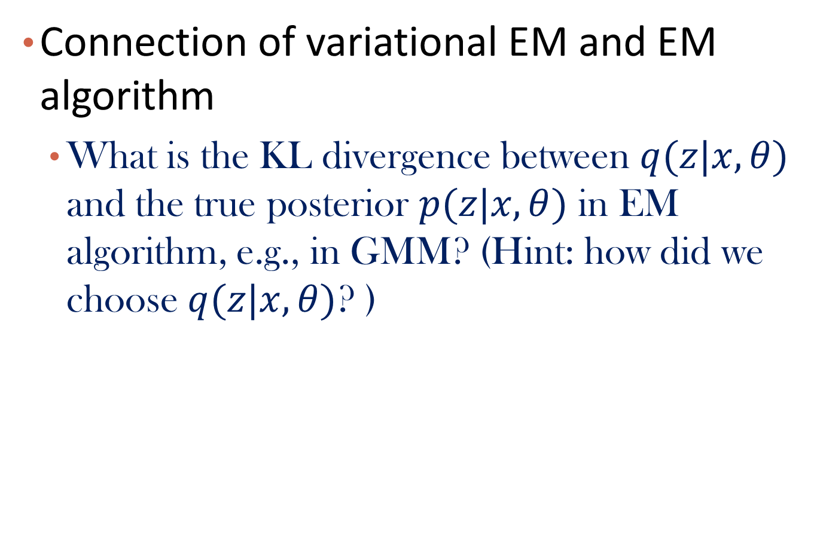
Question
Connection of variational EM and EM algorithm
  What is the KL divergence between $q(z|x,θ)$ and the true posterior $p(z|x,θ)$ in EM algorithm, e.g., in GMM? (Hint: how did we choose $q(z|x,θ)$? )

Slide 57
Audience Q&A Session
ⓘ Start presenting to display the audience questions on this slide.

Slide 58
Text Data: Topic Models
Text Data and Topic Models
Revisit of Multinomial Mixture Model
Probabilistic Latent Semantic Analysis (pLSA)
Latent Dirichlet Allocation (LDA)
Summary

Slide 59
Summary
Basic Concepts
  Word/term, document, corpus, topic
  How to represent a document
Mixture of unigrams
pLSA
  Generative model
  Likelihood function
  EM algorithm
LDA
  Dirichlet-multinomial conjugate
  Posterior inference

Slide 60
References
T. Hofmann. Probabilistic latent semantic indexing. Proceedings of the Twenty-Second Annual International SIGIR Conference, 1999.
David Blei, lecture notes on variational inference: https://www.cs.princeton.edu/courses/archive/fall11/cos597C/lectures/variational-inference-i.pdf
David Blei, Andrew Ng, Michael Jordan, “Latent Dirichlet Allocation”, JMLR, 2003. http://www.jmlr.org/papers/volume3/blei03a/blei03a.pdf
Thomas L. Griffiths and Mark Steyvers, “Finding Scientific Topics”, PNAS, 2004. https://www.pnas.org/content/101/suppl_1/5228

