Slide 1
CS247: Advanced Data Mining
06: Text Data: Word Embedding
Instructor: Yizhou Sun
yzsun@cs.ucla.edu
January 30, 2024

Slide 2
Text Data: Word Embedding
Introduction to Word Representation
Word2vec: CBOW and Skip-Gram
GloVe: Global Vectors for Word Representation
Summary

Slide 3
Why Word Representation?
Finding Synonyms: words that have the same meaning
  E.g., movie and film
Finding polysemy: words with multiple meanings
  E.g., light
Document representation
  E.g., aggregation of all the word representation

Slide 4
How to Represent a Word?
Challenge
  Discrete structure
Simple representation
  One-hot representation: a vector with one 1 and a lot of zeroes
  E.g., Motel =

Slide 5
Problem of One-Hot Representation
High dimensionality
  E.g., for Google news, 13M words
Sparse
  Only 1 non-zero value
Shallow representation
  E.g.,

Slide 6
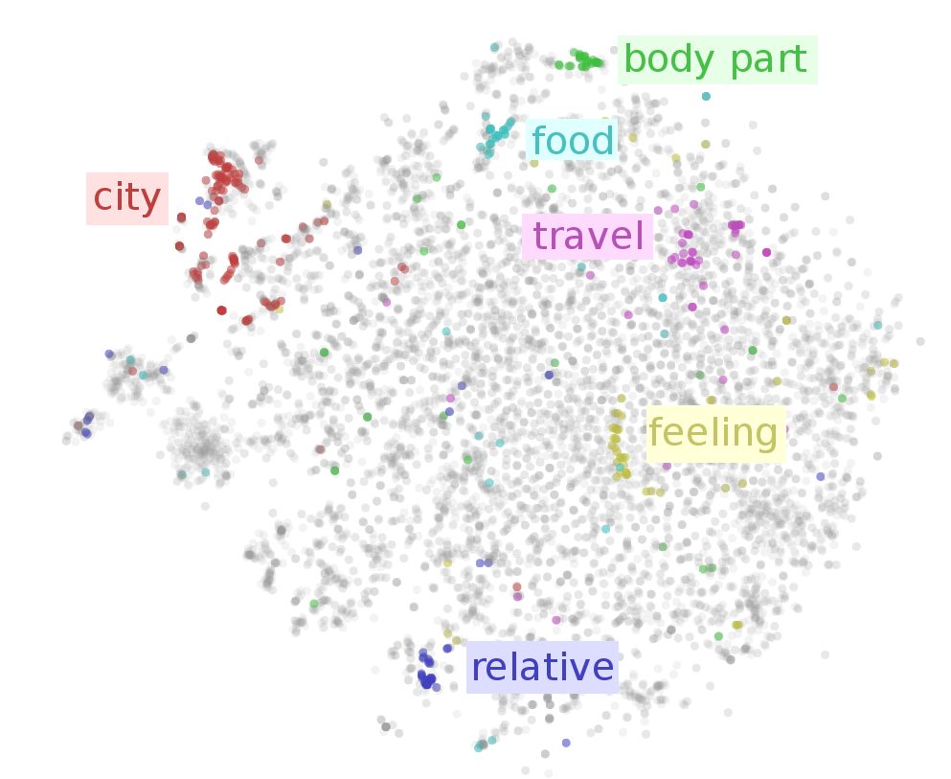
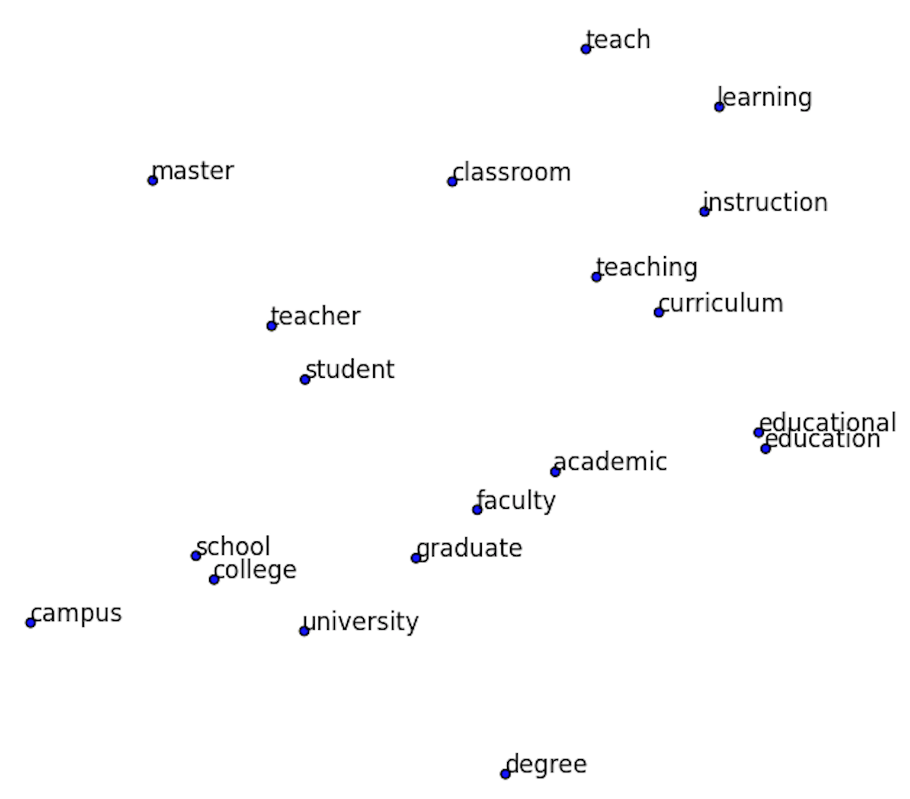
Word Embedding
Low dimensional vector representation of every word
  E.g., motel = [1.3, -1.4] and hotel = [1.2, -1.5]

Slide 7
How to Learn Such Embeddings?
Using context information!

Slide 8
How to Learn Such Embeddings?
Using context information!

Slide 9
A Naïve Approach
Build a co-occurrence matrix for words, and apply SVD
  Example Corpus:
    I like deep learning.
    I like NLP.
    I enjoy ﬂying.
Issues:
  Global context
  SVD is very expensive

Slide 10
Text Data: Word Embedding
Introduction to Word Representation
Word2vec: CBOW and Skip-Gram
GloVe: Global Vectors for Word Representation
Summary

Slide 11
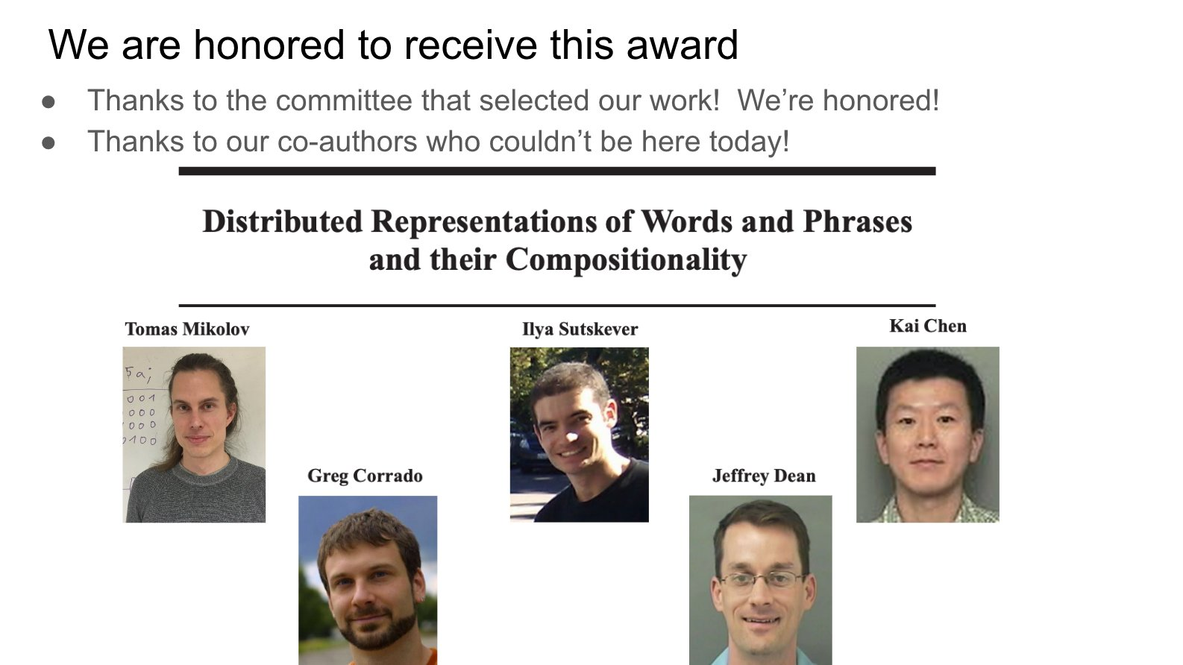
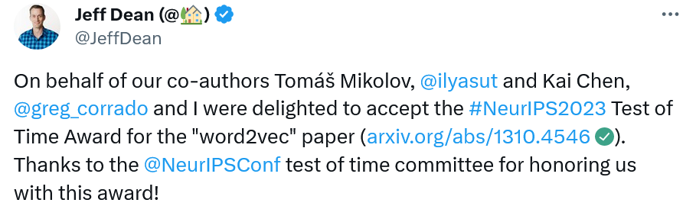
Word2Vec
Proposed by Mikolov et al. at Google in 2013
  The most popular word embedding models
  Won Test of Time Award of NeurIPS 2023

Slide 12
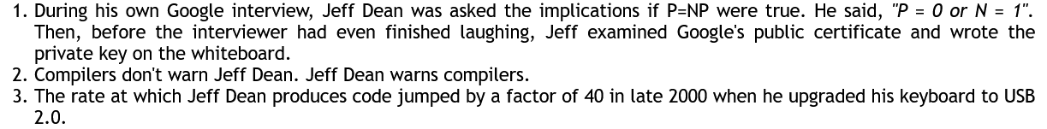
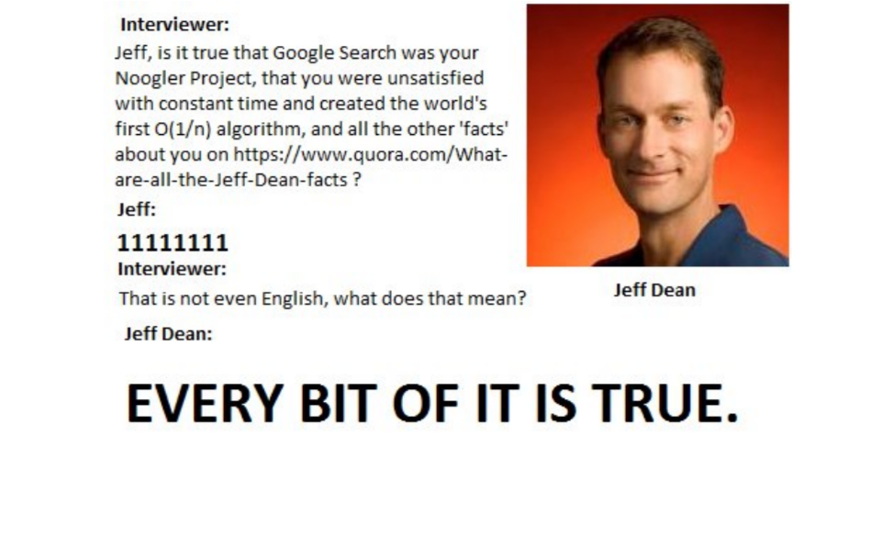
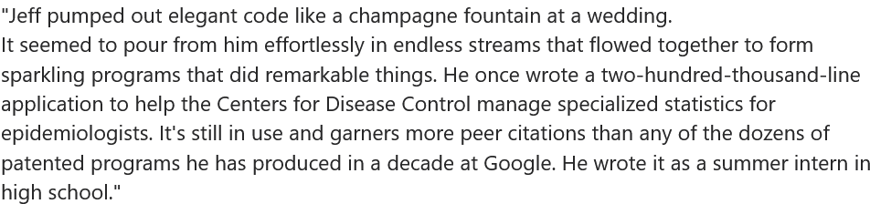
Jeff Dean Facts
https://www.quora.com/Jeff-Dean/What-are-all-the-Jeff-Dean-facts

Slide 13

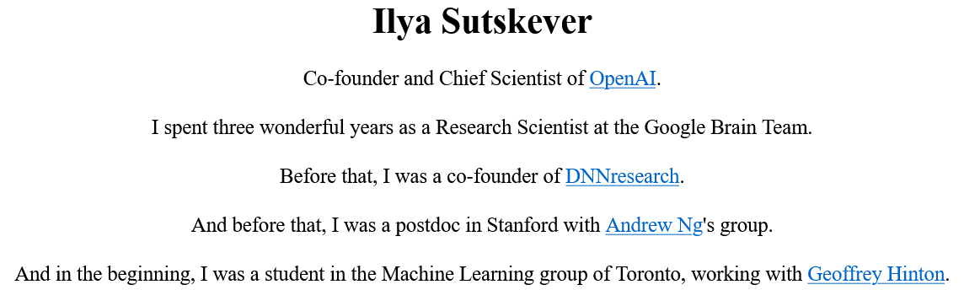
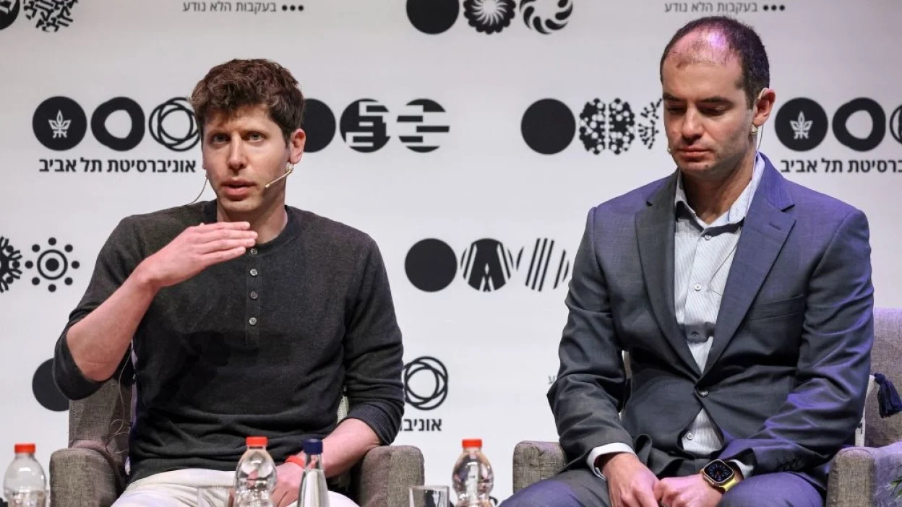
https://www.cs.toronto.edu/~ilya/
https://mashable.com/article/openai-ilya-sutskever-deeply-regrets-sam-altman-firing

Slide 14
Back to Word2Vec
Two architectures are proposed
  Continuous bag-of-words (CBOW)
  Skip-gram
Extremely fast
  “an optimized single-machine implementation can train on more than 100 billion words in one day”

Slide 15
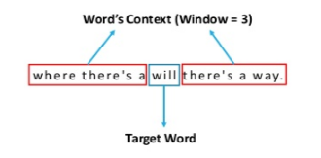
Main Idea of Word2Vec
Consider a local window of a target word
  CBOW: predict the target words given the neighbors
  Skip-gram: predict neighbors given the target words

Slide 16
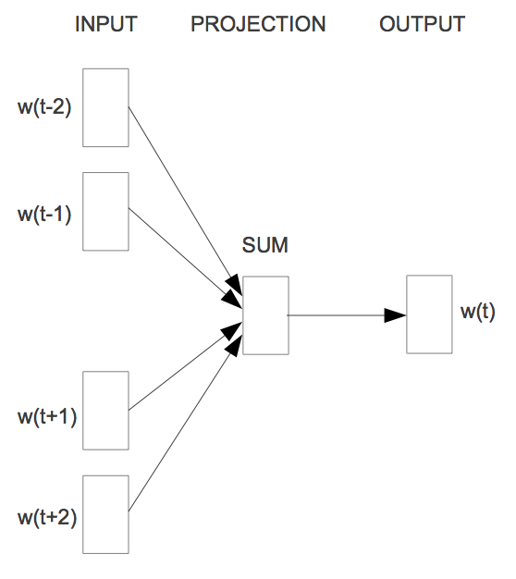
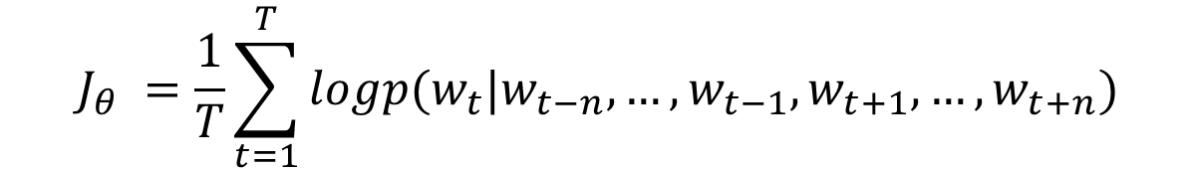
CBOW
Predicting target using neighbors
$$J_{θ} =\frac{1}{T}\sum_{t=1}^{T}{logp(w_{t}|w_{t−n},…,w_{t−1},w_{t+1},…,w_{t+n})}$$
More details can be found in: https://arxiv.org/pdf/1301.3781.pdf
https://papers.nips.cc/paper/2013/file/9aa42b31882ec039965f3c4923ce901b-Paper.pdf

Slide 17
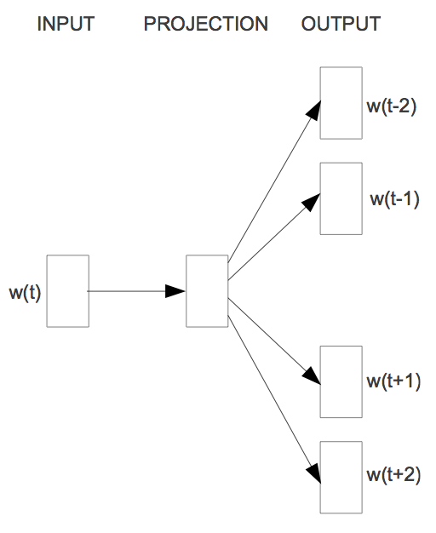
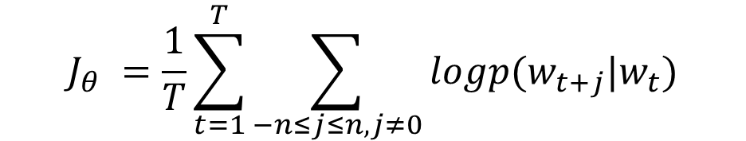
Skip-Gram
Predicting neighbors using target
$$J_{θ} =\frac{1}{T}\sum_{t=1}^{T}{\sum_{−n≤j≤n,j≠0}{logp(w_{t+j}|w_{t})}}$$

Slide 18
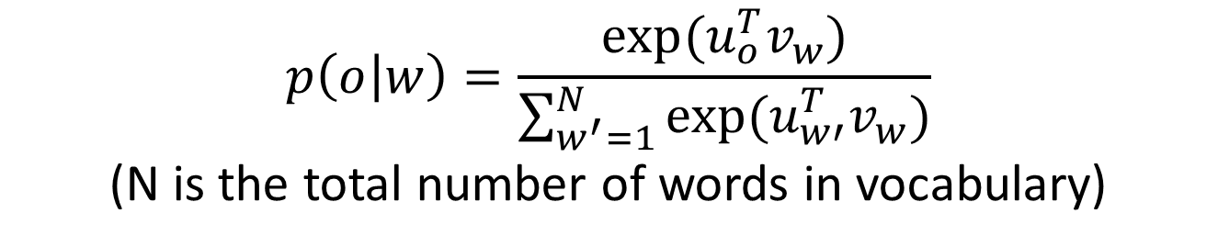
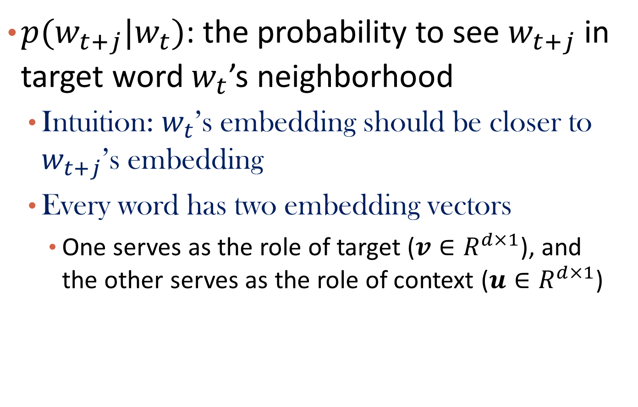
The Conditional Probability
$p(w_{t+j}|w_{t})$: the probability to see $w_{t+j}$ in target word $w_{t}$’s neighborhood
  Intuition: $w_{t}$’s embedding should be closer to $w_{t+j}$’s embedding
  Every word has two embedding vectors
    One serves as the role of target ($v∈R^{d×1}$), and the other serves as the role of context ($u∈R^{d×1}$)
$$p\left(o | w\right)=\frac{exp⁡(u_{o}^{T}v_{w})}{\sum_{w^{′}=1}^{N}{exp⁡(u_{w′}^{T}v_{w})}}$$
(N is the total number of words in vocabulary)

Slide 19
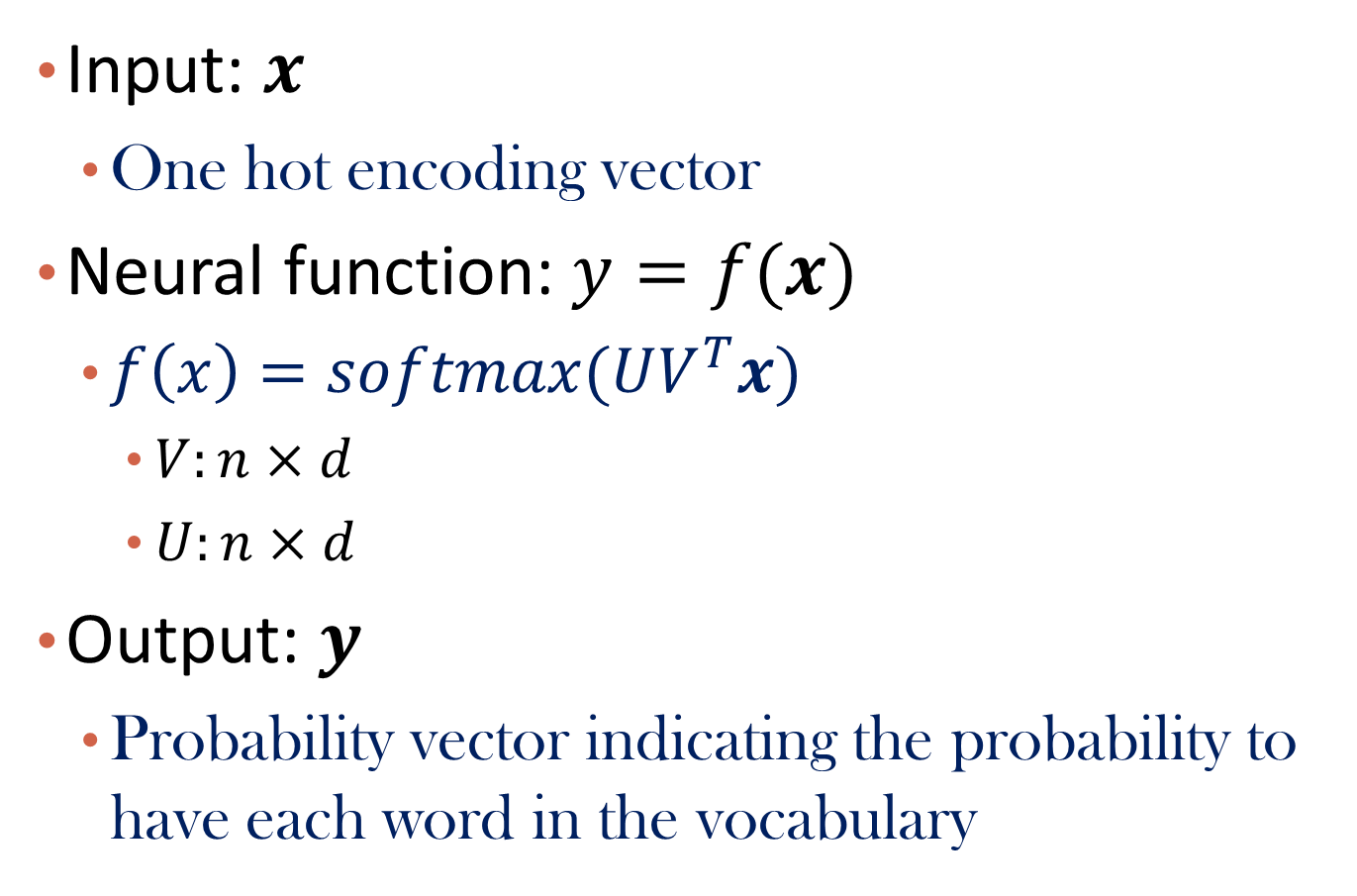
Transformation Function under the Neural Network
Input: $x$
  One hot encoding vector
Neural function: $y=f(x)$
  $f\left(x\right)=softmax(UV^{T}x)$
    $V:n×d$
    $U:n×d$
Output: $y$
  Probability vector indicating the probability to have each word in the vocabulary

Slide 20

A Neural Network Point of View
$$V^{T}$$
U
Input Layer:
one-hot vector
Hidden Layer:
Linear (Identity)
Output Layer:
softmax

Slide 21

Question
What’s the dimension of input layer?
What’s the dimension of hidden layer?
What’s the dimension of output layer?
    $$V:n×d;U:n×d$$

Slide 22
Demo
https://ronxin.github.io/wevi/
Weights:
Target Embedding
Weights:
Context Embedding

Slide 23
Embedding vs. NN Weights
V
U

Slide 24
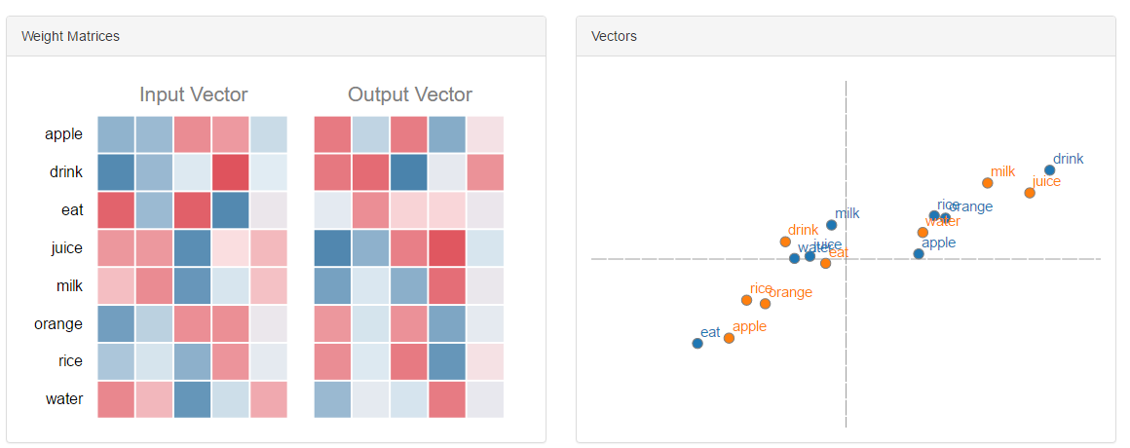
Embedding Visualization
V
U

Slide 25
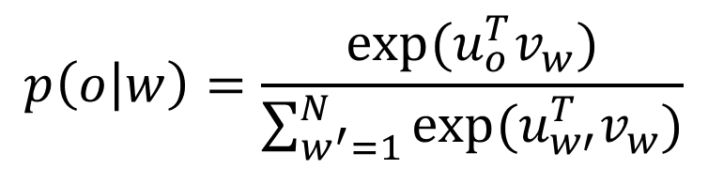
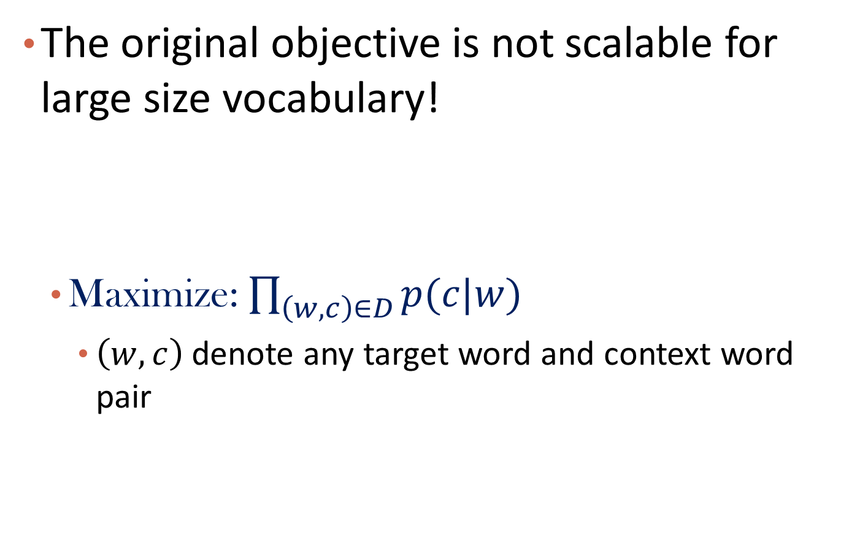
Original Objective Function
The original objective is not scalable for large size vocabulary!
  Maximize: $\prod_{\left(w,c\right)∈D}{p(c|w)}$
    $\left(w,c\right)$ denote any target word and context word pair
$$p\left(o | w\right)=\frac{exp⁡(u_{o}^{T}v_{w})}{\sum_{w^{′}=1}^{N}{exp⁡(u_{w′}^{T}v_{w})}}$$

Slide 26
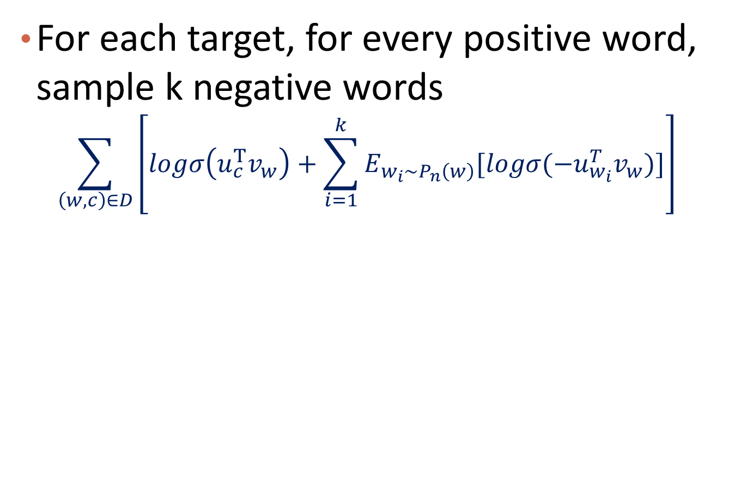
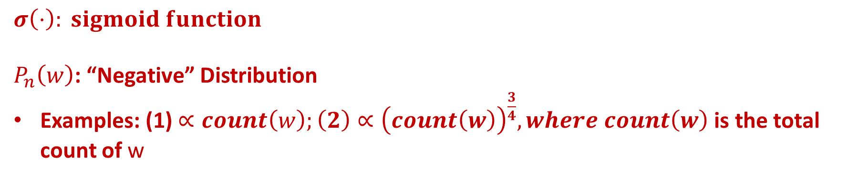
Negative Sampling for Skip-Gram
For each target, for every positive word, sample k negative words
  $$\sum_{\left(w,c\right)∈D}{\left[logσ\left(u_{c}^{T}v_{w}\right)+\sum_{i=1}^{k}{E_{w_{i}\sim P_{n}\left(w\right)}[logσ(−u_{w_{i}}^{T}v_{w})]}\right]}$$
$$σ\left(⋅\right): sigmoid function$$
$P_{n}\left(w\right)$: “Negative” Distribution
Examples: (1) $∝count\left(w\right);\left(2\right)∝{\left(count\left(w\right)\right)}^{\frac{3}{4}}, where count\left(w\right)$ is the total count of w

Slide 27
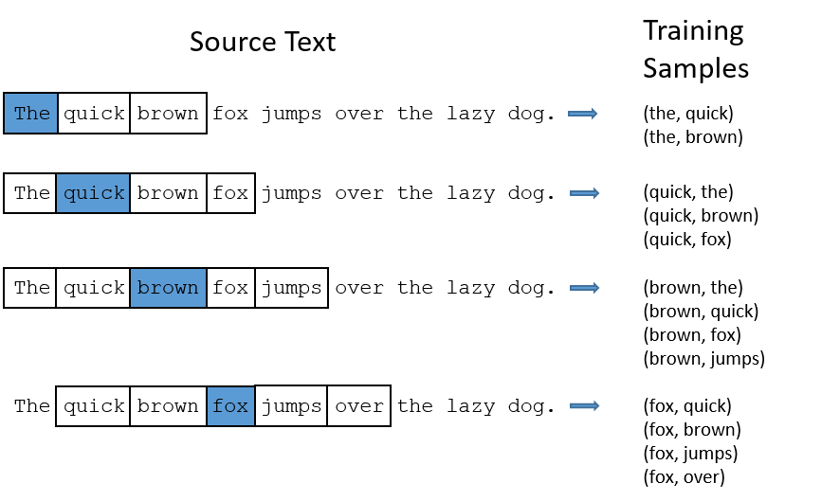
More on Negative Samples
Positive
Negative, e.g., k=3
(quick, dog)
(quick, sky)
(quick, flower)

Slide 28
A Potential Application
Relation detection and knowledge completion
    $$v_{Berlin}−v_{Germany}≈v_{Paris}−v_{France}$$

Slide 29
Text Data: Word Embedding
Introduction to Word Representation
Word2vec: CBOW and Skip-Gram
GloVe: Global Vectors for Word Representation
Summary

Slide 30
Combining Two Worlds
Matrix factorization for global word-word co-occurrence matrix
  E.g., SVD
  Global matrix factorization
Make predictions within local context windows
  E.g., word2vec
  Local context window

Slide 31

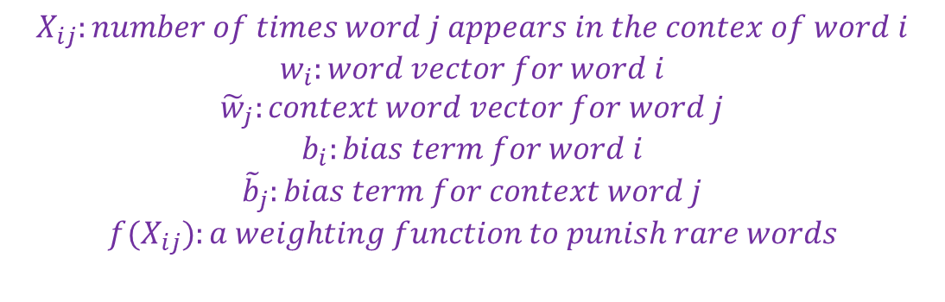
Objective Function
Predicted value
observed value
$$X_{ij}:number of times word j appears in the contex of word i$$
$$w_{i}:word vector for word i$$
$${\tilde{w}}_{j}:context word vector for word j$$
$$b_{i}:bias term for word i$$
$${\tilde{b}}_{j}:bias term for context word j$$
$${f(X}_{ij}):a weighting function to punish rare words$$
https://nlp.stanford.edu/pubs/glove.pdf

Slide 32
Question
How to optimize the objective function?

Slide 33
Some Interesting Results: Superlatives

Slide 34
Some Interesting Results: Company-CEO
https://nlp.stanford.edu/projects/glove/

Slide 35
Text Data: Word Embedding
Introduction to Word Representation
Word2vec: CBOW and Skip-Gram
GloVe: Global Vectors for Word Representation
Summary

Slide 36
Summary
Word embedding
  A low-dimensional vector representation for words
Word2vec
  Local context-based prediction: CBOW and Skip-Gram
Glove
  Matrix decomposition on local context co-occurrence matrix

Slide 37
References
Mikolov, T., Corrado, G., Chen, K., & Dean, J. (2013). Efficient Estimation of Word Representations in Vector Space. Proceedings of the International Conference on Learning Representations (ICLR 2013), 1–12.
Mikolov, T., Chen, K., Corrado, G., & Dean, J. (2013). Distributed Representations of Words and Phrases and their Compositionality. NIPS, 1–9.
Pennington, J., Socher, R., & Manning, C. D. (2014). Glove: Global Vectors for Word Representation. Proceedings of the 2014 Conference on Empirical Methods in Natural Language Processing, 1532–1543.
Yoav Goldberg and Omer Levy (2014). Word2vec Explained: Deriving Mikolov et al.’s Negative-Sampling Word-Embedding Method. https://arxiv.org/pdf/1402.3722v1.pdf

