Slide 1
CS247: Advanced Data Mining
07: Text Data: Transformers
Instructor: Yizhou Sun
yzsun@cs.ucla.edu
February 7, 2024

Slide 2
Text Data: Transformers
Introduction
Attention is all you need
Pretraining: BERT and GPT
Summary

Slide 3
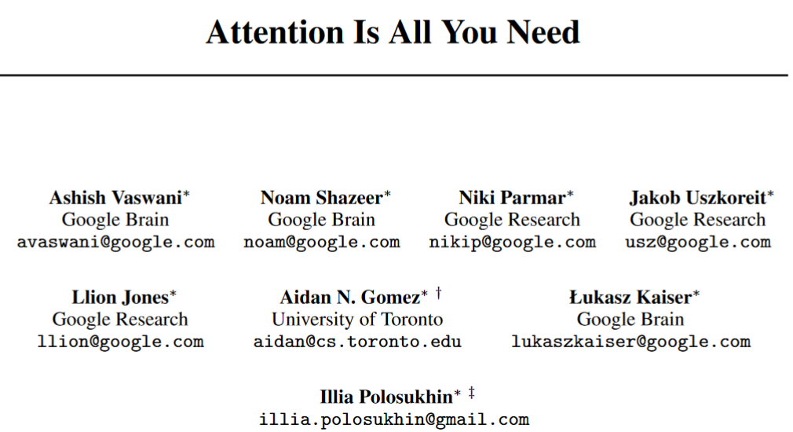
The First Transformer Paper
NIPS 2017: https://arxiv.org/pdf/1706.03762.pdf
107k+ citations by 2/4/2024!
Note: Word2Vec Paper (NIPS 2013): 42.3K citations

Slide 4
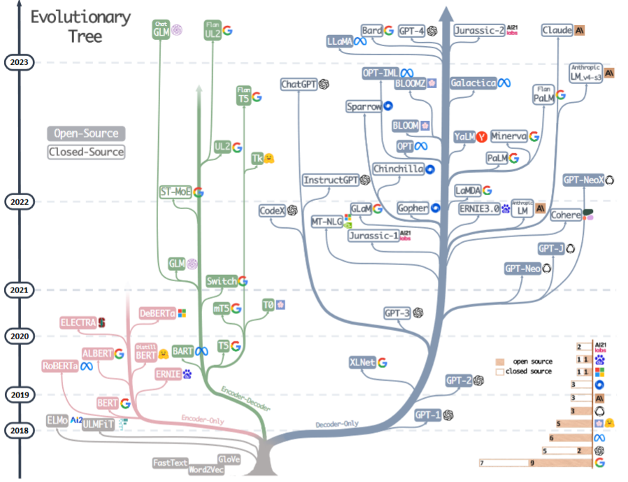
https://arxiv.org/pdf/2304.13712.pdf

Slide 5
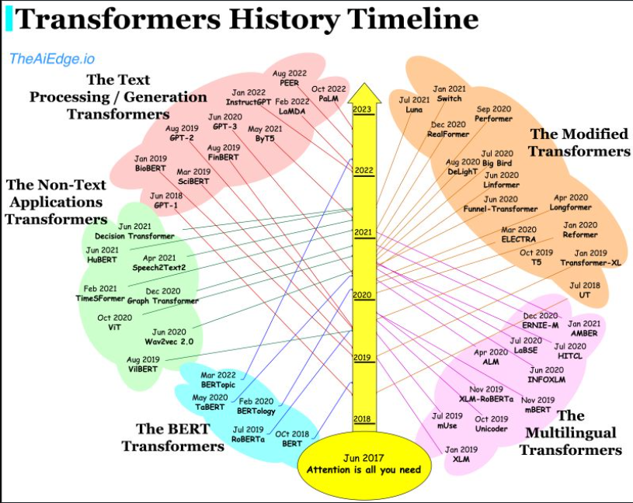
https://vinija.ai/models/Transformers/

Slide 6

Emergent capability of Large Models
https://ai.googleblog.com/2022/04/pathways-language-model-palm-scaling-to.html
Notes:
GPT 3.5: 175B
GTP 4:1T

Slide 7
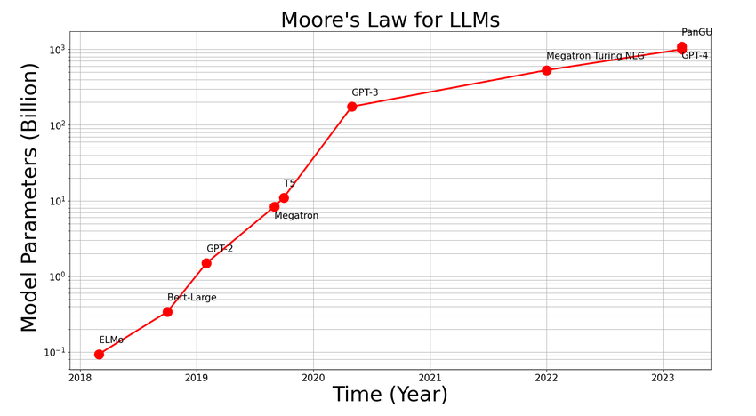
The New Moore’s Law?
https://www.researchgate.net/figure/LLMs-A-New-Moores-Law-as-presented-the-size-of-models-grows-exponentially-with-time_fig2_372248458

Slide 8
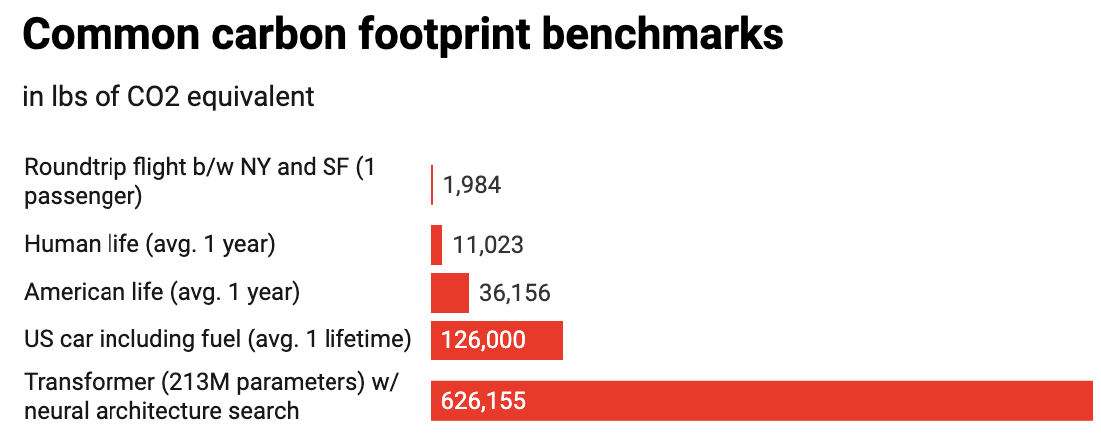
Large-scale deep learning is power hungry
These gigantic models require enormous computational resources and draw substantial energy and environmental cost
GPT-3 requires 190,000 Kwh of energy, 187,400 lbs CO₂
NAS with Transformer costs 626,000 lbs CO₂
We need sustainable and environmentally friendly AI

Slide 9
Text Data: Transformers
Introduction
Attention is all you need
Pretraining: BERT and GPT
Summary

Slide 10
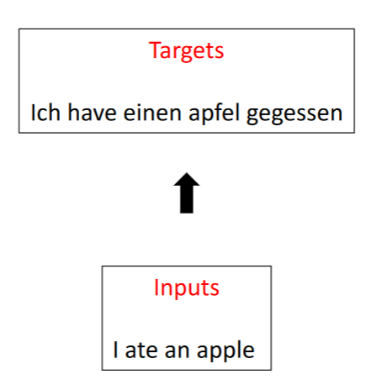
Start from Machine Translation Task

Slide 11
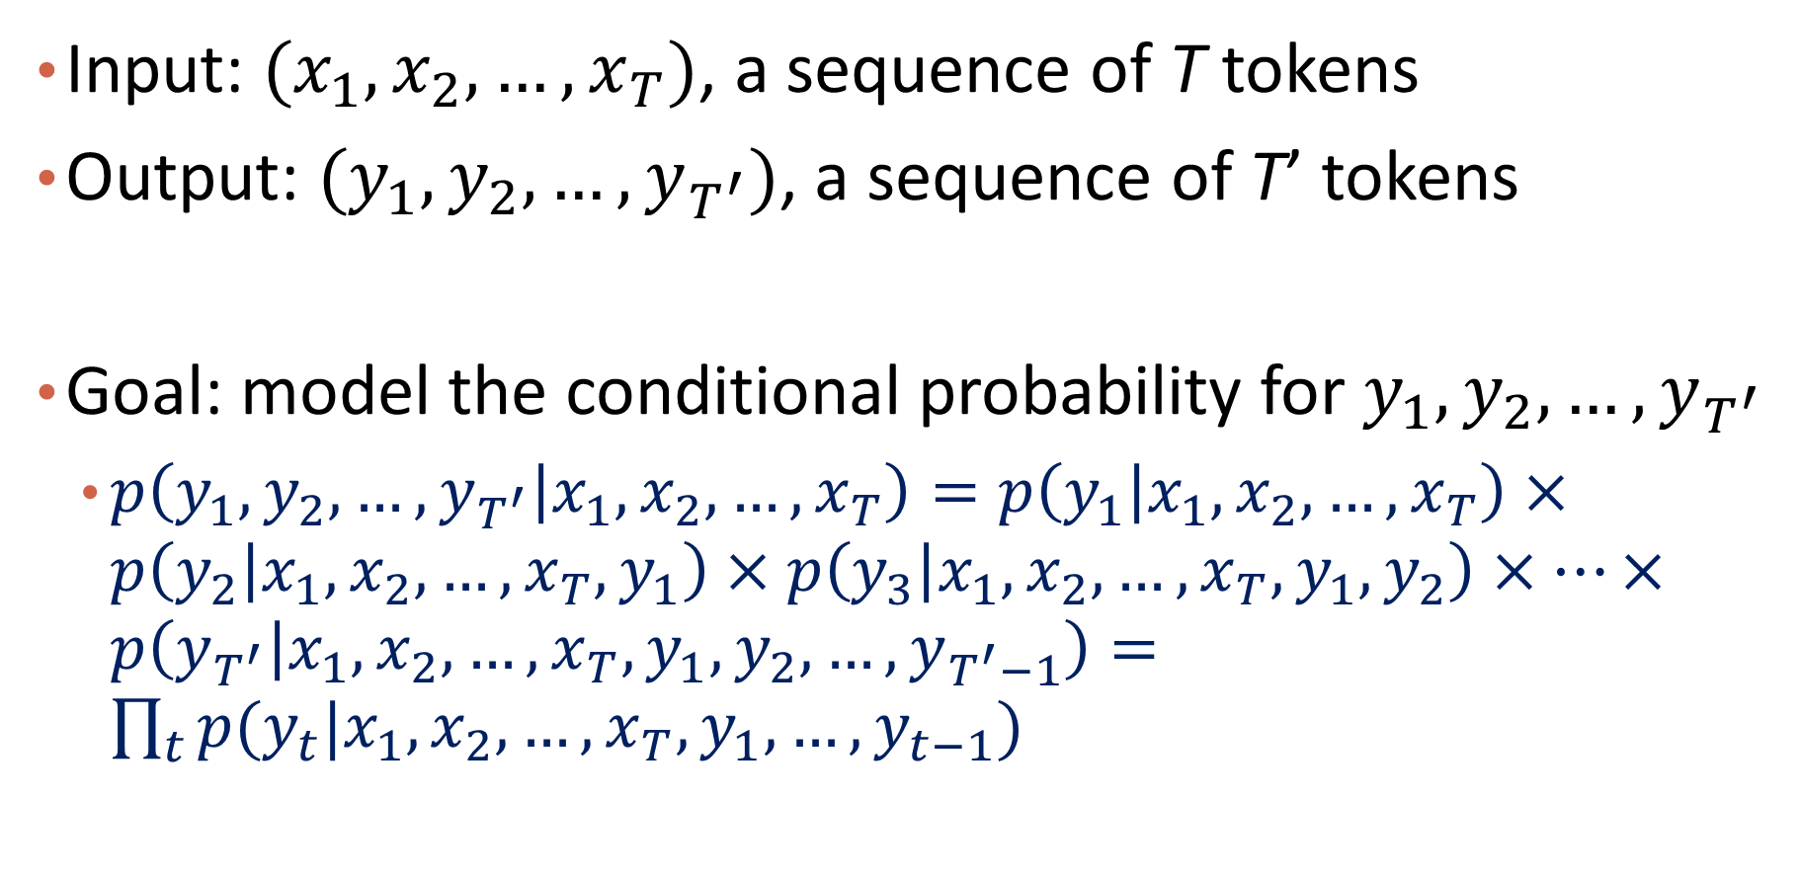
Problem Formalization
Input: $(x_{1},x_{2},…,x_{T})$, a sequence of T tokens
Output: $(y_{1},y_{2},…,y_{T^{′}})$, a sequence of T’ tokens
Goal: model the conditional probability for $y_{1},y_{2},…,y_{T^{′}}$
$p\left(y_{1},y_{2},…,y_{T^{′}} | x_{1},x_{2},…,x_{T}\right)=p\left(y_{1} | x_{1},x_{2},…,x_{T}\right)×p\left(y_{2} | x_{1},x_{2},…,x_{T},y_{1}\right)×p\left(y_{3} | x_{1},x_{2},…,x_{T},y_{1},y_{2}\right)×…×p\left(y_{T^{′}} | x_{1},x_{2},…,x_{T},y_{1},y_{2},…,y_{T^{′}−1}\right)=\prod_{t}{p(y_{t}|x_{1},x_{2},…,x_{T},y_{1},…,y_{t−1})}$

Slide 12
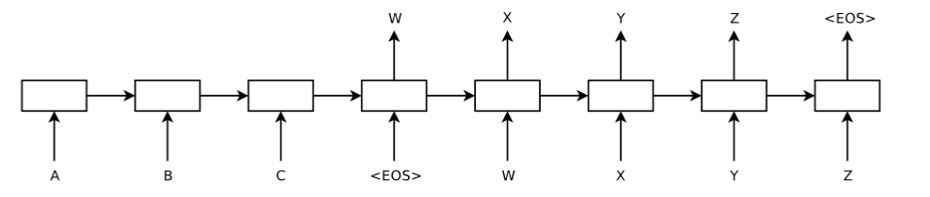
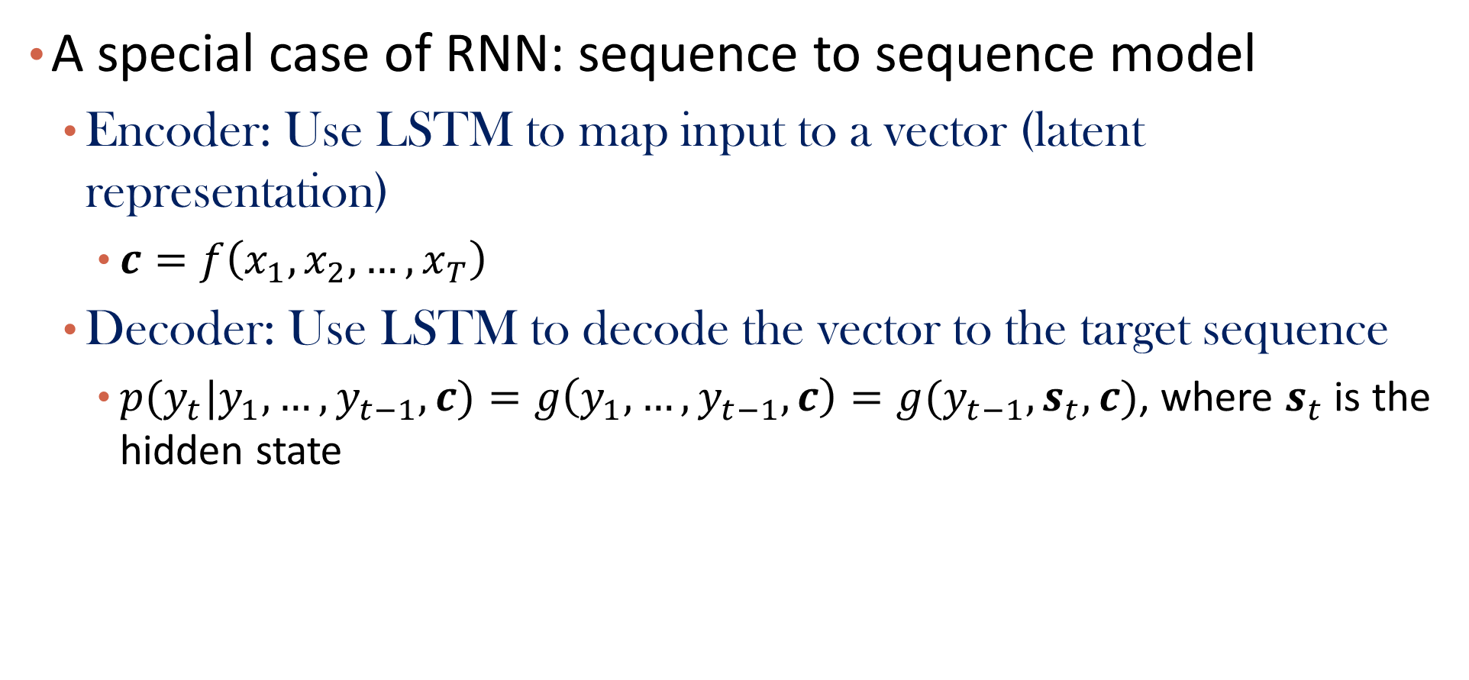
Recap: Seq2Seq
A special case of RNN: sequence to sequence model
Encoder: Use LSTM to map input to a vector (latent representation)
$c=f\left(x_{1},x_{2},…,x_{T}\right)$
Decoder: Use LSTM to decode the vector to the target sequence
$p(y_{t}|y_{1},…,y_{t−1}, c)=g\left(y_{1},…,y_{t−1}, c\right)=g(y_{t−1},s_{t},c)$, where $s_{t}$ is the hidden state

Slide 13
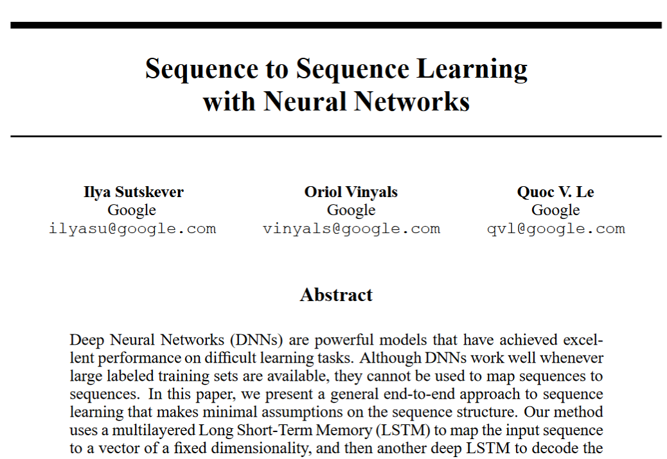
https://arxiv.org/pdf/1409.3215.pdf

Slide 14
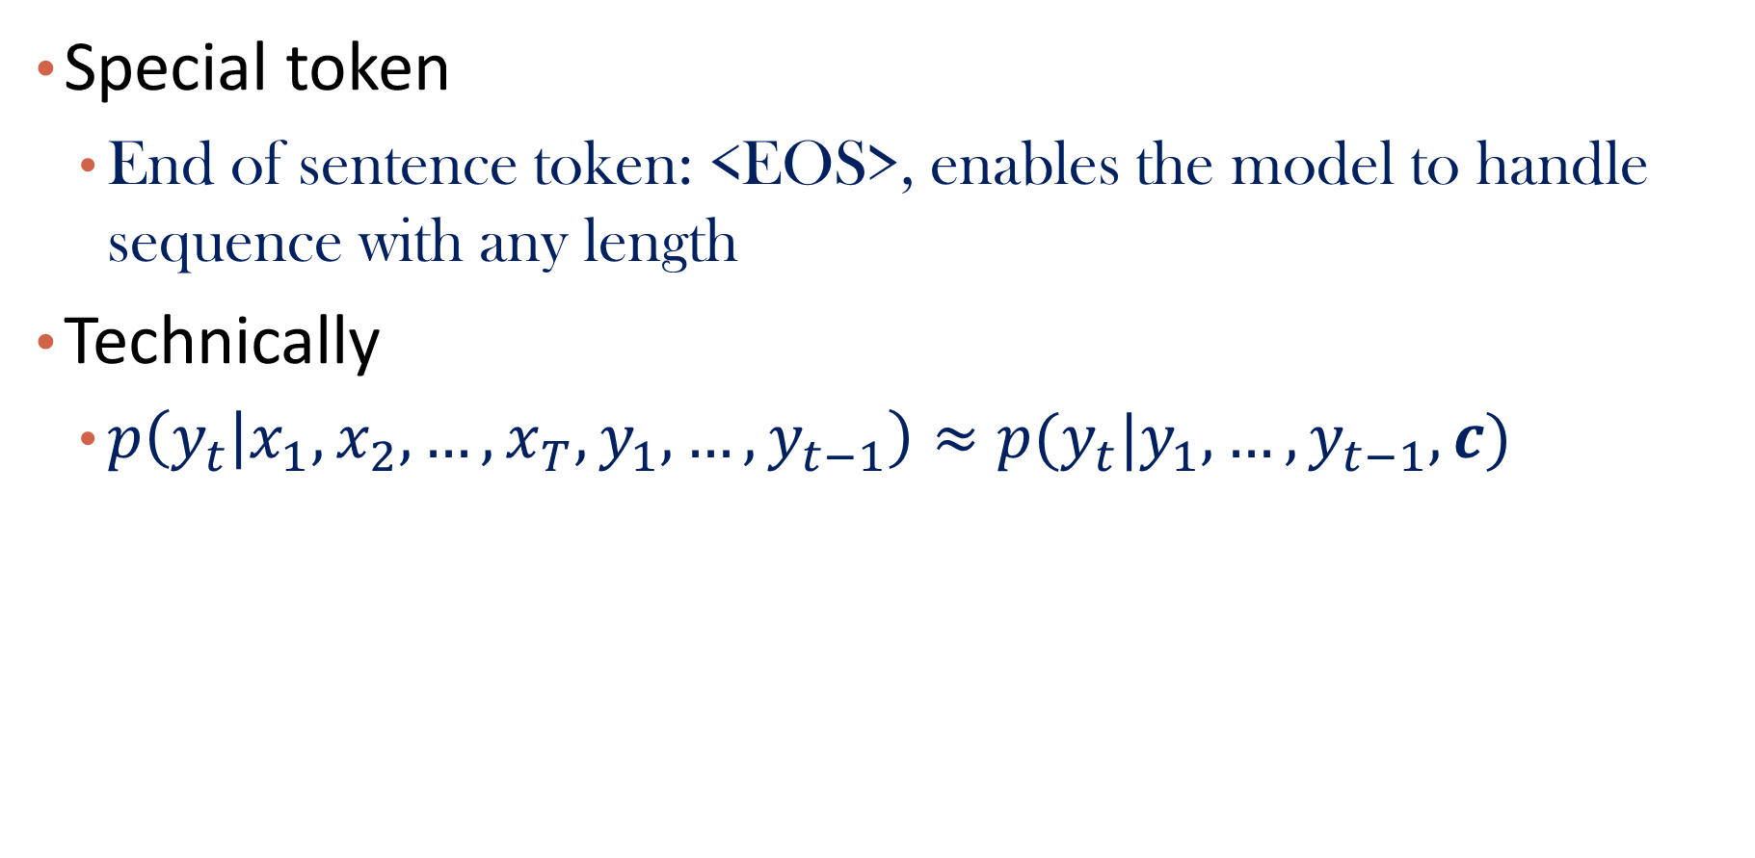
Some Details
Special token
End of sentence token: <EOS>, enables the model to handle sequence with any length
Technically
$p\left(y_{t} | x_{1},x_{2},…,x_{T},y_{1},…,y_{t−1}\right)≈p(y_{t}|y_{1},…,y_{t−1},c)$

Slide 15
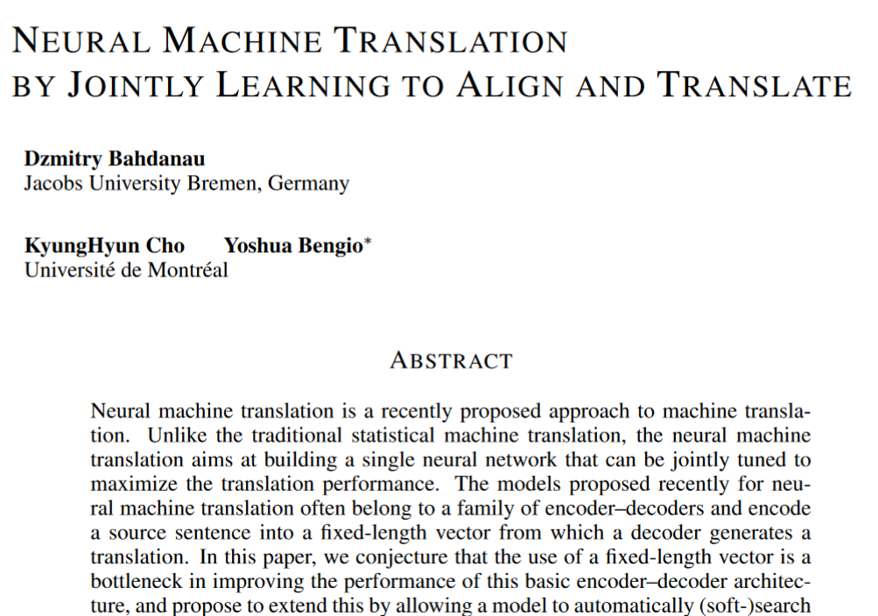


Can we do better? – Attention!
ICLR 2015
https://arxiv.org/pdf/1409.0473.pdf

Slide 16
Intuition
Attend different words in the input to predict the target
No need to compress entire input sequence to one fixed vector
Performance deteriorate if input sequence length increases for Seq2seq model

Slide 17
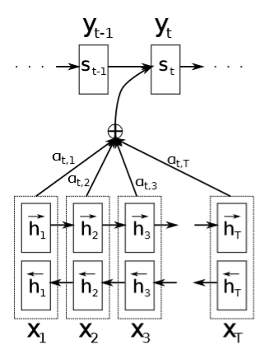
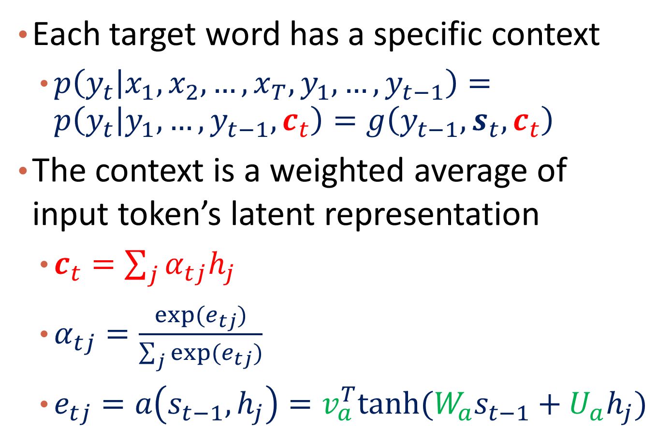
The Attention Mechanism and Bahdanau Attention
Each target word has a specific context
$p\left(y_{t} | x_{1},x_{2},…,x_{T},y_{1},…,y_{t−1}\right)=p\left(y_{t} | y_{1},…,y_{t−1}, c_{t}\right)=g\left(y_{t−1},s_{t},c_{t}\right)$
The context is a weighted average of input token’s latent representation
$c_{t}=\sum_{j}{α_{tj}h_{j}}$
$α_{tj}=\frac{exp⁡(e_{tj})}{\sum_{j}{exp⁡(e_{tj})}}$
$e_{tj}=a\left(s_{t−1},h_{j}\right)=v_{a}^{T}tanh⁡(W_{a}s_{t−1}+U_{a}h_{j})$

Slide 18


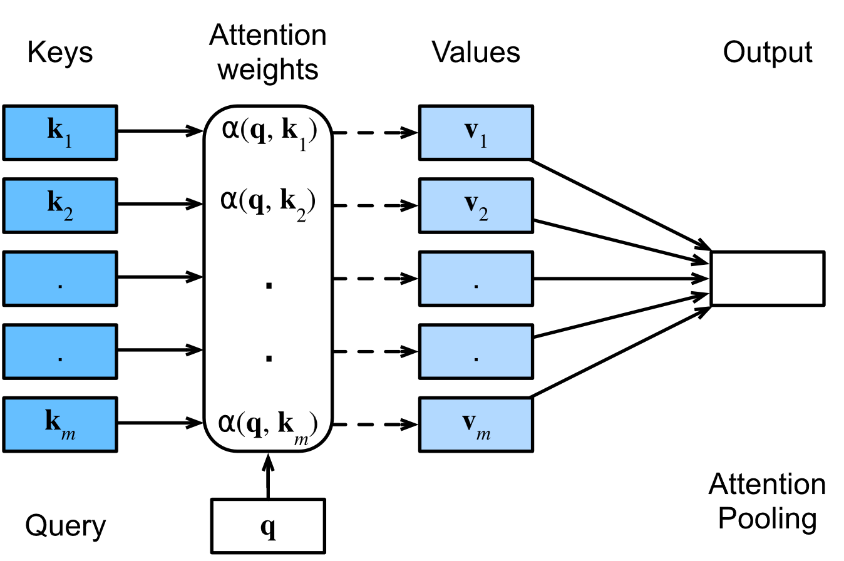

A General Framework of Attention
Given a dataset of m tuples of keys and values
Given q as a query vector, its attention over D:
https://d2l.ai/chapter_attention-mechanisms-and-transformers/queries-keys-values.html

Slide 19

Recap: KNN and Kernel Methods
Weighted KNN
$y_{q}=\frac{∑w_{i}y_{i}}{∑w_{i}}$, where $x_{i}$’s are $x_{q}$’s nearest neighbors
E.g., $w_{i}=exp⁡(−{\left|\left|x_{q}−x_{i}\right|\right|}^{2}/2σ^{2})$, a gaussian kernel

Slide 20
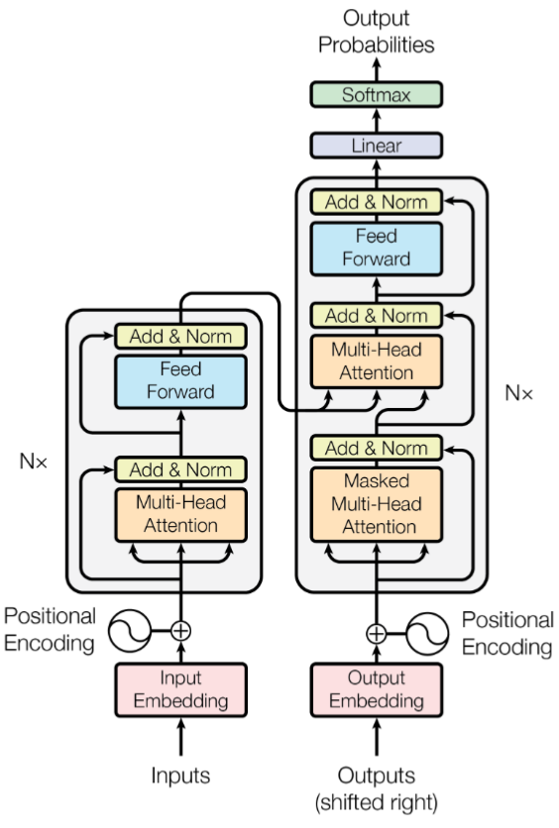
Now to the Transformer
Left: Encoder
Representation
Right: Decoder
Generation
The following slides are adapted from:
https://deeplearning.cs.cmu.edu/F23/document/slides/lec19.transformersLLMs.pdf

Slide 21
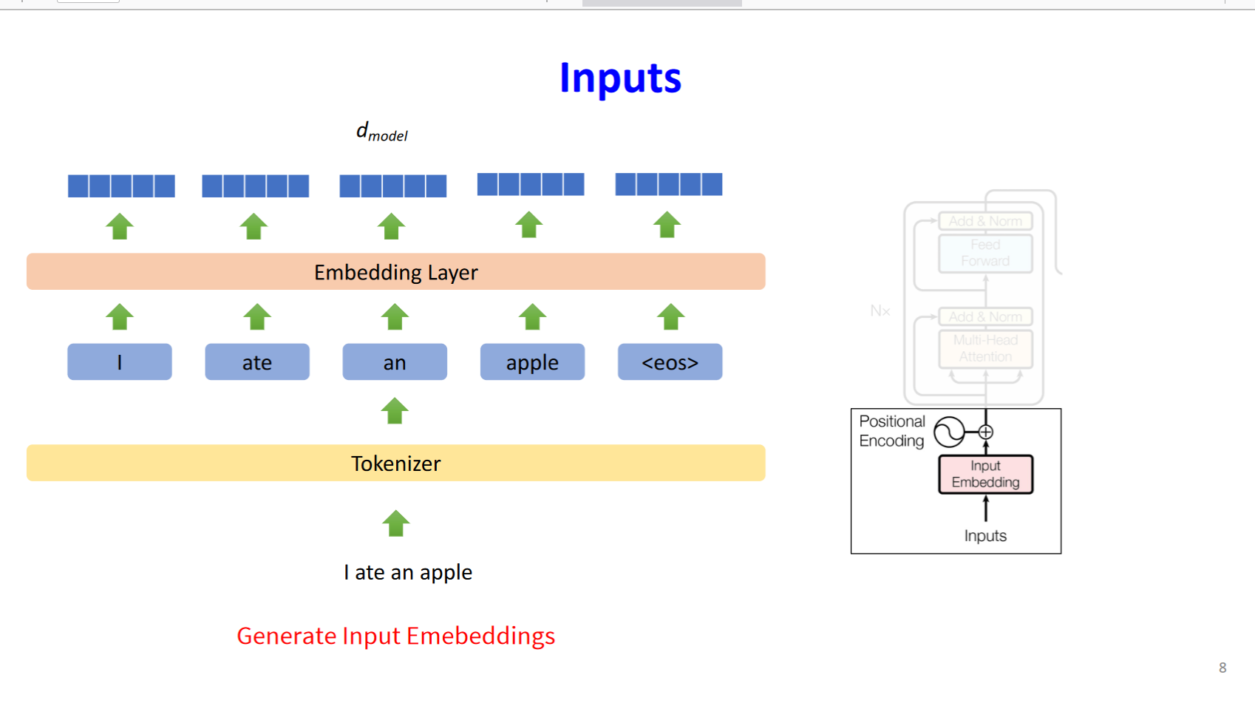
Generate learnable embedding for each token

Slide 22
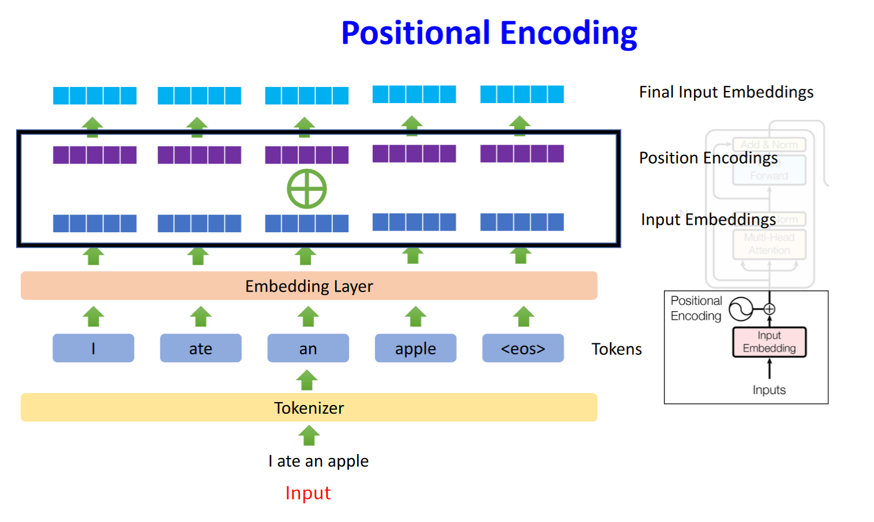

Slide 23
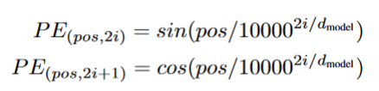
Positional Encoding
For each dimension, read out values from sine and cosine with different frequencies

Slide 24
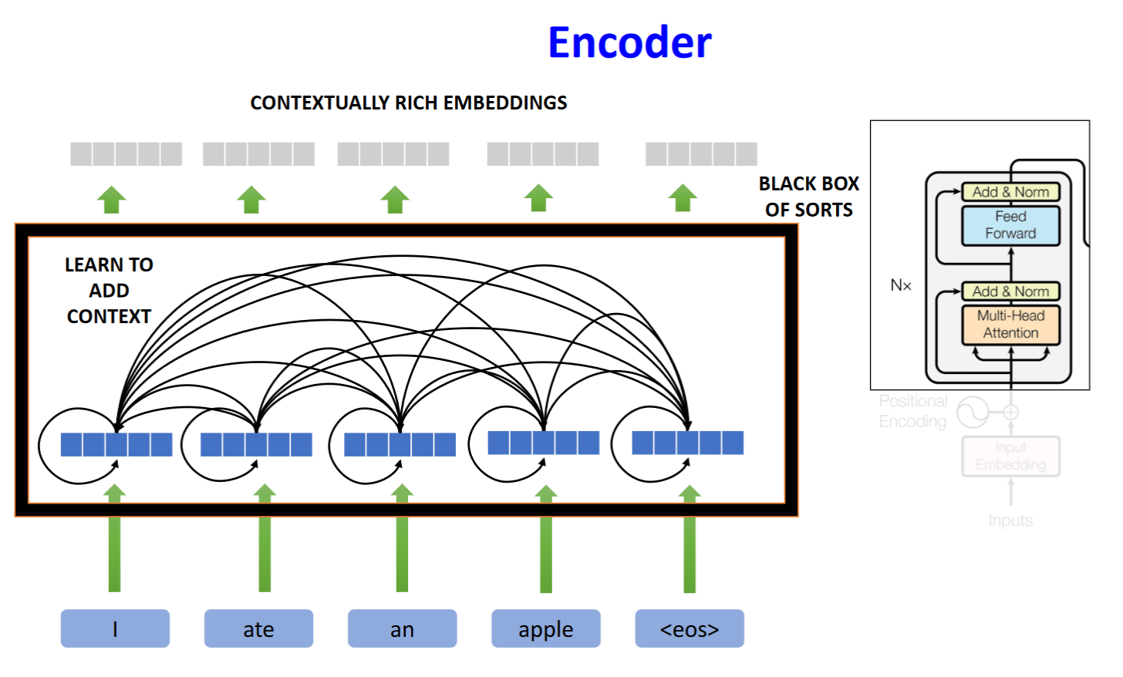

Slide 25
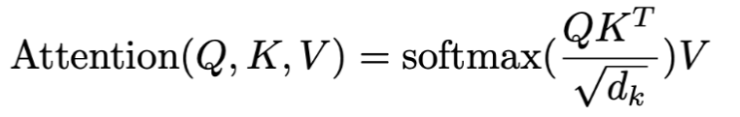
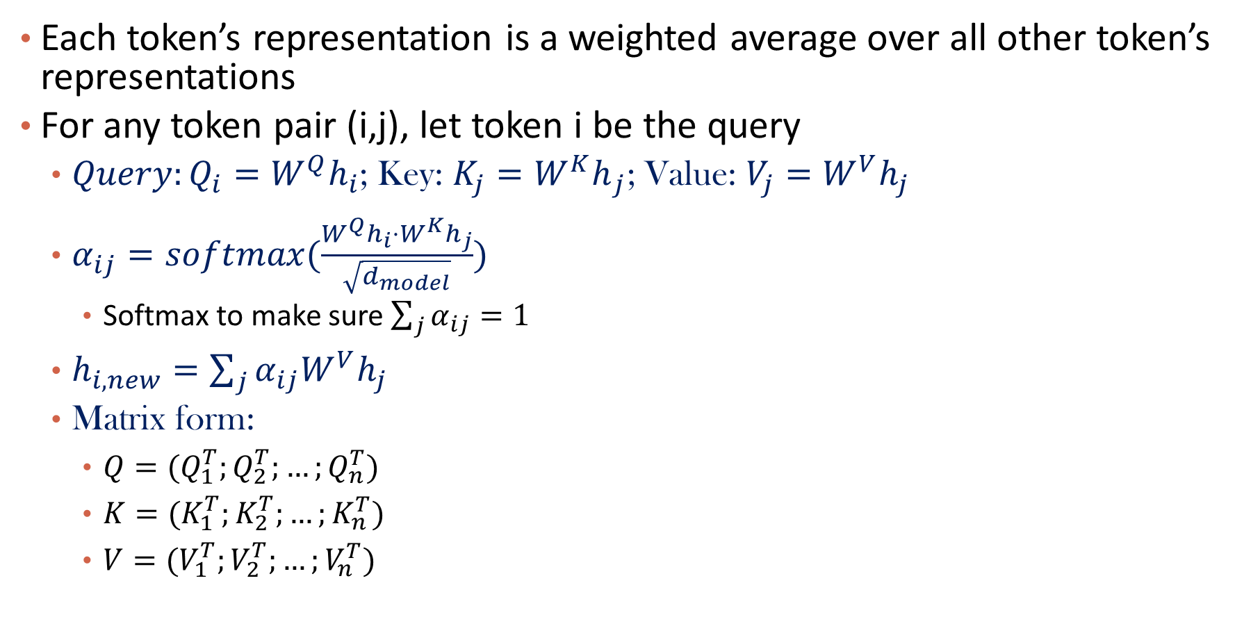
Scaled Dot Product Attention
Each token’s representation is a weighted average over all other token’s representations
For any token pair (i,j), let token i be the query
$Query:Q_{i}={W^{Q}h}_{i}$; Key: ${{K_{j}=W}^{K}h}_{j}$; Value: $V_{j}={W^{V}h}_{j}$
$α_{ij}=softmax(\frac{W^{Q}h_{i}⋅W^{K}h_{j}}{\sqrt{d_{model}}})$
Softmax to make sure $\sum_{j}{α_{ij}=1}$
$h_{i,new}=\sum_{j}{α_{ij}W^{V}h_{j}}$
Matrix form:
$Q=(Q_{1}^{T};Q_{2}^{T};…;Q_{n}^{T})$
$K=(K_{1}^{T};K_{2}^{T};…;K_{n}^{T})$
$V=(V_{1}^{T};V_{2}^{T};…;V_{n}^{T})$

Slide 26
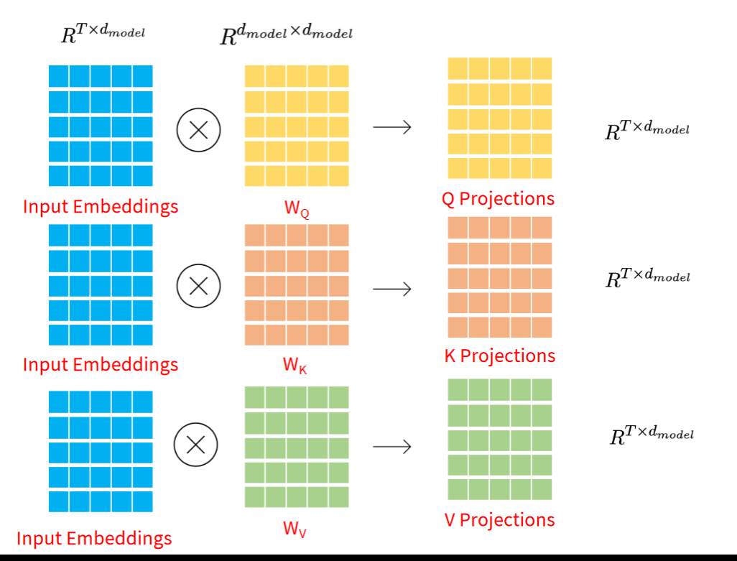

Slide 27
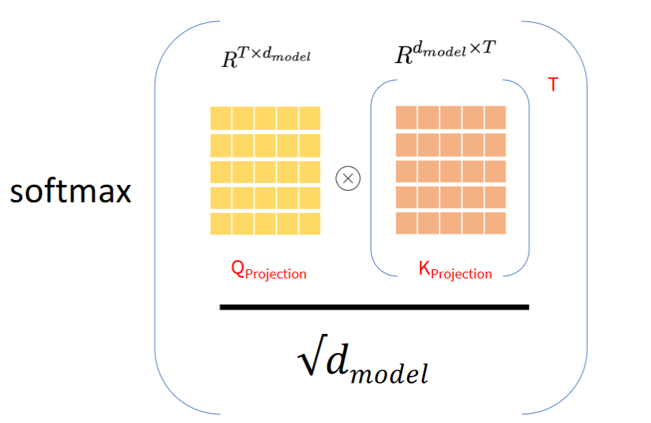

Slide 28
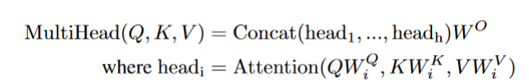
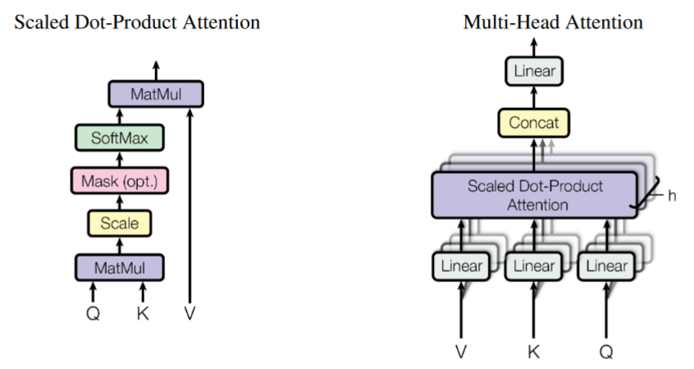

Multi-Head Attention
Multiple $W^{Q},W^{K},W^{V}$

Slide 29
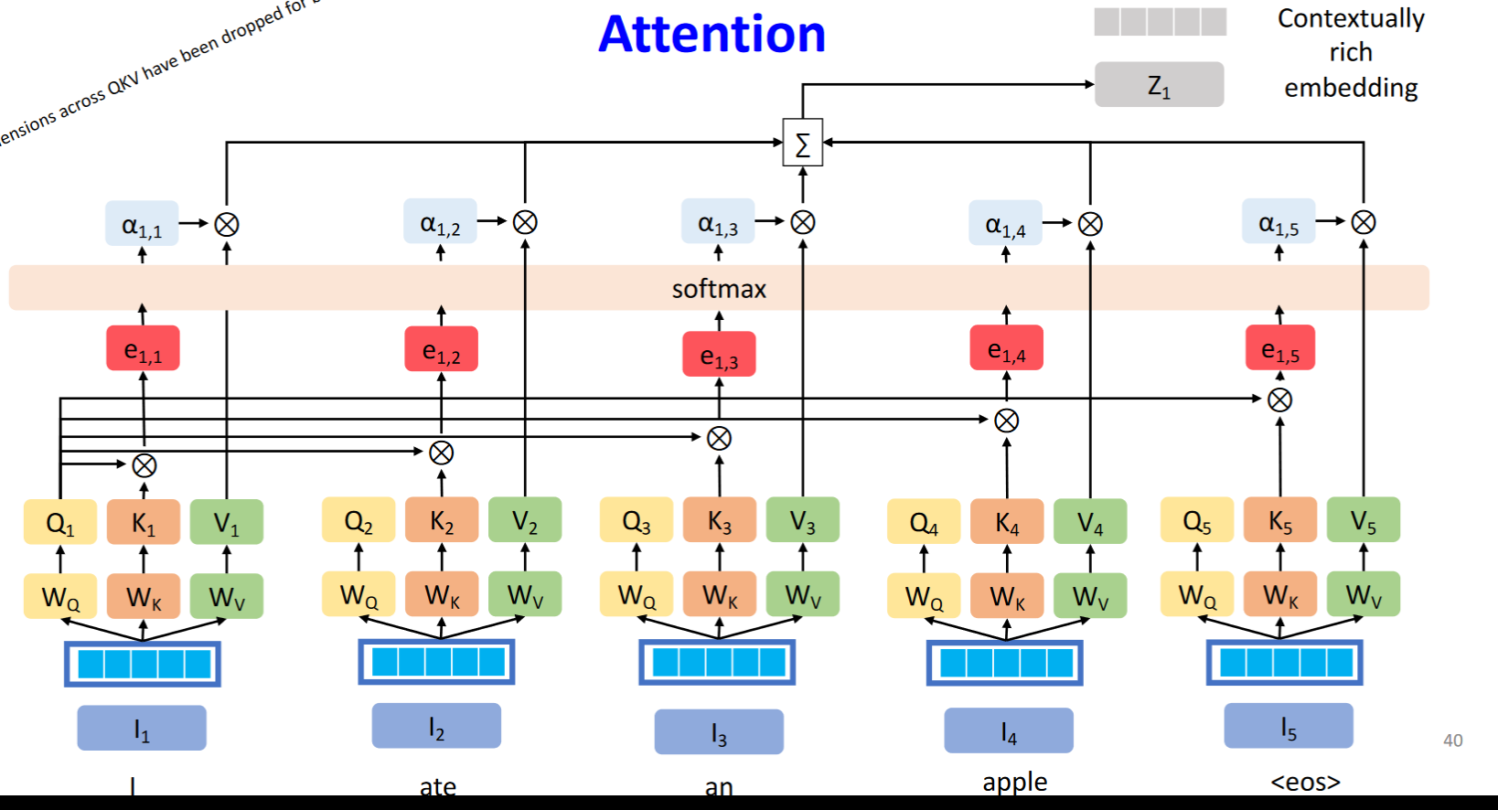








Slide 30
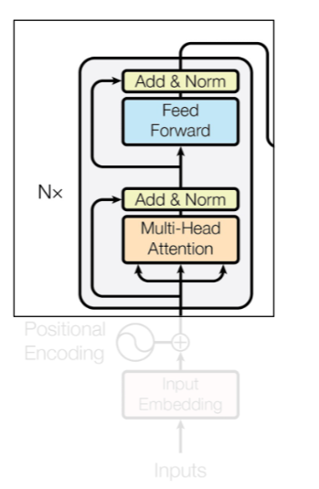

Add and Norm
Add:
Residual connection
Input + new embedding
Norm:
Layer normalization
Every output neuron is standardized
Critical
https://arxiv.org/pdf/2305.02582.pdf

Slide 31
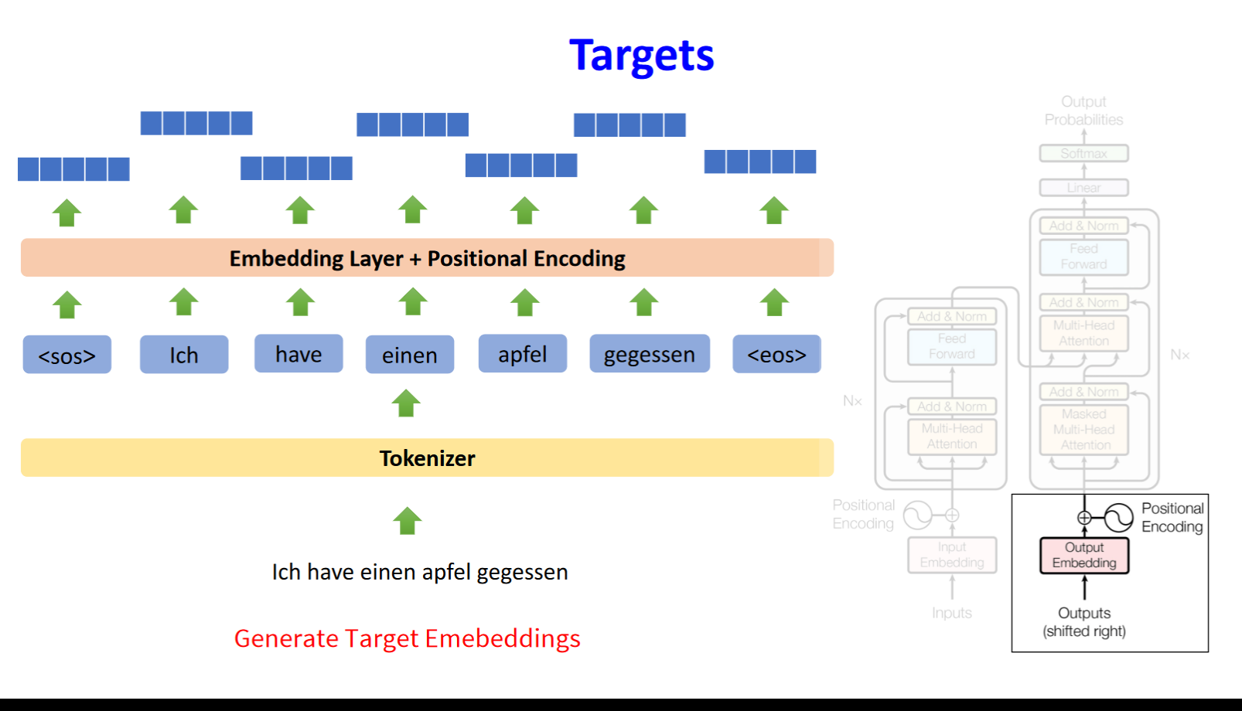
Now come to the decoding part

Slide 32
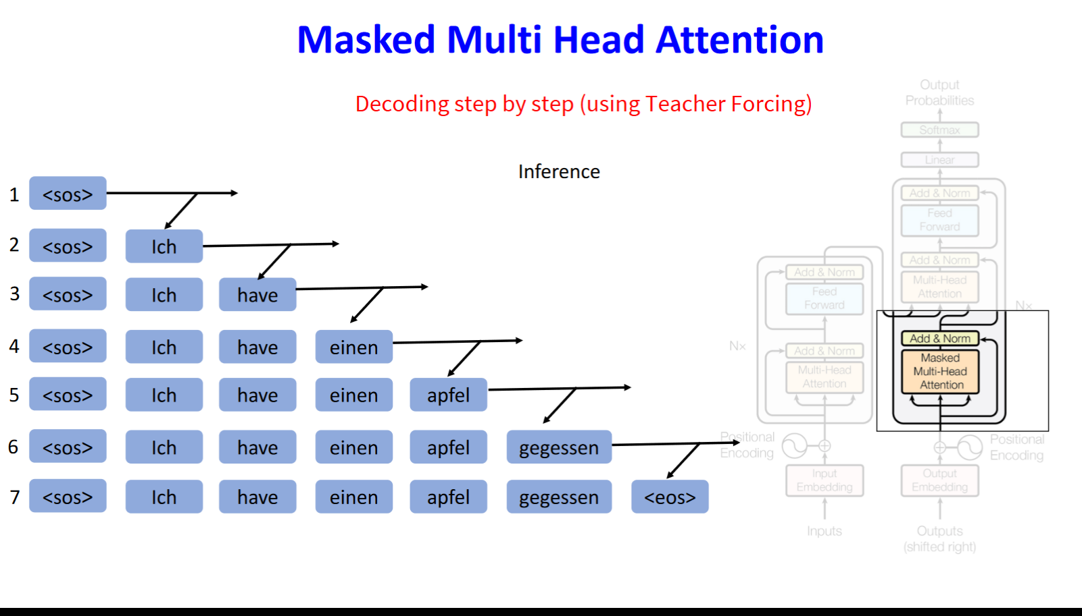

Slide 33
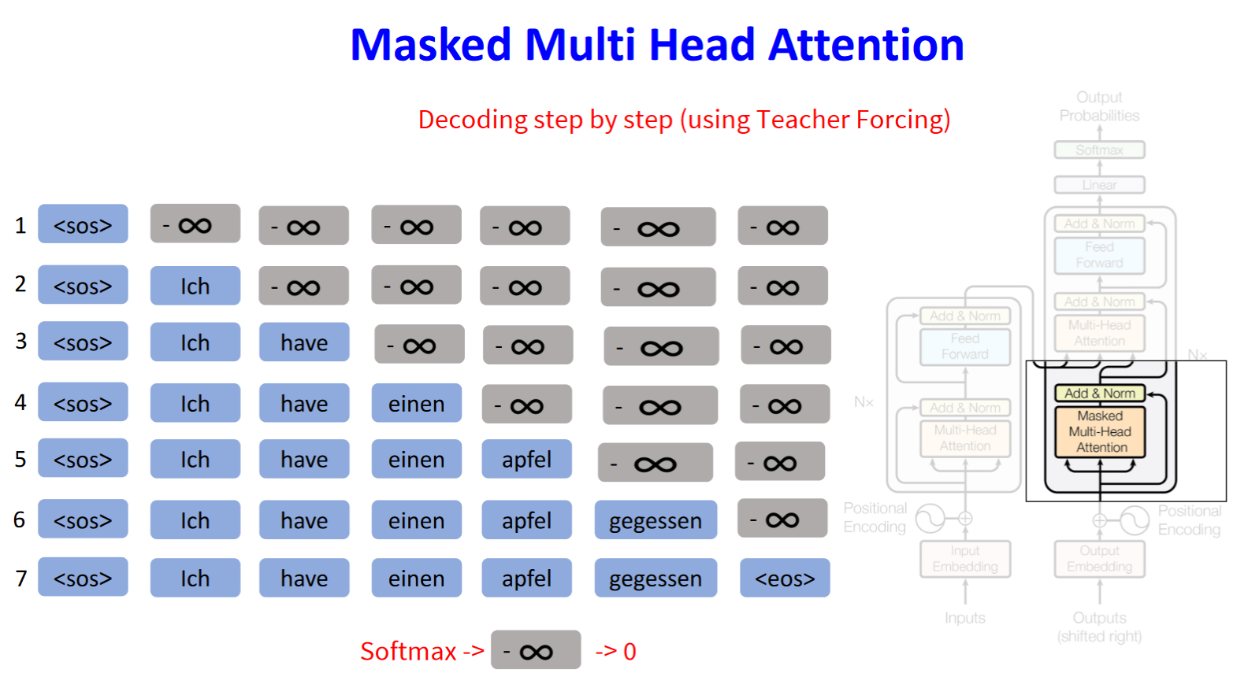
Training stage: soft mask to allow parallelization

Slide 34
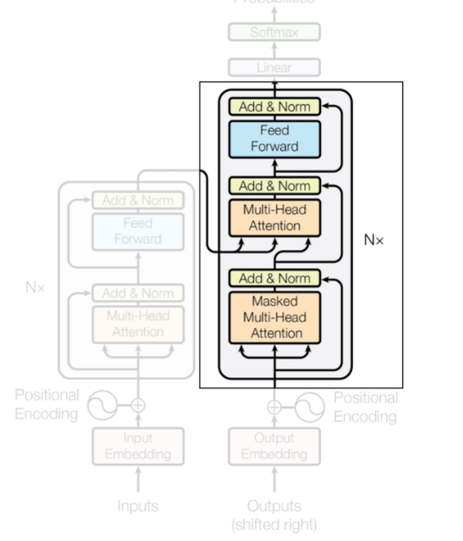
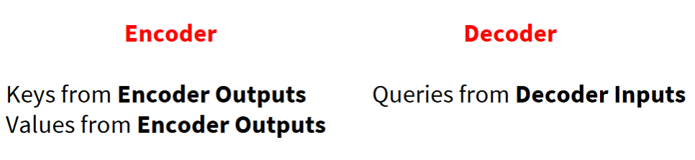
Encoder-Decoder Attention

Slide 35

Putting together
$p\left(y_{t} | x_{1},x_{2},…,x_{T},y_{1},…,y_{t−1}\right)=Dec(Enc\left(x_{1},x_{2},…,x_{T}\right),y_{1},…,y_{t−1})$

Slide 36
Question
What’s the training objective?

Slide 37
Text Data: Transformers
Introduction
Attention is all you need
Pretraining: BERT and GPT
Summary

Slide 38
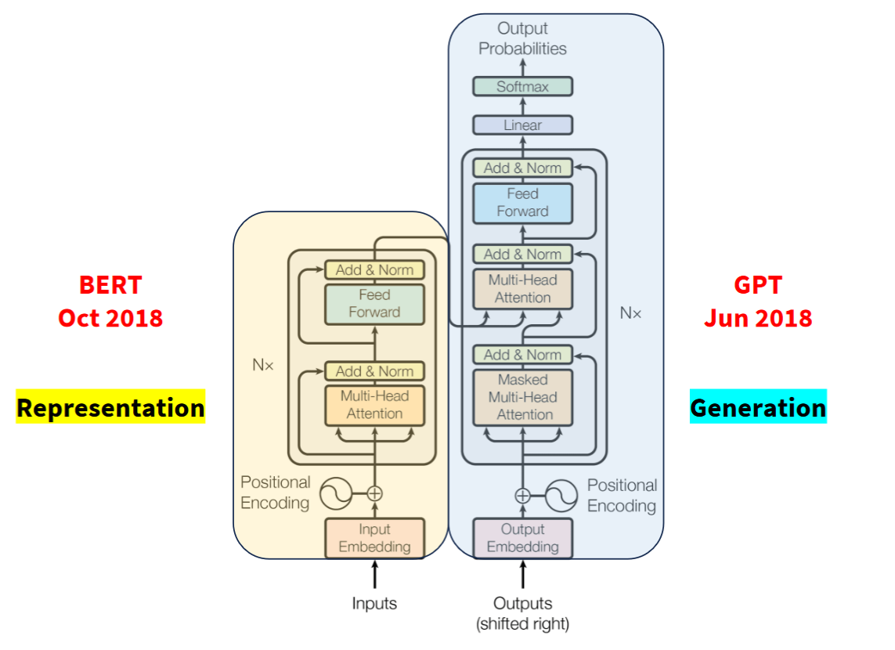
The Era of LLMs
Pre-training models with large corpus

Slide 39
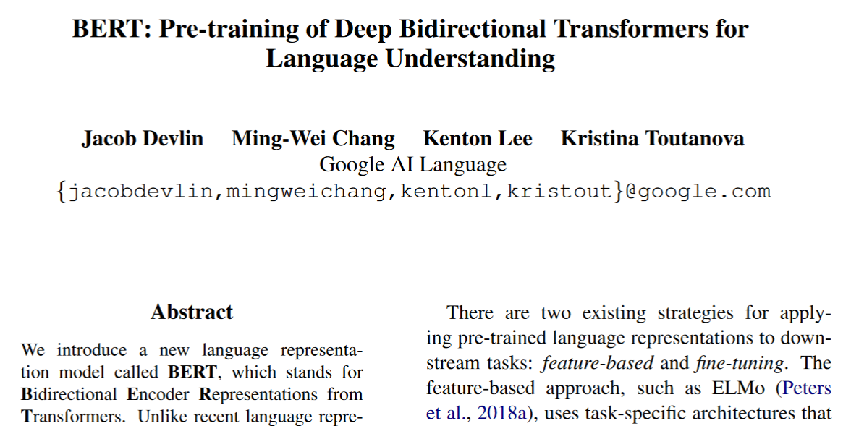
https://arxiv.org/pdf/1810.04805.pdf

Slide 40
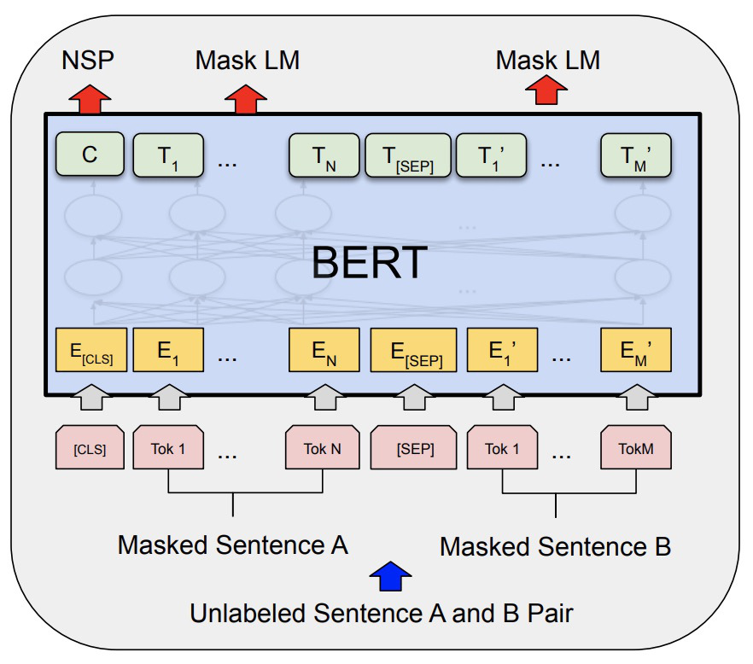
BERT: Bidirectional Encoder Representations from Transformer
BERT Pre-Training Corpus:
English Wikipedia - 2,500 million words
Book Corpus - 800 million words
BERT Pre-Training Tasks:
MLM (Masked Language Modeling)
NSP (Next Sentence Prediction)
BERT Pre-Training Results:
BERT-Base – 110M Params
BERT-Large – 340M Params

Slide 41
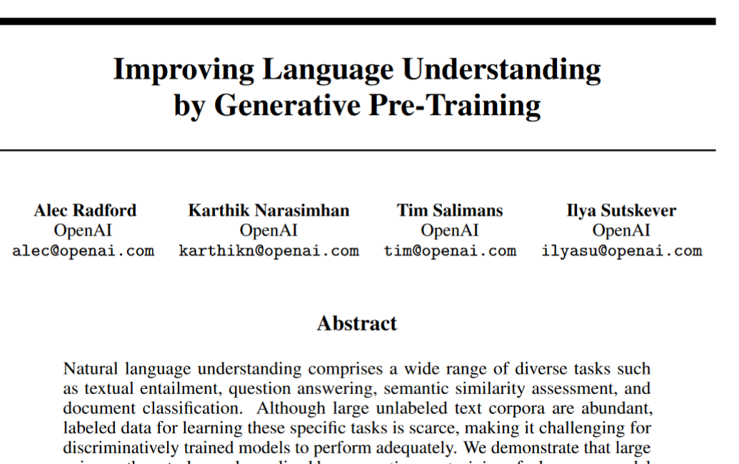

Slide 42
GPT: Generative Pre-Training
GPT Pre-Training Corpus:
Books Corpus and English Wikipedia
GPT Pre-Training Tasks:
Predict the next token, given the previous tokens
More learning signals than MLM
GPT Pre-Training Results:
GPT – 117M Params

Slide 43
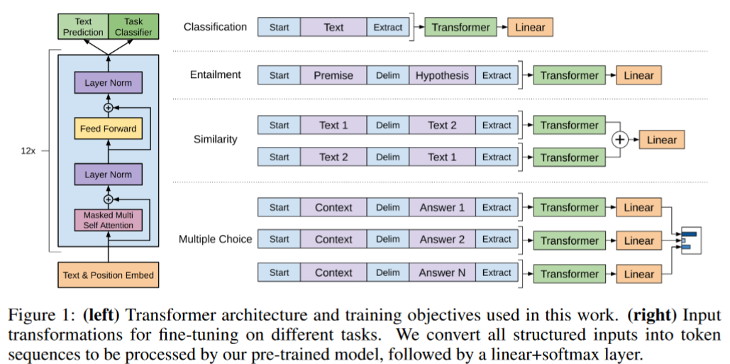
Architecture

Slide 44
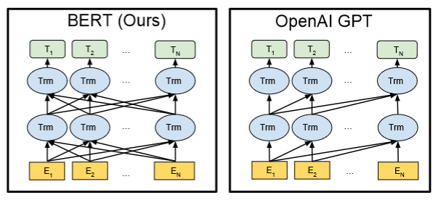
BERT Vs. GPT
From BERT paper

Slide 45
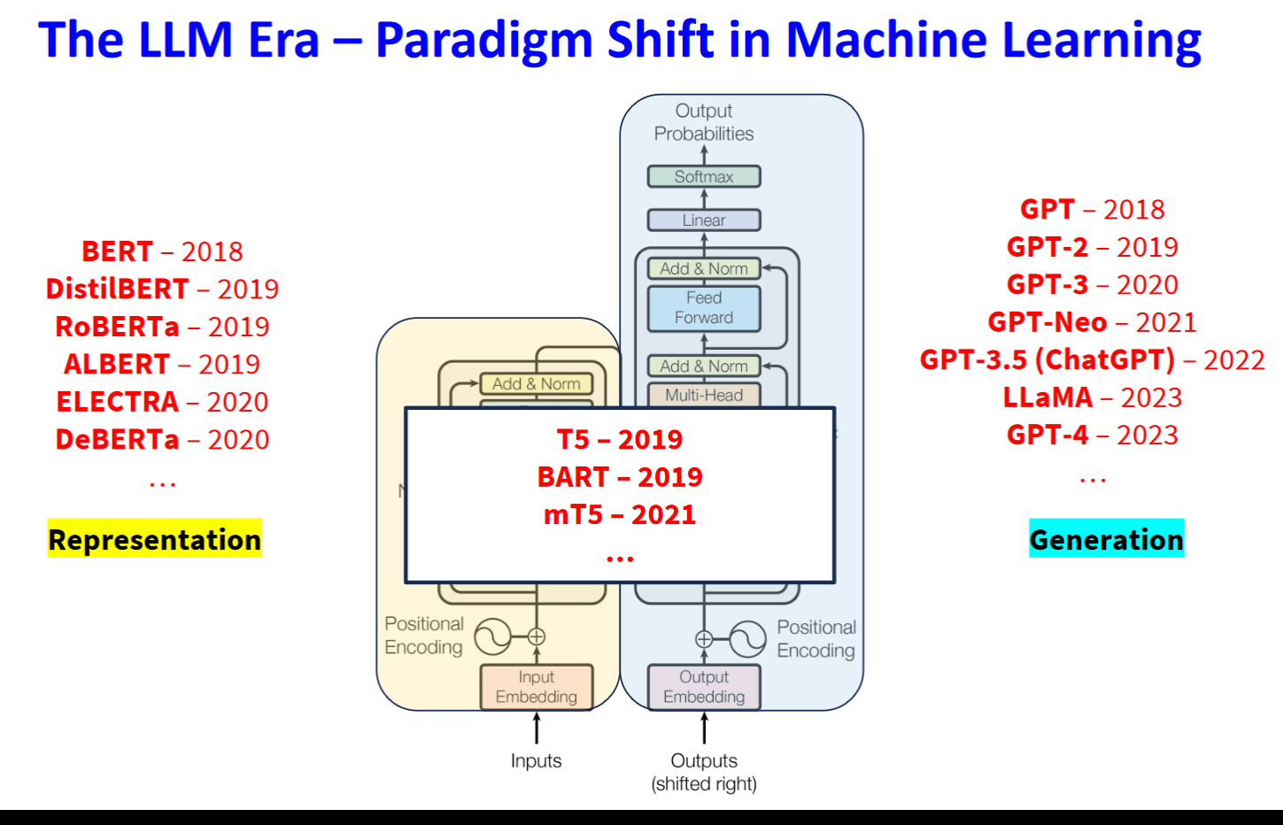

Slide 46
Text Data: Transformers
Introduction
Attention is all you need
Pretraining: BERT and GPT
Summary

Slide 47
Summary
Transformer
Encoder-Decoder Framework
Attention
LLMs
Encoder-only pretraining: BERT
Decoder-only pretraining: GPT

Slide 48
References
Course: https://deeplearning.cs.cmu.edu/F23/document/slides/lec19.transformersLLMs.pdf
A detailed introduction of Attention and Transformers: https://d2l.ai/chapter_attention-mechanisms-and-transformers/index.html
Interactive visualization of encoder-only models (BERT): https://colab.research.google.com/drive/1hXIQ77A4TYS4y3UthWF-Ci7V7vVUoxmQ?usp=sharing

